Slide 1



2020 – Volume III
A Second Look
10 Slides to Diversify
Your Marketing Strategy

Slide 2


About VAB
VAB is an insights-driven organization that inspires marketers to reimagine their media strategies resulting in fully informed decisions.
Drawing on our marketing expertise, we simplify the complexities in our industry and discover new insights that transform the way marketers look at their media strategy.
Simplify
We save you time by bringing you the latest data & actionable takeaways you can use to inform your marketing plans.
Discover
We keep you one step ahead with the latest thinking so you can create innovative, forward-looking strategies.
Transform
We help you build your brand by focusing on core marketing principles that will help drive tangible business outcomes.
This information is exclusively provided to VAB members and qualified marketers. Further distribution is prohibited.
PAGE 2

Slide 3
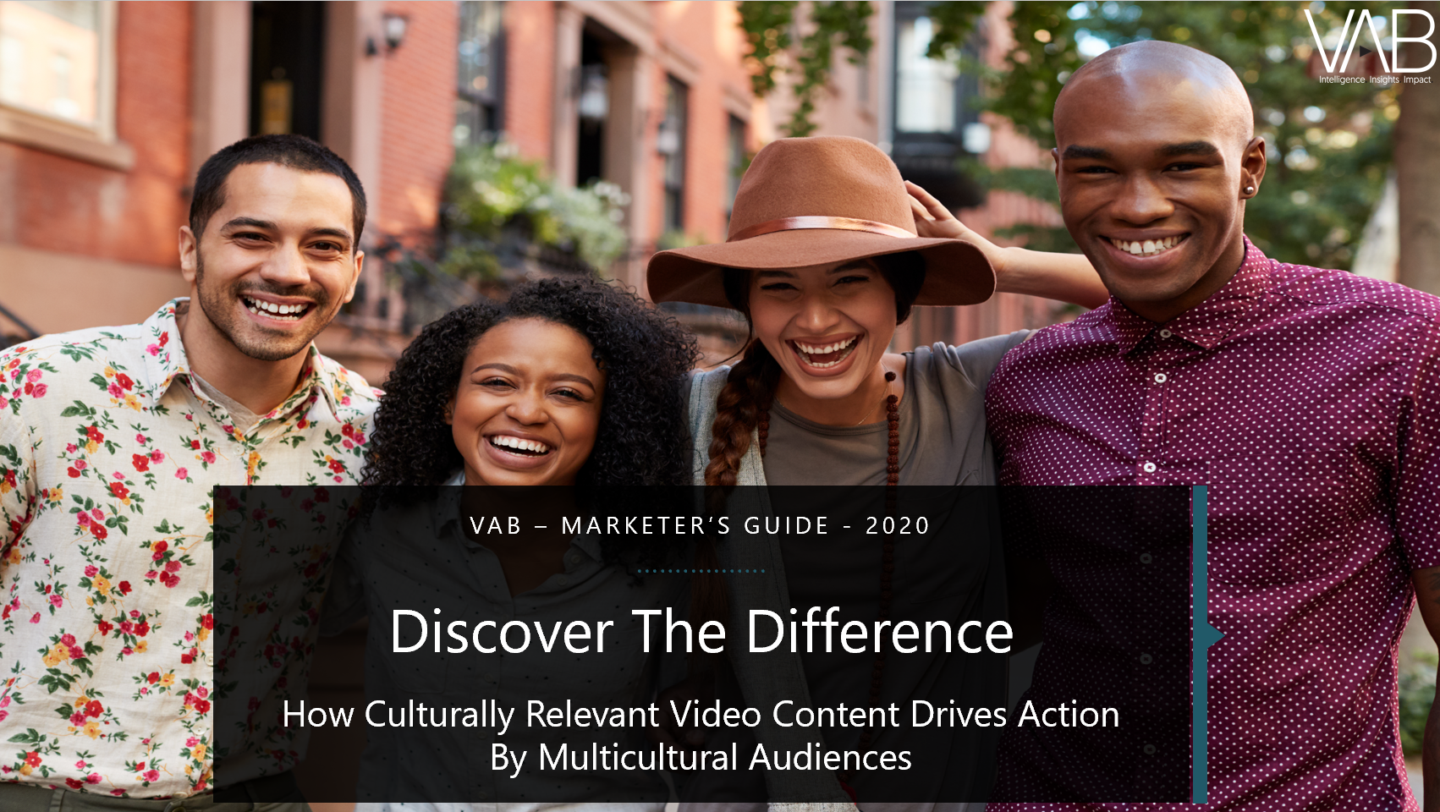
Multicultural consumers are particularly important to reach as Black, Hispanic and Asian Americans will collectively account for 40% of the population by 2023
Click here for the full report
136,613
% of Total Pop
14%
19%
7%
40%
125,428
% of Total Pop
13%
18%
7%
38%
113,068
% of Total Pop
13%
17%
5%
35%
100,672
% of Total Pop
13%
15%
5%
33%
Source: VAB Analysis of U.S. Census Bureau data, 2017 National Population Projections Datasets: Table 1. Projected Population by Single Year of Age, Sex, Race, and Hispanic Origin for the United States: 2016 to 2060. 2008 National Population Projections Datasets, Table 1. Projected Population by Single Year of Age, Sex, Race, and Hispanic Origin for the United States: July 1, 2000 to July 1, 2050. Population = age 0 – 100.
This information is exclusively provided to VAB members and qualified marketers. Further distribution is prohibited.
PAGE 3

Slide 4
Black, Hispanic and Asian Americans skew much younger than their non-Hispanic white counterparts – with approximately one-half under the age of 34
Click here for the full report
% 2018 U.S. Population by Age & Ethnicity
(000)
Source: VAB Analysis of U.S. Census Bureau data, 2017 National Population Projections Datasets: Table 1. Projected Population by Single Year of Age, Sex, Race, and Hispanic Origin for the United States: 2016 to 2060.
This information is exclusively provided to VAB members and qualified marketers. Further distribution is prohibited.
PAGE 4

Slide 5
Multicultural consumers have immense spending power – their collective expenditures have increased 57%, or almost $2.2 trillion, over the last 10 years
Click here for the full report
U.S. Annual Aggregate Expenditures
Billions
$2,187.8
$1,592.4
$1,389.6
Source: VAB Analysis of Bureau of Labor Statistics data, Race of reference person: Shares of annual aggregate expenditures and sources of income, Consumer Expenditure Survey, 2008, 2013 & 2018; Hispanic or Latino origin of reference person: Shares of annual aggregate expenditures and sources of income, Consumer Expenditure Survey, 2008, 2013 & 2018.
This information is exclusively provided to VAB members and qualified marketers. Further distribution is prohibited.
PAGE 5

Slide 6
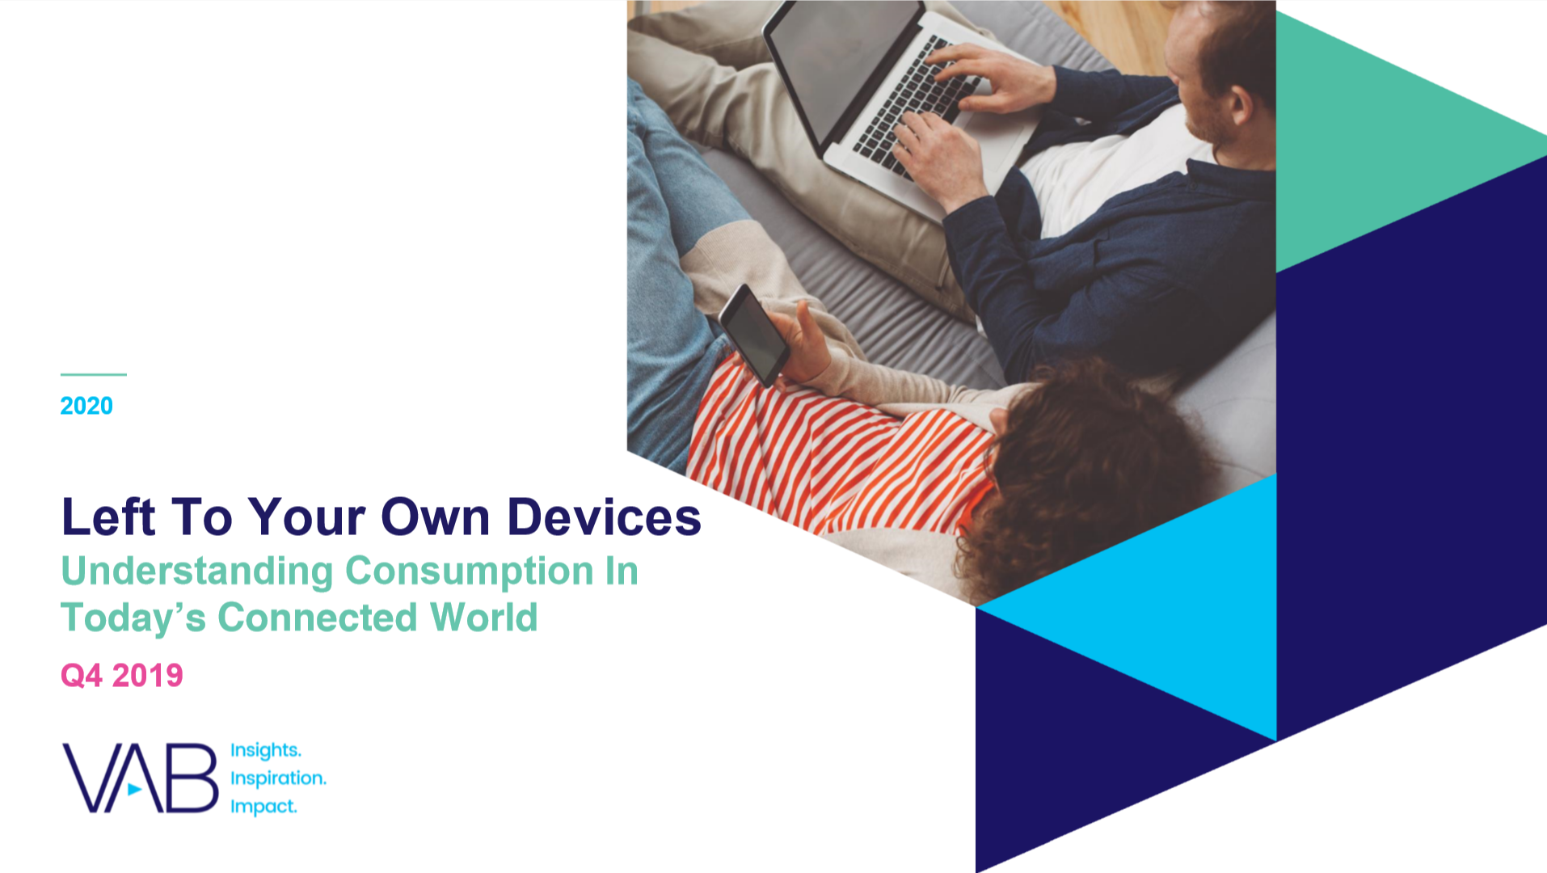
All major ethnicities are spending a large portion of their video time with TV, especially Black audiences
Click here for the full report
P18+ Average Weekly “Time Spent” – Q4 ’19
(Hrs:Mins Among U.S. Population)
Source: Nielsen Total Audience Report Q4 2019, hours:minutes among users, P18+. Internet-Connected Device = devices connected to the TV that are used to stream content such as Apple TV, Roku, Google Chromecast, Amazon Fire TV, Smartphone, Computer/Laptops, etc. (inclusive of smart TV app usage). Charts exclude reach for DVD/Blu-ray devices.
This information is exclusively provided to VAB members and qualified marketers. Further distribution is prohibited.
PAGE 6

Slide 7
Multicultural audiences have a high affinity for their favorite TV programming, characters and personalities and this relevancy is much more likely to drive product purchases
Click here for the full report
% vs. Non-Hispanic White 18+
Black A18+
Hispanic A18+
Asian A18+
‘I have purchased a product I saw while watching a TV program or endorsed by a favorite TV personality / actor’
+65%
+59%
+52%
68%
66%
63%
XX%
= % of Respondents
Source: VAB / Dynata ‘Multicultural Video Engagement Survey,’ August 2019. Q10: Please indicate how often you do the following. Respondents Answer = Always, Frequently or Occasionally. African American/Black/Caribbean American = 302 Respondents, Hispanic = 300 Respondents, Asian American/Pacific Islander = 100 Respondents, Non-Hispanic White = 300 Respondents.
This information is exclusively provided to VAB members and qualified marketers. Further distribution is prohibited.
PAGE 7

Slide 8
TV programming plays an important role when it comes to inspiring viewers to get involved in social issues that are critical to their community, especially among Black audiences
Click here for the full report
% vs. Non-Hispanic White 18+
Black A18+
Hispanic A18+
Asian A18+
‘I felt inspired to take a social action / take up a cause because of something I saw on a TV program’
+96%
+88%
+68%
27%
26%
23%
‘I felt inspired to have sought out more info about a social cause
or historical event because of something I saw on a TV program’
Black & Hispanic A18-34
are 23% more likely than Non-Hispanic White A18-34 to have sought out more information about a social cause or a historical event because of something they saw on TV
+63%
+39%
+26%
37%
32%
29%
XX%
= % of Respondents
Source: VAB / Dynata ‘Multicultural Video Engagement Survey,’ August 2019. Q12: Which of the following actions have you taken as a result of something you saw on a TV program? African American/Black/Caribbean American = 302 Respondents, Hispanic = 300 Respondents, Asian American/Pacific Islander = 100 Respondents, Non-Hispanic White = 300 Respondents.
This information is exclusively provided to VAB members and qualified marketers. Further distribution is prohibited.
PAGE 8

Slide 9

Powerful and culturally relevant storytelling within TV content also has the ability to energize multicultural audiences to make their voices heard
Click here for the full report
% vs. Non-Hispanic White 18+
Bonus Slide!
Black A18+
Hispanic A18+
Asian A18+
‘I felt inspired to attend a rally / protest because of something I saw on a TV program’
‘I felt inspired to sign a petition because of something I saw on a TV program’
‘I felt inspired to register to vote because of something I saw on a TV program’
+165%
+128%
+67%
+59%
+33%
+12%
+116%
+95%
+50%
16%
14%
10%
23%
19%
16%
29%
26%
20%
XX%
= % of Respondents
Source: VAB / Dynata ‘Multicultural Video Engagement Survey,’ August 2019. Q12: Which of the following actions have you taken as a result of something you saw on a TV program? African American/Black/Caribbean American = 302 Respondents, Hispanic = 300 Respondents, Asian American/Pacific Islander = 100 Respondents, Non-Hispanic White = 300 Respondents.
This information is exclusively provided to VAB members and qualified marketers. Further distribution is prohibited.
PAGE 9

Slide 10
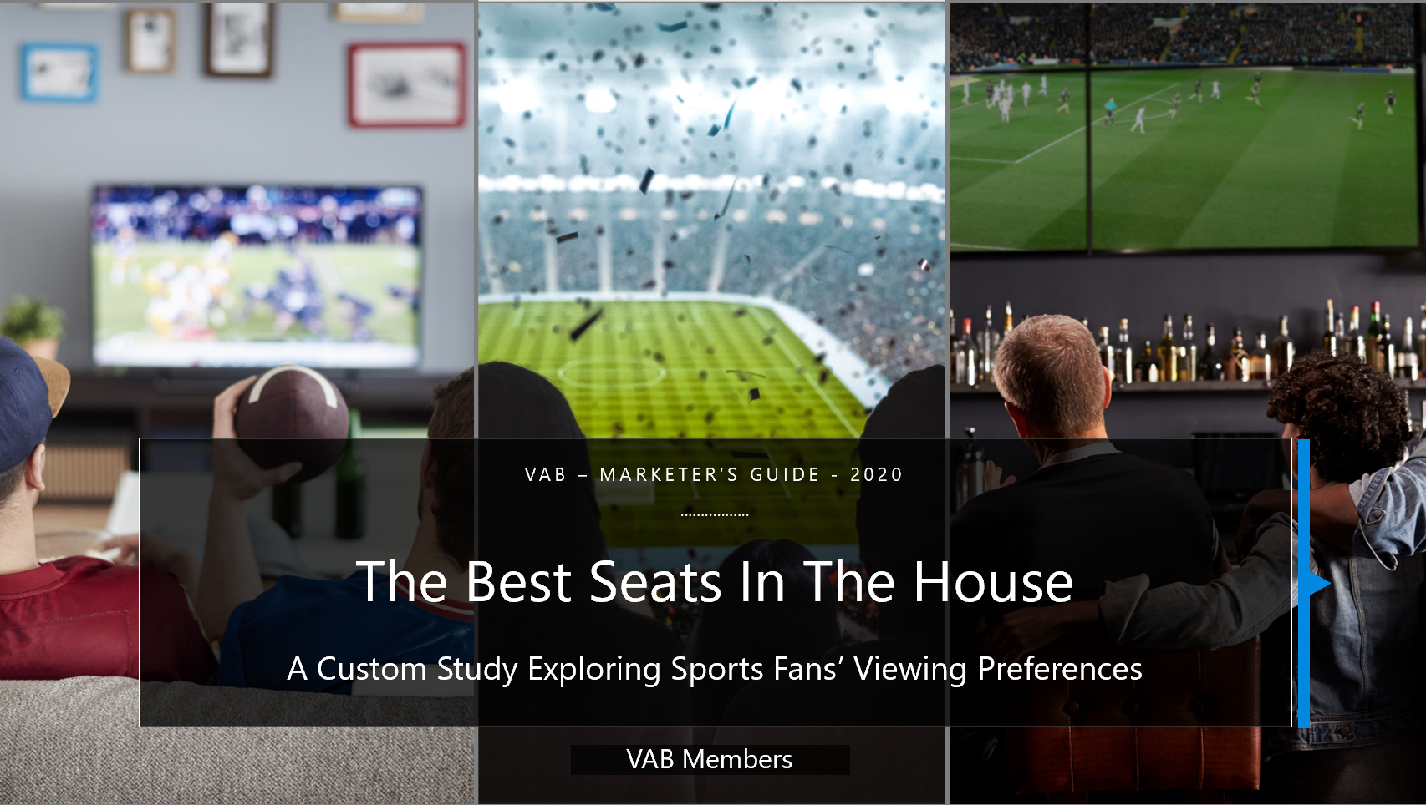
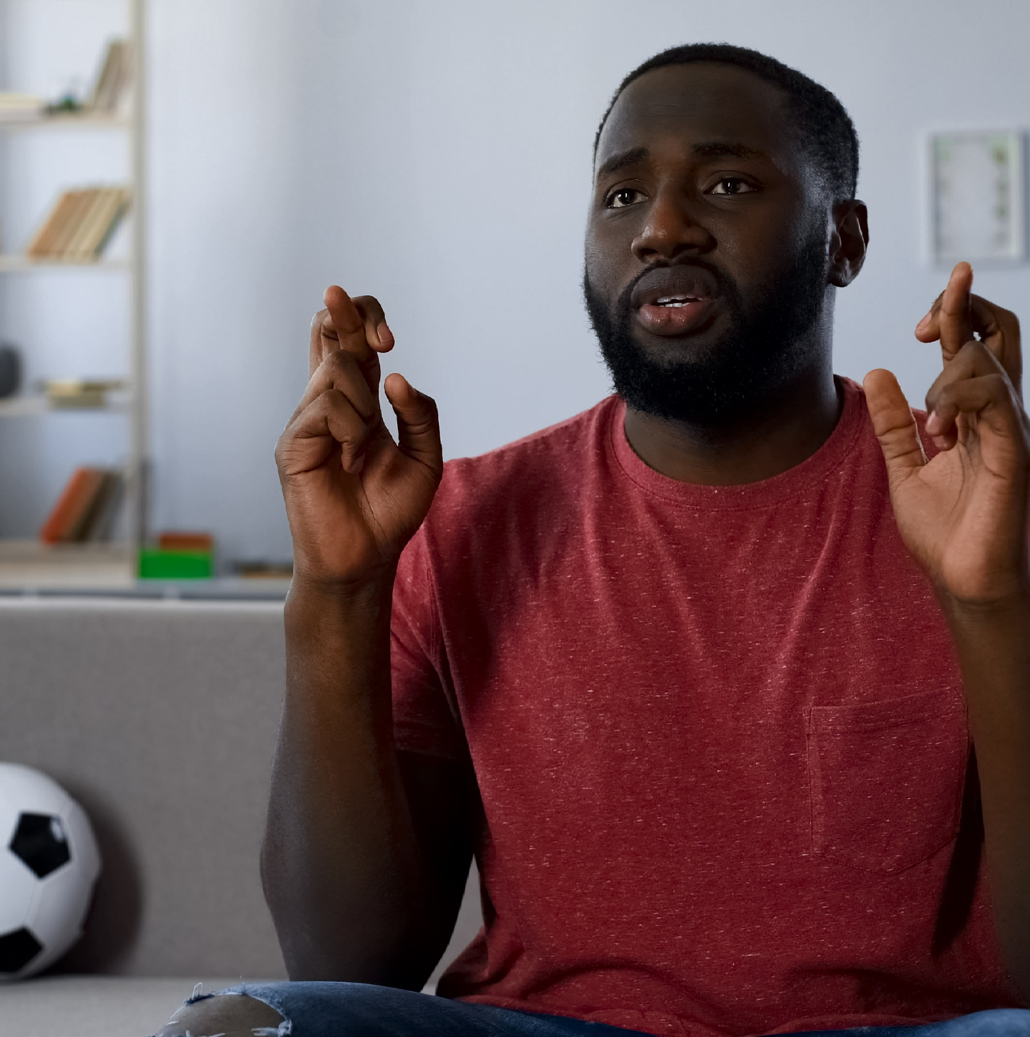
Commitment runs deep among avid sports fans, especially among multicultural ones - they are passionate to the point of superstition when it comes to their favorite teams
Click here for the full report
“I have a ritual I do before or during ‘big’ games to help my team win”
(% who agree)
Black Sports Fans
Hispanic Sports Fans
27%
179 index vs. Non-Hispanic White Sports Fans
24%
155 index vs. Non-Hispanic White Sports Fans
Source: VAB / Dynata ‘Sports Viewing Experience Survey,’ September 2019. Survey base = self-identified sports fans, P18+. Q20: Which of the following statements do you believe are true for you? Avid Fans Respondents (habitually watch sports on TV, intensely follow teams / players, etc).
This information is exclusively provided to VAB members and qualified marketers. Further distribution is prohibited.
PAGE 10

Slide 11
Multicultural sports fans are heavier sports TV viewers –
60% of Black fans and 58% of Hispanic fans watch live sports at least every other day
Click here for the full report
How Often Do Sports Fans Watch Live Sports On TV*?
Non-Hispanic White Sports Fans
Black Sports Fans
Hispanic Sports Fans
*TV is inclusive of all devices (ie., TV, connected-TV device, smartphone, tablet, etc) and locations (i.e., at home, at a bar/restaurant, someone else’s home, etc)
Source: VAB / Dynata ‘Sports Viewing Experience Survey,’ September 2019, Survey base: self-identified sports fans, P18+. Q S4: On average, how often do you watch live sports on TV in a given month? Please indicate any viewing that takes place regardless of device (i.e., TV, smartphone, tablet, etc) or location (i.e. at home, at a bar / restaurant, someone else’s home, etc).
This information is exclusively provided to VAB members and qualified marketers. Further distribution is prohibited.
PAGE 11

Slide 12
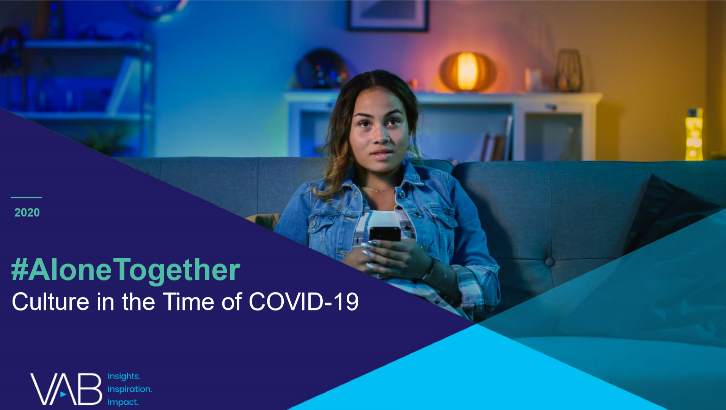
Multicultural audiences have significant influence on online conversation - 27% of total trending topics were related to subjects, content and programming that specifically featured people of color or a diverse cast
Click here for the full report
% of Top 10 ‘Diversity-Focused’ Trending Topics by Platform
(March 16th – April 26th)
86% of total topics were video-based
Source: VAB custom analysis of Top 10 trending Twitter Topics each night (9:30p & 11p) aggregated during the analysis time period (3/16/2020 – 4/26/2020). Results include both ‘direct’ and ‘related’ topics. Other video platforms include Facebook Live, HBO, Netflix, Twitter and YouTube. NFL is excluded from the count of topics due to the mainstream nature of the sport and online conversations.
This information is exclusively provided to VAB members and qualified marketers. Further distribution is prohibited.
PAGE 12

Slide 13
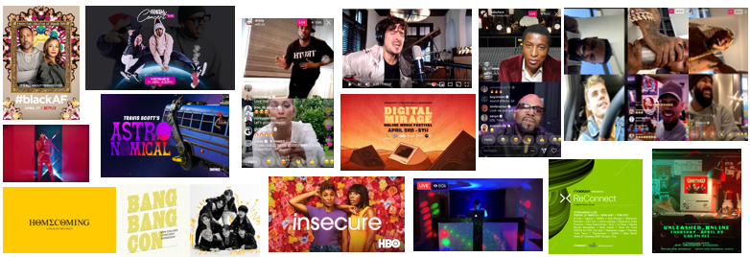
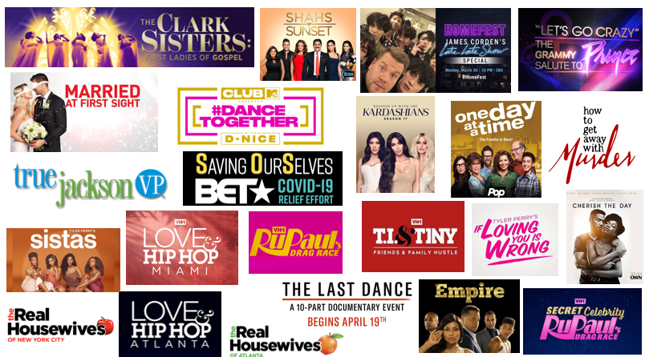
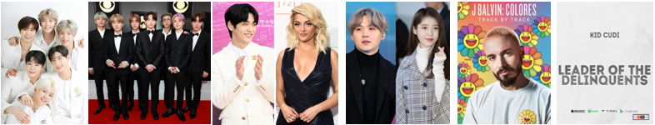
Diversity-focused social conversations during the COVID-19 pandemic were led by ad-supported TV, streaming programs, Instagram Live music battles, K-Pop streaming events and more
Click here for the full report
Diversity-Featured Programming / Content Trends In The Top 10 By Platform
(March 16th – April 26th)
Ad-Supported TV (23+)
Other Video Platforms (15+)
K-Pop and Album Releases (13+)
Source: VAB custom analysis of Top 10 trending Twitter Topics each night (9:30p & 11p) aggregated during the analysis time period (3/16/2020 – 4/26/2020). Results include both ‘direct’ and ‘related’ topics. Various Video Platforms include YouTube, Netflix, Fortnite, Facebook Live, Twitch, and HBO. Ad-supported TV Networks count (+) because TV-related news topics can be trending due to coverage across multiple TV news networks and Other Video Platforms count (+) because some events were streamed across multiple platforms. (#) = number of programs / content within each grouping that have trended. Music shown is a sampling of content. Various Video Content features Bad Bunny’s music video for ‘Yo Perreo Sola’, Diddy and J.Lo reuniting on Instagram Live, Tommy Torres performing live via YouTube, DJ Yamil on Facebook Live, and Quarantine Radio on Instagram Live. Music features several K-Pop artists and groups including Astro, BTS, Soobin and Bebe Rexha, along with album releases from J Balvin and Kid Cudi.
This information is exclusively provided to VAB members and qualified marketers. Further distribution is prohibited.
PAGE 13

Slide 14

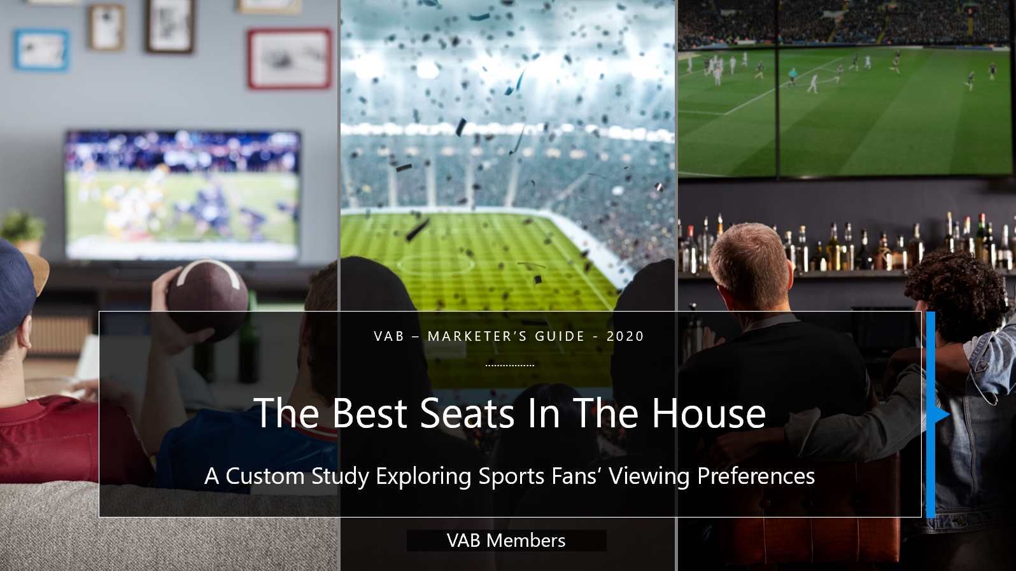
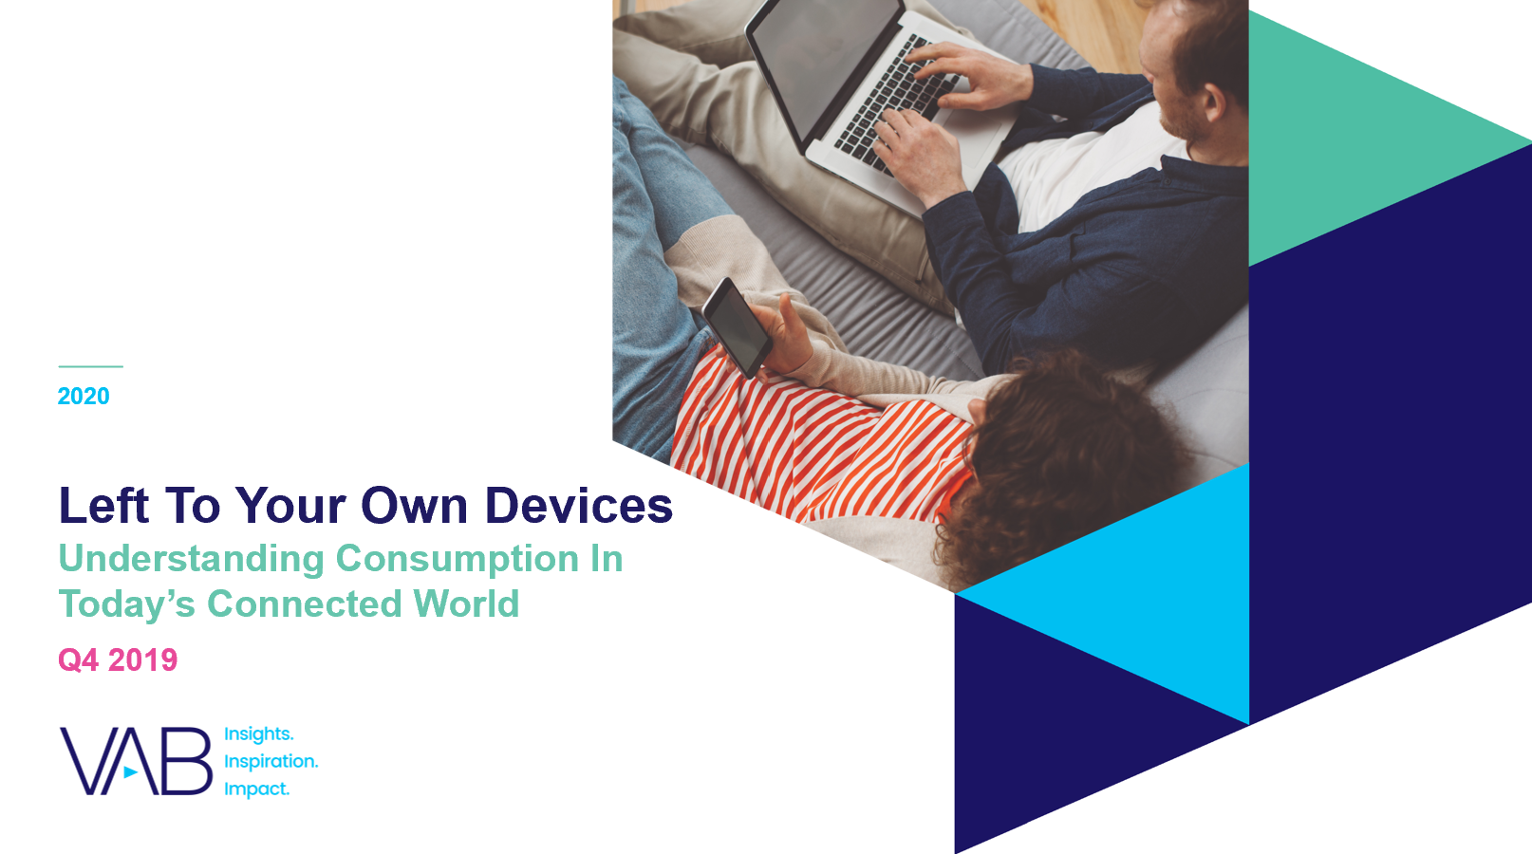

Thank You
Creators
Leah Montner-Dixon
Karolina Guillen
Insights Manager
leahm@thevab.com
Senior Insights Analyst
karolinag@thevab.com
Interested in learning more? Check out this related content:
Discover The Difference
How Culturally Relevant Video Content Drives Action By Multicultural Audiences
The Best Seats In The House
A Custom Study Exploring Sports Fans’ Viewing Preferences
#AloneTogether
Culture in the Time of COVID-19
Left To Your Own Devices Q4’ 19
Understanding Consumption In Today’s Connected World
This information is exclusively provided to VAB members and qualified marketers. Further distribution is prohibited.
PAGE 14

Slide 15

Get immediate access to the VAB Insights library
We’ve answered hundreds of marketers’ questions.
Our guides, reports, webinars and videos provide actionable insights to help marketers navigate today’s video landscape and think differently about their strategy.
We are committed to your business growth and proud to offer brand marketers and agencies complimentary access to our continuously-growing Insights library.
Get Access at theVAB.com or visit us here
This information is exclusively provided to VAB members and qualified marketers. Further distribution is prohibited.
PAGE 15

