Slide 1



September – 2020
A Sea Change in Video Viewing
Helping Marketers Find More Fish in the Streaming Ecosystem

Slide 2

About VAB
VAB is an insights-driven organization that inspires marketers to reimagine their media strategies resulting in fully informed decisions.
Drawing on our marketing expertise, we simplify the complexities in our industry and discover new insights that transform the way marketers look at their media strategy.
Simplify
We save you time by bringing you the latest data & actionable takeaways you can use to inform your marketing plans.
Discover
We keep you one step ahead with the latest thinking so you can create innovative, forward-looking strategies.
Transform
We help you build your brand by focusing on core marketing principles that will help drive tangible business outcomes.
This information is exclusively provided to VAB members and qualified marketers. Further distribution is prohibited.
PAGE 2

Slide 3
Contents
1
5
AVOD’s Rising Tide
The Path to Ad-Supported Streaming Services’ Surging Potential
What You’ll Learn
2
6
Methodology
Charting the Course Ahead for Video Streaming
3
A Whale of an Appetite for Video Streaming
Exploring the Shifts in Streaming Behavior
7
Key Takeaways For Marketers
4
Rocking the Boat
How Content-Seekers are Driving AVOD’s Rise in Popularity
8
Member Exclusive Section

Slide 4
What You’ll Learn…
How video streaming is experiencing a sea of change, with audiences of all ages and backgrounds increasingly streaming every day, if not multiple times a day.
Why ad-supported streaming services are attracting content-hungry audiences with their vast supply of library content.
What the future of video streaming may hold as consumers begin to reach their limit on paid streaming services.
This information is exclusively provided to VAB members and qualified marketers. Further distribution is prohibited.
PAGE 4

Slide 5
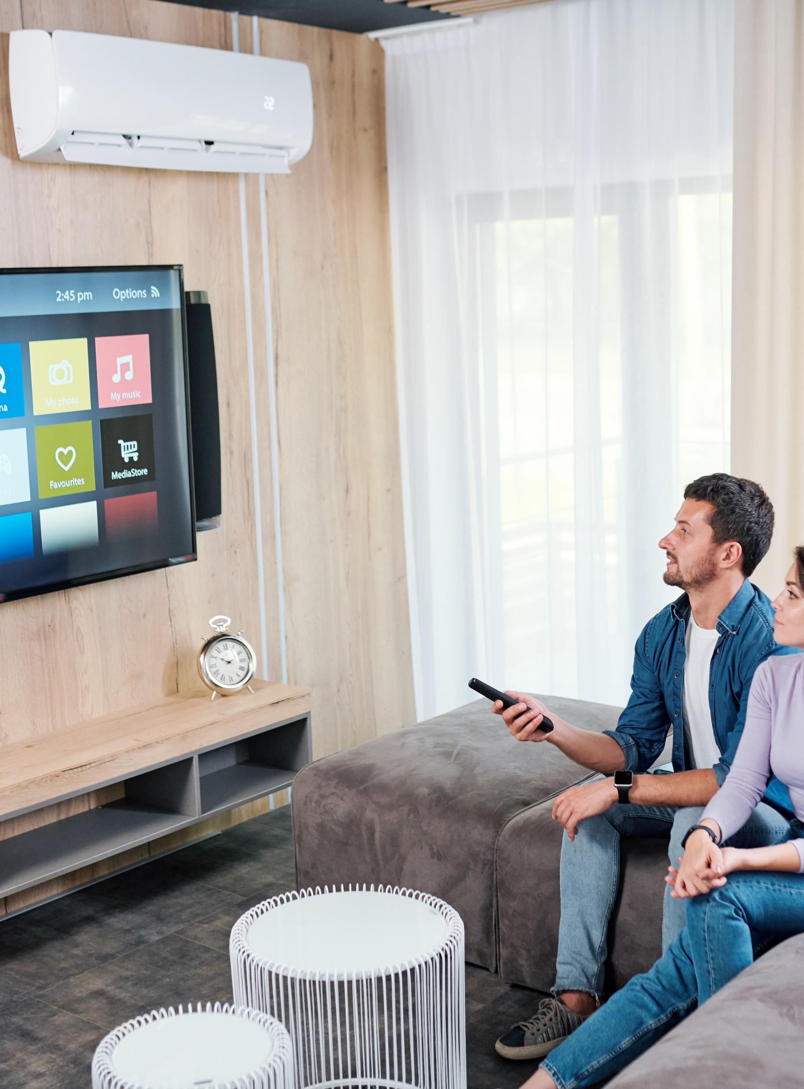
Intention & Methodology
We conducted a custom study to capture and understand the evolving media consumption habits and behaviors of adults following the first few months of the COVID-19 pandemic.
We commissioned Lucid to conduct an online survey June 24 –29, 2020. The results are based on 1,000 U.S. adults 18+ in households with access to streaming services and have viewed content on streaming services. The respondents cover all age groups, races and ethnic backgrounds.
The purpose of this report is to provide the latest streaming usage data and insights into how viewing has evolved since the pandemic.
This information is exclusively provided to VAB members and qualified marketers. Further distribution is prohibited.
PAGE 5

Slide 6

A Whale of an Appetite
for Video Streaming
Exploring the Shifts
in Streaming Behavior

Slide 7

Searching for additional TV content while sheltered in place, viewers have become more comfortable streaming video
“I have become more comfortable streaming video”
% of respondents who agree completely
A18-34
71%
A35-54
77%
HHI$100K+
80%
Employed Full-time
76%
Hispanic A18+
72%
Households w/ Children
78%
Source: VAB / Lucid ‘COVID-19 Streaming Behavior Survey,’ June 2020. Survey base: A18+ in households with access to streaming services and have viewed content on streaming services (n=1,000). Q9.Thinking of your behavior over the past 30 days, which of the following statements do you feel apply to you?
This information is exclusively provided to VAB members and qualified marketers. Further distribution is prohibited.
PAGE 7

Slide 8

And as comfort levels rise, time spent streaming increases
With many individuals and households experiencing significant lifestyle changes such as more time at home or adult children moving back in with parents, older audiences have started streaming more
“I am spending more time streaming video”
% of respondents who agree
A18+
A55+
59%
42%
Source: VAB / Lucid ‘COVID-19 Streaming Behavior Survey,’ June 2020. Survey base: A18+ in households with access to streaming services and have viewed content on streaming services (n=1,000). Q4. Overall, please choose the statement below that best describes your video streaming viewing (e.g., Netflix, Disney+, Pluto TV, TV network or cable provider app, etc.) during the past 30 days.
This information is exclusively provided to VAB members and qualified marketers. Further distribution is prohibited.
PAGE 8
PAGE 1

Slide 9

With more time, viewers tend to access more services – more than one-third have access to 4 or more services
Young adults, affluent households, and families, along with regular users of ad-supported streaming services, are most likely to subscribe to more services
How many streaming services does your household currently have access to?
Source: VAB / Lucid ‘COVID-19 Streaming Behavior Survey,’ June 2020. Survey base: A18+ in households with access to streaming services and have viewed content on streaming services (n=1,000). Q2. How many streaming services does your household currently have access to? AVOD Users = respondents who regularly watch free subscription streaming services with commercials (e.g., Crackle, Pluto TV, Tubi TV) (n= 298).
This information is exclusively provided to VAB members and qualified marketers. Further distribution is prohibited.
PAGE 9
PAGE 1

Slide 10

Time, comfort, and more choices have all lead to the adoption of video streaming as a daily activity
Young adults and families, the early adopters, are now ‘super streamers’, including 20% of respondents who stream multiple times a day
On average, how many times per week do you watch a video streaming service?
Source: VAB / Lucid ‘COVID-19 Streaming Behavior Survey,’ June 2020. Survey base: A18+ in households with access to streaming services and have viewed content on streaming services (n=1,000). S3. On average, how many times per week do you watch a video streaming service? (e.g., Netflix, Disney +, Tubi, Hulu, CBS All Access, etc.)
This information is exclusively provided to VAB members and qualified marketers. Further distribution is prohibited.
PAGE 10
PAGE 1

Slide 11
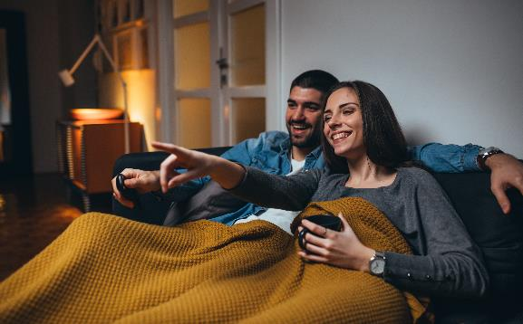


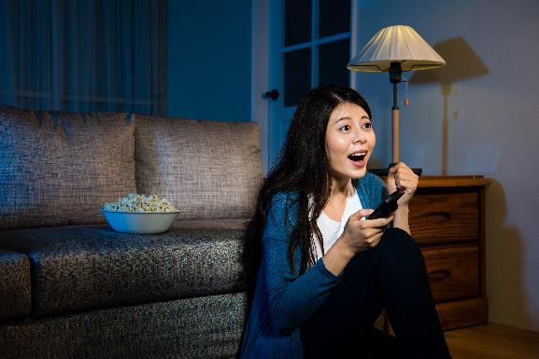
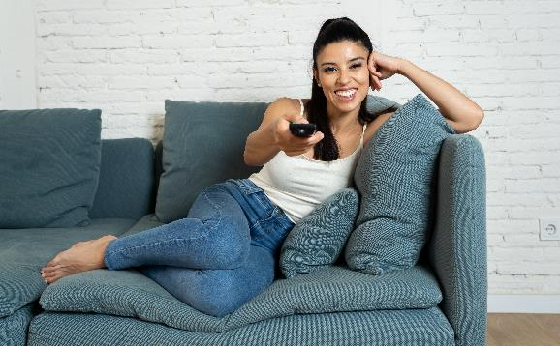

Currently streamers are comfortable with the value they receive from their streaming services
Audiences across the board find that the array of services available to them are worth it because they love the content, whether they’re paying for a subscription or watching ads, especially among women (62%)
“Streaming services are a good value for your money”
% of respondents who agree completely
AVOD Users:
59%
A45-54:
59%
SVOD Users:
58%
A18-24:
57%
Hispanic:
53%
Households with Children:
62%
Source: VAB / Lucid ‘COVID-19 Streaming Behavior Survey,’ June 2020. Survey base: A18+ in households with access to streaming services and have viewed content on streaming services (n=1,000). Q3. When thinking about streaming video services, how much do you agree or disagree with the following statements? AVOD Users = respondents who regularly watch free subscription streaming services with commercials (e.g., Crackle, Pluto TV, Tubi TV) (n= 298). SVOD Users = respondents who regularly watch paid subscription streaming services with no commercials (e.g., Netflix, Disney+) (n= 817).
This information is exclusively provided to VAB members and qualified marketers. Further distribution is prohibited.
PAGE 11

Slide 12


However, there are limits to how much consumers are willing to pay even though there are no limits to the amount of content they want access to
59% of American streamers will not pay more than $20 a month for streaming subscriptions, and while that might limit paid options, free streaming services are the answer to those looking for more content without the added expense
% of respondents who agree with the statement
“My attitude is, the more content, the better!”*
“I would rather watch ads than pay more for an ad-free experience”
A18+
AVOD Users
A18+
AVOD Users
38%
43%
42%
59%
Source: Needham & Company, Streamingg Wars: Winners & Losers, 8/14/20. The Trade Desk, January 2020. VAB / Lucid ‘COVID-19 Streaming Behavior Survey,’ June 2020. Survey base: A18+ in households with access to streaming services and have viewed content on streaming services (n=1,000). Q8. How much do you agree or disagree with the following statements? *Reflects respondents who answered ‘agree completely’. Q10. Which of the following statements describe your views on free streaming services? (e.g., Tubi, Pluto, Crackle , etc.) AVOD Users = respondents who regularly watch free subscription streaming services with commercials (e.g., Crackle, Pluto TV, Tubi TV) (n= 298).
This information is exclusively provided to VAB members and qualified marketers. Further distribution is prohibited.
PAGE 12
PAGE 1

Slide 13
Summary: A Whale of an Appetite
for Video Streaming
Audiences across the board are now streaming every day or even multiple times a day, especially among early adopters (young adults & families), expanding the opportunity for marketers to reach these coveted groups
Paid subscription services have been embraced by streamers; however, new competitors and ad-supported services with extensive content libraries are quickly becoming appealing
Content-hungry viewers subscribe to multiple services, showcasing room for growth for ad supported services, especially as we hit the limit consumers are willing to spend in this category
This information is exclusively provided to VAB members and qualified marketers. Further distribution is prohibited.
PAGE 13

Slide 14
Rocking the Boat
How Content-Seekers are Driving AVOD’s Rise in Popularity

Slide 15





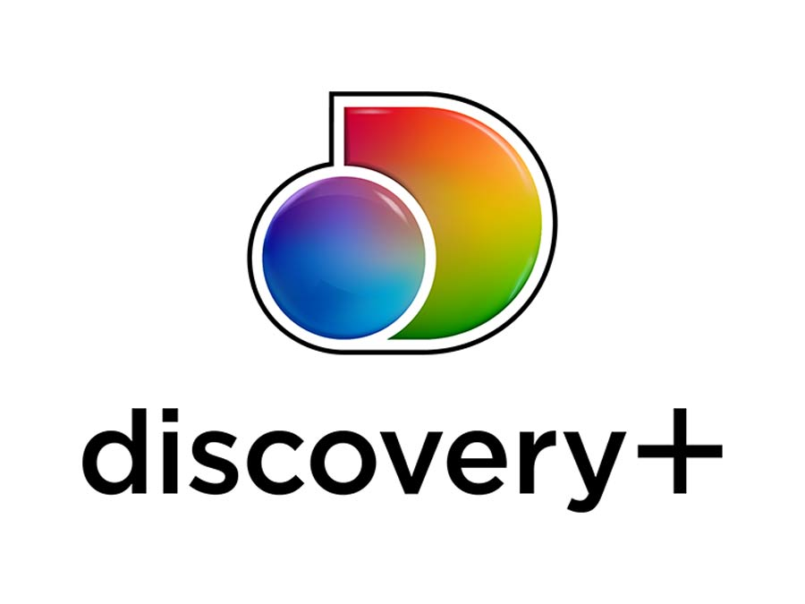















With an established content library and name recognition on their side, paid streaming services currently have the largest subscriber base
Ad-supported video-on-demand services (AVOD) have been gaining traction over the last few years as they increase their content libraries and intensify their tactics to attract subscribers
Streaming platforms used regularly by type
% of respondents that use the following services regularly
Ad-Supported Subscription Services
Paid Subscription Services
vMVPD Services
Source: VAB / Lucid ‘COVID-19 Streaming Behavior Survey,’ June 2020. Survey base: A18+ in households with access to streaming services and have viewed content on streaming services (n=1,000). Q7. Please select which of the following services you currently watch regularly.
This information is exclusively provided to VAB members and qualified marketers. Further distribution is prohibited.
PAGE 15
PAGE 1

Slide 16

Although Netflix is dominating paid streaming today, new competitors with strong offerings have recently emerged hoping to cut into their market share
Disney+ has established a loyal, robust subscriber base in less than a year, proving there is still room in the paid streaming category for new entries with a vast content library
Regularly Watched Paid Streaming Services
% of respondents that use the following services regularly
83%
52%
38%
26%
14%
13%
9%
5%
Source: VAB / Lucid ‘COVID-19 Streaming Behavior Survey,’ June 2020. Survey base: A18+ in households with access to streaming services and have viewed content on streaming services (n=1,000). Q7. Please select which of the following services you currently watch regularly. Does not equal 100% due to the ability to choose multiple responses.
This information is exclusively provided to VAB members and qualified marketers. Further distribution is prohibited.
PAGE 16
PAGE 1

Slide 17

Fearing that consumers’ threshold for paid services is nearing its max,
ad-supported streaming services have embraced a different model to grab viewer attention
“You have all these choices, but you're paying for them all and they quickly add up….We're trying to approach streaming in a different way, the combination of high-quality programming that's available at a very affordable price. There's nothing more affordable than free.“
Matt Strauss
Chairman, Peacock
USA Today, 7/13/20
This information is exclusively provided to VAB members and qualified marketers. Further distribution is prohibited.
PAGE 17

Slide 18

Due to heightened interest and attention during COVID-19, trial and adoption of AVOD services accelerated, with 1 in 4 viewers stacking AVOD subscriptions on top of paid
27%
of SVOD users also subscribe to AVOD services
75%
of AVOD users also access SVOD services
Source: VAB / Lucid ‘COVID-19 Streaming Behavior Survey,’ June 2020. Survey base: A18+ in households with access to streaming services and have viewed content on streaming services (n=1,000). Q5. Which of the following streaming service types do you watch regularly? Does not equal 100% due to the ability to choose multiple responses. AVOD Users = respondents who regularly watch free subscription streaming services with commercials (e.g., Crackle, Pluto TV, Tubi TV) (n= 298). SVOD Users = respondents who regularly watch paid subscription streaming services with no commercials (e.g., Netflix, Disney+) (n= 817).
This information is exclusively provided to VAB members and qualified marketers. Further distribution is prohibited.
PAGE 18

Slide 19



AVOD services satisfy viewers' desire for more premium current and library TV shows
Which of the following statements about streaming video content do you agree with?
% of respondents who agree completely
AVOD Users
72%
“I like the large selection of TV shows and movies they offer”
67%
“I like having access to every show, past or present”
58%
“I enjoy the original content the service offers”
Source: VAB / Lucid ‘COVID-19 Streaming Behavior Survey,’ June 2020. Survey base: A18+ in households with access to streaming services and have viewed content on streaming services (n=1,000). Q3. When thinking about streaming video services, how much do you agree with the following statements? Does not equal 100% due to the ability to choose multiple responses. AVOD Users = respondents who regularly watch free subscription streaming services with commercials (e.g., Crackle, Pluto TV, Tubi TV) (n= 298).
This information is exclusively provided to VAB members and qualified marketers. Further distribution is prohibited.
PAGE 19

Slide 20
Library content, a core attribute for many AVOD services, is an important driver for signups, especially for young adults who appreciate ‘retro’ classics
A combination of both newer originals and older classics appeal rather equally to both AVOD users (67%) and SVOD users (66%)
“I like having access to every show, past or present”
% of respondents who agree completely
Source: VAB / Lucid ‘COVID-19 Streaming Behavior Survey,’ June 2020. Survey base: A18+ in households with access to streaming services and have viewed content on streaming services (n=1,000). Q3. When thinking about streaming video services, how much do you agree or disagree with the following statements? AVOD Users = respondents who regularly watch free subscription streaming services with commercials (e.g., Crackle, Pluto TV, Tubi TV) (n= 298). SVOD Users = respondents who regularly watch paid subscription streaming services with no commercials (e.g., Netflix, Disney+) (n= 817).
This information is exclusively provided to VAB members and qualified marketers. Further distribution is prohibited.
PAGE 20

Slide 21
Early returns signify satisfaction among subscribers as nearly half cite watching more content on AVOD than paid
“I have found myself streaming more free, ad-supported video content than paid content”
% of respondents who agree completely
Source: VAB / Lucid ‘COVID-19 Streaming Behavior Survey,’ June 2020. Survey base: A18+ in households with access to streaming services and have viewed content on streaming services (n=1,000). Q9. Thinking of your behavior over the past 30 days, which of the following statements do you feel apply to you? Does not equal 100% due to the ability to choose multiple responses. AVOD Users = respondents who regularly watch free subscription streaming services with commercials (e.g., Crackle, Pluto TV, Tubi TV) (n= 298).
This information is exclusively provided to VAB members and qualified marketers. Further distribution is prohibited.
PAGE 21

Slide 22

…And almost 40% hope more ad-supported services launch
Nearly 4 in 10 AVOD users wish
there were more free streaming video services
Source: VAB / Lucid ‘COVID-19 Streaming Behavior Survey,’ June 2020. Survey base: A18+ in households with access to streaming services and have viewed content on streaming services (n=1,000). Q10.Which of the following statements describe your views on free streaming services? (e.g., Tubi, Pluto, Crackle , etc.)
This information is exclusively provided to VAB members and qualified marketers. Further distribution is prohibited.
PAGE 22

Slide 23
Why? Viewers are not deterred by advertising, in fact they acknowledge that ads make their viewing experience more affordable
Which of the following statements about streaming video content do you agree with?
% of respondents who agree completely
“I appreciate the fact that ads are making this service cheaper for me”
“I don’t mind seeing ads in free streaming programming”
AVOD Users
AVOD Users
53%
35%
A18-34
A35-54
A18-34
A35-44
41%
35%
25%
30%
Source: VAB / Lucid ‘COVID-19 Streaming Behavior Survey,’ June 2020. Survey base: A18+ in households with access to streaming services and have viewed content on streaming services (n=1,000). Q10. Which of the following statements describe your views on free streaming services? Q12. Which of the following statements about advertisements that appear in streaming services that have ads do you agree with? Does not equal 100% due to the ability to choose multiple responses. AVOD Users = respondents who regularly watch free subscription streaming services with commercials (e.g., Crackle, Pluto TV, Tubi TV) (n= 298).
This information is exclusively provided to VAB members and qualified marketers. Further distribution is prohibited.
PAGE 23

Slide 24

AVOD subscribers appreciate the limited commercial load and customized creative found in a free subscription streaming environment
Many ad-supported services have improved the ad experience by:
Committing to limited commercial time
Using interactive ads to increase engagement
Source: VAB / Lucid ‘COVID-19 Streaming Behavior Survey,’ June 2020. Survey base: A18+ in households with access to streaming services and have viewed content on streaming services (n=1,000). Q12. Which of the following statements about advertisements that appear in streaming services that have ads do you agree with? AVOD Users = respondents who regularly watch free subscription streaming services with commercials (e.g., Crackle, Pluto TV, Tubi TV) (n= 298).
This information is exclusively provided to VAB members and qualified marketers. Further distribution is prohibited.
PAGE 24

Slide 25
Summary: Rocking the Boat
While paid services are the most popular streaming platforms, their content libraries are under siege as new services are being rolled out by nearly all of the major media players
Consumers value content and are looking to get it wherever they can, providing more opportunity for free ad-supported streaming services
AVOD viewers are not deterred by ads or even cost – their ultimate driver is a passion for content
Ad-supported services’ growth is a positive sign for marketers looking to reach an engaged and expanding audience, particularly women and those who are time-pressed
This information is exclusively provided to VAB members and qualified marketers. Further distribution is prohibited.
PAGE 25

Slide 26
AVOD’s Rising Tide
The Path to Ad-Supported Streaming Services’ Surging Potential

Slide 27
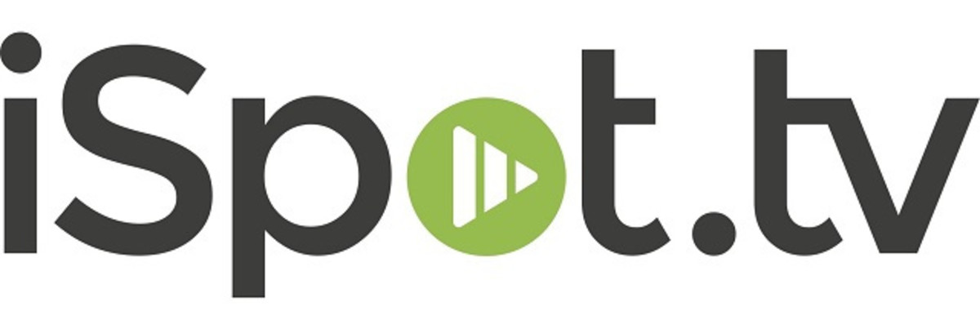
To drive subscribers and decrease churn, paid streamers typically spend tens of millions of dollars each quarter to promote their shows or services
% Change in Subscriptions
Pre-pandemic (2/12 – 2/25) vs. Post (4/22 – 5/5)
Paid Streaming Services’ National TV Spend*
2nd Quarter 2020
+23%
N/A
N/A
+9%
$32.7MM
$44.3MM
+7%
+213%
+102%
+7%
$86.1MM
Total 2019 $222MM
$10.8MM
Total 2019 $106MM
XX%
= % change vs. Q2 2019
Source: VIP+: Variety Intelligence Platform, COVID Impact on Media, 8/14/20. Hub Research. VAB analysis of iSpot.tv data, Q2 ‘20 vs. Q2 ‘19. *The above brands represent a sampling of those included in iSpot’s ‘Video Streaming Services’ industry.
This information is exclusively provided to VAB members and qualified marketers. Further distribution is prohibited.
PAGE 27

Slide 28


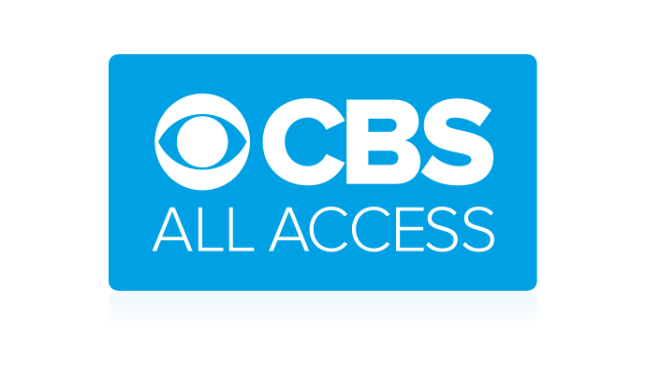

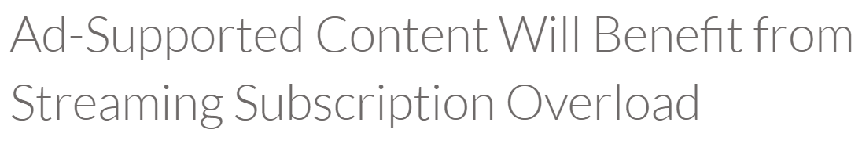



Due to the appeal of their programming and attractive cost, AVOD platforms have been able to drive subscribers despite relatively low ad spend
NBCU’s Peacock streaming service has reached 15 million signups as of September 15th, a 50% increase since July 15th
AVOD Streaming Services’ National TV Spend*
Q2, 2020
August 18th, 2020
$26.3MM
$6.3MM
$3.7MM
September 2nd, 2020
$89.0K
$29.6K
September 10th, 2020
Source: VAB analysis of iSpot.tv data, Q2 ’20.. *The above brands represent a sampling of those included in iSpot’s ‘Video Streaming Services’ industry. Broadcasting & Cable, 9/15/20.
This information is exclusively provided to VAB members and qualified marketers. Further distribution is prohibited.
PAGE 28

Slide 29
Since COVID-19, viewers have not only been signing up but watching AVOD services at higher rates
Use of Major AVOD Services
% of U.S. A18+ using service
Source: VIP+: Variety Intelligence Platform, COVID Impact on Media, 8/14/20. Hub Research.
This information is exclusively provided to VAB members and qualified marketers. Further distribution is prohibited.
PAGE 29

Slide 30


Resulting in an increase in impressions and revenue across all major AVOD services
Ad revenues across some of the top AVOD services rose 31% in Q2 2020, for a total of $849 million
Ad revenues across 5 AVOD streaming services
2Q ’20 ($ in millions)
In April of 2020, 58.5 million households were using AVOD, an increase of 9% vs. January 2020
Source: MediaPost, 8/14/20. Comscore, State of OTT, 2020.
This information is exclusively provided to VAB members and qualified marketers. Further distribution is prohibited.
PAGE 30

Slide 31
Summary: AVOD’s Rising Tide
Ad-supported streaming services experienced a boost due to COVID-19 and the growth is holding as consumer awareness continues to grow
While paid services currently have advantages thanks to heavy investments in advertising, nearly universal built-in functionality and availability across devices, ad-supported services are emerging as a serious competitor
AVOD services are generating an increase in ad-revenue and once they tackle awareness, ease of use will come with it
This information is exclusively provided to VAB members and qualified marketers. Further distribution is prohibited.
PAGE 31

Slide 32
Charting the Course
Ahead for Video Streaming

Slide 33

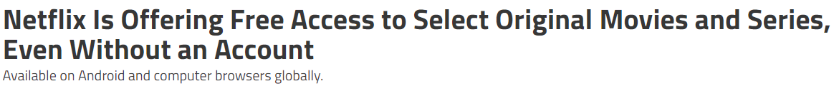
As the demand for content increases and competition abounds, even the largest of the streaming services is offering incentives to increase subscriptions
“We're looking at different marketing promotions to attract new members and give them a great
Netflix experience.”
- Netflix, Gadgets 360, 8/31/20
August 31st, 2020
Source: VAB / Lucid ‘COVID-19 Streaming Behavior Survey,’ June 2020. Survey base: A18+ in households with access to streaming services and have viewed content on streaming services (n=1,000). Q10. Which of the following statements describe your views on free streaming services? (e.g., Tubi, Pluto, Crackle , etc.) AVOD Users = respondents who regularly watch free subscription streaming services with commercials (e.g., Crackle, Pluto TV, Tubi TV) (n= 298). Paid Subscribers = respondents who regularly watch paid subscription streaming services with no commercials (e.g., Netflix, Disney+) (n= 817). Needham & Company, Streamingg Wars: Winners & Losers, 8/14/20.
This information is exclusively provided to VAB members and qualified marketers. Further distribution is prohibited.
PAGE 33

Slide 34

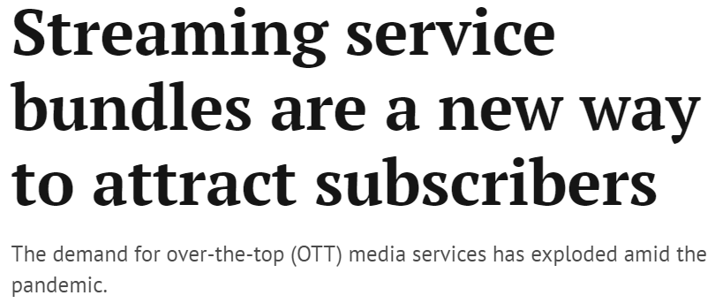

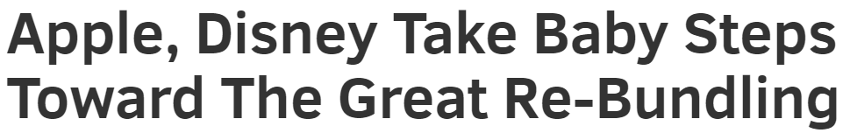

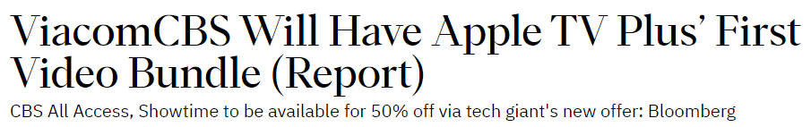
In fact, many of the major media companies are setting up bundle partnerships to entice new subscribers by making their services more accessible to viewers, as well as more affordable
Which of the following statements about streaming video content do you agree with?
% of respondents who agree completely
A18+
“I wish there were discounts for bundling certain streaming services”
August 18th, 2020
57%
August 18th, 2020
“I wish there was one bundle I could buy that included everything”
53%
August 13th, 2020
Source: VAB / Lucid ‘COVID-19 Streaming Behavior Survey,’ June 2020. Survey base: A18+ in households with access to streaming services and have viewed content on streaming services (n=1,000). Q3. When thinking about streaming video services, how much do you agree or disagree with the following statements?
This information is exclusively provided to VAB members and qualified marketers. Further distribution is prohibited.
PAGE 34

Slide 35
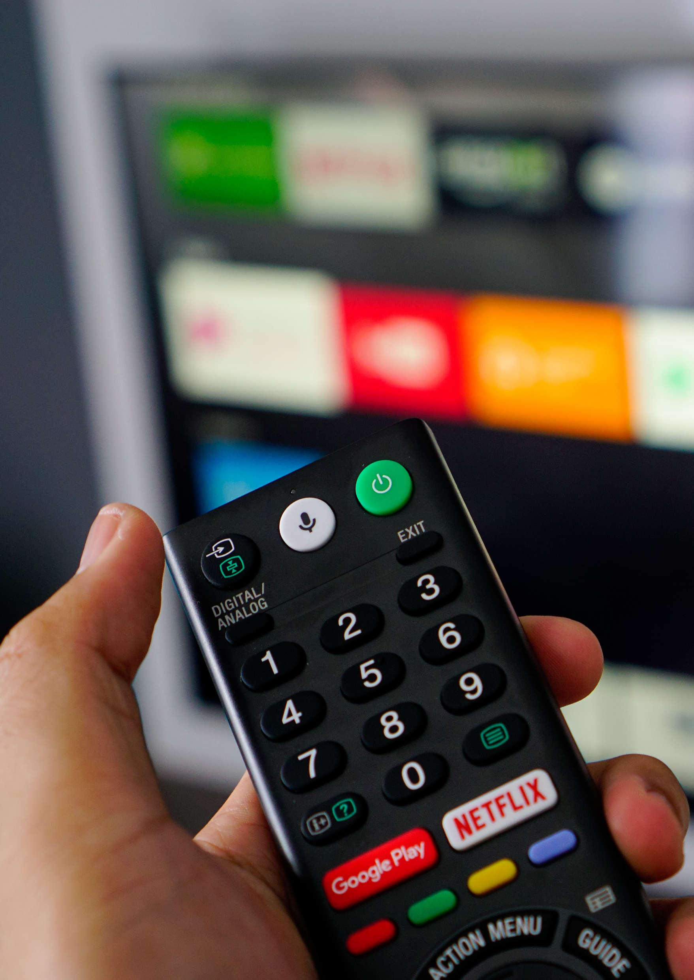
In addition to bundling, consumers are looking for ease of use in the form of built-in functionality and availability across all devices
The established paid services currently have the advantage, as many smart TVs and devices offer one-click access for viewers, whereas the ad-supported services are still building their relationships with OEM's
When considering video streaming attributes:
81%
of consumers place a high importance on ease of use
58%
value availability across devices
Source: Nielsen Total Audience Report, February 2020..
This information is exclusively provided to VAB members and qualified marketers. Further distribution is prohibited.
PAGE 35

Slide 36
Summary: Charting the Course Ahead for Video Streaming
Although the video streaming ecosystem has not yet hit saturation, the limit of paid services may be peaking, giving rise to the demand for free ad-supported services
In order to stay competitive, paid services may need to introduce tiered pricing options, including ad-supported options, or offer some content for free to attract new subscribers
With so much content spread across multiple services, bundling has become a popular strategy for attracting new viewers
Partnerships have already begun as existing services seek to make their own content more accessible while also adding on to their own library content
This information is exclusively provided to VAB members and qualified marketers. Further distribution is prohibited.
PAGE 36

Slide 37





Key Takeaways for Marketers
All audiences are streaming video more than ever, and their insatiable appetite for content is paving the way for free ad-supported services at a time when paid services appear to be reaching saturation
AVOD is an Incremental Reach Opportunity
AVOD is in Growth Mode
Content is King
Opportunity in the Ad Experience
Audiences across the board are now streaming every day or even multiple times a day and viewing multiple services. As viewers continue to stack AVOD platforms on top of paid, marketers have an opportunity to expand reach and ‘fuel their funnel’ with more consumers.
The increased access, comfort-level and time viewers had early-on in the pandemic drove increases in video streaming. These behaviors appear to be holding, signaling AVOD’s viability as an important piece of a holistic video campaign into the future.
Viewers choose which platforms to watch based upon the content, not the price or even the presence of ads. Because of their extensive libraries of quality programming, AVOD platforms attract viewers and deliver marketers an engaged, attentive, and committed audience.
Viewers accept and appreciate that ads are a ‘part of the deal’ in getting free content. With this comes a marketing opportunity to be creative, interactive and targeted with your brand message and build relationships with these engaged viewers.
This information is exclusively provided to VAB members and qualified marketers. Further distribution is prohibited.
PAGE 37

Slide 38

In addition to a variety of content, the ability to stream their favorite shows anytime and anywhere is key for time-pressed adults and families with a passion for video
With the sheer volume of content available, 26% of adults 18+ streamers and 33% of AVOD users feel that they often don’t have enough time to watch everything they would like to watch, showcasing the need for ease of use when streaming
“I can watch anytime, anywhere, on any device”
% of respondents who agree completely
32% of households with children appreciate that AVOD services have content their kids can enjoy
Source: VAB / Lucid ‘COVID-19 Streaming Behavior Survey,’ June 2020. Survey base: A18+ in households with access to streaming services and have viewed content on streaming services (n=1,000). Q3. When thinking about streaming video services, how much do you agree or disagree with the following statements? Q8. How much do you agree or disagree with the following statements? Reflects respondents who answer ‘agree completely”. Q10. Which of the following statements describe your views on free streaming services? (e.g., Tubi, Pluto, Crackle , etc.) AVOD Users = respondents who regularly watch free subscription streaming services with commercials (e.g., Crackle, Pluto TV, Tubi TV) (n= 298).
This information is exclusively provided to VAB members and qualified marketers. Further distribution is prohibited.
PAGE 38

Slide 39

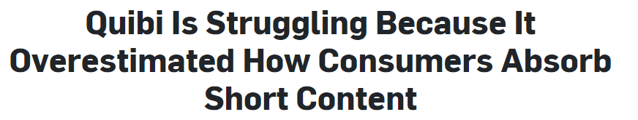
And while consumers have a seemingly endless appetite for streaming services, most still prefer full-length premium content rather than short-form video
The recent launch of Quibi, the streaming service dedicated to mobile-only short-form video, has brought to light what consumers are really looking for when it comes to paying for premium video entertainment
What type of videos do you typically prefer to stream?
% of respondents
May 15th, 2020
“[The viewer] might only watch 10 minutes of content, but they’d rather watch part of a high-quality program than 100% of something they perceive to be a lesser quality product.”
- Ben Silverstein, Founder, AdCoach
Source: VAB / Lucid ‘COVID-19 Streaming Behavior Survey,’ June 2020. Survey base: A18+ in households with access to streaming services and have viewed content on streaming services (n=1,000). Q13. What type of videos do you typically prefer to stream? Full-length TV episodes - 30 minutes or more.
This information is exclusively provided to VAB members and qualified marketers. Further distribution is prohibited.
PAGE 39
PAGE 1
Notes:
Clear preferences for long-form content

Slide 40


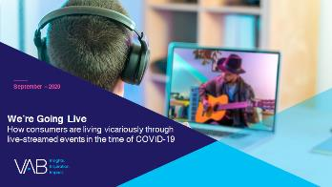
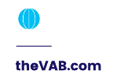
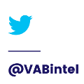

Thank You
Creators
Kathy Grey
Leah Montner-Dixon
Karolina Guillen
SVP, Research Innovation kathyg@thevab.com
Insights Manager
leahm@thevab.com
Senior Insights Analyst
karolinag@thevab.com
Interested in learning more? Check out this related content:
Navigating the Flood:
Charting Your Way Through Today’s Streaming Ecosystem
VAB Inspire Virtual Learning Series:
Streaming Trends & Insights
We’re Going Live:
How Consumers Are Living Vicariously Through Live-streamed Events in the Time of COVID-19
This information is exclusively provided to VAB members and qualified marketers. Further distribution is prohibited.
PAGE 40

Slide 41

Get immediate access to the VAB Insights library
We’ve answered hundreds of marketers’ questions.
Our guides, reports, webinars and videos provide actionable insights to help marketers navigate today’s video landscape and think differently about their strategy.
We are committed to your business growth and proud to offer brand marketers and agencies complimentary access to our continuously-growing Insights library.
Get Access at theVAB.com or visit us here
This information is exclusively provided to VAB members and qualified marketers. Further distribution is prohibited.
PAGE 41

