Slide 1


VIDEO ADVERTISING BUREAU - REPORT 2019
.................
Risky Business
Exploring Brand Safety on YouTube

Slide 2
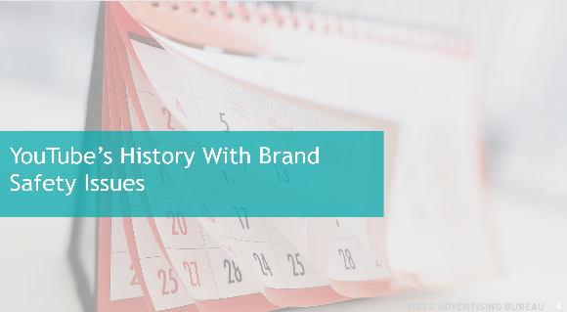
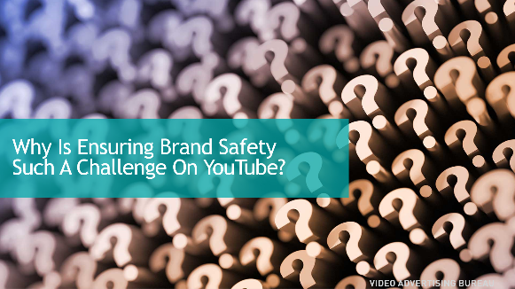
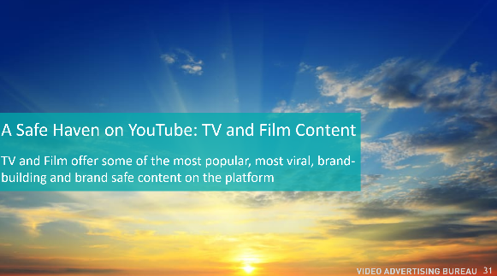
Contents
1
Risk Management
2
2
YouTube’s History With Brand Safety Issues
3
Why a Brand Safe Environment Matters
4
4
Why is Ensuring Brand Safety Such a Challenge on YouTube?
5
A Safe Haven on YouTube: TV and Film Content
6
Choosing To Protect Your Brand
5
2

Slide 3
Risk Management
YouTube has been under continued scrutiny for allowing a host of inappropriate videos to live on its platform as many marketers object to their advertisements appearing adjacent to this unsavory content. YouTube has made repeated efforts at ensuring a more brand-safe environment, however with 400 hours of video uploaded every minute, it is certainly a daunting task to regulate, monitor and control all content.
In response to this heightened scrutiny of content, many advertisers have pared down their list of acceptable YouTube channels considerably… some going from millions down to a few thousand. But is that enough? Is the risk and lack of transparency worth the potential reward when you consider that 37% of consumers change how they think of brands that run alongside offensive content and YouTube videos with lower brand safety experience 51% less consumer engagement?
With transparency one of Advertising’s most important issues, marketers demand their messaging appear within a brand-safe environment where they can exert control over their placements. However amidst all the talk about transparency and brand safety, many marketers continue to allow their ads to run on digital platforms that constantly put their brands in questionable environments. On many platforms, brand safety is a given, yet YouTube struggles to fix its issues despite the importance of creating brand-safe environments for their valued partners.
YouTube is certainly a viable platform, but content and context matter. Marketers must be vigilant about protecting their brand. Most, if not all, other media platforms guarantee brand safety as advertiser control over placements is standard operating procedure. We therefore explored how realistic it is that YouTube will be able to guarantee brand safety in the short-term. To answer this, we took a deep-dive into the following questions:
Why is ensuring brand safety such a challenge on YouTube?
Where do these threats to brand safety exist?
What are the implications for brands?
Are there opportunities on YouTube to advertise within premium, brand safe content at scale?
3

Slide 4
YouTube’s History With Brand Safety Issues
4

Slide 5


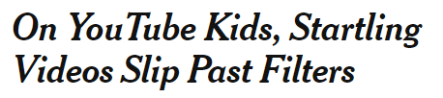


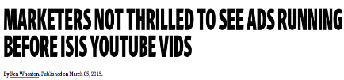
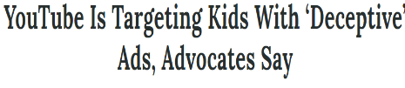


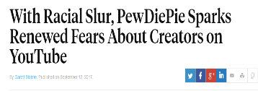
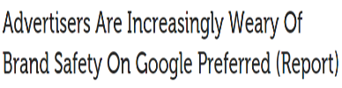


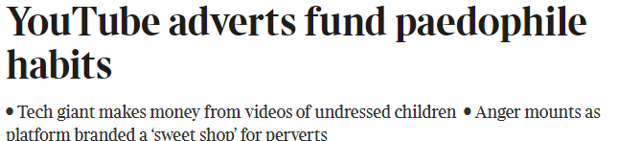
2017
Brand Safety Issues On YouTube Began Years Ago…
Ads ran within objectionable content such as divisive, violent, pornographic or extremist videos
2015
March
April
March
September
November
5

Slide 6
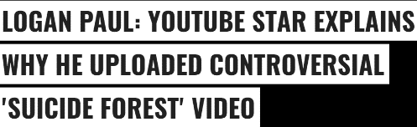






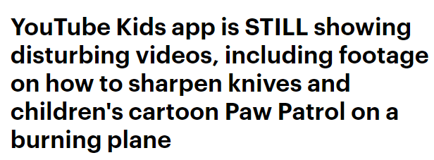

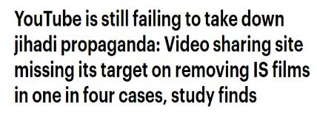
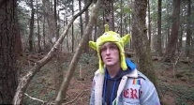



…And Persisted Through 2018
Several months featured a publicized major breach in brand safety
2018
January
February
April
June
July
6

Slide 7

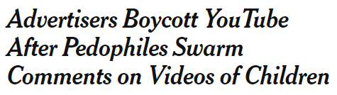
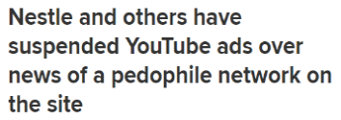
…And Continue Today
2019
February
7

Slide 8
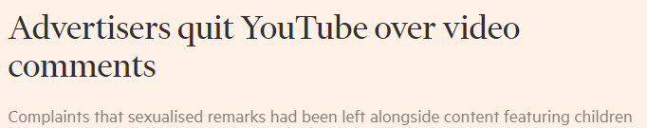


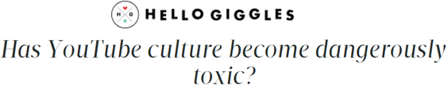



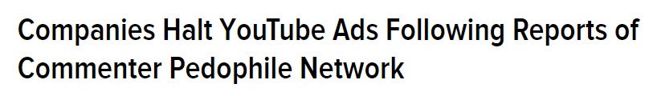

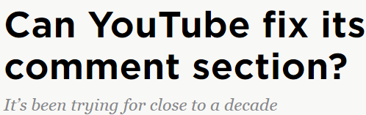
Further Contributing To A Toxic Environment Are Inappropriate, Offensive And Lewd User Comments
“
YouTube’s comment section is one of the internet’s most infamous cesspools, much to the company’s chagrin.
- Polygon
8

Slide 9
Why A Brand Safe Environment Matters

Slide 10

Viewer Engagement with YouTube Videos
Videos offering higher vs. lower brand safety
Most Consumers Are Disturbed By Inappropriate Videos And Disengage
Videos with high brand safety scores
Videos with low brand safety scores
+38%
Views Per Video
-26%
A recent independent study analyzed 425 videos produced by the top YouTube channels for their level of brand safety. “Unsafe” content included themes/images like weapons, drugs, violence, scandals, profanity, negativity or hate speech.
The videos that had lower brand safety scores (based upon their increased incidence of the themes above) experienced far less engagement than those which were brand-suitable (had fewer instances of inappropriate content).
+73%
Engagements Per Video
-51%
(+/- are vs. the average YT video in the study)
Engagement thrives in brand-safe environments as audiences are more responsive and have greater opportunities to view (for instance, people shy away from viewing “NSFW” videos at work or in public places).
Provocative content may be thought of as more likely to spark conversation and interaction but, in reality, viewers often turn their attention away from these videos
Source: Delmondo + Uru “The Top YouTube Stars Ranked by Brand Safety”, March 2018; analysis included the top 25 most recent videos from each of the top 17 YT influencers as per SocialBlade global ranking (by subscribers) disregarding mainstream music artists. “Unsafe/Unsuitable” content defined as content showcasing unsafe objects and themes such as weapons, drugs, terrorism, and celebrity scandals; unsafe language, such as profanities, misogyny, and hate speech; paid or sponsored content, negative sentiment; not safe for work content such as nudity and extreme violence. “NSFW” = Not Safe For Work
10

Slide 11


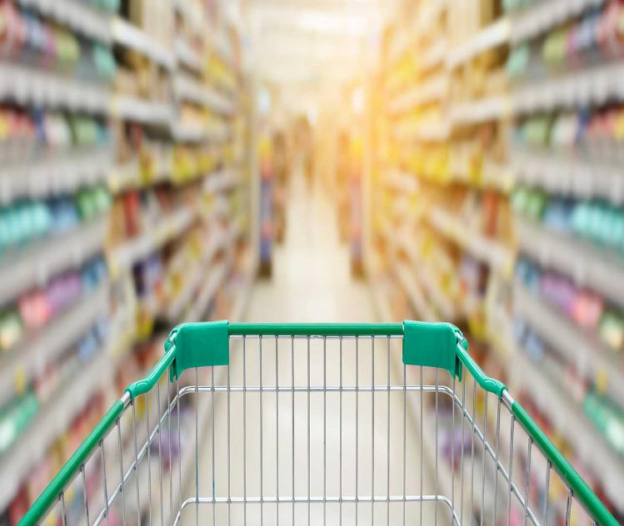
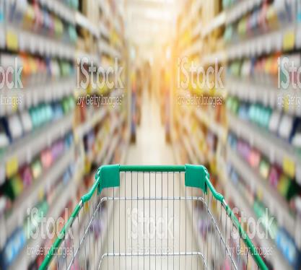

This Distaste For Objectionable Content Has Real Implications For Brands
36% of consumers think an ad is an endorsement by the brand
20% of consumers will boycott, be vocal, or raise issues about brands that run adjacent to offensive content
37% of consumers change how they think of brands that run alongside offensive content when making a decision to buy
Source: AdWeek, March 28,2018 - CMO Council, “How Brands Annoy Fans” June 2017
11
Notes:
https://www.istockphoto.com/photo/female-hand-giving-thumbs-up-gm627216922-111032079
https://www.istockphoto.com/vector/manifestation-gm499556971-42527774
https://www.istockphoto.com/photo/consumer-affairs-gm542084198-96988803

Slide 12




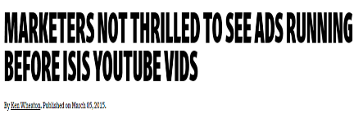
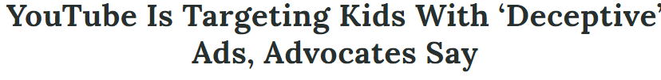

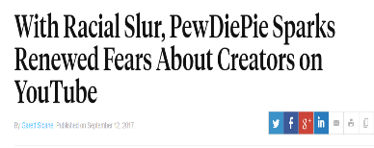





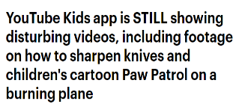



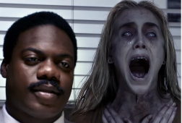
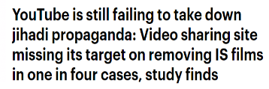




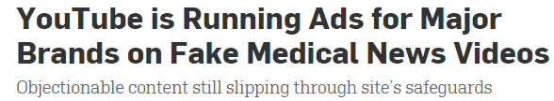
Acknowledging The Need For Greater Brand Safety, YouTube Has Reportedly Made Several Major Attempts At Fixing The Platform, Yet Issues Persist
March 2015
April 2015
March 2017
April 2017
Sept 2017
Nov 2017
YT Partner Program Requirement: Channel must have 10,000 lifetime views
January 2018
February 2018
April 2018
June 2018
July 2018
February 2019
YT Partner Program Requirements: - Channel must have 4,000 hrs of watch time over the last 12 months + a minimum of 1,000 subscribers
- Increased human review of videos
12

Slide 13
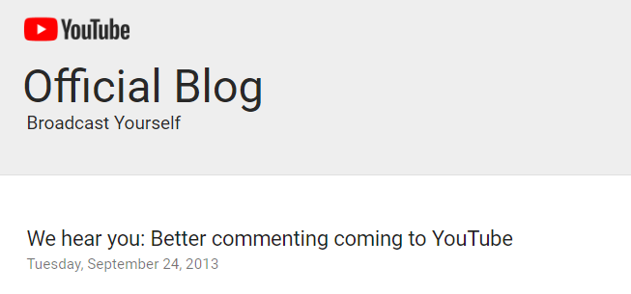
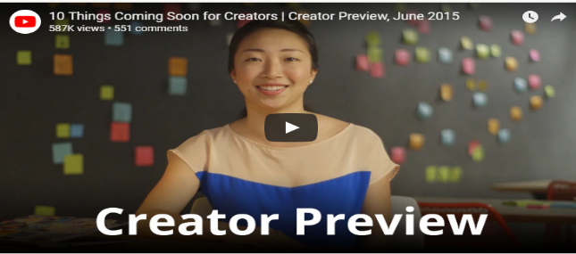
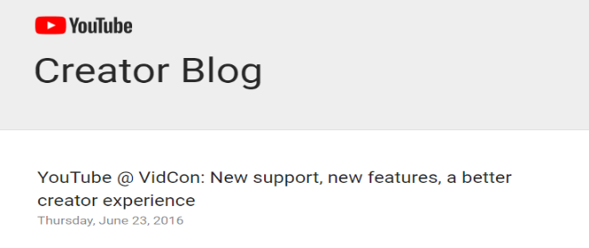
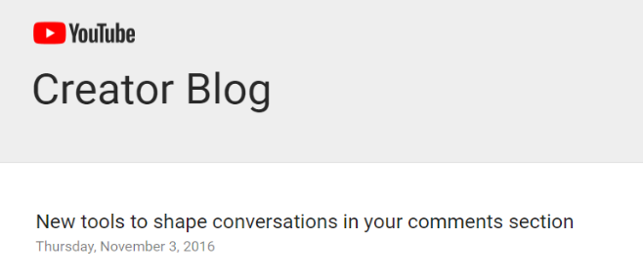

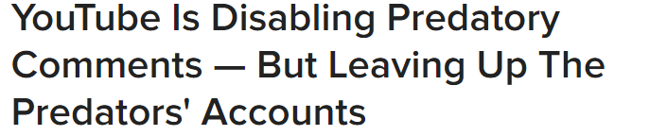
Similarly, YouTube Has Repeatedly Struggled To Fix The Comments Section
Offensive comments are rife, despite numerous reported attempts at eliminating them
2013: Enabled comments to be powered by Google Plus
2015: Employed a Ranking System
2016 (June): Enabled creators to delegate moderation
2016 (November): Provided Creators with a Moderation Tool
2017: Disabled Comments
13

Slide 14
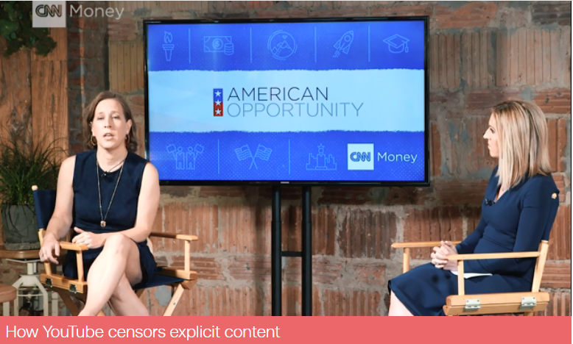

But Without A Proactive Solution At The Point Of Upload, Can Brand Safety Ever Be Truly Assured?
As 400 hours of video are uploaded to its platform every minute, it may just be too cumbersome at this point for YouTube to control the influx of content and comments and to guarantee a brand-safe environment to advertisers
“The way we manage our platform…we have community guidelines, content we do not want to have on the platform…And the way we manage it is we have a system that by which users flag that content and so if you ever see a video that is inappropriate, that gets flagged, it gets put into a queue, it gets reviewed by a human, and that human says “does this meet our guidelines or not?” and if not, that video gets pulled down. And that’s essentially how we manage the platform.”
- Susan Wojcicki, CEO YouTube
Source: CNN Money, 4/23/17
14

Slide 15
Why Is Ensuring Brand Safety Such A Challenge On YouTube?
Notes:
https://www.istockphoto.com/photo/question-mark-background-3d-rendering-gm599678244-102932457

Slide 16

A large part of the issue is rooted in the way the platform is structured and the sheer volume of content it hosts
But this volume is necessary to create the platform scale that marketers are looking for in their campaigns
16

Slide 17








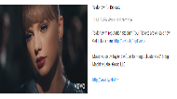

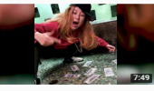


The YouTube Content Structure Includes Multi-Channel Networks (MCNs), Channels, and Videos
examples
MCNs
(Aggregate
multiple channels)
Channels
(Can be part of an MCN or not)
Videos
Keep in mind, anyone with a Google account can post a video
17
Notes:
https://www.istockphoto.com/photo/the-wooden-diagramme-gm521203912-91259853

Slide 18






The Ever-Increasing Amount Of Content To Review And Monitor Is Staggering
MCNs
(Aggregate
multiple channels)
Channels
(Can be part of an MCN or not)
Videos
This is a massive amount of content to continuously evaluate
6,722
38,466
29,447
41,371
11,983
~ Number of channels within the top 5 MCNs ~
50,000,000+ channels
Reportedly 400 hours of video uploaded every minute from anyone with an account around the globe
Source: MCNs: Vidooly, top 5 based on total views, channels are global; Number of channels: Omnicore, February 2018
18

Slide 19

Additionally, Out Of 50 Million Channels, Only .04% Of YouTube MCNs/Channels Are comScore Measured
Accurate measurement of the 50+ Million channels on YouTube is a daunting, if not impossible, task and only 17,398 properties are measured in the comScore YouTube Partners Report
The other properties are seemingly so insignificant audience-wise that they are not even measured
Source: comScore YouTube Partners Report [Undup] Video Metrix Multi-Platform, Feb 2018, Total Audience. The number of total channels is based upon the unexpanded view of the Partners Report, with channels rolled-up in to their MCNs. This is done in order to avoid double counting channels that are already included within their MCNs; ‘Properties’ defined as MCN or Channel.
19

Slide 20
Even Within The .04% Universe Of Measured Channels, The Results Show An Extremely Long Tail Of Tiny Properties
In our custom analysis, the measured YouTube properties (a combination of MCNs + Channels) were segmented into 5 quintiles. These properties were ranked on Time Spent from most to least, and broken into quintiles
The most viewed properties, which collectively represent the top 20% of total time spent on YouTube, fall into Quintile 1, while the least viewed properties, which collectively represent the bottom 20%, fall into Quintile 5
YouTube Quintile Analysis (Time Spent)
Measured Properties
 | Quintile 1 (the most viewed properties, collectively representing the top 20% of total time spent on YouTube) | Quintile 2 | Quintile 3 | Quintile 4 | Quintile 5 (the least viewed properties, collectively representing the bottom 20% of total time spent on YouTube)
# of Properties | 4 | 14 | 113 | 629 | 16,658
% of Properties | <1% | <1% | <1% | 4% | 95%
Source: VAB analysis of comScore YouTube Partners Report - total measured properties, 17,398, Video Metrix Multi-Platform, Feb 2018, Total Audience; The number of total channels is based upon the unexpanded view of the Partners Report, with channels rolled-up in to their MCNs. This is done in order to avoid double counting channels that are already included within their MCNs; ‘Properties’ defined as MCN or Channel.
20

Slide 21
Nearly Half Of The Measured Time Viewers Spend With YouTube Is With These Extremely Long Tail Properties
99% of all YouTube measured properties are long-tail (quintile 4/5) channels
YouTube Quintile Analysis (Time Spent)
Measured Properties
 | Quintile 1 (the most viewed properties, collectively representing the top 20% of total time spent on YouTube) | Quintile 2 | Quintile 3 | Quintile 4 | Quintile 5 (the least viewed properties, collectively representing the bottom 20% of total time spent on YouTube)
# of Properties | 4 | 14 | 113 | 629 | 16,658
% of Properties | <1% | <1% | <1% | 4% | 95%
…plus Millions of additional channels seemingly so insignificant that they aren’t measured
Source: VAB analysis of comScore YouTube Partners Report - total measured properties, 17,398, Video Metrix Multi-Platform, Feb 2018, Total Audience; The number of total channels is based upon the unexpanded view of the Partners Report, with channels rolled-up in to their MCNs. This is done in order to avoid double counting channels that are already included within their MCNs; ‘Properties’ defined as MCN or Channel.
21

Slide 22













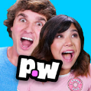


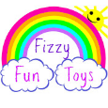

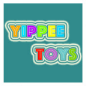


The Issue Is That These Long-Tail Channels Are Highly Likely To Be User Generated Content And Therefore Can Potentially Present Brand Safety Concerns
YouTube Quintile Analysis (Time Spent)
Measured Properties
 | Quintile 1 (the most viewed properties, collectively representing the top 20% of total time spent on YouTube) | Quintile 2 | Quintile 3 | Quintile 4 | Quintile 5 (the least viewed properties, collectively representing the bottom 20% of total time spent on YouTube)
# of Properties | 4 | 14 | 113 | 629 | 16,658
% of Properties | <1% | <1% | <1% | 4% | 95%
Less UGC More UGC
Toy Jelly
Rooster Teeth
Jeffreestar
Ambition
ChannelFrederator
Source: VAB analysis of comScore YouTube Partners Report - total measured properties, 17,398, Video Metrix Multi-Platform, Feb 2018, Total Audience; The number of total channels is based upon the unexpanded view of the Partners Report, with channels rolled-up in to their MCNs. This is done in order to avoid double counting channels that are already included within their MCNs; ‘Properties’ defined as MCN or Channel. Channel examples (logos) are taken from the top 5% of each quintile
22

Slide 23

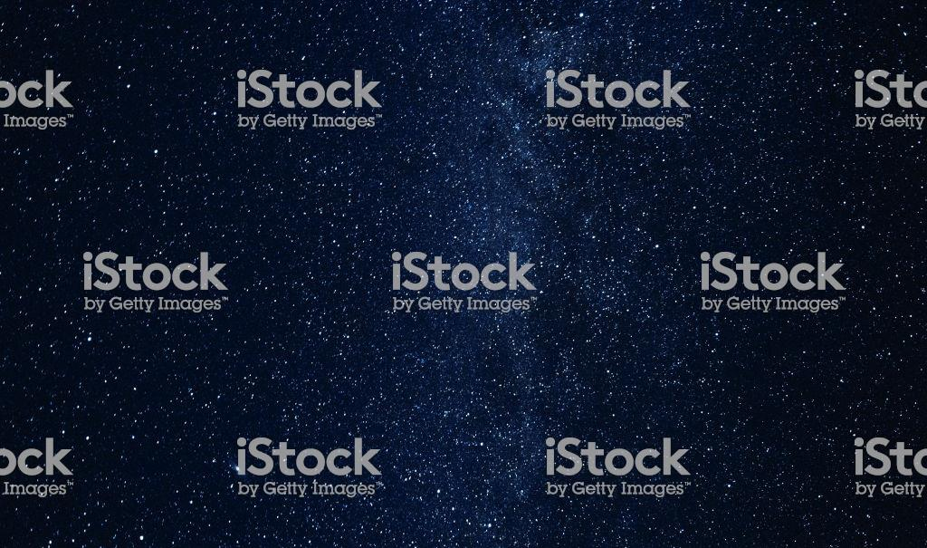
While these long tail, UGC channels create an environment ripe for brand safety issues, the problems extend to YouTube’s premium content as well.
The lack of transparency into YouTube’s most desirable inventory, coupled with the relative creative autonomy of top channels and influencers, contributes to an uncertain content environment for advertisers.
23
Notes:
https://www.istockphoto.com/photo/spring-snow-showers-in-the-alps-gm525961908-92499261

Slide 24
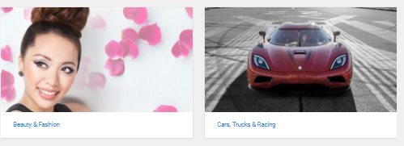
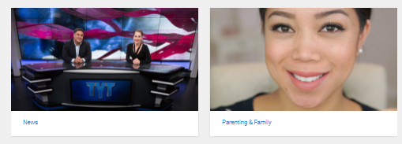
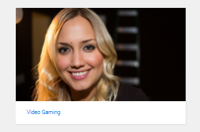
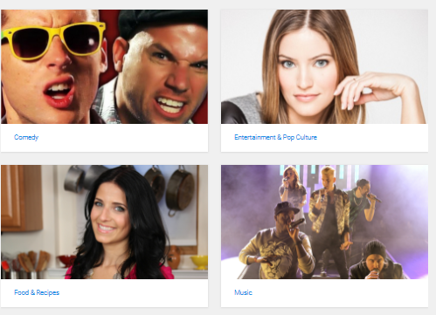
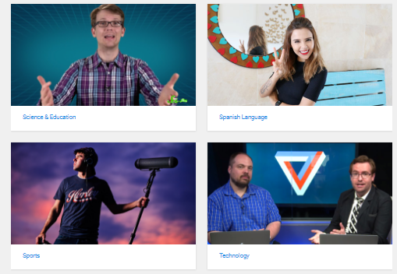
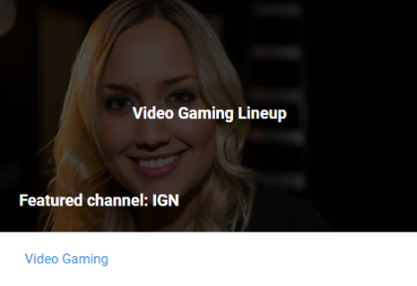
Details on the channels – including basic information such as a current list of channels within each vertical – are not publicly available
YouTube Offers Little Transparency Into Google Preferred, Its Top 5%
of Channels Across Several Vertical Categories
Example: When the Video Gaming vertical is clicked on, only one sample channel is offered.
Even sample line-ups, once provided in the past, do not appear to exist
24

Slide 25
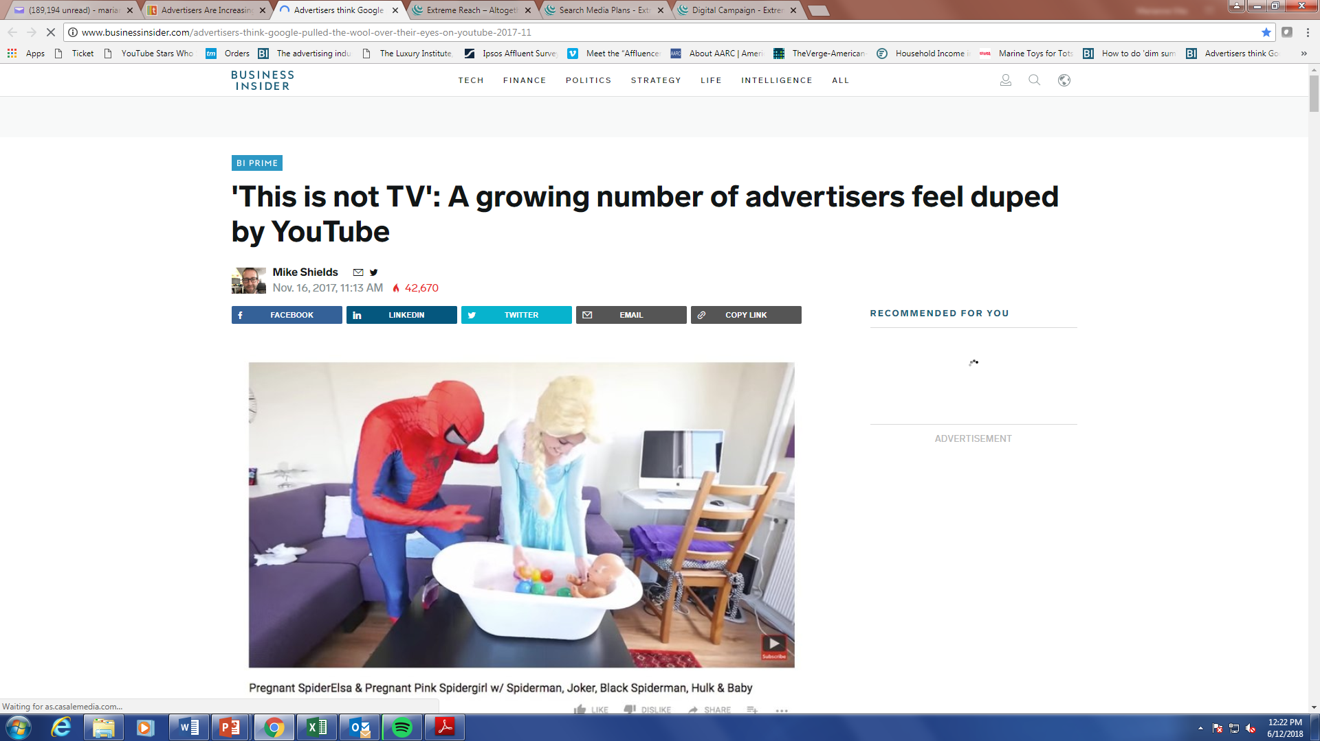

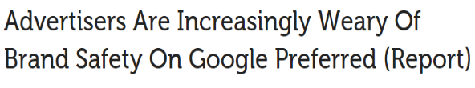


Marketers pay a premium for a brand-building, brand-safe environment, however that is not always what they get
“Given that YouTube doesn’t share the specifics of the lineup, several ad buyers ‘felt misled’ for paying top dollar on campaigns that could or did end up running against questionable content.
“As more ad buyers dig into what’s really for sale through Google Preferred, there’s a growing sense among some that Google oversold the premium, brand safe nature of these videos.
Source: Tubefilter, 11/21/17; Business Insider, 11/16/17
25

Slide 26
Similarly, the top YouTube influencers adhere to varying degrees of brand safety or suitability
Not even a quarter of Influencers were deemed brand safe (a score over 80%)
67% of videos contained or displayed unsafe language
61% of videos contained negative sentiment
% brand safe content among each channel’s most recent 25 videos
These Influencers are heavily monetized (ad supported). In total, they are estimated to earn as much as $88 million annually, but what kind of branding environment do they offer?
Source: Delmondo + Uru “The Top YouTube Stars Ranked by Brand Safety”, March 2018; analysis included the top 25 most recent videos from the top 17 YT influencers as per SocialBlade global ranking (by subscribers) disregarding mainstream music artists. Safety Score reflects the amount of brand safe content among recent videos. “Unsafe” content is defined as content showcasing unsafe objects and themes such as weapons, drugs, terrorism, and celebrity scandals; unsafe language, such as profanities, misogyny, and hate speech; paid or sponsored content, negative sentiment; not safe for work content such as nudity and extreme violence; Influencer estimates from Socialblade, August 2018. Scoring Methodology: Uru uses a combination of computer vision, natural language processing, and other artificial intelligence to generate video brand safety scores.
26

Slide 27


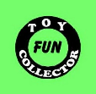

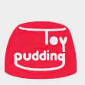















A Look At Recent Videos Produced By Some Of The Most Popular Channels Illustrates Their Questionable Quality
Ryan Toys Review
13.5M Subscribers
21B Video Views
PewDiePie
62.3M Subscribers
18B Video Views
Fun Toys Collector
10.2M Subscribers
14B Video Views
Popular MMOs
14.3M Subscribers
11B Video Views
Toy Pudding TV
14.5M Subscribers
10B Video Views
Current pieces of content from the top 5 YouTube original content producers (based on Views; M=millions)
Source: SocialBlade.com, 4/25/18, based upon “top YouTubers in the United States sorted by video views” Includes only YouTube original content (e.g. no music or TV content). M = millions, B = Billions.
27

Slide 28























While edgy content may be suitable for some brands, it is the exception, not the rule. Given their relative creative autonomy, “Influencers” are able to blur the line between provocative and inappropriate, with brands along for the ride.
Even categories and brands that may be more open to edgy content have recently boycotted YouTube. Companies such as these:
Example Beam Suntory brands
Example Beam Suntory brands
Example PepsiCo brands
Example Pepsico brands
Example Diageo brands
Example Diageo brands
Source: Business Insider, March 2017; Variety, November 2017; Adidas and Diageo boycott was in Fall 2017 in UK; Beam Suntory and PepsiCo boycott was in Spring 2017 US.
28

Slide 29



In Order To Find Brand-Appropriate Content Some Marketers Have Reduced The Number Of Channels They Appear On, But Many Still Need To Go Thousands Deep To Get The Scale They Desire
Under Armor has begun “implementing additional filters and controls to ensure our brand presence on YouTube reflects our values”
P&G has reduced the number of channels it advertises on from
3 million to 10,000
In attempts to find a scalable solution, JP Morgan Chase has whittled down its list from 400,000 channels to 3,000
29

Slide 30

YouTube offers a deep list of channels to advertisers because, in aggregate, it is what’s required to build audience reach
However, advertisers need to ask themselves if it’s worth risking brand stature (at best) or brand safety (at worst) by running on hundreds (or thousands) of channels
30

Slide 31
A Safe Haven on YouTube: TV and Film Content
TV and Film offer some of the most popular, most viral, brand-building and brand safe content on the platform
31

Slide 32












Quality, Brand Safe TV & Film Content Can Routinely Garner Hundreds Of Thousands To Millions Of Video Views
32

Slide 33



















































This Professionally Produced, Premium TV and Film Content Is Backed By An Annual Production Investment Of Over $62 Billion
This means a slew of new content is available on YouTube each day, from broad general interest programming to niche content
Source: S&P Global Market Intelligence, SNL Kagan; film negative cost inclusive of domestic films released during calendar 2017; TV data reflective of 2018 programming expenses estimates.
33

Slide 34

Top 10 Trending Topics On Twitter By Platform
A study of the top 10 Twitter Topics over 4-week period
TV and movies are also some of the most “talked about” topics across social media, much more so than YouTube content.
83
Ad-Supported
Television
A custom VAB analysis, #TVisSocial, revealed that Ad-supported TV dominates the social conversation online. Conversely, the audience fragmentation and long-tail nature of YouTube severely limits any mass exposure, and therefore conversation.
5
Movies
2
Source: VAB custom analysis of Top 10 trending Twitter Topics each night (8:30p, 9:30p, 10:30p, 11:30p) during 4-week time period (5/15/2017 – 6/11/2017). Based on unique program counts. For the purposes of this chart, “program / content” is an all-encompassing definition for individual pieces of content on each platform.
YouTube
34

Slide 35


So It’s No Surprise That Viewers Actively Seek Out More Professionally-Produced Content On YouTube
A custom Program Engagement survey conducted by VAB confirmed that consumers use YouTube as a supplementary destination for TV clips and content.
Interestingly, Millennials were proven to be insatiable consumers of TV content on YouTube.
55% of Millennials always or frequently watch TV clips on YouTube
49% of Millennials always or frequently post comments on the TV clips they watch to engage with other fans
Source: VAB custom Program Engagement Study, April 2018, survey respondents: 1,000 : Q9-3- Watch clips from TV shows on YouTube; Q9_4. Read or post comments about TV content on YouTube
35
Notes:
https://www.istockphoto.com/photo/looking-at-the-laptop-gm841487188-137244913
https://www.istockphoto.com/photo/emotional-young-attractive-female-expressing-surprise-gm693209504-128000233

Slide 36


In fact, TV show clips and film trailers are among the most popular content on YouTube, more than vlogger or celebrity videos
205 million views
Official Trailer
56 million views
Superbowl 50 Half-Time
Show Clip
Source: Statista, Q3 2016
36

Slide 37







This Popularity Drives A Swell Of Virality Which Leads To TV & Film Content Being Some Of The Highest Trending Videos On The Platform
6 of the top 10 trending videos in 2017 were ad-supported TV or Film; content absent of brand safety concerns or long-tail audience limitations.
The Mask Singer2 (Thailand)
America’s Got Talent – Darci Lynne
Carpool Karaoke – Ed Sheeran
240MM Views
48MM Views
45MM Views
Lady Gaga’s Full Super Bowl LI Halftime Show / NFL
In a Heartbeat – Animated Short Film
Children Interrupt BBC News Interview
42MM Views
36MM Views
27MM Views
Source: Adweek, 12/6/2017 “YouTube Reveals Most Popular Videos of 2017”- ‘top trending’ rankings based upon views, shares, comments, likes, and more.
37

Slide 38


  As A Result Of This Virality, TV Clips And Film Trailers Drive More Buzz And Views Than YouTube Original Content
In April 2018, VAB performed a custom analysis tracking the top 10 trending videos each day over a 2 week period on YouTube. The total videos & video views were analyzed and categorized.
Source: VAB custom analysis, Top 10 Trending Videos on YouTube collected each afternoon, 4/17-4/30; Excludes professionally-produced music video channels (e.g. Vevo). “Other” is comprised of content posted by other media publishers such as Buzzfeed, Wired, and non-ad supported TV.
38
Notes:
https://www.istockphoto.com/vector/large-group-of-people-gm853506948-140485047

Slide 39

Much Of This Buzz Is Supported By The Large Social Followings Of TV And Film Actors In Relation To Even The Most Popular YouTubers
TV, Film and YouTube Personalities With Largest Twitter Followers
39
Source: Twitter.com, 4/25/18; TV – TV personalities with the largest Twitter followings; YouTube – Twitter followers of the top YouTube personalities, by subscriber count. M= Million

Slide 40



YouTube TV: If You Can’t Beat ‘Em, Join ‘Em
Recognizing the power and popularity of TV content, YouTube launched subscription-based, YouTube TV in April 2017. YouTube TV enables viewers to stream 60+ entertainment & sports networks for $40/month.
“Having more premium content, and access to more popular content, was always of interest to our advertisers.”
- Debbie Weinstein, managing director, YouTube/Video Global Solutions
In order to offer advertisers the premium, brand-safe content they demand, YouTube began selling ads in live YouTube TV programming. YouTube TV will also be included as part of Google Preferred as more quality content is required to justify the premium pricing.
40

Slide 41




Choosing to Protect Your Brand
No guarantees
The sheer volume of content and lack of regulation at the point of upload makes YouTube a difficult ad platform to guarantee 100% brand safety.
Scale comes at a price
By aggregating content across hundreds or thousands of channels, YouTube offers advertisers the reach they want, but is it to the detriment of brand stature and brand safety?
Threats are pervasive
Brand safety issues are most prevalent on long-tail user generated channels, but can also be found within premium content. Given relatively few channels are measured and the lack of transparency into what’s sold as YouTube’s most premium content, can advertisers be assured of what environment their ads are placed in?
Popularity of Brand Safe TV & Film Content
Some of the most popular content on YouTube are Film and TV-related videos. This premium, emotionally compelling content delights consumers and is reassuring to advertisers seeking quality programming in a brand safe environment.
41
Notes:
https://www.istockphoto.com/photo/businessman-builds-a-tower-gm515604620-88577133
https://www.istockphoto.com/vector/exclamation-point-sign-in-red-triangle-vector-icon-gm894875516-247346339
https://www.istockphoto.com/photo/cheerful-young-couple-enjoying-at-home-gm1021841934-274392615

Slide 42




And Just Remember, Content Environment Matters To Consumers So It Should Definitely Matter To Marketers
Videos with high brand safety scores
Videos with low brand safety scores
+38%
Views Per Video
-26%
+73%
Engagements Per Video
-51%
(+/- are vs. the average YT video in the study)
36% of consumers think an ad is an endorsement by the brand
20% of consumers will boycott, be vocal, or raise issues about brands that run adjacent to offensive content
37% of consumers change how they think of brands that run alongside offensive content when making a decision to buy
42

Slide 43




Contact Us
Danielle DeLauro
Executive Vice President
danielled@thevab.com
Jason Wiese
SVP, Director of Strategic Insights
jasonw@thevab.com
Join Our Email List
Marianne Vita
VP, Strategic Insights
mariannev@thevab.com
Reed Kiely
Senior Multi-Platform Video Analyst reedk@thevab.com
VAB (Video Advertising Bureau)
@VideoAdBureau

Slide 44



Lastly, Because YouTube Is Used As a Supplementary TV Destination,
It Also Houses A Massive Amount of TV/Film-Related Videos
TV fans are so passionate about the programs and characters they love that they are inspired to create, post, and share TV clips and content on YouTube.
A look at the top 5 TV programs and films & the top 5 YouTube channels shows that there are significantly more videos related to those TV/Films (clips, fan commentary, behind the scenes) than to the YouTube channels/influencer.
Top 2018 TV Programs/Films & YouTube Channels - # of Related Videos
Source: TV Programs – Nielsen PowerPlay, Q1 2018 Entertainment-Primetime Ranker, excluding Specials, P2+, Live +SD, TV with Digital, Linear with VOD. Programs are Young Sheldon, This is Us, 60 Minutes, The Voice, Bull. YouTube – Channels based upon total number of views, Social Blade, 4/25 – Toy Pudding, Ryan Toys Review, PewDiePie, Fun Toys Collector, Popular MMOs; Films – Box Office Mojo, based on 2018 to-date (Aug) box office gross sales – Black Panther, The Avengers: Infinity War, The Incredibles 2, Jurassic World Fallen Kingdom, Deadpool 2.

