Slide 1





Rising Tides
26 Streaming Insights That Are Impacting Marketing Plans in 2026
March 2026

Slide 2


The ‘rising tides’ of ad-supported streaming are surging to new heights
As the ad-supported ecosystem continues to evolve, we are highlighting 26 insights shaping the streaming landscape for 2026, which marks VAB’s 12th year of analyzing this marketplace.
These insights provide the latest research on streaming behaviors, device and platform usage, the growth of
ad-supported services and tiers, and the importance of
quality content.
The high-water mark of ad-supported streaming has cemented its role as a cornerstone of Premium Video
and Multiscreen TV strategies as it drives innovation across CTV home screens, live sports and retail media, creating new opportunities for brands to connect with engaged audiences.
Read on to explore how these 26 insights are reshaping
ad-supported streaming and marketing plans in 2026.
This information is exclusively provided to VAB members and qualified marketers.
PAGE 2

Slide 3

26 Streaming Insights That Are Impacting Marketing Plans in 2026
Audience Currents
How viewers define, connect
and engage with TV
Where Streaming Flows
The devices, platforms and viewing behaviors shaping CTV
The Ad-Supported Wave
The rapid rise of ad-supported streaming across platforms
High Tide for Quality
Entertainment content and live sports & news are powering growth
Consumer Definition of TV
TV Usage by Device
CTV Home Screen Ads
Content Shift to Streaming
Pace of Cord-Cutting
TV by Access Type
Growth of AVOD Viewers
The Ubiquity of Multiscreen TV
Diverse Streaming Audiences
Communal Viewing
Appetite for Ads on Streaming
Top Content Genres
Smart TV Ownership
Co-Viewing by CTV Platform
Ad Preference on Streaming
Live Sports Streaming
Convergent TV Ad Spend
CTV Session Length
Growing Adoption of Ad Tiers
Bundling Up
Services Streamed Annually
Ad Time by TV Platform
Smart TV App Monthly Usage
Growth of FAST
CTV Sports Access
CTV Retail Media
This information is exclusively provided to VAB members and qualified marketers.
PAGE 3

Slide 4

1
Audience Currents
How viewers define, connect
and engage with TV

Slide 5


Consumer Definition of TV
While younger adults are more likely to have a broader definition of ‘TV,' they are increasingly thinking of it in terms of TV as the device
How do you personally define TV?
% of video streamers who agree
‘Anything I can watch on my TV set whether it’s
via streaming or cable, satellite, fiber optic’
‘Anything I can watch on any device’
Source: VAB analysis of MRI-Simmons March 2025 & March 2026 Cord Evolution Studies, A18+. Base = ‘Streamed in the past 12 months.’
This information is exclusively provided to VAB members and qualified marketers.
PAGE 5

Slide 6


Pace of Cord-Cutting
Non-pay TV HHs have overtaken total pay-TV HHs (including vMVPDs) during 2026 with nearly 71 million homes
59% of adults 18+ consider themselves ‘cordless,’ with ‘cord cutters’ accounting for 34% and ‘cord nevers’ making up 25%*
Share of U.S. Pay TV vs. Non-Pay TV Households
Pay-TV HH universe include vMVPDs
63.4MM HHs
70.8MM HHs
66.6MM HHs
66.6MM HHs
70.4MM HHs
61.9MM HHs
Source: Emarketer, Pay TV Households & Viewers & Non-Pay TV Households & Viewers – U.S., October 2025. Note: Pay TV households are those with a subscription to a traditional or digital (vMVPD) pay TV service. Non-Pay-TV households are those without a subscription to a traditional or digital (vMVPD) pay TV service. Additional Note: Traditional pay TV services include cable, satellite, telecom and fiber operators, multiple system operators (MSOs), multichannel video programming distributors (MVPDs), and major TV broadcast and cable networks. Virtual multichannel video programming distributors (vMVPDs) are internet-delivered live TV services (e.g., Hulu + Live TV, Sling TV, YouTube TV). *VAB analysis of MRI-Simmons March 2026 Cord Evolution Study, A18+. Cord Cutters’: no pay-TV; cancelled it, ‘Cord Nevers’: no pay-TV; never had it.
This information is exclusively provided to VAB members and qualified marketers.
PAGE 6

Slide 7
Diverse Streaming Audiences
Multicultural audiences now account for over half of adult 18-34 streamers, underscoring their importance to multiscreen TV campaigns
Multicultural Streaming Audiences
% of U.S. A18+ Streaming Population by Age
vs. 40%
of A18+ pop
(103 Index)
vs. 28%
of A50+ pop
(105 Index)
Source: VAB analysis of MRI-Simmons March 2025 & March 2026 Cord Evolution Study, A18+. Base = ‘Streamed in the past 12 months.’ ‘Multicultural Audiences’ includes respondents who are of Spanish or Hispanic origin, non-Hispanic Black / African American, non-Hispanic Asian, non-Hispanic American Indian or Alaska Native and non-Hispanic other.
This information is exclusively provided to VAB members and qualified marketers.
PAGE 7

Slide 8
Smart TV Ownership
Smart TVs are now the standard in homes, with continued growth and increasing prevalence of households with multiple connected TVs
Smart TV Set Installed Base
In millions
  Average # of Smart TVs per HH
% of Total TV Households
Smart TV % of Total TV Set Installed Base
45%
55%
63%
74%
76%
79%
82%
83%
25%
36%
45%
56%
64%
72%
78%
85%
Source: Industry data; S&P Global Market Intelligence Kagan estimates. Data compiled October 2025. ‘Installed Base’ refers to the total number of units of a product currently in use by customers. Compound Annual Growth Rate (CAGR): 9.0%.
Click here to download the full report, ‘Left To Your Own (Connected) Devices – January 2026’ to learn more about Connected TVs.
This information is exclusively provided to VAB members and qualified marketers.
PAGE 8

Slide 9

Convergent TV Ad Spend
Ad dollars within convergent TV are following audiences and steadily shifting share to CTV at a pace of 10 percentage points every two years
U.S. TV and Connected TV (CTV) Ad Spend
in billions
$86.6
$87.8
$87.4
$90.7
Source: Emarketer, U.S. Connected TV Ad Spending & U.S. TV Ad Spending, December 2025. Note: CTV includes digital advertising that appears on CTV devices, includes display ads that appear on home screens and in-stream video ads that appear on CTVs from platforms like Hulu, Roku and YouTube, and excludes network-sold inventory from traditional linear TV and addressable TV advertising; traditional TV includes broadcast TV (network, syndication and spot) and cable TV, and excludes digital.
This information is exclusively provided to VAB members and qualified marketers.
PAGE 9

Slide 10

2
Where Streaming Flows
The devices, platforms and viewing behaviors shaping TV

Slide 11
TV Usage by Device
While TV as the device has remained very consistent, the entry point for watching content has shifted significantly towards smart TV apps
Default Devices for Watching TV
Total TV
74%
Total TV
74%
Source: Hub Entertainment, Decoding The Default, August 2025. Note: Smart TV built-in apps refer to both pre-installed apps and those that the owner installs. *TV: Streaming media player (net), e.g., Roku, Fire TV, Apple TV.
This information is exclusively provided to VAB members and qualified marketers.
PAGE 11

Slide 12
TV by Access Type
Streaming is accessed on 85% of all TVs while consumers are watching only streaming content exclusively across more than one-third of TVs now
% of TVs by Access Type
83%
83%
83%
84%
85%
Source: Inscape, TV Market Trends Report, Q3 2025. Inscape Nationally Representative Panel, Base: 1hr+ of total viewing to at least one source type in quarter. Gaming console viewing is not included in these calculations. Results do not add up to 100% due to rounding.
This information is exclusively provided to VAB members and qualified marketers.
PAGE 12

Slide 13

Communal Viewing
Streaming serves as a shared experience, bringing viewers together for quality time with family at home and communal gatherings with friends
% of Streaming Adults Who…
75%
52%
agree members of their household use streaming together as a form of quality time
(+4% YoY)
are watching with other people they don’t live with, like going to a friend’s house
(+15% YoY)
Source: Tubi, The Stream 2026: When Intention Becomes Attention, March 2026.
This information is exclusively provided to VAB members and qualified marketers.
PAGE 13

Slide 14

Co-Viewing by CTV Platform
Connected TV viewers are much more likely to be co-viewing with others on Premium Video Platforms vs. YouTube which drives greater ad recall
Average ‘Co-viewing’
% of total impressions
‘Co-viewing’ is
+33%
stronger on Premium Video Platforms than YouTube
Source: VAB + TVision Custom Study. July 2024-June 2025. P2+. ‘Co-viewing’ indicates the % of total impressions that occur with another viewer in the room. Weighted based on share of impressions. Premium Video Platforms represent an average of the 21 Premium Video Platforms analyzed.
Click here to download the full report, ‘The Impression Gap: What works harder for marketers on CTV - Premium Video or YouTube?’ to learn more.
This information is exclusively provided to VAB members and qualified marketers.
PAGE 14

Slide 15
CTV Session Length
Viewing sessions on CTVs are 49% longer for Premium Video Platforms than YouTube, which creates more opportunities for brand engagement
Average Session Length by App Type on CTV
hours, minutes across a 12-month time period
YouTube
Source: VAB + TVision Custom Study. July 2024 – June 2025. P2+. Weighted based on duration of session.
Click here to download the full report, ‘The Impression Gap: What works harder for marketers on CTV - Premium Video or YouTube?’ to learn more.
This information is exclusively provided to VAB members and qualified marketers.
PAGE 15

Slide 16

Services Streamed Annually
Consumers total usage of streaming services across the year has recently plateaued as they sought to slightly consolidate their viewing options
Average # of Streaming Services Used in the Past 12 Months
80%
of U.S. adults have used 3+ streaming services in the past 12 months
Source: MRI-Simmons, Inside the TVideo Shift: How Consumers Watch, Choose, and Engage Today, January 2026 & From Cable to Clicks: The Evolution of American TV Habits, January 2025. Audience insights from MRI-Simmons’ 2025 & 2024 Cord Evolution Study. Streaming services Includes a mix of ad-supported, ad-free, paid subscriptions, free services and TV network apps.
This information is exclusively provided to VAB members and qualified marketers.
PAGE 16

Slide 17
Smart TV App Monthly Usage
Consumers use three to four streaming services habitually each month with a slight seasonal increase during Fall and Winter months
Average Number of Apps Used Monthly Per Streaming TV
Source: Inscape, TV Market Trends Report, Q3 2025. Base: Opted-in Inscape TVs with at least 6 minutes of app viewing. Streaming includes viewership on vMVPDs. Gaming console viewing is not included in these calculations.
This information is exclusively provided to VAB members and qualified marketers.
PAGE 17

Slide 18
CTV Sports Access
CTV app distribution adoption continues to grow for sports as the genre expands across streaming, with FAST services as an emerging opportunity
CTV Apps Used to Stream Sports
Source: LG Ad Solutions, Stadium to Screen: Streaming Live Sports in 2025.
Click here to download the full report, ‘Fast Break: 20 Facts on Sports Fandom, Viewership & Advertising Impact’ to get more insights on sports streaming.
This information is exclusively provided to VAB members and qualified marketers
PAGE 18

Slide 19
3
The Ad-Supported Wave
The rapid rise of ad-supported streaming across platforms

Slide 20
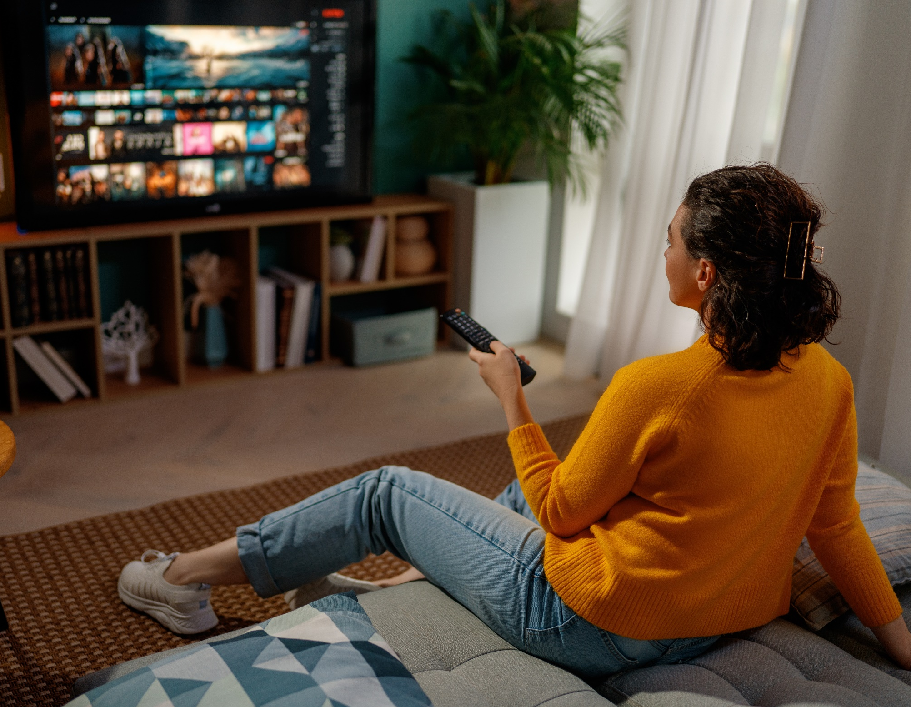

CTV Home Screen Ads
Nearly all CTV viewers see advertising on their home screens when they turn on their TV, even before they navigate to services and content
Share of U.S. CTVs with Home Screen Ads
Source: ESHAP Media, War & Peace: The 2026 Agenda, 1/5/26.
This information is exclusively provided to VAB members and qualified marketers.
PAGE 20

Slide 21
Growth of AVOD Viewers
Ad-supported streaming services are viewed by almost 210 million consumers, providing a platform to reach nearly two-thirds of the U.S.
Ad-Supported Video on Demand (AVOD) Viewers
In Millions
+32%
vs. 2023
% of U.S. pop
49%
55%
60%
62%
63%
Source: Emarketer, Ad-Supported Video on Demand (AVOD) Viewers, February 2026.
Click here to download the full report, ‘Staying Current on Streaming: The Latest on Connected TV Consumer Behaviors’ to get more key insights on ad-supported streaming.
This information is exclusively provided to VAB members and qualified marketers.
PAGE 21

Slide 22
Appetite for Ads on Streaming
More than two-thirds of viewers would choose watching ads in streaming content if it means saving more money each month
Which statement comes closest to how you feel about ads?
+13%
(+8pp)
vs Dec ‘21
I’d rather save money:
If watching ads will cost $4-$5 less than watching ad-free, I’ll almost always choose that option
I’d rather avoid ads:
If there is an ad-free option, I’ll almost always choose it even if
it costs $4-$5 more per month
Source: Hub Entertainment, TV Advertising: Fact vs Fiction, December 2025.
This information is exclusively provided to VAB members and qualified marketers.
PAGE 22

Slide 23

Ad Preference on Streaming
Most audiences, especially younger demographics, actually prefer free streaming services with ads over ad-free subscriptions
‘I prefer streaming free video content with ads / commercials instead of paying for a subscription without ads / commercials’
% of video streamers that agree
Source: VAB analysis of MRI-Simmons March 2025 & March 2026 Cord Evolution Study, A18+. ‘I prefer streaming free video content with ads/commercials instead of paying for a subscription without ads/commercials’ (strongly / somewhat agree). Base = ‘Streamed in the past 12 months’.
This information is exclusively provided to VAB members and qualified marketers.
PAGE 23

Slide 24
Growing Adoption of Ad Tiers
Nearly half of all streaming subscriptions are now for ad-supported tiers and services, as consumers shift their consumption preferences
Premium SVOD Subscriptions by Plan Tier
+39%
(+13 PP)
vs. 2023
Source: Antenna, State of Subscriptions: Adds & Ads, May 2025. US-only. Excludes Apple TV+, Starz, Free Tiers, MVPD + Telco Distribution and select Bundles. Premium SVOD services with an ad plan are included: Discovery+, Disney+, Hulu, Max, Netflix, Paramount+ and Peacock.
This information is exclusively provided to VAB members and qualified marketers.
PAGE 24

Slide 25
Ad Time by TV Platform
Streaming’s share of TV advertising time is incrementally growing alongside a consumer shift towards ad-supported platforms and services
National Share of Ad Time by Platform
(15 networks)
(125 networks)
(50 networks)
Source: Comscore, The Scoreboard - Holiday Viewing Lifts Streaming Ad Time in December, February 2026. Comscore share of ad time data, rolling four-week periods ending during broadcast months of September to December 2025. Includes measurements of all ads, including linear-originating, streaming-originating, national, and local for all 210 markets tracked by Comscore. Share of ad time is based on publisher-specific entities across broadcast networks, cable networks, and streaming services.
This information is exclusively provided to VAB members and qualified marketers.
PAGE 25

Slide 26




Growth of FAST
FAST platforms and services are achieving meaningful scale as viewership becomes more habitual and advertising opportunities increase
+57%
+19%
+54%
+25%
increase in number of FAST channels
in 2025 vs. 2023
increase in
FAST viewers
in 2025 vs. 2022
increase in time spent with FAST
in 2025 vs. 2022
increase in average channel sessions duration
in 2025 vs. 2024
Source: VAB, Free For All: Understanding The Growth of FAST Through Three Key Questions, October 2025.
Click here to download the infographic, ‘6 Fast Facts on FAST: Understanding the FAST Ecosystem’ to get more key insights on FAST.
This information is exclusively provided to VAB members and qualified marketers.
PAGE 26

Slide 27



CTV Retail Media
Retail media on CTV is steadily growing while expanding data partnerships and shoppable ad opportunities on streaming platforms
CTV retail media ad spending is projected to double over a five-year period between 2025 - 2029
U.S. Retail Media Connected TV Ad Spending
$ in billions
Sampling of Recent News about Retail Media
6/26/25
QVC and HSN head to Philo: As the company hones in on livestreaming e-commerce, the partnership with Philo TV guarantees new viewers for QVC Group.
7/8/25
Retail media’s mid-2025 reality: Why advertisers are going all in on full-funnel
9/1/25
Walmart+ Celebrates 5th Anniversary With Expanded Video Streaming Choices
1/7/26
1/9/26
What 2026 has in store for commerce media, according to experts
Brands may seek out buying simplicity, and AI agents could mean a “battle for the soul of retail media,” one executive said.
Walmart Connect takes a play out of the Amazon playbook to make agentic AI the next battleground in retail media
Source: Emarketer, U.S. Retail Media Connected TV Ad Spending, December 2025. Note: Digital advertising that appears on websites or apps that are primarily engaged in retail ecommerce or is bought through a retailer's media network or demand-side platform (DSP); examples of websites or apps primarily engaged in retail ecommerce include Amazon, Walmart, and eBay; examples of retail media networks include Amazon's DSP and Etsy's Offsite Ads; includes ads purchased through retail media networks that may not appear on ecommerce sites or apps. Additional Note: Includes advertising that appears on desktop and laptop computers as well as mobile phones, tablets, and other internet-connected devices, and includes all the various formats of advertising on those platforms.
This information is exclusively provided to VAB members and qualified marketers.
PAGE 27

Slide 28
4
High Tide for Quality
Entertainment content and live sports & news are powering growth

Slide 29
Content Shift to Streaming
Content spend is following audiences’ evolving video consumption habits as platforms increasingly invest in ‘streaming-first’ programming
Global Content Spend by Company Type
% Share
($154B)
($101B)
Source: Ampere Analysis, January 2026.’All Others’ include commercial broadcasters, public broadcasters, theatrical studios and Pay-TV networks.
This information is exclusively provided to VAB members and qualified marketers.
PAGE 29

Slide 30

The Ubiquity of Multiscreen TV
The desire for professionally produced, premium video content across multiscreen TV streaming services is quite ubiquitous across all audiences
% of streamers who have used a network TV app or streaming service owned by a multiscreen TV company
Last 30 days*
A18-24
89%
A25-34
90%
A35-49
88%
A50+
85%
Source: VAB analysis of MRI-Simmons March 2026 Cord Evolution Study, A18+. *Q: Non ad-supported and ad-supported streaming services used in the past 30 days. Base = ‘streamed in the past 12 months’. Note: To be considered a multiscreen TV app you must be a TV network, or an associated streaming app (e.g., Adult Swim, NBC) or an MVPD app (e.g., Spectrum, Xfinity) or a service owned by one of the major multiscreen TV companies (e.g., Disney+, Max, Paramount+).
This information is exclusively provided to VAB members and qualified marketers.
PAGE 30

Slide 31
Top Content Genres
Viewers have a growing desire for sports and news content on streaming beyond the ever-popular entertainment genres of movies and TV series
Top Drivers to Use / Subscribe to a Streaming Service*
% of streamers
Source: VAB analysis of MRI-Simmons March 2025 & March 2026 Cord Evolution Study, A18+. Base = ‘streamed in the past 12 months’. Original series - e.g., Stranger Things, Handmaids Tale, The Crown, etc. Movies - Old and new releases. Acquired content – Includes ‘Series that no longer air on traditional TV networks (e.g., Friends, How I Met Your Mother, Friday Night Lights, etc.’ & ‘Series that are currently airing on traditional TV networks (e.g., The Walking Dead, The Good Place, This Is Us, etc.)’, Sports – Includes ‘Sports events the service streams (e.g. Football, Soccer, etc.) & ‘Sports talk/debate/betting show’ (e.g. First Take, Around the Horn, etc.).
This information is exclusively provided to VAB members and qualified marketers.
PAGE 31

Slide 32
Live Sports Streaming
Live sports has seen significant CTV viewership growth as leagues, such as the NFL, expand their presence across streaming services
Which of the following sports have you streamed live in the last 12 months?
% of sports streamers
% of streamers that...
60%
Like to stream live sports
40%
Have streamed sports
in the last month
Summer or Winter
Source: VAB analysis of MRI-Simmons Cord Evolution March 2024 (fielded Jan 16, 2024 - Jan 28, 2024) & March 2026 (fielded Jan 19, 2026 - Feb 2, 2026) studies, Base: has streamed live sports in the last 30 days. Note: Olympics can include people streaming relevant content such as replays, highlights and other related programming after the Olympics have aired.
Click here to download the full report, ‘What are the most popular sports to reach audiences through streaming?’ to see multicultural sports streaming insights and more.
This information is exclusively provided to VAB members and qualified marketers.
PAGE 32

Slide 33
Bundling Up
More than one-quarter of subscriptions are bundled with multiple services as consumers look to access more content while gaining cost efficiencies
Premium SVOD Subscriptions by Bundle Type
+52%
(+13 PP)
vs. Q4 ‘23
Source: Antenna, State of Subscriptions: Premium SVOD – 2025 Year in Review, February 2026. US-only. Excludes Free Tiers, MVPD + Telco Distribution, and select Bundles. Note: Bundles exclude consumers who get access to services included in broad intracompany bundles (e.g., Amazon Prime Video and Amazon Music within Amazon Prime) or inter-company bundles (e.g. SVOD service included at no additional charge in a Comcast Xfinity 200 channel package).
This information is exclusively provided to VAB members and qualified marketers.
PAGE 33

Slide 34
Adults over 50 account for 36% of the total population and nearly half of all adults
The ‘rising tides’ of streaming are creating more opportunities for ad investment in premium video
With streaming reshaping consumer perceptions of TV, more
ad dollars are shifting across multiscreen premium video platforms to follow evolving viewer behaviors
As audiences streamline their streaming services and become more intentional with how they consume content, Premium
Video platforms offer marketers an opportunity to connect with communal audiences that creates sustained viewing experiences
Consumer appetite, preference and adoption for ad-supported tiers and services on streaming are growing, creating greater scale for brands to reach highly engaged audiences across AVOD, SVOD, FAST & vMVPD platforms
Viewers gravitate towards services that create, and invest in,
high quality content – such as movies, original series, acquired libraries and live sports & news – providing marketers the opportunity to reach highly engaged audiences in premium
video environments
Key Marketer Takeaways
This information is exclusively provided to VAB members and qualified marketers.
PAGE 34

Slide 35

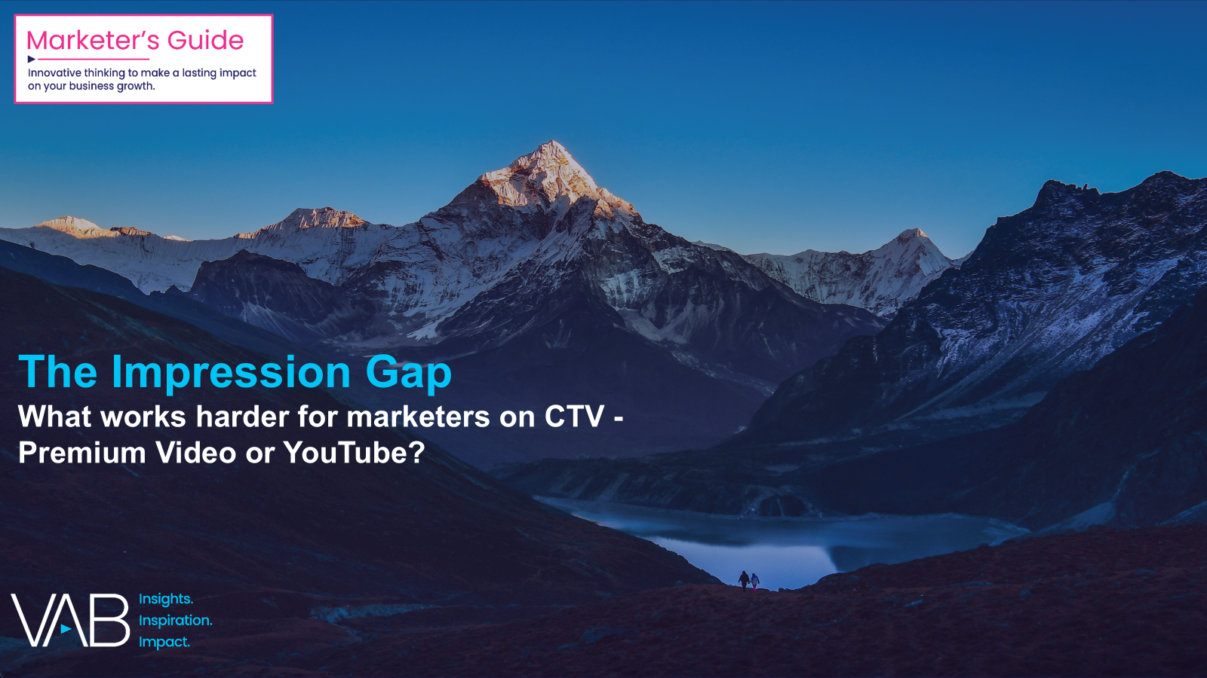
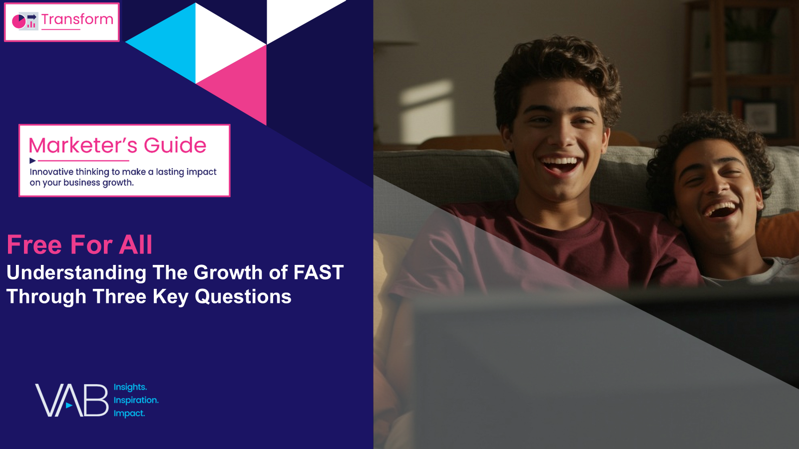
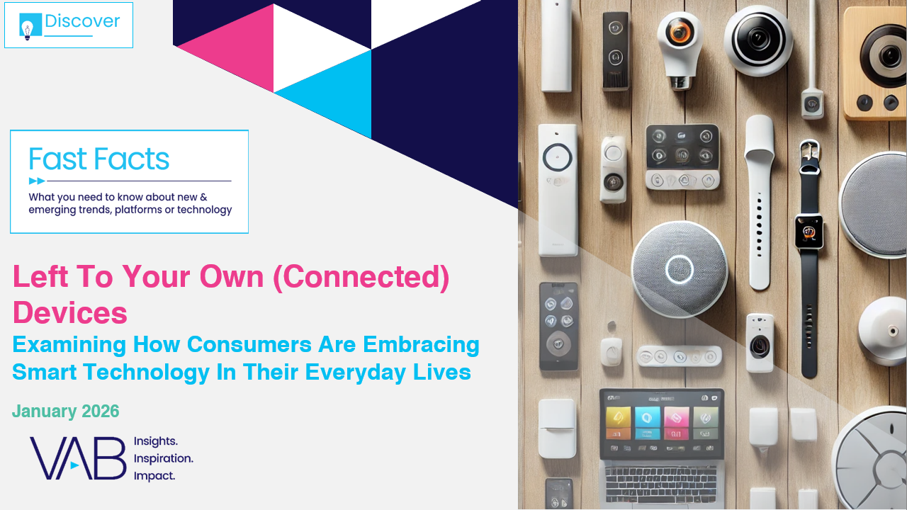
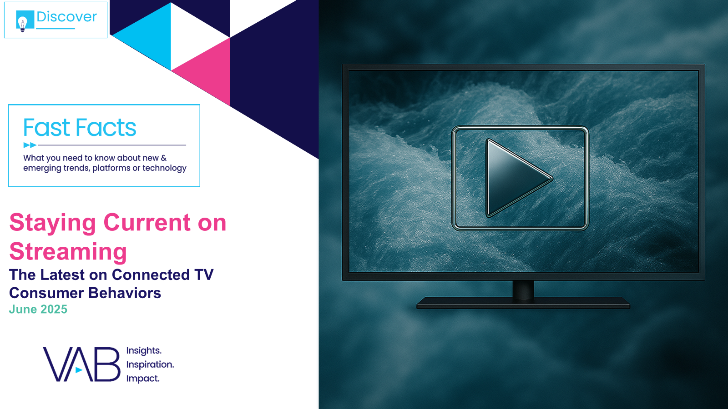

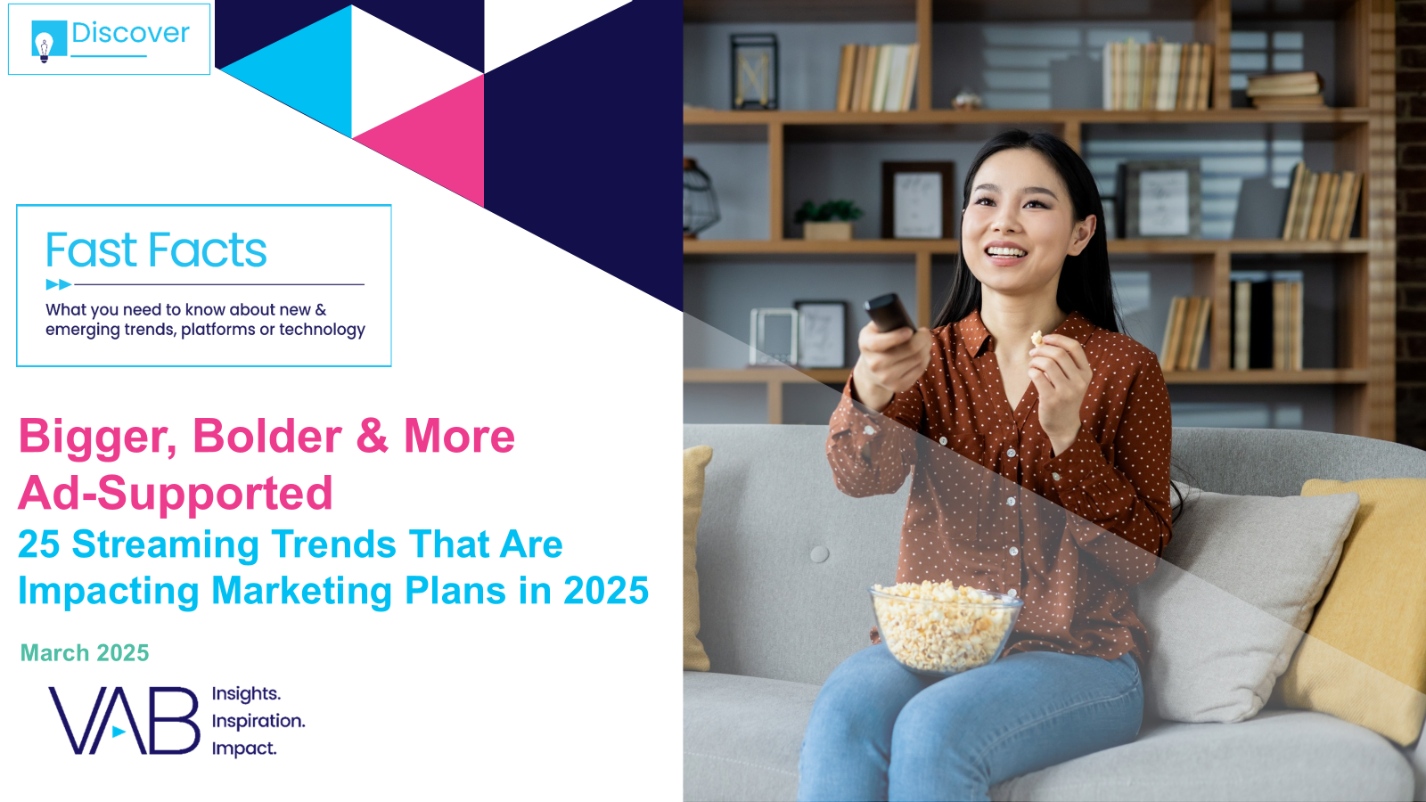

Creators
Jason Wiese
Reed Kiely
EVP, Strategic Insights & Measurement
jasonw@thevab.com
VP, Data Insights & Trends
reedk@thevab.com
Karolina Guillen
Amanda Cashman
The Impression Gap
What works harder for marketers on CTV – Premium Video or YouTube?
Free for All
Understanding the Growth of FAST Through Three Key Questions
Associate Director, Insights, Strategy & Analytics karolinag@thevab.com
Insights Analyst
amandac@thevab.com
Discover more
Looking for more data, insights and takeaways? Check out this related VAB content
Visit our Streaming Video Resources Hub
for the latest consumption stats, trends and advertising opportunities.
Left To Your Own (Connected) Devices Examining How Consumers Are Embracing Smart Technology In Their Everyday Lives – Jan ‘26
Staying Current on Streaming
The Latest on Connected TV Consumer
Behaviors - June 2025
The Power of Premium Video
What it Means for Multiscreen TV and Why it Matters to Marketers
Bigger, Bolder, More Ad-Supported
25 Streaming Trends That Are Impacting Marketing Plans in 2025
VAB Members, brand marketers and agencies get free and immediate access to VAB’s content library. Get access at theVAB.com
This information is exclusively provided to VAB members and qualified marketers.
PAGE 35

Slide 36


About VAB
VAB is an insights-driven organization that inspires marketers to reimagine their media strategies resulting in fully informed decisions.
Drawing on our marketing expertise, we simplify the complexities in our industry and discover new insights that transform the way marketers look at their media strategy.
We are committed to your business growth and proud to offer VAB members, brand marketers and agencies complimentary access to our continuously-growing Insights library. Get immediate access at theVAB.com.
This information is exclusively provided to VAB members and qualified marketers.
PAGE 36

