Slide 1
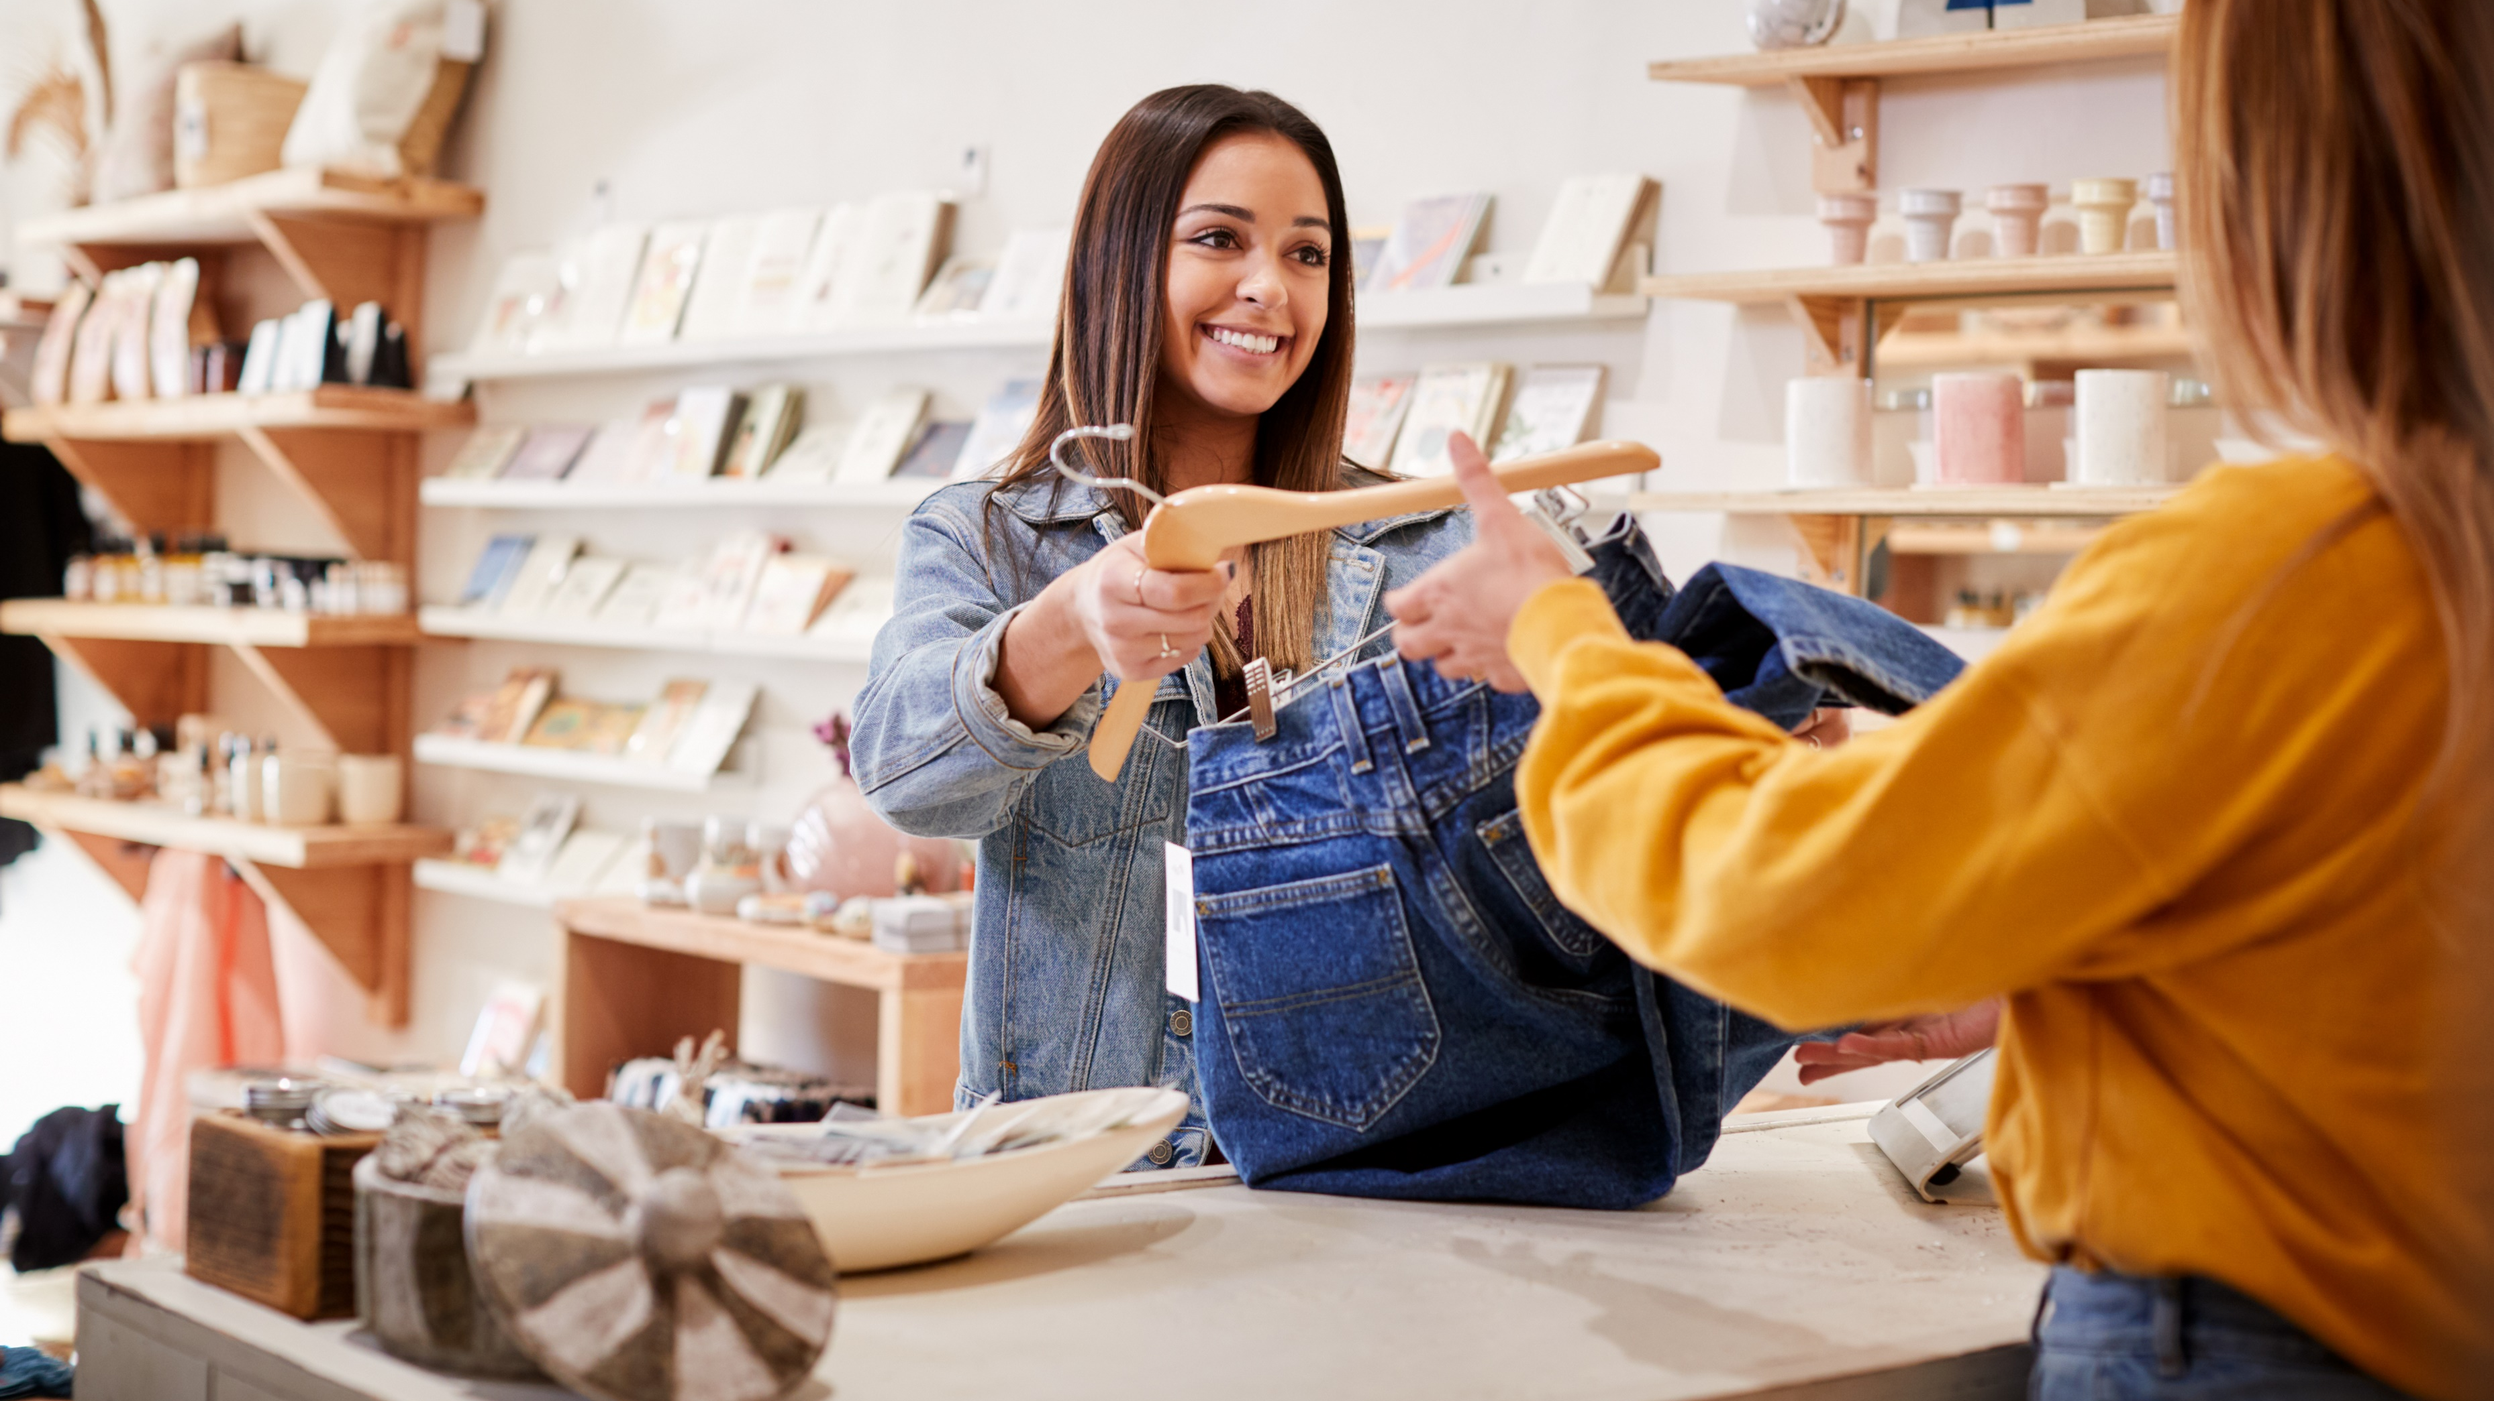


Case Study Corner
xx
Retail Category
Brand success stories highlighted through real-world multiscreen TV case studies

Slide 2





8 Retail category ‘real world’ case studies showcasing how multiscreen TV drives business outcomes across the funnel
Upper Funnel Outcomes
Awareness
Multiscreen TV campaigns that expand reach and drive brand recall against a brand’s best customer prospects*
Sampling of ‘awareness-based’ outcomes that can be measured:
Reach / Reach Extension / Incremental Reach
Ad / Brand Recall
Cost Efficiencies (Reach / Targeted IMPs)
Mid-to-Lower Funnel Outcomes
Action
Multiscreen TV campaigns that increase the likelihood the intended audience will be motivated to act*
Sampling of ‘action-based’ outcomes that can be measured:
Conversion Rates (website traffic,
app downloads, subscription sign-ups,
tune-in, foot traffic)
Sales / Revenues
Optimizations / ROI
Cost Efficiencies (Conversions)
Full-Funnel Outcomes
Awareness + Action
Multiscreen TV campaigns that expand reach and drive brand recall while also increasing the likelihood that the intended audience will be motivated to act*
Sampling of full-funnel outcomes:
Reach → Brand Recall → Conversion Rates → Sales → Optimizations →
Cost Efficiencies
*based on campaign KPIs
This information is exclusively provided to VAB members and qualified marketers.
PAGE 2

Slide 3
Upper Funnel
Case Studies
Awareness
Multiscreen TV campaigns expand reach
and drive brand recall against a brand’s
best customer prospects
Sampling of ‘awareness-based’ outcomes that can be measured:
    Reach / Reach Extension / Incremental Reach
    Ad / Brand Recall
    Cost Efficiencies (Reach / Targeted IMPs)
How Multiscreen TV drives
Awareness
This information is exclusively provided to VAB members and qualified marketers.
PAGE 3

Slide 4


Category:
Retail
A retail brand redistributed impressions towards Light & Medium TV viewers, helping increase targeted reach and frequency
Challenge
A retail brand wanted to suppress Heavy TV Viewers from their addressable campaign in hopes to increase frequency and reach among Light and Medium TV viewers
Solution
5-week national + addressable media campaign
Target Segment
A25-54 Light & Medium TV Viewers
Results
The addressable campaign successfully redistributed impressions towards the targeted Light & Medium TV viewers
The campaign shifted the weight of Light & Medium impressions from 46% for national to 71% for national + addressable
Increased overall reach from 74% to 89% for the retail brand
Company / Platform / Media Type
Addressable TV / DIRECTV Viewership Data
% of Total Impressions Delivered by Target
+177%
+20%
Weekly Frequency Lift
Light & Medium TV Viewers
(Addressable & National vs. National Campaign)
Reach Lift
Overall
(Addressable & National vs. National Campaign)
Source: DIRECTV, Addressable Reach-Frequency Optimization Retail Case study. 4Q’22 Viewership data. Incremental reach within DIRECTV footprint.
This information is exclusively provided to VAB members and qualified marketers.
PAGE 4

Slide 5
Mid-To-Lower Funnel
Case Studies
Action
Multiscreen TV campaigns increase the likelihood that the intended audience will be motivated to act
(e.g., make a purchase, download an app, sign-up
for a subscription, make a booking, etc.)
Sampling of ‘action-based’ outcomes that can be measured:
    Conversion Rates (website traffic, app downloads, subscription sign-ups, tune-in, foot traffic)
    Sales / Revenues
    Optimizations / ROI
    Cost Efficiencies (Conversions)
How Multiscreen TV drives
Action
This information is exclusively provided to VAB members and qualified marketers.
PAGE 5

Slide 6
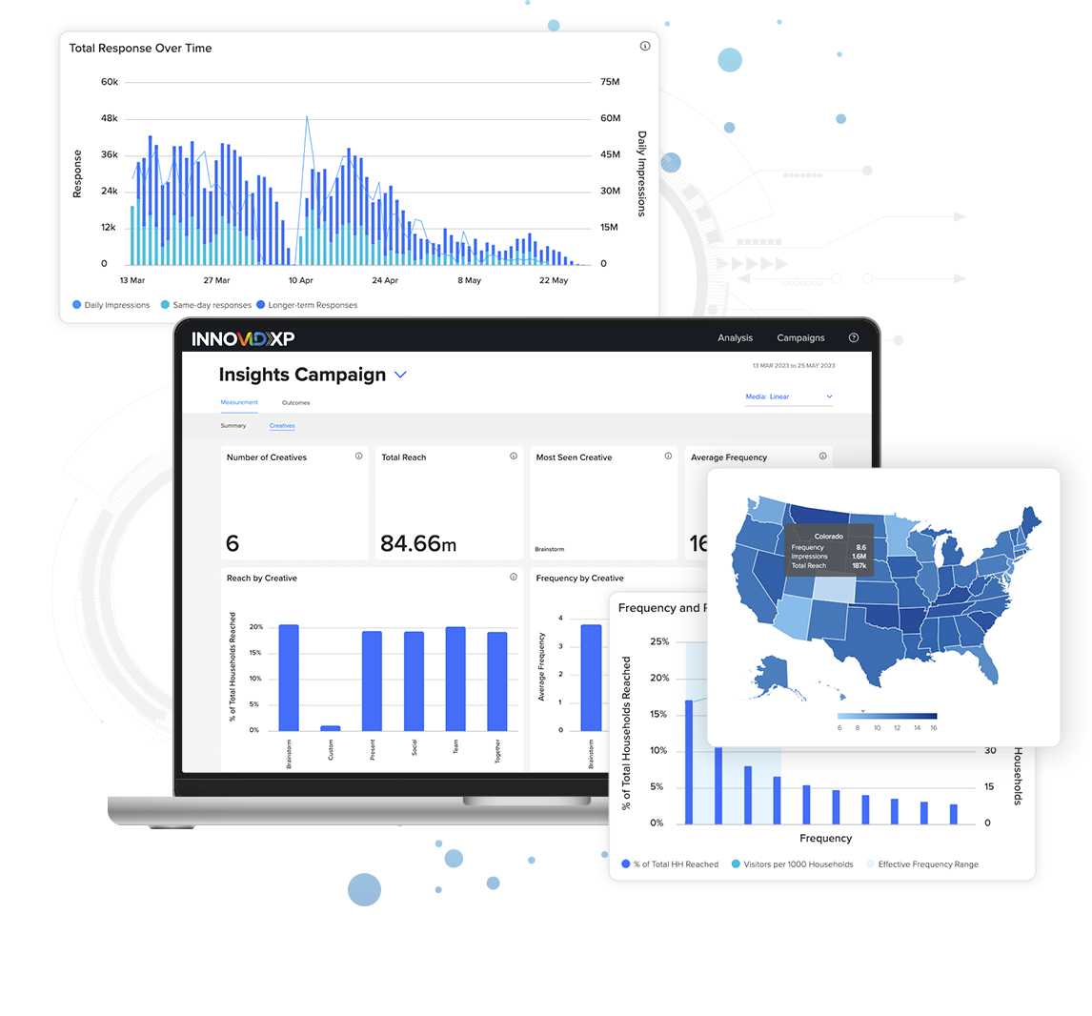


Category:
Retail
Haix optimizes converged TV with InnovidXP to increase ecommerce response
Challenge
As a global manufacturer of tactical footwear, Haix produces more than 1 million pairs of shoes and boots annually. While its footwear can be purchased in brick-and-mortar stores, Haix embarked on a converged TV campaign to drive response and direct ecommerce sales via its website.
Measurement Solution
InnovidXP
Target Segment
Haix footwear is designed for firefighters, EMTs, paramedics, law enforcement officers, foresters and safety workers.
Learnings
Leveraging InnovidXP, Haix measured its campaigns’ immediate and longer-term impact on site traffic.
The always-on analytics provided Haix with the ability to leverage granular performance data for campaign insights and media and creative optimizations.
Viewing Source / Media Type
CTV and linear
55%
Improvement in ROI
+37%
Increase in Immediate Visits
+24%
Increase in Longer-Term Visits
+78%
Increase in TV Inventory YoY
Source: Innovid x Haix, Retail Case study.
This information is exclusively provided to VAB members and qualified marketers.
PAGE 6

Slide 7






Category:
Beauty / Retail
Beauty Retailer drove higher in-store traffic and conversions through advanced TV targeting
Challenge
Increase store traffic for a beauty retail company
Solution
Using their Precision1 tool, Lifetime created custom linear and digital targets (Nielsen MRI / Krux), tracked ad exposure on Vizio smart TVs (iSpot), resolved identities (LiveRamp / Experian) and measured foot traffic to retail locations via mobile (PlaceIQ)
  Partnered with iSpot to develop attribution analysis to guarantee conversion lift based on data from year prior
Target Segment
Beauty Enthusiasts – custom target created using Nielsen MRI (linear) and Krux (digital)
Results
Through audience-based targeting and measurement, Lifetime delivered an in-store conversion rate lift (CRL) 10x greater than the guarantee
Company / Platform
A+E Networks’ Precision1 / Multiplatform TV
Setting a Benchmark & Guaranteeing Outcomes
Multi-Viewing Precision Targeting
Performance
Linear Precision1
“Beauty Enthusiast” target created using Nielsen MRI data source
Airing on Lifetime only
Digital Precision1
“Beauty Enthusiast” target created using Krux data source
Airing on Lifetime only
Business Outcomes Guarantee
+8% Conversion Rate Lift in Fall/Holiday foot traffic to store locations vs. year prior
‘Beauty Enthusiasts’ TV Conversion Rates Outcomes
14-day attribution window, Lifetime TV Network
+65% vs. GTE
+80%
LIFT
vs Benchmark
+8% GTE
Source: A+E Networks, “Beauty Enthusiast” Precision + Performance Case Study. Audience targets based on data from Nielsen MRI (Linear) and Krux (Digital). *Retail locations included in malls and shopping centers in addition to being stand-alone structures. Data partners: iSpot, Vizio, LiveRamp, Experian, PlaceIQ. Flight duration: 9/1/19 – 12/24/19, with a 14-day attribution window.
This information is exclusively provided to VAB members and qualified marketers.
PAGE 7

Slide 8




Category:
Retail
A national retailer leveraged cross-screen campaign insights to drive website traffic and sales
Challenge
A national retailer’s holiday 2020 campaign goal required driving shopper behavior across the brand’s core brick & mortar footprint while monitoring ecommerce outcomes
Solution
Media agency Mediahub used an audience-first approach to target shoppers across live linear & streaming devices within a regionalized footprint while measuring website visits post ad-exposure
Ampersand’s Targeted TV solution delivered a geo-targeted, multiscreen campaign across premium live & on-demand platforms, which was measured in partnership with TVSquared to demonstrate how TV exposure drives web traffic*
Target Segment
A25-54
Results
Campaign insights revealed:
  Optimal linear TV dayparts and networks: daytime drove 33% of immediate site visitors
  Streaming TV insights demonstrated timely impact of campaign, with 30% of website visitors & order confirmations occurring within 2 days of ad exposure
Company / Platform / Media Type
Ampersand’s Targeted TV solution / Streaming + Linear TV / Local Linear TV, OTT, Connected TV (CTV), Desktop, Mobile, Tablet
Local Targeted TV
Impact on Outcomes
Streaming TV
9% Direct
(<10min)
Website Visits
Website Visits
320,994
Immediate visitors
30 minutes
Retailer Site
91% Drag
(10-30min)
99,242
Responses
6 days
435,038
Repeat Visitors
14 days
39,321
Within 14 days
Order Confirmations
7,580
Within 6 days
Linear Results
Streaming Results
Cable TV ad exposure insights identified areas to drive increased performance based on the following:
Diversify Dayparts: Daytime and Weekend Daytime drove 33% of immediate visitors
Heavy Up Networks: 3 networks drove 21% of immediate visitors
27% of website responses & 36% of on-site order confirmations occurred during the weeks of Thanksgiving & Cyber Monday (11/12-12/6)
30% of website visitors + order confirmations occurred within 2-days of ad exposure
26% of all visitors/responses were from Daytime whereas 22% were from Prime
Source: Ampersand, Case study: Targeted TV Effectiveness: Local multi-screen holiday TV campaign drives shopper engagement + sales. Campaign time period: flight date – 9/28/20-12/25/20; measurement period – 10/13/20-12/27/20. Campaign agency: Mediahub. Data partner: TVSquared. Geos: 19 total based on store proximity. Frequency: even weekly pacing + 95% video completion rate (VCR). Actions measured: retailer site visitation (any page), order confirmation page. Attribution based on website visitation following linear ad or digital ad exposure; Attribution windows: Local targeted TV – 30 minutes = immediate response, 14 days from Immediate Response = Return Response; Streaming – within 7 days Post Initiative Exposure. *Website visits measured by TVSquared pixels.
This information is exclusively provided to VAB members and qualified marketers.
PAGE 8

Slide 9




Category:
Retail
A major retailer partnered with LiveRamp to drive and validate ad effectiveness in driving sales
Challenge
A major MVPD was looking to prove that their addressable TV inventory, across both their set-top-box and streaming inventory, consistently drove sales for a Big Box Retailer
Measurement Innovation
Using Data Plus Math’s sales attribution solution, the major MVPD was able to validate their addressable TV effectiveness on the retailer’s
in-store and online sales
Target Segment
Occasional Shoppers
Learnings
Over the course of a year, the retailer’s TV campaign media produced consistent lift among their target audience over the control in the retailer’s target household sales, both in-store and online
Company / Viewing Source / Media Type
LiveRamp & Data+Math / Linear & Streaming TV / Addressable TV
Campaign Results
+30%
+51%
Sales Lift over four quarters after exposure to the Addressable TV campaigns, on average
Lift in Units Purchased over
four quarters after exposure to
the Addressable TV campaigns,
on average
Source: LiveRamp, retail brand case study. Campaign time period: Feb-March 2021, May-July 2021, August - Sept 2021, and Oct-Dec 2021.
This information is exclusively provided to VAB members and qualified marketers.
PAGE 9

Slide 10
Awareness
How Multiscreen TV drives
Full-Funnel Outcomes
Multiscreen TV campaigns expand reach
and drive brand recall against a brand’s
best customer prospects
Action
Multiscreen TV campaigns increase the likelihood
that the intended audience will be motivated to act
(e.g., visit a website, download an app, sign-up
for a subscription, make a purchase, etc.)
Case Studies
This information is exclusively provided to VAB members and qualified marketers.
PAGE 10

Slide 11




Category:
Retail (Balsam Brands)
Balsam Brands drove ROAS via a programmatic CTV campaign and achieved incremental reach while driving responses
Challenge
Balsam Brands, a leading retailer of holiday décor, wanted to drive quality site traffic from holiday decoration shoppers and drive ROAS*
Solution
MediaMath & TVSquared partnered to measure the effectiveness of Balsam Brand’s reach and messaging across publisher partners, enabling optimizations to be made throughout the programmatic CTV campaign against high-performing publishers & devices
Target Segment
Custom Audience Target
Results
Balsam Brands was able to drive a ROAS by 150% vs. year prior, and achieved incremental unique reach over linear by 78%
Company / Platform / Media Type
TVSquared, MediaMath / Streaming Only / Connected TV (CTV)
CTV
LINEAR
3% overlap
78% of CTV reach was unique, tapping into a subset of users unreachable on linear
4.7M
households reached
35M
impressions
131K
responses from CTV
Source: TVSquared, Case study: Driving Performance with CTV: MediaMath partnered with TVSquared to measure the effectiveness of Balsam Brand’s reach and messaging across publisher partners. Campaign time period: Holiday Season 2019 vs. 2020 (mid-October – end November (peak holiday shopping season). *Return on ad spend.
This information is exclusively provided to VAB members and qualified marketers.
PAGE 11

Slide 12
Category:
Retail
DIRECTV drove significant brand attribute lifts for a specialty retailer by enabling an addressable and pause ad campaign
Challenge
A specialty retailer sought to improve their KPIs during the holiday shopping season
Solution
6-week Addressable + out-of-stream Pause Ads media campaign
Target Segment
Custom segment of holiday gift shoppers, based on client first-party data and third-party data
Results
The addressable campaign with out-of-stream pause ads campaign outperformed high-aided brand awareness* campaign benchmarks and increased agreement with all brand attributes (based on brand health measurement data from Kantar)
Pause Ads drove significant lifts among brand favorability, consideration intent and purchase intent
Company / Platform / Media Type
DIRECTV Viewership Data / Addressable TV
4.7x
5.2x
Aided Brand Awareness
Campaign Norms
(target vs. norm)
Brand Favorability
Campaign Norms
(target vs. norm)
+38%
+25%
+63%
Brand Attributes
“A brand for people like me”
(recall vs. do not recall)
Brand Attributes
“A brand that offers new and innovative products”
(recall vs. do not recall)
Brand Attributes
“A brand that is relevant to my everyday life”
(recall vs. do not recall)
+5%
+9%
6%
Brand Favorability
Pause Ads Exposure
(target vs. control)
Consideration Intent
Pause Ads Exposure
(target vs. control)
Purchase Intent
Pause Ads Exposure
(target vs. control)
Source: DIRECTV, Addressable + Pause ads, Retail Case study, advertiser first-party data, third-party data & Kantar. Case study results are based on individual campaign factors. DIRECTV makes no performance warranties. Control: Represents 10% of DTV HHs within the target that did not receive exposure to the addressable or pause ad. *An advertiser falls into high-aided brand awareness category if the control reports over a 70% familiarity with the brand in Kantar’s Brand Health survey.
This information is exclusively provided to VAB members and qualified marketers.
PAGE 12

Slide 13


Additional Insights:
Creative Performance

Slide 14

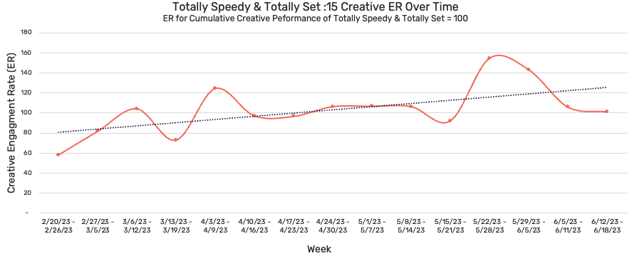

Category:
Retail
Monitoring a retail campaign, EDO determined that the ad maintained both strong engagement and creative longevity
Challenge
EDO assessed the long-term effectiveness and wear-in/out patterns of a retail brand’s :15 creative. They aimed to determine whether the ad’s performance remained strong over time or diminished after repeated viewings.
Creative
‘Totally Speedy & Totally Set’ :15
Performance
15% above average brand ad
Key Findings
EDO data indicates that this creative remained a strong performer throughout its entire flight, suggesting that performance could remain strong if this creative continued to air, despite having been active for 15 weeks and accumulating 2.1B total impressions
Observations
Performance stabilized during weeks 6 through 11 (4/10 - 5/21) before peaking the week of 5/22 and 5/29
During the week of 5/22, the creative was 54% more effective than the average week
Notably, this creative features summer weather and a kids soccer practice, which may have contributed to the increased engagement around Memorial Day
Company / Platform
EDO / Linear TV
Flight: 2/26/23 – 6/18/23
Media Weight:
2.1B
impressions
Source: EDO, Case study: Creative wear-in/out analysis of an above average performing Retail Brand creative indicates extended creative shelf life. Campaign time period: 2/26/23 - 6/18/23.
This information is exclusively provided to VAB members and qualified marketers. Further distribution is prohibited.
PAGE 14

Slide 15

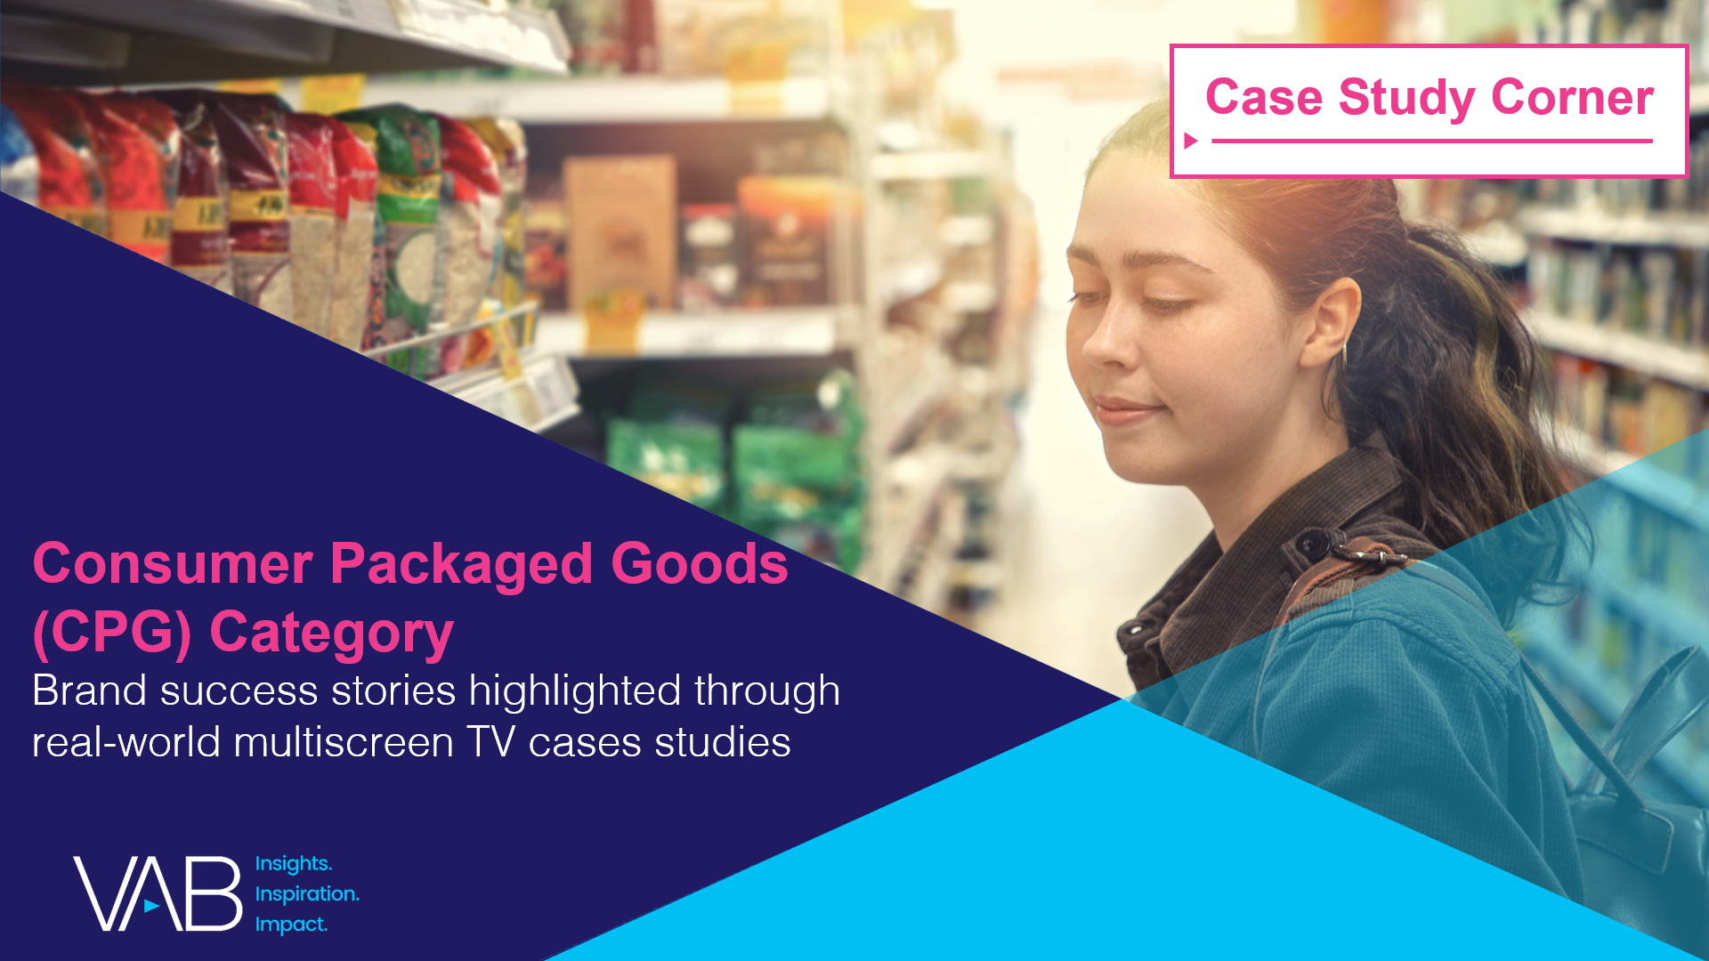



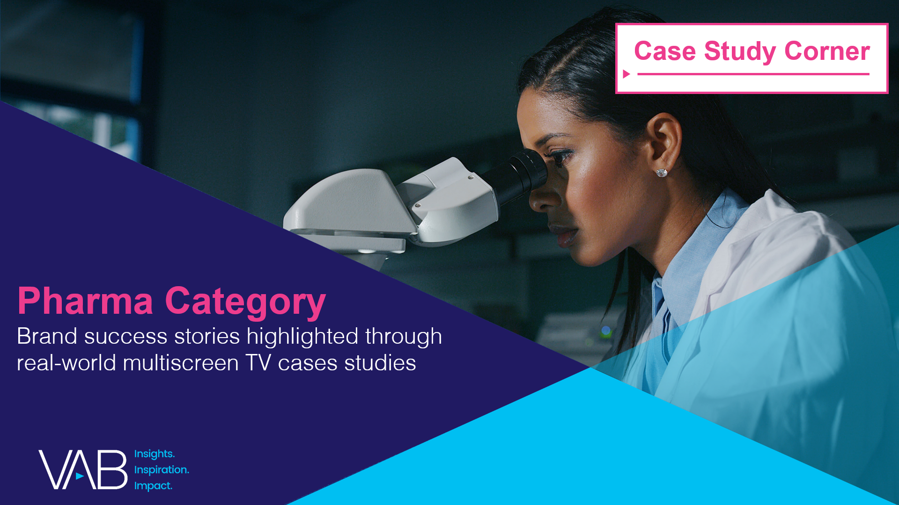

Want more? VAB has a wealth of case studies across additional categories
Automotive
Consumer Packaged Goods (CPG)
Entertainment & Tune-In
Financial Services & Insurance
Health, Wellness & Beauty
Pharmaceuticals
Restaurants
Access more case studies at www.thevab.com
This information is exclusively provided to VAB members and qualified marketers.
PAGE 15

Slide 16


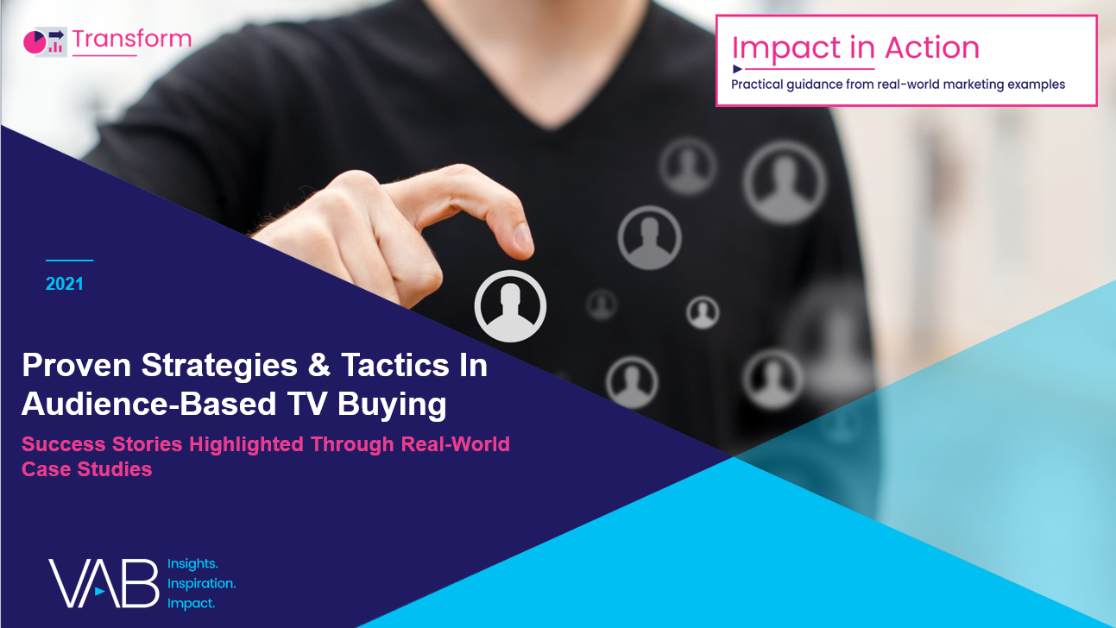





Want more? VAB also has case studies organized across multiscreen TV platforms including linear TV and streaming / CTV
Stream On
How can a convergent TV strategy drive business
results for my brand?
Proven Strategies & Tactics In Audience-Based TV Buying
Opportunities in VOD Addressable
Q1 ‘22 Today’s Innovations in Measurement
Q2 ‘22 Today’s Innovations in Measurement
Q3 ‘22 Today’s Innovations in Measurement
Q4 ‘22 Today’s Innovations in Measurement
Access more case studies at www.thevab.com
This information is exclusively provided to VAB members and qualified marketers.
PAGE 16

Slide 17


About VAB
VAB plays a dual role in the video advertising industry. We are leading the change to bring about a more innovative and transparent marketplace. We also provide the insights and thought leadership that enables marketers to develop business-driving marketing strategies.
Drawing on our marketing expertise, we simplify the complexities in our industry and discover new insights that transform the way marketers look at their media strategy.
We are committed to your business growth and proud to offer VAB members, brand marketers and agencies complimentary access to our continuously-growing Insights library. Get immediate access at theVAB.com.
This information is exclusively provided to VAB members and qualified marketers.
PAGE 17

