Slide 1



Case Study Corner
xx
Restaurant Category
Brand success stories highlighted through real-world multiscreen TV case studies

Slide 2




13 Restaurant category ‘real world’ case studies showcasing how multiscreen TV drives business outcomes across the funnel
Upper Funnel Outcomes
Awareness
Multiscreen TV campaigns that expand reach and drive brand recall against a brand’s best customer prospects*
Sampling of ‘awareness-based’ outcomes that can be measured:
Reach / Reach Extension / Incremental Reach
Ad / Brand Recall
Cost Efficiencies (Reach / Targeted IMPs)
Mid-to-Lower Funnel Outcomes
Action
Multiscreen TV campaigns that increase the likelihood the intended audience will be motivated to act*
Sampling of ‘action-based’ outcomes that can be measured:
Conversion Rates (website traffic,
app downloads, subscription sign-ups,
tune-in, foot traffic)
Sales / Revenues
Optimizations / ROI
Cost Efficiencies (Conversions)
*based on campaign KPIs
This information is exclusively provided to VAB members and qualified marketers.
PAGE 2

Slide 3


Upper Funnel
Case Studies
Awareness
Multiscreen TV campaigns expand reach
and drive brand recall against a brand’s
best customer prospects
Sampling of ‘awareness-based’ outcomes that can be measured:
    Reach / Reach Extension / Incremental Reach
    Ad / Brand Recall
    Cost Efficiencies (Reach / Targeted IMPs)
How Multiscreen TV drives
Awareness
This information is exclusively provided to VAB members and qualified marketers.
PAGE 3

Slide 4


Category:
Quick Service Restaurant
A QSR brand efficiently optimized their linear TV campaign to grow their strategic target’s reach within budget
Challenge
A major QSR company wanted to improve reach and concentration against its custom strategic target (ST) while achieving cost efficiencies within their budget
Solution
By optimizing a baseline plan via Amobee’s daypart reallocator, the new data-driven linear schedule delivered a +46% increase in equivalized units at the same budget
Target Segment
QSR Strategic Target*
Results
Demo and strategic reach increased while significant savings were realized within budget
Company / Platform
Amobee / Data-driven linear
+6%
-12%
$3.3M
Increase in Reach
Amongst the
Strategic Target
Reduction in
Strategic Target
CPM
Targeted Delivery Savings
Source: Amobee, Case Study: Audience Based Buying in a Linear TV Ecosystem. *Custom brand-developed target.
This information is exclusively provided to VAB members and qualified marketers.
PAGE 4

Slide 5


Category:
Casual Dining
A casual dining brand utilized 605 to understand & measure audience reach and composition across video platforms
Challenge
A casual dining brand wanted to understand and measure audience reach and demographic composition across TV and digital platforms
Audience Measurement Innovation
605 utilizes a custom weighting methodology designed to account for incomplete exposure datasets (due to digital tracking & ID resolution) and platform biases, enabling 605 to holistically measure & project national reach across individual and overlapping platforms
Target Segment
A18+, A21+, A18 34, A18-49
Learnings
The data-driven linear live campaign (TV C3) reached more households vs. national live and served a higher frequency of impressions to those HHs
TV & digital platforms (O&Os and digital TV*) reached mostly distinct audiences. Only 18.7% of households reached on digital platforms were also reached on TV
Households reached on Live+7 linear were about 2x
as likely to be reached on Digital O&O* than those reached on live TV
Company / Viewing Source / Media Type
605 / Automated Content Recognition (ACR),
Set-Top Box / Linear TV
Overview Of Platform Overlap For Each Target Segment
Reach (thousands)
Average Frequency
Target Segments
Platform | Digital TV | Digital O&O | TV C3
Digital TV | 58.4
Digital O&O | 1.9 | 1,094.4
TV C3 | 10.1 | 203.4 | 31,867.4
Digital TV | Digital O&O | TV C3
2.0
7.7 | 3.8
6.2 | 8.6 | 4.6
18+
Platform | Digital TV | Digital O&O | TV C3
Digital TV | 29.3
Digital O&O | 1.0 | 648.5
TV C3 | 5.2 | 127.9 | 14,764.3
Digital TV | Digital O&O | TV C3
2.0
8.2 | 3.8
6.2 | 8.5 | 4.6
18-34
Platform | Digital TV | Digital O&O | TV C3
Digital TV | 42.8
Digital O&O | 1.5 | 884.5
TV C3 | 7.5 | 168.8 | 21,733.1
Digital TV | Digital O&O | TV C3
2.0
7.4 | 3.8
6.3 | 8.5 | 4.5
18-49
Source: 605, Case study: Campaign for Casual Dining / Take Out. Campaign time period: 10/21/2019 – 12/30/2019. *Digital O&O (Owned & Operated) refers to ads placed on digital properties (i.e., apps) vs. digital TV which is more akin to linear TV viewed through web or app.
This information is exclusively provided to VAB members and qualified marketers.
PAGE 5

Slide 6




Category:
Quick Service Restaurant
LiveRamp partnered with a QSR brand to optimize their converged TV campaign in order to drive incremental reach
Challenge
A major QSR brand needed to concretely identify how their key OTT/CTV partners overlapped with their linear TV buy
Audience Measurement Innovation
LiveRamp helped the brand create a learning agenda based on their OTT/CTV partnerships
(see footnote for more details*)
Focused on the brand’s most desired partners,
the plan centered on YOY comparisons on how well each OTT/CTV partner drove incremental reach relative to complement their linear TV buy
Target Segment
All households
Learnings
The brand gained the ability to better optimize toward incremental reach across OTT/CTV (see charts on the right side)
Company / Viewing Source / Media Type
LiveRamp, Data Plus Math (D+M) / ACR, Pixel Integration / National Linear TV, CTV, OTT
The brand gained the ability to evolve its linear media strategy
to maximize its incremental reach across OTT/CTV
Incremental OTT/CTV campaign reach averaged a 5x increase over the course of media flights, allowing the campaign to reach a wider audience
Eliminated wasted impressions going to HHs who had already
seen their benchmark of < 8 linear impressions per month
Source: LiveRamp, Case study: How a Major QSR Brand Revised their Linear Media Strategy Toward Driving Incremental Reach With CTV/OTT. Campaign time period: 9/28/2020-11/8/2020 & 11/9/2020-12/26/2020. Advanced TV Measurement: Data Plus Math. *Innovation Detail: Combining ad exposures from ACR data via Inscape partnership and D+M pixel integration with CTV/OTT publishers resolved to RampID & HHID, x-screen projection scaling methodology, custom report views to support insights agenda.
This information is exclusively provided to VAB members and qualified marketers.
PAGE 6

Slide 7
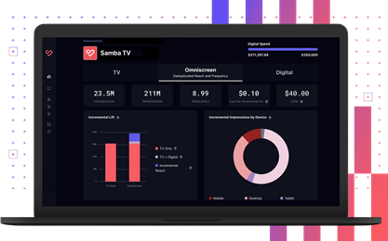

Category:
Quick Service Restaurant
A QSR brand partnered with Samba TV to drive incremental reach to their linear TV campaign
Challenge
A national QSR brand wanted to reach net-new households and drive incremental reach beyond their linear campaign
Measurement Innovation
A QSR brand utilized Samba TV’s iCPM* product. This TV data and identify graph helped the QSR brand to target deduplicated, incremental audiences
Target Segment
Households unexposed to linear ad campaign
Learnings
The combination of iCPM Audience Insights (an incremental reach-focused dashboard) and real-time optimization capabilities drove incremental reach across streaming, online and mobile video
Samba TV’s iCPM product saved the brand money by identifying and only counting incremental impressions
Company / Viewing Source / Media Type
Samba TV / ACR, Set-top Box / Linear, CTV,
Other Digital
Campaign Results
Reached
Drove
Drove
4.9M
Incremental households
$0.23
Cost Per Incremental Household
10.4M
Incremental impressions
Beyond the advertisers’ 80M linear television reach, resulting in a 6% Incremental Reach Lift
For massive incremental reach efficiencies
Served to brand new households
By activating on iCPM, and only paying for incremental impressions, the QSR brand saved $38k compared to a standard CPM campaign
Source: Samba TV, QSR Case Study. Campaign time period: 2/15/21 - 11/21/21. *iCPM: incremental cost per thousand impressions.
This information is exclusively provided to VAB members and qualified marketers.
PAGE 7

Slide 8

Category:
Quick Service Restaurant
DIRECTV’s addressable campaign redistributed impressions to successfully drive reach across intended audiences
Challenge
A large QSR brand wanted to reach lighter TV viewers that were difficult to find with national linear TV alone
Solution
Suppress heavy viewers to increase reach & frequency of lighter TV viewers
Target Segment
A19-49
Light & Medium TV viewers
Results
The 6-week DIRECTV addressable campaign successfully redistributed impressions towards the light & medium TV viewers, helping to offset the national campaign’s imbalance
The QSR brand shifted the weight of impressions for light & medium TV viewers from 47% within the national campaign to 89% for the combined campaign
Additionally, the QSR brand drove +23% greater reach against their intended audience
Company / Platform
Addressable TV / DIRECTV Viewership Data
% of Campaign Impressions Delivered by Target
+398%
+23%
Weekly Frequency Lift
Light & Medium TV Viewers
(Addressable & National vs. National Campaign)
Reach Lift
Overall
(Addressable & National vs. National Campaign)
Source: DIRECTV, Addressable Reach-Frequency QSR Optimization Case Study. Lifts are based on a subset of the target HHs for which DIRECTV got premium path data.
This information is exclusively provided to VAB members and qualified marketers.
PAGE 8

Slide 9

Mid-To-Lower Funnel
Case Studies
Action
Multiscreen TV campaigns increase the likelihood that the intended audience will be motivated to act
(e.g., make a purchase, download an app, sign-up
for a subscription, make a booking, etc.)
Sampling of ‘action-based’ outcomes that can be measured:
    Conversion Rates (website traffic, app downloads, subscription sign-ups, tune-in, foot traffic)
    Sales / Revenues
    Optimizations / ROI
    Cost Efficiencies (Conversions)
How Multiscreen TV drives
Action
This information is exclusively provided to VAB members and qualified marketers.
PAGE 9

Slide 10


Category:
Quick Service Restaurant
A QSR brand drove incremental visitation through a convergent, audience-based campaign
Challenge
A QSR brand sought to bring awareness to a new product offering and drive in-store visits through a convergent, audience-based campaign
Solution
ViacomCBS’ as-run and impression-level delivery data, combined with Foursquare’s location data & attribution methodology, enabled measurement of incremental foot traffic compared to concurrent non-targeted inventory
Target Segment
High Value QSR Custom Target
Results*
Vantage-targeted inventory exceeded Foursquare’s performance benchmarks, driving greater reach and in-store visits, with 1:1 environments yielding the most significant impact
Company / Platform / Media Type
ViacomCBS Vantage, Foursquare / Streaming + Multiscreen / Linear TV, STB live linear addressable and VOD, EyeQ** [CTV/OTT (desktop, mobile)]
Vantage-targeted campaign drove…..
Target Segment Delivery:
Campaign achieved a 38% gain in impressions delivered in target segment vs. vs non-targeted concurrent buy
Incremental Visits:
Across all platforms, Vantage inventory drove a statistically significant lift of 4.3%
Increased Store Visitation:
Vantage cross-platform campaign outperformed non-targeted media by more than 7x
Better Performance Than Category Benchmarks:
Overall campaign performance exceeded Foursquare’s omnichannel campaign behavioral lift benchmark by +50%
1:1 exposure yielded most significant impact
1:1 environments*** delivered 24% lift in target segment reach
Vantage live linear addressable & targeted OTT media together drove 34% lift, a 10x increase over linear alone, and 3x over the non-targeted digital media campaign.
Source: ViacomCBS, Attribution case study: ViacomCBS and Foursquare show increased media impact by measuring multi channel campaign. Segmentation source: MRI-Simmons. Attribution partner: Foursquare. Optimizer: ViacomCBS’ Vantage (proprietary). Comparable benchmarks: non-targeted media on same platforms. Campaign time period: Q3 2020. *Total campaign delivered 87% cost efficiency on incremental visits, with streaming showing the greatest efficiency. **Encompasses Pluto TV and all ViacomCBS O&O apps including CBS All Access. ***1:1 environments: STB live linear addressable and VOD, CTV, OTT.
This information is exclusively provided to VAB members and qualified marketers.
PAGE 10

Slide 11

Category:
Quick Service Restaurant
A QSR brand saw lifts in foot traffic among all exposure groups, especially target HHs, through a data-driven linear TV campaign
Challenge
A QSR brand wanted to drive foot traffic to restaurant locations during a limited-time promotion
Solution
Using NBCU’s AdSmart audience targeting solution, the brand ran a national TV campaign across the NBCU portfolio to reach their custom target. Data Plus Math was utilized to measure the incremental impact of the campaign on driving foot traffic to the brand’s locations.
Target Segment
Custom LiveRamp look-alike target modeled from the brand’s 1st-party database of mobile app users
Results
By implementing a targeted data-driven TV campaign, overall restaurant visitations increased +4.5% with a +5% increase among in-target HHs
Company / Platform
NBCU’s AdSmart solution / Data-driven linear
% Lift in Restaurant Visitation
+4.5%
+5%
+4.5%
Overall
In-Target
Non-Target
(Total HHs Exposed to AdSmart Campaign vs.
Total HHs Exposed to Non-AdSmart Campaign)
(Target HHs Exposed to AdSmart Campaign vs.
Target HHs exposed to non-AdSmart campaign,
the non-target lift indicates a strong halo effect)
AdSmart Exposure Among Target HHs Drove Higher Restaurant Visitation, Validating The Targeting
+18%
Higher In-Target Restaurant Visitation vs. Overall
+22%
Higher In-Target Restaurant Visitation vs. Non-Target
Source: NBCU, AdSmart + QSR Case Study.
This information is exclusively provided to VAB members and qualified marketers.
PAGE 11

Slide 12

Category:
Quick Service Restaurant
A data-driven linear TV campaign overdelivered the foot traffic guarantees for a QSR brand
Challenge
A QSR brand wanted to increase foot traffic into select restaurant locations
Solution
Using their Precision solution, A+E Networks created a custom strategic target for a cross network buy and partnered with Data Plus Math to set a benchmark guarantee and measure foot traffic through a pixel in the creative served to households in the area of 20 brand-validated locations
Target Segment
QSR Strategic Target*
Results
Using strategic targeting, A+E Network’s data-driven linear TV campaign contributed almost 3MM incremental visits to the target locations over the three waves and outperformed the foot traffic guarantee by +4% overall
Company / Platform
A+E Networks’ Precision+Performance / Data-driven linear
Wave 1 (Pre-Pandemic)
1/6/20 – 3/1/20
2,808,388
Post-Exposed Visits
+32.6%
Incremental Lift
916,892
Additional Incremental Visits
(above what would have occurred without presence of the linear campaign)
104
LCI Index**
Wave 2-3 (mid-Pandemic)
3/2/20 – 5/16/20
5,434,204
Post-Exposed Visits
+36.4%
Incremental Lift
(+12% higher than pre-COVID)
1,979,627
Additional Incremental Visits
(above what would have occurred without presence of the linear campaign)
103
LCI Index**
Source: A+E Networks, Case Study: QSR Foot Traffic. Networks include A&E, HISTORY, Lifetime, LMN and FYI. *Custom brand-developed, data-driven target aided by A+E Networks Precision data-driven solution. **LCI = Linear Campaign Index which is based on the incremental visits lift network TV average across all networks. Flight duration: 1/6/20 – 5/16/20.
This information is exclusively provided to VAB members and qualified marketers.
PAGE 12

Slide 13

Category:
Quick Service Restaurant
Audiences exposed to interactive ads saw 3x lift in purchase rate for a QSR brand’s cross-screen campaign
Challenge
A QSR brand looked to drive sales through personalized messages prompting user engagement
Solution
Hulu delivered selected audiences GatewayGo ads. These interactive units allow viewers to engage through personalized message prompting users to open a push notification, email or scan
a QR code
Campaign was delivered & measured in collaboration with Hulu, a credit card transaction partner and a data connectivity platform
Target Segment
A18-49 across 5 DMAs
Results
Hulu viewers exposed to the GatewayGo unit showed heightened responsiveness to campaign and drove a 0.27% shop rate and a high average household spend of $0.13
Company / Platform / Media Type
Hulu / Streaming + Multiscreen / Connected TV (CTV), Desktop, Mobile
% of HHs Exposed | 79% | 28%
Source: Hulu, GatewayGo Case Study, Q2 2020. Campaign length: 2 months. *A slate is a branded title card that appears before video creative.
This information is exclusively provided to VAB members and qualified marketers.
PAGE 13

Slide 14



Category:
Quick Service Restaurant
Wurl’s emotion-based targeting CTV campaign motivated consumers and successfully increased engagement and sales for a QSR brand
Challenge
PMG, a global independent marketing solutions and technology company, sought to combat consumer pullback and declining sales at a QSR by finding new creative ways to market products and services that garner consumer attention and drive more sales
Solution
PMG’s client leveraged Wurl’s BrandDiscovery to run emotionally targeted CTV ads across Wurl’s network
of premium content publishers to enhance viewer engagement by more seamlessly connecting their ads
to the CTV programs
To deliver the right ad at the right time, GenAI was used to evaluate emotions in both ads and program content, aligning messaging to resonate with emotions
Wurl developed custom QSR segments to target emotions related to craving and hunger and partnered with Innovid to serve creative dynamically to those emotions and further personalize for location, with each asset promoting regional food specials
Results
The use of dynamic ad delivery alongside emotionally resonant content increased engagement and optimized ROI
The emotion-based targeting campaign drove a 40% increase in incremental restaurant visits
Emotion-based targeting resulted in a 48% lift in incremental sales
Company / Platform
Wurl / CTV
40%
Increase in incremental
store visits
48%
Lift in incremental
sales
Source: Wurl, PMG QSR Case study.
This information is exclusively provided to VAB members and qualified marketers.
PAGE 14

Slide 15
Category:
Quick Service Restaurant
A QSR brand gained insight into the impact of different convergent TV platforms on location visits and sales
Challenge
A QSR brand was looking to better understand how investment across linear TV & digital video impacted both location visits and sales
Solution
To determine causal impact, 605 utilized a “Matched Control” to remove outside influences and biases. This is done by applying machine learning methods to match each exposed household to unexposed households that compose a “Matched Control” group
Target Segments
Sales measurements were run on 12 segments (each projected nationally):
  Everyone: Any (target / non-target) households exposed to the campaign
  Target: Heavy and Medium QSR Purchasers (top 2/3 of purchasers, >$24.71); Medium and Light Combined Competitor (bottom 1/2 of purchasers)
  Competitor Purchasers, any in the past year: 4 QSR’s
  QSR Purchasers in the past year: Heavy (11+ visits), Medium (4-10 visits), Light (1-3 visits), and Non-Purchasers
  Non-Target: Any households that fall outside of those segments that were exposed to the campaign.
Results
QSR Target households responded positively to the Q1 campaign, resulting in nearly 857K incremental visits and over $15.6M in incremental sales
Visitors and total spend increased among all previous QSR purchase groups. “Target” Segment ads were effective at persuading the Low QSR Buyer segment, where the exposed group saw a 25% lift and exposures were 3.6x more effective than “Non-Target” segment ads
Company / Platform
605 / Linear TV, Targeted Digital / CTV
Platform | Segment | Index - Transactions | Incremental Sales | Incremental Visits
TV Client Network | Everyone | 608.4 | $7,031,026 | 996,225
 | Target | 723.2 | $5,197,835 | 865,070
TV Non-Client Network | Everyone | 97.0 | $14,391,766 | -
 | Target | 96.1 | $10,366,239 | -
Digital | Everyone | 105.0 | $133,836 | -
 | Target | 106.7 | $114,331 | 217,443
Any Exposure (Linear + Digital) | Everyone | - | $21,556,647.00 | 988,186
 | Target | - | $15,678,420.00 | 856,580
Source: 605, Case study: Campaign for QSR Brand. Campaign time period: 12/23/2020 – 3/29/2021.
This information is exclusively provided to VAB members and qualified marketers.
PAGE 15

Slide 16
Category:
Quick Service Restaurant
DIRECTV’s addressable campaign successfully drove incremental visits and sales for a QSR brand
Challenge
A QSR brand sought to drive foot traffic and increase sales
Solution
8-week Addressable TV media campaign
Target Segment
Quick Serve Enthusiasts in specific DMAs where the restaurant is located
Results
The addressable campaign successfully increased foot traffic and sales at specifically defined QSR locations
The campaign generated 33,085 incremental visits that would not have occurred without the exposure to this campaign and $253,828 in incremental sales
Company / Platform
Third-party data for targeting & measurement / Addressable TV
+31%
Restaurant Visit Lift
Overall Visit Rate
(exposed vs. control)
+50%
Sales Lift
Increase in Penetration
Rate
(exposed vs. control)
+73%
Sales Lift
In-Store Incremental
Spend
(exposed vs. control)
+19%
Sales Lift
Increase in Transaction
Rate
(exposed vs. control)
Source: DIRECTV, Addressable QSR Dining Case Study. Case study results are based on individual campaign factors. DirecTV makes no performance warranties. 4Q’23.
This information is exclusively provided to VAB members and qualified marketers.
PAGE 16

Slide 17






Category:
Quick Service Restaurant
Carl’s Jr. teamed up with PMG and IRIS.TV to drive in-store visits and sales through a targeted CTV campaign
Challenge
Carl’s Jr. sought to target audiences in specific regions in the U.S. watching CTV to drive in-store visits and sales
Solution
PMG targeted run-of-network content as well as IRIS-enabled PMPs (private marketplace), a solution that targets curated CTV inventory with video-level contextual data enriched by AI
Target Segment
Younger, male, Hispanic and interested in video games, sports and anime
Results
CTV viewers targeted by IRIS-enabled PMPs drove a +35% incremental lift in visits converting at a higher rate than all other targeting tactics deployed by PMG
Additionally, they drove a 152% incremental sales lift and were the most cost-efficient with more than double return on ad spend
Company / Platform / Media Type
IRIS.TV / CTV
+35%
Incremental Visit Lift
+21%
Higher than the average
of other tactics
(1st-party identity and behavioral data,
as well as content-based strategies, including run-of-network)
152%
Incremental Sales Lift
2.2x
ROAS
Source: ViacomCBS, Attribution case study: ViacomCBS and Foursquare show increased media impact by measuring multi channel campaign. Campaign flight:
This information is exclusively provided to VAB members and qualified marketers.
PAGE 17

Slide 18

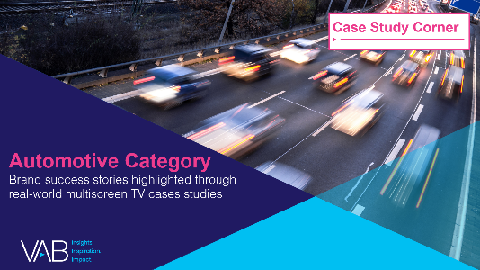
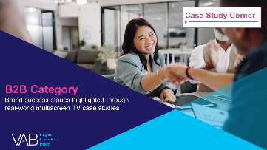
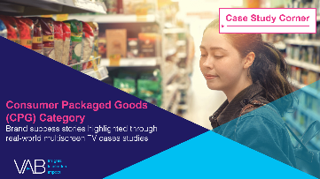
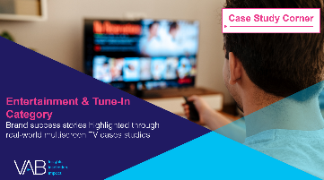

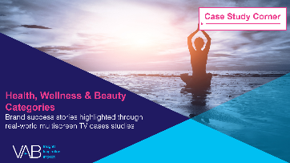
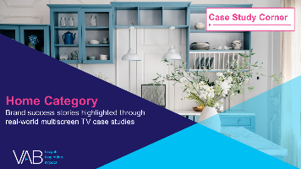

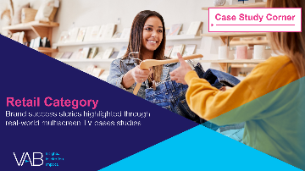

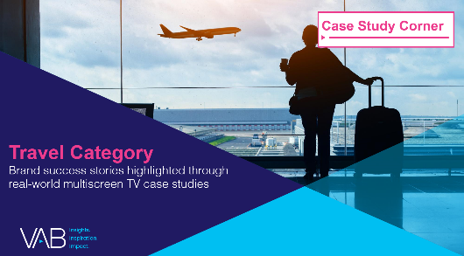
Want more? VAB has a wealth of case studies across additional categories
Automotive
Business-to-Business (B2B)
Consumer Packaged Goods (CPG)
Entertainment & Tune-In
Financial Services & Insurance
Health, Wellness & Beauty
Home
Pharmaceuticals
Retail
Technology
Travel
Access more case studies at www.thevab.com
This information is exclusively provided to VAB members and qualified marketers.
PAGE 18

Slide 19
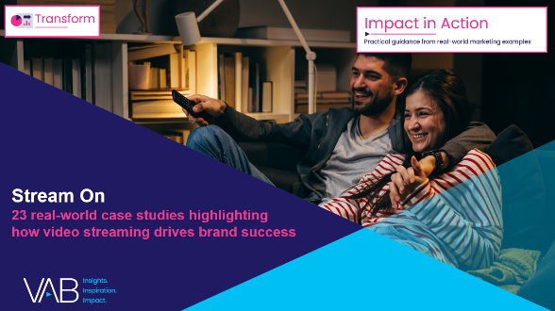
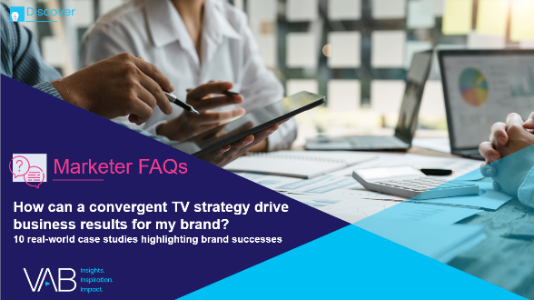
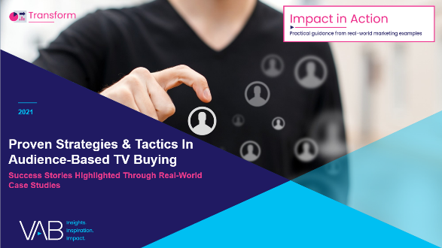
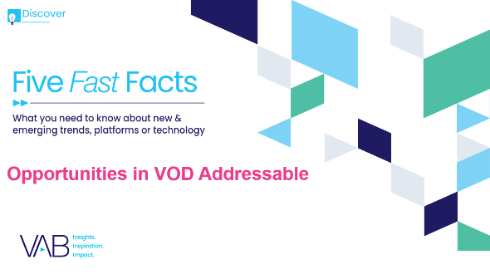



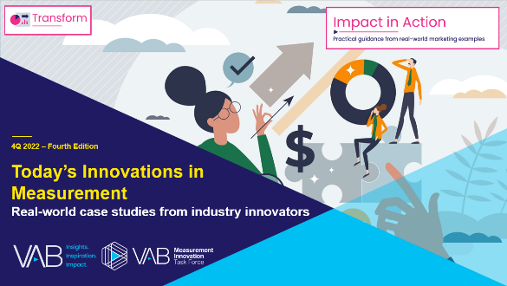
Want more? VAB also has case studies organized across multiscreen TV platforms including linear TV and streaming / CTV
Stream On
How can a convergent TV strategy drive business
results for my brand?
Proven Strategies & Tactics In Audience-Based TV Buying
Opportunities in VOD Addressable
Q1 ‘22 Today’s Innovations in Measurement
Q2 ‘22 Today’s Innovations in Measurement
Q3 ‘22 Today’s Innovations in Measurement
Q4 ‘22 Today’s Innovations in Measurement
Access more case studies at www.thevab.com
This information is exclusively provided to VAB members and qualified marketers.
PAGE 19

Slide 20


About VAB
VAB plays a dual role in the video advertising industry. We are leading the change to bring about a more innovative and transparent marketplace. We also provide the insights and thought leadership that enables marketers to develop business-driving marketing strategies.
Drawing on our marketing expertise, we simplify the complexities in our industry and discover new insights that transform the way marketers look at their media strategy.
We are committed to your business growth and proud to offer VAB members, brand marketers and agencies complimentary access to our continuously-growing Insights library. Get immediate access at theVAB.com.
This information is exclusively provided to VAB members and qualified marketers.
PAGE 20

