Slide 1





Marketing Success Strategies
#1: Prioritize Quality
The importance of value when selecting video ad platforms

Slide 2


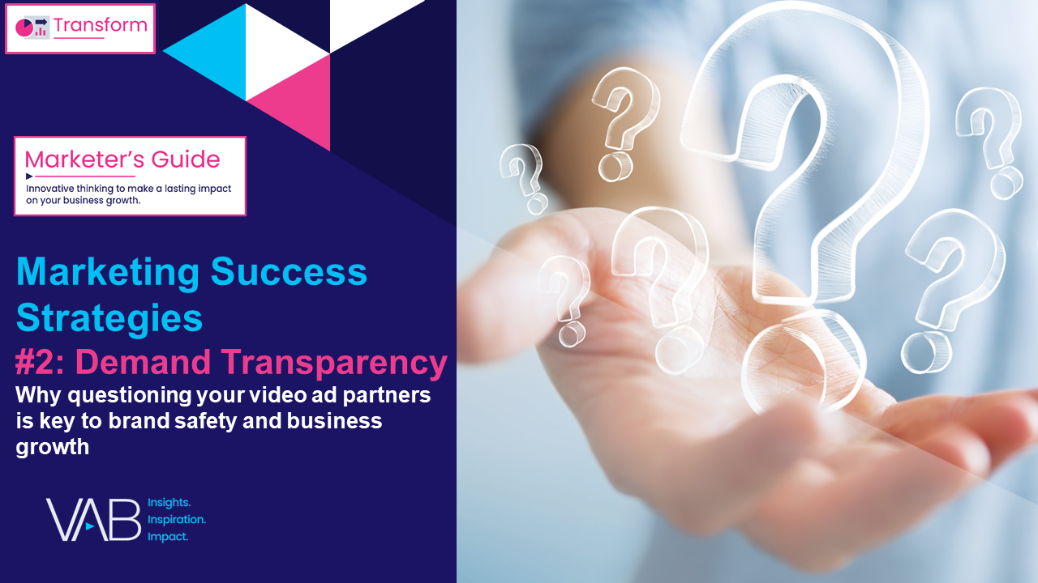


Four Marketing Success Strategies That Will Grow Your Brand
VAB's vast knowledge of the ever-evolving video ecosystem empowers marketers with analyses, insights and the confidence to create more effective and impactful marketing strategies.
This 4-part series provides marketers with a set of strategies
to create successful video campaigns in 2024 and beyond.
Four Marketing Success Strategies in 2024
#1: Prioritize Quality
#2: Demand Transparency
#3: Embrace Innovation
#4: Adopt Alternatives
Click report cover above to download the appropriate report
This information is exclusively provided to VAB members and qualified marketers.
PAGE 2

Slide 3


Marketing Success Strategy #1: Prioritize Quality
Why is this important?
Marketers who prioritize investing in high-quality video content within their campaign will drive higher engagement, increased business outcomes and greater long-term brand value.
Why does this matter in 2024?
Recent cases of digital ad fraud within video campaigns have once again put issues of transparency, content quality and brand safety into sharp focus across the industry.
While low-cost inventory may lead to pricing efficiencies, marketers must weigh the risks, impact and effectiveness of those placements within their campaign to determine true value.
This information is exclusively provided to VAB members and qualified marketers
PAGE 3

Slide 4




Most marketers have similar quality criteria for what constitutes premium media partners within their video campaigns
How important are the following factors when buying premium video inventory?
% of buyers who responded important / very important
91%
89%
85%
81%
Brand Safety
High Production Quality
Publisher
of Content
Demand
for Content
Source: Comcast Advertising, What is Premium Video: Redefining what it Means to be Premium in Advertising, November 2023.
This information is exclusively provided to VAB members and qualified marketers.
PAGE 4

Slide 5






The premium video ecosystem consists of several different content and distribution platforms accessible from both in and outside the home
vMVPD
(Virtual MVPD)
Streaming
(SVOD, AVOD & FAST)
Premium video refers to
high-quality, professionally produced, audiovisual content, primarily encompassing TV shows and movies which are often distributed through multiscreen TV platforms, streaming services and movie theaters.
Premium Video Ecosystem
TV Network Extensions
(TV Network Apps &
Set-top-box VOD)
Cinema
Linear TV
(Cable & Broadcast)
This information is exclusively provided to VAB members and qualified marketers.
PAGE 5

Slide 6














These premium video platforms provide a constant pipeline of high-quality, long-form content to engaged viewers throughout the year
Sampling of Premium Video Programming
Linear TV
Streaming
Cinema
This information is exclusively provided to VAB members and qualified marketers.
PAGE 6

Slide 7
Engaging content creates audience love and excitement for quality, premium video content across platforms
Viewers’ Passion for Premium Video
Linear TV
Streaming
Cinema
76%
75%
95%
of adults say that
‘they just love watching TV’
of adults say that
‘they love streaming
TV shows’
of adults say that
‘going to movies is an event
I make plans for in advance’*
Source: MRI-Simmons Cord Evolution, August 2023. Base = Adults 18+, any agree. *NCM, Behind the Screens Survey, August 2022.
This information is exclusively provided to VAB members and qualified marketers.
PAGE 7

Slide 8



Consumers view high-quality entertainment content as part of their identity, a passion which they share with others
53%
54%
38%
‘My passion for my
favorite entertainment
franchises is part of my identity’
‘I make an effort to pass
on my passion for my favorite
entertainment franchises to my friends and family members
(my spouse, my children, etc.)’
‘I interact with, and extend, my favorite entertainment franchises by creating my own fan-made
content (reviews, analyses,
designs, artwork, etc.)’
Source: Dentsu Consumer Navigator: Entertainment 2023, September 2023.
This information is exclusively provided to VAB members and qualified marketers.
PAGE 8

Slide 9



By aligning with premium entertainment video content, brands can drive more attention, greater consideration and increased purchase intent
If a brand sponsors or collaborates with your favorite entertainment properties…
52%
51%
49%
‘I will pay more attention’
‘My opinion will improve’
‘I will consider purchasing’
Source: Dentsu Consumer Navigator: Entertainment 2023, September 2023.
This information is exclusively provided to VAB members and qualified marketers.
PAGE 9

Slide 10
Engagement with high-quality, long-form premium video content generates higher ‘eyes on’ viewing than other digital and social channels
Avg. Seconds Viewed of :15 Ad by Platform
(Comparing second x second viewing via eye-tracking methodology*)
Cinema, TV & Streaming
Digital & Social
Cinema
Linear TV
CTV
In-Stream*
In-Article
Social**
11.3
Secs
7.4
Secs
7.3
Secs
3.0
Secs
2.4
Secs
1.6
Secs
Source: *NCM & Lumen, ‘Cinema in the Media Mix,’ March 2023; Cinema attention is based on an in-theater second-by-second eye tracking study with Lumen Research conducted in November 2022; Linear TV & CTV reflects platform norms from TVision data. In-Stream & Social reflects digital norms from Attention Economy figures based on US Lumen mobile passive panel data. *In-Stream reflects the average of two platforms (2.6 secs & 3.3 Secs). **Social reflects the average of two platforms (2.0 Secs & 1.1 Secs).
This information is exclusively provided to VAB members and qualified marketers.
PAGE 10

Slide 11
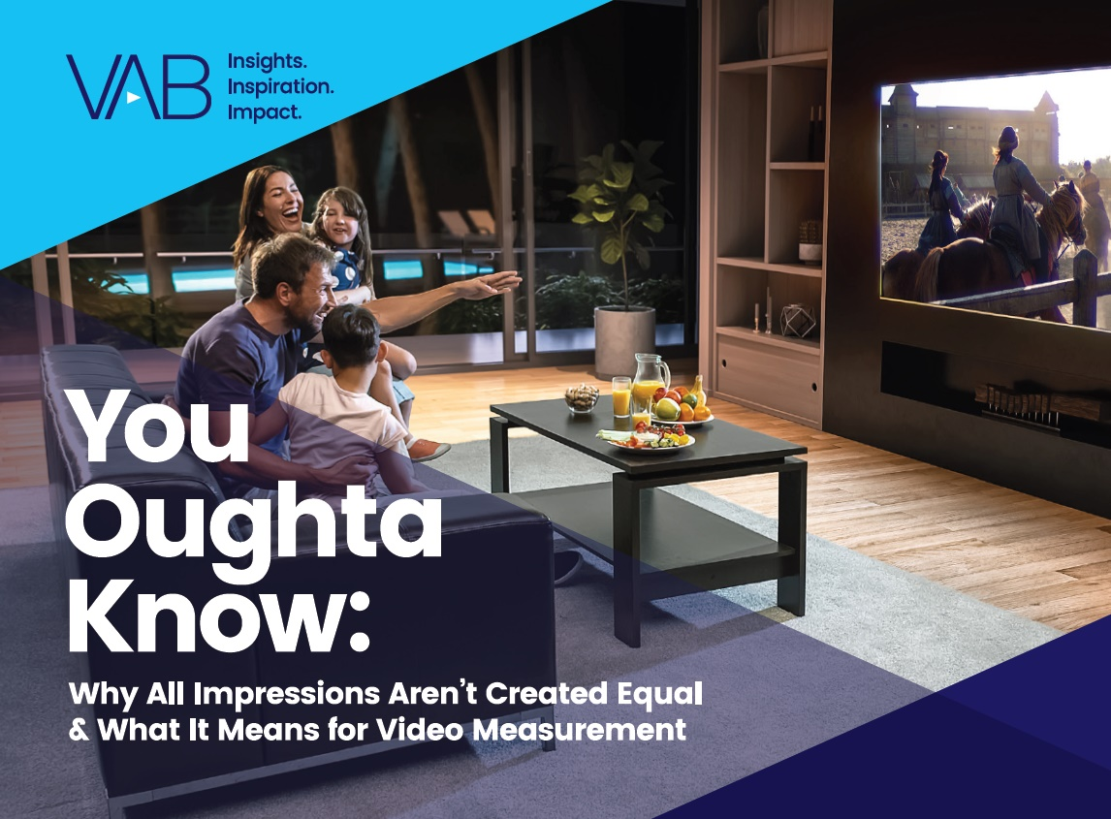
Research has shown that ad placements in premium video creates higher quality ad impressions and drives results across the consumer journey
Reasons why all impressions aren’t equal
To learn more about why all impressions aren’t created equal, click below to download
‘You Oughta Know’
Dwell Time
Attention Levels
Viewability
Screen Size
Screen Coverage
Ad Size
Premium Content
Context
Sound
Creative
Notes: Dwell Time means the amount of time an ad is watched. Cinema was not measured within the analyses included within ‘You Oughta Know.’
This information is exclusively provided to VAB members and qualified marketers.
PAGE 11

Slide 12
Awareness
Consideration
Sales
High-quality, premium video drives greater attention levels, with a :30 TV ad driving more attention than any other platform
aPM: combines the %
of people that look at ad and the average time spent looking at an ad.
NO SKIP
BUMPER
STORIES
INFEED
INFEED
TV
YOUTUBE
SOCIAL MEDIA
DIGITAL DISPLAY
Source: Ebiquity, with Lumen, TVision – The Challenge of Attention, June 2021. aPM (attentive seconds per thousand impressions): combines the viewing percentage (how many people look at the ad) with the mean average eyes-on dwell time’ (the time they spend looking at the ad) and multiplying it by a thousand. For example, if you were to buy 1,000 30-second TV ad impressions, Ebiquity would predict that 430 of them would be viewed, but they would be viewed for about 14 seconds each on average, generating around 6,000 attentive seconds. Conversely, 860 of 1,000 YouTube non-skippable impressions might get looked at, but only for about 5 seconds on average, generating around 4,500 attentive seconds. Note: Cinema was not measured within this analysis. Click here to download VAB’s marketer’s guide ‘You Oughta Know’ to learn more.
This information is exclusively provided to VAB members and qualified marketers.
PAGE 12

Slide 13
Awareness
Consideration
Sales
High-quality, premium video drives more short-term sales and long-term ad recall than non-premium content
Brand memorability across media platforms
Group | Initial STAS | # days until no more impact
TV on TV Screen | 144 | 109
TV Mobile | 161 | 66
Facebook Mobile | 121 | 6
YouTube Mobile | 137 | 8
The halo effect of premium multiscreen content drives the ability of ads in TV programming on a mobile device to stay in a consumer’s memory for 66 days, on average.
How to interpret ‘Initial STAS’ (Short-Term Advertising Strength) column:
An exposure to an ad on Television drove 44% more sales than not seeing the ad at all
Source: Karen Nelson-Field – Amplified Intelligence – “Not All Reach is Equal: An Investigation into Cross Platform Advertising Effectiveness,” ThinkTV Australia, 2019. Short-Term Advertising Strength (STAS) is calculated by determining the proportion of category buyers who bought a specific brand having not been exposed to that brand’s advertising and comparing this to the proportion of category buyers who were exposed to advertising and went on to buy the brand. STAS is built to capture short term effects, capturing impact up to a month after exposure. A STAS score of 100 indicates no advertising impact in that those who were exposed to the advertising were just as likely to purchase as those who were not. A score above 100 indicates that the advertising had an impact on sales. Indices based on % who were exposed to an ad that purchased a product divided by % who were not exposed to an ad that purchased a product. Note: Cinema was not measured within this analysis.
Click here to download VAB’s marketer’s guide ‘You Oughta Know’ to learn more.
This information is exclusively provided to VAB members and qualified marketers.
PAGE 13

Slide 14



Awareness
Consideration
Sales
High-quality video content, across all devices, outperforms even the best ROI seen with other online video platforms
TV generates the greatest sales impact through its premium environment, screen coverage, viewability and ad engagement
Sales impact across media platforms
‘Initial STAS’ (Short-Term Advertising Strength)
TV ads viewed on smaller screens deliver even more sales — 61% more sales on mobile and 53% on desktop, when compared to a non-exposure scenario. This is likely due to how easy it is for mobile and computer users to move to make a purchase on those devices.
The rise of ecommerce / shoppable ads via QR codes and other connected TV technologies should further strengthen the sales impact of TV in the coming years.
 | TV | Desktop | Mobile
Television | 144 | 153 | 161
Facebook | --- | 118 | 121
YouTube | --- | 116 | 137
How to read above chart: An exposure to an ad on Television drove 44% more sales than not seeing the ad at all
Source: Karen Nelson-Field – Amplified Intelligence – “Not All Reach is Equal: An Investigation into Cross Platform Advertising Effectiveness,” ThinkTV Australia, 2019. Short-Term Advertising Strength (STAS) is calculated by determining the proportion of category buyers who bought a specific brand having not been exposed to that brand’s advertising and comparing this to the proportion of category buyers who were exposed to advertising and went on to buy the brand. STAS is built to capture short term effects, capturing impact up to a month after exposure. A STAS score of 100 indicates no advertising impact in that those who were exposed to the advertising were just as likely to purchase as those who were not. A score above 100 indicates that the advertising had an impact on sales. Indices based on % who were exposed to an ad that purchased a product divided by % who were not exposed to an ad that purchased a product. Note: Cinema was not measured within this analysis.
Click here to download VAB’s marketer’s guide ‘You Oughta Know’ to learn more.
This information is exclusively provided to VAB members and qualified marketers.
PAGE 14

Slide 15
Beyond fostering outcomes, the high-quality viewing experience creates
a distinct trust advantage for TV ads among consumers
Types of Advertising U.S. Adults Find Trustworthy
% of respondents
U.S. adults are more likely to find ads on TV trustworthy vs. ads on digital platforms
2.5x
More Likely
to trust ads on TV
vs. ads on social media
1.5x
More Likely
to trust ads on TV
vs. ads on websites
Source: YouGov, Global Study: Which Types of Ads Do People Trust?, commissioned by Campaign, 2/5/2021. Note: Ages 18+ who selected very/somewhat trustworthy. Click here to download VAB’s report ‘The Credibility Crisis’ to learn more.
This information is exclusively provided to VAB members and qualified marketers
PAGE 15

Slide 16
Adults over 50 account for 36% of the total population and nearly half of all adults
Prioritize. Partner with trusted premium video platforms that feature high production quality, brand-safe, in-demand content.
Evaluate. To optimize effectiveness, look beyond CPMs to metrics that measure campaign impact and business outcomes.
Quantify. Since not all ad impressions are equal, employ measurement to understand what platforms and placements are creating greater value than others.
As marketers develop their video campaigns, remember these tips
This information is exclusively provided to VAB members and qualified marketers.
PAGE 16

Slide 17



When prioritizing quality, marketers need to uphold audience trust,
keep partners accountable and demand full transparency
Uphold Audience Trust and Standards:
■The ad experience should be premium like the content around it – with quality audio and video and relevant creative.
■ Partners should use programmatic tools that are built for premium transactions vs. legacy display, ensuring transactions are rooted in trust, and delivery isn’t compromised.
■ Ad quantity should be in line with content length, with minimal disruption, low latency, proportional ad breaks, and carefully crafted ad loads.
Quality of Environment
Hold Partners Accountable:
■ Partners should meet brand requirements, uphold category exclusivity, and maintain competitive separation.
■ Partners should ensure no placements with objectionable content – or objectionable audiences.
■ Legitimate verification processes should be in place to understand what is being bought and sold.
Brand Safety
Know What You Are Buying:
■ Creative should run where it is planned to, in the right context.
■ Buyers & sellers should agree on the kind of impressions purchased – ads should run adjacent to or within the right content and be viewed by real people. They should not run on MFA sites or be delivered to bots.
■ Ads should be viewable, not out-streamed, muted, auto-played, or hidden. Non-viewable impressions should be removed from reporting.
Transparency & Legitimacy
To learn more, click here to download the FreeWheel Council for Premium Video’s & VAB’s ‘Buying Premium Video: A Definitive Checklist’
This information is exclusively provided to VAB members and qualified marketers.
PAGE 17

Slide 18

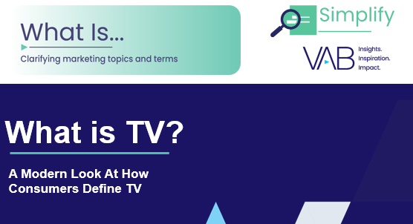

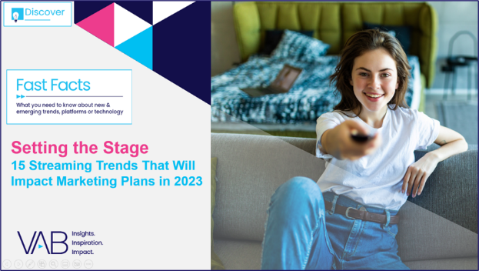
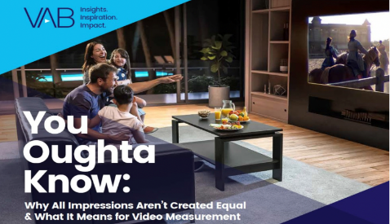

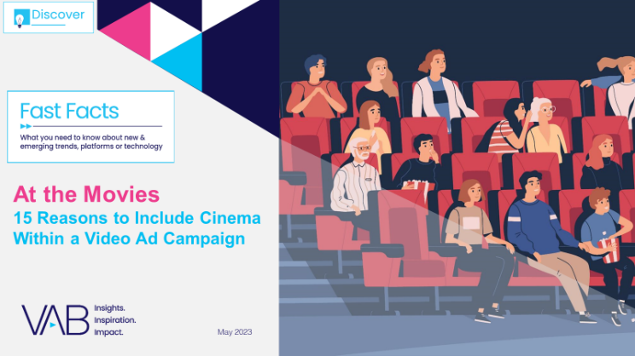

Creators
Jason Wiese
Benjamin Vandegrift
SVP, Director of Strategic Insights
jasonw@thevab.com
VP, Measurement Solutions
benjaminv@thevab.com
Kailyn Hartmann
Leah Montner-Dixon
VP, Advanced Analytics & Intelligence
kailynh@thevab.com
Director, Audience & Behavioral Insights
leahm@thevab.com
What is TV?
A Modern Look At How Consumers
Define TV
25 Ways TV Grows Brands
Powering Performance Through
Full-Funnel Business Outcomes
Reed Kiely
Karolina Guillen
Director, Data Insights & Trends
reedk@thevab.com
Insights Manager
karolinag@thevab.com
Discover more
Looking for more data, insights and takeaways? Check out this related VAB content
Setting the Stage
15 Streaming Trends That Will
Impact Marketing Plans in 2023
You Oughta Know
Why all impressions aren’t created equal
& what it means for video measurement
With increasing pressure to show results, marketers are looking for proof that their advertising investment will have a direct impact on their KPIs.
We’re here to help.
Visit our Multiscreen TV Attribution Resource Center
for a curated a list of resources filled with the data, analysis
and insights needed to make informed investment decisions.
The Passion of the Cinema
Tapping into people’s excitement
for quality, premium video content
At the Movies
15 Reasons to Include Cinema
Within a Video Ad Campaign
VAB Members, brand marketers and agencies get free and immediate access to VAB’s content library. Get access at theVAB.com
This information is exclusively provided to VAB members and qualified marketers.
PAGE 18

Slide 19


About VAB
VAB plays a dual role in the video advertising industry. We are leading the change to bring about a more innovative and transparent marketplace. We also provide the insights and thought leadership that enables marketers to develop business-driving marketing strategies.
Drawing on our marketing expertise, we simplify the complexities in our industry and discover new insights that transform the way marketers look at their media strategy.
We are committed to your business growth and proud to offer VAB members, brand marketers and agencies complimentary access to our continuously-growing Insights library. Get immediate access at theVAB.com.
This information is exclusively provided to VAB members and qualified marketers.
PAGE 19

