Slide 1





Marketing Success Strategies
#3: Embrace Innovation
How modern ad solutions elevate your video campaign’s performance

Slide 2





Four Marketing Success Strategies That Will Grow Your Brand
VAB's vast knowledge of the ever-evolving video ecosystem empowers marketers with analyses, insights and the confidence to create more effective and impactful marketing strategies.
This 4-part series provides marketers with a set of strategies
to create successful video campaigns in 2024 and beyond.
Four Marketing Success Strategies in 2024
#3: Embrace Innovation
#1: Prioritize Quality
#2: Demand Transparency
#4: Adopt Alternatives
Click report cover above to download the appropriate report
PAGE 2
This information is exclusively provided to VAB members and qualified marketers.

Slide 3


Marketing Success Strategy #3: Embrace Innovation
Why is this important?
Being agile in how to precisely target and engage audiences - using solutions like audience-based buying, interactive & shoppable TV ads and generative AI - allows marketers to quickly adapt to emerging technologies and gain a competitive advantage through fresh and innovative solutions.
Why does it matter in 2024?
A variety of innovative multiscreen TV ad formats, technologies and applications designed to boost engagement and inspire consumer action are available for brands to explore, test and integrate into
their video campaign strategies.
A proactive approach ensures that marketers are not only keeping pace with the current marketplace but also anticipating future shifts, securing their position as industry leaders.
This information is exclusively provided to VAB members and qualified marketers.
PAGE 3

Slide 4

Marketers are looking for innovation in the form of customizable targeting, creative partnerships and innovative ad formats to drive their KPIs
The Top Five Factors of Innovation & Creativity in Advertising-Supported Media
Source: The Myers Report / MediaVillage Education Foundation / American Association of Advertising Agencies (4A’s), based on survey of 3,400 agency professionals in July / August 2023.
This information is exclusively provided to VAB members and qualified marketers.
PAGE 4

Slide 5

With a focus on ‘reaching the right audience,’ engagement and targeting capabilities are the most important factors for marketers’ video campaigns
How important are the following factors when buying premium video inventory?
% who responded important / very important*
Reaching the right audience is the #1 priority for marketers’ video campaigns
(61% of marketers rank it as #1)
Source: VAB / Spectrum Reach / Advertiser Perceptions ‘Audience-Based Buying Survey,’ February 2023, fielded 1/ 11 – 1/27/23 (n=210). Survey base: Advertising decision-makers who are involved in buying or planning digital video, cable / broadcast TV, or advanced TV. Q15. Please rank the 3 most important priorities for your [companies/main client’s] video campaigns (Rank 1-3; 1 = most important). Base = Total Respondents. Download VAB’s marketer’s guide ‘Unlocking Brand Growth with Audience-Based Buying’ to learn more. *Comcast Advertising, What is Premium Video: Redefining what it Means to be Premium in Advertising, November 2023. Reflects respondents who said audience engagement / targeting capabilities are ‘important’ or ‘very important’.
This information is exclusively provided to VAB members and qualified marketers.
PAGE 5

Slide 6



Marketers are harnessing a variety of innovative solutions to enrich their engagement among best customer prospects
Examples of Innovative Strategies
Audience-Based Buying
Interactive & Shoppable
TV Ads
Generative AI
This information is exclusively provided to VAB members and qualified marketers.
PAGE 6

Slide 7


Marketers are implementing audience-based buying to improve the effectiveness of their multiscreen TV campaigns

Slide 8

Four out of ten marketers are now using audience-based buying as a key part of their multiscreen TV strategy
Audience-Based TV Buying refers to the practice of segmenting viewers beyond traditional demographics to target a group of consumers based on behavioral, attitudinal, lifestyle and/or transactional data
39%
of marketers say audience-based buying is a key part of their TV strategy
(2023, wave 2)
33%
2021 (Wave 1)
Source: VAB / Spectrum Reach / Advertiser Perceptions ‘Audience-Based Buying Survey,’ February 2023. Wave 2 fielded January 11 – 27, 2023 (n=210); Wave 1 fielded March 23 – 31, 2021 (n=211). Survey base: Advertising decision-makers who are involved in buying or planning digital video, cable / broadcast TV, or advanced TV. Q70. Which of the following best describes your (company’s/main client’s) current approach to audience-based buying for TV advertising? (key part of my TV strategy – 39%; small part of my TV strategy – 29%; testing it to determine role in TV strategy – 23%; not currently using it as party of my TV strategy – 10%). Base = Total Respondents. Download VAB’s marketer’s guide ‘Unlocking Brand Growth with Audience-Based Buying’ to learn more.
This information is exclusively provided to VAB members and qualified marketers.
PAGE 8

Slide 9
More marketers are implementing audience-based buying within their TV strategy because it drives brand results through the purchase journey
% of total marketers who believe audience-based TV buying can impact each of the following KPIs
Awareness
Consideration
Intent
Sales
Full-Funnel
Source: VAB / Spectrum Reach / Advertiser Perceptions ‘Audience-Based Buying Survey,’ February 2023. Wave 2 fielded January 11 – 27, 2023 (n=210); Survey base: Advertising decision-makers who are involved in buying or planning digital video, cable / broadcast TV, or advanced TV. Q150. To what extent do you believe audience-based buying of TV advertising can impact each of the following KPIs? (extremely impactful / very impactful). Base = Total Respondents. Base = Total Respondents. Download VAB’s marketer’s guide ‘Unlocking Brand Growth with Audience-Based Buying’ to learn more.
This information is exclusively provided to VAB members and qualified marketers.
PAGE 9

Slide 10




Many brands are integrating ABB within their other modern TV buying strategies to optimize campaign effectiveness and efficiencies
How does audience-based buying fit within your overall targeting & personalization strategies for TV?
% of respondents using ABB
51%
52%
48%
“Audience-based TV buying is a part of our shift from traditional, GRP-driven TV buying to an impressions-based
TV buying approach”
“Audience-based TV buying is included in our current programmatic initiatives”
“Audience-based TV buying is included in our addressable initiatives”
Source: VAB / Spectrum Reach / Advertiser Perceptions ‘Audience-Based Buying Survey,’ February 2023, fielded January 11 – 27, 2023 (n=210). Survey base: Advertising decision-makers who are involved in buying or planning digital video, cable / broadcast TV, or advanced TV. Q135. How does audience-based TV buying fit in with your [company’s /main client’s] overall targeting & personalization strategies for TV? Base = ‘Audience-Based Buying is a key part/small part/testing for TV’ (n=190). Download VAB’s marketer’s guide ‘Unlocking Brand Growth with Audience-Based Buying’ to learn more.
This information is exclusively provided to VAB members and qualified marketers.
PAGE 10

Slide 11




ABB enables brands to seamlessly engage with multiple target audiences across premium, brand-safe platforms beyond linear TV
Tactics currently being used within audience-based TV buying strategies
% of total marketers using ABB
49%
44%
41%
31%
are running their campaign across different platforms / screens beyond linear TV
are targeting multiple audiences in order to focus
on best customer prospects
are targeting different audiences across different screens
are using an audience-based TV buying self-serve platform developed by a media partner
Source: VAB / Spectrum Reach / Advertiser Perceptions ‘Audience-Based Buying Survey,’ February 2023, fielded January 11 – 27, 2023 (n=210). Survey base: Advertising decision-makers who are involved in buying or planning digital video, cable / broadcast TV, or advanced TV. Q140. What tactics is your [company/main client] currently using within [their/your] audience-based TV buying strategies? Base = ‘Audience-Based Buying is a key part/small part/testing for TV’ (n=190). *Q154. Thinking about the impact of brand safety on [your/your main client’s] implementation of audience-based TV campaigns, how much do you agree or disagree with the following statements? (strongly/somewhat agree). Base = Total Respondents. Download VAB’s marketer’s guide ‘Unlocking Brand Growth with Audience-Based Buying’ to learn more. ABB = audience-based buying.
This information is exclusively provided to VAB members and qualified marketers.
PAGE 11

Slide 12



Audience-based buying also allows marketers to easily tailor and adjust creative messaging by target segments for optimal campaign impact
% of total marketers who agree with the following statements regarding campaign creative
91%
80%
74%
say that creative messaging can have a significant impact on the success of an audience-based TV campaign
are aligning their creative messaging with contextually relevant TV programming that targets audience segment(s)
frequently adjusts their creative to be tailored for specific audience-based campaigns
Source: VAB / Spectrum Reach / Advertiser Perceptions ‘Audience-Based Buying Survey,’ February 2023, fielded January 11 – 27, 2023 (n=210). Survey base: Advertising decision-makers who are involved in buying or planning digital video, cable / broadcast TV, or advanced TV. Q152. Thinking about your [company’s/main client’s] creative, how much do you agree or disagree with the following statements? (strongly/somewhat agree). Base = Total Respondents. Download VAB’s marketer’s guide ‘Unlocking Brand Growth with Audience-Based Buying’ to learn more.
This information is exclusively provided to VAB members and qualified marketers.
PAGE 12

Slide 13
Interactive and shoppable TV ads are transforming viewer engagement and action

Slide 14



Innovative ad formats are enabling deeper audience engagement across screens via remote controls and connected devices
The proliferation of streaming has made innovative ads more commonplace and therefore more valuable to marketers as they look for greater opportunities to engage with and measure audiences
Examples of Ad Formats with Exciting & Innovative Ways to Quantify Engagement
Dynamic Placement
Interactive
Shoppable
Enables audiences to take immediate action with a brand by actively participating with an ad
Enables audiences to make a purchase directly through an advertisement or piece of content
Enables audiences to connect with a brand in a contextual environment through the placement of ads directly within content in a targetable and unobtrusive way
Example
Audiences can “choose their own adventure” with an ad, share their brand sentiment via an in-ad survey, or download an app via a QR code.
Example
Shop the product(s) of a brand used directly in content such as cookware on a cooking show or clothing worn by your favorite sitcom character via a remote control, or by scanning a QR code
Example
Brand logo being placed on a score board during a sports telecast or a beverage being consumed by their favorite sitcom character.
Download VAB’s ‘What’s the Deal with What’s Next in Measurement?’ to learn more.
This information is exclusively provided to VAB members and qualified marketers.
PAGE 14

Slide 15
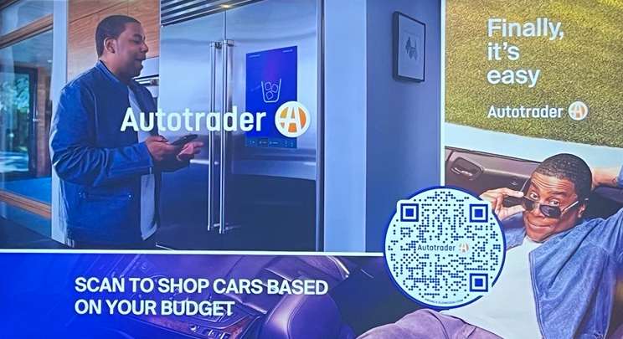

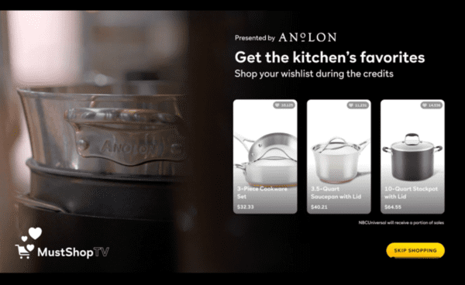
Shoppable TV ads can shorten the path to purchase for consumers by putting a brand’s digital platform directly in front of viewers
Three different categories of shoppable ad experiences
Shoppable commercials
Direct-selling segments
Shoppable television shows
Video ads that air during traditional
ad breaks which include a method, such as a scannable QR code, for viewers to engage with to get more information or to purchase a product
Interactive ads that are integrated into traditional programming to direct viewers towards specific products, such as cookware being promoted during a cooking segment
The ability to purchase is seamlessly woven into programming by integrating products into shows and then letting viewers know how they can purchase them
Source: Retail TouchPoints, Has the Age of Shoppable TV Finally Arrived? NBCU is Banking on it, 7/6/2023. Download VAB’s marketer’s guide ‘Shortening the Path to Purchase’ to learn more.
This information is exclusively provided to VAB members and qualified marketers.
PAGE 15

Slide 16
Younger audiences are more likely to recall seeing shoppable TV ads, providing brands an opportunity to connect with this valuable segment
% of A16+ who recall seeing different types of interactive ad formats when watching TV
% of total respondents
Source: VAB custom research fielded by Hub Entertainment Research as part of the 2023 Monetization of Video report. Data sourced from Hub’s survey of 1,602 TV consumers, ages 16-74 who meet the following criteria: watch at least one hour of TV / week, have broadband access. Data collected June 2023. Q2: Which of the following types of ad formats do you recall seeing when watching TV (including: TV and streaming)? Download VAB’s marketer’s guide ‘Shortening the Path to Purchase’ to learn more.
This information is exclusively provided to VAB members and qualified marketers.
PAGE 16

Slide 17
The time viewers spend with interactive shoppable ads extends the average brand engagement by two to three times the length of the ad itself
Ad Length Plus Additional Time Gained During Interaction
in minutes and seconds
1:04
+113%
time spent with ad
:43
+187%
time spent with ad
Source: Magna Global, Media Economy Report, Vol. 15 - The Medium is the Message: How Data and Technology Are Informing The Creative Process, June 2019. Download VAB’s marketer’s guide ‘Shortening the Path to Purchase’ to learn more.
This information is exclusively provided to VAB members and qualified marketers.
PAGE 17

Slide 18
Due to their increased level of engagement, interactive shoppable ads are more likely to drive greater brand health KPIs across the purchase funnel
Lift in Brand KPIs by Ad Type
Source: Magna Global, Media Economy Report, Vol. 15, The Medium is the Message: How Data and Technology Are Informing the Creative Process, June 2019. Download VAB’s marketer’s guide ‘Shortening the Path to Purchase’ to learn more.
This information is exclusively provided to VAB members and qualified marketers.
PAGE 18

Slide 19


Viewers who interact with a shoppable ad are inherently more likely to then make a purchase
39%
70%
of U.S. adults who have viewed shoppable ads have engaged directly with them
of that group have made a purchase
Source: Aluma Insights, Aluma: 70% of Online Adults Who Have Engaged Shoppable TV Ads Purchased a Featured Product, 1/3/22. Download VAB’s marketer’s guide ‘Shortening the Path to Purchase’ to learn more.
.
This information is exclusively provided to VAB members and qualified marketers.
PAGE 19

Slide 20

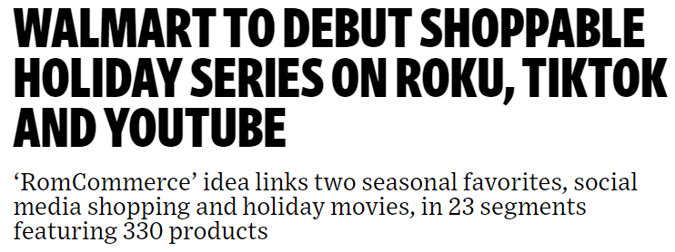

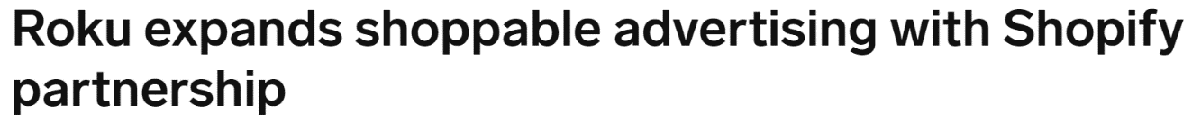









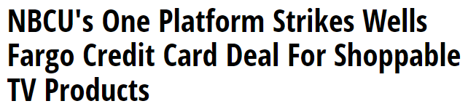




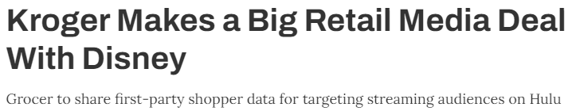








Interactive ad opportunities are growing as more media publishers and brands are partnering to introduce innovative formats across platforms
Examples of video platforms using interactive ad products
7/12/23
11/28/23
6/14/23
2/27/23
Examples of measurement vendors that monitor interactive ad campaigns
6/15/23
4/19/23
3/21/23
Click through the logos above to be brought directly to the corresponding company’s website
Download VAB’s marketer’s guide ‘Shortening the Path to Purchase’ to learn more.
This information is exclusively provided to VAB members and qualified marketers.
PAGE 20

Slide 21
Generative AI is enhancing video campaign optimization

Slide 22
Additionally, the impact of artificial intelligence is transforming marketing by optimizing campaign targeting and enhancing audience engagement
How are marketers, agencies and publishers using AI & ML?
Brand Marketers
Click here to see how brands like Amazon, Starbucks, Alibaba, Nike and BMW are using AI & machine learning to analyze data, personalize experiences, drive recommendations and optimize sales.
Media Agencies
Click here to see how media agencies like Havas and Horizon Media are using AI to optimize their media buys, evolve their creative approaches and boost ecommerce sales.
Media Publishers
Click here to see how Univision’s partnership
with Mirriad's AI-powered
in-content platform allows brands to engage with viewers, particularly multicultural audiences, directly in scenes.
50%
of businesses and organizations have adopted AI in at least one function
Download ‘Untangling Terminology within Generative AI & Machine Learning’ to learn more.
Source: QuantumBlack, AI by McKinsey, The State of AI in 2022, December 2022.
This information is exclusively provided to VAB members and qualified marketers.
PAGE 22

Slide 23
Adults over 50 account for 36% of the total population and nearly half of all adults
Innovate. As marketers aim to captivate audiences and optimize their campaigns to
drive business growth, utilizing creative targeting solutions and ad formats are valuable strategies to build a competitive advantage.
Advocate. By partnering with trusted media partners, marketers can ensure that modern campaigns run where they are planned to and
in front of the right audience.
Inquire. Implementing and testing new strategies can be complex. Demand transparent answers from media partners to ensure you get what you paid for.
As marketers embrace innovative strategies, remember these tips
This information is exclusively provided to VAB members and qualified marketers.
PAGE 23

Slide 24



When embracing innovative strategies, marketers need to uphold audience trust, keep media partners accountable and demand full transparency
Uphold Audience Trust and Standards:
■The ad experience should be premium like the content around it – with quality audio and video and relevant creative.
■ Partners should use programmatic tools that are built for premium transactions vs. legacy display, ensuring transactions are rooted in trust, and delivery isn’t compromised.
■ Ad quantity should be in line with content length, with minimal disruption, low latency, proportional ad breaks, and carefully crafted ad loads.
Quality of Environment
Hold Partners Accountable:
■ Partners should meet brand requirements, uphold category exclusivity, and maintain competitive separation.
■ Partners should ensure no placements with objectionable content – or objectionable audiences.
■ Legitimate verification processes should be in place to understand what is being bought and sold.
Brand Safety
Know What You Are Buying:
■ Creative should run where it is planned to, in the right context.
■ Buyers & sellers should agree on the kind of impressions purchased – ads should run adjacent to or within the right content and be viewed by real people. They should not run on MFA sites or be delivered to bots.
■ Ads should be viewable, not out-streamed, muted, auto-played, or hidden. Non-viewable impressions should be removed from reporting.
Transparency & Legitimacy
To learn more, click here to download the FreeWheel Council for Premium Video’s & VAB’s ‘Buying Premium Video: A Definitive Checklist’
This information is exclusively provided to VAB members and qualified marketers.
PAGE 24

Slide 25



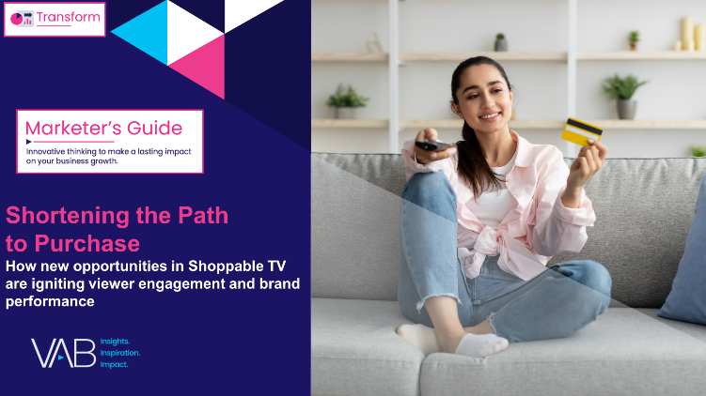




Creators
Jason Wiese
Benjamin Vandegrift
SVP, Director of Strategic Insights
jasonw@thevab.com
VP, Measurement Solutions
benjaminv@thevab.com
Kailyn Hartmann
Leah Montner-Dixon
Unlocking Brand Growth with Audience-Based Buying
A Fresh Look at How Marketers are Adopting Innovative TV Strategies
Reaching the Right Audiences
Why Brands and Agencies are Increasing Their Adoption of Audience-Based TV Buying
VP, Advanced Analytics & Intelligence
kailynh@thevab.com
Director, Audience & Behavioral Insights
leahm@thevab.com
Reed Kiely
Karolina Guillen
Director, Data Insights & Trends
reedk@thevab.com
Insights Manager
karolinag@thevab.com
Discover more
Looking for more data, insights and takeaways? Check out this related VAB content
Shortening the Path to Purchase
How New Opportunities in Shoppable TV are Igniting Viewer Engagement and Brand Performance
Generative AI & Machine Learning
Clarifying Market Topics & Terms
Visit our Audience-Based Buying Insights Center
to get data, insights, key takeaways and real-world examples to help you execute your buys confidently and successfully.
What’s the Deal with Engagement?
What’s the Deal with What’s Next in Measurement?
VAB Members, brand marketers and agencies get free and immediate access to VAB’s content library. Get access at theVAB.com
This information is exclusively provided to VAB members and qualified marketers.
PAGE 25

Slide 26


About VAB
VAB plays a dual role in the video advertising industry. We are leading the change to bring about a more innovative and transparent marketplace. We also provide the insights and thought leadership that enables marketers to develop business-driving marketing strategies.
Drawing on our marketing expertise, we simplify the complexities in our industry and discover new insights that transform the way marketers look at their media strategy.
We are committed to your business growth and proud to offer VAB members, brand marketers and agencies complimentary access to our continuously-growing Insights library. Get immediate access at theVAB.com.
This information is exclusively provided to VAB members and qualified marketers.
PAGE 26

