Slide 1





Marketing Success Strategies
#2: Demand Transparency
Why questioning your video ad partners
is key to brand safety and business growth

Slide 2




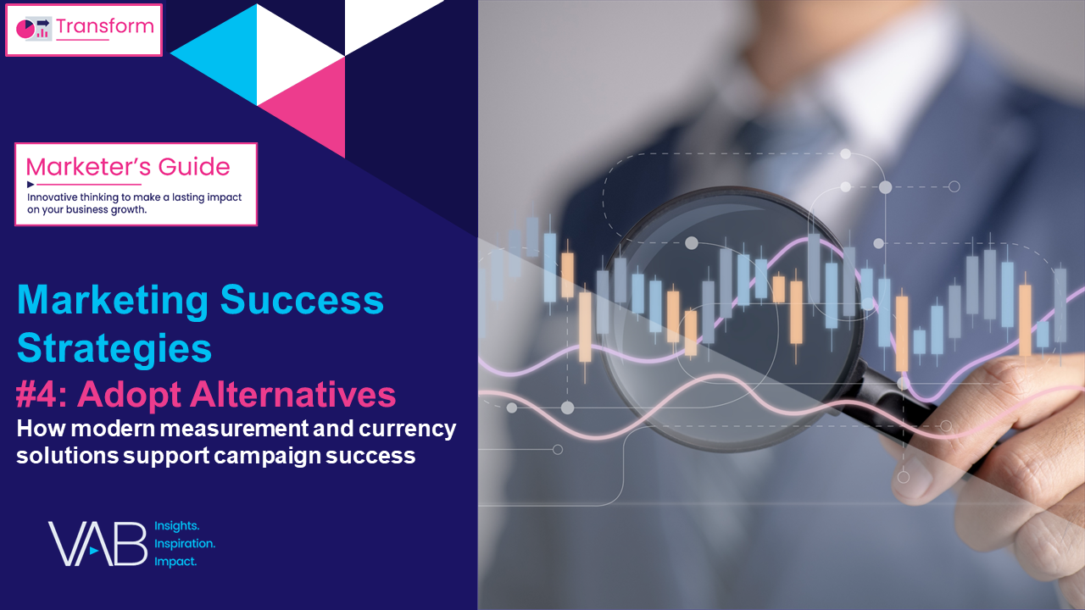
Four Marketing Success Strategies That Will Grow Your Brand
VAB's vast knowledge of the ever-evolving video ecosystem empowers marketers with analyses, insights and the confidence to create more effective and impactful marketing strategies.
This 4-part series provides marketers with a set of strategies
to create successful video campaigns in 2024 and beyond.
Four Marketing Success Strategies in 2024
#2: Demand Transparency
#1: Prioritize Quality
#3: Embrace Innovation
#4: Adopt Alternatives
Click report cover above to download the appropriate report
This information is exclusively provided to VAB members and qualified marketers.
PAGE 2

Slide 3


Marketing Success Strategy #2: Demand Transparency
Why is this important?
Ad fraud negatively affects publishers and consumers, but it is often advertisers who are hit the hardest. Along with wasted ad dollars and unseen impressions delivered to bots, ad fraud can also create reputational, financial and legal risks for advertisers.
Clear, confident engagement with trusted media partners is essential
to align objectives and achieve effective outcomes.
Why does it matter in 2024?
Digital ad fraud and the opaqueness of ad-tech walled gardens have come into sharp focus due to recent startling cases of campaign violations and transparency issues, necessitating a vigilant approach
by marketers as they steward their buys.
As marketers face more scrutiny of budgets amidst economic challenges, asking critical questions of media partners can protect
your brand and drive greater business results.
By fostering open dialogue and demanding accountability, marketers can safeguard their brand reputation and ensure
the integrity and effectiveness of their campaigns.
This information is exclusively provided to VAB members and qualified marketers.
PAGE 3

Slide 4
Ad transparency through trusted, brand-safe, high-quality content seen by real people is most important to marketers’ video campaigns
How important are the following factors when buying (buyers) premium video inventory?
% who responded important / very important
Source: Comcast Advertising, What is Premium Video: Redefining what it Means to be Premium in Advertising, November 2023.
This information is exclusively provided to VAB members and qualified marketers.
PAGE 4

Slide 5




A lack of transparency can have severe business ramifications, so it’s critical for marketers to ask important questions of their media partners
Financial
Risk
Brand Reputational
& Corporate Risk
Legal
Risk
Download VAB’s marketer’s guide ‘Hidden Costs’ to learn more.
This information is exclusively provided to VAB members and qualified marketers.
PAGE 5

Slide 6

Do you have full transparency on your campaign buy? An Adalytics study alleges that YouTube ad spend was allocated to audience network sites
Significant quantities of TrueView skippable in-stream ads appear to have been served on hundreds of thousands of websites and apps, including ‘Made for Advertising’ sites (MFA), in which the consumer experience did not meet Google’s stated quality standards.
Many of these TrueView in-stream ads were served muted and auto-playing as out-stream video or as obscured video players and often there was little to no organic video media content between ads, the video units simply played ads only.
42% - 75%
of YouTube TrueView in-stream ad spend was allocated to Google Video Partner (GVP) sites and apps which did not meet Google’s standards
Source: Adalytics Research LLC, ‘Did Google Mislead Advertisers About TrueView Skippable In-Stream Ads for the Past Three Years?’ report, June 2023. Note: after the Adalytics report was released, YouTube changed the name of their ‘in-stream ads’ format to ‘skippable ads’ throughout Google Display and Video 360, according to a ‘What’s New: July 2023’ Google Blog Post and reported by Adweek on 8/7/23. Download VAB marketer’s guide ‘Hidden Costs’ to learn more.
This information is exclusively provided to VAB members and qualified marketers.
PAGE 6

Slide 7









Are your ads being served in viewable, high-quality content? A lack of transparency can mean that video ads are wasted in poor environments
Examples of ads running in subpar placements
In a small corner or side of a page
In a fully muted video player
With little to no video content between consecutive ads
‘Auto-plays’ without any user interaction or initiation
Ad plays continuously on a loop
Multiple video ads playing simultaneously on the same page
The ‘skip’ button on a video ad is hidden or obscured
Runs out of sight while the audio plays
Ads served “stacked” on top of another ad
Download VAB’s marketer’s guide ‘Hidden Costs’ to learn more.
This information is exclusively provided to VAB members and qualified marketers.
PAGE 7

Slide 8


Are your ad placements in brand safe environments? Appearing alongside misinformation can have drastic negative impact to your brand
73%
65%
of consumers agree that they would feel unfavorably towards brands that have been associated with misinformation*
of consumers say that they are
likely to stop buying from a brand that advertises next to misinformation**
Source: Integral Ad Science, Advertising in the Age of Misinformation, 2022. Based on survey of 1,189 U.S. adults in July 2022. *Reflects respondents who answered ‘agree’ or ‘strongly agree’. **Reflects respondents who answered ‘likely’ or ‘very likely’. Download VAB’s report ‘The Credibility Crisis’ to learn more.
This information is exclusively provided to VAB members and qualified marketers.
PAGE 8

Slide 9

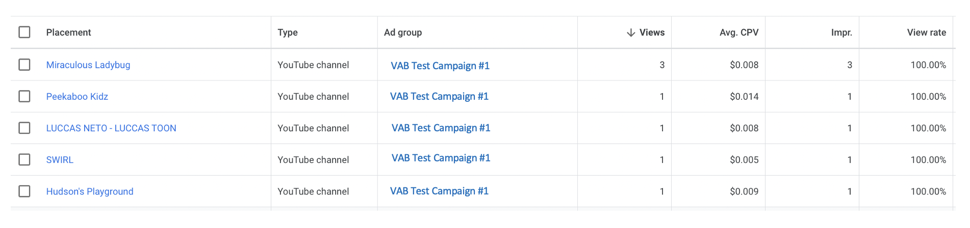
Is your campaign targeting the right audience? A VAB campaign buy not intended for kids saw placements on ‘Made for Kid’s’ YouTube channels
The VAB created a YouTube channel with neutral, brand safe content
and executed a campaign to conduct our experiment
In our analysis of the ‘Campaign Placement Report’ more than 25 placements to
“Made for Kid’s” channels were observed in campaign designed not to reach kids
5 examples of placements on “Made for Kid’s” channels
being served behaviorally targeted ads
One of the channels included is “Peekaboo Kidz”, which describes itself as “Specially designed for kids as they explore the World of Kids Educational Videos”
Link
Link
Link
Link
Link
*763 total campaign placements
Download VAB Investigation: Did YouTube allow for targeted campaigns to be served on 'Made for Kids' channels? to learn more.
This information is exclusively provided to VAB members and qualified marketers.
PAGE 9

Slide 10
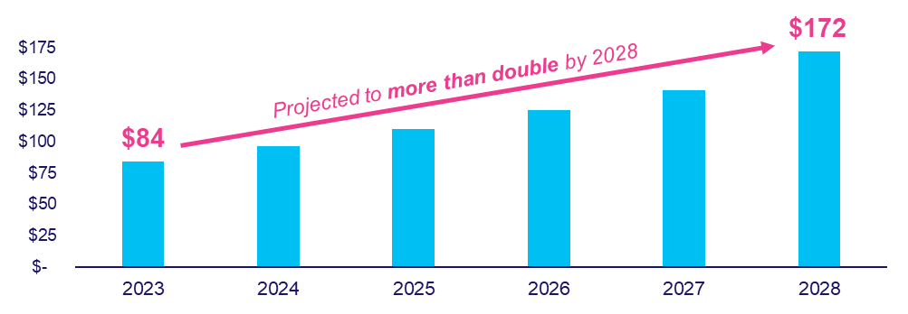
How do your media partners protect your campaigns against fraud?
As spend in digital grows so too does the level of ad fraud
Estimated Global Cost of Digital Ad Fraud
$ in Billions
$35 billion projected in North America alone (2023)
$72 billion projected in North America alone (2028)
Source: Juniper Research, Quantifying the Cost of Ad Fraud: 2023-2028, 9/26/2023. Download VAB’s ‘What is Digital Ad Fraud?’ to learn more.
This information is exclusively provided to VAB members and qualified marketers.
PAGE 10

Slide 11
Do you understand where all your digital ad dollars are going? Fraud often goes undetected due to complexities of the digital video supply chain
Digital Supply Chain Advertising Investment Allocation
Agency fee
Technology Fee (Demand Side)
Technology Fee (Supply Side)
Unknown
SSP
DSP
fee
Only half of spend goes to publisher
“missing” spend
Source: ISBA, May 2020 via Augustine Fou in Forbes, In Digital, ‘Wanamaker’s 50%’ Is Known. It’s Also Worse Than That, 12/19/20. Download VAB’s ‘What is the Digital Video Supply Chain?’ to learn more.
This information is exclusively provided to VAB members and qualified marketers.
PAGE 11

Slide 12

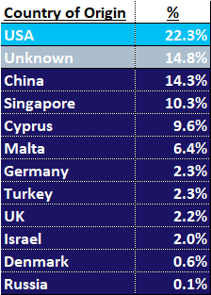
Do you know what your ad dollars are truly funding? Many long-tail websites originate outside the U.S., increasing risks from foreign criminals
% of spend by developer ‘country of origin’
for sub-set of TrueView ad budget that was allocated to Google Video Partner (GVP) network Android mobile apps
Source: Adalytics Research LLC, ‘Did Google Mislead Advertisers About TrueView Skippable In-Stream Ads for the Past Three Years?’ report, June 2023. Download VAB’s marketer’s guide ‘Hidden Costs’ to learn more.
This information is exclusively provided to VAB members and qualified marketers.
PAGE 12

Slide 13
How is your brands’, and your media partners’, data being handled? Platforms and brands have incurred hefty fines due to data misuse
Instagram
$402MM
in EU for allegedly mishandling children’s data
TikTok
$367MM
fine by Irish Data Protection Commission for allegedly mishandling children's data
Google
$155MM
in settlements over
location tracking
Twitter
$150MM
fine for allegedly breaking privacy promises
Amazon
$25MM
to settle charges that Amazon had violated COPPA
Microsoft
$20MM
for collecting and
retaining personal information from children
British Airways
£20MM
over breached data, some of which was shared with Google and Facebook
TikTok
$16MM
UK fine for misusing
children’s data
BetterHelp
$8MM
to online therapy users for alleged data misuse, including sharing metadata with Facebook and Google
GoodRx
$2MM
for sharing user’s health data with Google and Facebook
Download VAB’s marketer’s guide ‘Hidden Costs’ to learn more.
This information is exclusively provided to VAB members and qualified marketers.
PAGE 13

Slide 14




Do you have full transparency with your measurement and verification providers? Take control of your campaigns through modern solutions
Verified 3rd Party Measurement Enables Marketers to…
Ask for table-stakes cross-platform viewership metrics to be included in your reporting
Leverage advancements in viewership data collection to drive customer targeting, acquisition and engagement.
Prioritize the future.
Take steps now to
set yourself up for measurement success
Know where your
viewership data is coming from
Download VAB’s ‘What’s the Deal with Viewership Data Collection?’ to learn more.
This information is exclusively provided to VAB members and qualified marketers.
PAGE 14

Slide 15
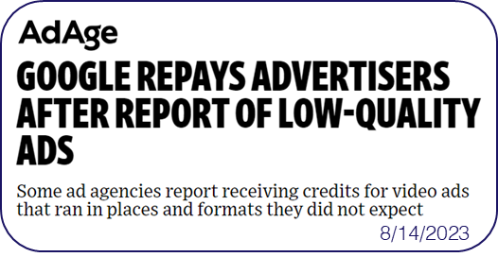
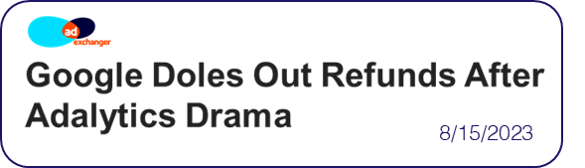

Are you being compensated for placements that do not meet your media partners’ own standards? Google provided repayments for low-quality ads
Download VAB’s marketer’s guide ‘Hidden Costs’ to learn more.
This information is exclusively provided to VAB members and qualified marketers.
PAGE 15

Slide 16
Adults over 50 account for 36% of the total population and nearly half of all adults
Know. Get real, verified answers on the actual placements of your ads to gain a true understanding of their reach and impact.
Insist. Get a comprehensive understanding of your media partners’ practices to ensure the integrity and effectiveness of your campaigns.
Protect. Implement robust measures to safeguard your brand’s reputation and advertising investments from the risks of a
lack of transparency, digital ad fraud and potential data misuses.
As marketers look to gain more insight into their campaigns, remember these tips
This information is exclusively provided to VAB members and qualified marketers.
PAGE 16

Slide 17



When executing their campaigns, marketers need to uphold audience trust, keep media partners accountable and demand full transparency
Uphold Audience Trust and Standards:
■The ad experience should be premium like the content around it – with quality audio and video and relevant creative.
■ Partners should use programmatic tools that are built for premium transactions vs. legacy display, ensuring transactions are rooted in trust, and delivery isn’t compromised.
■ Ad quantity should be in line with content length, with minimal disruption, low latency, proportional ad breaks, and carefully crafted ad loads.
Quality of Environment
Hold Partners Accountable:
■ Partners should meet brand requirements, uphold category exclusivity, and maintain competitive separation.
■ Partners should ensure no placements with objectionable content – or objectionable audiences.
■ Legitimate verification processes should be in place to understand what is being bought and sold.
Brand Safety
Know What You Are Buying:
■ Creative should run where it is planned to, in the right context.
■ Buyers & sellers should agree on the kind of impressions purchased – ads should run adjacent to or within the right content and be viewed by real people. They should not run on MFA sites or be delivered to bots.
■ Ads should be viewable, not out-streamed, muted, auto-played, or hidden. Non-viewable impressions should be removed from reporting.
Transparency & Legitimacy
To learn more, click here to download the FreeWheel Council for Premium Video’s & VAB’s ‘Buying Premium Video: A Definitive Checklist’
This information is exclusively provided to VAB members and qualified marketers.
PAGE 17

Slide 18



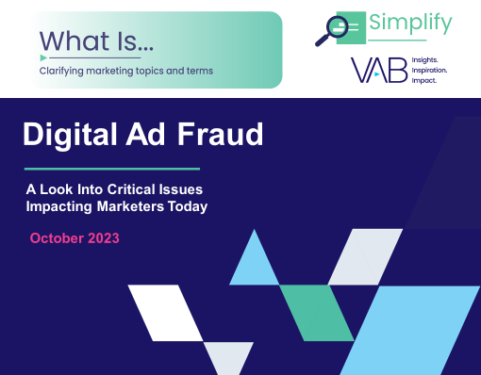




Creators
Jason Wiese
Benjamin Vandegrift
SVP, Director of Strategic Insights
jasonw@thevab.com
VP, Measurement Solutions
benjaminv@thevab.com
Kailyn Hartmann
Leah Montner-Dixon
Hidden Costs
Three Critical Business Ramifications of Digital Ad Fraud
VAB Investigation
Did YouTube allow for targeted campaigns
to be served on ‘Made for Kids’ channels?
VP, Advanced Analytics & Intelligence
kailynh@thevab.com
Director, Audience & Behavioral Insights
leahm@thevab.com
Reed Kiely
Karolina Guillen
Director, Data Insights & Trends
reedk@thevab.com
Insights Manager
karolinag@thevab.com
Discover more
Looking for more data, insights and takeaways? Check out this related VAB content
What is Digital Ad Fraud?
A Look Into Critical Issues
Impacting Marketers Today
What is The Digital Video
Supply Chain
Understanding the path of digital ad investments
We believe in modern TV measurement.
Let us be your guide.
Visit the VAB’s Measurement Resource Center to get clear answers to questions our industry is asking about TV measurement.
The Credibility Crisis
How people find trusted news amidst
a wave of misinformation
What’s the Deal with Viewership Data Collection?
VAB Members, brand marketers and agencies get free and immediate access to VAB’s content library. Get access at theVAB.com
This information is exclusively provided to VAB members and qualified marketers.
PAGE 18

Slide 19


About VAB
VAB plays a dual role in the video advertising industry. We are leading the change to bring about a more innovative and transparent marketplace. We also provide the insights and thought leadership that enables marketers to develop business-driving marketing strategies.
Drawing on our marketing expertise, we simplify the complexities in our industry and discover new insights that transform the way marketers look at their media strategy.
We are committed to your business growth and proud to offer VAB members, brand marketers and agencies complimentary access to our continuously-growing Insights library. Get immediate access at theVAB.com.
This information is exclusively provided to VAB members and qualified marketers.
PAGE 19

