Slide 1





Marketing Success Strategies
#4: Adopt Alternatives
How modern measurement and currency solutions support campaign success

Slide 2

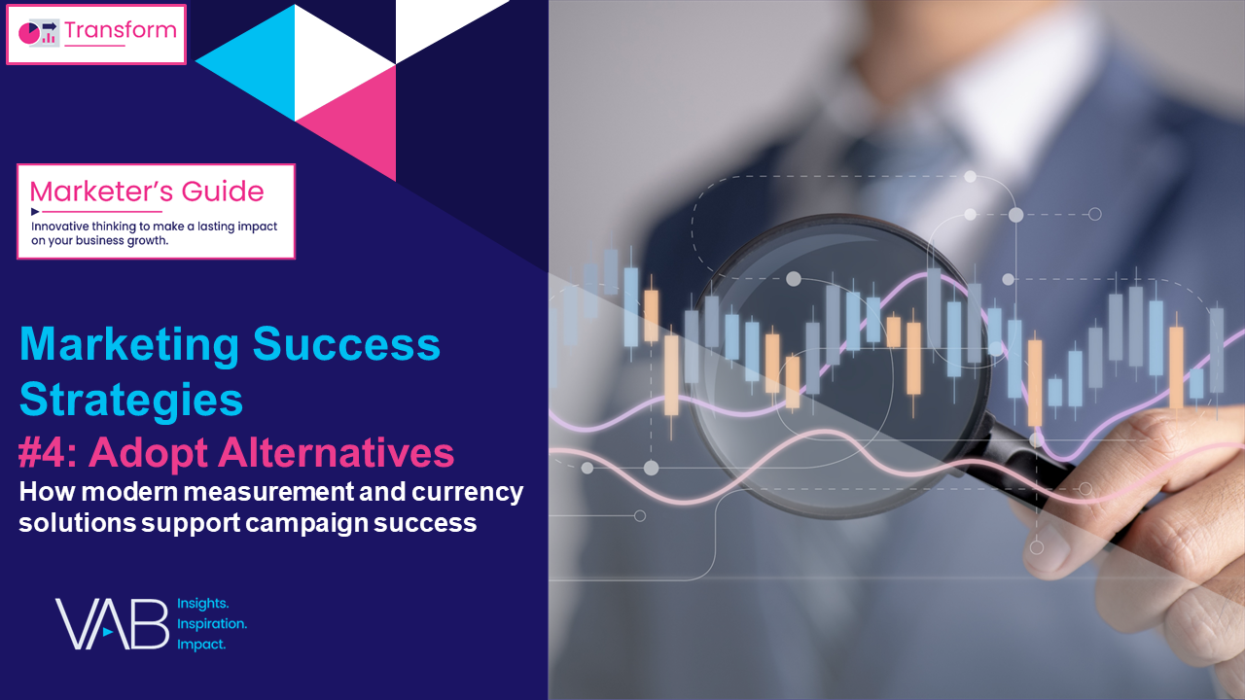



Four Marketing Success Strategies That Will Grow Your Brand
VAB's vast knowledge of the ever-evolving video ecosystem empowers marketers with analyses, insights and the confidence to create more effective and impactful marketing strategies.
This 4-part series provides marketers with a set of strategies
to create successful video campaigns in 2024 and beyond.
Four Marketing Success Strategies in 2024
#4: Adopt Alternatives
#1: Prioritize Quality
#2: Demand Transparency
#3: Embrace Innovation
Click report cover above to download the appropriate report
This information is exclusively provided to VAB members and qualified marketers.
PAGE 2

Slide 3


Marketing Success Strategy #4: Adopt Alternatives
Why is this important?
Modern media consumption is constantly evolving with increasing opportunities, and challenges, for marketers to effectively reach their target audiences.
Measurement solutions are advancing to accurately and holistically collect and report on consumer behaviors.
The way you plan, transact, measure and optimize should be reflective of the modern audience, which is key to future-proofing your marketing strategies.
Why does it matter in 2024?
Increasing media fragmentation, economic headwinds and category competition require efficient spending and transparent measurement to empower data-driven campaign strategies.
Get the most out of your campaign dollars today and in the future
by leveraging and embracing modern measurement solutions.
This information is exclusively provided to VAB members and qualified marketers.
PAGE 3

Slide 4
Marketers have the power to choose the alternative currencies that best meet their evolving business goals to set them up for future success
‘Currency’ Used for Audience-Based TV Buys
% of respondents using ABB
Alternate ‘Currency’ Used for Audience-Based TV Campaigns*
% of respondents using alternate ‘currency’ sources
Source: VAB / Spectrum Reach / Advertiser Perceptions ‘Audience-Based Buying Survey,’ February 2023, fielded January 11 – 27, 2023 (n=210). Survey base: Advertising decision-makers who are involved in buying or planning digital video, cable / broadcast TV, or advanced TV. Q240. Which of the following best describes how you’re transacting on your audience-based TV buys? Base = Audience-Based Buying is a Key Part/Small Part/Testing Phase (n=190). *Q240b. Which of the following alternate ‘currency’ sources is your [company/main client] using for audience-based TV campaigns? Base = ‘Using Alternate or Nielsen currency for audience-based TV campaigns’ (n=147). Download VAB’s marketer’s guide ‘Unlocking Brand Growth with Audience-Based Buying’ to learn more.
This information is exclusively provided to VAB members and qualified marketers.
PAGE 4

Slide 5




Viewership data collection is the foundation of modern audience measurement and currency
Why Viewership Data Collection is Important
The cornerstone of measurement is the data source(s) themselves and they should reflect modern viewing behaviors.
Viewership and audience data collected / stored properly from a representative source increases the likelihood of accurate measurement.
Many measurement providers take a multi-method approach.
It is important to consider how the differences in data collection can impact the results you see.
Transparency is paramount and measurement partners should be forthcoming in their methods.
Download VAB’s ‘What’s the Deal with Data Viewership Collection?’ to learn more.
This information is exclusively provided to VAB members and qualified marketers.
PAGE 5

Slide 6






Measurement and currency is evolving to keep pace with modern consumer viewing behaviors by providing optionality in the marketplace
Common Modern Viewership Data Collection Methods
ACR (Smart TV)
Set Top Box (STB)
Panel
Streaming
Big Data
Related Terms – ‘glass level’ & ‘from the glass’
Related Term – ‘RPD (Return Path Data)’
Related Term – ‘’Survey’, ‘Local People Meter’
Related Terms – ‘CTV’, ‘AVOD’ & ‘SVOD’
Identifies ads and programming content across Internet enabled TV-connected devices via audio or video fingerprints
Audience based viewing data that comes from calibrated
set-top boxes installed at
the subscribers' homes
Viewing habits, behaviors and demographic info are collected from a small group of people to represent a larger group
An OTT service that provides content from broadcast and cable networks, plus streaming providers
(e.g., Sling TV, YouTube TV, HBO Max, Netflix, Peacock, Hulu, fuboTV)
Census level data that is comprised of multiple sources, which can be used for insights
Can include data from (but not limited to) ACR (Smart TV), STB, Panel and Streaming
Collection Type: Device
Collection Type: Household
Collection Type: Person
Collection Type: Person / Device
Collection Type: Multiple
Solves For: Can capture both linear and OTT viewing
Solves For: Can provide more granular data for the insights on audience behavior across a large footprint
Solves For: When stable, panels can be used to provide a common view of the TV landscape
Solves For: Data can be collected in real time allowing for greater flexibility in campaign reporting and optimization
Solves For: More aggregated data can mean greater opportunities to find valuable insights
Download VAB’s ‘What’s the Deal with Outcomes’ to learn more.
This information is exclusively provided to VAB members and qualified marketers.
PAGE 6

Slide 7














Adopting modern measurement allows you to future-proof your campaigns enabling you to better evaluate the full consumer journey
Common Pillars of Modern Measurement
1
2
Outcomes & Engagement Data
3
Insights & Optimization Opportunities
Ad Data
Identity Resolution
Surveys
Aggregated
Online Behavior
Individual
Level
Household
Level
Privacy
Compliant
Outcomes Over Time
Target Audience Insights
Cross Platform
Outcomes
Impression
Data
Cross Platform Ad Exposure
Web Tags
Sales
Leverage impression-based ad exposure data that reflects when and where your ads ran across the video ecosystem
Collect full funnel engagement and outcomes data during your ad campaign to capture
a full picture look at the customer journey
Match ad data & outcomes data in a privacy compliant manner via an identity resolution at a HH or individual level
Outcome solutions rooted in identity enable true cross platform measurement of outcomes and supports the ability to layer in valuable audience information
Download VAB’s ‘What’s the Deal with Outcomes’ to learn more.
This information is exclusively provided to VAB members and qualified marketers.
PAGE 7

Slide 8





Identity is the connective tissue that links viewership data to audiences, engagement and outcomes
The Key Benefits of Identity for Modern Measurement
Ties ad exposure data to individuals or HHs
Can provide a singular view of your audience across platforms
Key element in generating insights & intelligence
about audiences
Increases marketer’s ability to effectively and efficiently manage their campaigns from activation to measurement
Supports marketers in their efforts to deliver a seamless customer experience
Download VAB’s ‘What’s the Deal with Identity’ to learn more.
This information is exclusively provided to VAB members and qualified marketers.
PAGE 8

Slide 9





Data clean rooms provide a secure and privacy-compliant environment for identity matching, data sharing, and campaign analysis
  Data Clean Room
  Benefits of Data Clean Rooms
  A secure software environment that enables data collaboration between two or more parties. Allowing sensitive customer data to be shared, and/or matched for joint analysis in a secure and privacy compliant manner
Secure & privacy compliant way to share & match data for analysis
Enables marketers to keep control of their own data and protect PII
Aids advanced audience-based targeting capabilities
Enables greater attribution capabilities
Example Data Clean Room Use Case
Partner Data
Data loaded into clean room software
Data Connection
Matched & anonymized dataset available for utilization
Outputs
Advertiser A
(1st Party Customer Data)
Measurement & Attribution
Data from each
partner is matched.
Creating a combined and anonymized dataset
Publisher B Data
(1st Party Ad Exposure Data)
Audience Analytics & Optimization
Download VAB’s ‘What’s the Deal with Identity’ to learn more.
This information is exclusively provided to VAB members and qualified marketers.
PAGE 9

Slide 10












When it comes to campaign analysis, go beyond audience count and measure impact and outcomes at all stages of the purchase funnel
Purchase Funnel Stage
Outcome Examples
Awareness
Intent
Ad Attention
Brand
Awareness
Brand
Recall
Consideration
Search
Queries
Social
Actions
Positive Brand Sentiment
Website
Visitors
In-Store
Visitors
Viewing
Product Online
Sales
Sales
B2B
Conversions
App
Downloads
Download VAB’s ‘What’s the Deal with Outcomes’ to learn more.
This information is exclusively provided to VAB members and qualified marketers.
PAGE 10

Slide 11





Proving the efficacy of your campaign is pivotal in measuring success and informing future data-driven business strategies
Why Measuring Advertising Outcomes Is Important
Provides proof of performance and justification for future and potentially increased budgets
Enables optimization of marketing levers for more efficient spend
Supplies full funnel intelligence on the effectiveness of creative units and messaging
Enables greater understanding
of a prospective customer’s behavior which can result in driving greater outcomes
Creates revenue generating opportunities through campaign optimization
Download VAB’s ‘What’s the Deal with Outcomes’ to learn more.
This information is exclusively provided to VAB members and qualified marketers.
PAGE 11

Slide 12




Five strategic steps for embracing and implementing modern solutions that empower you to be agile as the industry evolves
Collect information directly from your customer. 1st party insights can be leveraged for advanced targeting, transaction, and attribution. Enabling you to connect your campaign to consumer outcomes now and in the future.
1st Party Data
Anticipating changes in the industry enables you to:
Minimize future challenges
Embrace shifts in the landscape
Address future business requirements
Modern Currency
With multiple modern currency options built on big data sets available, buyers are given choice for meeting their business goals.
Conduct regular identity and privacy internal reviews to ensure you’re compliant with current laws and regulations. Familiarity with your own compliance will prepare to make shifts as laws and regulations evolve.
Identity & Privacy
Establish partnerships with measurement providers who have cross-platform capabilities. This can put you in an advantageous position to seamlessly measure future campaigns as viewing behaviors continue to evolve and shift.
Cross-Platform
Audience-Based Buying
As advanced targeting capabilities continue to grow, increasing investments in audience-based buying will drive revenue and expand your customer base.
Download VAB’s ‘What’s the Deal with What’s Next in Measurement?’ to learn more.
This information is exclusively provided to VAB members and qualified marketers.
PAGE 12

Slide 13
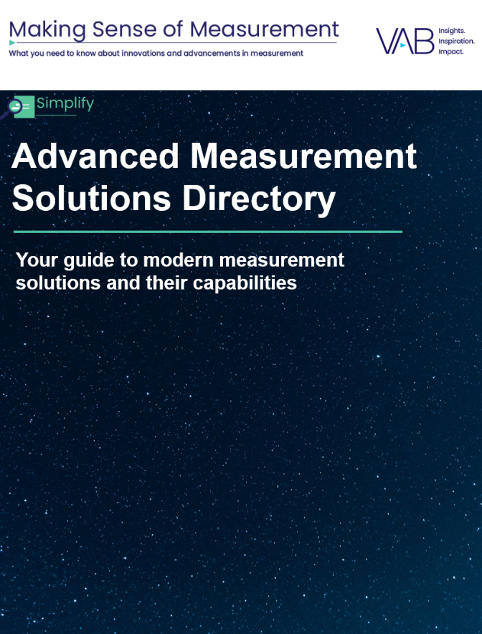
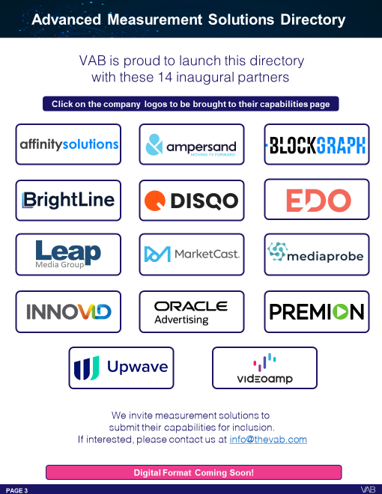
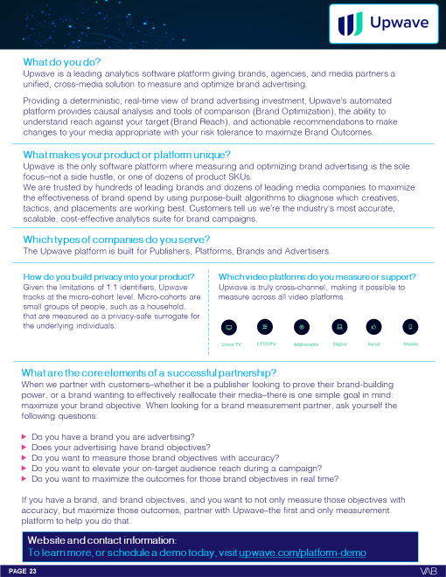
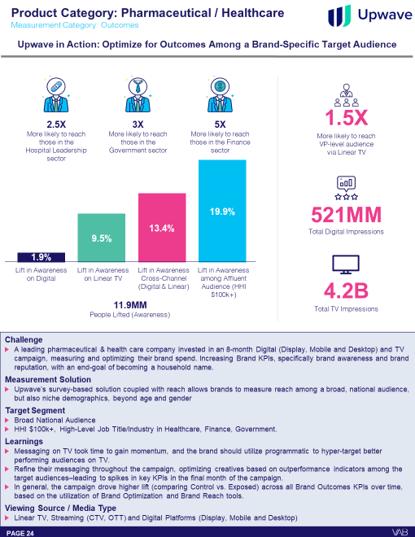
Utilizing VAB’s Advanced Measurement Solutions Directory allows marketers to find trusted and transparent measurement vendors
VAB’s Advanced Measurement Solutions Directory
The Advanced Measurement Solutions Directory serves as a reference guide to simplify and provide clarity in measurement solutions so that you can keep informed.
Developed in partnership with the solutions themselves, the directory is a compilation
of the topline capabilities and several applicable case studies.
We expect this directory to grow and welcome all measurement companies that would like to contribute.
Example of measurement solution & their capabilities
Directory preview
Download ‘Advanced Measurement Solutions Directory’ to learn more
This information is exclusively provided to VAB members and qualified marketers.
PAGE 13

Slide 14
Adults over 50 account for 36% of the total population and nearly half of all adults
Transform. Optionality is table stakes for modern-day measurement and currency.
Adapt. Leaning into advancements in measurement enables you to maximize
reach and outcomes through big data sets.
Invest. Continue vendor evaluations and carve out budgets on various measurement and currency solutions to build trust and comfort
with the methodologies and results.
As marketers look to adopt alternatives, take these initial steps
This information is exclusively provided to VAB members and qualified marketers.
PAGE 14

Slide 15



When adopting alternatives, marketers need to uphold audience trust, keep media partners accountable and demand full transparency
Uphold Audience Trust and Standards:
■The ad experience should be premium like the content around it – with quality audio and video and relevant creative.
■ Partners should use programmatic tools that are built for premium transactions vs. legacy display, ensuring transactions are rooted in trust, and delivery isn’t compromised.
■ Ad quantity should be in line with content length, with minimal disruption, low latency, proportional ad breaks, and carefully crafted ad loads.
Quality of Environment
Hold Partners Accountable:
■ Partners should meet brand requirements, uphold category exclusivity, and maintain competitive separation.
■ Partners should ensure no placements with objectionable content – or objectionable audiences.
■ Legitimate verification processes should be in place to understand what is being bought and sold.
Brand Safety
Know What You Are Buying:
■ Creative should run where it is planned to, in the right context.
■ Buyers & sellers should agree on the kind of impressions purchased – ads should run adjacent to or within the right content and be viewed by real people. They should not run on MFA sites or be delivered to bots.
■ Ads should be viewable, not out-streamed, muted, auto-played, or hidden. Non-viewable impressions should be removed from reporting.
Transparency & Legitimacy
To learn more, click here to download the FreeWheel Council for Premium Video’s & VAB’s ‘Buying Premium Video: A Definitive Checklist’
This information is exclusively provided to VAB members and qualified marketers.
PAGE 15

Slide 16







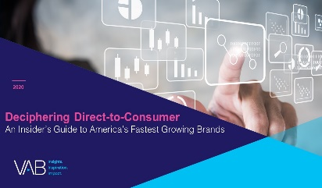

Creators
Jason Wiese
Benjamin Vandegrift
SVP, Director of Strategic Insights
jasonw@thevab.com
VP, Measurement Solutions
benjaminv@thevab.com
Kailyn Hartmann
Leah Montner-Dixon
VP, Advanced Analytics & Intelligence
kailynh@thevab.com
What’s the Deal with
Viewership Data Collection?
What’s the Deal with Identity?
Director, Audience & Behavioral Insights
leahm@thevab.com
Reed Kiely
Karolina Guillen
Director, Data Insights & Trends
reedk@thevab.com
Insights Manager
karolinag@thevab.com
Discover more
Looking for more data, insights and takeaways? Check out this related VAB content
What’s the Deal with Outcomes?
What’s the Deal with What’s Next in Measurement?
We believe in modern TV measurement.
Let us be your guide.
Visit the VAB’s Measurement Resource Center to get clear answers to questions our industry is asking about TV measurement.
What’s the Deal with Engagement?
Unlocking Brand Growth with Audience-Based Buying
VAB Members, brand marketers and agencies get free and immediate access to VAB’s content library. Get access at theVAB.com
This information is exclusively provided to VAB members and qualified marketers.
PAGE 16

Slide 17


About VAB
VAB plays a dual role in the video advertising industry. We are leading the change to bring about a more innovative and transparent marketplace. We also provide the insights and thought leadership that enables marketers to develop business-driving marketing strategies.
Drawing on our marketing expertise, we simplify the complexities in our industry and discover new insights that transform the way marketers look at their media strategy.
We are committed to your business growth and proud to offer VAB members, brand marketers and agencies complimentary access to our continuously-growing Insights library. Get immediate access at theVAB.com.
This information is exclusively provided to VAB members and qualified marketers.
PAGE 17

