Slide 1


June 13, 2025
Question of the Week:
“
What are the organizational disconnects that might exist between KPIs and business goals?
”

Slide 2


Our custom study of 200 brand marketers provides answers
Amid continuing conversations across the ad industry around investment in branding and performance marketing, we sought to understand what KPIs matter most to businesses of all sizes – and how are they determined?
To explore what drives brand marketers’ thinking and planning, we partnered with Advertiser Perceptions on a custom survey of 200 marketers.
In this piece, we spotlight a key finding: many companies struggle with internal misalignment between the KPIs they track and the business goals they’re working toward,
a disconnect that becomes more common as companies grow.
Learn where alignment breaks down and how marketers and media partners can move forward with greater clarity.
This information is exclusively provided to VAB members and qualified marketers.
PAGE 2

Slide 3
Marketers in larger, more layered companies are almost three times more likely than small businesses to believe there is an internal ‘KPI disconnect’
% of brand marketers who believe there is a disconnect between the KPIs and the goals their management has communicated for the organization
‘Small-Sized’ Businesses
‘Medium-Sized’ Businesses
‘Large-Sized’ Businesses
Source: VAB / Advertiser Perceptions ‘Marketer KPI Survey,’ February 2025, fielded January 27 – February 7, 2025 (n=200). Survey base: Brand marketers directly involved in influencing or executing video advertising. Q16. Do you believe there is a disconnect between the KPIs and the goals your management has communicated for the organization? ‘Small-Sized’ Businesses: Less than $1MM in annual ad spend, ‘Medium-Sized’ Businesses: $1MM to less than $25MM in annual ad spend, ‘Large-Sized’ Businesses: $25MM or more in annual ad spend.
This information is exclusively provided to VAB members and qualified marketers.
PAGE 3

Slide 4








Based on marketers’ own words, organizational disconnects between KPIs and business goals primarily occur because of eight different reasons
These reasons represent a mix of strategic, tactical, structural or market-driven challenges
Why do you think there is a disconnect between the KPIs and the goals your management has communicated for the organization?
Top themes based on summary of verbatim responses
Short-Term vs. Long-Term Focus
Misalignment Between Departments
Measurement Challenges
Leadership & Organizational Gaps
Unrealistic Goals & Budget Cuts
Technology &
Data Limitations
Compensation & Incentives
Consumer Buying Behavior
Source: VAB / Advertiser Perceptions ‘Marketer KPI Survey,’ February 2025, fielded January 27 – February 7, 2025 (n=200). Survey base: Brand marketers directly involved in influencing or executing video advertising.
Q16a. Why do you think there is a disconnect?. ‘Small-Sized’ Businesses: Less than $1MM in annual ad spend, ‘Medium-Sized’ Businesses: $1MM to less than $25MM in annual ad spend, ‘Large-Sized’ Businesses: $25MM or more in annual ad spend.
This information is exclusively provided to VAB members and qualified marketers.
PAGE 4

Slide 5









Marketers across sizes cite short-term pressures, misaligned priorities and measurement gaps as key drivers of KPI disconnects
Small brands face tactical hurdles, while large brands grapple with structural misalignment and resistance to long-term brand investment
Why do you think there is a disconnect between the KPIs and the goals your management has communicated for the organization?
Based on summary of verbatim responses
Category | Common Responses
Short-Term vs. Long-Term Focus | KPIs prioritize short-term sales over long-term brand building Leadership reluctant to invest in brand if it doesn’t show immediate revenue
Misalignment Between Departments | Finance, sales, and marketing have different priorities Quarterly reporting doesn’t align with customer buying cycles
Measurement Challenges | KPIs focus on media efficiency rather than actual sales outcomes Metrics prioritize attention and attribution over brand health and customer experience
Leadership & Organizational Gaps | Leadership doesn’t fully understand brand marketing Marketing is seen as a cost center rather than a growth driver
Unrealistic Goals & Budget Cuts | KPIs are set without considering real business needs Budgets get cut when business slows, even if brand building is needed
Technology & Data Limitations | Difficulty integrating new technology effectively Lack of long-term data retention for measuring brand impact
Compensation & Incentives | Employee incentives are tied to short-term performance, discouraging long-term thinking
Consumer Buying Behavior | Decision-makers don’t account for the long conversion timelines and multiple touchpoints needed to convert customers
Source: VAB / Advertiser Perceptions ‘Marketer KPI Survey,’ February 2025, fielded January 27 – February 7, 2025 (n=200). Survey base: Brand marketers directly involved in influencing or executing video advertising.
Q16a. Why do you think there is a disconnect?. ‘Small-Sized’ Businesses: Less than $1MM in annual ad spend, ‘Medium-Sized’ Businesses: $1MM to less than $25MM in annual ad spend, ‘Large-Sized’ Businesses: $25MM or more in annual ad spend.
This information is exclusively provided to VAB members and qualified marketers.
PAGE 5

Slide 6
In our full guide, we answer 10 key questions to help understand how businesses set strategy, define success and plan for growth
1
2
3
4
5
How well do business and marketing objectives align?
Who are the key decision-makers guiding marketing strategy?
How do marketers balance short-term sales with long-term brand growth?
What factors influence an organization’s selection of marketing KPIs?
Are there organizational disconnects between KPIs and overarching business goals?
6
7
8
9
10
What KPIs do marketers use to evaluate the impact
of their video campaigns?
Which media channels do marketers believe are the most effective in achieving KPIs throughout the funnel?
What do marketers expect from their
media partners to help achieve campaign success?
Would marketers shift their strategy if they could develop longer-term plans?
What KPIs would marketers be focused on for future growth?
This information is exclusively provided to VAB members and qualified marketers.
PAGE 6

Slide 7

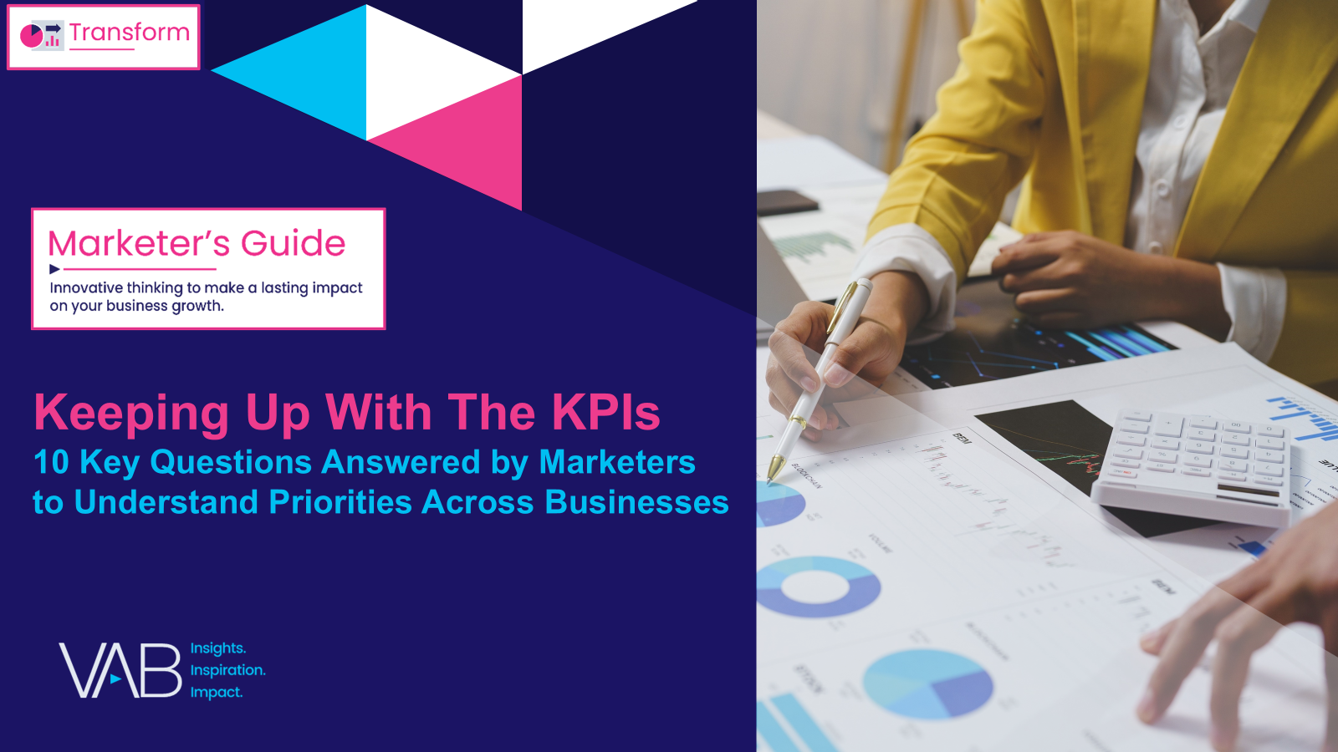
Download our full guide, Keeping Up With The KPIs, to learn the marketing strategies behind small, medium and large businesses
custom study
of 200 brand marketers
44 pages
This information is exclusively provided to VAB members and qualified marketers.
PAGE 7

Slide 8

About VAB
VAB plays a dual role in the video advertising industry. We are leading the change to bring about a more innovative and transparent marketplace. We also provide the insights and thought leadership that enables marketers to develop business-driving marketing strategies.
Drawing on our marketing expertise, we simplify the complexities in our industry and discover new insights that transform the way marketers look at their media strategy.
We are committed to your business growth and proud to offer VAB members, brand marketers and agencies complimentary access to our continuously-growing Insights library. Get immediate access at theVAB.com.
This information is exclusively provided to VAB members and qualified marketers.
PAGE 8

