Slide 1


June 20, 2025
Question of the Week:
“
Who are the key decision-makers guiding marketing strategy within businesses?
”

Slide 2


Our custom study of 200 brand marketers provides answers
Amid continuing conversations across the ad industry around investment in branding and performance marketing, we sought to understand what KPIs matter most to businesses of all sizes – and how are they determined?
To explore what drives brand marketers’ thinking and planning, we partnered with Advertiser Perceptions on a custom survey of 200 marketers.
In this piece, we spotlight a key finding: marketing departments take on a bigger ownership role in setting strategy for their business as companies grow and more organizational layers are established and refined.
Learn how decision-making roles evolve by company size and then download our full guide, Keeping Up With The KPIs, to understand what it means for KPI planning.
This information is exclusively provided to VAB members and qualified marketers.
PAGE 2

Slide 3
Strategy is most often led by senior leaders in small & medium-sized businesses while marketing takes the lead role in the largest companies
Company size can mean more specialization and layers, giving marketing departments greater control over KPI and budget decisions
Key Stakeholders / Primary Decision-Makers Responsible For Marketing Strategy (Budget & Guiding Direction)
% of brand marketer respondents
‘Small-Sized’ Businesses
‘Medium-Sized’ Businesses
‘Large-Sized’ Businesses
Source: VAB / Advertiser Perceptions ‘Marketer KPI Survey,’ February 2025, fielded January 27 – February 7, 2025 (n=200). Survey base: Brand marketers directly involved in influencing or executing video advertising. Q3. Who are the key stakeholders or primary decision-makers in your company responsible for budget and guiding direction (such as brand, goals, etc.)? Based on respondents selecting up to 3 choices. ‘Small-Sized’ Businesses: Less than $1MM in annual ad spend, ‘Medium-Sized’ Businesses: $1MM to less than $25MM in annual ad spend, ‘Large-Sized’ Businesses: $25MM or more in annual ad spend. *C-Suite, Regional Heads. **Investors, franchisees. Learn more about who the external partners responsible for budget and guiding direction are here. Box around chart denotes the top 3.
This information is exclusively provided to VAB members and qualified marketers.
PAGE 3

Slide 4
In our full guide, we answer 10 key questions to help understand how businesses set strategy, define success and plan for growth
1
2
3
4
5
How well do business and marketing objectives align?
Who are the key decision-makers guiding marketing strategy?
How do marketers balance short-term sales with long-term brand growth?
What factors influence an organization’s selection of marketing KPIs?
Are there organizational disconnects between KPIs and overarching business goals?
6
7
8
9
10
What KPIs do marketers use to evaluate the impact
of their video campaigns?
Which media channels do marketers believe are the most effective in achieving KPIs throughout the funnel?
What do marketers expect from their
media partners to help achieve campaign success?
Would marketers shift their strategy if they could develop longer-term plans?
What KPIs would marketers be focused on for future growth?
This information is exclusively provided to VAB members and qualified marketers.
PAGE 4

Slide 5

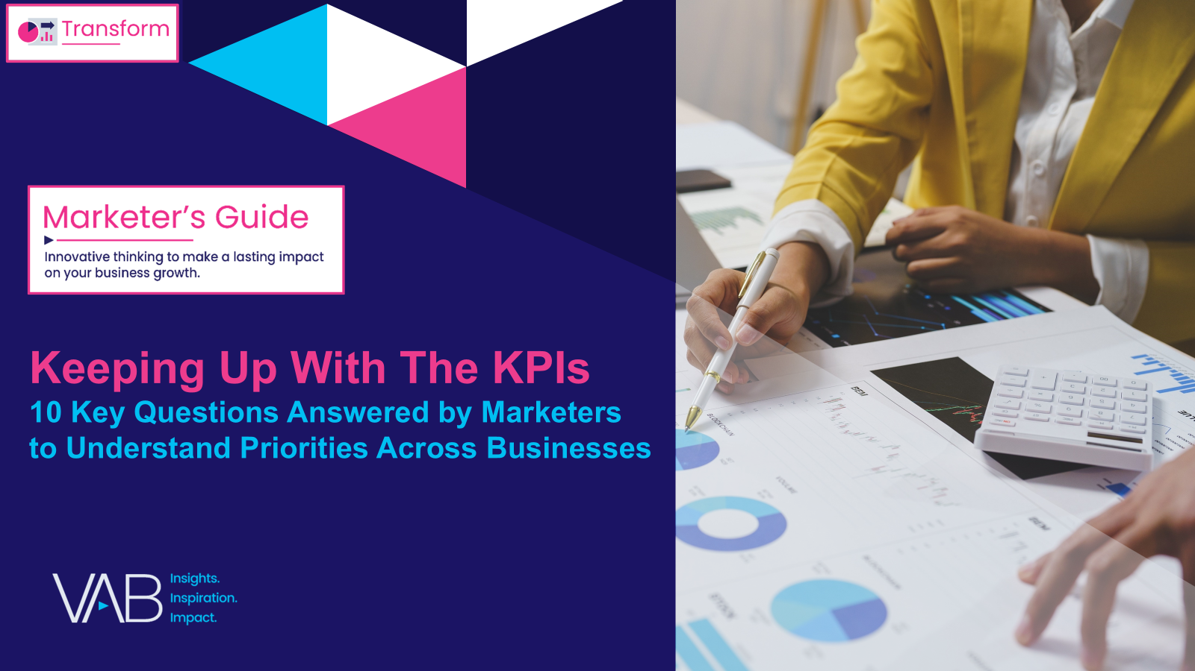
Download our full guide, Keeping Up With The KPIs, to learn the marketing strategies behind small, medium and large businesses
custom study
of 200 brand marketers
44 pages
This information is exclusively provided to VAB members and qualified marketers.
PAGE 5

Slide 6

About VAB
VAB plays a dual role in the video advertising industry. We are leading the change to bring about a more innovative and transparent marketplace. We also provide the insights and thought leadership that enables marketers to develop business-driving marketing strategies.
Drawing on our marketing expertise, we simplify the complexities in our industry and discover new insights that transform the way marketers look at their media strategy.
We are committed to your business growth and proud to offer VAB members, brand marketers and agencies complimentary access to our continuously-growing Insights library. Get immediate access at theVAB.com.
This information is exclusively provided to VAB members and qualified marketers.
PAGE 6

