Slide 1

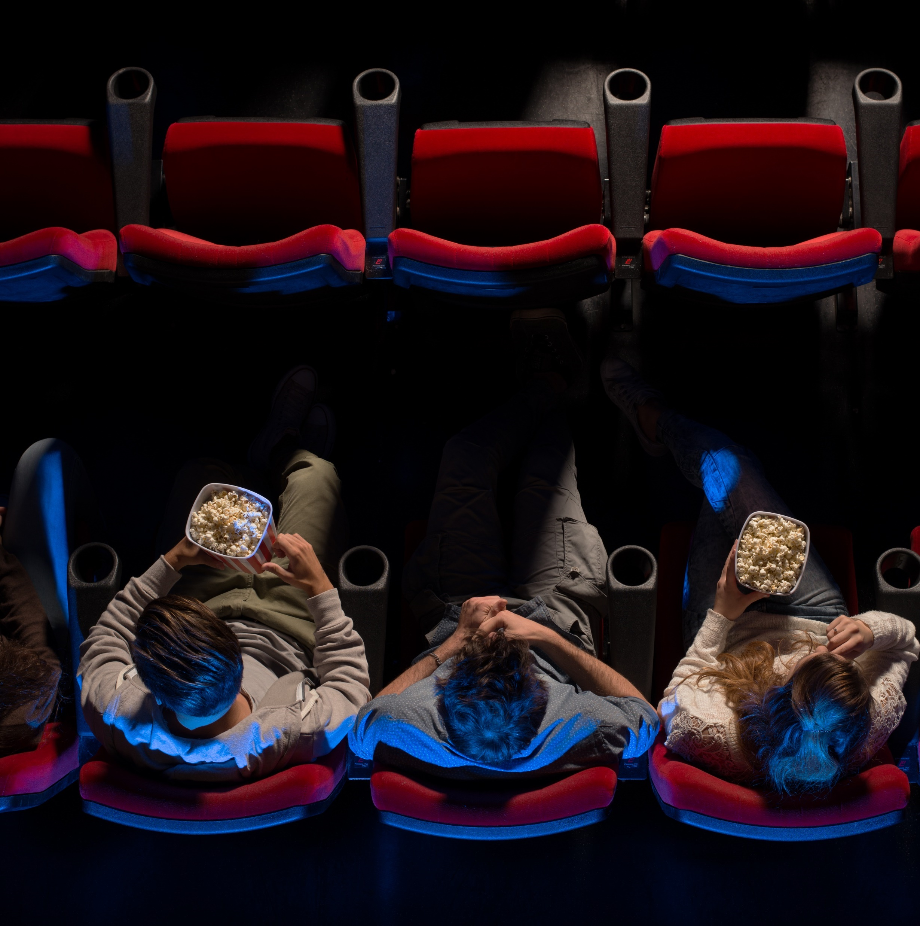




Reeling in Audiences
10 Acts of Attention Along
the Moviegoer’s Journey

Slide 2


The interest, anticipation and intent of moviegoers drives ad attention at cinemas
Cinema is known for delivering high ad attention levels among its audiences, but this attentiveness begins building well before
a captive audience gathers in front of a big screen within a dark theater.
The act of attention among moviegoers is an immersive journey that can span months, or even years, from the time a theatrical release is announced to opening weekend.
Watching trailers, crafting plans to see a movie with friends or family, buying tickets in advance and making the cineplex the center of their social life for a day or night, all aid in creating high ad attentiveness once they are in their seats within the theater.
This guide showcases 10 acts of attention along the moviegoer’s journey that ultimately drive ad attentiveness and creates meaningful business results for cinema advertisers.
This information is exclusively provided to VAB members and qualified marketers.
PAGE 2

Slide 3


10 Acts of Attention Along the Moviegoer’s Journey
The interest, anticipation and intent of going to the movies leads to high ad attentiveness
in the theater which drives business results for cinema advertisers
10 Acts of Attention Along the Moviegoer's Journey
1
2
3
4
5
6
7
8
9
10
Awareness
Enticement
Excitement
Anticipation
Intent
Preparation
Commitment
Showtime!
Reminisce
Extend
The ‘after show’
1+ Years
6+ Months
3-6 Months
2-3 Months
1+ Weeks
1+ Days
Day of
Before Theatrical Release
Note: timeline periods are estimates for illustrative purposes.
This information is exclusively provided to VAB members and qualified marketers.
PAGE 3

Slide 4

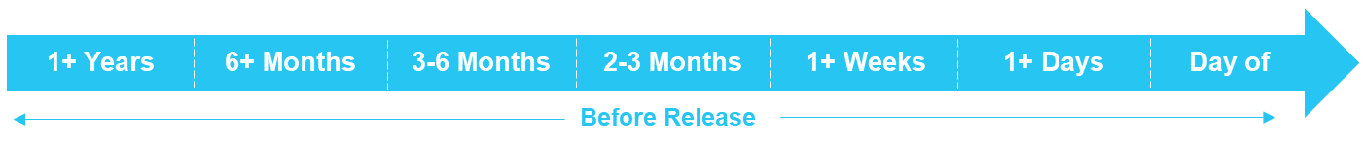
Before Theatrical Release: Acts of Attention Along the Moviegoer’s Journey
1
2
3
4
5
6
7
Awareness
Enticement
Excitement
Anticipation
Intent
Preparation
Commitment
Note: timeline periods are estimates for illustrative purposes.
This information is exclusively provided to VAB members and qualified marketers.
PAGE 4

Slide 5



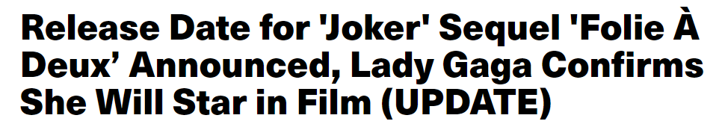
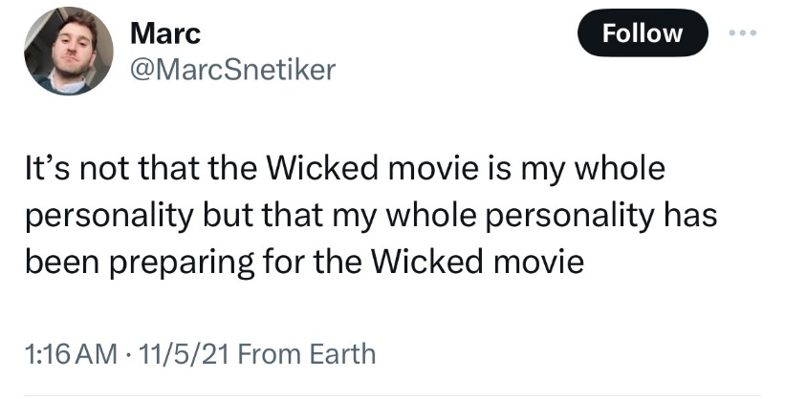
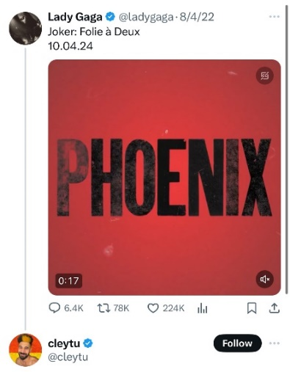

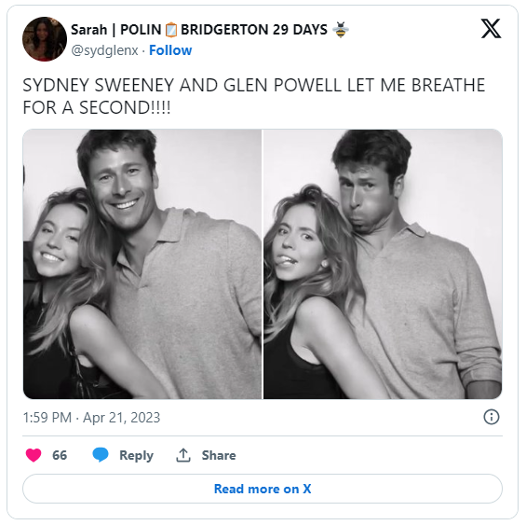
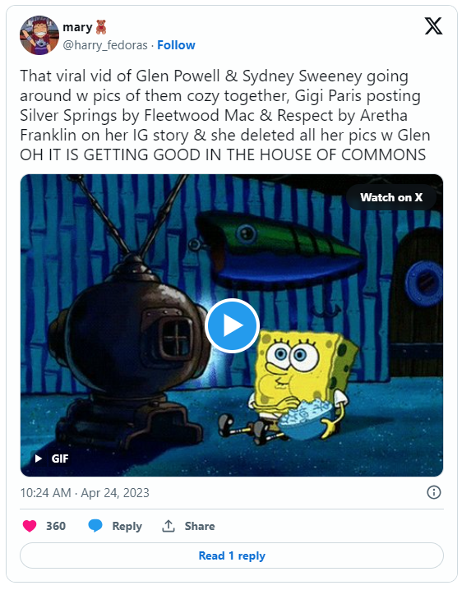
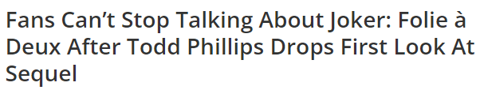
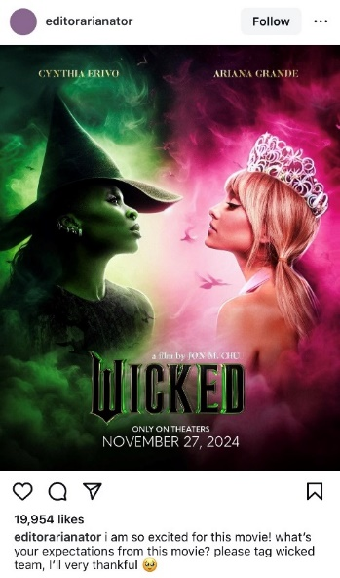

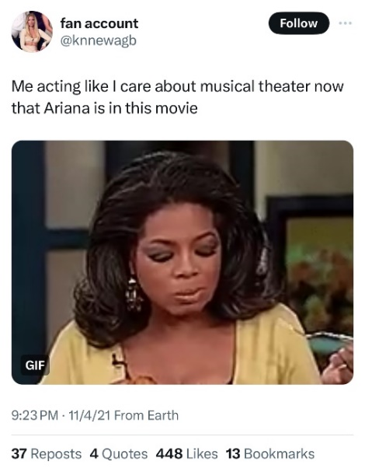
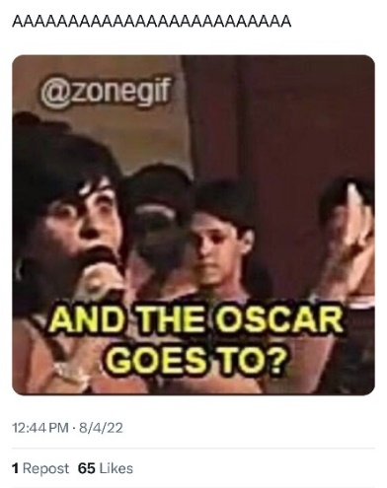
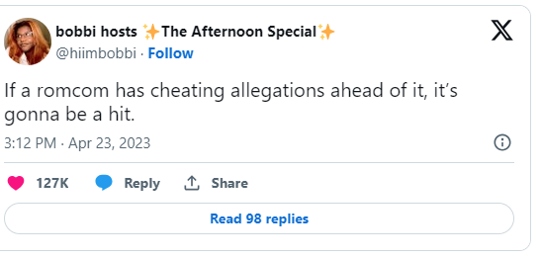

1+ Years Out: Awareness
Fans flock to become part of the social conversation when theatrical releases, and the stars attached to them, are formally announced
Sampling of Social Media Posts Around Upcoming Cinema Releases
Wicked
3 years before release
Joker: A Folie a Deux
2 years before release
Anyone But You
11 months before release
11/5/2021
8/3/2022
1/12/2023
Ariana Grande and Cynthia Erivo to Star in Jon M. Chu's Adaption of Wicked
Now that's how you create casting buzz.
12/11/2022
A corresponding surge in search queries is also typically seen around these announcements, according to Google Trends
This information is exclusively provided to VAB members and qualified marketers.
PAGE 5

Slide 6

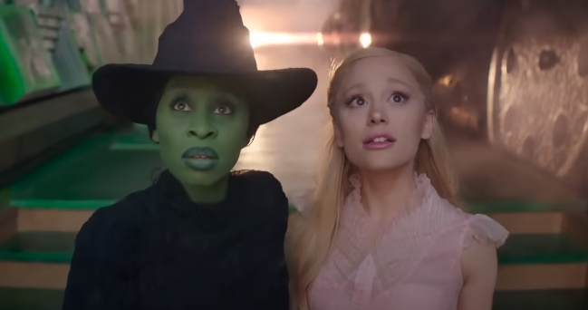

6+ Months Out: Enticement
Desire is created well in advance among large audiences, as evidenced
by movies being the two most engaging ads in this year’s Super Bowl
2024 Superbowl Ads
Ranked by Engagement Index
“Deadpool & Wolverine”
(Walt Disney Studios)
“Wicked: Part One”
(Universal Pictures)
“Twisters”
(Universal Pictures)
#1
~6 months from release
#2
10 months from release
#6
~6 months from release
23.4x
more engagement
as the median-performing Super Bowl LVIII ad airing
21.1x
more engagement
as the median-performing Super Bowl LVIII ad airing
16.9x
more engagement
as the median-performing Super Bowl LVIII ad airing
*Note: Each Super Bowl ad performance is indexed to the median-performing in-game spot (the median airing is scored at 100). Engagement is based online activity like search and website visits after airing.
Source: EDO, ‘Super Bowl LVIII Ad Rankings’, February 2024. Rank #3 was ‘Volkswagen – An American Love Story’ (1,694 index), Rank #4 was ‘Poppi – The Future of Soda is Now’ (1,661 index), Rank #5 was ‘Temu Billionaire’ (1,443 index). Click imagery above to watch commercial.
This information is exclusively provided to VAB members and qualified marketers.
PAGE 6

Slide 7






3-6 Months Out: Excitement
Millions of views are garnered for trailers on YouTube months before their theatrical release as people actively learn more about movies of interest
Period Between Trailer Release on YouTube and Theatrical Release
6
months
6
months
5.5
months
5.5
months
5
months
80%
Despicable Me 4
Posted: 1/28
Release Date: 7/3
Joker: Folie à Deux
Posted: 4/9
Release Date: 10/4
Beetlejuice
Beetlejuice
Posted: 3/21
Release Date: 9/6
Deadpool & Wolverine
Posted: 2/11
Release Date: 7/26
Furiosa
Posted: 11/30/23
Release Date: 5/24
of moviegoers
watch the trailer
before going to a movie
21MM views
31MM views
16MM views
29MM views
14MM views
Source: Screenvision, Screen Engine Data, March 2024. Base: Total Respondents (18+), ‘Thinking about your typical moviegoing experience, what do you do before deciding to go see a movie at the theater?’
*Total trailer views as of 4/23/2024 from the film studio’s official YouTube channel. Theatrical release dates as of 4/23/2024.
This information is exclusively provided to VAB members and qualified marketers.
PAGE 7

Slide 8



2-3 Months Out: Anticipation
A couple months out, interest and excitement turns into eagerness as moviegoers await the arrival of upcoming releases at their local theater
Interest for popular titles builds months in advance
% interested in seeing each film
as of 4/4/24*
89%
59%
54%
Bad Boys: Ride or Die
Release Date: 6/7
Inside Out 2
Release Date: 6/14
of moviegoers
‘eagerly’ anticipate
a new movie
Source: NCM, Moviegoing Audience Insights, Behind-The-Screens (BTS) Online Community, November/December 2023, Base: A18+ Moviegoers. *The Quorum, ‘Eight-Week Out Film Tracking’, 4/4/24.
This information is exclusively provided to VAB members and qualified marketers.
PAGE 8

Slide 9



1+ Weeks Out: Intent
Conversations make it out of group chats or the dinner table as friends and family start planning their trip to the theater
% of moviegoers that…
88%
always plan in advance
to see a new movie
88%
say ‘shared experiences’ provide
a sense of social connection
and bonding that creates
lasting memories they cherish
80%
say going to the movies
brings family and friends together*
Source: NCM, Moviegoing Audience Insights, Behind-The-Screens (BTS) Online Community, November/December 2023, Base: A18+ Moviegoers. *The Cinema Foundation, ‘The Value of A Movie Ticket’, April 2023.
This information is exclusively provided to VAB members and qualified marketers.
PAGE 9

Slide 10
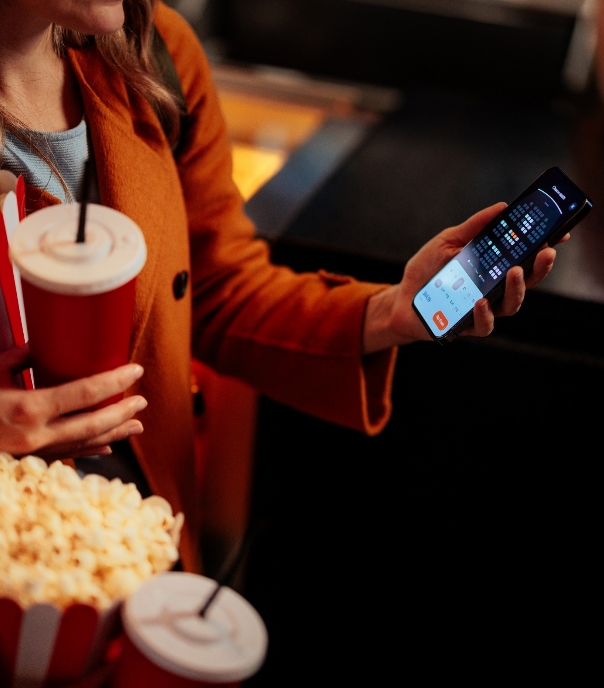

1+ Days Out: Preparation
Many moviegoers purchase their tickets well ahead of opening weekend to ensure they get their desired time and preferred seats
When do you typically purchase your tickets for a movie?
Base: Moviegoers
A Week or More
before release
3 Days or More
before release
One or More Days
before release
26%
40%
59%
Source: Screenvision, Screen Engine Data, March 2024. Base: Total Respondents (18+), ‘Thinking about your movie ticket purchasing behavior, when do you typically purchase your tickets for a movie you would like to see?’
This information is exclusively provided to VAB members and qualified marketers.
PAGE 10

Slide 11

Day Of: Commitment
Going to the cineplex is one of the most deliberate and dedicated acts of consumer choice within premium video as it requires moviegoers to travel
Moviegoers travel an average of
12 miles
to their local cineplexes
Source: Screenvision & The People Platform, 2023 average.
This information is exclusively provided to VAB members and qualified marketers.
PAGE 11

Slide 12

Showtime!: Acts of Attention Along the Moviegoer’s Journey
8
Showtime!
This information is exclusively provided to VAB members and qualified marketers.
PAGE 12

Slide 13

Showtime!
Movie-going is a shared experience for most people which creates
co-viewing engagement opportunities for cinema advertisers
The average moviegoing group size is
3.4
People
Source: Screenvision & The People Platform, 2023 average.
This information is exclusively provided to VAB members and qualified marketers.
PAGE 13

Slide 14
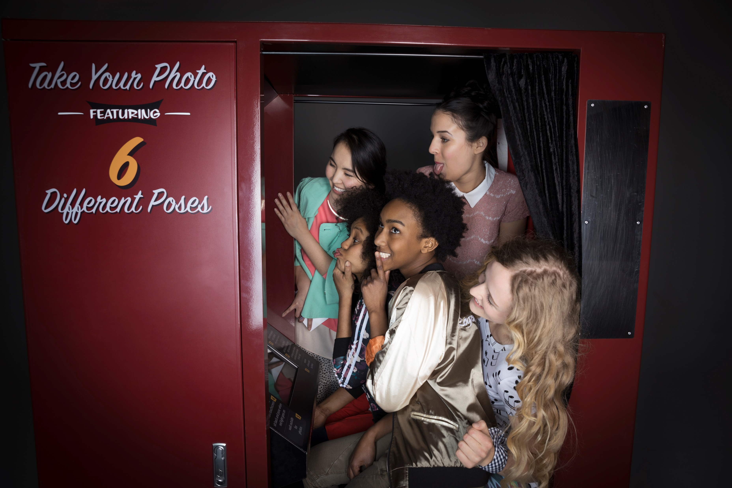


Showtime!
People enjoy the experience of the cinema and are thrilled to make the theater the center of their day, or night out, with friends or family
74%
64%
of moviegoers are interested in cinema lobby experiences
(product samplings, photo opportunities,
photo booths, giveaways, etc.)
of moviegoers say
the whole experience is
why they go to the movies
Source: Screenvision, Screen Engine Data, March 2024. Base: Total Respondents (18+), ‘Sometimes in the lobby area of theaters you may find product sampling, photo opportunities, photo booths, giveaways etc. How interested are you in participating in any of these special opportunities?’ and ‘What are some of the reasons why you go to see movies in theater?’
This information is exclusively provided to VAB members and qualified marketers.
PAGE 14

Slide 15


Showtime!
Affluent moviegoers also view cinema as essential to their social lives and therefore prefer theaters with luxury amenities that enrich their experience
73%
of affluent moviegoers prefer to visit theaters offering unique amenities, cocktails and fine dining
Source: Spotlight Cinema & YouGov Survey, September 2022, Base: P18-54 Moviegoers with $100K+ HHI.
This information is exclusively provided to VAB members and qualified marketers.
PAGE 15

Slide 16


Showtime!
Moviegoers are enjoying much more elevated experiences at their local theater as they turn ‘dinner and a movie’ into ‘dinner at the movies’
49%
76%
of these moviegoers…
of moviegoers have
purchased restaurant-style food at a movie theater
find restaurant-style
food at a theater as good or nearly as good as restaurants
Source: The Cinema Foundation, ‘The Value of A Movie Ticket’, April 2023.
This information is exclusively provided to VAB members and qualified marketers.
PAGE 16

Slide 17
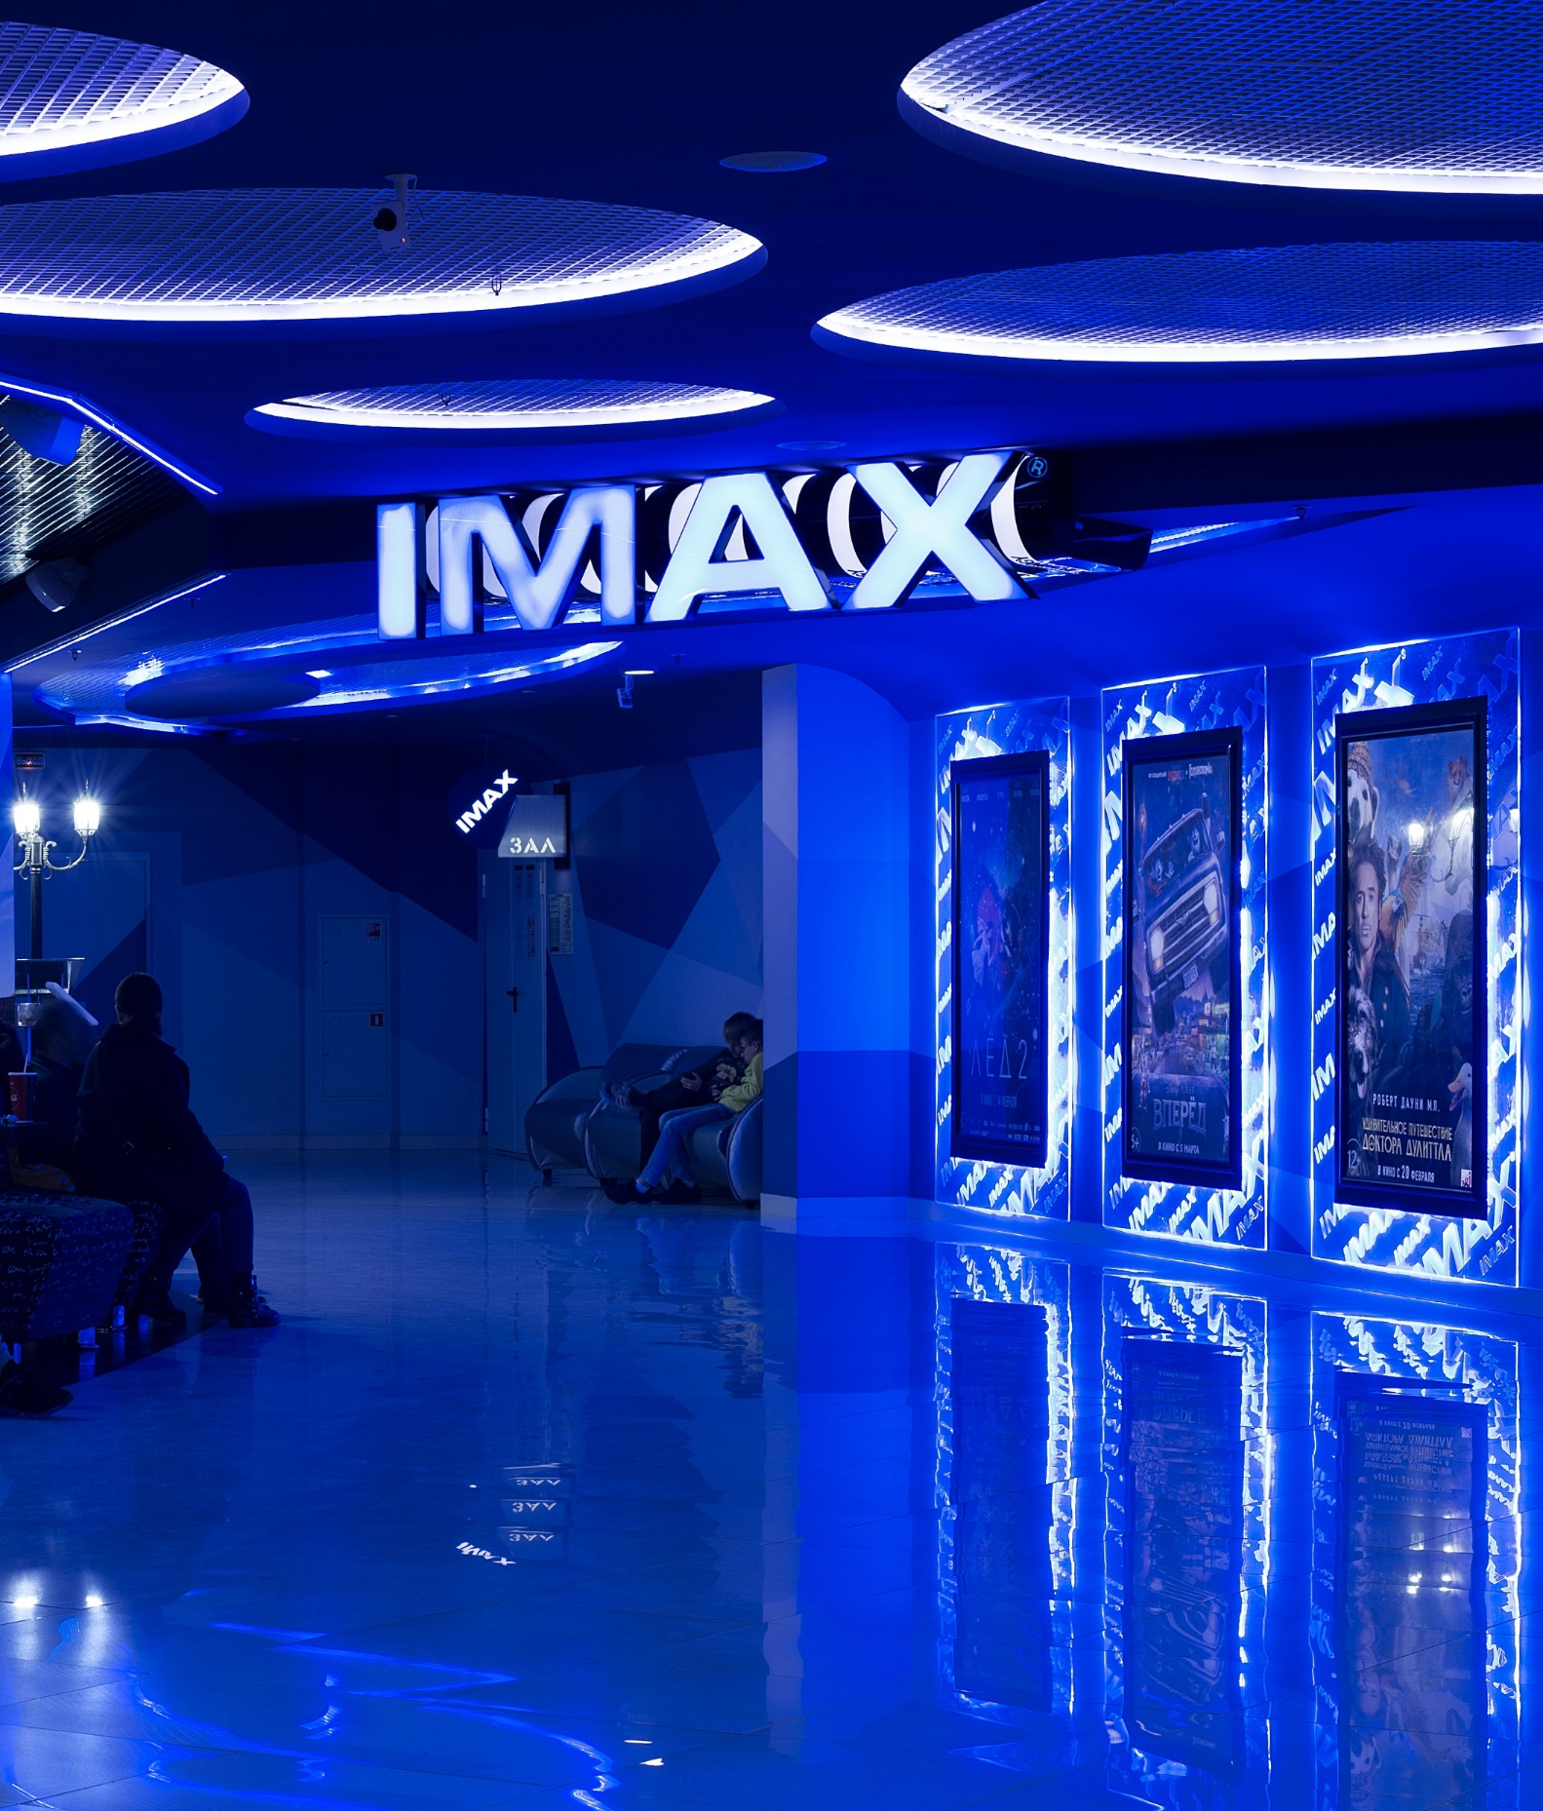
Showtime!
Premium large formats, like IMAX, are also attracting moviegoers who can’t replicate these unique, immersive experiences at home
Do you watch movies in Premium Large Formats (i.e. IMAX)?
Base: Moviegoers
85%
watch movies in Premium Large Format
Source: The Cinema Foundation, ‘The Value of A Movie Ticket’, April 2023.
This information is exclusively provided to VAB members and qualified marketers.
PAGE 17

Slide 18


Showtime!
Excited that their wait is finally over, most audiences, even those who bought advanced tickets, like to be in their seats early before showtime
23 mins
Moviegoers’ average arrival time
at the theater before showtime
The #1 reason for arriving early is to have time
to settle in before the movie starts
Source: Screenvision, Screen Engine Data, March 2024. Base: Total Respondents (P18+). ‘How long would you say you are typically in your seat in the auditorium before the movie starts?’ & ‘Why do you typically arrive to your seat early?’
This information is exclusively provided to VAB members and qualified marketers.
PAGE 18

Slide 19


Showtime!
Almost all moviegoers, including young adults, put their phones away once the lights go down, which creates a fully immersive atmosphere
% of moviegoers that…
P18+
P18-24
P18-34
97% / 95% / 96%
put away their phones
once the lights go down in the movie theater
Besides sleep, what other activity can get Gen Z’ers to put their phones away for over two hours?!?*
Source: Screenvision, Screen Engine Data, March 2024. Base: P18+, P18-24 & P18-34. ‘Once the lights in the theater go down, do you typically put your cell phone away?’ *Average length of a theatrical release is 2 hours, 6 minutes according to VAB’ At the Movies: 15 Reasons to Include Cinema Within a Video Ad Campaign.
This information is exclusively provided to VAB members and qualified marketers.
PAGE 19

Slide 20
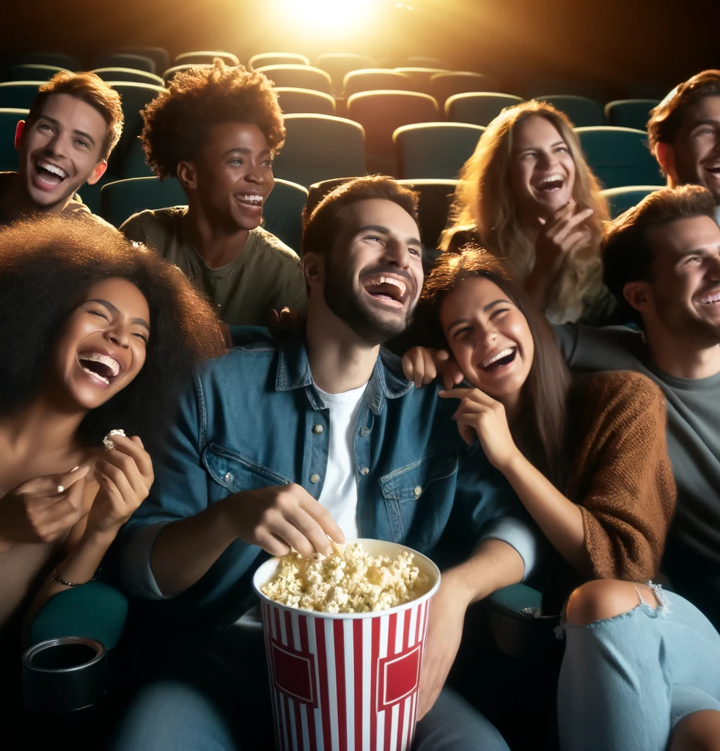


Showtime!
Bonding in person with friends or family while away from their phones and ‘outside noise’ produces an environment ripe for advertising attention
% of moviegoers who agree that…
93%
92%
Going to the movies is a
stress-relieving /
relaxing activity
Going to the movies provides an escape from life
Source: NCM, Moviegoing Audience Insights, Behind-The-Screens (BTS) Online Community, August 2023, Base: A18+ Moviegoers.
This information is exclusively provided to VAB members and qualified marketers.
PAGE 20

Slide 21


Showtime!
As an excited, emotionally invested and captive audience, moviegoers are highly attentive to cinema advertising
25 of 30
seconds viewed of a
:30 cinema ad, on average
Source: NCM & Lumen, Attention Study, October 8-12, 2023, n=364 A18+.
This information is exclusively provided to VAB members and qualified marketers.
PAGE 21

Slide 22






Showtime!
The theatrical experience achieves much greater audience attention for cinema advertising in comparison to other digital and social channels
Average Seconds Viewed of Ads
:30 second ads
:15 second ads or less
Source: NCM & Lumen, Attention Study, October 8-12, 2023, n=364 A18+. Lumen/Holdco Proprietary Audio/Social/Digital 2023 Study.
This information is exclusively provided to VAB members and qualified marketers.
PAGE 22

Slide 23

The ‘After Show’: Acts of Attention Along the Moviegoer’s Journey
9
10
Reminisce
Extend
This information is exclusively provided to VAB members and qualified marketers.
PAGE 23

Slide 24


Reminisce
Moviegoers enjoy reliving their theatrical experience together immediately after the movie which may include discussions about the ads as well
% of moviegoers that…
69%
Talk about the movie
with the people they saw
it with, after seeing it
in the movie theater
Source: Screenvision, Screen Engine Data, March 2024. Base: Total Respondents (18+). ‘Thinking about your typical moviegoing experience, what do you do after seeing a movie in the theater?’
This information is exclusively provided to VAB members and qualified marketers.
PAGE 24

Slide 25




Reminisce
Moviegoers’ high attentiveness to cinema ads and their overall experience increases brand recall and consideration for cinema advertisers
Cinema Advertising’s Impact on Brand Metrics
Unaided Awareness
Brand Recall
Message Recall
Consideration
+119%
87%
51%
+100%
lift in
unaided awareness
(vs. control)
recall brands
that advertise in
preshow cinema ads*
correctly recalled
the brands’ message
from a single exposure**
lift in
future consideration
(in next month vs. control)
Source: NCM & eWorks, Intercept Study, November 2023, P18-49. *Screenvision & Amplified Intelligence, ‘All Eyes on Us’, April 2023. **Screenvision & MAGNA, ‘Eyes on Screen’, January 2024.
This information is exclusively provided to VAB members and qualified marketers.
PAGE 25

Slide 26
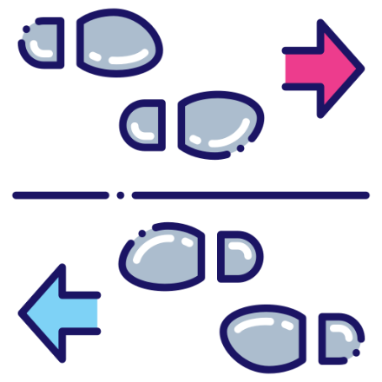
Reminisce
Brands are capitalizing on the attentiveness of moviegoers to drive meaningful business results shortly after their trip to the theater
“We were thrilled with the results. With the evolution of cinema advertising, we now know
we can expect meaningful data analytics and performance KPIs from our campaigns on the
big screen. We see cinema as a key media platform to drive meaningful business outcomes and brand awareness.”
Mazda saw a significant 22% lift in foot traffic, with 69% of those visits happening within five days of seeing the ad at the theater
Brad Audet, CMO, Mazda North America
Source: Digiday, ‘National CineMedia to offer guarantees on business outcomes this upfront’, 3/13/24.
This information is exclusively provided to VAB members and qualified marketers.
PAGE 26

Slide 27



Extend
Moviegoers are also likely to provide positive word-of-mouth ‘in real life’ and online which can expand audiences for movies and their advertisers
% of moviegoers that…
95%
33%
31%
Recommend seeing
a movie in a theater to
friends and family based upon their experiences
Visit or engage with
social media sites about
the movie after seeing a movie in theaters*
Post about seeing the movie on social media
after seeing a movie
in theaters*
Source: NCM, Moviegoing Audience Insights, Behind-The-Screens (BTS) Online Community, August 2023, Base: A18+ Moviegoers. *Screenvision, Screen Engine Data, March 2024. Base: Total Respondents (18+). ‘Thinking about your typical moviegoing experience, what do you do after seeing a movie in the theater?’
This information is exclusively provided to VAB members and qualified marketers.
PAGE 27

Slide 28

A consistent pipeline of new movie releases coming soon to a theater near you

Slide 29









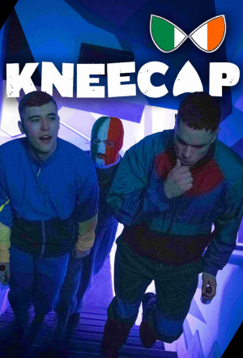




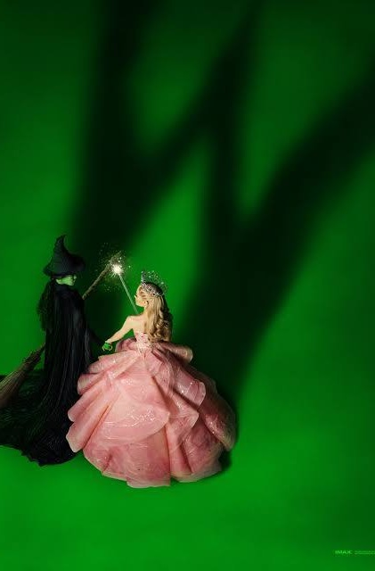

Upcoming Cinema Releases
The theatrical pipeline is filled with high-profile movies and specialty film releases for the summer season and beyond
5/24/24
6/14/24
6/21/24
6/28/24
7/5/24
7/12/24
7/19/24
7/26/24
7/26/24
8/2/24
8/9/24
9/6/24
10/4/24
11/22/24
11/27/24
12/13/24
Source: IMDb, Upcoming Releases, 2024. Note: Release dates planned as of 4/23/24 and subject to change.
This information is exclusively provided to VAB members and qualified marketers.
PAGE 29

Slide 30
People’s interest, anticipation and intent of going to their local cineplex – a journey that could be in the making for months, if not years, for a particular film – leads to high ad attentiveness in the theater
Moviegoers’ overall experience at the theater
and high attentiveness to cinema ads drives meaningful business results across the purchase funnel for brands
The upcoming slate of theatrical releases is filled with high-profile movies and specialty films which provides marketers with opportunities to reach highly engaged, desirable audiences in brand safe, premium video environments
Key Marketer Takeaways
This information is exclusively provided to VAB members and qualified marketers.
PAGE 30

Slide 31
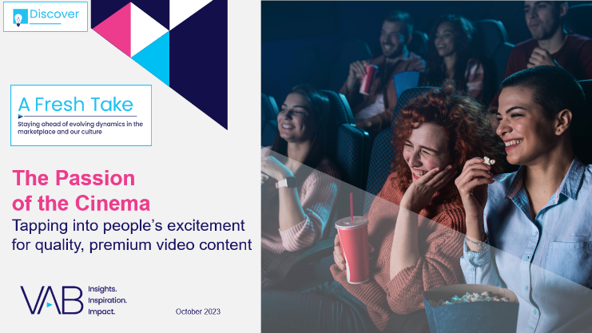
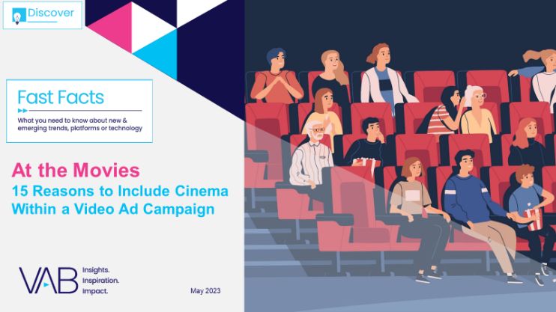

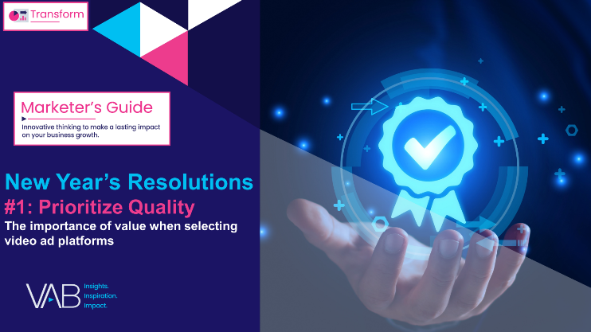
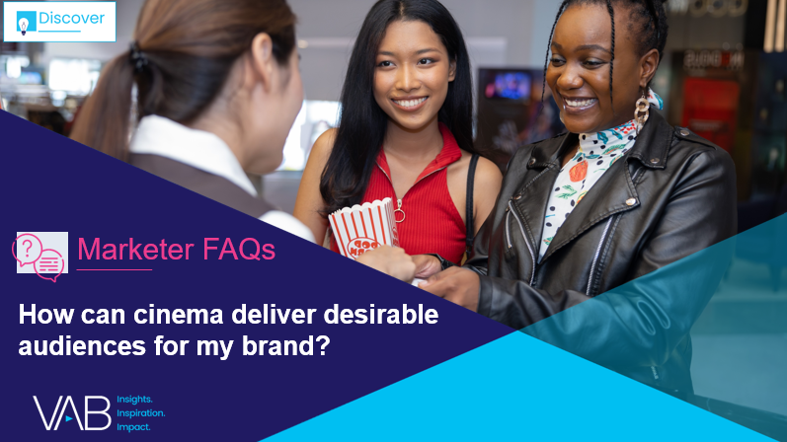

Creators
Jason Wiese
Reed Kiely
SVP, Director of Strategic Insights
jasonw@thevab.com
Director, Data Insights & Trends
reedk@thevab.com
The Passion of the Cinema
Tapping into people’s excitement
for quality, premium video content
At the Movies
15 Reasons to Include Cinema Within
a Video Campaign
Karolina Guillen
Kaileen Cain
Associate Director,
Insights, Strategy & Analytics
karolinag@thevab.com
Senior Insights Analyst
kaileenc@thevab.com
Discover more
Looking for more data, insights and takeaways? Check out this related VAB content
The Consumer Connection
Understanding the Effect of Quality Across Media Platforms
New Year’s Resolutions
#1: Prioritize Quality
The importance of value when selecting video ad platforms
How can cinema deliver desirable audiences for my brand?
I Know What You Did This Summer
Harnessing consumer momentum at the movies
VAB Members, brand marketers and agencies get free and immediate access to VAB’s content library. Get access at theVAB.com
This information is exclusively provided to VAB members and qualified marketers.
PAGE 31

Slide 32


About VAB
VAB plays a dual role in the video advertising industry. We are leading
the change to bring about a more innovative and transparent marketplace. We also provide the insights and thought leadership that enables marketers to develop business-driving marketing strategies.
Drawing on our marketing expertise, we simplify the complexities in our industry and discover new insights that transform the way marketers look at their media strategy.
We are committed to your business growth and proud to offer VAB members, brand marketers and agencies complimentary access to our continuously-growing Insights library. Get immediate access at theVAB.com.
This information is exclusively provided to VAB members and qualified marketers.
PAGE 32

