Slide 1
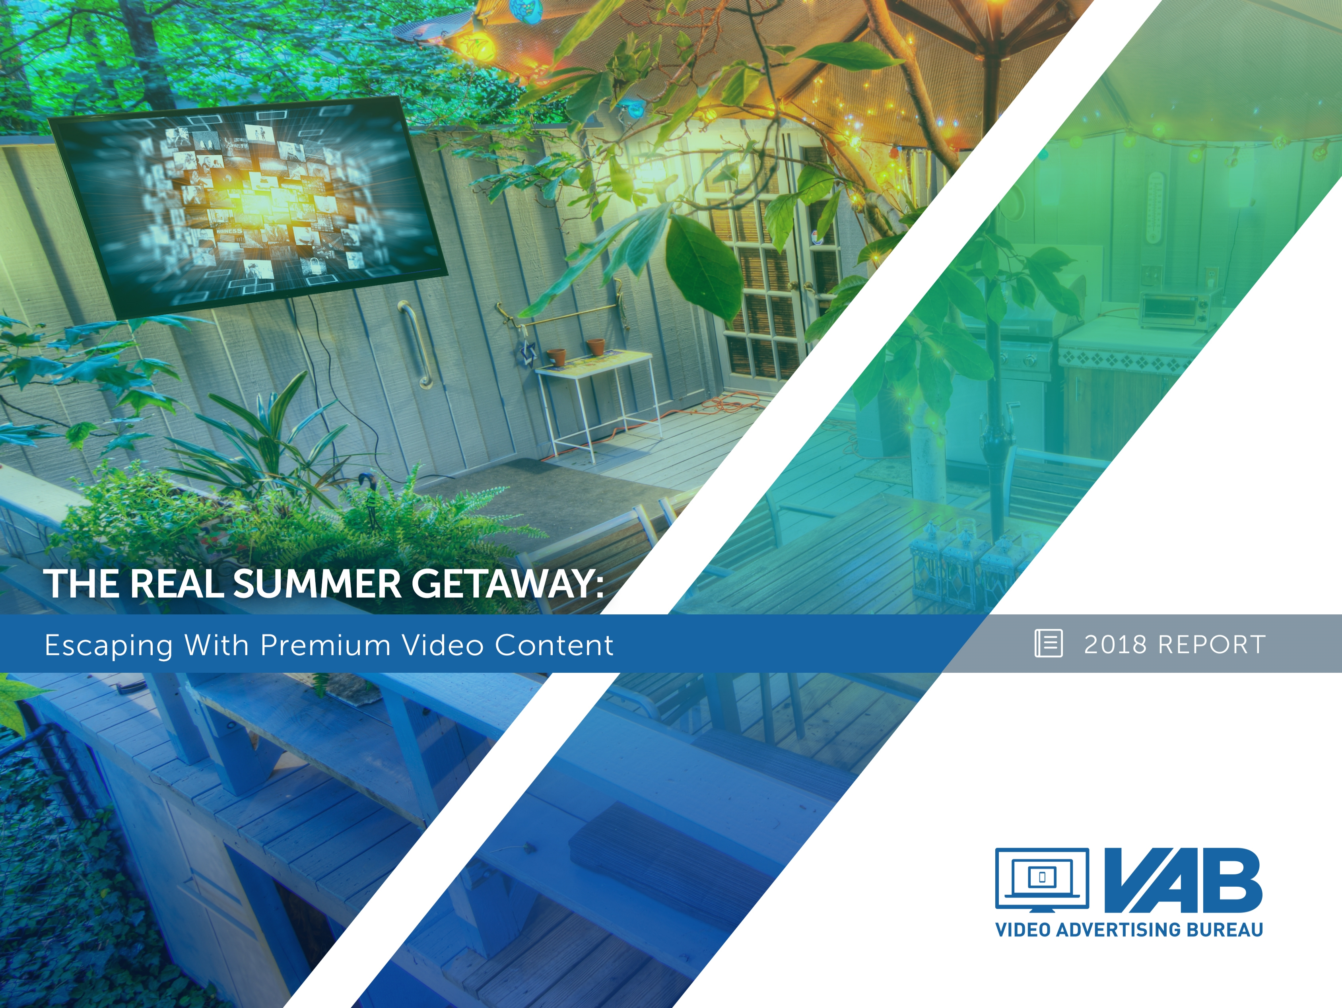
The Real Summer Getaway:
Escaping With Premium Video Content
Member Center

Slide 2
Summer Reading List
Summer-y 3-4
Summer Activities: 5-12
Understanding Seasonal Behaviors
Summertime TV Programming: 13-16
Highlighting The Scope of Content
Summer TV Trends: 17-27
Showcasing Season-long Stability
The Summer Solstice For TV Brands: 28-34
Achieving A High Point Through Multi-screen TV
The Summer Social Scene: 35-42
Examining TV’s Popularity In Online Conversations
Summer In The Cinema: 43-49
Delivering Scale Among Younger Audiences
Contact Information 50
Additional Member Slides 51-58
VAB: THE REAL SUMMER GETAWAY

Slide 3
Premium Video Content Provides The Habitual Escape And Relaxation That People Are Looking For During The Summer
Whether people are on vacation or at home this summer, one thing remains constant – people will actively seek out premium video content, in the form of both multi-screen TV brands and theatrical movie releases, to escape and relax from their daily lives.
Watching ad-supported TV and going to the local cineplex are the two most popular summer activities; they’re more popular than going to the beach, barbecuing, taking a vacation or even dining out. Additionally, the evolution of near-ubiquitous broadband connectivity has turned summer “reading lists” into summer “streaming lists” and have opened up more video viewing occasions for people to watch their favorite TV shows when away from their living rooms.
But make no mistake, even in the summer, Television continues to represent the large majority of overall video consumption. Between original programming, specials and sports, there is a wide breadth of summertime ad-supported TV content available. Because of this, tune-in and reach of ad-supported TV shows a steadiness and stability in relation to other time periods throughout the year, with only a minimal drop-off from a time spent perspective.
Also, due to the abundance of “live” TV content and near-weekly blockbuster theatrical releases, nothing gets people talking online during the summer like ad-supported TV and cinema as both are some of the most popular topics that trend on Twitter.
For those looking for millennials this summer, cinema delivers both a high reach and high concentration of those looking to escape and relax with friends. In fact, the millennial audience composition of cinema is higher than popular, targeted digital platforms like Snapchat, Instagram and YouTube.
With all the great original content available during the summer, it’s no surprise that people consider their time spent with premium, multi-screen video to be their real summer getaway.
VAB: THE REAL SUMMER GETAWAY

Slide 4
Summer Reading List – SparkNotes
Summer Activities: Understanding Seasonal Behaviors
93% of P18+ watch ad-supported TV during the summer
62% of P18+ go to the cinema
66% of P18+ believe TV is a good escape, while 60% say that TV relaxes them
64% of streamers say they are “streaming shows / series in places where they used to read”
77% of streamers use TV network websites/apps during the summer
Summer TV Trends: Showcasing Season-long Stability
HHs tune into ad-supported TV an average of 25 days per summer month, on par with the rest of the year
Average monthly summer reach for P13-17 (90%) is steady vs. other time periods throughout the year
On average, monthly time spent with ad-supported TV at the HH level is only 4% lower during summer months
90% of P18-24 ad-supported TV viewing, and 87% of P25-34, is done “live” which is on par with the rest of the year
The Summer Solstice For TV Brands: Achieving A High Point Through Multi-screen TV
The ad-supported multi-screen TV P18+ audience is 12x larger than Facebook, 8x larger than YouTube
The ad-supported multi-screen TV P18-34 audience is 6x larger than Facebook, 2x larger than YouTube
The Summer Social Scene: Examining TV’s Popularity In Online Conversations
Ad-supported TV accounted for 67% of the top 10 trending Twitter topics during a 4-week analysis last summer
83 ad-supported TV entertainment programs trended vs. 8 pay-TV shows / 3 Netflix shows / 2 YouTube channels
Summer In The Cinema: Delivering Scale Among Younger Audiences
Summer cinema P18-34 composition (53%) vs. total internet P18-34 composition (29%)
Cinema’s P18-34 composition is greater than Netflix (49%), Snapchat (47%), Facebook (34%), YouTube (32%)
VAB: THE REAL SUMMER GETAWAY

Slide 5

Summer Activities:
Understanding Seasonal Behaviors

Slide 6
Watching Ad-Supported TV & Going To The Local Cineplex Are The Two Most Popular Leisure Time Activities
*except for “watched ad-supported TV” which only reflects viewership during summer months
VAB: THE REAL SUMMER GETAWAY
Source: TV data based on VAB Analysis of Nielsen Npower R+F Time Period Report, P18+, 5/28/17-9/10/17, Live+7; Leisure Activities based on GFK MRI 2017 Doublebase, P18+

Slide 7
Only About Half Of All Americans Plan To Go Away On
A Summer Vacation
Many people look to TV content as a much more affordable way to escape and relax
66% of A18+ believe television is a good escape, while 60% say that TV relaxes them
VAB: THE REAL SUMMER GETAWAY
Source: Associated Press National Opinion Research Center Poll, 2017. Numbers may not equal 100% due to rounding. ; GfK MRI Doublebase 2017, P18+

Slide 8





Whether On Vacation Or At Home, Summer “Reading” Lists Have Evolved Into Summer “Streaming” Lists
Thanks to streaming, more video viewing occasions – through both time and locations - have opened up to the consumer and many are streaming more frequently and in spots where they used to read a book during the summer
64% say they are “streaming shows / series in places they used to read”
Inside the home
Relaxing on the porch
Lounging in the yard
On the beach
At a lake
62% say they are “streaming shows / series during times they used to be reading”
From a platform perspective, 77% of streamers use TV network websites / apps over the summer
When on vacation, people find streaming an integral part of their time away
  90% say that streaming shows gives them a sense of “me-time” where they can relax and decompress from other pressures
  75% say they talk more with their family and friends about the shows/series they’re streaming than the books they’re reading
  65% say they’re spending more quality time with family/friends because they’re streaming shows together
VAB: THE REAL SUMMER GETAWAY
Source: Miner & Co. Studio “Summer Streaming” 2016, Base: TV Viewers P18-59

Slide 9
Network Shows Are The Most Popular TV Content Streamed On All The Major SVOD Services
VAB: THE REAL SUMMER GETAWAY
Source: Kagan, a media research group within the TMT offering of 2018 S&P Global Market Intelligence. Results from an online consumer survey conducted in September 2017, base: Netflix users – 1,480; Hulu users – 549; Amazon Prime Video users – 938. Question: You indicated that you currently have a subscription to (online video service). Which of the following types of video content do you view from the service?

Slide 10



Collectively, Subscribers Also Find Acquired Network TV Series To Be More Enjoyable Than Original Content On These Services
Content Most Enjoyed on Netflix, Hulu and Amazon Prime Video
Source: Kagan, a media research group within the TMT offering of 2018 S&P Global Market Intelligence. Results from an online consumer survey conducted in September 2017, base: Netflix users – 1,480; Hulu users – 549; Amazon Prime Video users – 938. Question: Of the content you view on (online video service) which would you say is the content you most enjoy viewing? “Movies” include recent movies (released within past 2 years) and older movies (released over 2 years ago). “Acquired Network TV Series” includes prior seasons of network TV series and current season of network TV episodes.

Slide 11
Even With The Increase In Streaming Across Devices, TV Continues To Represent The Large Majority Of Overall Video Consumption
(Live + DVR / Time-Shifted)
PC
Smartphone
Tablet
VAB: THE REAL SUMMER GETAWAY
Source: Nielsen Comparable Metrics Report Q2 2017; Data based on average week between March 27, 2017 – June 25, 2017. A18+ UE = 245,740,000.

Slide 12
TV Also Represents The Majority Of Overall Video Consumption Against Millennials As Well
(Live + DVR / Time-Shifted)
PC
Smartphone
Tablet
VAB: THE REAL SUMMER GETAWAY
Source: Nielsen Comparable Metrics Report Q2 2017; Data based on average week between March 27, 2017 – June 25, 2017. A18+ UE = 245,740,000.

Slide 13

Summertime TV Programming:
Highlighting The Scope Of Content

Slide 14

























































The Summer Months Feature A Breadth Of Original Programming & Specials Across Ad-Supported TV Brands
77% believe that there’s no such thing as “too much” good TV, and 78% say having so many good TV options doesn’t stress them out
June 6
June 7-10
June 7-10
June 10
June 18
June 22-25
July 4
July 11
August 12
VAB: THE REAL SUMMER GETAWAY
Note: Programming above is based on summer 2017 program rankers and are not meant to be reflective of 2018 summer scheduling; some date for specials are tentative. Miner & Co. Studio “Summer of Peak TV” 2016, Base: TV Viewers P18-59.

Slide 15
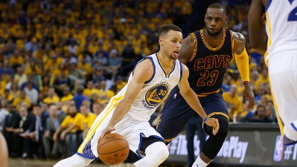

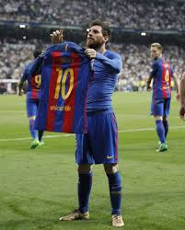
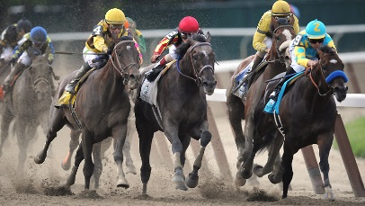

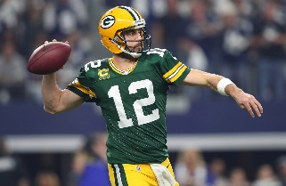
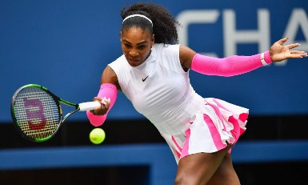

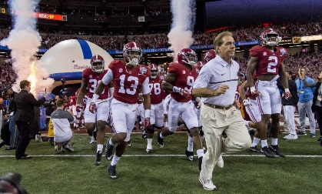
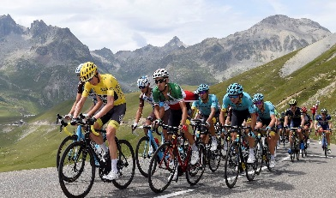

Original Scripted & Reality Programming Is Complemented By Signature Sports Events Throughout The Summer
NBA
Soccer
Horse Racing
Golf
NBA Finals (5/31-7/17)
NBA Draft (6/21)
World Cup (6/14-7/15)
Champions League Final (6/26)
MLS All-Star Game (8/1)
Belmont Stakes (6/9)
NFL
Tennis
US Women’s Open (5/31-6/3)
US Open (6/11-17)
British Open (7/15-22)
PGA Championships (8/9-12)
Fedex Cup Playoffs (8/23-9/23)
NHL
NFL Preseason (August)
NFL Season Kick-Off (9/6)
NCAA Football
Stanley Cup Finals (June)
French Open (5/27-6/10)
Wimbledon (7/2-15)
US Open (8/27-9/9)
Cycling
Extreme Sports
NCAA Football Kick-Off (8/25)
Tour De France (7/7-7/29)
Summer X-Games (7/19-22)
VAB: THE REAL SUMMER GETAWAY

Slide 16
In Addition To Signature Events, Several Sports Offer Continuity Across The Summer Months
VAB: THE REAL SUMMER GETAWAY
Note: Some 2018 dates are tentative

Slide 17

Summer TV Trends:
Showcasing Season-long Stability

Slide 18
The Number Of Days That The Average Household Is Tuned Into TV Is Similar For Both Summer & Non-Summer Months
Annual Monthly Average
25
VAB: THE REAL SUMMER GETAWAY
Source: VAB Analysis of Nielsen Npower Segmentation Report, Household, broadcast + cable TV, based on standard calendar months in 2017, Live+7

Slide 19
The Close Similarity In The Number Of Tune-In Days During Summer & Non-Summer Months Holds True Across Demos
Monthly average
Monthly average
Monthly average
VAB: THE REAL SUMMER GETAWAY
Source: VAB Analysis of Nielsen Npower Segmentation Report, broadcast + cable TV, based on standard calendar months in 2017, Live+7

Slide 20
Monthly Household Reach Remains Steady During Summer Months Compared To Non-Summer Months
Annual Monthly Average
96%
VAB: THE REAL SUMMER GETAWAY
Source: VAB analysis of Nielsen NPower R+F Time Period Report, Household, Total Day, broadcast + cable TV, based on standard calendar months in 2017, Live+7

Slide 21
Monthly Reach Also Holds Relatively Steady Across Demos During Summer & Non-Summer Months
Monthly average
Monthly average
Monthly average
VAB: THE REAL SUMMER GETAWAY
Source: VAB analysis of Nielsen Npower R+F Time Period Report, Total Day, broadcast + cable TV, based on standard calendar months in 2017, Live+7

Slide 22
Even On Popular Summer Holidays, Daily Reach Is Fairly Comparable To An Average Day Within The Same Month
% Ad-Supported TV Daily Reach (Total Day)
Live+SD
May
(Memorial Day)
July
(July 4th)
September
(Labor Day)
 | Memorial Day (Monday) | Other Mondays | Change | July 4th (Tuesday) | Other Tuesdays | Change | Labor Day (Monday) | Other Mondays | Change
Household | 82% | 83% | -1% | 78% | 80% | -2% | 82% | 83% | -1%
P13-17 | 43% | 40% | +3% | 35% | 39% | -4% | 40% | 37% | +3%
P18-24 | 39% | 38% | +1% | 35% | 36% | -1% | 37% | 36% | +1%
P25-34 | 52% | 53% | -1% | 46% | 48% | -2% | 51% | 53% | -2%
P35-49 | 70% | 69% | +1% | 64% | 64% | --- | 69% | 70% | -1%
“Other” Day = Average of other weekdays (i.e: Mondays) in the holiday month
VAB: THE REAL SUMMER GETAWAY
Source: VAB analysis of Nielsen Npower R+F Time Period Report, Live+SD, Total Day, broadcast + cable TV, based on 2017 dates, Live+SD.

Slide 23
On Average, Monthly Time Spent With Ad-Supported TV At The Household Level Is Only 4% Lower During Summer Months
235:31
217:08
207:24
219:10
215:18
222:17
201:09
205:31
198:29
201:40
205:32
207:07
Annual Monthly Average
211:18
VAB: THE REAL SUMMER GETAWAY
Source: VAB analysis of Nielsen Npower R+F Time Period Report, Total Day, Household, broadcast + cable TV, based on standard calendar months in 2017, Live+7

Slide 24
On A Demo Basis, Monthly Time Spent Is Only 6% Lower On Average During The Summer Vs. Winter Months
Monthly average
Monthly average
Monthly average
34:47
33:59
33:24
43:31
41:40
42:56
67:57
61:55
66:24
99:34
91:23
101:00
VAB: THE REAL SUMMER GETAWAY
Source: VAB analysis of Nielsen Npower R+F Time Period Report, Total Day, broadcast + cable TV, based on standard calendar months in 2017, Live+7

Slide 25
In Most Instances, People Are Watching More Ad-Supported TV
On Popular Summer Holidays Than On Comparable Days
% Ad-Supported TV Daily Time Spent (Total Day)
Live+SD (Hrs:Mins)
May
(Memorial Day)
July
(July 4th)
September
(Labor Day)
 | Memorial Day (Monday) | Other Mondays | Change | July 4th (Tuesday) | Other Tuesdays | Change | Labor Day (Monday) | Other Mondays | Change
Household | 8:13 | 7:50 | +:23 | 7:57 | 7:52 | +:05 | 8:26 | 8:05 | +:21
P13-17 | 2:47 | 2:22 | +:25 | 2:41 | 2:51 | -:10 | 2:33 | 2:18 | +:15
P18-24 | 3:16 | 3:10 | +:06 | 3:07 | 3:13 | -:06 | 3:22 | 3:19 | +:03
P25-34 | 3:54 | 3:31 | +:23 | 3:34 | 3:30 | +:04 | 3:57 | 3:41 | +:16
P35-49 | 4:39 | 4:11 | +:28 | 4:31 | 4:09 | +:22 | 4:45 | 4:19 | +:26
“Other” Day = Average of other weekdays (i.e: Mondays) in the holiday month
VAB: THE REAL SUMMER GETAWAY
Source: VAB analysis of Nielsen Npower R+F Time Period Report, Live+SD, Total Day, broadcast + cable TV, based on standard calendar months in 2017, Live+SD.

Slide 26
The Large Majority Of Ad-Supported TV Viewing During The Summer Is Done “Live” & Is On Par With The Rest of The Year
Annual Monthly Average
90%
VAB: THE REAL SUMMER GETAWAY
Source: VAB analysis of Nielsen NPower R+F Time Period Report, all TV Households, Total Day, broadcast + cable TV, based on standard calendar months in 2017, Live & Live+7

Slide 27
“Live” TV Also Represents The Large Majority Of Ad-Supported TV Viewing Across Demos And Is Stable Across The Year
Monthly average
Monthly average
Monthly average
VAB: THE REAL SUMMER GETAWAY
Source: VAB analysis of Nielsen Npower R+F Time Period Report, based on TV demo population, Total Day, broadcast + cable TV, based on standard calendar months in 2017, Live & Live+7

Slide 28

The Summer Solstice For TV Brands:
Achieving A High Point Through
Multi-screen TV

Slide 29
TV Brands’ Digital Reach Is Nearly Universal Among The Digital Population Throughout The Year, Including Summer
Annual Monthly Average
253,607
VAB: THE REAL SUMMER GETAWAY
Source: VAB Analysis of comScore Media Metrix Audience Duplication, Calendar Months, 2017, P2+ (desktop/laptop) / P18+ (mobile), Custom Ad-Supported TV Group, cume unique reach

Slide 30
Regardless Of The Time Period, TV Brands’ Digital Reach Is Nearly Universal Across The Major Demos As Well
Monthly average
Monthly average
Monthly average
VAB: THE REAL SUMMER GETAWAY
Source: VAB Analysis of comScore Media Metrix Audience Duplication, Calendar Months, 2017, Custom Ad-Supported TV Group, average cume unique reach.

Slide 31

























There Is A Thirst For Online TV Content During The Summer As Many Supported TV Brands Rank In The Top 5 Across Most Major Genres
Top 5 Rank by Internet Genre: August 2017
Total Audience
Sports
Sports
LGBTQ
TV Entertainment - Black
General News
Finance News
Adam4Adam
Yahoo Finance
Here Media
MSN Money
Online Buddies
Queerty
Dow Jones
Home
Weather
TV Entertainment
Food
Kids
Roblox
Hearst Lifestyle
AccuWeather
Allrecipes
Hometalk
WeatherBug
MSN Food & Drink
Houzz
MSN Weather
Bon Appetit
PBS Kids
CafeMedia Home
Yahoo Weather
HBONow
CafeMedia Food
TotallyKidz
VAB: THE REAL SUMMER GETAWAY
Source: VAB analysis of Media Metrix multi-platform comScore data, August 2017 (Ranking based on “Total Minutes Viewed”), P2+ (desktop/laptop) / P18+ (mobile)

Slide 32




This Thirst For Online TV Content During The Summer Holds True For Millennials As Well
Top 5 Rank by Internet Genre: August 2017
A18-34
Sports
Sports
Comedy
TV Entertainment - Black
General News
LGBTQ
Resignation Media
Buzzfeed
Adam4Adam
9GAG
Electus
Here Media
Queerty
EBaumsworld
HBO Now
Totally LGBT
Home
Weather
TV Entertainment
Food
Kids
Hearst
Bon Appetit
Roblox
AccuWeather
Houzz
WeatherBug
CafeMedia Food
CafeMedia Home
MSN Weather
Allrecipes
PBS Kids
Talemetry
Yahoo Weather
HBO Now
Time Inc Food
Totally Kidz
VAB: THE REAL SUMMER GETAWAY
Source: VAB analysis of Media Metrix multi-platform comScore data, August 2017 (Ranking based on “Total Minutes Viewed”)

Slide 33
During The Summer, The Combined Multi-Screen TV Audience Continues To Be Much Larger Than Popular Digital Platforms
Source: Nielsen Npower Live+7 August 2017, P18+, VAB analysis of comScore duplicated 2017 data (mediametrix, multiplatform). Ad-Supported Television Brands represents all measured Ad-Supported Cable nets, Broadcast Television and MVPDs.
On average, in any given minute, the ad-supported multi-screen TV P18+ audience is:
12x larger than Facebook & 8x larger than YouTube
Multiscreen (TV + online)
Multiscreen (TV + online)
Multiscreen (TV + online)
Multiscreen (TV + online)
Source: multi-screen TV data based on VAB Analysis of Nielsen Npower R+F Time Period Report, 2017, P18+, Live+7, includes all ad-supported TV viewing sources & VAB analysis of comScore audience duplication, P18+, 2017 data (mediametrix, multiplatform). Ad-Supported Television Brands represents all measured Ad-Supported Cable nets, Broadcast Television and MVPDs. Digital platform data: comScore Media Trend, P18+, 2017 except for YouTube data which is based on VAB analysis of comScore Video Metrix, 2017, P18+.

Slide 34
Against Millennials, The Multi-Screen TV Audience Is Also Much Larger Than Popular Digital Platforms During The Summer
On average, in any given minute, the ad-supported multi-screen TV P18-34 audience is:
6x larger than Facebook & over 2x larger than YouTube
Multiscreen (TV + online)
Multiscreen (TV + online)
Multiscreen (TV + online)
Multiscreen (TV + online)
Source: multi-screen TV data based on VAB Analysis of Nielsen Npower R+F Time Period Report, 2017, P18-34, Live+7, includes all ad-supported TV viewing sources & VAB analysis of comScore audience duplication, P18-34, 2017 data (mediametrix, multiplatform). Ad-Supported Television Brands represents all measured Ad-Supported Cable nets, Broadcast Television and MVPDs. Digital platform data: comScore Media Trend, P18-34, 2017 except for YouTube data which is based on VAB analysis of comScore Video Metrix, 2017, P18-34.

Slide 35

The Summer Social Scene:
Examining TV’s Popularity In Online Conversations

Slide 36
Nothing Gets People Talking Online Like Ad-Supported TV;
It’s The Most Popular Type Of Trending Topic During The Summer
Ad-Supported TV accounted for Nearly 7 Of The Top 10 trending Twitter topics through a four-week primetime period in early summer last year (May ’17 / June ‘17)
67%
Overall Total % of TV-topics in Top 10 During Primetime
Although this analysis was conducted as the summer season was getting underway between May-June,
ad-supported TV continued to dominate the top social conversations on Twitter
8:30p
Total % of
TV-topics In Top 10: 50%
9:30p
Total % of
TV-topics In Top 10: 70%
10:30p
Total % of
TV-topics In Top 10: 76%
11:30p
Total % of
TV-topics In Top 10: 72%
VAB: THE REAL SUMMER GETAWAY
Source: VAB custom analysis of Top 10 trending Twitter Topics each night (8:30p, 9:30p, 10:30p, 11:30p) aggregated during 4-week time period (5/15/2017 – 6/11/2017). Results include both “direct” and “related” TV topics.

Slide 37
There Was Virtually No Difference In TV’s Social Popularity Between May And The Post Memorial Day Time Period
TV-related topics dominated social conversations both before and after the first summer holiday; Television even held a majority of the top trending topics during Memorial Day Weekend itself
Topic Breakout: Overall Total % of Top 10 Trending Twitter Topics
May - Pre-Memorial Day Weekend
(May 15th – May 25th)
Memorial Day Weekend - June
(May 26th – June 11th)
Memorial Day Weekend: 58%
VAB: THE REAL SUMMER GETAWAY
Source: VAB custom analysis of Top 10 trending Twitter Topics each night (8:30p, 9:30p, 10:30p, 11:30p) during 4-week time period (5/15/2017 – 6/11/2017). Pre-Memorial Day Weekend = 5/15 – 5/25; Memorial Day Weekend & Beyond = 5/26 – 6/11; Memorial Day Weekend = Friday, 5/26 – Monday, 5/29. Results include both “direct” and “related” TV topics.

Slide 38
Overall, At Least Half Of The Top 10 Trending Topics On
Any Summer Night Were Based on Ad-Supported TV Content
Four Week Average: % of Top 10 Trending Topics That Are Based On TV Content
Monday
Tuesday
Wednesday
Thursday
Friday
Saturday
Sunday
Overall
81%
69%
66%
68%
51%
56%
78%
8:30p
65% 48% 40% 38% 35% 48% 78%
9:30p
85% 73% 68% 75% 55% 55% 80%
10:30p
85% 80% 80% 80% 58% 68% 80%
11:30p
88% 75% 78% 78% 58% 55% 73%
VAB: THE REAL SUMMER GETAWAY
Source: VAB custom analysis of Top 10 trending Twitter Topics each night (8:30p, 9:30p, 10:30p, 11:30p) during 4-week time period (5/15/207 – 6/11/2017). Reflects four week average by day and time. Results include both “direct” and “related” TV topics.

Slide 39
Members Slide
The Majority Of The Top 10 Trending Twitter TV Topics Involved Programming On Ad-Supported Cable TV
Four-Week Time Period
% Breakout of Ad-Supported TV Topics By Medium
*Ad-Supported Cable TV & Broadcast TV includes programs or topics that aired, or were discussed, on multiple networks such as popular news events (i.e., the Comey testimony) or soccer events.
VAB: THE REAL SUMMER GETAWAY
Source: VAB custom analysis of Top 10 trending Twitter Topics each night (8:30p, 9:30p, 10:30p, 11:30p) aggregated during 4-week time period (5/15/2017 – 6/11/2017). Results include both “direct” and “related” TV topics.

Slide 40
Sports & Entertainment Both Account For A Large Portion Of The Total Ad-Supported TV Topics That Trended In The Top 10
Four-Week Time Period
Genre % Breakout of Top 10 Ad-Supported TV Trending Topics
VAB: THE REAL SUMMER GETAWAY
Source: VAB custom analysis of Top 10 trending Twitter Topics each night (8:30p, 9:30p, 10:30p, 11:30p) aggregated during 4-week time period (5/15/2017 – 6/11/2017). Results include both “direct” and “related” TV topics.

Slide 41
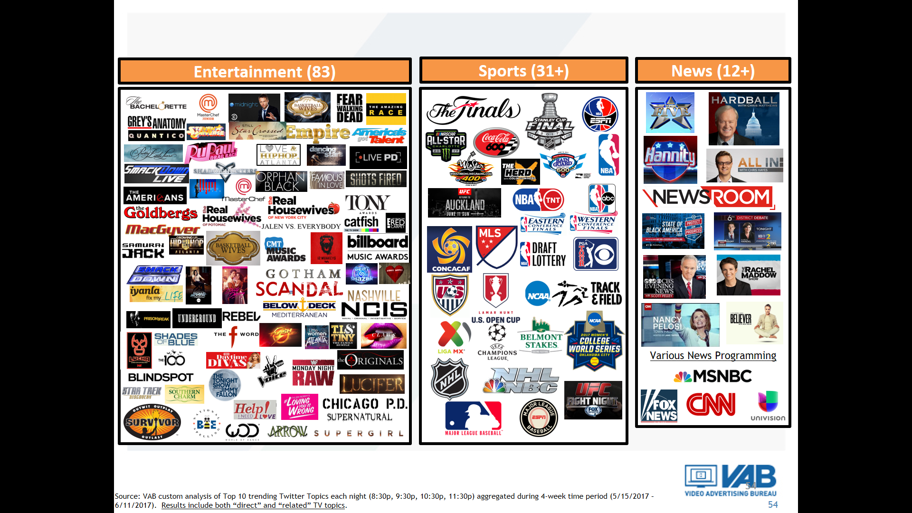
Over 126 TV Programs Trended During The Four Week Analysis Which Speaks To The Breadth Of Summer Programming
VAB: THE REAL SUMMER GETAWAY
Source: VAB custom analysis of Top 10 trending Twitter Topics each night (8:30p, 9:30p, 10:30p, 11:30p) during 4-week time period (5/15/2017 – 6/11/2017). Results include both “direct” and “related” TV topics.

Slide 42
Ad-Supported TV Owns The Summer Social Space When It Comes To Conversations Around Entertainment Content
Interestingly, two of the three Netflix shows that trended in the Top 10 on Twitter did so because the streaming service announced their cancellation (The Get Down & Sense8)
Four-Week Time Period
# of Top 10 Trending Entertainment Programs / Content By Platform
(HBO, Showtime, Starz)
(UFC Fight Pass, WWE Network)
Other platform “program” highlights: Netflix – House of Cards, Sense8, The Get Down; Music – T-Wayne, Rake It Up; Online Radio – Most Requested Live (iHeart Radio); YouTube – Car Boys; HBO – HBO Boxing, Mommy Dead & Dearest, Real Time with Bill Maher, The Leftovers; Showtime – Twin Peaks; Starz – American Gods; PPV – UFC 212; Facebook Live – CFDAAwards; Snapchat – Ask Ethan & Grayson; WWE Network – WWE Backlash; Video Games – Injustice 2, Life Is Strange 2; Other streaming – E3
Source: VAB custom analysis of Top 10 trending Twitter Topics each night (8:30p, 9:30p, 10:30p, 11:30p) during 4-week time period (5/15/2017 – 6/11/2017). Based on unique program counts. For the purposes of this chart, “program / content” is an all-encompassing definition for individual pieces of content on each platform (albums & singles for music, video games, channel on YouTube, live streaming and/or personality on a social media platform, etc).

Slide 43

Summer In The Cinema:
Delivering Scale Among Younger Audiences

Slide 44




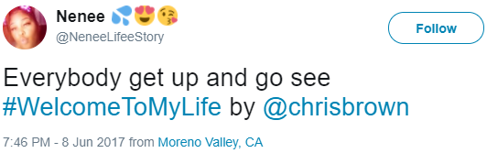
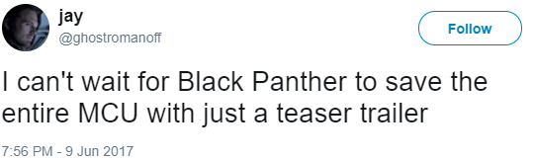
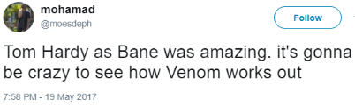
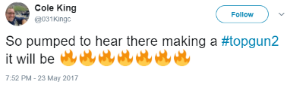
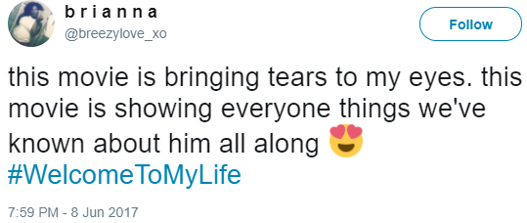
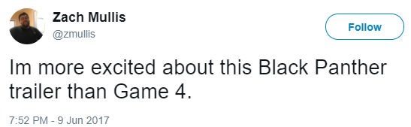
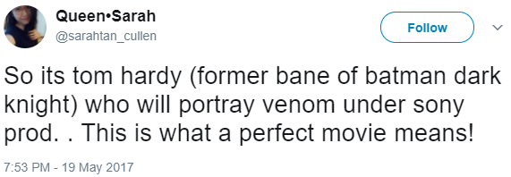
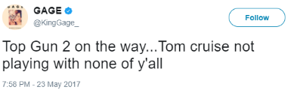
People Can’t Wait To Share Their Excitement Online When They Hear About Movie-Related Content & Subjects
Examples of movie topics that trended in the top 10 on Twitter during early summer 2017
Special Premieres
New Trailer Released
Production Announcements
Cast & Crew Announcements
Thurs, June 8th – Chris Brown: Welcome To My Life is shown in theatres for one night only
_____________
#WelcomeToMyLife trends in the top 10 that night (reaches #6)
Fri, June 9th – Marvel releases the new trailer for Black Panther
_____________
Black Panther is #1 trending topic at Twitter during the 10:30p period
Fri, May 19th – Tom Hardy announced as Venom in a new Spiderman spinoff movie
_____________
Tom Hardy trends in the top 10 that night (reaches #6)
Tues, May 23rd – Tom Cruise tells an Australian talk show that Top Gun 2 will be filming in the next year.
_____________
Top Gun 2 trends in the top 10 throughout the night (reaches #4)
VAB: THE REAL SUMMER GETAWAY
Source: VAB custom analysis of Top 10 trending Twitter Topics each night (8:30p, 9:30p, 10:30p, 11:30p) during 4-week time period (5/15/2017 – 6/11/2017).

Slide 45
Cinema Delivers High Reach In Key Demographics During The Summer
VAB: THE REAL SUMMER GETAWAY
Source: VAB Analysis of Nielsen Media Impact, Cinema = NCM & Screenvision, 5/28/17-9/10/17. Reach vs. demo population.

Slide 46
In Addition To The Reach Provided By TV, Look No Farther Than The Local Cineplex To Find Millennials During The Summer
Cinema has a much higher composition of Millennials than digital platforms
Summer Audience Composition
Cinema vs. Total Internet (July)
VAB: THE REAL SUMMER GETAWAY
Source: Nielsen Cinema Audience Report, July 2017 for cinema audience composition. VAB Analysis of comScore July 2017, Media Trend Multiplatform for Total Internet based on unique visitors. Composition for both cinema and digital based on P2+.

Slide 47
Cinema Provides Both Scale & High Concentration Of Millennials In Comparison To The Most Popular & Targeted Digital Platforms
P18-34 Audience Composition
Cinema vs. Select Digital Platforms (25MM+ P18-34 UVs)
VAB: THE REAL SUMMER GETAWAY
Source: Nielsen Media Impact, July 2017 for unique cinema reach P18-34 (25MM+); Nielsen Cinema Audience Report, July 2017 for cinema audience composition. comScore July 2017, mediametrix multiplatform for we domains (excluding Snapchat which was pulled at the property level). P18-34 composition for both cinema and digital based on total measured audience of each platform.

Slide 48
Against Millennials, Cinema Has The Ability To Add Double-Digit Reach To Television During The Summer
+9% Reach
+14% Reach
+10% Reach
22,385
+17% Reach
21,689
17,635
16,835
VAB: THE REAL SUMMER GETAWAY
Source: VAB Analysis of Nielsen Media Impact 5/28/17 – 9/10/17; Cinema includes NCM & Screenvision; P18-24, P25-34.

Slide 49













Big Theatrical Releases Are Slated Throughout Summer 2018 Featuring Top Stars & Popular Franchises
May 25
June 8
June 15
June 22
June 29
June 29
July 4
July 6
July 13
July 20
July 27
August 3
VAB: THE REAL SUMMER GETAWAY
Note: Some release dates are tentative

Slide 50


Slide 51
Time Spent With Radio Is Relatively Flat During The Summer Months And Continues To Be Dwarfed By Television
Members Slide
VAB: THE REAL SUMMER GETAWAY
Source: VAB Analysis of Nielsen Comparable Metrics Report, P18+. TV reflects Live + DVR/Timeshifted; Radio reflects AM/FM terrestrial radio.

Slide 52
Time Spent With Radio By Millennials Is Also Relatively Flat During The Summer Months And Is Dwarfed By Television
Members Slide
VAB: THE REAL SUMMER GETAWAY
Source: VAB Analysis of Nielsen Comparable Metrics Report, P18-34. TV reflects Live + DVR/Timeshifted; Radio reflects AM/FM terrestrial radio.

Slide 53
Much Like Total Day, Monthly Household Primetime Reach Remains Steady During Summer Months
Members Slide
Annual Monthly Average
94%
VAB: THE REAL SUMMER GETAWAY
Source: VAB analysis of Nielsen NPower R+F Time Period Report, Household, Primetime, broadcast + cable TV, based on standard calendar months in 2017, Live+7

Slide 54
There’s Only A Slight Decline In Primetime Monthly Reach Across Demos During The Summer Months
Members Slide
Monthly average
Monthly average
Monthly average
VAB: THE REAL SUMMER GETAWAY
Source: VAB analysis of Nielsen Npower R+F Time Period Report, Primetime, broadcast + cable TV, based on standard calendar months in 2017, Live+7

Slide 55
On Average, Primetime Viewing At The Household Level Is Only 7% Lower During Summer Months
Members Slide
57:55
56:37
50:37
54:16
51:43
51:37
46:43
46:45
49:04
53:40
52:12
49:26
Annual Monthly Average 51:43
VAB: THE REAL SUMMER GETAWAY
Source: VAB analysis of Nielsen Npower R+F Time Period Report, Household, Primetime, broadcast + cable TV, based on standard calendar months in 2017, Live+7

Slide 56
On A Demo Basis, Primetime Viewing Is 13% Lower On Average During The Summer Vs. Winter Months
Members Slide
Monthly average
Monthly average
Monthly average
10:47
9:16
10:11
12:17
11:01
12:11
20:20
17:25
19:57
28:37
24:41
28:38
VAB: THE REAL SUMMER GETAWAY
Source: VAB analysis of Nielsen Npower R+F Time Period Report, Primetime, broadcast + cable TV, based on standard calendar months in 2017, Live+7

Slide 57
Slightly More Ad-Supported TV Is Watched “Live” As A Percent Of Total Primetime Viewing During The Summer Months
Members Slide
Annual Monthly Average
82%
VAB: THE REAL SUMMER GETAWAY
Source: VAB analysis of Nielsen NPower R+F Time Period Report, all TV Households, Primetime, broadcast + cable TV, based on standard calendar months in 2017, Live & Live+7

Slide 58
The Younger Demos Tend To Watch More Of Their Ad-Supported TV Viewing “Live” Throughout The Year
Members Slide
Monthly average
Monthly average
Monthly average
VAB: THE REAL SUMMER GETAWAY
Source: VAB analysis of Nielsen Npower R+F Time Period Report, based on TV demo population, Primetime, broadcast + cable TV, based on standard calendar months in 2017, Live & Live+7

