Slide 1




Reaching ‘Corded’ and ‘Cordless’ Audiences Through Video Streaming

Slide 2


Video streaming has evolved into a nearly ubiquitous behavior across all ‘corded’ and ‘cordless’ audiences.
Why is this important to marketers?
Regardless of ‘cord’ status, most adults have streamed in the last year, showcasing the growing opportunity marketers have to reach audiences, particularly ‘cord cutters’ and ‘cord nevers’.
As more people turn to streaming platforms, particularly free / ad-based ones, marketers can connect with engaged viewers through relevant messaging that inspires action and drives brand success.
This information is exclusively provided to VAB members and qualified marketers. Further distribution is prohibited.
PAGE 2

Slide 3

Video Streaming’s Growth Spurt: A Nearly Ubiquitous Behavior Across Audiences

Slide 4
The four largest video viewer segments out of the 10 measured ‘cord’ groups in MRI-Simmons Cord Evolution Study represent 88% of the adult population
% of Adult Population by ‘Cord’ Status
‘Corded’
‘Cordless’
39%
5%
26%
18%
Cord Loyalists
Cord Shavers
Cord Cutters
Cord Nevers
Households with Pay-TV who have made no changes to their subscription
Households with Pay-TV, but have reduced their services or channels
Households that previously had a Pay-TV subscription but cancelled it
Households that have never had a Pay-TV subscription
53% of adults 18+ subscribe to Pay TV with the two largest ‘corded’ groups - ‘cord loyalists’ and ‘cord shavers’ - accounting for 83% of MVPD subscribers
Source: MRI-Simmons, Cord Evolution Study, July 2021, P18+. ‘Cord Loyalists’ (99.2MM), ‘Cord Cutters’ (66.0MM), ‘Cord Nevers’ (44.9MM), ‘Cord Shavers’ (12.3MM). MVPD Subscribers = 134.8MM (53.3% of adult 18+ population). MVPD / Pay-TV = HH subscribers to cable, satellite or fiber optic TV.
This information is exclusively provided to VAB members and qualified marketers. Further distribution is prohibited.
PAGE 4

Slide 5

Regardless of cord status, the overwhelming percent of adults have streamed in the last year, underscoring its reach potential
‘Cord cutters’ are the most likely to stream as they look to replace the large amount of content they had access to through their MVPD subscription while the ‘corded’ are stacking video subscriptions
% that have ‘streamed in the past 12 months’
based on respondent ‘cord’ status
‘Corded’
‘Cordless’
Cord Loyalists
Cord Shavers
Cord Cutters
Cord Nevers
+7% pp
vs. 2018
+12% pp
vs. 2018
+13% pp
vs. 2018
+15% pp
vs. 2018
July ‘21
69%
85%
92%
86%
July ‘18
61%
73%
79%
71%
Source: VAB analysis of MRI-Simmons Cord Evolution Study, July 2018, July 2019, July 2020 & July 2021, P18+. ‘Cord Loyalists’: have pay-TV; no changes, ‘Cord Shavers’: have pay-TV; reduced services or channels, ‘Cord Cutters’: no pay-TV; cancelled it, ‘Cord Nevers’: no pay-TV; never had it. PP = percentage points.
This information is exclusively provided to VAB members and qualified marketers. Further distribution is prohibited.
PAGE 5

Slide 6

Each of the major ‘cord’ groups has a strong passion for streaming TV content which fosters greater engagement, translating into more attentive audiences
‘I love streaming TV shows’
% of streamers who agree, based on respondent ‘cord’ status
Cord Loyalists
Cord Shavers
‘Corded’
81%
77%
Cord Cutters
Cord Nevers
‘Cordless’
82%
79%
Source: VAB analysis of MRI-Simmons Cord Evolution Study, July 2018, July 2019, July 2020 & July 2021, P18+. ‘Cord Loyalists’: have pay-TV; no changes, ‘Cord Shavers’: have pay-TV; reduced services or channels, ‘Cord Cutters’: no pay-TV; cancelled it, ‘Cord Nevers’: no pay-TV; never had it. Base = ‘Streamed in the past 12 months’; respondents who agree (strongly / somewhat).
This information is exclusively provided to VAB members and qualified marketers. Further distribution is prohibited.
PAGE 6

Slide 7
Covid served as a streaming accelerator as viewers added new services, with almost all saying they will keep them even after the pandemic
% of video streamers that
added a new streaming service as a result of COVID-19
Based on respondent ‘cord’ status
% of video streamers that are
likely to keep their new streaming services after COVID-19 ends
Based on respondent ‘cord’ status
Cord Loyalists
Cord Shavers
Cord Loyalists
Cord Shavers
‘Corded’
54%
56%
96%
95%
Cord Cutters
Cord Nevers
Cord Cutters
Cord Nevers
‘Cordless’
66%
62%
98%
95%
Source: VAB analysis of MRI-Simmons Cord Evolution Study, July 2021, P18+. ‘Cord Loyalists’: have pay-TV; no changes, ‘Cord Shavers’: have pay-TV; reduced services or channels, ‘Cord Cutters’: no pay-TV; cancelled it, ‘Cord Nevers’: no pay-TV; never had it. Added a new streaming service: Base = ‘Streamed in the past 12 months’. Likely to keep new streaming services: Base = ‘Added a new streaming service as a result of COVID-19’
This information is exclusively provided to VAB members and qualified marketers. Further distribution is prohibited.
PAGE 7

Slide 8
Usage of free / ad-based streaming services is seeing double-digit growth while paid subscription services are reaching a saturation point among ‘corded’ groups
% with access to free / ad-based vs. subscription streaming services
July ‘18 vs. July ‘21
Cord Loyalists
Cord Shavers
+8%
vs. 2018
-1%
vs. 2018
+10%
vs. 2018
+19%
vs. 2018
Source: VAB analysis of MRI-Simmons Cord Evolution Study, July 2018 and July 2021, P18+. ‘Cord Loyalists’: have pay-TV; no changes, ‘Cord Shavers’: have pay-TV; reduced services or channels, Base = ‘Streamed in the past 12 months’. Free Streaming services (e.g., Pluto TV, YouTube, Tubi, etc.). Subscription services may include ads or limited ad load tiers.
This information is exclusively provided to VAB members and qualified marketers. Further distribution is prohibited.
PAGE 8

Slide 9
An even higher percentage of ‘cord cutters’ and ‘cord nevers’ are turning to free / ad-based streaming services, signaling a burgeoning incremental reach opportunity among these elusive audiences
% with access to free / ad-based vs. subscription streaming services
July ‘18 vs. July ‘21
Cord Cutters
Cord Nevers
flat
vs. 2018
-3%
vs. 2018
+38%
vs. 2018
+48%
vs. 2018
Source: VAB analysis of MRI-Simmons Cord Evolution Study, July 2018 and July 2021, P18+. ‘Cord Cutters’: no pay-TV; cancelled it, ‘Cord Nevers’: no pay-TV; never had it. Base = ‘Streamed in the past 12 months’. Free Streaming services (e.g., Pluto TV, YouTube, Tubi, etc.). Subscription services may include ads or limited ad load tiers.
This information is exclusively provided to VAB members and qualified marketers. Further distribution is prohibited.
PAGE 9

Slide 10
Collectively, the number of ‘cord cutters’ and ‘cord nevers’ has nearly doubled over the last three years, underscoring the importance of streaming video as an incremental reach opportunity
‘Cordless’ audiences now account for 44% of adults vs. 23% in 2018, with significant growth in ‘cord cutters’ occurring during Covid
% of adults 18+ who are ‘Cord Cutters’ or ‘Cord Nevers’
+63%
vs. 2020
+13%
vs. 2020
Source: VAB analysis of MRI-Simmons Cord Evolution Study, July 2018, July 2019, July 2020 & July 2021, P18+. ‘Cord Cutters’: no pay-TV; cancelled it, ‘Cord Nevers’: no pay-TV; never had it.
This information is exclusively provided to VAB members and qualified marketers. Further distribution is prohibited.
PAGE 10
This information is exclusively provided to VAB members and qualified marketers. Further distribution is prohibited.

Slide 11
It’s important to understand that TV is TV to most ‘cordless’ people –
they are just watching across different platforms, connections and devices
How do you personally define TV?
% of video streamers based on respondent ‘cord’ status
“Anything I can watch on my TV set whether it's via streaming or cable, satellite, fiber optic provider”
“Any shows available via cable, satellite, fiber optic provider”
“Anything I can watch on any device”
“Any shows created by a TV network”
46% / 46%
32% / 27%
7% / 11%
15% / 16%
vs. adults 18+: 48%
vs. adults 18+: 24%
vs. adults 18+: 13%
vs. adults 18+: 15%
Source: VAB analysis of MRI-Simmons Cord Evolution Study, July 2021, P18+. ‘Cord Cutters’: no pay-TV; cancelled it, ‘Cord Nevers’: no pay-TV; never had it. ‘How do you personally define TV?’. Base = ‘Streamed in the past 12 months’.
This information is exclusively provided to VAB members and qualified marketers. Further distribution is prohibited.
PAGE 11
This information is exclusively provided to VAB members and qualified marketers. Further distribution is prohibited.

Slide 12

Because of this, streaming TV has largely replaced traditional TV for many of them, a consistent attitude among ‘cord cutters’ and ‘cord nevers’ over the last few years
‘Streaming has replaced traditional TV for me’
% of video streamers who agree, based on respondent ‘cord’ status
Source: VAB analysis of MRI-Simmons Cord Evolution Study, July 2019 & 2021, P18+. ‘Cord Cutters’: no pay-TV; cancelled it, ‘Cord Nevers’: no pay-TV; never had it. ‘Streaming has replaced traditional TV for me’ (strongly / somewhat agree). Base = ‘Used any streaming service in the past 12 months’.
This information is exclusively provided to VAB members and qualified marketers. Further distribution is prohibited.
PAGE 12

Slide 13





Not surprisingly, many ‘cord cutters’ and ‘cord nevers’ are attracted to streaming services offering a wide variety of high-quality library content that either originally aired, or is airing, on traditional TV networks
What drives you to want to use / subscribe to a new streaming service?
% of streamers (top 5 ranked), based on respondent ‘cord’ status
Library content
Original content
Library content
56% / 43%
54% / 41%
42% / 35%
Access to movies (old & new releases)
Access to original series exclusive to service
Access to series that no longer air on traditional TV networks
(e.g., Friends, How I Met Your Mother, Friday Night Lights, etc.)
Live content
Live content
37% / 32%
22% / 20%
Access to series that are currently airing on traditional TV networks
(e.g., The Walking Dead, The Good Place, This Is Us, etc.)
Access to sports events the service streams
Source: VAB analysis of MRI-Simmons Cord Evolution Study, July 2019, 2020 & 2021, P18+. ‘Cord Cutters’: no pay-TV; cancelled it, ‘Cord Nevers’: no pay-TV; never had it. Base = ‘Used any streaming service in the past 12 months’.
This information is exclusively provided to VAB members and qualified marketers. Further distribution is prohibited.
PAGE 13
This information is exclusively provided to VAB members and qualified marketers. Further distribution is prohibited.

Slide 14
AVOD Drives Reach and Engagement Across All Major ‘Cord’ Groups

Slide 15
Viewers are increasing their usage of ad-supported streaming platforms which is bolstering streaming’s ability to drive incremental reach
% of video streamers that have…
Accessed a free streaming service
Used a TV Everywhere app OR a TV network app in the past 12 months
Used vMVPDs in the past 12 months
Cord Loyalists
22%
58%
8%
Cord Shavers
31%
71%
11%
Cord Cutters
36%
29%
18%
Cord Nevers
37%
25%
8%
Source: VAB analysis of MRI-Simmons Cord Evolution Study, July 2021, P18+. ‘Cord Loyalists’: have pay-TV; no changes, ‘Cord Shavers’: have pay-TV; reduced services or channels, ‘Cord Cutters’: no pay-TV; cancelled it, ‘Cord Nevers’: no pay-TV; never had it. TV network apps include ‘through free TV network apps’ and ‘through paid TV network apps’. Base = ‘Streamed in the past 12 months’.
This information is exclusively provided to VAB members and qualified marketers. Further distribution is prohibited.
PAGE 15

Slide 16
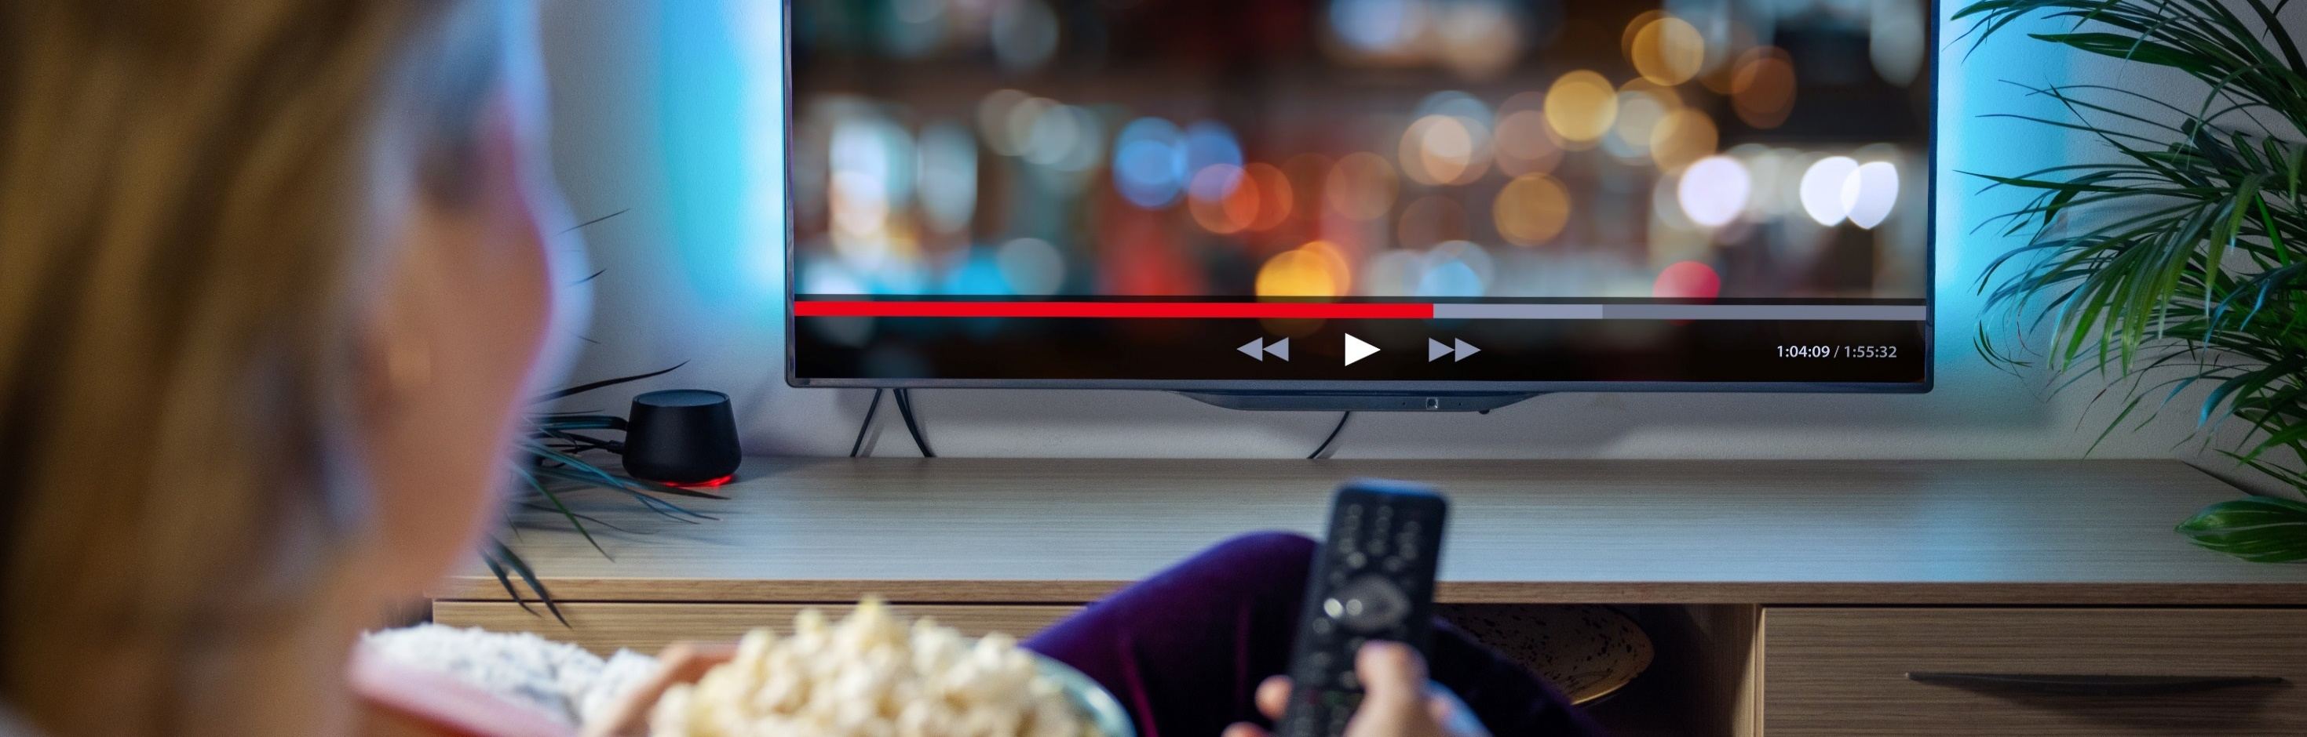
Well over half of video streamers prefer free content with ads rather than pay for a commercial-free subscription
People are generally more tolerant of the limited commercial time found in ad-based streaming services
% of video streamers that agree with the following statements
based on respondent ‘cord’ status
“I prefer streaming free video content with ads/commercials instead of paying for a subscription without ads / commercials”
“I like that streaming services have
less ads / commercials”
64%
64%
87%
86%
57%
63%
84%
85%
Source: VAB analysis of MRI-Simmons Cord Evolution Study, July 2021, P18+. ‘Cord Loyalists’: have pay-TV; no changes, ‘Cord Shavers’: have pay-TV; reduced services or channels, ‘Cord Cutters’: no pay-TV; cancelled it, ‘Cord Nevers’: no pay-TV; never had it. ‘I prefer streaming free video content with ads/commercials instead of paying for a subscription without ads/commercials’ (strongly / somewhat agree). ‘I like that streaming services have less ads/commercials’ (strongly / somewhat agree). Base = ‘Streamed in the past 12 months’.
This information is exclusively provided to VAB members and qualified marketers. Further distribution is prohibited.
PAGE 16

Slide 17


Many video streamers find ads on streaming platforms to be both relevant and memorable, traits which are more likely to spark consumer action
Previously harder-to-reach ‘cord nevers’ are proving to be an especially engaged audience for advertisers through streaming
% of video streamers who agree with the following statements
Based on respondent ‘cord’ status
“The ads/commercials I see on streaming services I use are relevant to me”
“Ads/commercials are more memorable when I see them while streaming”
44%
45%
35%
38%
36%
54%
26%
46%
Source: VAB analysis of MRI-Simmons Cord Evolution Study, July 2021, P18+. ‘Cord Loyalists’: have pay-TV; no changes, ‘Cord Shavers’: have pay-TV; reduced services or channels, ‘Cord Cutters’: no pay-TV; cancelled it, ‘Cord Nevers’: no pay-TV; never had it. ‘The ads/commercials I see on streaming services I use are relevant to me’ (strongly / somewhat agree). ‘Ads/commercials are more memorable when I see them while streaming’ (strongly / somewhat agree). Base = ‘Streamed in the past 12 months’.
This information is exclusively provided to VAB members and qualified marketers. Further distribution is prohibited.
PAGE 17

Slide 18
As streaming grows in its ability to drive greater incremental reach and consumer action, the AVOD opportunity for marketers is expected to more than double in the next five years to over $31 billion by 2026
U.S. AVOD Ad Revenue Forecasts
millions
+141%
vs. 2021
Source: Digital TV Research, Global AVOD Forecasts by Country ($ million), May 2021.
This information is exclusively provided to VAB members and qualified marketers. Further distribution is prohibited.
PAGE 18

Slide 19
Video streaming is a nearly ubiquitous behavior among all ‘corded’ and ‘cordless’ audiences. This shift in viewing behaviors means that marketers can engage with passionate and attentive audiences within premium OTT environments to inspire action and deliver on key business outcomes.
More than half of video streamers prefer to use free ad-supported streaming services rather than pay for another subscription. Marketers can leverage the rising popularity of premium AVOD to ensure their multiscreen video campaigns resonate with all audiences, regardless of their ‘cord’ status.
While the incremental reach opportunity exists across all groups, especially as non-corded groups continue to grow, marketers should consider adding a streaming component (i.e., AVOD, TVE app, TV network app) to their video campaigns to engage consumers at scale.
Key Marketer Takeaways
This information is exclusively provided to VAB members and qualified marketers. Further distribution is prohibited.
PAGE 19

Slide 20
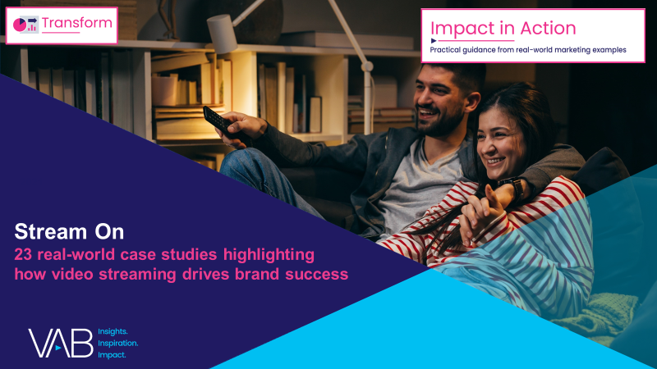
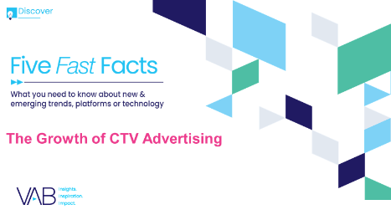
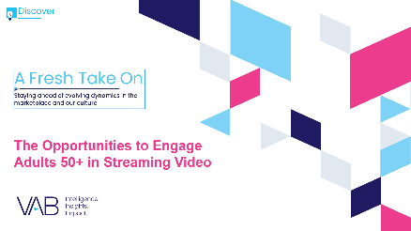
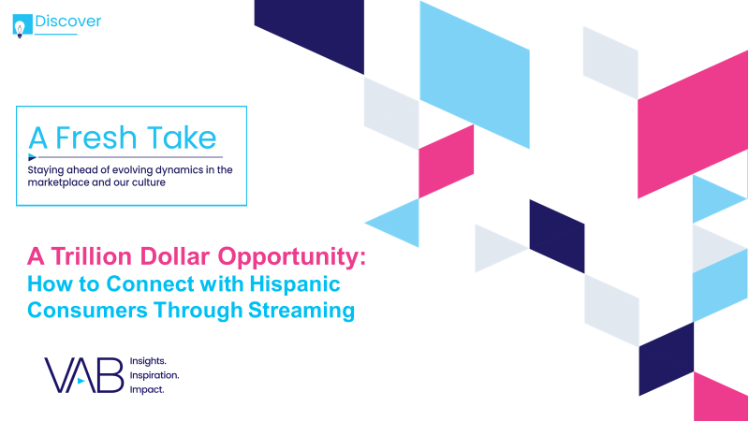
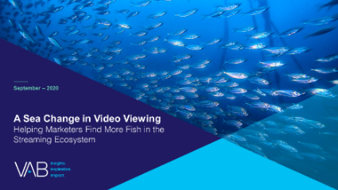
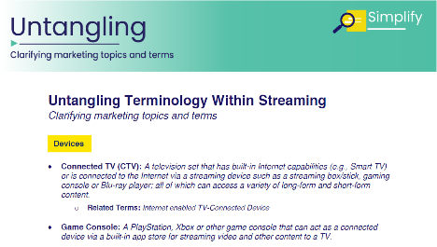
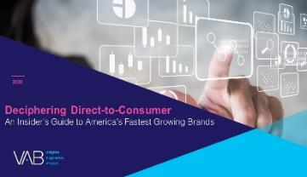
Creators
Jason Wiese
Leah Montner-Dixon
SVP, Director of Strategic Insights
jasonw@thevab.com
Associate Insights Director
leahm@thevab.com
Stream On
23 Real-World Case Studies Highlighting How Video Streaming Drives Brand Success
Five Fast Facts
The Growth of CTV Advertising
Discover more
Looking for more data, insights and takeaways? Check out this related VAB content
A Fresh Take On
The Opportunities to Engage Adults 50+ in Streaming Video
A Trillion Dollar Opportunity
How to Connect with Hispanic Consumers Through Streaming
A Sea Change in Video Viewing
Helping Marketers Find More Fish
in the Streaming Ecosystem
Untangling Terminology
Within Streaming
VAB Members, brand marketers and agencies get free and immediate access to VAB’s content library. Get access at theVAB.com
This information is exclusively provided to VAB members and qualified marketers. Further distribution is prohibited.
PAGE 20

Slide 21

About VAB
VAB is an insights-driven organization that inspires marketers to reimagine their media strategies resulting in fully informed decisions.
Drawing on our marketing expertise, we simplify the complexities in our industry and discover new insights that transform the way marketers look at their media strategy.
Discover
We keep you one step ahead with the latest thinking so you can create innovative, forward-looking strategies.
Simplify
We save you time by bringing you the latest data & actionable takeaways you can use to inform your marketing plans.
Transform
We help you build your brand by focusing on core marketing principles that will help drive tangible business outcomes.
We are committed to your business growth and proud to offer VAB members, brand marketers and agencies complimentary access to our continuously-growing Insights library. Get immediate access at theVAB.com.
This information is exclusively provided to VAB members and qualified marketers. Further distribution is prohibited.
PAGE 21

Slide 22
‘Cord’ Group Profiles
Exclusive content for members

Slide 23


Within their Cord Evolution Study, MRI-Simmons identifies 10 separate consumer ‘cord’ group
Collectively, these 10 ‘cord groups’ account for 98.9% of the adult 18+ population
% of A18+ by ‘Cord’ Status
Source: MRI-Simmons, Cord Evolution Study, July 2021, P18+. ‘Cord Increasers’: have pay-TV; have increased services (4.4MM), ‘Cord Increaser Intenders’ : have pay-TV; plan on increasing services (0.9MM), ‘Cord Loyalists’: have pay-TV; no changes (99.2MM), ‘Cord Returners’: have pay-TV; had it, cancelled it, re-subscribed (2.2MM), ‘Cord Cutting Regretters’: no pay-TV; cancelled, likely to re-subscribe (4.4MM), ‘Cord Shaver Intenders’: have pay-TV; plan on reducing services (9.0MM), ‘Cord Shavers’: have pay-TV; reduced services or channels (12.3MM), ‘Cord Cutter Intenders’: have pay-TV; plan on cancelling pay-TV (6.8MM), ‘Cord Cutters’: no pay-TV; cancelled it (66.0MM), ‘Cord Nevers’: no pay-TV; never had it (44.9MM).
This information is exclusively provided to VAB members and qualified marketers. Further distribution is prohibited.
PAGE 23

Slide 24
‘Cord’ Group Demographic Profile
Race/Ethnicity*
White / Hispanic / Black / Asian / AIAN / Other
Children Under 17 Living at Home
Education Bachelor’s Degree+**
Male / Female
Comp
Median
Age
Median
HHI
Employed
Cord Loyalists
46% / 54%
57
$82,823
51%
42%
72% / 13% / 12% / 3% / 1% / 2%
33%
(96) / (104)
(88)
(118)
(97)
Cord Shavers
46% / 54%
52
$76,998
55%
34%
58% / 20% / 17% / 3% / 1% / 3%
28%
(95) / (105)
(94)
(95)
(84)
Cord Cutters
50% / 50%
43
$84,748
65%
44%
66% / 17% / 11% / 4% / 1% / 3%
36%
(104) / (96)
(112)
(123)
(107)
Cord Nevers
50% / 50%
33
$61,705
66%
42%
58% / 21% / 12% / 7% / 2% / 4%
35%
(104) / (96)
(113)
(118)
(105)
(XXX) = Index vs. A18+
Source: MRI-Simmons, Cord Evolution Study, July 2021, P18+. ‘Cord Loyalists’: have pay-TV; no changes (99.2MM). ‘Cord Shavers’: have pay-TV; reduced services or channels (12.3MM). Cord Cutters’: no pay-TV; cancelled it (66.0MM). Cord Nevers’: no pay-TV; never had it (44.9MM). *Reflects ‘non-Hispanic’ for all groups except for ‘Hispanic/Latino’; ‘AIAN’ = American Indian or Alaska Native. **Bachelor’s Degree+’ includes bachelor’s degree, master’s degree, professional school degree and doctorate degree.
This information is exclusively provided to VAB members and qualified marketers. Further distribution is prohibited.
PAGE 24
This information is exclusively provided to VAB members and qualified marketers. Further distribution is prohibited.

