Slide 1




Quantifying TV Audiences
In Partnership With

Slide 2


In this latest ‘Fresh Take On,’ we partner with iSpot.tv to demonstrate how metrics, particularly
ad ratings, can be applied to measure and quantify audiences.
We focus on the heart of the COVID pandemic
as our ‘moment in time.’ During this period, there was a particular agility in TV as networks quickly pivoted their programming to combat the challenges posed by COVID. These production-related pivots excited viewers and ignited their interests as they discovered innovative shows, experimental programming and new genres.
This information is exclusively provided to VAB members and qualified marketers. Further distribution is prohibited.
PAGE 2

Slide 3



Three main components of iSpot’s modern measurement
to better understand TV audiences’ viewing behaviors
Scale
Measure Ads, Not Programs
Count All Forms of TV
iSpot utilizes a large panel of TV ad data that requires no in-home calibration or maintenance. The panel is calibrated against multiple forms of measurement, including set-top box, smart TV, personal-level panels, census data, device graphs and household demographics; resulting in a representative view of TV audiences.
Ads are increasingly getting decoupled from programs given the continued growth in streaming and addressable in viewing environments. The best way to get accurate measurement is on-the-glass verification of ads, a method which iSpot utilizes to detect all ads across their footprint of 18 MM TVs.
Today, TV ad measurement must account for linear, streaming, addressable, cable, over-the-air, set-top box and various forms of streaming devices. iSpot can detect ads across all of these formats to present a full picture on when and where a brand’s ad appeared and its performance relative to audience attention, effectiveness and business outcomes.
See appendix for the overall methodology of iSpot.tv’s media measurement
This information is exclusively provided to VAB members and qualified marketers. Further distribution is prohibited.
PAGE 3

Slide 4

Summary: Quantifying TV Audiences During COVID
According to iSpot data, the number of chances brands had to reach households increased during the year of the pandemic, with year-over-year average ad ratings up 6%
Across time periods, dayparts and genres, major demos’ ad ratings (A18-49 & A25-54) were generally in line with household ratings and did not experience any meaningful variances
Viewers expanded their daypart viewing during the pandemic but sought out unique experiences that ignited their interest throughout the day - or time of week - between news, entertainment and instructional, binge-able programming
Audiences also discovered and embraced new genres and innovative formats that they may not have typically watched in the past such as game shows, news magazines and interview / talk shows
This information is exclusively provided to VAB members and qualified marketers. Further distribution is prohibited.
PAGE 4

Slide 5

Viewership grew as TV pivoted
TV ad ratings by time period
*iSpot’s Ad Rating = a measure of total households where at least one TV had a verified exposure to a given TV ad. The verification is done by the on-screen detection of the ad play in 18M homes, balanced and extrapolated to the U.S. Census. The ‘average ad rating’ is the average of all ad units within each day, daypart and measured network.

Slide 6












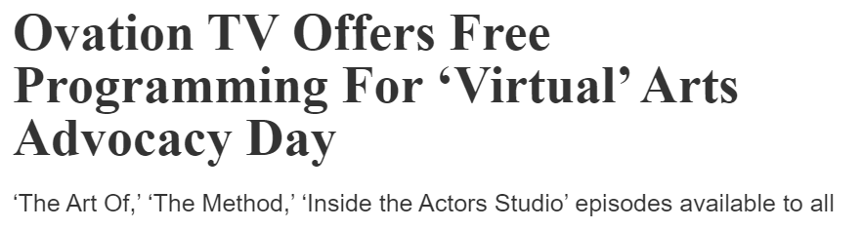



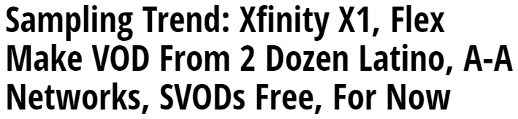

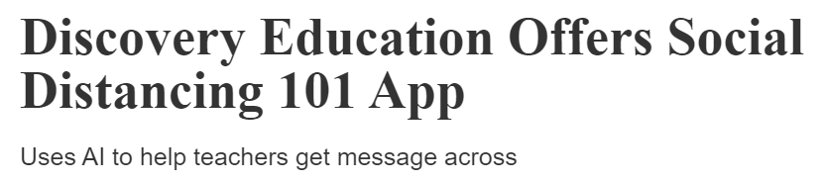


Understanding the emotional significance of TV during a crisis, programmers and distributors were fast to offer free access to content and even Wi-Fi at the onset of the pandemic
This information is exclusively provided to VAB members and qualified marketers. Further distribution is prohibited.
PAGE 6

Slide 7









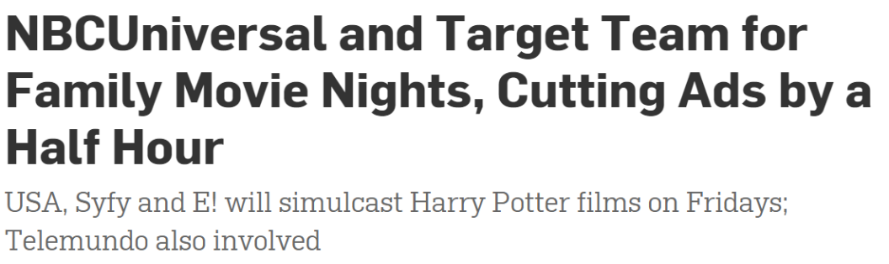

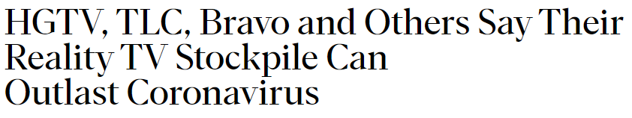


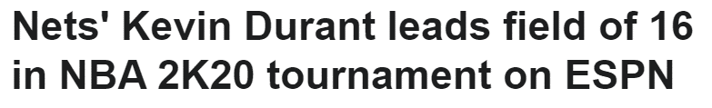
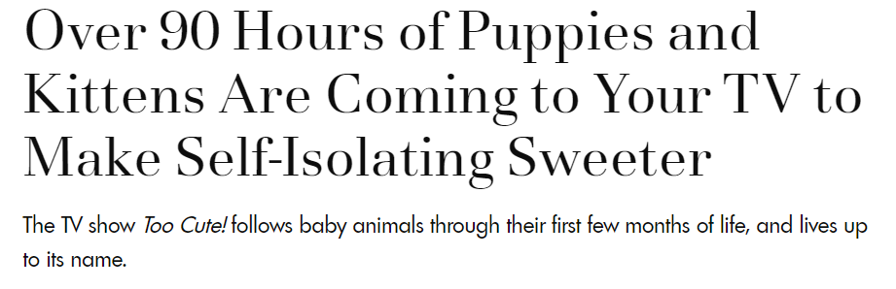

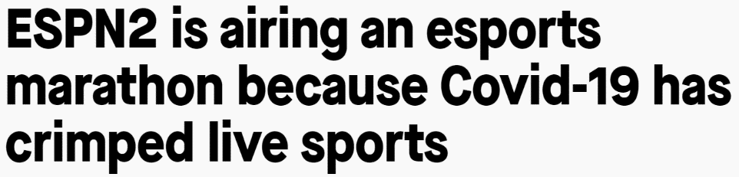

TV brands also quickly pivoted their programming content with more news, more specials, binge-able marathons of popular programs, re-airings of classic content and other stunts to entertain and inform viewers
This information is exclusively provided to VAB members and qualified marketers. Further distribution is prohibited.
PAGE 7

Slide 8
Because of TV’s ability to quickly pivot their content, year-over-year average ad ratings were up 6% on HHs and 5% on major demos
+5.9%
YoY Difference By Demo (in millions)
P18-49:
1,881
1,970
+4.8%
P25-54:
1,921
2,015
+4.9%
Source: iSpot.tv. Data represents 117 measured broadcast and cable TV networks and is based on national ad units viewed on a live + same day basis, plus up to 30-day time-shifted, includes over-the-top streaming, over-the-air transmissions. Data is built up from individual ad impressions for every national ad unit (i.e., ad ratings), as extrapolated from the iSpot.tv panel to the U.S. TV viewer census. The resulting data set takes the average ad rating within each day, network and daypart combination and is then added up to generate results for all of TV (i.e., ‘total monthly average’). Base = households, with A18-49 & A25-54. See appendix for more methodology details.
This information is exclusively provided to VAB members and qualified marketers. Further distribution is prohibited.
PAGE 8

Slide 9
Ad ratings were consistently up through the summer as news was strong, TV networks released new specials and sports returned
+12.7%
+4.5%
+6.6%
-0.3%
YoY % Difference By Demo
P18-49:
+2.3%
+11.4%
+5.9%
-0.6%
P25-54:
+2.8%
+11.9%
+6.3%
-1.5%
Source: iSpot.tv. Data represents 117 measured broadcast and cable TV networks and is based on national ad units viewed on a live + same day basis, plus up to 30-day time-shifted, includes over-the-top streaming, over-the-air transmissions. Data is built up from individual ad impressions for every national ad unit (i.e., ad ratings), as extrapolated from the iSpot.tv panel to the U.S. TV viewer census. The resulting data set takes the average ad rating within each day, network and daypart combination and is then added up to generate results for all of TV (i.e., ‘total monthly average’). Base = households, with A18-49 & A25-54. See appendix for more methodology details.
This information is exclusively provided to VAB members and qualified marketers. Further distribution is prohibited.
PAGE 9

Slide 10
Major demos were very much in line with monthly household ad ratings throughout the year, with very little fall off by comparison
YOY % Diff:
+2%
+3%
+8%
+15%
+11%
+12%
+11%
+7%
+1%
-2%
0%
+1%
YoY % Difference By Demo
P18-49:
-1%
+2%
+6%
+14%
+9%
+11%
+10%
+6%
+1%
-2%
0%
0%
P25-54:
0%
+1%
+7%
+14%
+9%
+12%
+11%
+7%
+1%
-2%
-1%
-1%
Source: iSpot.tv. Data represents 117 measured broadcast and cable TV networks and is based on national ad units viewed on a live + same day basis, plus up to 30-day time-shifted, includes over-the-top streaming, over-the-air transmissions. Data is built up from individual ad impressions for every national ad unit (i.e., ad ratings), as extrapolated from the iSpot.tv panel to the U.S. TV viewer census. The resulting data set takes the average ad rating within each day, network and daypart combination and is then added up to generate results for all of TV (i.e., ‘total monthly average’). Base = households, with A18-49 & A25-54. See appendix for more methodology details.
This information is exclusively provided to VAB members and qualified marketers. Further distribution is prohibited.
PAGE 10

Slide 11
Viewers expanded their daypart diet for different experiences
TV ad ratings by daypart
*iSpot’s Ad Rating = a measure of total households where at least one TV had a verified exposure to a given TV ad. The verification is done by the on-screen detection of the ad play in 18M homes, balanced and extrapolated to the U.S. Census. The ‘average ad rating’ is the average of all ad units within each day, daypart and measured network.

Slide 12
With the rise in ‘work from home,’ audiences were able to watch programming in more dayparts than they did pre-pandemic
+2.4%
+7.8%
+11.1%
+13.2%
+5.2%
+4.0%
-5.0%
YoY % Difference By Demo
P18-49:
+3.4%
+12.3%
+10.2%
+1.4%
+6.2%
-6.0%
+3.6%
P25-54:
+2.7%
+11.6%
+9.4%
+2.0%
+6.6%
-5.6%
+4.7%
Source: iSpot.tv. Data represents 117 measured broadcast and cable TV networks and is based on national ad units viewed on a live + same day basis, plus up to 30-day time-shifted, includes over-the-top streaming, over-the-air transmissions. Data is built up from individual ad impressions for every national ad unit (i.e., ad ratings), as extrapolated from the iSpot.tv panel to the U.S. TV viewer census. The resulting data set takes the average ad rating within each day, network and daypart combination and is then added up to generate results for all of TV (i.e., ‘total monthly average’). Base = households, with A18-49 & A25-54. See appendix for more methodology details.
This information is exclusively provided to VAB members and qualified marketers. Further distribution is prohibited.
PAGE 12

Slide 13
Daytime: News & talk programming drove increased viewership during traditional ‘work hours’ through 2020
+25.1%
+9.7%
+11.4%
+6.5%
YoY % Difference By Demo
P18-49:
+7.5%
+24.4%
+10.9%
+6.4%
P25-54:
+8.1%
+24.5%
+9.9%
+3.8%
Source: iSpot.tv. Data represents 117 measured broadcast and cable TV networks and is based on national ad units viewed on a live + same day basis, plus up to 30-day time-shifted, includes over-the-top streaming, over-the-air transmissions. Data is built up from individual ad impressions for every national ad unit (i.e., ad ratings), as extrapolated from the iSpot.tv panel to the U.S. TV viewer census. The resulting data set takes the average ad rating within each day, network and daypart combination and is then added up to generate results for all of TV (i.e., ‘total monthly average’). Base = households, with A18-49 & A25-54. See appendix for more methodology details.
This information is exclusively provided to VAB members and qualified marketers. Further distribution is prohibited.
PAGE 13

Slide 14
Primetime: Specials, stunts and other experimental programming excited viewers and boosted ratings through the summer
+0.9%
+8.4%
+3.3%
-2.8%
YoY % Difference By Demo
P18-49:
-1.0%
+7.0%
+2.6%
-2.9%
P25-54:
-0.4%
+7.8%
+3.5%
-2.6%
Source: iSpot.tv. Data represents 117 measured broadcast and cable TV networks and is based on national ad units viewed on a live + same day basis, plus up to 30-day time-shifted, includes over-the-top streaming, over-the-air transmissions. Data is built up from individual ad impressions for every national ad unit (i.e., ad ratings), as extrapolated from the iSpot.tv panel to the U.S. TV viewer census. The resulting data set takes the average ad rating within each day, network and daypart combination and is then added up to generate results for all of TV (i.e., ‘total monthly average’). Base = households, with A18-49 & A25-54. See appendix for more methodology details.
This information is exclusively provided to VAB members and qualified marketers. Further distribution is prohibited.
PAGE 14

Slide 15
Late Fringe: The quick return of new ‘taped from home’ episodes of late-night talk shows re-ignited excitement from viewers
+12.3%
+10.5%
+4.7%
+3.1%
YoY % Difference By Demo
P18-49:
+2.3%
+10.8%
+9.1%
+2.3%
P25-54:
+2.1%
+11.5%
+10.3%
+1.9%
Source: iSpot.tv. Data represents 117 measured broadcast and cable TV networks and is based on national ad units viewed on a live + same day basis, plus up to 30-day time-shifted, includes over-the-top streaming, over-the-air transmissions. Data is built up from individual ad impressions for every national ad unit (i.e., ad ratings), as extrapolated from the iSpot.tv panel to the U.S. TV viewer census. The resulting data set takes the average ad rating within each day, network and daypart combination and is then added up to generate results for all of TV (i.e., ‘total monthly average’). Base = households. Late Fringe includes Late Fringe AM + Late Fringe PM dayparts. See appendix for more methodology details.
This information is exclusively provided to VAB members and qualified marketers. Further distribution is prohibited.
PAGE 15

Slide 16
Weekend: Binge-able marathons, especially around home & food instructional programming, stirred continued interest from viewers
+3.0%
+12.6%
+5.2%
+0.1%
YoY % Difference By Demo
P18-49:
+0.8%
+10.6%
+4.1%
-0.8%
P25-54:
+2.4%
+11.4%
+5.0%
0.0%
Source: iSpot.tv. Data represents 117 measured broadcast and cable TV networks and is based on national ad units viewed on a live + same day basis, plus up to 30-day time-shifted, includes over-the-top streaming, over-the-air transmissions. Data is built up from individual ad impressions for every national ad unit (i.e., ad ratings), as extrapolated from the iSpot.tv panel to the U.S. TV viewer census. The resulting data set takes the average ad rating within each day, network and daypart combination and is then added up to generate results for all of TV (i.e., ‘total monthly average’). Base = households. Weekend includes Weekend Day+ Weekend Afternoon dayparts. See appendix for more methodology details.
This information is exclusively provided to VAB members and qualified marketers. Further distribution is prohibited.
PAGE 16

Slide 17
Viewers discovered new genres and embraced different formats
TV ad ratings by genre
*iSpot’s Ad Rating = a measure of total households where at least one TV had a verified exposure to a given TV ad. The verification is done by the on-screen detection of the ad play in 18M homes, balanced and extrapolated to the U.S. Census. The ‘average ad rating’ is the average of all ad units within each day, daypart and measured network.

Slide 18
Audiences sought out additional genres and innovative formats that they might not normally have watched before the pandemic
+6.6%
+8.0%
+5.0%
+17.0%
+32.9%
+11.4%
+6.5%
+45.7%
+9.0%
YoY % Difference By Demo
P18-49:
+4.4%
+10.0%
+4.5%
+21.1%
+42.1%
+9.6%
+6.8%
+47.4%
+8.6%
P25-54:
+4.9%
+8.9%
+5.5%
+23.4%
+41.3%
+7.6%
+5.6%
+44.2%
+9.3%
Source: iSpot.tv. Data represents 117 measured broadcast and cable TV networks and is based on national ad units viewed on a live + same day basis, plus up to 30-day time-shifted, includes over-the-top streaming, over-the-air transmissions. Data is built up from individual ad impressions for every national ad unit (i.e., ad ratings), as extrapolated from the iSpot.tv panel to the U.S. TV viewer census. The resulting data set takes the average ad rating within each day, network and daypart combination and is then added up to generate results for all of TV (i.e., ‘total monthly average’). Base = households, with A18-49 & A25-54. Chart reflects sub-genres within top 20 based on monthly average ad impressions that had YoY increases.
This information is exclusively provided to VAB members and qualified marketers. Further distribution is prohibited.
PAGE 18

Slide 19
News & Information: A continuous news cycle on COVID, the election and social unrest kept viewers engaged through the year
+44.1%
+23.6%
+27.0%
+18.5%
Major demos
saw higher YoY increases vs. HHs
YoY % Difference By Demo
P18-49:
+23.3%
+49.6%
+30.8%
+24.4%
P25-54:
+22.6%
+47.8%
+31.3%
+22.2%
Source: iSpot.tv. Data represents 117 measured broadcast and cable TV networks and is based on national ad units viewed on a live + same day basis, plus up to 30-day time-shifted, includes over-the-top streaming, over-the-air transmissions. Data is built up from individual ad impressions for every national ad unit (i.e., ad ratings), as extrapolated from the iSpot.tv panel to the U.S. TV viewer census. The resulting data set takes the average ad rating within each day, network and daypart combination and is then added up to generate results for all of TV (i.e., ‘total monthly average’). Base = households, with A18-49 & A25-54. See appendix for more methodology details.
This information is exclusively provided to VAB members and qualified marketers. Further distribution is prohibited.
PAGE 19

Slide 20
Entertainment: Binge-able marathons, specials and experimental ‘live/taped from home’ shows helped boost viewing through summer
+9.5%
-1.5%
+0.4%
-4.2%
YoY % Difference By Demo
P18-49:
-3.5%
+7.9%
-0.9%
-5.5%
P25-54:
-2.8%
+8.7%
-0.4%
-6.2%
Source: iSpot.tv. Data represents 117 measured broadcast and cable TV networks and is based on national ad units viewed on a live + same day basis, plus up to 30-day time-shifted, includes over-the-top streaming, over-the-air transmissions. Data is built up from individual ad impressions for every national ad unit (i.e., ad ratings), as extrapolated from the iSpot.tv panel to the U.S. TV viewer census. The resulting data set takes the average ad rating within each day, network and daypart combination and is then added up to generate results for all of TV (i.e., ‘total monthly average’). Base = households, with A18-49 & A25-54. See appendix for more methodology details.
This information is exclusively provided to VAB members and qualified marketers. Further distribution is prohibited.
PAGE 20

Slide 21
Sports: With viewers thirsty for competitive action, the return
of NBA and MLB stabilized audiences during the summer
August did see a +9% YoY increase with the return of the NBA and MLB
-4.2%
-22.7%
-2.8%
-53.1%
YoY % Difference By Demo
P18-49:
-3.4%
-54.3%
-3.2%
-22.6%
P25-54:
-1.8%
-54.5%
-3.0%
-23.4%
Source: iSpot.tv. Data represents 117 measured broadcast and cable TV networks and is based on national ad units viewed on a live + same day basis, plus up to 30-day time-shifted, includes over-the-top streaming, over-the-air transmissions. Data is built up from individual ad impressions for every national ad unit (i.e., ad ratings), as extrapolated from the iSpot.tv panel to the U.S. TV viewer census. The resulting data set takes the average ad rating within each day, network and daypart combination and is then added up to generate results for all of TV (i.e., ‘total monthly average’). Base = households, with A18-49 & A25-54. See appendix for more methodology details.
This information is exclusively provided to VAB members and qualified marketers. Further distribution is prohibited.
PAGE 21

Slide 22
For TV Viewing:
The ability for TV to quickly pivot during the pandemic created a host of new and innovative programming across dayparts and genres which ignited viewer interest and drove ad ratings
For Media Measurement:
Evaluate and understand the different approaches to TV audience measurement and the underlying methodologies of data providers within the ecosystem
Utilize multiple audience measurement providers when planning and buying your video investments to ensure a higher level of data accuracy
Continually, and rigorously, analyze these multiple third-party data sources to ensure greater transparency, accuracy and accountability
through the buying process
Key Marketer Takeaways
This information is exclusively provided to VAB members and qualified marketers. Further distribution is prohibited.
PAGE 22

Slide 23




Discover more
Looking for more data, insights and takeaways? Check out this related VAB content
Make Yourself at Home
Video Viewing in the Time
of COVID-19
As Time Goes By
How Media Consumption is Helping America Cope
Five Fast Facts on
Nielsen TV Measurement
During COVID
Nielsen in COVID
TV Measurement Defects and
Systemic Under-Counting
VAB Members, brand marketers and agencies get free and immediate access to VAB’s content library. Get access at theVAB.com
This information is exclusively provided to VAB members and qualified marketers. Further distribution is prohibited.
PAGE 23

Slide 24

About VAB
VAB is an insights-driven organization that inspires marketers to reimagine their media strategies resulting in fully informed decisions.
Drawing on our marketing expertise, we simplify the complexities in our industry and discover new insights that transform the way marketers look at their media strategy.
Discover
We keep you one step ahead with the latest thinking so you can create innovative, forward-looking strategies.
Simplify
We save you time by bringing you the latest data & actionable takeaways you can use to inform your marketing plans.
Transform
We help you build your brand by focusing on core marketing principles that will help drive tangible business outcomes.
We are committed to your business growth and proud to offer VAB members, brand marketers and agencies complimentary access to our continuously-growing Insights library. Get immediate access at theVAB.com.
This information is exclusively provided to VAB members and qualified marketers. Further distribution is prohibited.
PAGE 24

Slide 25

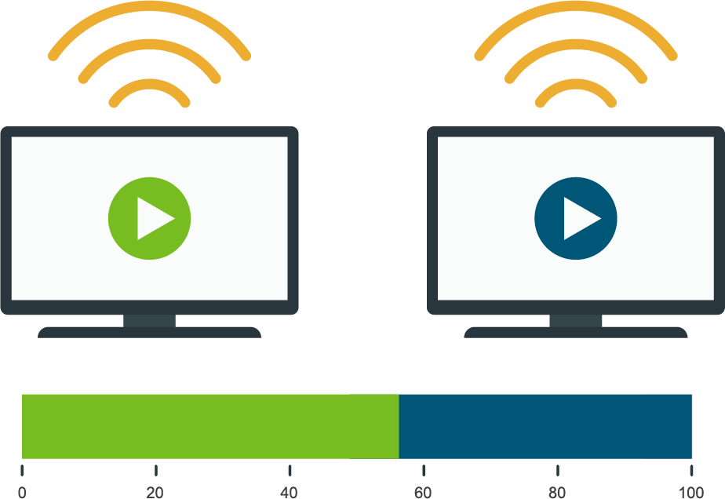






iSpot.tv Media Measurement – Overall Methodology
Networks Tracked
Airings & Creatives Detected
Airings & Impressions Matched
Extrapolation
Airings Tracked Utilizing Audio & Video ACR cross-referencing our ad catalog
Match Airings to Impressions
Extrapolation and balancing of impressions by DMA and against the US Census households, set-top box data and person-level panel
iSpot tracks creative and media across ~155 networks across the US covering all 210 markets
Audio Fingerprinting
of First Time Airings
New Creative added to iSpot Ad Catalog
Creative and program Impressions are sent to iSpot from VIZIO daily. VIZIO has a panel of ~18M IP-Enabled TVs
Performance Analytics for ad buys output in the iSpot Dashboard in real-time
This information is exclusively provided to VAB members and qualified marketers. Further distribution is prohibited.
PAGE 25

Slide 26
iSpot’s Analysis & Measurement Methodology & Details
TV Ad Ratings / IMPs Analysis Methodology
iSpot.tv Media Measurement Methodology Details
Analysis data is comprised of ad ratings trended daily and monthly in aggregate in 2020 as compared to 2019
  National ad units viewed on a live + same day basis, plus up to 30-day time-shifted, including across over-the-top streaming and over-the-air transmissions
  Includes 117 broadcast and cable TV networks on which every ad unit was measured throughout 2020 and 2019
Data is built up from individual ad impressions (i.e., ad ratings) for every national ad unit, as extrapolated from iSpot.tv’s panel to U.S. TV Viewer Census
The resulting data set takes the average ad rating within each day, network and daypart combination which is then added up by comparable month to generate results for all of TV
  Data can then be filtered by network, program genre, daypart, etc
Media unit accuracy is audited internally at a 99% accuracy and is also audited externally by iSpot clients and the MRC (pending accreditation)
Entire iSpot ad catalog is tracked on 18 MM smart TVs using ACR technologies to verify ad play
The Smart TV panel has rigorous standards for a TV set to be included
  TV must be fully opted in by consumer, IP address must be stable, TV must have been collecting data for at least 90 days, there is a limit of how many new TVs can enter the panel in any one day, TV cannot be dormant for more than 90 days to stay in panel
Data is cleansed, balanced and extrapolated to U.S. census in all 210 markets
  iSpot’s 2020 HH TV universe estimate: 113.3 MM
Each media unit on linear TV gets a total impression and HH/TRP rating counts for households and each major age/gender group
This information is exclusively provided to VAB members and qualified marketers. Further distribution is prohibited.
PAGE 26

