Slide 1

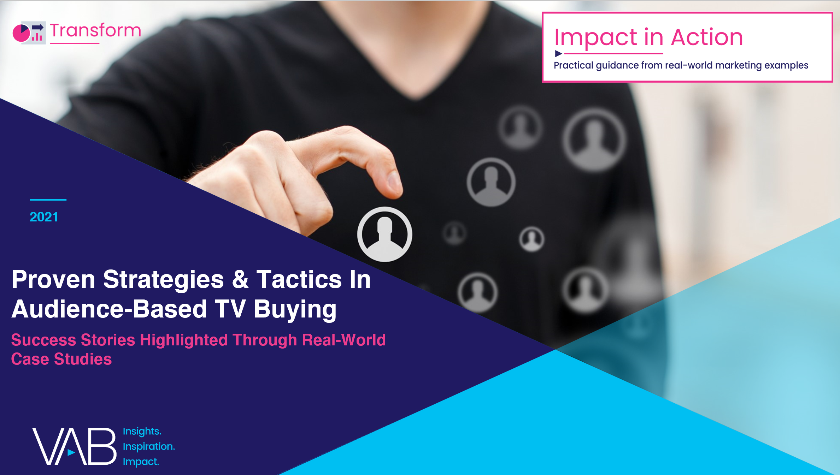

2021
Marketer Supplement:
Additional Case Studies Highlighting the Ability of an Audience-First Buying Approach to Drive Successful Outcomes for Brands

Slide 2


What is ‘Audience-Based Buying’?
Many marketers plan and purchase television advertising based upon a demographic - primarily age and/or gender, such as adults 25-54 or women 18-49.
However, with advances in technology and measurement, marketers can target and buy multiscreen TV ad campaigns against specific audiences such as lifestyle characteristics and purchase behavior.
The process of planning and buying advertising in this way is called ‘audience-based buying’.
Using anonymized aggregated data to inform their decision-making, marketers can deliver relevant advertising directly to custom audience segments like “new parents” or “in-market car shoppers”, wherever and whenever they are watching.
This insights piece focuses on audience-based buying as it relates specifically to data-driven multiscreen TV
This information is exclusively provided to VAB members and qualified marketers. Further distribution is prohibited.
PAGE 2

Slide 3


Category:
Quick Service Restaurant
A QSR brand efficiently optimized their linear TV campaign to grow their strategic target’s reach within budget
Challenge
A major QSR company wanted to improve reach and concentration against its custom strategic target (ST) while achieving cost efficiencies within their budget
Solution
By optimizing a baseline plan via Amobee’s daypart reallocator, the new data-driven linear schedule delivered a +46% increase in equivalized units at the same budget
Target Segment
QSR Strategic Target*
Results
Demo and strategic reach increased while significant savings were realized within budget
Company / Platform
Amobee / Data-driven linear
+6%
-12%
$3.3M
Increase in Reach
Amongst the
Strategic Target
Reduction in
Strategic Target
CPM
Targeted Delivery Savings
Source: Amobee, Case Study: Audience Based Buying in a Linear TV Ecosystem. *Custom brand-developed target.
This information is exclusively provided to VAB members and qualified marketers. Further distribution is prohibited.
PAGE 3

Slide 4


Category:
Automotive
Through advanced TV targeting, a luxury auto brand drove sales lifts and achieved buy rates that beat national benchmarks
Challenge
A leading luxury auto manufacturer sought to increase sales for their compact SUV just as they were releasing an all-new design
Solution
Using NBCU’s AdSmart audience targeting solution, the brand ran a national TV campaign across the NBCU portfolio to reach their custom target. IHS Markit was utilized to measure the impact of the campaign on driving sales lift for the advertising SUV and the advertiser overall.
Target Segment
Custom IHS Market ‘In-Market Luxury Auto Intenders’
Results
By implementing a targeted data-driven TV campaign, the brand saw a +10% total sales lift for their advertised SUV and the buy rate beat national benchmarks
Company / Platform
NBCU’s AdSmart solution / Data-driven linear
NBCU AdSmart Exposure Drove Sales Lift
Advertised SUV
+10%
Total Sales Lift
+7%
In-Target Sales Lift
2.5X
Higher In-Target Buy Rate
(vs. Non-Target)
Advertiser Overall
+11%
Total Sales Lift
+4%
In-Target Sales Lift
3X
Higher In-Target Buy Rate
(vs. Non-Target)
NBCU AdSmart Buy Rate Beat National Benchmarks
Advertised SUV
Advertiser Overall
2X
Higher Total Buy Rate
1.3X
Higher Total Buy Rate
4X
Higher In-Target Buy Rate
3X
Higher In-Target Buy Rate
Source: NBCU, AdSmart + Luxury Auto SUV Case Study.
This information is exclusively provided to VAB members and qualified marketers. Further distribution is prohibited.
PAGE 4

Slide 5



Category:
Financial
A financial services brand utilized advanced TV audience targeting to drive a higher rate of mobile app installs
Challenge
A financial services firm wanted to understand the effectiveness of mobile targeting capabilities on driving mobile actions through a TV campaign
Solution
The brand partnered with Simulmedia to create and activate a media plan focused on finding where their custom mobile look-alike target was watching across national TV.
  To understand the effectiveness of mobile targeting, Simulmedia ran two campaigns simultaneously using two targeting strategies - a mobile target and a standard psychographic MRI target - with the same creatives
Target Segment
Mobile app look-alike users using Simulmedia’s Kochava integration
Results
The mobile targeted campaign has a 16% higher install conversion rate than the standard targeting campaign
Company / Platform
Simulmedia’s Kochava integration / Data-driven linear
The campaign targeting a look-alike audience of this brand’s mobile app users resulted in a 12% lower cost per install than standard targeting
Additionally, the mobile targeted campaign had a 16% higher install conversion rate (% of people who saw TV commercial then installed the app) than standard targeting
Source: Simulmedia, Case Study: How Simulmedia Drove More App Installs for Financial Services Brand with our Kochava Integration. Install conversion rate based on % of people who saw TV commercial then installed the app.
This information is exclusively provided to VAB members and qualified marketers. Further distribution is prohibited.
PAGE 5

Slide 6

Category:
Quick Service Restaurant
A data-driven linear TV campaign overdelivered the foot traffic guarantees for a QSR brand
Challenge
A QSR brand wanted to increase foot traffic into select restaurant locations
Solution
Using their Precision solution, A+E Networks created a custom strategic target for a cross network buy and partnered with Data Plus Math to set a benchmark guarantee and measure foot traffic through a pixel in the creative served to households in the area of 20 brand-validated locations
Target Segment
QSR Strategic Target*
Results
Using strategic targeting, A+E Network’s data-driven linear TV campaign contributed almost 3MM incremental visits to the target locations over the three waves and outperformed the foot traffic guarantee by +4% overall
Company / Platform
A+E Networks’ Precision+Performance / Data-driven linear
Wave 1 (Pre-Pandemic)
1/6/20 – 3/1/20
2,808,388
Post-Exposed Visits
+32.6%
Incremental Lift
916,892
Additional Incremental Visits
(above what would have occurred without presence of the linear campaign)
104
LCI Index**
Wave 2-3 (mid-Pandemic)
3/2/20 – 5/16/20
5,434,204
Post-Exposed Visits
+36.4%
Incremental Lift
(+12% higher than pre-COVID)
1,979,627
Additional Incremental Visits
(above what would have occurred without presence of the linear campaign)
103
LCI Index**
Source: A+E Networks, Case Study: QSR Foot Traffic. Networks include A&E, HISTORY, Lifetime, LMN and FYI. *Custom brand-developed, data-driven target aided by A+E Networks Precision data-driven solution. **LCI = Linear Campaign Index which is based on the incremental visits lift network TV average across all networks. Flight duration: 1/6/20 – 5/16/20.
This information is exclusively provided to VAB members and qualified marketers. Further distribution is prohibited.
PAGE 6

Slide 7



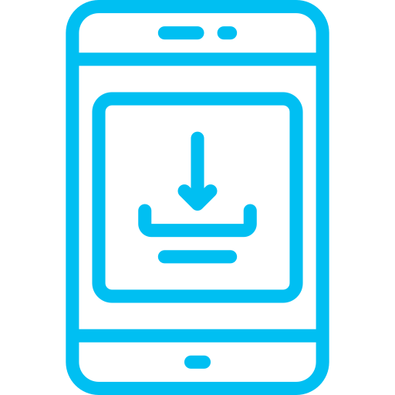
Category:
Entertainment
A TV network implemented a broad, audience-based TV buying strategy which drove incremental reach and most of the total campaign’s digital engagement
Challenge
A national TV network wanted to increase engagement with its digital content (website visits and app downloads) and sought an efficient way to find viewers beyond those they were able to reach with on-network promotion
Solution
Using their software platform, Simulmedia created a customized target audience and, after matching the audience with their nationally representative viewing panel, executed an audience-based campaign that ran on 56 other TV networks. The TV network also ran a simultaneous on-air campaign.
Target Segment
A custom target built in Simulmedia’s platform that combined multiple attributes and specific viewing behaviors
Results
The broad-based, audience-targeted buy drove incremental reach and an outsized number of website visitations and app installs
  Based on these results, the network was able to optimize future campaigns and increase digital engagement
Company / Platform
Simulmedia / Data-driven linear
11MM
70%
66%
Unique People Reached
More Web Visits Driven
Additional App Installs Delivered
With a budget of $150K, Simulmedia’s targeted campaign reached over 11MM unique people, and accounted for more than 66% of the total app installs attributable to the campaign, as well as over 70% of the website visits.
Source: Simulmedia, Case Study: Network Increases App Downloads With New TV Strategy.
This information is exclusively provided to VAB members and qualified marketers. Further distribution is prohibited.
PAGE 7

Slide 8

Category:
Home Improvement
A home improvement brand drove double-digit incremental reach and decreased their cost-per-visit through an optimized buy
Challenge
A home improvement company was looking for a complement to their Direct Response (DR) TV buying strategy to find a solution that could reach more of their potential customers for a lower cost
Solution
Simulmedia utilized their patented predictive technology and direct integrations with national TV networks to maximize reach against the brand’s custom target audience. Within the approach, Simulmedia consistently optimized for incremental reach while also driving the cost-per-visit (CPV) down
Target Segment
Custom Home Target
Results
The data-driven linear TV campaign achieved an incremental reach of 21% with just 5% of the budget the DRTV plan had, and the brand has also seen their CPV decreased by 49%
Company / Platform
Simulmedia / Data-driven linear
Custom Target Audience Reach:
Optimized Audience-Based vs. Direct Response TV Plan
21%
Unique to Simulmedia
9%
Reached by Both
70%
Unique to Base
Since activating and optimizing with Simulmedia,
the brand has seen their cost-per-visit decrease by 49%
Source: Simulmedia, Case Study: How Simulmedia Drove Growth for a Leading Home Improvement Brand
This information is exclusively provided to VAB members and qualified marketers. Further distribution is prohibited.
PAGE 8

Slide 9

Eight proven strategies and tactics in successful audience-based TV buying campaigns
Understand your consumer and
their behaviors
Utilize 1st, 2nd and/or 3rd party data & tools for targeting and measurement
Consider
cross-platform opportunities
Implement
‘test and learn’ campaigns
Buy a broad & deep schedule of TV networks
Effective targeting improves cost efficiencies which maximizes ROI
Understand which outcomes are most important to your objectives
Optimize to outcomes for your current & future TV buys
This information is exclusively provided to VAB members and qualified marketers. Further distribution is prohibited.
PAGE 9

Slide 10



Key Takeaways For Marketing Plans
Think Cross-Platform When Developing Video Buys
Define Your Target Audience Based on Your Campaign’s KPI
Test and Learn to Set Your Brand Up for Future Success
Accelerated by the conditions of
the pandemic, video viewing across screens and platforms has increased significantly. This provides advertisers with more opportunities to find their audiences. In developing an audience-first buying strategy, consider expanding video campaigns across screens to increase scale and reach of your best potential consumers.
The buy should be designed specifically to meet your brand’s KPI. For example, you can create an audience group that will expose your brand to new customers (incremental reach). If you are looking to drive website visits among likely purchasers, an audience group can be crafted based on that audience’s characteristics (e.g. fitness enthusiasts). Start with your KPI and design your audience and strategies
to best meet it.
Advancements in data-driven targeting capabilities will only increase. Similarly, the number of video viewing platforms consumers watch will also increase. This is the time to test what audiences and strategies work best for your brand. Test and learn now to position your brand to drive business outcomes into the future.
This information is exclusively provided to VAB members and qualified marketers. Further distribution is prohibited.
PAGE 10

Slide 11

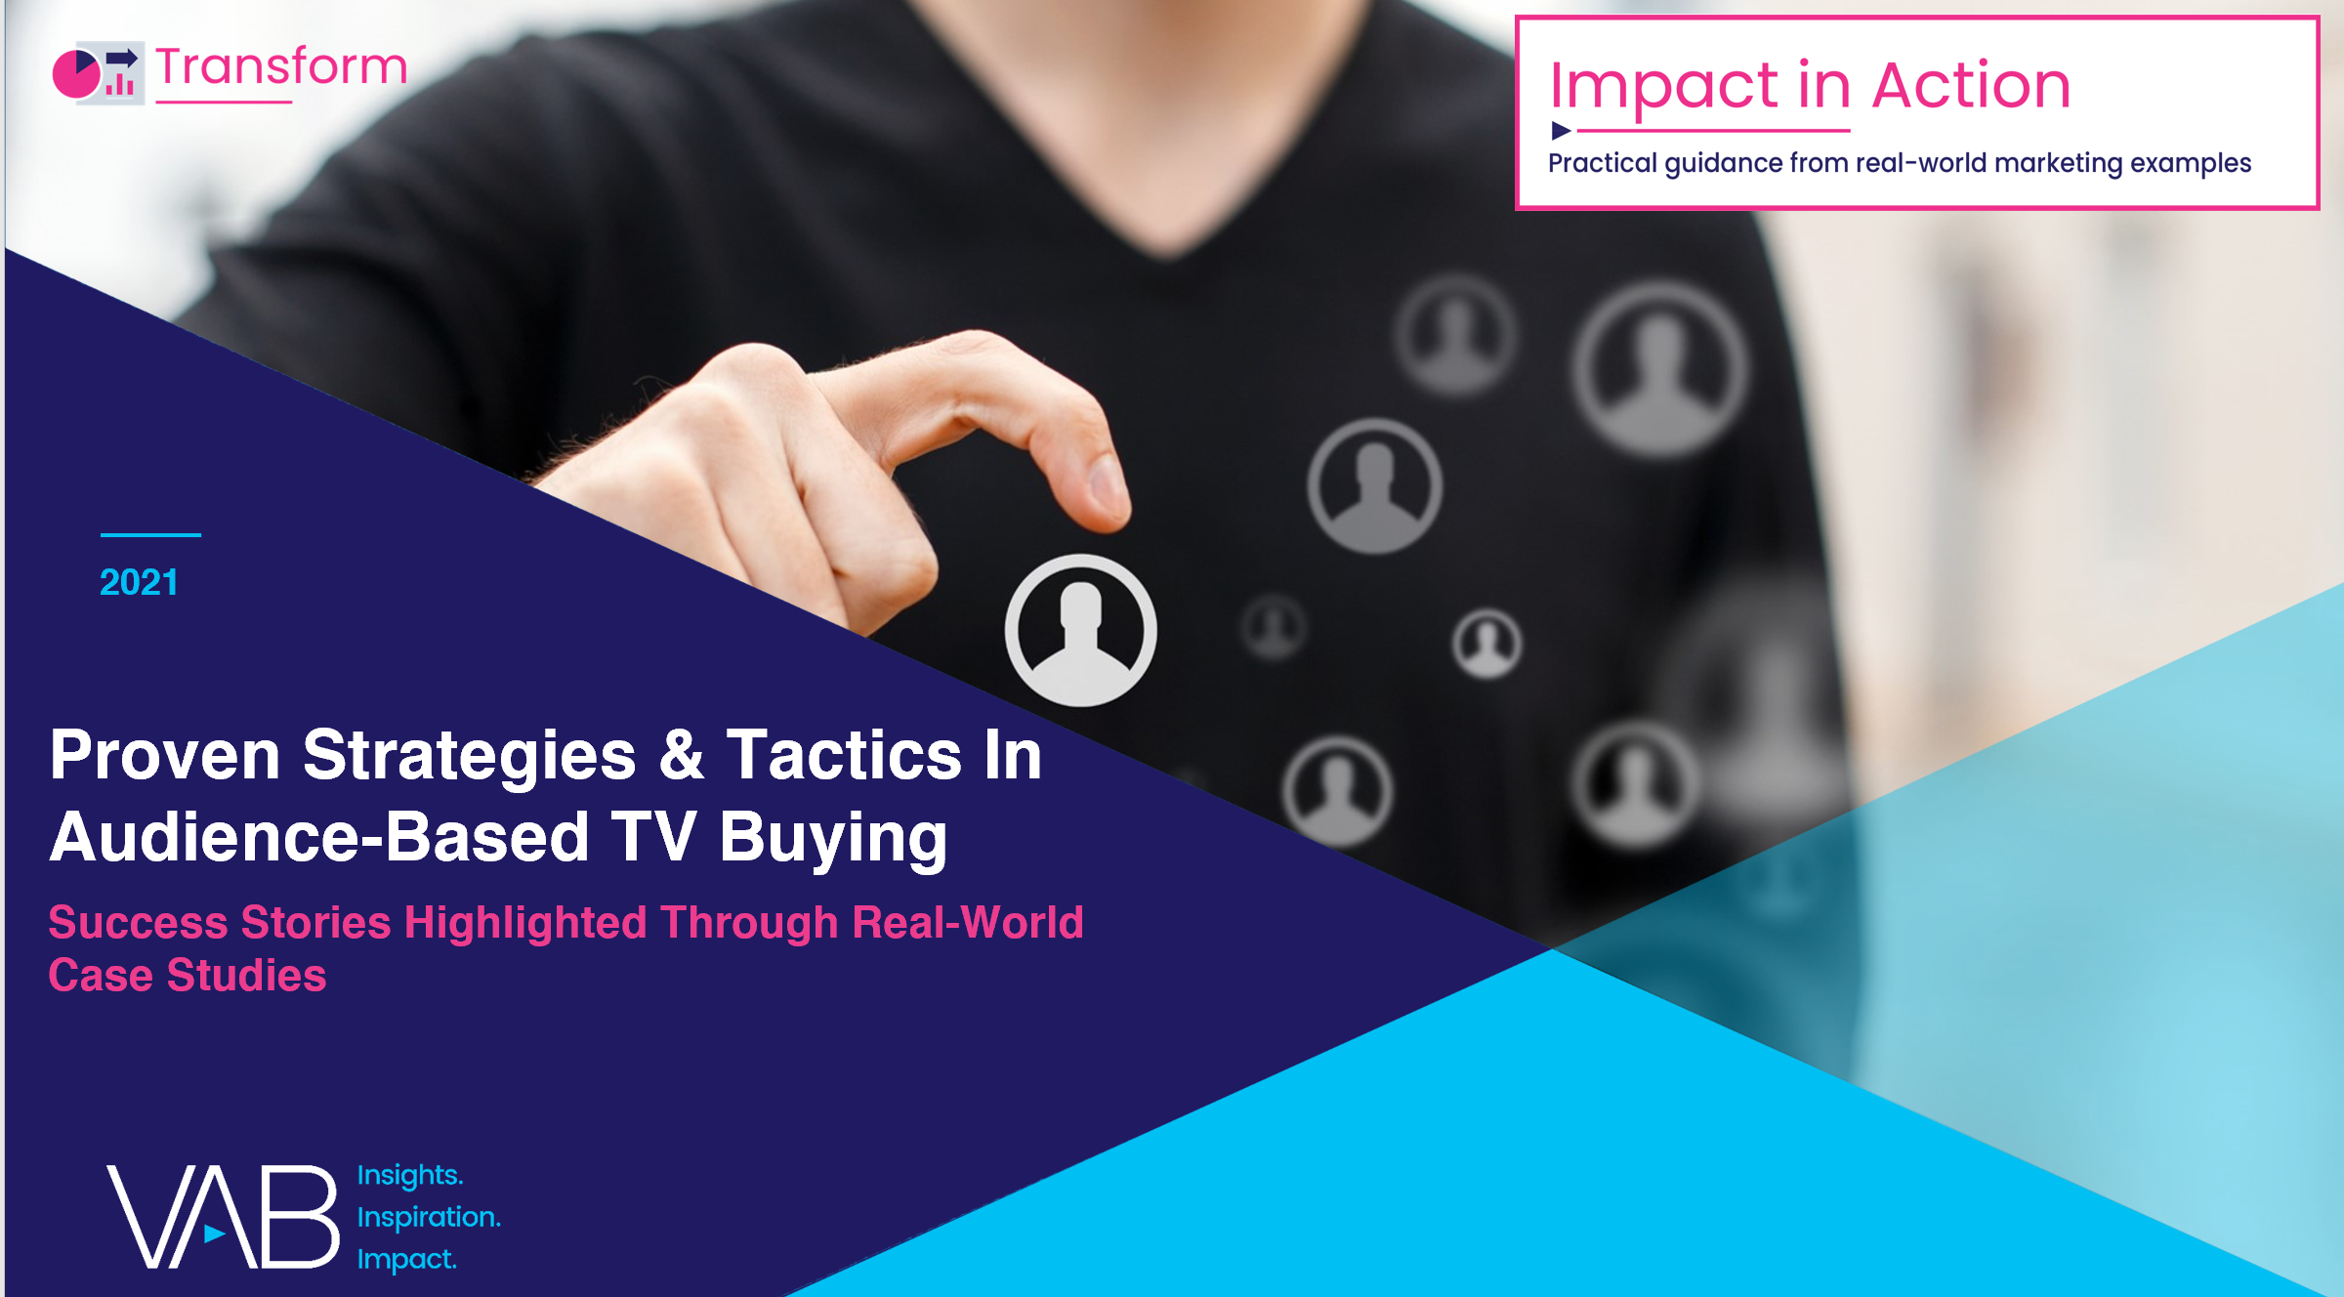
Jason Wiese
Leah Montner-Dixon
Karolina Guillen
SVP, Director of Strategic Insights
jasonw@thevab.com
Insights Manager
leahm@thevab.com
Senior Insights Analyst
karolinag@thevab.com
You can find another 17 brand case studies in “Proven Strategies & Tactics In Audience-Based TV Buying”
Additional categories include education, consumer electronics, travel, CPG, real estate, wellness and healthcare
This information is exclusively provided to VAB members and qualified marketers. Further distribution is prohibited.
PAGE 11

Slide 12

About VAB
VAB is an insights-driven organization that inspires marketers to reimagine their media strategies resulting in fully informed decisions.
Drawing on our marketing expertise, we simplify the complexities in our industry and discover new insights that transform the way marketers look at their media strategy.
Transform
We help you build your brand by focusing on core marketing principles that will help drive tangible business outcomes.
Simplify
We save you time by bringing you the latest data & actionable takeaways you can use to inform your marketing plans.
Discover
We keep you one step ahead with the latest thinking so you can create innovative, forward-looking strategies.
We are committed to your business growth and proud to offer VAB members, brand marketers and agencies complimentary access to our continuously-growing Insights library. Get immediate access at theVAB.com.
This information is exclusively provided to VAB members and qualified marketers. Further distribution is prohibited.
PAGE 12

