Slide 1



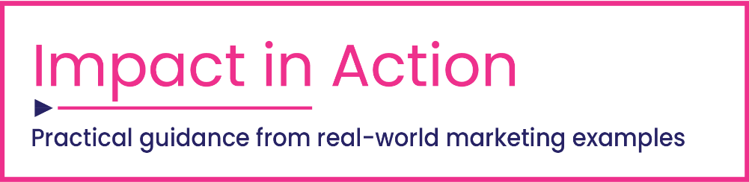

2021
Proven Strategies & Tactics In Audience-Based TV Buying
Success Stories Highlighted Through Real-World Case Studies

Slide 2
What You’ll Learn…
You’ll learn how to get started planning a successful audience-based buy on multiscreen TV. We answer questions like…
  What is audience-based buying and how does it differ from a traditional TV ad campaign?
  What type of audiences can be targeted?
  What TV platforms can it be implemented on?
  Which companies support and measure this activity?
  How is success measured?
Be inspired by real-world examples showing how brands used an audience-first buying approach to meet a business challenge to drive success. Inside, and in the related supplement, is a detailed look at how 23 brands across 16 product categories met KPIs such as incremental reach/awareness, increased website visits, greater in-store traffic and more.
This information is exclusively provided to VAB members and qualified marketers. Further distribution is prohibited.
PAGE 2

Slide 3

Delivering Greater Impact For Multiscreen TV Campaigns
Examining the building blocks behind audience-based buying

Slide 4


What is ‘Audience-Based Buying’?
Many marketers plan and purchase television advertising based upon a demographic - primarily age and/or gender, such as adults 25-54 or women 18-49.
However, with advances in technology and measurement, marketers can target and buy multiscreen TV ad campaigns against specific audiences such as lifestyle characteristics and purchase behavior.
The process of planning and buying advertising in this way is called ‘audience-based buying’.
Using anonymized aggregated data to inform their decision-making, marketers can deliver relevant advertising directly to custom audience segments like “new parents” or “in-market car shoppers”, wherever and whenever they are watching.
This insights piece focuses on audience-based buying as it relates specifically to data-driven multiscreen TV
This information is exclusively provided to VAB members and qualified marketers. Further distribution is prohibited.
PAGE 4

Slide 5


How does an audience-based TV buying strategy differ from a traditional TV campaign?
Different approaches involve different targeting parameters, currency, buying practices and measurement
Traditional TV Campaigns
Audience-Based TV Campaigns
Overall Approach: Reach a planned number of viewers within a buying demographic
Target: Based on demos like age and gender (e.g., A25-54, W18-49)
Currency: GRPs, CPP/CPM
Informed by: Program ratings, panel / survey data
Buying practices*:
  Creative messaging allocated by time of day (dayparts), often focuses on higher rated time periods (prime)
  A premium is typically placed on higher rated networks or ‘buzz worthy’ programs
Measures of Success: Demographic delivery
Reporting: Post-buy
Overall Approach: Reach the audiences that are most receptive to, and most likely to take action on, your ad based on their interests and behaviors
Target: Total audience (P18+) with focus on specific behaviors, buying habits and psychographics
Currency: Impressions, Effective CPM (eCPM)
Informed by: Data (e.g., first-, second-, third-party data)
Buying practices*:
  Reach, frequency and creative messaging optimization
  Data-informed daypart allocation around target audience’s viewing behaviors
  Targeted campaigns across deeper network list
Measures of Success: Business outcomes
Reporting: Test-and-learn capabilities provided by data partners allow for optimization
*This reflects a sampling of buying strategies that can be utilized
This information is exclusively provided to VAB members and qualified marketers. Further distribution is prohibited.
PAGE 5
This information is exclusively provided to VAB members and qualified marketers. Further distribution is prohibited.

Slide 6

















What type of audiences can be targeted?
With audience-based buying, marketers can target beyond traditional demographics via data-driven targets based on buying habits, personal characteristics and TV viewing behaviors
Buying Habits
Potential New Homeowners
Fast Food Regulars
Truck Intenders
Resort Travelers
Home Improvement Shoppers
In-Market Vehicle Buyers
Beauty Enthusiasts
Mobile Gamers
Personal Characteristics
Physicians
Health-Conscious Adults
Expectant Mothers
TV Viewing Behaviors
Entertainment
News
Award Shows
Heavy Viewers
Non-Heavy Viewers
This information is exclusively provided to VAB members and qualified marketers. Further distribution is prohibited.
PAGE 6
This information is exclusively provided to VAB members and qualified marketers. Further distribution is prohibited.

Slide 7



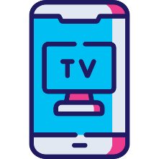




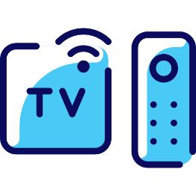
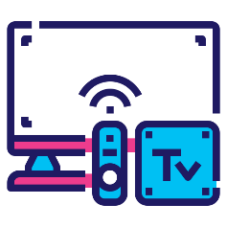
What TV platforms can you buy on?
Audience-based buying can be implemented across screens, providing marketers with a variety of TV platforms to choose from
Programmatic TV
Data-Driven Linear TV
Audience-Based Buying
Mobile / Digital (FEP*)
Addressable TV
OTT
Connected TV
Set-Top Box VOD
*FEP=Full Episode Player
This information is exclusively provided to VAB members and qualified marketers. Further distribution is prohibited.
PAGE 7
This information is exclusively provided to VAB members and qualified marketers. Further distribution is prohibited.

Slide 8


























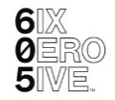










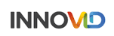







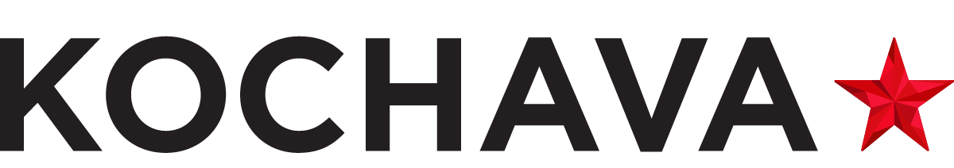

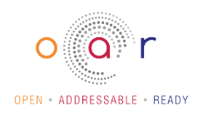
Which companies support and measure audience-based TV buying?
Programmers, content distributors and data & analytics companies have already introduced solutions to provide marketers with precision targeting and the ability to connect with consumers at scale
Where can you buy inventory?
Who can help you measure / optimize your campaigns?
Who is working to standardize and simplify the process?
*This reflects a sampling of companies within the audience-based ecosystem.
This information is exclusively provided to VAB members and qualified marketers. Further distribution is prohibited.
PAGE 8
This information is exclusively provided to VAB members and qualified marketers. Further distribution is prohibited.

Slide 9



How is the success of an audience-based campaign measured?
Audience-based multiscreen TV campaigns can deliver measurable outcomes through the marketing funnel, driving greater awareness of their brands and motivating the most relevant consumers to take action
Awareness
Action
Audience-based buying can expand reach and drive brand recall by targeting the consumers who are most likely to be interested in a brand or product based on their interests and shopping behaviors
By targeting the most relevant consumers with an ad, brands increase the likelihood that the intended audience will be motivated to act (e.g., make a purchase, download an app, subscription sign-ups, bookings)
Sampling of ‘awareness-based’ outcomes that can be measured:
    Reach / Reach Extension / Incremental Reach
    Ad / Brand Recall
    Cost Efficiencies (Reach / Targeted IMPs)
Sampling of ‘action-based’ outcomes that can be measured:
    Conversion Rates (website traffic, app downloads, subscription sign-ups, tune-in, foot traffic)
    Sales / Revenues
    Optimizations / ROI
    Cost Efficiencies (Conversions)
This information is exclusively provided to VAB members and qualified marketers. Further distribution is prohibited.
PAGE 9
This information is exclusively provided to VAB members and qualified marketers. Further distribution is prohibited.

Slide 10
Audience-Based Buying in Practice
Real-world case studies highlighting business outcomes throughout the marketing funnel

Slide 11

Audience-Based Buying in Action
An audience-based buying approach offers marketers a smarter way to plan and buy TV - one that provides greater precision to reach their target audiences, that integrates comparable metrics to plan and buy cross-platform campaigns and that delivers the ability to tie campaigns directly to brand outcomes.
For that reason, audience-based buying has gained momentum in the industry and is being implemented by a wide variety of marketers.
The following case studies, representing 15 different client categories and 11 different media companies, illustrate how audience-based buying is being used today.
Organized by the brand’s primary attribution objective (awareness or action), the following case studies detail the marketer’s challenge, solution, target segment and campaign result.
This information is exclusively provided to VAB members and qualified marketers. Further distribution is prohibited.
PAGE 11

Slide 12



















Case Study Directory: By Category, By Media Company
Awareness
Action
Through the Funnel
*Color Coded by Measurable Outcomes
Automotive
Education
Mobile Gaming
Ampersand
Travel (Resorts)
a4 Media
Simulmedia
Effectv
NBCUniversal
NY Interconnect
Entertainment
Quick Service Restaurant (QSR)
Beauty / Retail
TVSquared
NBCUniversal
A+E Networks
Tune-In
Real Estate
NY Interconnect
Consumer Electronics
Financial Tech (DTC)
NBCUniversal
AMC Networks
TVSquared
Consumer Packaged Goods (CPG)
Healthcare / Pharma
Travel (Hotels)
Wellness
Amobee
DeepIntent
Simulmedia
A+E Networks
Click on any company to go directly to their case study
This information is exclusively provided to VAB members and qualified marketers. Further distribution is prohibited.
PAGE 12

Slide 13
Eight proven strategies and tactics in successful audience-based TV buying campaigns
Understand your consumer and
their behaviors
Utilize 1st, 2nd and/or 3rd party data & tools for targeting and measurement
Consider
cross-platform opportunities
Implement
‘test and learn’ campaigns
Buy a broad & deep schedule of TV networks
Effective targeting improves cost efficiencies which maximizes ROI
Understand which outcomes are most important to your objectives
Optimize to outcomes for your current & future TV buys
This information is exclusively provided to VAB members and qualified marketers. Further distribution is prohibited.
PAGE 13

Slide 14
Awareness
Upper Funnel
Case Studies
Audience-based buying can expand reach and drive brand recall by targeting the consumers who are most likely to be interested in a brand or product based on their interests and shopping behaviors
How Audience-Based Buying Can Drive
Awareness
Sampling of ‘awareness-based’ outcomes that can be measured:
    Reach / Reach Extension / Incremental Reach
    Ad / Brand Recall
    Cost Efficiencies (Reach / Targeted IMPs)
This information is exclusively provided to VAB members and qualified marketers. Further distribution is prohibited.
PAGE 14

Slide 15


Category:
Automotive
Auto brand drove double-digit incremental reach through optimized buy
+14%
Impressions from the AND-based buy vs. traditional
Challenge
Auto brand sought to extend the reach of their campaign against truck buyers
Solution
Utilizing ‘Define + Find’ within Ampersand’s audience-based buying solution, The AND Platform, the brand optimized their buy across more networks and dayparts based on target audience viewership data
Target Segment
Truck Intenders
Results
While adhering to market specific CPM and weekly impression goals, the optimized buy lifted total impressions by 14%
Company / Platform
Ampersand’s The AND Platform / Data-driven linear
Test Campaign | # of Dayparts | # of Networks | Total Impressions
4Q’19 (Traditional Buy) | 3 | 11 | 3,575,600
4Q’20 (AND-based Buy) | 7 | 25 | 4,061,500
TRUCK Campaign by Daypart - Washington DC
Traditional Buy
4Q’19
AND-Based Buy
4Q’20
58%
of time spent by the target audience segment was spent outside of Primetime
Source: Ampersand, “Automotive Brand” Test Campaign: The AND Platform.
This information is exclusively provided to VAB members and qualified marketers. Further distribution is prohibited.
PAGE 15

Slide 16

Category:
Consumer Packaged Goods
A multi-brand CPG efficiently augmented their strategic target’s reach across a large portfolio of brands
Challenge
The agency of a leading CPG brand needed to efficiently allocate spend and maximize reach across all its upfront commitments, while overcoming a legacy system of manually allocating TV units across each brand
Solution
By leveraging data-driven linear TV planning and optimization, a multi-brand CPG was able to:
  Automate quarterly optimizations and allocations against their schedule of upfront inventory
  Achieve deep granularity and maximum efficiency against strategic targets (ST) across the entire brand family
  Maximize the outcome for each brand’s target within a demo-based portfolio
Target Segment
CPG Strategic Target*
Results
Campaign efficiency increased while demo and strategic reach increased
Company / Platform
Amobee / Data-driven linear
+31%
+24%
-19%
Increase in Demo Reach Across All Brands
Improvement in Strategic Target Reach
Reduction in
Strategic Target eCPM
Source: Amobee, Case Study: Major Agency Augments Multi-Brand Reach with Data Driven Linear. *Strategic targets varied according to brand, Beyond age and gender, targets leveraged data such as purchase history, family situation, location, pet ownership and household income.
This information is exclusively provided to VAB members and qualified marketers. Further distribution is prohibited.
PAGE 16

Slide 17

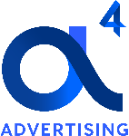
Category:
Education
Education brand extended linear TV campaign to OTT, reaching new consumers and creating efficiencies
Challenge
Seeking to increase awareness by reaching a new audience, an education brand sought to supplement their linear TV campaign with OTT
Solution
Utilizing pre-campaign data, a4 Advertising identified which households were less likely to be exposed to the linear campaign, enabling them to build a highly optimized incremental OTT campaign targeting homes based on exposure in-flight.
Target Segment
HHs Unexposed to Linear TV Campaign
Results
Optimizing in-flight, a4 was able to focus on unexposed homes while enhancing campaign efficiency, ultimately growing the OTT incremental reach from 3.7% to 14.7%
Company/ Platform
a4 Advertising / OTT
Target Audience Exposure Profile
OTT Incremental Reach Campaign Efficiency
Only 7.8% of target HHs were exposed to the ad on both linear and OTT, confirming the campaign reached primarily net new homes
Of all the homes reached via OTT during the campaign, 86% were exposed to OTT only, efficiently driving incremental reach
The incremental reach generated purely by the OTT campaign grew from 3.7% to 14.7% (+297% growth rate) from week 1 to week 6
Source: a4 Advertising, OTT Incremental Reach Case Study, based on 6 on-air weeks campaign flight.
This information is exclusively provided to VAB members and qualified marketers. Further distribution is prohibited.
PAGE 17

Slide 18




Category:
Healthcare / Pharma
Healthcare company raised awareness of new medication by engaging qualified physicians in CTV
Challenge
Increase market share for a prescription migraine medication by raising awareness amongst physicians who prescribe competitive drugs
Solution
DeepIntent® matched the brand’s NPI (National Provider Identifier) list with their HCP universe to identify and target on a 1:1 basis on smart TVs, gaming consoles and streaming devices including Roku, Samsung and Apple TV
Target Segment
Highly Qualified Healthcare Professionals (HCP)
  75%+ of the 1.6MM HCP universe is addressable by DeepIntent’s platform daily
Results
A high-quality database mixed with 1st party data, fueled by constant optimization resulted in an on-target reach of over 60%
Company / Platform
DeepIntent® / DeepIntent Healthcare DSP / CTV
62%
on-target reach;
exceeding the brand’s expectations
99%+
exposed HCPs matched to NPI for physician-level measurement and reporting
This information is exclusively provided to VAB members and qualified marketers. Further distribution is prohibited.
PAGE 18

Slide 19



Category:
Consumer Electronics (DTC)
An optimized test campaign led to significant investment in OTT for a Consumer Electronic (DTC) brand
Challenge
Looking to increase awareness and attract new customers, a DTC consumer electronics brand sought to optimize their existing OTT campaign to ensure new households were being targeted
Solution
TVSquared optimized the brand’s publisher mix, heavying up where net new impressions were available and determining the ideal frequency (between 4-6x/mo), driving better ROI and minimizing waste
Target Segment
Households unexposed to other publishers
Results
By optimizing delivery and frequency by focusing on unique audience reach, “wasted” impressions were reduced and household reach was boosted 35% per month
Company / Platform
TVSquared / OTT
1 9
+150%
+35%
New publishers added over 6-month period
Increase in OTT ad spend in 2nd half 2020 by advertiser after testing OTT in early 2020
Increase in net new HHs reached per month
Source: TVSquared, Case study: Extending Audience Reach with OTT. Flight duration: August 2020-Jan 2021.
This information is exclusively provided to VAB members and qualified marketers. Further distribution is prohibited.
PAGE 19

Slide 20
Action
By targeting the most relevant consumers with an ad, brands increase the likelihood that the intended audience will be motivated to act (e.g., make a purchase, download an app, subscription sign-ups, bookings)
Lower Funnel
Case Studies
How Audience-Based Buying Can Drive
Action
Sampling of ‘action-based’ outcomes that can be measured:
    Conversion Rates (website traffic, app downloads, subscription sign-ups, tune-in, foot traffic)
    Sales / Revenues
    Optimizations / ROI
    Cost Efficiencies (Conversions)
This information is exclusively provided to VAB members and qualified marketers. Further distribution is prohibited.
PAGE 20

Slide 21



Category:
Real Estate
A realty brand utilized advanced TV targeting to increase traffic to their website
Challenge
A major realty brand sought to increase traffic to their website
Solution
The brand worked with AMC Networks to build a plan to effectively reach their custom target, after examining historical iSpot website conversions based on the brand’s past demo-based buys, AMCN determined a benchmark and applied a guaranteed conversion lift for the new audience-targeted campaign
Target Segment
Potential New Homeowners (MRI Fusion)
Results
Through advanced TV targeting, AMC Networks overdelivered on the brand’s web visit conversion rate guarantee by nearly +6% within the 14-day attribution window
Company / Platform
AMC Networks / Data-driven linear
+6%
Benchmark:
8.4%
Source: AMC Networks, iSpot TV, iSpot conversion data, Q1 2020, 14-day attribution window. Target based on MRI Fusion data.
This information is exclusively provided to VAB members and qualified marketers. Further distribution is prohibited.
PAGE 21

Slide 22




Category:
Travel (Resorts)
A luxury resort brand increased their website traffic through addressable VOD
Challenge
A leading luxury resort group sought to increase traffic to their website
Solution
Using NBCU’s AdSmart audience targeting solution, the brand ran an addressable TV campaign across the NBCU VOD portfolio to reach their custom ‘traveler’ target. Data Plus Math was utilized to measure the impact of the campaign on driving traffic to the advertiser’s website.
Target Segment
Custom Mastercard ‘Luxury Hotel & Resort Travelers’
Results
By implementing a targeted addressable TV campaign, the brand saw a double-digit lift in overall website visitations
Company / Platform
NBCU’s AdSmart solution / Addressable TV
  (VOD: NBCU set-top box VOD, NBCU CTV O&O apps, NBCU on Hulu)
AdSmart drove double-digit site visitation lift
+24% lift in visitation to the advertiser’s website
+35% lift in unique visitors to the advertiser’s website
AdSmart drove double-digit page visitation lift across the site
+50% lift in visitation to the advertiser’s homepage
+56% lift in visitation to property search pages
+27% lift in visitation to resort booking pages
+42% lift in visitation to special offers pages
+34% lift in visitation to resort + flight booking pages
+19% lift in visitation to resort-only booking pages
Source: NBCU, AdSmart + Luxury Resort Case Study.
This information is exclusively provided to VAB members and qualified marketers. Further distribution is prohibited.
PAGE 22

Slide 23

Category:
Entertainment
A new SVOD service utilized a test and learn approach constantly optimizing their target, resulting in higher response rates
Challenge
Promote a new SVOD service for a premium national TV network
Solution
Leveraged programmatic CTV to run a targeted TV campaign to understand which targets were driving subscriptions and test look-alike audiences
Target Segment
Look-alike Audiences
Results
A constant test and learn approach enabled a diversified impression allocation across the campaign, resulting in more look-alikes, increasing the response rate and improving the cost-per-conversion
Company / Platform
TVSquared / CTV
The ‘test and learn’ approach of this targeted programmatic CTV campaign resulted in…
10 to 20
50% Increase
Increased Look-alike Segments
in Response Rate
60% Shift
30% Improvement
Re-allocated Imps
to New Audiences
Optimized
Cost-per-Conversion
Source: TVSquared, Case study: The Power of Programmatic TV. Flight duration: October 2020 – January 2021.
This information is exclusively provided to VAB members and qualified marketers. Further distribution is prohibited.
PAGE 23

Slide 24


Category:
Tune-In
An audience-targeted linear & digital campaign drove TV tune-in conversion for a cable TV network
Challenge
A cable TV network wanted to drive viewership to their summer programming
Solution
The network utilized addressable TV to target specific households and optimize creative throughout the week in addition to IP targeting which involved pre-roll videos and display ads to the same targeted household segments
Target Segment
Households who have viewed the network but are “non-heavy” viewers
Targeted households who have viewed competitive programming
Results
Households exposed to both the linear TV and OTT campaign converted at an average rate that was 67% higher than that of the average non-exposed household
Company / Platform
New York Interconnect / Addressable TV, OTT (Digital)
RESULTS
Incremental Tune-In Lift (Linear + Digital ad exposure)
EXPOSED
TUNE-IN RATE
1.81%
67%
Targeted Households
376,358*
UNEXPOSED
TUNE-IN RATE
1.08%
Households exposed to both the linear and digital campaign converted at an average rate that was 67% higher than that of the average non-exposed households.
11.8% of medium (11-50 imps) exposed Linear-only converted households tuned to four or more (4+) summer movies across the 8 campaign weeks
38.3% of heavy (51+ imps) exposed Linear-only converted households tuned to four or more (4+) summer movies across the 8 campaign weeks
Exposed households displayed the highest tune-in conversion rates during Daytime (9A-6P) and Primetime (6P-12A)
TV Impressions
21.4MM
Digital/OTT Impressions
5.8MM
Source: NY Interconnect, a4 Advertising & Data Solutions, Total Audience Data. Conversion analysis based on set-top box and Digital ad exposure. Incremental Lift = (Exposed tune-in rate – Unexposed tune-in rate)/Unexposed tune-in rate; All rates are rounded to two decimals; *Target Households represents the weekly average throughout the campaign. 5 Minute Cumulative QH Minimum/5 Hour Maximum Edit Rule utilized in tuning data. Live+3 tuning data utilized from the Optimum footprint. Flight duration: 3Q 2020 (8-week campaign)
This information is exclusively provided to VAB members and qualified marketers. Further distribution is prohibited.
PAGE 24

Slide 25







Category:
Beauty / Retail
Beauty Retailer drove higher in-store traffic and conversions through advanced TV targeting
Challenge
Increase store traffic for a beauty retail company
Solution
Using their Precision1 tool, Lifetime created custom linear and digital targets (Nielsen MRI / Krux), tracked ad exposure on Vizio smart TVs (iSpot), resolved identities (LiveRamp / Experian) and measured foot traffic to retail locations via mobile (PlaceIQ)
  Partnered with iSpot to develop attribution analysis to guarantee conversion lift based on data from year prior
Target Segment
Beauty Enthusiasts – custom target created using Nielsen MRI (linear) and Krux (digital)
Results
Through audience-based targeting and measurement, Lifetime delivered an in-store conversion rate lift (CRL) 10x greater than the guarantee
Company / Platform
A+E Networks’ Precision1 / Multiplatform TV
Setting a Benchmark & Guaranteeing Outcomes
Multi-Viewing Precision Targeting
Performance
Linear Precision1
“Beauty Enthusiast” target created using Nielsen MRI data source
Airing on Lifetime only
Digital Precision1
“Beauty Enthusiast” target created using Krux data source
Airing on Lifetime only
Business Outcomes Guarantee
+8% Conversion Rate Lift in Fall/Holiday foot traffic to store locations vs. year prior
‘Beauty Enthusiasts’ TV Conversion Rates Outcomes
14-day attribution window, Lifetime TV Network
+65% vs. GTE
+80%
LIFT
vs Benchmark
+8% GTE
Source: A+E Networks, “Beauty Enthusiast” Precision + Performance Case Study. Audience targets based on data from Nielsen MRI (Linear) and Krux (Digital). *Retail locations included in malls and shopping centers in addition to being stand-alone structures. Data partners: iSpot, Vizio, LiveRamp, Experian, PlaceIQ. Flight duration: 9/1/19 – 12/24/19, with a 14-day attribution window.
This information is exclusively provided to VAB members and qualified marketers. Further distribution is prohibited.
PAGE 25

Slide 26

Category:
Quick Service Restaurant
A QSR brand saw lifts in foot traffic among all exposure groups, especially target households, through a data-driven linear TV campaign
Challenge
A QSR brand wanted to drive foot traffic to restaurant locations during a limited-time promotion
Solution
Using NBCU’s AdSmart audience targeting solution, the brand ran a national TV campaign across the NBCU portfolio to reach their custom target. Data Plus Math was utilized to measure the incremental impact of the campaign on driving foot traffic to the brand’s locations.
Target Segment
Custom LiveRamp look-alike target modeled from the brand’s 1st-party database of mobile app users
Results
By implementing a targeted data-driven TV campaign, overall restaurant visitations increased +4.5% with a +5% increase among in-target HHs
Company / Platform
NBCU’s AdSmart solution / Data-driven linear
% Lift in Restaurant Visitation
+4.5%
+5%
+4.5%
Overall
In-Target
Non-Target
(Total HHs Exposed to AdSmart Campaign vs.
Total HHs Exposed to Non-AdSmart Campaign)
(Target HHs Exposed to AdSmart Campaign vs.
Target HHs exposed to non-AdSmart campaign,
the non-target lift indicates a strong halo effect)
AdSmart Exposure Among Target HHs Drove Higher Restaurant Visitation, Validating The Targeting
+18%
Higher In-Target Restaurant Visitation vs. Overall
+22%
Higher In-Target Restaurant Visitation vs. Non-Target
Source: NBCU, AdSmart + QSR Case Study.
This information is exclusively provided to VAB members and qualified marketers. Further distribution is prohibited.
PAGE 26

Slide 27




Category:
Mobile Gaming
Mobile gaming company saw lift in users, engagement and monetization through data-driven linear TV campaign
Challenge
After running digital-centric campaigns for years, a mobile gaming company was looking for additional ways to reach new and existing customers and get those customers to monetize at a higher rate
Solution
To reach new, existing and former customers, Simulmedia created custom target audiences, developed a detailed forecast of the programs they were predicted to watch during the duration of the campaign and developed a media plan that maximized reach by advertising on 53 networks
Target Segment
Custom target based on brand’s first-party customer data matched to viewing panel data
Results
By implementing a data-driven linear TV campaign, the ROAS was 4.5x greater and every KPI increased (account creation, login, monetization)
Company / Platform
Simulmedia / Data-driven linear
Conversion Rate by Action
P2+
2.8x
Lift from Exposure
3.9x
Lift from Exposure
4.5x
Lift from Exposure
Exposure to the campaign resulted in:
4.6X
Higher acquisition rate for new users
4.1X
Higher win-back rate for users who hadn’t played in 2-4 weeks
$1.31
Return on advertising spend (ROAS) from a 4.5X greater monetization rate & increased in-game spending
Source: Simulmedia, Case Study: Mobile Gaming Company Uses Simulmedia to Increase Acquisition and Monetization.
This information is exclusively provided to VAB members and qualified marketers. Further distribution is prohibited.
PAGE 27

Slide 28



Category:
Wellness
Audience-based buying outperformed traditional linear TV in online sales lift and conversion efficiency for a wellness brand
Challenge
A wellness brand sought to improve the online conversion performance of their traditional linear TV plan
Solution
The brand utilized A+E Network’s Precision solution to follow the custom target’s journey from where they were engaged and from engagement to conversion. Then A+E’s Performance solution was utilized for:
  TV Lift Performance (TLP): measures the relative performance of a campaign component’s contribution and impact on TV Lift
  Conversion Efficiency (Index): compares estimated spend (via iSpot) divided by the attributed campaign conversions to TV norms
Target Segment
Health-Conscious Adults
Results
Through audience-based targeting and measurement, A+E Networks contributed to a +42% lift in TV performance and +15% in conversion efficiency
Company / Platform
A+E Networks’ Precision+Performance / Data-driven linear
Outcome: Online Purchases
TV Lift Performance %
Conversion Efficiency Index
+42%
+15%
(IMP)
Traditional Linear
A+E Precision
Traditional Linear
A+E Precision
A+E Precision optimization increases vs. the cable TV average:
Lift performance: +27%
Conversion Efficiency Index: +41%
Source: A+E Networks, Case Study: Digital Conversion From Linear Campaign. Traditional Linear = consists of A+E networks and competitors where the brand is running advertisements. TV Lift Performance (TLP): Measure the relative performance of a campaign component's contribution and impact on TV Lift. Conversion Efficiency (Index): Index comparing estimated spend (via iSpot) divided by the attributed campaign conversions to TV norms.
This information is exclusively provided to VAB members and qualified marketers. Further distribution is prohibited.
PAGE 28

Slide 29







Category:
Automotive
Leading auto manufacturer shifted to an addressable + data-driven TV strategy which drove incremental sales revenue
Challenge
A leading auto manufacturer set a goal to increase sales in the NY area for five specific model vehicles
Solution
To ensure the initiative focused on the most qualified in-market prospects, NYI created spot addressable and linear TV campaigns exposing messaging to four target auto segments
Target Segment
Four targeted auto segments
Results
By concentrating on the four auto segments, conversion among those homes skyrocketed: four of the five models experienced an incremental lift; net incremental sales revenue increased $7.1M with most sales occurring with two months of seeing the first ad
Company/ Platform
NY Interconnect / Addressable TV, Data-driven linear
Results / ROI
Additional Key Findings
Target Model Vehicles Only
336 Incremental sales
+6% Incremental lift in sales
ROI
Net Incremental Sales Revenue: $7.1M
$4.53 per dollar spent
Households exposed to the campaign purchased 6,302 target model vehicles
Four of the five models experienced positive sales lift outcomes
Three of the models ranked among the Top 3 in share within their respective competitive classes;
One of the models ranked #1 in its competitive class
Increased ad exposure had a positive impact as the conversion rate increased along with the number of exposures
The majority of sales occurred 60 days after first being exposed to the ad
Source: NY Interconnect, Case study: Addressable TV Collaboration Drives Up Sales. NY DMA, Conversion analysis based on set-top box ad exposure matched to Experian Automotive sales data. Incremental Lift = (Exposed Buy Rate – Unexposed Buy rate)/Unexposed Buy rate), Incremental Sales = (Exposed Households * (Exposed Buy Rate – Unexposed Buy Rate). Spot Addressable TV – Altice, Linear TV – Charter, Comcast. Campaign time period: 4Q ’19.
This information is exclusively provided to VAB members and qualified marketers. Further distribution is prohibited.
PAGE 29

Slide 30
Awareness
Awareness
Audience-based buying can expand reach and drive brand recall by targeting the consumers who are most likely to be interested in a brand or product based on their interests and shopping behaviors
Audience-based buying can drive expand reach and drive brand recall by targeting the consumers who are most likely to be interested in a brand or product based on their interests and shopping behaviors
Case Studies
How Audience-Based Buying Can Drive Outcomes
Through the Funnel
Action
Action
By targeting the most relevant consumers with an ad, brands increase the likelihood that the intended audience will be motivated to act (e.g., make a purchase, download an app, sign-up for a streaming service).
By targeting the most relevant consumers with an ad, brands increase the likelihood that the intended audience will be motivated to act (e.g., make a purchase, download an app, subscription sign-ups, bookings)
This information is exclusively provided to VAB members and qualified marketers. Further distribution is prohibited.
PAGE 30

Slide 31

Category:
Automotive
An optimized test led to an audience-based TV campaign which drove incremental reach, increased sales and cost efficiencies for the local auto dealership
Challenge
Tate Automotive (Dodge, Chrysler, Jeep) in Glen Burnie, Maryland sought to increase sales by expanding their customer base while achieving cost efficiencies
Solution
Following a small test based on a data-driven TV campaign with Effectv, which showed that incremental reach is achieved within a broader schedule, the brand applied those learnings to a full-scale audience-based campaign utilizing more than twice as many networks as the previous year
Target Segment
In-Market for a New Vehicle
Results
The full-scale audience-based campaign led to:
  Greater efficiencies: +24% YoY investment increase vs. +46% YoY increase in target HH reach (vs. traditional campaign in 2019)
  Sales: 160 cars sold, #1 brand dealer in the state
Company / Platform
Effectv’s Audience Intelligence for Local / Data-driven linear
Traditional vs. Targeted Campaign
Campaign | # of Networks | Target Reach | Frequency
August 2019 | 12 | 48% | 3.7
August 2020 | 34 | 70% | 11.1
August 2020 Results
160
Cars Sold
#1
Brand Dealer
in the State
August 2020: Full Scale, Audience-Based Campaign
Campaign Target HH Reach
In-Market for a New Vehicle
+20% incremental reach for Sports/News
50%
reach for audience targeted schedule
Source: Effectv, Automotive Case Study. *AIL = Audience Intelligence for Local, Effectv’s audience-based video solution. The test campaign ran between June-July 2020.
This information is exclusively provided to VAB members and qualified marketers. Further distribution is prohibited.
PAGE 31

Slide 32

Category:
Financial Tech (DTC)
A DTC financial technology brand utilized a targeted, data-driven, multiplatform campaign to deliver full-funnel impact
Challenge
A DTC financial technology company that built its customer base through digital / social channels wanted to reach a larger prospective audience to maintain existing base & drive new adopters
Solution
Using NBCU’s AdSmart audience targeting solution, the brand engaged with their target across the NBCU multiplatform portfolio via data-driven national linear TV, desktop & mobile video and display content. To measure the full-funnel impact of the campaign, YouGov was leveraged for pre- vs. post-campaign metrics and Data Plus Math was utilized for direct web attribution.
Target Segment
Scalable custom target audience based on brand’s 1st-party CRM data
Results
The targeted multiplatform campaign increased key brand metrics significantly and drove double-digit lift in site visits, app installs, sign-ups and completed registrations
Company / Platform
NBCU’s AdSmart solution / Multiplatform (TV & Digital)
Brand metrics increased significantly vs. pre-campaign
+9%
Lift in Brand Awareness
+33%
Lift in Brand Opinion
+30%
Lift in Brand Purchase Intent
NBCU’s AdSmart campaign exposure drove double-digit lift
in site visits & app installs
+28%
Lift in Website Visits
+52%
Lift in Homepage Visits
+27%
Lift in Mobile App Installs
NBCU’s AdSmart campaign exposure drove double-digit lift
in sign-ups & completed registrations
+27%
Lift in Web Sign-Ups
+25%
Lift in Mobile App Sign-Ups
+24%
Lift in Completed
Web Registrations
+33%
Lift in Completed Mobile App Registrations
Source: NBCU, AdSmart + DTC Financial Technology Brand Case Study. Source for brand metrics: YouGov. Source for site visits, app installs, sign-ups, and registration: custom Data Plus Math measurement. Flight duration: 10/13/20 – 12/30/20.
This information is exclusively provided to VAB members and qualified marketers. Further distribution is prohibited.
PAGE 32

Slide 33






Category:
Travel (Hotels)
A hotel brand implemented an optimized data-driven TV campaign to increase their unique reach, conversion rates and cost efficiencies
Challenge
Choice Hotels wanted to increase their bookings by targeting and reaching frequent business travelers before their next trip
Solution
Choice partnered with Simulmedia to develop an optimized data-driven linear TV campaign that maximized the target audience reach, then Simulmedia’s viewing panel was matched with Choice’s loyalty card data to determine the campaign’s impact
Target Segment
Frequent business travelers supplemented with Choice’s 1st party CRM data
Results
The data-driven linear TV campaign drove positive impact across the funnel – increased unique reach, higher conversions and greater cost efficiencies
Company / Platform
Simulmedia / Data-driven linear
11.5%
59.4%
66.7%
37.7%
Unique Reach
Extension
(with just 18% of the budget)
Higher Conversion Rate by Exposed Viewers
Lower Cost per Reach
Lower Cost per Incremental Purchaser
Source: Simulmedia, Case Study: Choice Hotels Gives Bookings A Boost.
This information is exclusively provided to VAB members and qualified marketers. Further distribution is prohibited.
PAGE 33

Slide 34



Key Takeaways For Marketing Plans
Think Cross-Platform When Developing Video Buys
Define Your Target Audience Based on Your Campaign’s KPI
Test and Learn to Set Your Brand Up for Future Success
Accelerated by the conditions of
the pandemic, video viewing across screens and platforms has increased significantly. This provides advertisers with more opportunities to find their audiences. In developing an audience-first buying strategy, consider expanding video campaigns across screens to increase scale and reach of your best potential consumers.
The buy should be designed specifically to meet your brand’s KPI. For example, you can create an audience group that will expose your brand to new customers (incremental reach). If you are looking to drive website visits among likely purchasers, an audience group can be crafted based on that audience’s characteristics (e.g. fitness enthusiasts). Start with your KPI and design your audience and strategies
to best meet it.
Advancements in data-driven targeting capabilities will only increase. Similarly, the number of video viewing platforms consumers watch will also increase. This is the time to test what audiences and strategies work best for your brand. Test and learn now to position your brand to drive business outcomes into the future.
This information is exclusively provided to VAB members and qualified marketers. Further distribution is prohibited.
PAGE 34

Slide 35

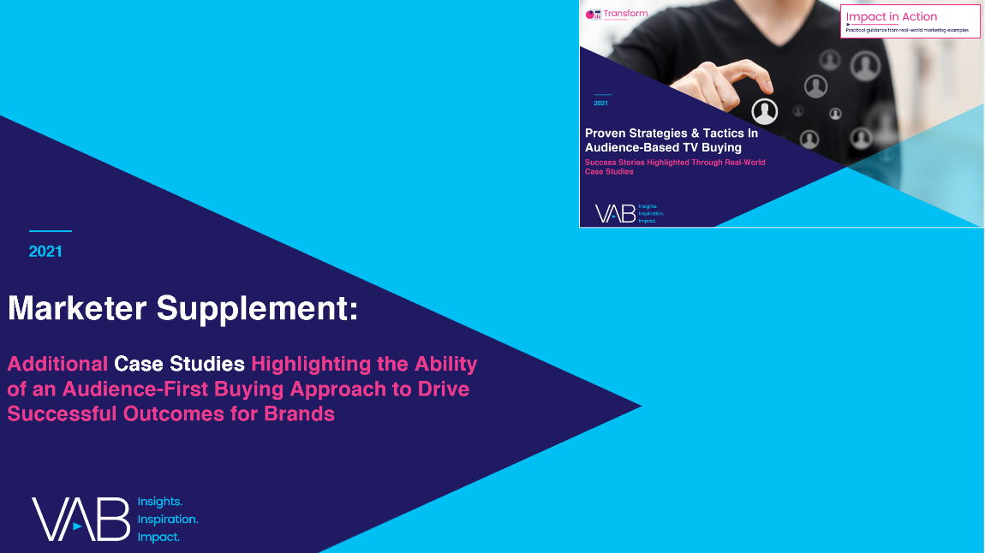
Jason Wiese
Leah Montner-Dixon
Karolina Guillen
SVP, Director of Strategic Insights
jasonw@thevab.com
Insights Manager
leahm@thevab.com
Senior Insights Analyst
karolinag@thevab.com
Looking for more?
Download our supplemental piece with
six more case studies that further showcase how audience-based buying can drive business outcomes
This information is exclusively provided to VAB members and qualified marketers. Further distribution is prohibited.
PAGE 35

Slide 36

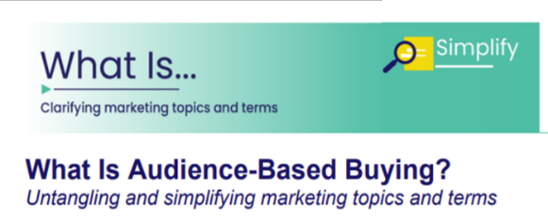
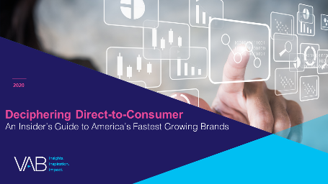
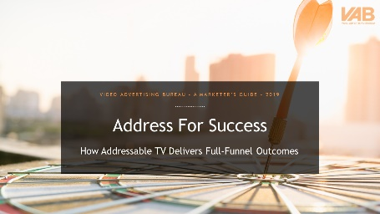

Jason Wiese
Leah Montner-Dixon
Karolina Guillen
SVP, Director of Strategic Insights
jasonw@thevab.com
Insights Manager
leahm@thevab.com
Senior Insights Analyst
karolinag@thevab.com
Check out our related content
What Is Audience-Based Buying?
Simplifying Marketing Topics and Terms
Audience Migration in Context
Leveraging Population Shifts To Unlock $4 Trillion in Buying Power
More data, insights and takeaways to help you make informed marketing decisions
Deciphering Direct-to-Consumer
An Insider’s Guide to America’s Fastest Growing Brands
Address For Success
How Addressable TV Delivers
Full-Funnel Outcomes
VAB Members, brand marketers and agencies get free and immediate access to VAB’s content library. Get access at theVAB.com
This information is exclusively provided to VAB members and qualified marketers. Further distribution is prohibited.
PAGE 36

Slide 37

About VAB
VAB is an insights-driven organization that inspires marketers to reimagine their media strategies resulting in fully informed decisions.
Drawing on our marketing expertise, we simplify the complexities in our industry and discover new insights that transform the way marketers look at their media strategy.
Transform
We help you build your brand by focusing on core marketing principles that will help drive tangible business outcomes.
Simplify
We save you time by bringing you the latest data & actionable takeaways you can use to inform your marketing plans.
Discover
We keep you one step ahead with the latest thinking so you can create innovative, forward-looking strategies.
We are committed to your business growth and proud to offer VAB members, brand marketers and agencies complimentary access to our continuously-growing Insights library. Get immediate access at theVAB.com.
This information is exclusively provided to VAB members and qualified marketers. Further distribution is prohibited.
PAGE 37

