Slide 1




























Programmatic TV Advertising Ecosystem Overview
The Programmatic TV ecosystem is comprised of many tools, platforms and solutions that enable marketers to access Premium TV inventory in an automated way.
Ad Exchange: A marketplace where the buy side and sell side meet enabling DSPs (Demand Side Platforms) to bid on impressions supplied by SSPs (Supply Side Platforms).
Demand Side Platform
Supply Side Platform
Enables advertisers to bid automatically for available inventory across streaming apps, CTV platforms, linear and addressable TV.
Who Uses It: Advertisers who want to plan, target and purchase TV ads in real time.
Why DSPs are Essential:
Automates the buying process
Centralizes media buying
Enables advanced targeting and frequency capping capabilities
Increased campaign flexibility and adjustability for optimized results
Enables publishers and media owners to
sell inventory efficiently, at scale, and with precision.
Who Uses It: Publishers, streaming apps,
TV networks and device platforms
Why SSPs are Essential:
Automates the selling process
Maximizes yield of inventory
Provides marketers access to premium, brand safe and curated inventory
Allows buyers to align ads with relevant genres, shows, or moments in a privacy compliant way
Ad Server: Ensures ads are delivered to the right viewer on the right screen while also tracking results
Ad Tech Platforms: Technology backbone that enables and optimizes the buying, selling, delivery and measurement of digital ads across the programmatic TV ecosystem
Companies shown above represent a sampling
PAGE 1
This information is exclusively provided to VAB members and qualified marketers.

Slide 2

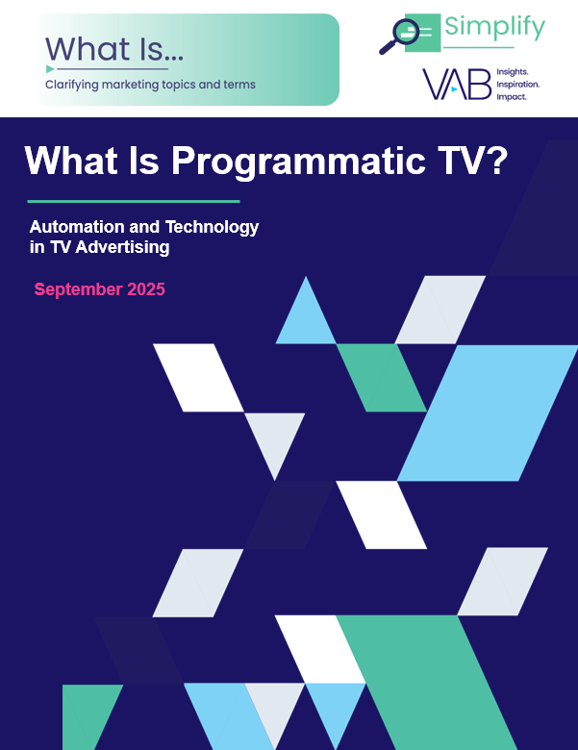
Want to learn more about Programmatic TV?
DOWNLOAD THE FULL GUIDE
Plus, visit our Advertising Essentials page to view our full library of overviews and glossaries on a variety of industry topics.
About VAB
VAB plays a dual role in the video advertising industry. We are leading the change to bring about a more innovative and transparent marketplace. We also provide the insights and thought leadership that enables marketers to develop business-driving marketing strategies.
Drawing on our marketing expertise, we simplify the complexities in our industry and discover new insights that transform the way marketers look at their media strategy.
We are committed to your business growth and proud to offer VAB members, brand marketers and agencies complimentary access to our continuously-growing Insights library. Get immediate access at theVAB.com.
PAGE 2
This information is exclusively provided to VAB members and qualified marketers.

