Slide 1





Marketer FAQs
Why is it important for my brand to align
with trusted and transparent media partners?

Slide 2


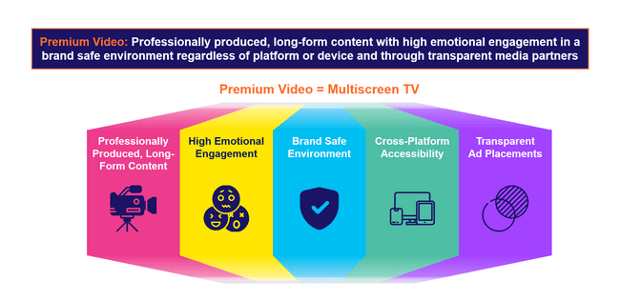
Transparent ad placements are one of the defining aspects of premium video
The essence of ‘premium video’ is rooted in high quality, emotionally engaging content within transparent, brand safe environments across platforms and devices. These core pillars also directly align with the value and benefits of multiscreen TV.
Why should investing in premium video matter to marketers?
The pillars of premium video, and multiscreen TV by extension, combine to drive full-funnel performance and business outcomes for marketers:
This information is exclusively provided to VAB members and qualified marketers.
PAGE 2

Slide 3





Investing in premium video platforms provides transparent ad placements which not only protects and preserves brand value but also strengthens it
Professionally produced, long-form content with high emotional engagement in a brand safe environment regardless of platform or device and through transparent media partners
Premium Video = Multiscreen TV
Professionally Produced, Long-Form Content
High Emotional Engagement
Brand Safe Environment
Cross-Platform Accessibility
Transparent
Ad Placements
This information is exclusively provided to VAB members and qualified marketers.
PAGE 3

Slide 4






What It Means: Transparent Ad Placements
Transparency ensures visibility into ad placements and the quality of data used to inform and measure campaign success
Transparency refers to the amount of information shared throughout the campaign lifecycle, enabling clear communication between the sell-side and the buy-side.
Complete transparency on…
True verification
The full lifecycle of all video ad units within your campaign by
media partner
All calculations
of video ad impressions by media partner
The granular details of exact ad placements, by type and inventory source, across each media partner
The composition of ad placement types and inventory sources in audience metrics such as reach calculations by media partner
Have media partners bring in a truly independent third party to provide transparency on
a now-permanent basis
Source: Download VAB’s ‘Hidden Costs’ to learn more.
This information is exclusively provided to VAB members and qualified marketers.
PAGE 4

Slide 5









Why It Matters: Transparent Ad Placements
Transparency issues and ad fraud often means that video ads will appear in cluttered, low-quality digital advertising environments
Examples of Ads Running in Subpar Placements
In a small corner or side of a page
In a fully muted video player
With little to no video content between consecutive ads
‘Auto-plays’ without any user interaction or initiation
Ad plays continuously on a loop
Multiple video ads playing simultaneously on the same page
The ‘skip’ button on a video ad is hidden or obscured
Runs out of sight while the audio plays
Ads served “stacked” on top of another ad
Download VAB’s marketer’s guide ‘Hidden Costs’ to learn more.
This information is exclusively provided to VAB members and qualified marketers.
PAGE 5

Slide 6



Why It Matters: Transparent Ad Placements
An annoying, low-quality advertising experience devalues a brand and negatively affects its reputation among consumers
% of respondents that agree with the following on digital ads
86%
72%
66%
Too many ads on a webpage makes them feel overwhelmed and
more likely to ignore
the advertisement
Annoying or intrusive ad experiences have negatively affected their perception of a brand
Annoying or intrusive ad experiences make them less likely to purchase from that brand in future
Source: YouGov / Picnic, Ad UX Survey, 2023.
This information is exclusively provided to VAB members and qualified marketers.
PAGE 6

Slide 7

Why It Matters: Transparent Ad Placements
Conversely, transparent premium environments contribute to a more positive overall ad experience which leads to better results for brands
Rating Premium vs. Non-Premium Environments
% of U.S. respondents who agree on the effects of premium environments
Source: NBCUniversal and FreeWheel, Prescribing Premium: What a high-quality viewing experience means for consumers and why advertisers should take advantage of it, September 2024. Reflects U.S. respondents only. Note: Premium content in the study was publisher created episodic content with 100% of the ads viewable. Non-premium content was individual created short form content with 50% of the ads viewable. All content was delivered on a TV screen.
This information is exclusively provided to VAB members and qualified marketers.
PAGE 7

Slide 8
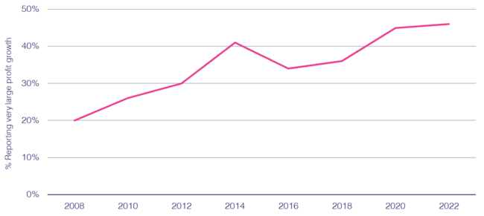
Why It Matters: Transparent Ad Placements
Ad campaigns that have built consumer trust in transparent environments have a direct, positive effect on brand profitability
% cases with strong ‘trust’ growth reporting strong ‘profit’ growth
82%
of consumers say it is important that a brand’s ads appear on content that is safe, accurate and trustworthy
Source: Peter Field, Why TV is Still at the Heart of Effectiveness, presented at ‘The Future of TV Advertising Global’ conference in December 2023. Base: IPA Databank 2004-2022 for profit cases reporting very large trust improvements. NB: insufficient data prior to 2008. Click here to view Peter Field’s full presentation online. *DoubleVerify & Harris Poll, Consumers Reject Brands That Advertise on ‘Fake News’ and Objectionable Content Online, June 2019.
This information is exclusively provided to VAB members and qualified marketers.
PAGE 8

Slide 9

Why It Matters: Transparent Ad Placements
Marketers should ask themselves if a lack of transparency in their media buys is worth risking 20% of their company’s total valuation
The Contribution of ‘Brand’ to Enterprise Value
The Relative Contribution to Shareholder Value for the S&P 500
20%
of a company’s enterprise value is based on their ‘brand’
Source: Forbes, New Global Standards For Reporting Brand Value Can Help CEOs Grow Share Price, 5/3/2018. Applying the Marketing Accountability Standards Board (MASB) Brand Investment & Valuation Model, Marketing Accountability Standards Board, 2017. Ocean Tomo Annual Study of Intangible Assets, 2015. ‘Brand value’ is the worth of a brand as an asset for an entity. ‘Enterprise value’ is a measure of the value of a company’s business operations. ‘Intangible assets’ can include things like patents, trademarks and customer lists. ‘Tangible’ assets can include things like equipment, inventory and real estate. Note: totals may not equal 100% due to rounding.
This information is exclusively provided to VAB members and qualified marketers.
PAGE 9

Slide 10

In their own words: Marketers agree on the need for transparency and accountability, and expect as much from media partners
“I think it's our job to really demand of our partners that they treat us well. I think the way that we hold them to that is we look for a lot of granularity in the data we get back. We ask questions on what they're doing to prevent fraud and when we see something that looks strange, we bring it to their attention.
If they don't have a good answer, we find a different partner.”
CMO, Consumer Electronics Category (Anonymous)
“On the advertiser side, it's on me. It's my budget, I own the money, I represent the company so it's on me to confirm that I'm doing things right. The publisher is equally responsible. It's on me to figure out if they're sketchy, but if they're operating illegally or immorally, then it's the publisher's fault. I buy from an intermediary/DSP and it's on them as well. Everyone is culpable.”
VP, Brand & Media, e-commerce Category (Anonymous)
Source: VAB / Advertiser Perceptions ‘Marketer Sentiment on Ad Fraud’ Survey, based on in-depth interviews, fielded October 2023. Survey base: Marketer and agency contacts from the Advertiser Perceptions ‘Senior Marketer’ and ‘Streaming Video’ online communities.
This information is exclusively provided to VAB members and qualified marketers.
PAGE 10

Slide 11
The Power of Premium Video = The Marketer Benefits of Multiscreen TV
Professionally produced, long-form content with high emotional engagement in a brand safe environment regardless of platform or device and through transparent media partners
Premium Video = Multiscreen TV
Professionally Produced, Long-Form Content
High Emotional Engagement
Brand Safe Environment
Cross-Platform Accessibility
Transparent
Ad Placements
The Power
of Premium Video:
Positive halo effect for brands
Fosters greater
ad recall
Boosts credibility, perception and brand salience
Increases brand favorability
Increases purchase intent
Inspires customer action
Builds consumer trust
Does not risk brand equity
Drives higher conversion rates
Creates higher consumer attention
Drives greater purchase intent
Protects and preserves brand value
Transparency
and trust have a positive effect on brand profitability
This information is exclusively provided to VAB members and qualified marketers.
PAGE 11

Slide 12



Buying Premium Video: A Definitive Checklist
Quality is key to successful campaigns, therefore marketers need to uphold audience trust, keep partners accountable and demand full transparency
Uphold Audience Trust and Standards:
■The ad experience should be premium like the content around it – with quality audio and video and relevant creative.
■ Partners should use programmatic tools that are built for premium transactions vs. legacy display, ensuring transactions are rooted in trust, and delivery isn’t compromised.
■ Ad quantity should be in line with content length, with minimal disruption, low latency, proportional ad breaks, and carefully crafted ad loads.
Quality of Environment
Hold Partners Accountable:
■ Partners should meet brand requirements, uphold category exclusivity, and maintain competitive separation.
■ Partners should ensure no placements with objectionable content – or objectionable audiences.
■ Legitimate verification processes should be in place to understand what is being bought and sold.
Brand Safety
Know What You Are Buying:
■ Creative should run where it is planned to, in the right context.
■ Buyers & sellers should agree on the kind of impressions purchased – ads should run adjacent to or within the right content and be viewed by real people. They should not run on MFA sites or be delivered to bots.
■ Ads should be viewable, not out-streamed, muted, auto-played, or hidden. Non-viewable impressions should be removed from reporting.
Transparency & Legitimacy
To learn more, click here to download the FreeWheel Council for Premium Video’s & VAB’s ‘Buying Premium Video: A Definitive Checklist’
This information is exclusively provided to VAB members and qualified marketers.
PAGE 12

Slide 13

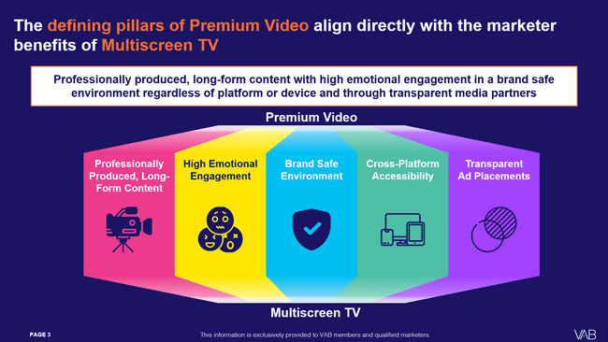

Download our full guide to learn more about how the five defining pillars of premium video directly aligns with the benefits of multiscreen TV
Click here to download ‘The Power of Premium Video’
This information is exclusively provided to VAB members and qualified marketers.
PAGE 13

Slide 14
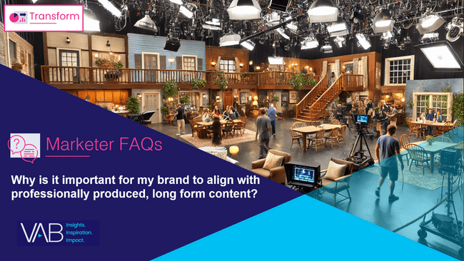


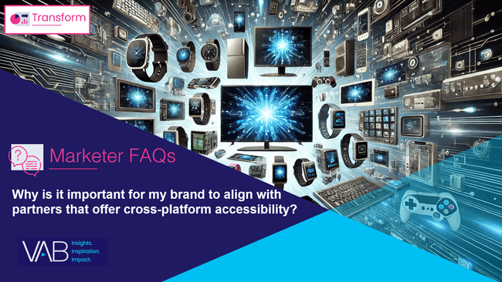
Creators
Download our four other marketer FAQs based on The Power of Premium Video
Jason Wiese
Benjamin Vandegrift
EVP, Strategic Insights & Measurement
jasonw@thevab.com
VP, Measurement Solutions & Innovations benjaminv@thevab.com
Kailyn Hartmann
Leah Montner-Dixon
VP, Advanced Analytics & Intelligence
kailynh@thevab.com
Director, Audience & Behavioral Insights
leahm@thevab.com
Reed Kiely
Karolina Guillen
Director, Data Insights & Trends
reedk@thevab.com
Associate Director, Insights, Strategy & Analytics karolinag@thevab.com
Why is it important for my brand to align with professionally produced, long form content?
Why is it important for my brand to align with emotionally engaging content?
Kaileen Cain
Senior Insights Analyst
kaileenc@thevab.com
Discover more
Looking for more data, insights and takeaways? Check out this related VAB content
Why is it important for my brand
to align with brand safe environments?
Why is it important for my brand
to align with partners that offer cross-platform accessibility?
VAB Members, brand marketers and agencies get free and immediate access to VAB’s content library. Get access at theVAB.com
This information is exclusively provided to VAB members and qualified marketers.
PAGE 14

Slide 15


About VAB
VAB plays a dual role in the video advertising industry. We are leading the change to bring about a more innovative and transparent marketplace. We also provide the insights and thought leadership that enables marketers to develop business-driving marketing strategies.
Drawing on our marketing expertise, we simplify the complexities in our industry and discover new insights that transform the way marketers look at their media strategy.
We are committed to your business growth and proud to offer VAB members, brand marketers and agencies complimentary access to our continuously-growing Insights library. Get immediate access at theVAB.com.
This information is exclusively provided to VAB members and qualified marketers.
PAGE 15

