Slide 1





Marketer FAQs
Why is it important for my brand to align with partners that offer cross-platform accessibility?

Slide 2


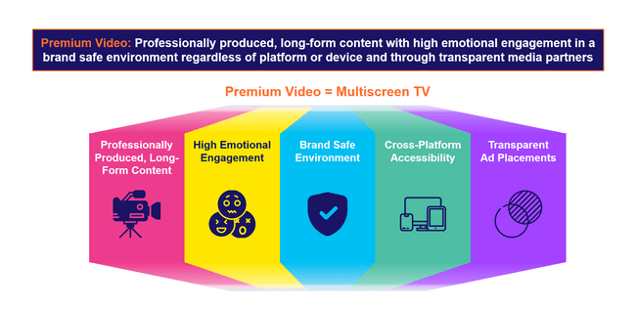
Cross-platform accessibility is one of the defining aspects of premium video
The essence of ‘premium video’ is rooted in high quality, emotionally engaging content within transparent, brand safe environments across platforms and devices. These core pillars also directly align with the value and benefits of multiscreen TV.
Why should investing in premium video matter to marketers?
The pillars of premium video, and multiscreen TV by extension, combine to drive full-funnel performance and business outcomes for marketers:
This information is exclusively provided to VAB members and qualified marketers.
PAGE 2

Slide 3





Premium video is available across platforms and devices and a multiplatform approach creates higher attention and purchase intent
Professionally produced, long-form content with high emotional engagement in a brand safe environment regardless of platform or device and through transparent media partners
Premium Video = Multiscreen TV
Professionally Produced, Long-Form Content
High Emotional Engagement
Brand Safe Environment
Cross-Platform Accessibility
Transparent
Ad Placements
This information is exclusively provided to VAB members and qualified marketers.
PAGE 3

Slide 4
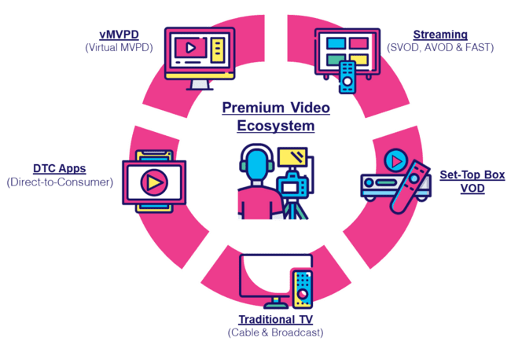
What It Means: Cross-Platform Accessibility
Today’s consumer has more optionality than ever before to access content available across the premium video landscape
“In a world where people are choosing content over platform, we have to make sure that we’re able to target them where they are using data. That’s not easy when every platform and every partner has slightly different offerings.”
- Katie Haniffy, VP of Media, Dick’s Sporting Goods
Advertising Week New York 2024
“If you’re not buying or placing your campaigns across every platform that you can, you’re really not reaching 100% of viewership—whether it be for a particular program or a particular audience”
- Evan Adlman, EVP Commercial Sales & Rev Operations, AMC Networks
Advertising Week New York 2024
This information is exclusively provided to VAB members and qualified marketers.
PAGE 4

Slide 5


What It Means: Cross-Platform Accessibility
While the TV set remains most prominent, many consumers have widened their definition of TV to include content across devices
How do you personally define TV?
% of video streamers who agree
‘Anything I can watch on my TV set whether it’s
via streaming or cable, satellite, fiber optic’
‘Anything I can watch on any device’
Source: VAB analysis of MRI-Simmons November 2024 Cord Evolution Study, A18+. Base = ‘Streamed in the past 12 months.’
This information is exclusively provided to VAB members and qualified marketers.
PAGE 5

Slide 6




Media habits are converging across demographics, allowing marketers to reach audiences with cross-platform and cross-generational content
What It Means: Cross-Platform Accessibility
Media Habits by Generation
Gen Z
(1997 – 2012)
Millennials
(1981 – 1996)
Generation X
(1965 – 1980)
Baby Boomers
(1946 – 1964)
56%
Watch TV Monthly
(Average ≤ 1 Hour per day)
62%
Watch TV Monthly
(Average ≥1.5 hours per day)
79%
Use a Streaming Service
67%
Adopted Streaming Services
(Average ≥1 hour per day)
95%
of Gen Z use a streaming service
92%
of Millennials use a Streaming service
75%
of Gen X watch
TV monthly
(Average ≥ 3 hours per day)
82%
of Boomers watch TV
or Streaming monthly
(Average ≤ 5 hours per day)
Source: Marketing Architects, Understanding TV Viewing Habits Across Generations.
This information is exclusively provided to VAB members and qualified marketers.
PAGE 6

Slide 7
Why It Matters: Cross-Platform Accessibility
Multiplatform buying strategies create higher consumer attention and greater purchase intent compared to campaigns with fewer platforms
Ads on Multiple Platforms Drive Attention
% who paid full attention
Full Media Mix Drives Purchase Intent
% of people likely to consider a company or brand after watching an ad
Source: Spectrum / MAGNA Media Trends, Ad Mix Synergy: Myth or Reality?, 2023.
This information is exclusively provided to VAB members and qualified marketers.
PAGE 7

Slide 8
The Power of Premium Video = The Marketer Benefits of Multiscreen TV
Professionally produced, long-form content with high emotional engagement in a brand safe environment regardless of platform or device and through transparent media partners
Premium Video = Multiscreen TV
Professionally Produced, Long-Form Content
High Emotional Engagement
Brand Safe Environment
Cross-Platform Accessibility
Transparent
Ad Placements
The Power
of Premium Video:
Positive halo effect for brands
Fosters greater
ad recall
Boosts credibility, perception and brand salience
Increases brand favorability
Increases purchase intent
Inspires customer action
Builds consumer trust
Does not risk brand equity
Drives higher conversion rates
Creates higher consumer attention
Drives greater purchase intent
Protects and preserves brand value
Transparency
and trust have a positive effect on brand profitability
This information is exclusively provided to VAB members and qualified marketers.
PAGE 8

Slide 9



Buying Premium Video: A Definitive Checklist
Quality is key to successful campaigns, therefore marketers need to uphold audience trust, keep partners accountable and demand full transparency
Uphold Audience Trust and Standards:
■The ad experience should be premium like the content around it – with quality audio and video and relevant creative.
■ Partners should use programmatic tools that are built for premium transactions vs. legacy display, ensuring transactions are rooted in trust, and delivery isn’t compromised.
■ Ad quantity should be in line with content length, with minimal disruption, low latency, proportional ad breaks, and carefully crafted ad loads.
Quality of Environment
Hold Partners Accountable:
■ Partners should meet brand requirements, uphold category exclusivity, and maintain competitive separation.
■ Partners should ensure no placements with objectionable content – or objectionable audiences.
■ Legitimate verification processes should be in place to understand what is being bought and sold.
Brand Safety
Know What You Are Buying:
■ Creative should run where it is planned to, in the right context.
■ Buyers & sellers should agree on the kind of impressions purchased – ads should run adjacent to or within the right content and be viewed by real people. They should not run on MFA sites or be delivered to bots.
■ Ads should be viewable, not out-streamed, muted, auto-played, or hidden. Non-viewable impressions should be removed from reporting.
Transparency & Legitimacy
To learn more, click here to download the FreeWheel Council for Premium Video’s & VAB’s ‘Buying Premium Video: A Definitive Checklist’
This information is exclusively provided to VAB members and qualified marketers.
PAGE 9

Slide 10

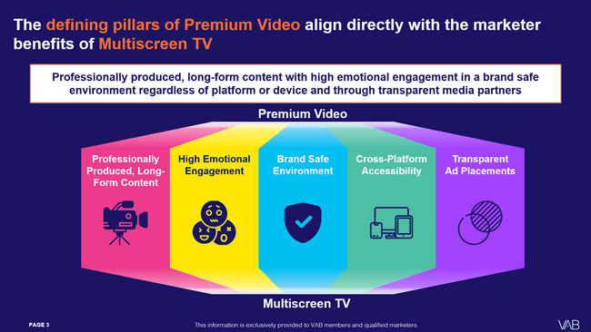

Download our full guide to learn more about how the five defining pillars of premium video directly aligns with the benefits of multiscreen TV
Click here to download ‘The Power of Premium Video’
This information is exclusively provided to VAB members and qualified marketers.
PAGE 10

Slide 11
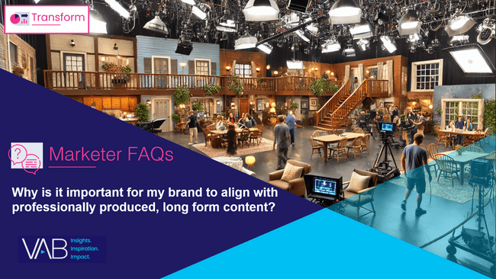

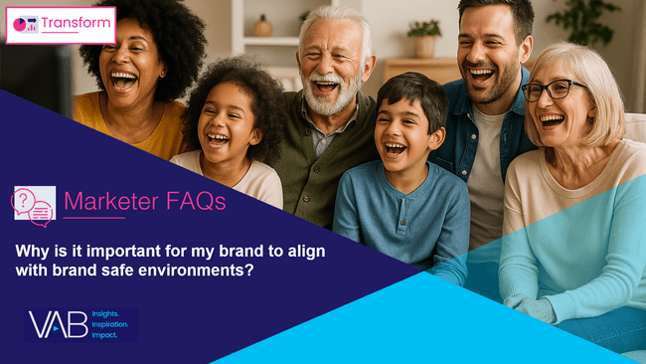

Creators
Download our four other marketer FAQs based on The Power of Premium Video
Jason Wiese
Benjamin Vandegrift
EVP, Strategic Insights & Measurement
jasonw@thevab.com
VP, Measurement Solutions & Innovations benjaminv@thevab.com
Kailyn Hartmann
Leah Montner-Dixon
VP, Advanced Analytics & Intelligence
kailynh@thevab.com
Director, Audience & Behavioral Insights
leahm@thevab.com
Reed Kiely
Karolina Guillen
Director, Data Insights & Trends
reedk@thevab.com
Associate Director, Insights, Strategy & Analytics karolinag@thevab.com
Why is it important for my brand to align with professionally produced, long form content?
Why is it important for my brand to align with emotionally engaging content?
Kaileen Cain
Senior Insights Analyst
kaileenc@thevab.com
Discover more
Looking for more data, insights and takeaways? Check out this related VAB content
Why is it important for my brand
to align with brand safe environments?
Why is it important for my brand
to align with trusted and transparent media partners?
VAB Members, brand marketers and agencies get free and immediate access to VAB’s content library. Get access at theVAB.com
This information is exclusively provided to VAB members and qualified marketers.
PAGE 11

Slide 12


About VAB
VAB plays a dual role in the video advertising industry. We are leading the change to bring about a more innovative and transparent marketplace. We also provide the insights and thought leadership that enables marketers to develop business-driving marketing strategies.
Drawing on our marketing expertise, we simplify the complexities in our industry and discover new insights that transform the way marketers look at their media strategy.
We are committed to your business growth and proud to offer VAB members, brand marketers and agencies complimentary access to our continuously-growing Insights library. Get immediate access at theVAB.com.
This information is exclusively provided to VAB members and qualified marketers.
PAGE 12

