Slide 1





Marketer FAQs
Why is it important for my brand to align
with brand safe environments?

Slide 2
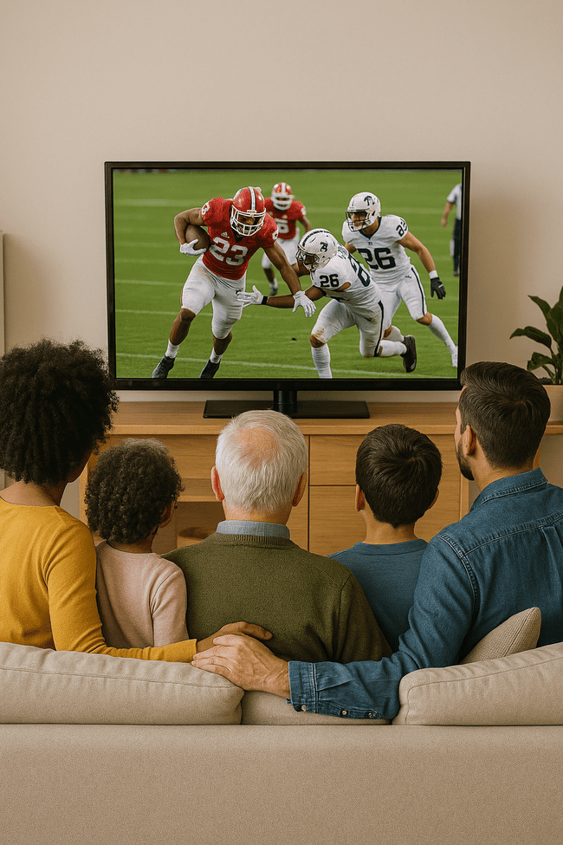

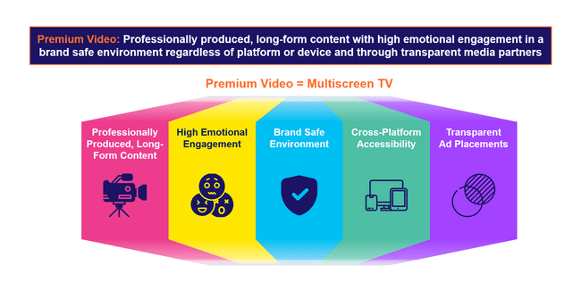
A brand safe environment is one of the defining aspects of premium video
The essence of ‘premium video’ is rooted in high quality, emotionally engaging content within transparent, brand safe environments across platforms and devices. These core pillars also directly align with the value and benefits of multiscreen TV.
Why should investing in premium video matter to marketers?
The pillars of premium video, and multiscreen TV by extension, combine to drive full-funnel performance and business outcomes for marketers:
This information is exclusively provided to VAB members and qualified marketers.
PAGE 2

Slide 3





A brand safe environment is a cornerstone of premium video and ad placements on these platforms drive much higher conversion rates
Professionally produced, long-form content with high emotional engagement in a brand safe environment regardless of platform or device and through transparent media partners
Premium Video = Multiscreen TV
Professionally Produced, Long-Form Content
High Emotional Engagement
Brand Safe Environment
Cross-Platform Accessibility
Transparent
Ad Placements
This information is exclusively provided to VAB members and qualified marketers.
PAGE 3

Slide 4





What It Means: Brand Safe Environment
Brand safe environments prioritize transparency, self-regulation and content control to minimize risks and protect advertiser trust
‘Spectrum of Risk’ to Brand Safety Issues Across Platforms
Low Brand Safety
High Brand Safety
Social
Ad environments comprised mostly
of UGC present a greater risk for brands appearing next to unsafe content without control of placement
Digital
Ad tech walled gardens powered by opaque supply chains creates risk for brands appearing next to unsavory content
CTV
Direct relationships with Premium CTV publishers who offer transparency and adhere to the TV rating system offer greater brand safety protection
Linear TV
Fully transparent ad environments with regulated and rated content greatly diminishes the risk of brand safety challenges
Cinema
100% brand safe, fully transparent opt-in environment with protection built in via the MPA rating system
Download VAB’s ‘What is Brand Safety’ to learn more.
This information is exclusively provided to VAB members and qualified marketers.
PAGE 4

Slide 5
What It Means: Brand Safe Environment
Premium video earns credibility through its commitment to brand safety, with trust levels for multiscreen TV four times higher than social media
“Trust is very important for brand marketing. It’s the driver for purchasing behavior for most consumers. A lot of the time, trust is going to play a different role in the relationships consumers have with brands.”
TV is the #1 trusted media platform among adults, and they are…
4x
over 4x more likely to trust TV
vs. social media
- Matt Prince, Head of PR, Taco Bell
Taco Bell’s Matt Prince on how trust ties brands to new consumers, WARC, 9/24/24
Source: VAB analysis of MRI-Simmons Spring 2024 USA Study, A18+. Q: What is the media you trust the most? (pick one: TV, radio, podcasts, mobile internet, internet on computer, social media, magazines, newspapers).
This information is exclusively provided to VAB members and qualified marketers.
PAGE 5

Slide 6

Why It Matters: Brand Safe Environment
Marketers equate premium video with exceptional, high-quality content
in brand safe environments, which are the hallmarks of multiscreen TV
91%
of buyers feel brand safety
is important when buying premium video inventory
Source: Comcast Advertising, What is Premium Video: Redefining what it Means to be Premium in Advertising, November 2023. Based on respondents who answered ‘important’ or ‘very important’.
This information is exclusively provided to VAB members and qualified marketers.
PAGE 6

Slide 7
Why It Matters: Brand Safe Environment
Many consumers will stop buying a brand if its ads appear near objectionable content, favoring platforms they feel are more trustworthy
nearly
73%
67%
90%
of consumers feel that
brands bear responsibility
for ensuring their ads run
beside content that is safe
of consumers agree that they would feel unfavorably towards brands that have been associated with misinformation*
of consumers would be
likely to stop using the
brand if they viewed the brand’s digital advertising beside
false, objectionable
or inflammatory content
Source: DoubleVerify & Harris Poll, Consumers Reject Brands That Advertise on ‘Fake News’ and Objectionable Content Online, June 2019. *Integral Ad Science, Advertising in the Age of Misinformation, 2022. Based on survey of 1,189 U.S. adults in July 2022. Reflects respondents who answered ‘agree’ or ‘strongly agree’. Download VAB’s ‘What is Brand Safety’ to learn more.
This information is exclusively provided to VAB members and qualified marketers.
PAGE 7

Slide 8

Why It Matters: Brand Safe Environment
‘Brand safe’ ad placements deliver much higher conversion rates for advertisers underscoring the value of quality and trusted environments
+233%
lift in conversions for
brand safe impressions vs.
non brand safe impressions
Source: Integral Ad Science, Does Media Quality Drive Attention and Outcomes?, March 2022. Download VAB’s ‘What is Brand Safety’ to learn more.
This information is exclusively provided to VAB members and qualified marketers.
PAGE 8

Slide 9
The Power of Premium Video = The Marketer Benefits of Multiscreen TV
Professionally produced, long-form content with high emotional engagement in a brand safe environment regardless of platform or device and through transparent media partners
Premium Video = Multiscreen TV
Professionally Produced, Long-Form Content
High Emotional Engagement
Brand Safe Environment
Cross-Platform Accessibility
Transparent
Ad Placements
The Power
of Premium Video:
Positive halo effect for brands
Fosters greater
ad recall
Boosts credibility, perception and brand salience
Increases brand favorability
Increases purchase intent
Inspires customer action
Builds consumer trust
Does not risk brand equity
Drives higher conversion rates
Creates higher consumer attention
Drives greater purchase intent
Protects and preserves brand value
Transparency
and trust have a positive effect on brand profitability
This information is exclusively provided to VAB members and qualified marketers.
PAGE 9

Slide 10



Buying Premium Video: A Definitive Checklist
Quality is key to successful campaigns, therefore marketers need to uphold audience trust, keep partners accountable and demand full transparency
Uphold Audience Trust and Standards:
■The ad experience should be premium like the content around it – with quality audio and video and relevant creative.
■ Partners should use programmatic tools that are built for premium transactions vs. legacy display, ensuring transactions are rooted in trust, and delivery isn’t compromised.
■ Ad quantity should be in line with content length, with minimal disruption, low latency, proportional ad breaks, and carefully crafted ad loads.
Quality of Environment
Hold Partners Accountable:
■ Partners should meet brand requirements, uphold category exclusivity, and maintain competitive separation.
■ Partners should ensure no placements with objectionable content – or objectionable audiences.
■ Legitimate verification processes should be in place to understand what is being bought and sold.
Brand Safety
Know What You Are Buying:
■ Creative should run where it is planned to, in the right context.
■ Buyers & sellers should agree on the kind of impressions purchased – ads should run adjacent to or within the right content and be viewed by real people. They should not run on MFA sites or be delivered to bots.
■ Ads should be viewable, not out-streamed, muted, auto-played, or hidden. Non-viewable impressions should be removed from reporting.
Transparency & Legitimacy
To learn more, click here to download the FreeWheel Council for Premium Video’s & VAB’s ‘Buying Premium Video: A Definitive Checklist’
This information is exclusively provided to VAB members and qualified marketers.
PAGE 10

Slide 11

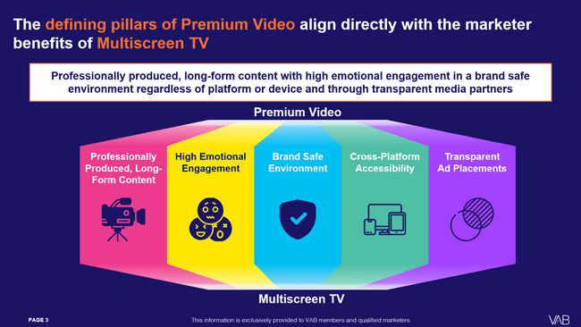
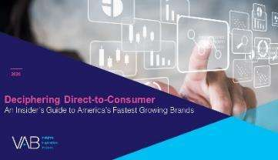
Download our full guide to learn more about how the five defining pillars of premium video directly aligns with the benefits of multiscreen TV
Click here to download ‘The Power of Premium Video’
This information is exclusively provided to VAB members and qualified marketers.
PAGE 11

Slide 12
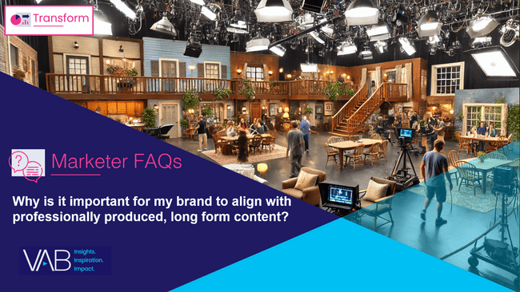
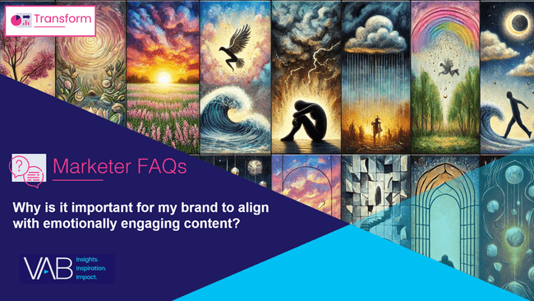
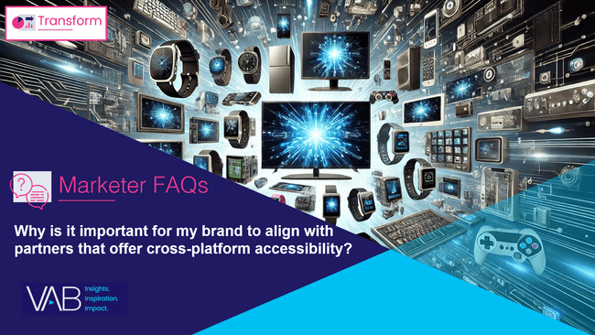
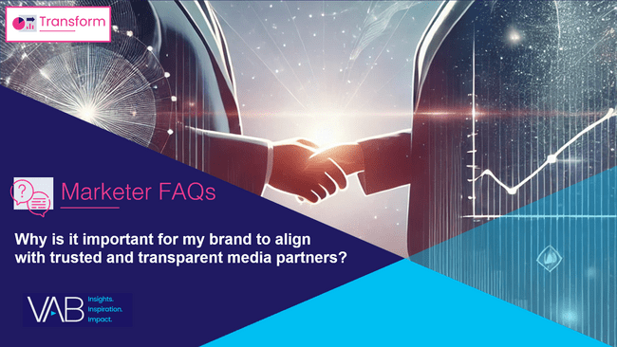
Creators
Download our four other marketer FAQs based on The Power of Premium Video
Jason Wiese
Benjamin Vandegrift
EVP, Strategic Insights & Measurement
jasonw@thevab.com
VP, Measurement Solutions & Innovations benjaminv@thevab.com
Kailyn Hartmann
Leah Montner-Dixon
VP, Advanced Analytics & Intelligence
kailynh@thevab.com
Director, Audience & Behavioral Insights
leahm@thevab.com
Reed Kiely
Karolina Guillen
Director, Data Insights & Trends
reedk@thevab.com
Associate Director, Insights, Strategy & Analytics karolinag@thevab.com
Why is it important for my brand to align with professionally produced, long form content?
Why is it important for my brand to align with emotionally engaging content?
Kaileen Cain
Senior Insights Analyst
kaileenc@thevab.com
Discover more
Looking for more data, insights and takeaways? Check out this related VAB content
Why is it important for my brand
to align with partners that offer cross-platform accessibility?
Why is it important for my brand
to align with trusted and transparent media partners?
VAB Members, brand marketers and agencies get free and immediate access to VAB’s content library. Get access at theVAB.com
This information is exclusively provided to VAB members and qualified marketers.
PAGE 12

Slide 13


About VAB
VAB plays a dual role in the video advertising industry. We are leading the change to bring about a more innovative and transparent marketplace. We also provide the insights and thought leadership that enables marketers to develop business-driving marketing strategies.
Drawing on our marketing expertise, we simplify the complexities in our industry and discover new insights that transform the way marketers look at their media strategy.
We are committed to your business growth and proud to offer VAB members, brand marketers and agencies complimentary access to our continuously-growing Insights library. Get immediate access at theVAB.com.
This information is exclusively provided to VAB members and qualified marketers.
PAGE 13

