Slide 1





Marketer FAQs
Why is it important for my brand to align
with emotionally engaging content?

Slide 2


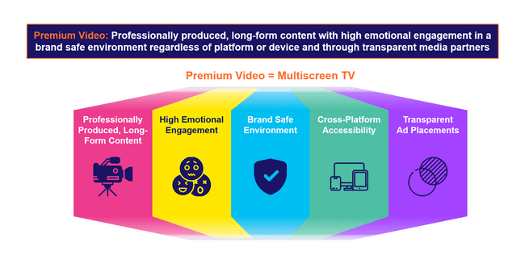
Emotionally engaging content is one
of the defining aspects of premium video
The essence of ‘premium video’ is rooted in high quality, emotionally engaging content within transparent, brand safe environments across platforms and devices. These core pillars also directly align with the value and benefits of multiscreen TV.
Why should investing in premium video matter to marketers?
The pillars of premium video, and multiscreen TV by extension, combine to drive full-funnel performance and business outcomes for marketers:
This information is exclusively provided to VAB members and qualified marketers.
PAGE 2

Slide 3





Premium video fosters deeper audience connections through high emotional engagement which drives brand favorability and purchase intent
Professionally produced, long-form content with high emotional engagement in a brand safe environment regardless of platform or device and through transparent media partners
Premium Video = Multiscreen TV
Professionally Produced, Long-Form Content
High Emotional Engagement
Brand Safe Environment
Cross-Platform Accessibility
Transparent
Ad Placements
This information is exclusively provided to VAB members and qualified marketers.
PAGE 3

Slide 4





























What It Means: High Emotional Engagement
Exciting, high-quality premium content captures audience attention and fosters engagement through strong emotional connections
Aligning ads with emotional content can quadruple their effectiveness in creating impact and building brand equity*
Sampling of Premium Video Programming
‘Emotion’ is the new ‘Premium’
‘Premium content’ – industry shorthand for advertising impact – has primarily been related to the cost of production, with more expensive programming being deemed more premium.
However, research suggests that ‘premium’ has more to do with the emotional connection viewers have with their favorite content, which can be significantly impactful at driving ad receptivity.
Source: Kantar, Harness the power of emotion in digital advertising, 3/13/2023.
This information is exclusively provided to VAB members and qualified marketers.
PAGE 4

Slide 5
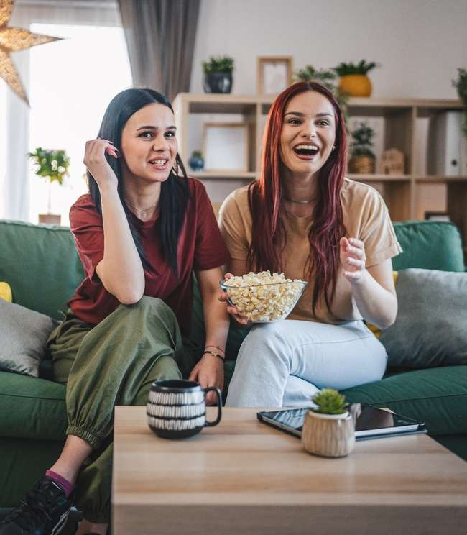


What It Means: High Emotional Engagement
Audiences’ passion for premium video reflects its ability to foster deep emotional connections and enduring appeal
Adult’s Passion for Premium Video Across Screens
A18+
Linear TV
Streaming
74%
73%
say that they
‘just love watching TV’
(A18-34: 74%)
say that they
‘love streaming TV shows’
(A18-34: 79%)
Source: VAB analysis of MRI-Simmons November 2024 Cord Evolution, Study/ Based on A18+ respondents, ‘any agree.’
This information is exclusively provided to VAB members and qualified marketers.
PAGE 5

Slide 6
What It Means: High Emotional Engagement
On average, people across all ages and demographics spend much more time with premium video than with social video & UGC platforms
Hours Per Week Spent Watching TV Shows & Movies vs. Non-premium Videos
Among weekly non-premium video content viewers
Source: Hub Entertainment Research, Video Redefined, January 2024. Based on survey of 1,900 consumers, ages 13-74. P13-24 respondents = 620 (unweighted); P25-34 respondents = 285 (unweighted); P35+ respondents = 995 (unweighted). Hispanic respondents = 325 (unweighted). Black respondents = 228 (unweighted). Data collected December 2023. ‘Non-premium video’ includes short-form or user-generated video on YouTube, influencer video content, etc. Download VAB’s ‘The Big Picture: 12 Key Charts on the Impact of TV & Streaming vs. Social Media Platforms’ to learn more.
This information is exclusively provided to VAB members and qualified marketers.
PAGE 6

Slide 7





What It Means: High Emotional Engagement
People form more meaningful bonds with characters and personalities from premium video content compared to social media
% of platform users who ‘feel personally connected to a character / personality’ on the following platforms
13-24
25-34
35+
 | % | TV / Streaming vs. Social Media % most likely* | % | TV / Streaming vs. Social Media % most likely | % | TV / Streaming vs. Social Media % most likely
TV / Streaming | 39% |  | 41% |  | 38%
 | 32% | +21% | 26% | +56% | 23% | +67%
 | 24% | +63% | 22% | +83% | 21% | +84%
 | 30% | +29% | 33% | +23% | 26% | +48%
 | 27% | +47% | 27% | +51% | 20% | +91%
 | 31% | +27% | 33% | +23% | 27% | +40%
*How to read: P13-24 are 21% more likely to feel personally connected to a character / personality from TV or streaming content vs. TikTok content
Source: VAB custom research fielded by Hub Entertainment Research as part of the 2023 Video Redefined report. Data sourced from Hub’s survey of 1,900 consumers, ages 13-74. P13-24 respondents = 620 (unweighted). P25-34 respondents = 285 (unweighted). P35+ respondents = 995 (unweighted). Data collected December 2023. Q1: Which of the following statements apply to you when you watch videos, shows or movies on the following platforms? Based on users of the platform.
This information is exclusively provided to VAB members and qualified marketers.
PAGE 7

Slide 8

Why It Matters: High Emotional Engagement
Premium video creates positive vibes which makes people more inclined to purchase products they see advertised
Impact of Positive Mindset on Response to Advertising
+18%
+35%
Increase in brand favorability
Increase in purchase intent
Source: Hearst, Power of Positivity, 2023.
This information is exclusively provided to VAB members and qualified marketers.
PAGE 8

Slide 9
Why It Matters: High Emotional Engagement
The deep emotional connection that premium video fosters is more likely to inspire customer action and the purchasing of goods and services
% who ‘have eaten at a restaurant or purchased a cookbook’ that was featured in content on the following platforms
13-24
25-34
35+
 | % | TV / Streaming vs. Social Media % most likely* | % | TV / Streaming vs. Social Media % most likely | % | TV / Streaming vs. Social Media % most likely
TV / Streaming | 21% |  | 21% |  | 17%
 | 16% | +27% | 19% | +6% | 13% | +28%
 | 15% | +35% | 15% | +34% | 13% | +32%
 | 17% | +20% | 17% | +17% | 12% | +39%
 | 17% | +22% | 18% | +13% | 15% | +12%
 | 17% | +20% | 19% | +9% | 12% | +43%
*How to read: P13-24 are 35% more likely to have eaten at a restaurant or purchased a cookbook featured in TV or streaming content vs. Snapchat content
Source: VAB custom research fielded by Hub Entertainment Research as part of the 2023 Video Redefined report. Data sourced from Hub’s survey of 1,900 consumers, ages 13-74. P13-24 respondents = 620 (unweighted). P25-34 respondents = 285 (unweighted). P35+ respondents = 995 (unweighted). Data collected December 2023. Q3: Which of the following actions have you taken as a result of watching something on the following platforms?
This information is exclusively provided to VAB members and qualified marketers.
PAGE 9

Slide 10
The Power of Premium Video = The Marketer Benefits of Multiscreen TV
Professionally produced, long-form content with high emotional engagement in a brand safe environment regardless of platform or device and through transparent media partners
Premium Video = Multiscreen TV
Professionally Produced, Long-Form Content
High Emotional Engagement
Brand Safe Environment
Cross-Platform Accessibility
Transparent
Ad Placements
The Power
of Premium Video:
Positive halo effect for brands
Fosters greater
ad recall
Boosts credibility, perception and brand salience
Increases brand favorability
Increases purchase intent
Inspires customer action
Builds consumer trust
Does not risk brand equity
Drives higher conversion rates
Creates higher consumer attention
Drives greater purchase intent
Protects and preserves brand value
Transparency
and trust have a positive effect on brand profitability
This information is exclusively provided to VAB members and qualified marketers.
PAGE 10

Slide 11



Buying Premium Video: A Definitive Checklist
Quality is key to successful campaigns, therefore marketers need to uphold audience trust, keep partners accountable and demand full transparency
Uphold Audience Trust and Standards:
■The ad experience should be premium like the content around it – with quality audio and video and relevant creative.
■ Partners should use programmatic tools that are built for premium transactions vs. legacy display, ensuring transactions are rooted in trust, and delivery isn’t compromised.
■ Ad quantity should be in line with content length, with minimal disruption, low latency, proportional ad breaks, and carefully crafted ad loads.
Quality of Environment
Hold Partners Accountable:
■ Partners should meet brand requirements, uphold category exclusivity, and maintain competitive separation.
■ Partners should ensure no placements with objectionable content – or objectionable audiences.
■ Legitimate verification processes should be in place to understand what is being bought and sold.
Brand Safety
Know What You Are Buying:
■ Creative should run where it is planned to, in the right context.
■ Buyers & sellers should agree on the kind of impressions purchased – ads should run adjacent to or within the right content and be viewed by real people. They should not run on MFA sites or be delivered to bots.
■ Ads should be viewable, not out-streamed, muted, auto-played, or hidden. Non-viewable impressions should be removed from reporting.
Transparency & Legitimacy
To learn more, click here to download the FreeWheel Council for Premium Video’s & VAB’s ‘Buying Premium Video: A Definitive Checklist’
This information is exclusively provided to VAB members and qualified marketers.
PAGE 11

Slide 12

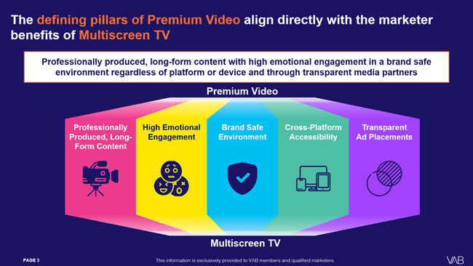

Download our full guide to learn more about how the five defining pillars of premium video directly aligns with the benefits of multiscreen TV
Click here to download ‘The Power of Premium Video’
This information is exclusively provided to VAB members and qualified marketers.
PAGE 12

Slide 13
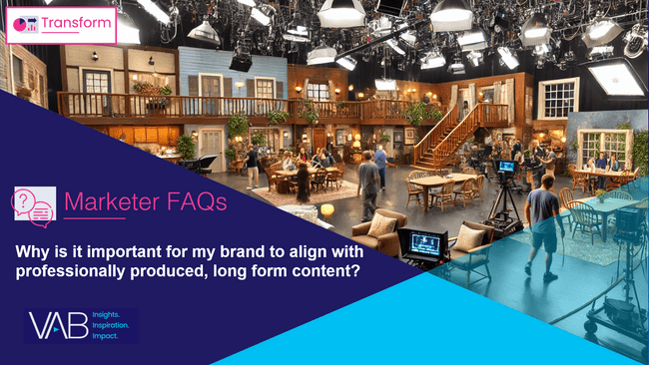
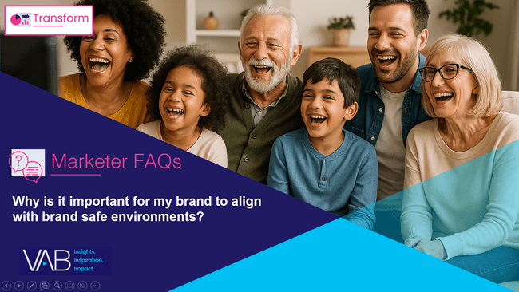
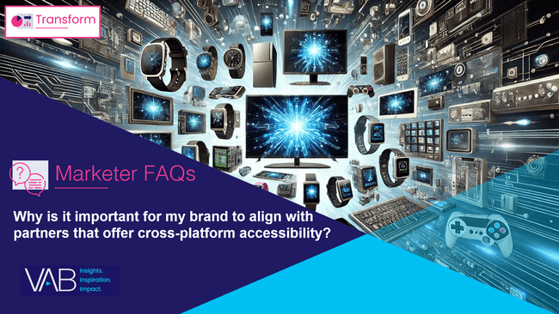
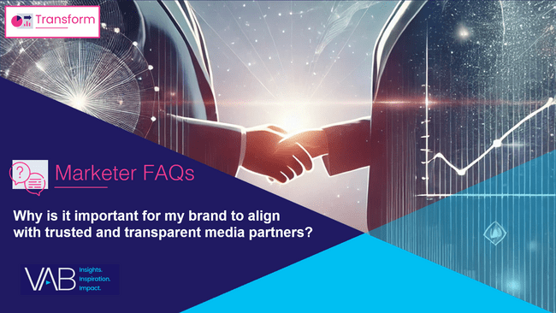
Creators
Download our four other marketer FAQs based on The Power of Premium Video
Jason Wiese
Benjamin Vandegrift
EVP, Strategic Insights & Measurement
jasonw@thevab.com
VP, Measurement Solutions & Innovations benjaminv@thevab.com
Kailyn Hartmann
Leah Montner-Dixon
VP, Advanced Analytics & Intelligence
kailynh@thevab.com
Director, Audience & Behavioral Insights
leahm@thevab.com
Reed Kiely
Karolina Guillen
Director, Data Insights & Trends
reedk@thevab.com
Associate Director, Insights, Strategy & Analytics karolinag@thevab.com
Why is it important for my brand to align with professionally produced, long form content?
Why is it important for my brand to align with brand safe environments?
Kaileen Cain
Senior Insights Analyst
kaileenc@thevab.com
Discover more
Looking for more data, insights and takeaways? Check out this related VAB content
Why is it important for my brand
to align with partners that offer cross-platform accessibility?
Why is it important for my brand
to align with trusted and transparent media partners?
VAB Members, brand marketers and agencies get free and immediate access to VAB’s content library. Get access at theVAB.com
This information is exclusively provided to VAB members and qualified marketers.
PAGE 13

Slide 14


About VAB
VAB plays a dual role in the video advertising industry. We are leading the change to bring about a more innovative and transparent marketplace. We also provide the insights and thought leadership that enables marketers to develop business-driving marketing strategies.
Drawing on our marketing expertise, we simplify the complexities in our industry and discover new insights that transform the way marketers look at their media strategy.
We are committed to your business growth and proud to offer VAB members, brand marketers and agencies complimentary access to our continuously-growing Insights library. Get immediate access at theVAB.com.
This information is exclusively provided to VAB members and qualified marketers.
PAGE 14

