Slide 1





Why is it important for my brand to align with professionally produced, long form content?
Marketer FAQs

Slide 2


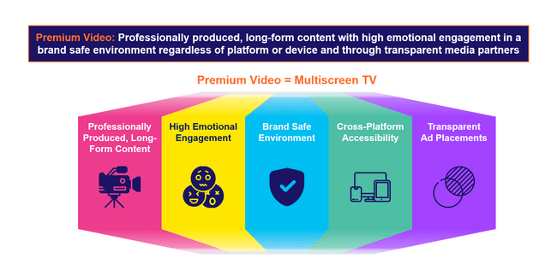
Professionally produced content is one of the defining aspects of premium video
The essence of ‘premium video’ is rooted in high quality, emotionally engaging content within transparent, brand safe environments across platforms and devices. These core pillars also directly align with the value and benefits of multiscreen TV.
Why should investing in premium video matter to marketers?
The pillars of premium video, and multiscreen TV by extension, combine to drive full-funnel performance and business outcomes for marketers:
This information is exclusively provided to VAB members and qualified marketers.
PAGE 2

Slide 3





Premium video captivates audiences through professionally produced, long-form content which creates a positive halo effect for advertisers
Professionally produced, long-form content with high emotional engagement in a brand safe environment regardless of platform or device and through transparent media partners
Premium Video = Multiscreen TV
Professionally Produced, Long-Form Content
High Emotional Engagement
Brand Safe Environment
Cross-Platform Accessibility
Transparent
Ad Placements
This information is exclusively provided to VAB members and qualified marketers.
PAGE 3

Slide 4





What It Means: Professionally Produced, Long-Form Content
High-quality video environments have specific characteristics that differentiate them from lower quality platforms
What differentiates premium content found on multiscreen TV in all its forms
from user-generated content (UGC) on digital platforms?
Content Duration
Complex Character Development
Emotional Storytelling
High Production (e.g., multiple
camera angles)
Brand Safe Environment
Download VAB’s ‘What Is TV’ to learn more.
This information is exclusively provided to VAB members and qualified marketers.
PAGE 4

Slide 5




What It Means: Professionally Produced, Long-Form Content
Nearly all consumers view the rich viewing experience of long-form video programming as the 'gold standard' of premium content
Long-form content’s production value, exclusivity and ability to connect friends and family are key reasons viewers define it as a premium video experience
97%
9 in 10
62%
of viewers believe that
long-form is the ‘gold standard’
of premium content
viewers say watching
long-form premium content is a valuable use of their time
Value brands that advertise
in long-form premium content
Source: DIRECTV Advertising, Premium, Defined: Long-Form Content Drives Ad Success, May 2024. Note: ‘Long-Form Content’ refers to video content longer than 20 minutes.
This information is exclusively provided to VAB members and qualified marketers.
PAGE 5

Slide 6
Why It Matters: Professionally Produced, Long-Form Content
The 'halo effect' of premium environments boosts consumer perception
of advertisers compared to all other platforms, especially social
Media signaling:
The perceived cost and scale
of an advertising channel that
can enhance brand attributes
in the eyes of the consumer.
Signaling determines a platform’s ability to strengthen brand perception in terms of its financial footing, popularity and degree to which it could be trusted.
‘Signaling Strength’ by Channel
How to read: 46% of respondents believe TV advertising enhances a brand’s attributes
Source: WARC, Why media quality will take centre stage in 2024, 1/22/24.
This information is exclusively provided to VAB members and qualified marketers.
PAGE 6

Slide 7

Why It Matters: Professionally Produced, Long-Form Content
Premium content amplifies brand attributes, fostering higher recall and stronger brand positioning through high-quality, credible environments
Premium Content Compared to Non-Premium Content*
% of U.S. respondents who agree
+58%
Higher recall for premium compared with non-premium content
Source: Comcast Advertising, What is Premium, Nov 2023. Note: Premium content in the study was publisher created episodic content with 100% of the ads viewable. Non-premium content was individual created short form content with 50% of the ads viewable. All content was delivered on a TV screen. *NBCUniversal and FreeWheel, Prescribing Premium: What a high-quality viewing experience means for consumers and why advertisers should take advantage of it, September 2024. Reflects U.S. respondents only.
This information is exclusively provided to VAB members and qualified marketers.
PAGE 7

Slide 8

Why It Matters: Professionally Produced, Long-Form Content
Increased credibility and quality perception means that ads in premium environments are more likely to drive brand salience and customer action
Premium Environments Compared to Non-Premium
% of U.S. respondents who agree
76%
More Likely to Notice
More Likely to Consider
or Buy From in the Future
72%
More Likely to Conduct
Further Research
69%
Source: NBCUniversal and FreeWheel, Prescribing Premium: What a high-quality viewing experience means for consumers and why advertisers should take advantage of it, September 2024. Reflects U.S. respondents only. Note: Premium content in the study was publisher created episodic content with 100% of the ads viewable. Non-premium content was individual created short form content with 50% of the ads viewable. All content was delivered on a TV screen.
This information is exclusively provided to VAB members and qualified marketers.
PAGE 8

Slide 9
The Power of Premium Video = The Marketer Benefits of Multiscreen TV
Professionally produced, long-form content with high emotional engagement in a brand safe environment regardless of platform or device and through transparent media partners
Premium Video = Multiscreen TV
Professionally Produced, Long-Form Content
High Emotional Engagement
Brand Safe Environment
Cross-Platform Accessibility
Transparent
Ad Placements
The Power
of Premium Video:
Positive halo effect for brands
Fosters greater
ad recall
Boosts credibility, perception and brand salience
Increases brand favorability
Increases purchase intent
Inspires customer action
Builds consumer trust
Does not risk brand equity
Drives higher conversion rates
Creates higher consumer attention
Drives greater purchase intent
Protects and preserves brand value
Transparency
and trust have a positive effect on brand profitability
This information is exclusively provided to VAB members and qualified marketers.
PAGE 9

Slide 10



Buying Premium Video: A Definitive Checklist
Quality is key to successful campaigns, therefore marketers need to uphold audience trust, keep partners accountable and demand full transparency
Uphold Audience Trust and Standards:
■The ad experience should be premium like the content around it – with quality audio and video and relevant creative.
■ Partners should use programmatic tools that are built for premium transactions vs. legacy display, ensuring transactions are rooted in trust, and delivery isn’t compromised.
■ Ad quantity should be in line with content length, with minimal disruption, low latency, proportional ad breaks, and carefully crafted ad loads.
Quality of Environment
Hold Partners Accountable:
■ Partners should meet brand requirements, uphold category exclusivity, and maintain competitive separation.
■ Partners should ensure no placements with objectionable content – or objectionable audiences.
■ Legitimate verification processes should be in place to understand what is being bought and sold.
Brand Safety
Know What You Are Buying:
■ Creative should run where it is planned to, in the right context.
■ Buyers & sellers should agree on the kind of impressions purchased – ads should run adjacent to or within the right content and be viewed by real people. They should not run on MFA sites or be delivered to bots.
■ Ads should be viewable, not out-streamed, muted, auto-played, or hidden. Non-viewable impressions should be removed from reporting.
Transparency & Legitimacy
To learn more, click here to download the FreeWheel Council for Premium Video’s & VAB’s ‘Buying Premium Video: A Definitive Checklist’
This information is exclusively provided to VAB members and qualified marketers.
PAGE 10

Slide 11

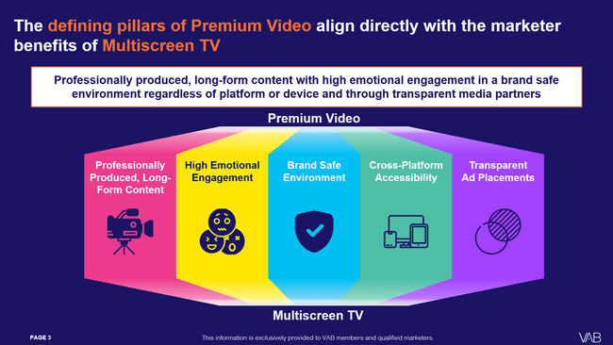

Download our full guide to learn more about how the five defining pillars of premium video directly aligns with the benefits of multiscreen TV
Click here to download ‘The Power of Premium Video’
This information is exclusively provided to VAB members and qualified marketers.
PAGE 11

Slide 12
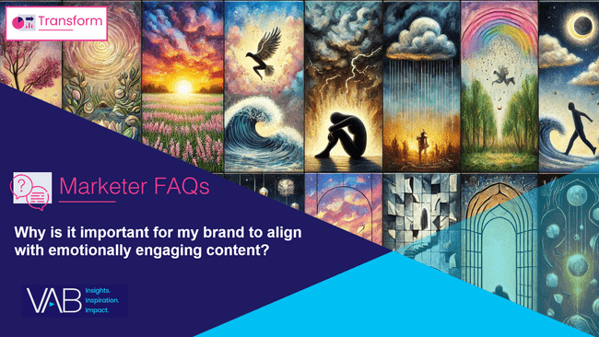

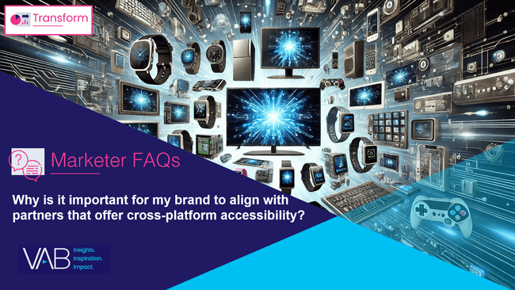
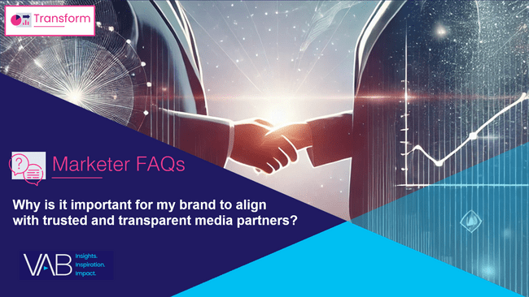
Creators
Download our four other marketer FAQs based on The Power of Premium Video
Jason Wiese
Benjamin Vandegrift
EVP, Strategic Insights & Measurement
jasonw@thevab.com
VP, Measurement Solutions & Innovations benjaminv@thevab.com
Kailyn Hartmann
Leah Montner-Dixon
VP, Advanced Analytics & Intelligence
kailynh@thevab.com
Director, Audience & Behavioral Insights
leahm@thevab.com
Reed Kiely
Karolina Guillen
Director, Data Insights & Trends
reedk@thevab.com
Associate Director, Insights, Strategy & Analytics karolinag@thevab.com
Why is it important for my brand to align with emotionally engaging content?
Why is it important for my brand to align with brand safe environments?
Kaileen Cain
Senior Insights Analyst
kaileenc@thevab.com
Discover more
Looking for more data, insights and takeaways? Check out this related VAB content
Why is it important for my brand
to align with partners that offer cross-platform accessibility?
Why is it important for my brand
to align with trusted and transparent media partners?
VAB Members, brand marketers and agencies get free and immediate access to VAB’s content library. Get access at theVAB.com
This information is exclusively provided to VAB members and qualified marketers.
PAGE 12

Slide 13


About VAB
VAB plays a dual role in the video advertising industry. We are leading the change to bring about a more innovative and transparent marketplace. We also provide the insights and thought leadership that enables marketers to develop business-driving marketing strategies.
Drawing on our marketing expertise, we simplify the complexities in our industry and discover new insights that transform the way marketers look at their media strategy.
We are committed to your business growth and proud to offer VAB members, brand marketers and agencies complimentary access to our continuously-growing Insights library. Get immediate access at theVAB.com.
This information is exclusively provided to VAB members and qualified marketers.
PAGE 13

