Slide 1





The Power of Premium Video
What It Means for Multiscreen TV and Why It Matters to Marketers

Slide 2


The power of Premium Video aligns with key marketer benefits of Multiscreen TV
The essence of ‘premium video’ is rooted in high quality, emotionally engaging content within transparent, brand safe environments across platforms and devices. These core pillars also directly align with the value and benefits of multiscreen TV.
Why should investing in premium video matter to marketers?
The pillars of premium video, and multiscreen TV by extension, combine to drive full-funnel performance and business outcomes for marketers:
High quality content develops a positive halo effect for brands by boosting ad recall, consumer perception and brand salience
Emotional engagement increases brand favorability and purchase intent
Brand safe environments build consumer trust and drives conversion rates
Cross-platform buying strategies create higher attention and greater purchase intent
Transparency protects and preserves brand value and has a positive effect on brand profitability
Continue reading to learn more about how the power of premium video fuels the key benefits of multiscreen TV and why it matters to marketers…
This information is exclusively provided to VAB members and qualified marketers.
PAGE 2

Slide 3





The defining pillars of Premium Video align directly with the marketer benefits of Multiscreen TV
Professionally produced, long-form content with high emotional engagement in a brand safe environment regardless of platform or device and through transparent media partners
Premium Video
Professionally Produced, Long-Form Content
High Emotional Engagement
Brand Safe Environment
Cross-Platform Accessibility
Transparent
Ad Placements
Multiscreen TV
This information is exclusively provided to VAB members and qualified marketers.
PAGE 3

Slide 4



Premium video equates to high quality environments which captures audience attention and delivers compelling, thematically relevant content
Indicators of a Quality Viewing Environment
The channel’s main formats can deliver
high levels of eyes-on-attention
The programming or content the ads sit around is of sufficient quality to attract and retain the audience for a long period
The channel offers the opportunity to place an ad next to thematically relevant content or programming, and the scale of that opportunity
Source: WARC, Fragmentation forces media planners to rethink the founding principles of their craft, per Zenith research, Jan 2023.
This information is exclusively provided to VAB members and qualified marketers.
PAGE 4

Slide 5

To appreciate the value of premium video,
it’s key to understand what each pillar means for multiscreen TV and why it matters to marketers

Slide 6
Premium video captivates audiences through professionally produced, long-form content which creates a positive halo effect for advertisers
Professionally produced, long-form content with high emotional engagement in a brand safe environment regardless of platform or device and through transparent media partners
Premium Video
Professionally Produced, Long-Form Content
High Emotional Engagement
Brand Safe Environment
Cross-Platform Accessibility
Transparent
Ad Placements
Multiscreen TV
This information is exclusively provided to VAB members and qualified marketers.
PAGE 6

Slide 7





What It Means: Professionally Produced, Long-Form Content
High-quality video environments have specific characteristics that differentiate them from lower quality platforms
What differentiates premium content found on multiscreen TV in all its forms
from user-generated content (UGC) on digital platforms?
Content Duration
Complex Character Development
Emotional Storytelling
High Production (e.g., multiple
camera angles)
Brand Safe Environment
Download VAB’s ‘What Is TV’ to learn more.
This information is exclusively provided to VAB members and qualified marketers.
PAGE 7

Slide 8




What It Means: Professionally Produced, Long-Form Content
Nearly all consumers view the rich viewing experience of long-form video programming as the 'gold standard' of premium content
Long-form content’s production value, exclusivity and ability to connect friends and family are key reasons viewers define it as a premium video experience
97%
9 in 10
62%
of viewers believe that
long-form is the ‘gold standard’
of premium content
viewers say watching
long-form premium content is a valuable use of their time
Value brands that advertise
in long-form premium content
Source: DIRECTV Advertising, Premium, Defined: Long-Form Content Drives Ad Success, May 2024. Note: ‘Long-Form Content’ refers to video content longer than 20 minutes.
This information is exclusively provided to VAB members and qualified marketers.
PAGE 8

Slide 9
Why It Matters: Professionally Produced, Long-Form Content
The 'halo effect' of premium environments boosts consumer perception
of advertisers compared to all other platforms, especially social
Media signaling:
The perceived cost and scale
of an advertising channel that
can enhance brand attributes
in the eyes of the consumer.
Signaling determines a platform’s ability to strengthen brand perception in terms of its financial footing, popularity and degree to which it could be trusted.
‘Signaling Strength’ by Channel
How to read: 46% of respondents believe TV advertising enhances a brand’s attributes
Source: WARC, Why media quality will take centre stage in 2024, 1/22/24.
This information is exclusively provided to VAB members and qualified marketers.
PAGE 9

Slide 10

Why It Matters: Professionally Produced, Long-Form Content
Premium content amplifies brand attributes, fostering higher recall and stronger brand positioning through high-quality, credible environments
Premium Content Compared to Non-Premium Content*
% of U.S. respondents who agree
+58%
Higher recall for premium compared with non-premium content
Source: Comcast Advertising, What is Premium, Nov 2023. Note: Premium content in the study was publisher created episodic content with 100% of the ads viewable. Non-premium content was individual created short form content with 50% of the ads viewable. All content was delivered on a TV screen. *NBCUniversal and FreeWheel, Prescribing Premium: What a high-quality viewing experience means for consumers and why advertisers should take advantage of it, September 2024. Reflects U.S. respondents only.
This information is exclusively provided to VAB members and qualified marketers.
PAGE 10

Slide 11

Why It Matters: Professionally Produced, Long-Form Content
Increased credibility and quality perception means that ads in premium environments are more likely to drive brand salience and customer action
Premium Environments Compared to Non-Premium
% of U.S. respondents who agree
76%
More Likely to Notice
More Likely to Consider
or Buy From in the Future
72%
More Likely to Conduct
Further Research
69%
Source: NBCUniversal and FreeWheel, Prescribing Premium: What a high-quality viewing experience means for consumers and why advertisers should take advantage of it, September 2024. Reflects U.S. respondents only. Note: Premium content in the study was publisher created episodic content with 100% of the ads viewable. Non-premium content was individual created short form content with 50% of the ads viewable. All content was delivered on a TV screen.
This information is exclusively provided to VAB members and qualified marketers.
PAGE 11

Slide 12
Premium video fosters deeper audience connections through high emotional engagement which drives brand favorability and purchase intent
Professionally produced, long-form content with high emotional engagement in a brand safe environment regardless of platform or device and through transparent media partners
Premium Video
Professionally Produced, Long-Form Content
High Emotional Engagement
Brand Safe Environment
Cross-Platform Accessibility
Transparent
Ad Placements
Multiscreen TV
This information is exclusively provided to VAB members and qualified marketers.
PAGE 12

Slide 13




























What It Means: High Emotional Engagement
Exciting, high-quality premium content captures audience attention and fosters engagement through strong emotional connections
Aligning ads with emotional content can quadruple their effectiveness in creating impact and building brand equity*
Sampling of Premium Video Programming
‘Emotion’ is the new ‘Premium’
‘Premium content’ – industry shorthand for advertising impact – has primarily been related to the cost of production, with more expensive programming being deemed more premium.
However, research suggests that ‘premium’ has more to do with the emotional connection viewers have with their favorite content, which can be significantly impactful at driving ad receptivity.
Source: Kantar, Harness the power of emotion in digital advertising, 3/13/2023.
This information is exclusively provided to VAB members and qualified marketers.
PAGE 13

Slide 14



What It Means: High Emotional Engagement
Audiences’ passion for premium video reflects its ability to foster deep emotional connections and enduring appeal
Adult’s Passion for Premium Video Across Screens
A18+
Linear TV
Streaming
74%
73%
say that they
‘just love watching TV’
(A18-34: 74%)
say that they
‘love streaming TV shows’
(A18-34: 79%)
Source: VAB analysis of MRI-Simmons November 2024 Cord Evolution, Study/ Based on A18+ respondents, ‘any agree.’
This information is exclusively provided to VAB members and qualified marketers.
PAGE 14

Slide 15
What It Means: High Emotional Engagement
On average, people across all ages and demographics spend much more time with premium video than with social video & UGC platforms
Hours Per Week Spent Watching TV Shows & Movies vs. Non-premium Videos
Among weekly non-premium video content viewers
Source: Hub Entertainment Research, Video Redefined, January 2024. Based on survey of 1,900 consumers, ages 13-74. P13-24 respondents = 620 (unweighted); P25-34 respondents = 285 (unweighted); P35+ respondents = 995 (unweighted). Hispanic respondents = 325 (unweighted). Black respondents = 228 (unweighted). Data collected December 2023. ‘Non-premium video’ includes short-form or user-generated video on YouTube, influencer video content, etc. Download VAB’s ‘The Big Picture: 12 Key Charts on the Impact of TV & Streaming vs. Social Media Platforms’ to learn more.
This information is exclusively provided to VAB members and qualified marketers.
PAGE 15

Slide 16





What It Means: High Emotional Engagement
People form more meaningful bonds with characters and personalities from premium video content compared to social media
% of platform users who ‘feel personally connected to a character / personality’ on the following platforms
13-24
25-34
35+
 | % | TV / Streaming vs. Social Media % most likely* | % | TV / Streaming vs. Social Media % most likely | % | TV / Streaming vs. Social Media % most likely
TV / Streaming | 39% |  | 41% |  | 38%
 | 32% | +21% | 26% | +56% | 23% | +67%
 | 24% | +63% | 22% | +83% | 21% | +84%
 | 30% | +29% | 33% | +23% | 26% | +48%
 | 27% | +47% | 27% | +51% | 20% | +91%
 | 31% | +27% | 33% | +23% | 27% | +40%
*How to read: P13-24 are 21% more likely to feel personally connected to a character / personality from TV or streaming content vs. TikTok content
Source: VAB custom research fielded by Hub Entertainment Research as part of the 2023 Video Redefined report. Data sourced from Hub’s survey of 1,900 consumers, ages 13-74. P13-24 respondents = 620 (unweighted). P25-34 respondents = 285 (unweighted). P35+ respondents = 995 (unweighted). Data collected December 2023. Q1: Which of the following statements apply to you when you watch videos, shows or movies on the following platforms? Based on users of the platform.
This information is exclusively provided to VAB members and qualified marketers.
PAGE 16

Slide 17

Why It Matters: High Emotional Engagement
Premium video creates positive vibes which makes people more inclined to purchase products they see advertised
Impact of Positive Mindset on Response to Advertising
+18%
+35%
Increase in brand favorability
Increase in purchase intent
Source: Hearst, Power of Positivity, 2023.
This information is exclusively provided to VAB members and qualified marketers.
PAGE 17

Slide 18
Why It Matters: High Emotional Engagement
The deep emotional connection that premium video fosters is more likely to inspire customer action and the purchasing of goods and services
% who ‘have eaten at a restaurant or purchased a cookbook’ that was featured in content on the following platforms
13-24
25-34
35+
 | % | TV / Streaming vs. Social Media % most likely* | % | TV / Streaming vs. Social Media % most likely | % | TV / Streaming vs. Social Media % most likely
TV / Streaming | 21% |  | 21% |  | 17%
 | 16% | +27% | 19% | +6% | 13% | +28%
 | 15% | +35% | 15% | +34% | 13% | +32%
 | 17% | +20% | 17% | +17% | 12% | +39%
 | 17% | +22% | 18% | +13% | 15% | +12%
 | 17% | +20% | 19% | +9% | 12% | +43%
*How to read: P13-24 are 35% more likely to have eaten at a restaurant or purchased a cookbook featured in TV or streaming content vs. Snapchat content
Source: VAB custom research fielded by Hub Entertainment Research as part of the 2023 Video Redefined report. Data sourced from Hub’s survey of 1,900 consumers, ages 13-74. P13-24 respondents = 620 (unweighted). P25-34 respondents = 285 (unweighted). P35+ respondents = 995 (unweighted). Data collected December 2023. Q3: Which of the following actions have you taken as a result of watching something on the following platforms?
This information is exclusively provided to VAB members and qualified marketers.
PAGE 18

Slide 19
A brand safe environment is a cornerstone of premium video and ad placements on these platforms drive much higher conversion rates
Professionally produced, long-form content with high emotional engagement in a brand safe environment regardless of platform or device and through transparent media partners
Premium Video
Professionally Produced, Long-Form Content
High Emotional Engagement
Brand Safe Environment
Cross-Platform Accessibility
Transparent
Ad Placements
Multiscreen TV
This information is exclusively provided to VAB members and qualified marketers.
PAGE 19

Slide 20





What It Means: Brand Safe Environment
Brand safe environments prioritize transparency, self-regulation and content control to minimize risks and protect advertiser trust
‘Spectrum of Risk’ to Brand Safety Issues Across Platforms
Low Brand Safety
High Brand Safety
Social
Ad environments comprised mostly
of UGC present a greater risk for brands appearing next to unsafe content without control of placement
Digital
Ad tech walled gardens powered by opaque supply chains creates risk for brands appearing next to unsavory content
CTV
Direct relationships with Premium CTV publishers who offer transparency and adhere to the TV rating system offer greater brand safety protection
Linear TV
Fully transparent ad environments with regulated and rated content greatly diminishes the risk of brand safety challenges
Cinema
100% brand safe, fully transparent opt-in environment with protection built in via the MPA rating system
Download VAB’s ‘What is Brand Safety’ to learn more.
This information is exclusively provided to VAB members and qualified marketers.
PAGE 20

Slide 21
What It Means: Brand Safe Environment
Premium video earns credibility through its commitment to brand safety, with trust levels for multiscreen TV four times higher than social media
“Trust is very important for brand marketing. It’s the driver for purchasing behavior for most consumers. A lot of the time, trust is going to play a different role in the relationships consumers have with brands.”
TV is the #1 trusted media platform among adults, and they are…
4x
over 4x more likely to trust TV
vs. social media
- Matt Prince, Head of PR, Taco Bell
Taco Bell’s Matt Prince on how trust ties brands to new consumers, WARC, 9/24/24
Source: VAB analysis of MRI-Simmons Spring 2024 USA Study, A18+. Q: What is the media you trust the most? (pick one: TV, radio, podcasts, mobile internet, internet on computer, social media, magazines, newspapers).
This information is exclusively provided to VAB members and qualified marketers.
PAGE 21

Slide 22

Why It Matters: Brand Safe Environment
Marketers equate premium video with exceptional, high-quality content
in brand safe environments, which are the hallmarks of multiscreen TV
91%
of buyers feel brand safety
is important when buying premium video inventory
Source: Comcast Advertising, What is Premium Video: Redefining what it Means to be Premium in Advertising, November 2023. Based on respondents who answered ‘important’ or ‘very important’.
This information is exclusively provided to VAB members and qualified marketers.
PAGE 22

Slide 23
Why It Matters: Brand Safe Environment
Many consumers will stop buying a brand if its ads appear near objectionable content, favoring platforms they feel are more trustworthy
nearly
73%
67%
90%
of consumers feel that
brands bear responsibility
for ensuring their ads run
beside content that is safe
of consumers agree that they would feel unfavorably towards brands that have been associated with misinformation*
of consumers would be
likely to stop using the
brand if they viewed the brand’s digital advertising beside
false, objectionable
or inflammatory content
Source: DoubleVerify & Harris Poll, Consumers Reject Brands That Advertise on ‘Fake News’ and Objectionable Content Online, June 2019. *Integral Ad Science, Advertising in the Age of Misinformation, 2022. Based on survey of 1,189 U.S. adults in July 2022. Reflects respondents who answered ‘agree’ or ‘strongly agree’. Download VAB’s ‘What is Brand Safety’ to learn more.
This information is exclusively provided to VAB members and qualified marketers.
PAGE 23

Slide 24

Why It Matters: Brand Safe Environment
‘Brand safe’ ad placements deliver much higher conversion rates for advertisers underscoring the value of quality and trusted environments
+233%
lift in conversions for
brand safe impressions vs.
non brand safe impressions
Source: Integral Ad Science, Does Media Quality Drive Attention and Outcomes?, March 2022. Download VAB’s ‘What is Brand Safety’ to learn more.
This information is exclusively provided to VAB members and qualified marketers.
PAGE 24

Slide 25
Premium video is available across platforms and devices and a multiplatform approach creates higher attention and purchase intent
Professionally produced, long-form content with high emotional engagement in a brand safe environment regardless of platform or device and through transparent media partners
Premium Video
Professionally Produced, Long-Form Content
High Emotional Engagement
Brand Safe Environment
Cross-Platform Accessibility
Transparent
Ad Placements
Multiscreen TV
This information is exclusively provided to VAB members and qualified marketers.
PAGE 25

Slide 26
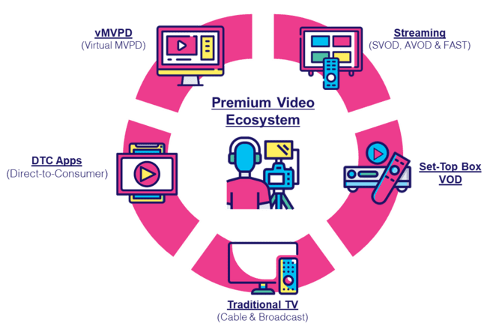
What It Means: Cross-Platform Accessibility
Today’s consumer has more optionality than ever before to access content available across the premium video landscape
“In a world where people are choosing content over platform, we have to make sure that we’re able to target them where they are using data. That’s not easy when every platform and every partner has slightly different offerings.”
- Katie Haniffy, VP of Media, Dick’s Sporting Goods
Advertising Week New York 2024
“If you’re not buying or placing your campaigns across every platform that you can, you’re really not reaching 100% of viewership—whether it be for a particular program or a particular audience”
- Evan Adlman, EVP Commercial Sales & Rev Operations, AMC Networks
Advertising Week New York 2024
This information is exclusively provided to VAB members and qualified marketers.
PAGE 26

Slide 27


What It Means: Cross-Platform Accessibility
While the TV set remains most prominent, many consumers have widened their definition of TV to include content across devices
How do you personally define TV?
% of video streamers who agree
‘Anything I can watch on my TV set whether it’s
via streaming or cable, satellite, fiber optic’
‘Anything I can watch on any device’
Source: VAB analysis of MRI-Simmons November 2024 Cord Evolution Study, A18+. Base = ‘Streamed in the past 12 months.’
This information is exclusively provided to VAB members and qualified marketers.
PAGE 27

Slide 28




Media habits are converging across demographics, allowing marketers to reach audiences with cross-platform and cross-generational content
What It Means: Cross-Platform Accessibility
Media Habits by Generation
Gen Z
(1997 – 2012)
Millennials
(1981 – 1996)
Generation X
(1965 – 1980)
Baby Boomers
(1946 – 1964)
56%
Watch TV Monthly
(Average ≤ 1 Hour per day)
62%
Watch TV Monthly
(Average ≥1.5 hours per day)
79%
Use a Streaming Service
67%
Adopted Streaming Services
(Average ≥1 hour per day)
95%
of Gen Z use a streaming service
92%
of Millennials use a Streaming service
75%
of Gen X watch
TV monthly
(Average ≥ 3 hours per day)
82%
of Boomers watch TV
or Streaming monthly
(Average ≤ 5 hours per day)
Source: Marketing Architects, Understanding TV Viewing Habits Across Generations.
This information is exclusively provided to VAB members and qualified marketers.
PAGE 28

Slide 29
Why It Matters: Cross-Platform Accessibility
Multiplatform buying strategies create higher consumer attention and greater purchase intent compared to campaigns with fewer platforms
Ads on Multiple Platforms Drive Attention
% who paid full attention
Full Media Mix Drives Purchase Intent
% of people likely to consider a company or brand after watching an ad
Source: Spectrum / MAGNA Media Trends, Ad Mix Synergy: Myth or Reality?, 2023.
This information is exclusively provided to VAB members and qualified marketers.
PAGE 29

Slide 30
Investing in premium video platforms provides transparent ad placements which not only protects and preserves brand value but also strengthens it
Professionally produced, long-form content with high emotional engagement in a brand safe environment regardless of platform or device and through transparent media partners
Premium Video
Professionally Produced, Long-Form Content
High Emotional Engagement
Brand Safe Environment
Cross-Platform Accessibility
Transparent
Ad Placements
Multiscreen TV
This information is exclusively provided to VAB members and qualified marketers.
PAGE 30

Slide 31





What It Means: Transparent Ad Placements
Transparency ensures visibility into ad placements and the quality of data used to inform and measure campaign success
Transparency refers to the amount of information shared throughout the campaign lifecycle, enabling clear communication between the sell-side and the buy-side.
Complete transparency on…
True verification
The full lifecycle of all video ad units within your campaign by
media partner
All calculations
of video ad impressions by media partner
The granular details of exact ad placements, by type and inventory source, across each media partner
The composition of ad placement types and inventory sources in audience metrics such as reach calculations by media partner
Have media partners bring in a truly independent third party to provide transparency on
a now-permanent basis
Source: Download VAB’s ‘Hidden Costs’ to learn more.
This information is exclusively provided to VAB members and qualified marketers.
PAGE 31

Slide 32









Why It Matters: Transparent Ad Placements
Transparency issues and ad fraud often means that video ads will appear in cluttered, low-quality digital advertising environments
Examples of Ads Running in Subpar Placements
In a small corner or side of a page
In a fully muted video player
With little to no video content between consecutive ads
‘Auto-plays’ without any user interaction or initiation
Ad plays continuously on a loop
Multiple video ads playing simultaneously on the same page
The ‘skip’ button on a video ad is hidden or obscured
Runs out of sight while the audio plays
Ads served “stacked” on top of another ad
Download VAB’s marketer’s guide ‘Hidden Costs’ to learn more.
This information is exclusively provided to VAB members and qualified marketers.
PAGE 32

Slide 33



Why It Matters: Transparent Ad Placements
An annoying, low-quality advertising experience devalues a brand and negatively affects its reputation among consumers
% of respondents that agree with the following on digital ads
86%
72%
66%
Too many ads on a webpage makes them feel overwhelmed and
more likely to ignore
the advertisement
Annoying or intrusive ad experiences have negatively affected their perception of a brand
Annoying or intrusive ad experiences make them less likely to purchase from that brand in future
Source: YouGov / Picnic, Ad UX Survey, 2023.
This information is exclusively provided to VAB members and qualified marketers.
PAGE 33

Slide 34

Why It Matters: Transparent Ad Placements
Conversely, transparent premium environments contribute to a more positive overall ad experience which leads to better results for brands
Rating Premium vs. Non-Premium Environments
% of U.S. respondents who agree on the effects of premium environments
Source: NBCUniversal and FreeWheel, Prescribing Premium: What a high-quality viewing experience means for consumers and why advertisers should take advantage of it, September 2024. Reflects U.S. respondents only. Note: Premium content in the study was publisher created episodic content with 100% of the ads viewable. Non-premium content was individual created short form content with 50% of the ads viewable. All content was delivered on a TV screen.
This information is exclusively provided to VAB members and qualified marketers.
PAGE 34

Slide 35
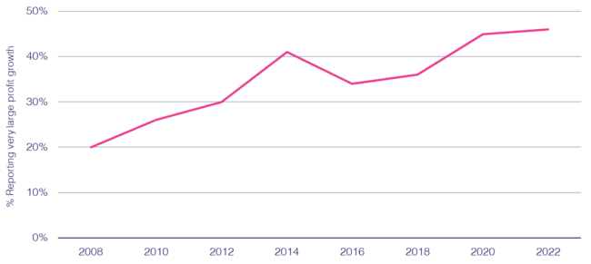
Why It Matters: Transparent Ad Placements
Ad campaigns that have built consumer trust in transparent environments have a direct, positive effect on brand profitability
% cases with strong ‘trust’ growth reporting strong ‘profit’ growth
82%
of consumers say it is important that a brand’s ads appear on content that is safe, accurate and trustworthy
Source: Peter Field, Why TV is Still at the Heart of Effectiveness, presented at ‘The Future of TV Advertising Global’ conference in December 2023. Base: IPA Databank 2004-2022 for profit cases reporting very large trust improvements. NB: insufficient data prior to 2008. Click here to view Peter Field’s full presentation online. *DoubleVerify & Harris Poll, Consumers Reject Brands That Advertise on ‘Fake News’ and Objectionable Content Online, June 2019.
This information is exclusively provided to VAB members and qualified marketers.
PAGE 35

Slide 36

Why It Matters: Transparent Ad Placements
Marketers should ask themselves if a lack of transparency in their media buys is worth risking 20% of their company’s total valuation
The Contribution of ‘Brand’ to Enterprise Value
The Relative Contribution to Shareholder Value for the S&P 500
20%
of a company’s enterprise value is based on their ‘brand’
Source: Forbes, New Global Standards For Reporting Brand Value Can Help CEOs Grow Share Price, 5/3/2018. Applying the Marketing Accountability Standards Board (MASB) Brand Investment & Valuation Model, Marketing Accountability Standards Board, 2017. Ocean Tomo Annual Study of Intangible Assets, 2015. ‘Brand value’ is the worth of a brand as an asset for an entity. ‘Enterprise value’ is a measure of the value of a company’s business operations. ‘Intangible assets’ can include things like patents, trademarks and customer lists. ‘Tangible’ assets can include things like equipment, inventory and real estate. Note: totals may not equal 100% due to rounding.
This information is exclusively provided to VAB members and qualified marketers.
PAGE 36

Slide 37

In their own words: Marketers agree on the need for transparency and accountability, and expect as much from media partners
“I think it's our job to really demand of our partners that they treat us well. I think the way that we hold them to that is we look for a lot of granularity in the data we get back. We ask questions on what they're doing to prevent fraud and when we see something that looks strange, we bring it to their attention.
If they don't have a good answer, we find a different partner.”
CMO, Consumer Electronics Category (Anonymous)
“On the advertiser side, it's on me. It's my budget, I own the money, I represent the company so it's on me to confirm that I'm doing things right. The publisher is equally responsible. It's on me to figure out if they're sketchy, but if they're operating illegally or immorally, then it's the publisher's fault. I buy from an intermediary/DSP and it's on them as well. Everyone is culpable.”
VP, Brand & Media, e-commerce Category (Anonymous)
Source: VAB / Advertiser Perceptions ‘Marketer Sentiment on Ad Fraud’ Survey, based on in-depth interviews, fielded October 2023. Survey base: Marketer and agency contacts from the Advertiser Perceptions ‘Senior Marketer’ and ‘Streaming Video’ online communities.
This information is exclusively provided to VAB members and qualified marketers.
PAGE 37

Slide 38



Buying Premium Video: A Definitive Checklist
Quality is key to successful campaigns, therefore marketers need to uphold audience trust, keep partners accountable and demand full transparency
Uphold Audience Trust and Standards:
■The ad experience should be premium like the content around it – with quality audio and video and relevant creative.
■ Partners should use programmatic tools that are built for premium transactions vs. legacy display, ensuring transactions are rooted in trust, and delivery isn’t compromised.
■ Ad quantity should be in line with content length, with minimal disruption, low latency, proportional ad breaks, and carefully crafted ad loads.
Quality of Environment
Hold Partners Accountable:
■ Partners should meet brand requirements, uphold category exclusivity, and maintain competitive separation.
■ Partners should ensure no placements with objectionable content – or objectionable audiences.
■ Legitimate verification processes should be in place to understand what is being bought and sold.
Brand Safety
Know What You Are Buying:
■ Creative should run where it is planned to, in the right context.
■ Buyers & sellers should agree on the kind of impressions purchased – ads should run adjacent to or within the right content and be viewed by real people. They should not run on MFA sites or be delivered to bots.
■ Ads should be viewable, not out-streamed, muted, auto-played, or hidden. Non-viewable impressions should be removed from reporting.
Transparency & Legitimacy
To learn more, click here to download the FreeWheel Council for Premium Video’s & VAB’s ‘Buying Premium Video: A Definitive Checklist’
This information is exclusively provided to VAB members and qualified marketers.
PAGE 38

Slide 39
The Power of Premium Video = The Marketer Benefits of Multiscreen TV
Professionally produced, long-form content with high emotional engagement in a brand safe environment regardless of platform or device and through transparent media partners
Premium Video
Professionally Produced, Long-Form Content
High Emotional Engagement
Brand Safe Environment
Cross-Platform Accessibility
Transparent
Ad Placements
The Power
of Premium Video:
Positive halo effect for brands
Fosters greater
ad recall
Boosts credibility, perception and brand salience
Increases brand favorability
Increases purchase intent
Inspires customer action
Builds consumer trust
Does not risk brand equity
Drives higher conversion rates
Creates higher consumer attention
Drives greater purchase intent
Protects and preserves brand value
Transparency
and trust have a positive effect on brand profitability
Multiscreen TV
This information is exclusively provided to VAB members and qualified marketers.
PAGE 39

Slide 40
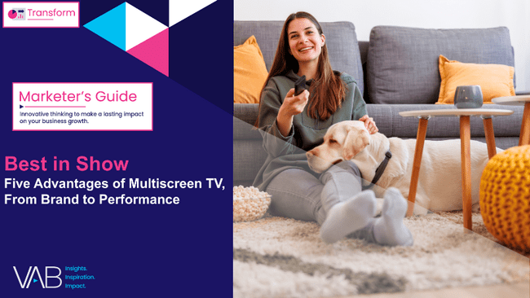
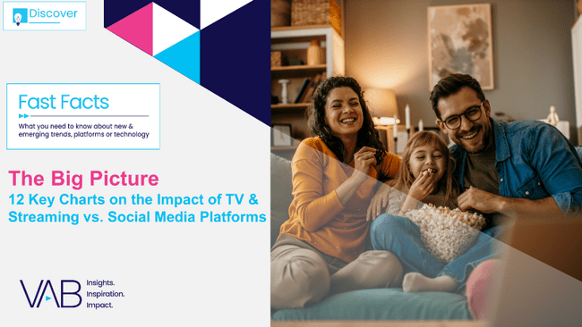

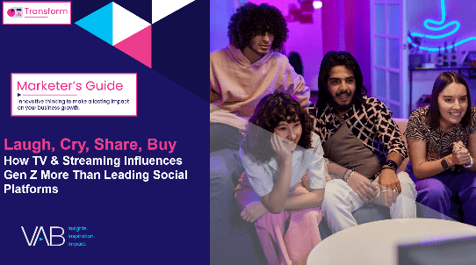
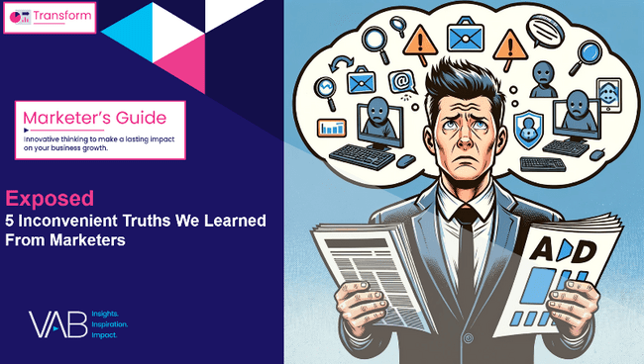


Creators
Jason Wiese
Benjamin Vandegrift
SVP, Director of Strategic Insights
jasonw@thevab.com
VP, Measurement Solutions & Innovations benjaminv@thevab.com
Kailyn Hartmann
Leah Montner-Dixon
Best in Show
Five Advantages of Multiscreen TV, From Brand to Performance
The Big Picture
12 Key Charts on the Impact of TV & Streaming vs. Social Media Platforms
VP, Advanced Analytics & Intelligence
kailynh@thevab.com
Director, Audience & Behavioral Insights
leahm@thevab.com
Reed Kiely
Karolina Guillen
Director, Data Insights & Trends
reedk@thevab.com
Associate Director, Insights, Strategy & Analytics karolinag@thevab.com
Kaileen Cain
Breaking Through
How New Advertisers Are Using TV To Ignite Interest & Turn Consumers Into Customers
Laugh, Cry, Share, Buy
How TV & Streaming Influences Gen Z
More Than Leading Social Platforms
Senior Insights Analyst
kaileenc@thevab.com
Discover more
Looking for more data, insights and takeaways? Check out this related VAB content
Exposed
5 Inconvenient Truths We Learned From Marketers
Hidden Costs
Three Critical Business Ramifications
of Digital Ad Fraud
VAB Members, brand marketers and agencies get free and immediate access to VAB’s content library. Get access at theVAB.com
This information is exclusively provided to VAB members and qualified marketers.
PAGE 40

Slide 41


About VAB
VAB plays a dual role in the video advertising industry. We are leading the change to bring about a more innovative and transparent marketplace. We also provide the insights and thought leadership that enables marketers to develop business-driving marketing strategies.
Drawing on our marketing expertise, we simplify the complexities in our industry and discover new insights that transform the way marketers look at their media strategy.
We are committed to your business growth and proud to offer VAB members, brand marketers and agencies complimentary access to our continuously-growing Insights library. Get immediate access at theVAB.com.
This information is exclusively provided to VAB members and qualified marketers.
PAGE 41

