Slide 1



The Lessons Brands Can Learn From The Impact of Presidential Election Ad Spending

Slide 2
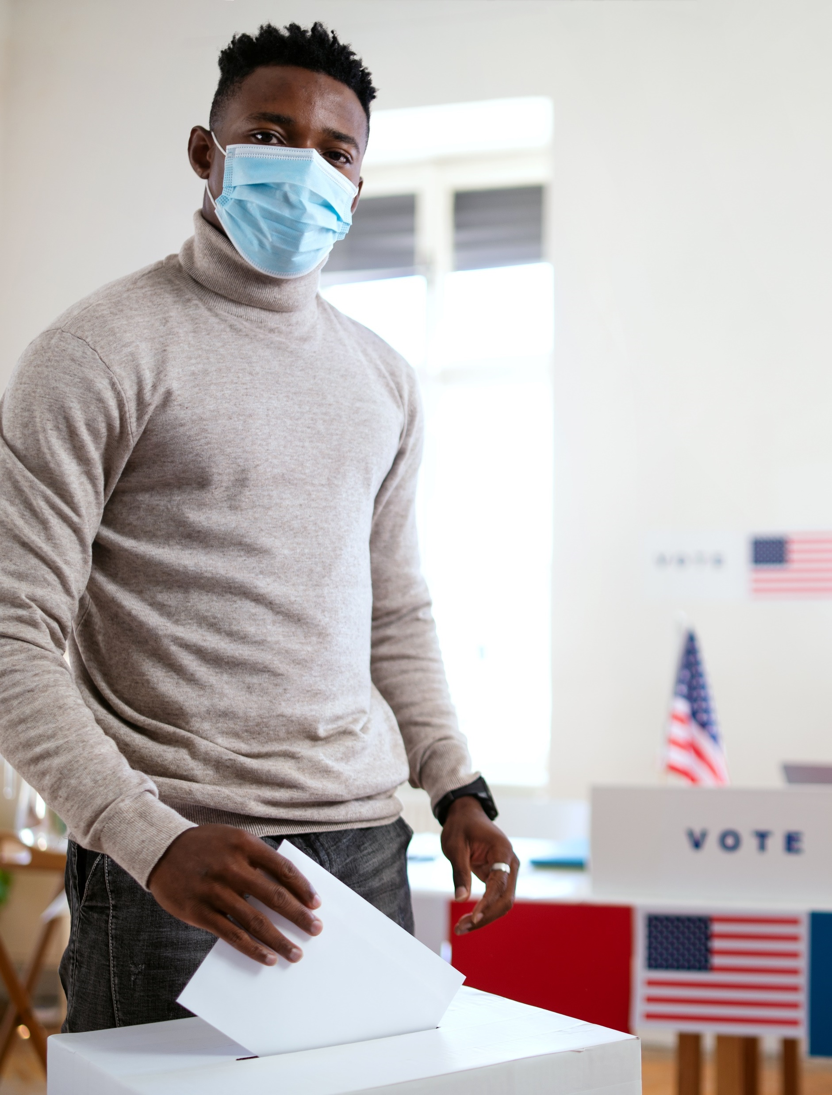


As Monday marked Presidents’ Day, we thought we would take this opportunity to reflect on the record-breaking election cycle that just passed.
2020 witnessed the highest political advertising spend ever at over $8.5 billion, nearly double (+90%) what was spent across all races during the 2016 Presidential election season.
With billions of dollars committed, which culminated
in Democrat Joe Biden’s victory in the Presidential election, we were curious to understand if there
was a correlation between advertising investment
and election results within this highly-competitive, outcomes-obsessed category and how these findings can be applied by marketers across all categories.
Source: Ad Age ‘Political Ad Spending This Year Reached a Whopping $8.5 Billion’,11/23/20; VAB analysis of Kantar Media ‘Advertisers Spent $5.25 Billion on the Midterm Election’, 11/15/18
This information is exclusively provided to VAB members and qualified marketers. Further distribution is prohibited.
PAGE 2

Slide 3
What’s new to know?
This information is exclusively provided to VAB members and qualified marketers. Further distribution is prohibited.
PAGE 3

Slide 4

In one of the most contentious and competitive races ever, Democrats won by utilizing the right media mix
to ensure they effectively reached a wide swath of voters
In contrast, Republicans employed a more digital heavy strategy, potentially oversaturating their already loyal base, which reinforces the importance of reaching a wide audience including new voters
2020 Presidential General Election: Spending By Media
(Candidate, Party & Issue-Based)
Democrat
$1,032 MM
Republican
$760 MM
TV was 77% of Democrat spend
TV was 68% of Republican spend
Source: VAB analysis of Kantar CMAG Political Competitive Data Gathering, 2020 Presidential Election data measured from 4/7/20 to 11/10/20 across general election spend. Total spend reflects: TV platforms, radio platforms and digital platforms. TV Platforms: Cable TV, Broadcast TV (including Spanish Language Broadcast TV), Spanish Language Broadcast TV and Satellite TV. Radio Platforms: AM Radio, FM Radio, State Radio Networks and General Radio. Digital Platforms: Google and Facebook. Candidate represents spend from only the candidates. Party represents spend from the political party and candidate/party co-op. Issue-Based represents spend from election-affiliated third-party sources (e.g. PACs, The Lincoln Project, NRA Victory Fund, Republican Voters Against Trump).
This information is exclusively provided to VAB members and qualified marketers. Further distribution is prohibited.
PAGE 4

Slide 5
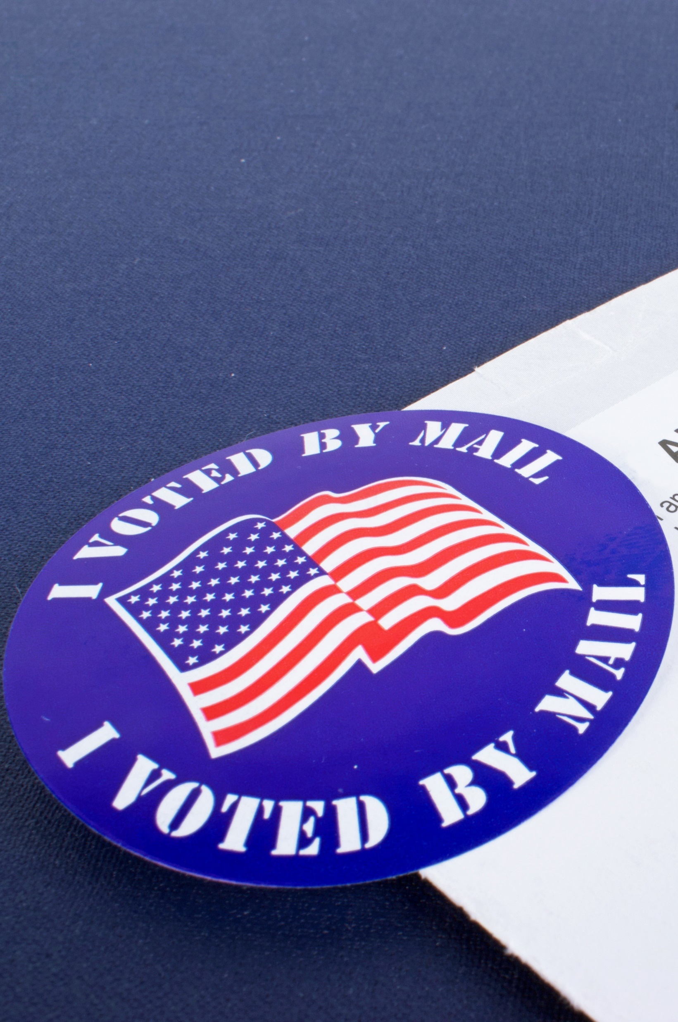
Biden, who held the SOV advantage, primarily leveraged TV to build his relationship with voters which led to his popular vote and electoral college victory
A prominent figure prior to his Presidential run, television enabled Biden to reintroduce himself to all voters, especially undecided ones
2020 Presidential General Election: Share of Voice
(Candidate Only)
Biden also held a 70% SOV in cable TV
All Media
$1,093 MM
TV
$727 MM
Source: VAB analysis of Kantar CMAG Political Competitive Data Gathering, 2020 Presidential Election data measured from 4/7/20 to 11/10/20 across general election spend. All media spend reflects: TV platforms, radio platforms and digital platforms. TV Platforms: Cable TV, Broadcast TV (including Spanish Language Broadcast TV), Spanish Language Broadcast TV and Satellite TV. Radio Platforms: AM Radio, FM Radio, State Radio Networks and General Radio. Digital Platforms: Google and Facebook. Candidate represents spend from only the candidates. Party represents spend from the political party and candidate/party co-op. Issue-Based represents spend from election-affiliated third-party sources (e.g. PACs, The Lincoln Project, NRA Victory Fund, Republican Voters Against Trump). SOV = Share of Voice.
This information is exclusively provided to VAB members and qualified marketers. Further distribution is prohibited.
PAGE 5

Slide 6
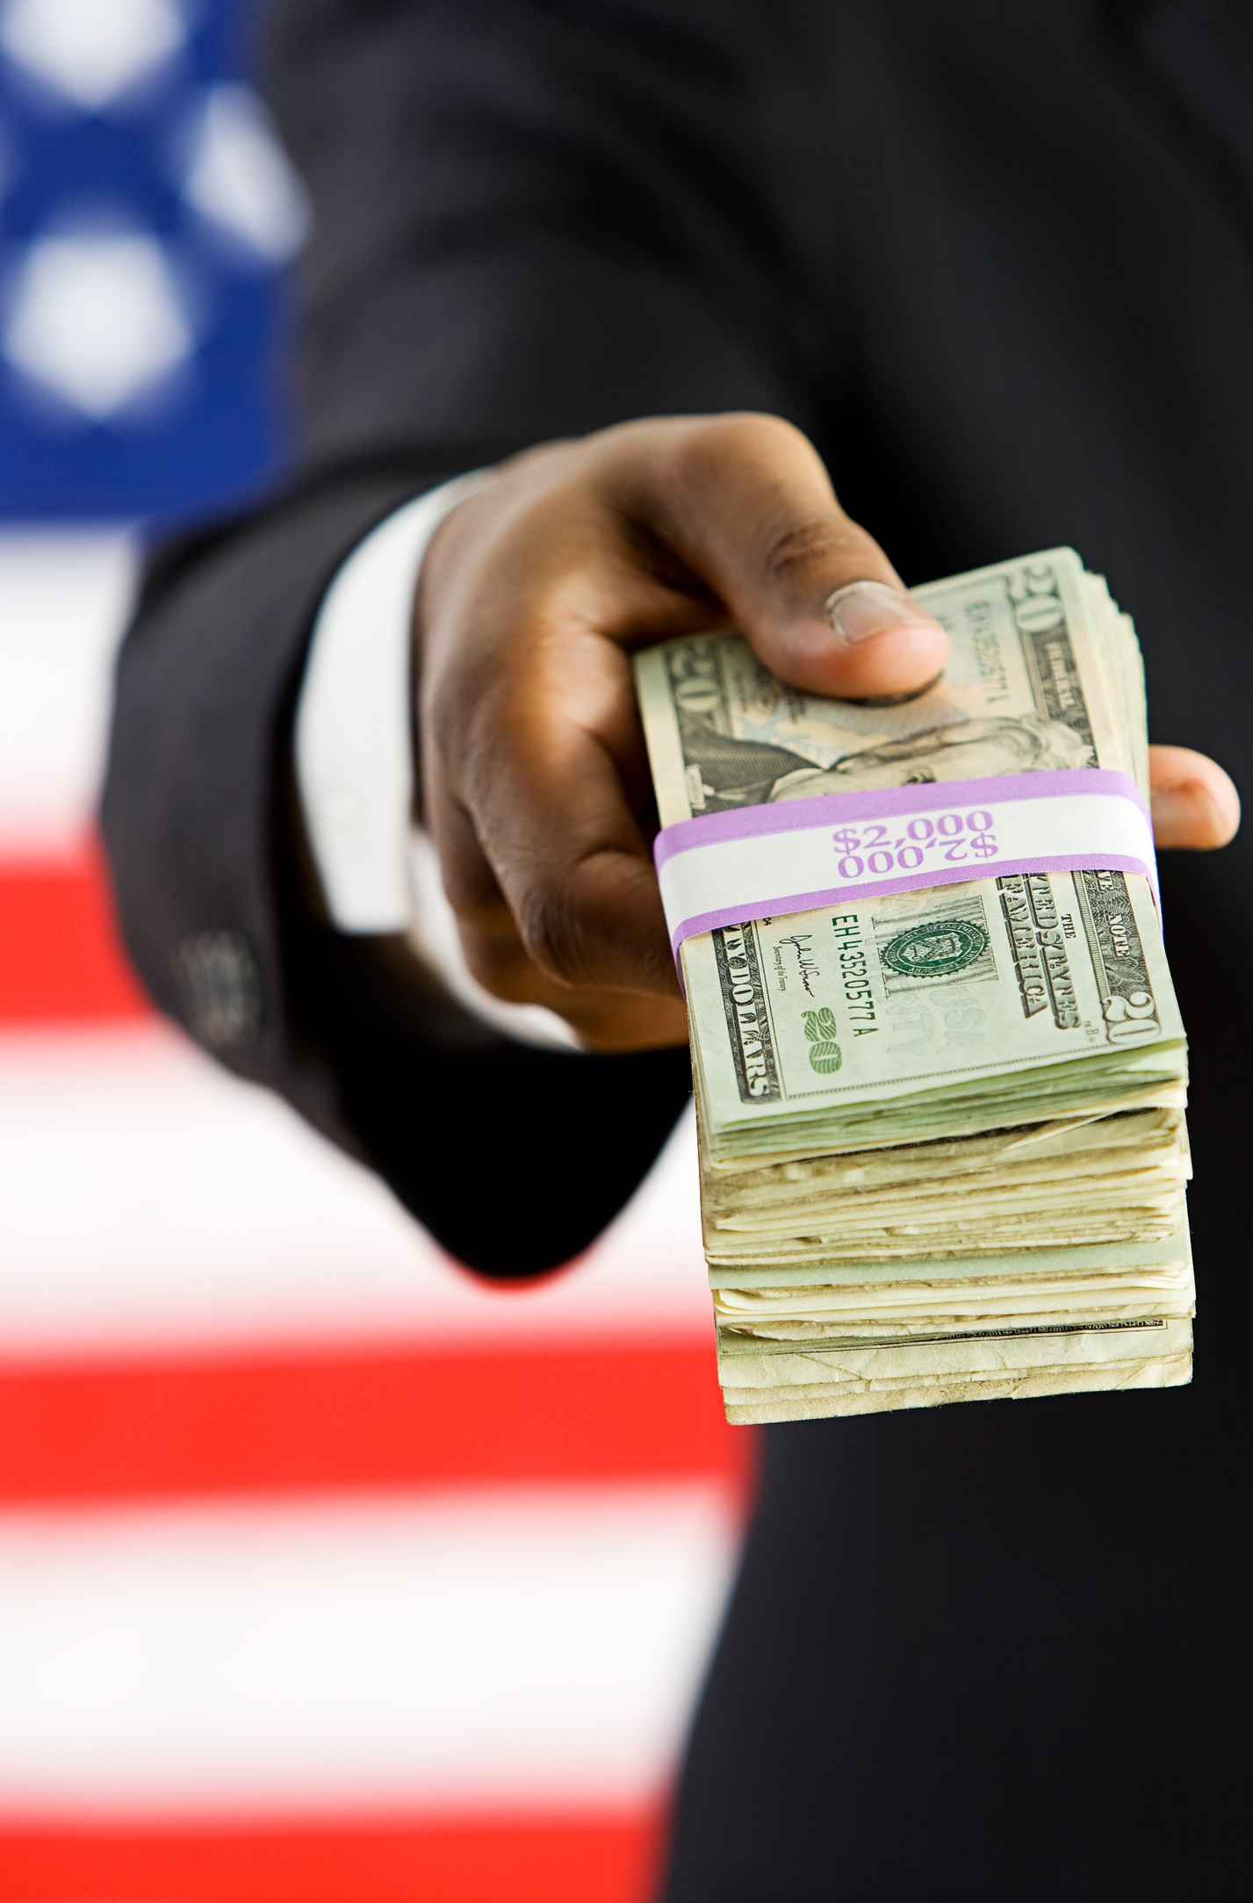
Super PACs, who are singularly focused on delivering results, predominantly invest in TV to achieve success (collectively represents 87% of their total media spend)
Outcomes-obsessed PACs are some of the most intensely behavioral data-driven organizations in any category and marketers would be wise to follow their playbook
2020 Presidential General Election: Share of Voice
(Issue-Based: PACs & other ‘special-interest / policy’ groups)
All Media
$616 MM
TV
$532 MM
Democratic PACs: 90% of spend was on TV
Republican PACs: 83% of spend was on TV
Source: VAB analysis of Kantar CMAG Political Competitive Data Gathering, 2020 Presidential Election data measured from 6/16/20 to 11/2/20 across general election ‘heavy-up period’ spend. TV Platforms: Cable TV, Broadcast TV (including Spanish Language Broadcast TV), Spanish Language Broadcast TV and Satellite TV. Candidate represents spend from only the candidates. Party represents spend from the political party and candidate/party co-op. Issue-Based represents spend from election-affiliated third-party sources (e.g. PACs - The Lincoln Project, NRA Victory Fund, Republican Voters Against Trump). Democrat PACs with over $10MM in TV general election spend: Future Forward ($105MM), Priorities Action USA ($56MM), Independence USA ($40MM), American Bridge ($35MM), The Lincoln Project ($13MM) & Unite the Country ($12MM). Republican PACs with over $10MM in TV general election spend: Preserve America ($98MM), America First Action ($89MM) & Restoration ($14MM). PACs = political action committees. 69 total PACs spent in the Presidential race (D = 50 / R = 19).
This information is exclusively provided to VAB members and qualified marketers. Further distribution is prohibited.
PAGE 6

Slide 7
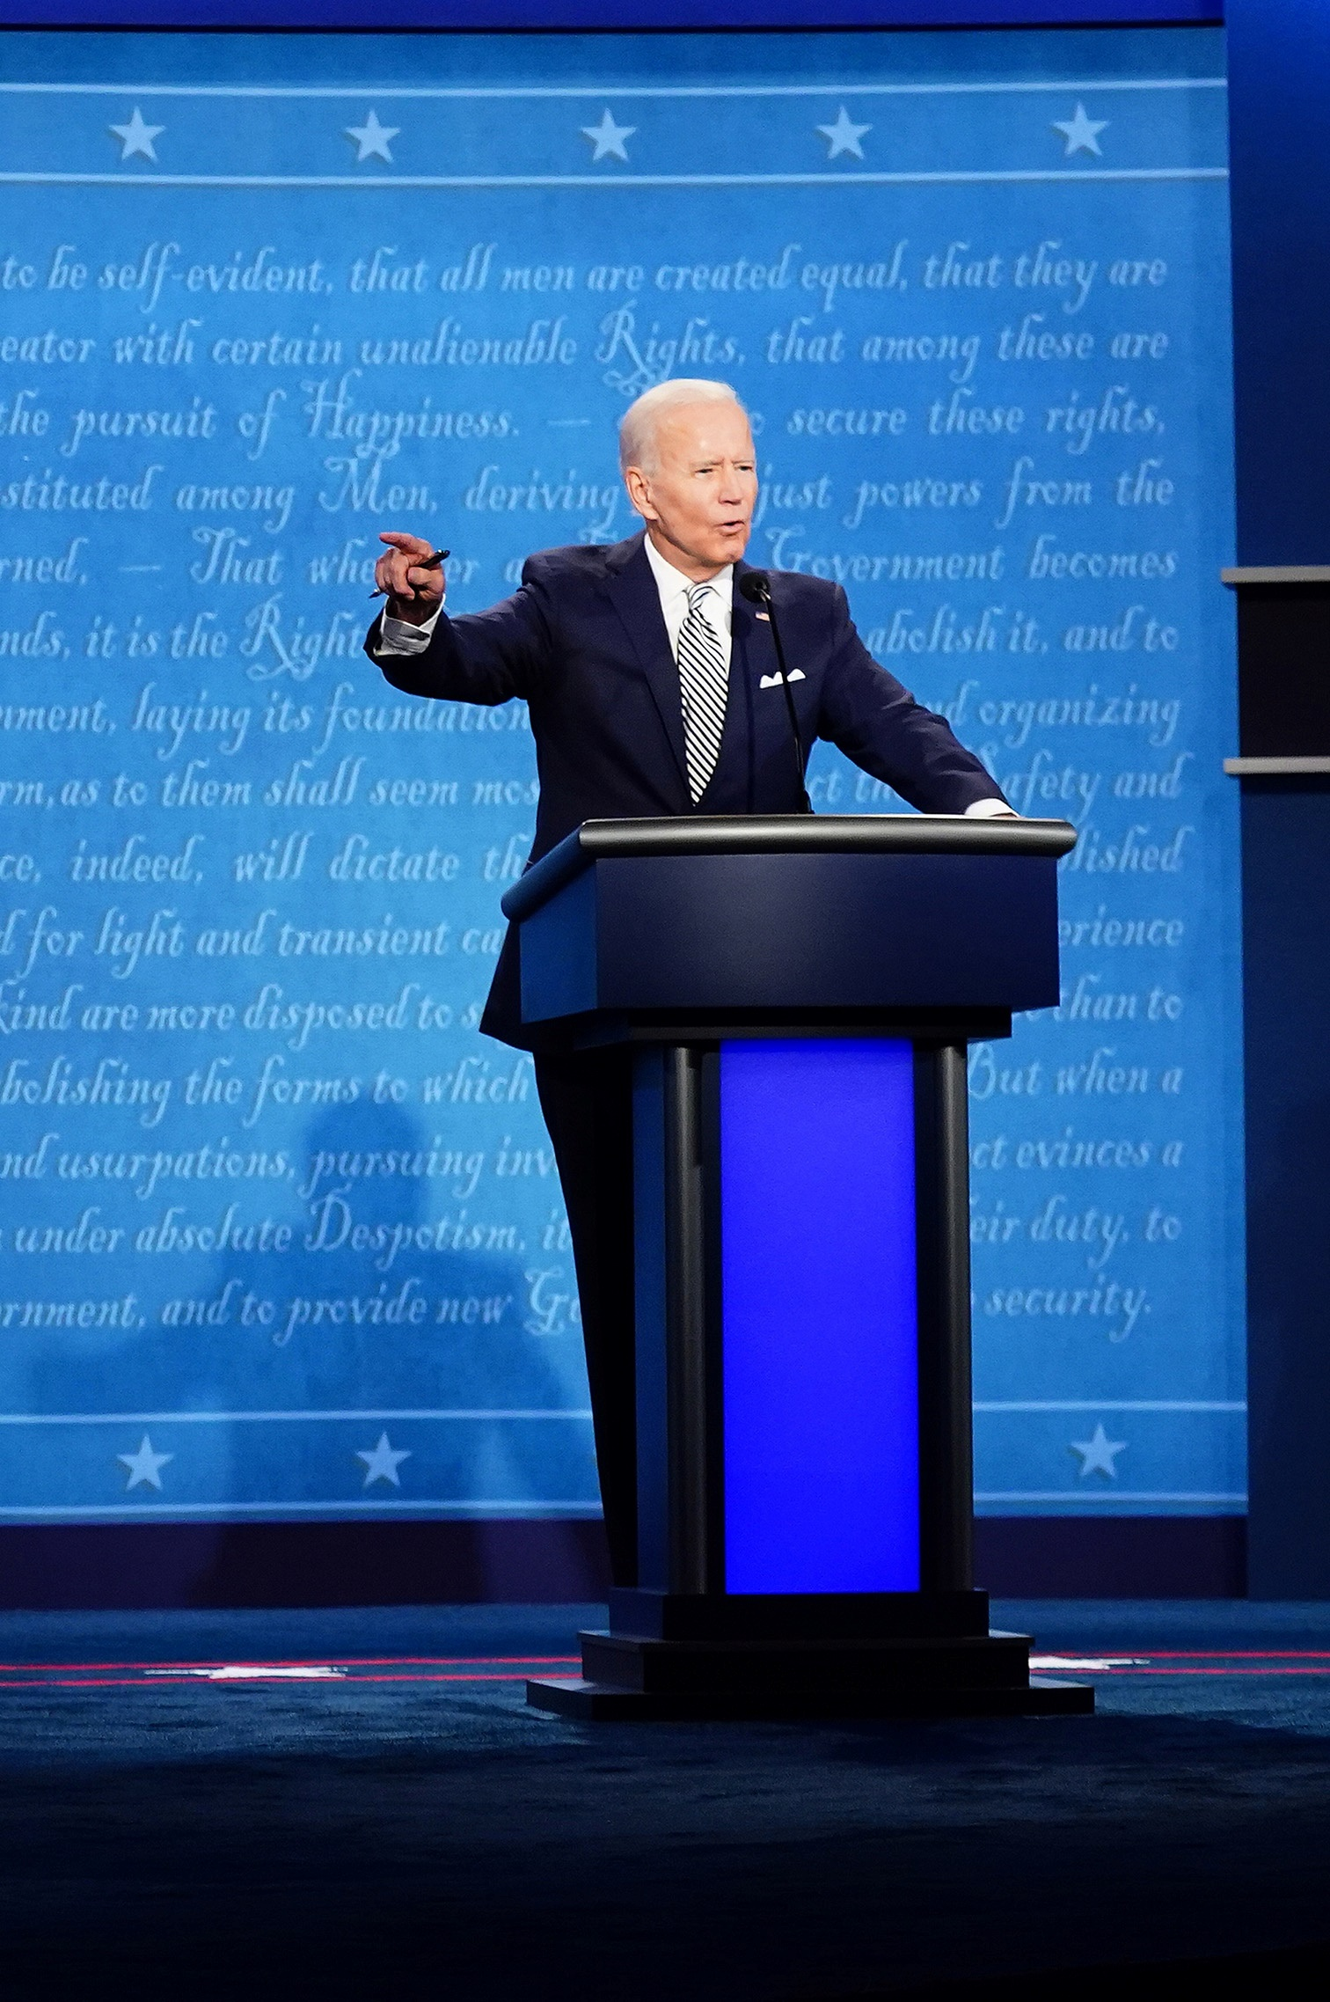
The winning formula is a continuous investment throughout a campaign with an extended heavy-up leading right into voter decision time
For Biden, a continuous advertising presence built ‘brand salience’ – top of mind awareness that creates a propensity of a brand to be thought of in ‘buying’ situations
2020 Presidential General Election: Weekly TV Spend
(Candidate, Party & Issue-Based)
$ in Millions, 6/16/20 – 11/2/20
Source: VAB analysis of Kantar CMAG Political Competitive Data Gathering, 2020 Presidential Election data measured from 6/16/20 to 11/2/20 across general election ‘heavy-up period’ spend. Political weeks begin Tuesdays and end Mondays. TV Platforms: Cable TV, Broadcast TV (including Spanish Language Broadcast TV), Spanish Language Broadcast TV and Satellite TV. Candidate represents spend from only the candidates. Party represents spend from the political party and candidate/party co-op. Issue-Based represents spend from election-affiliated third-party sources (e.g. PACs, The Lincoln Project, NRA Victory Fund, Republican Voters Against Trump). Note: Biden invested over $15MM in TV during 12 separate weeks vs. 7 for Trump.
This information is exclusively provided to VAB members and qualified marketers. Further distribution is prohibited.
PAGE 7

Slide 8

Democrats used TV SOV to influence brand loyalists, turning several projected ‘red’ states into ‘toss ups’
and ‘toss ups’ into ‘blue-leaning’ states before the election
82% (9 out of 11) of the battleground states listed below had a direct correlation between the shift in their electoral college vote projection and Democratic TV SOV
2020 Presidential General Election: Electoral College Projections vs. TV SOV
(reflects candidate, party & issue-based TV spending)
Cook Political Report Rating* / State | Total TV Spend | Democratic TV SOV | Republican TV SOV | Race Projection Shift vs. TV SOV Advantage Correlation?
‘Likely Republican’ to ‘Toss Up’: Electoral College Vote Projection (1/9/19 vs. 10/28/20)
Texas | $78 MM | 99% | 1% | Yes
Ohio | $37 MM | 88% | 12% | Yes
‘Lean Republican’ to ‘Toss Up’: Electoral College Vote Projection (1/9/19 vs. 10/28/20)
North Carolina | $147 MM | 47% | 53% | No
Iowa | $91 MM | 82% | 18% | Yes
Georgia | $51 MM | 37% | 63% | No
Maine 2nd CD | $6.6 MM | 81% | 19% | Yes
Nebraska 2nd CD | $3.8 MM | 89% | 11% | Yes
‘Toss Up’ to ‘Lean Democrat’: Electoral College Vote Projection (1/9/19 vs. 10.28/20)
Pennsylvania | $247 MM | 88% | 12% | Yes
Michigan | $133 MM | 78% | 22% | Yes
Arizona | $131 MM | 69% | 31% | Yes
Wisconsin | $121 MM | 67% | 33% | Yes
Source: VAB analysis of Kantar CMAG Political Competitive Data Gathering, 2020 Presidential Election data measured from 4/7/20 to 11/10/20 across general election spend. TV Platforms: Cable TV, Broadcast TV (including Spanish Language Broadcast TV), Spanish Language Broadcast TV and Satellite TV. Candidate represents spend from only the candidates. Party represents spend from the political party and candidate/party co-op. Issue-Based represents spend from election-affiliated third-party sources (e.g. PACs - The Lincoln Project, NRA Victory Fund, Republican Voters Against Trump). *VAB analysis of The Cook Political Report ‘2020 Electoral College Ratings’ 1/9/19 vs. 10/28/20. SOV = Share of Voice. CD – Congressional District.
This information is exclusively provided to VAB members and qualified marketers. Further distribution is prohibited.
PAGE 8

Slide 9
Due to its reach, saliency, legitimacy and storytelling abilities, TV is the preferred platform with the largest share of media spend across candidates and political action committees within this highly competitive category
A ‘share of voice’ advantage driven by a continuous advertising presence to stay top-of-mind with audiences up to their decision time is a key factor in achieving successful outcomes
TV has the influence to shift consumer perceptions in highly competitive markets and a higher ‘share of voice’ enables a challenger brand to establish themselves, amplify their messaging and steal share from a category incumbent
What’s important for marketers to know?
This information is exclusively provided to VAB members and qualified marketers. Further distribution is prohibited.
PAGE 9

Slide 10

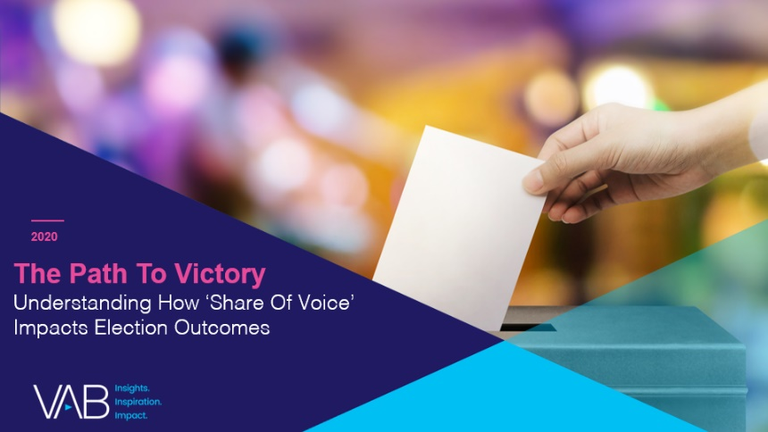

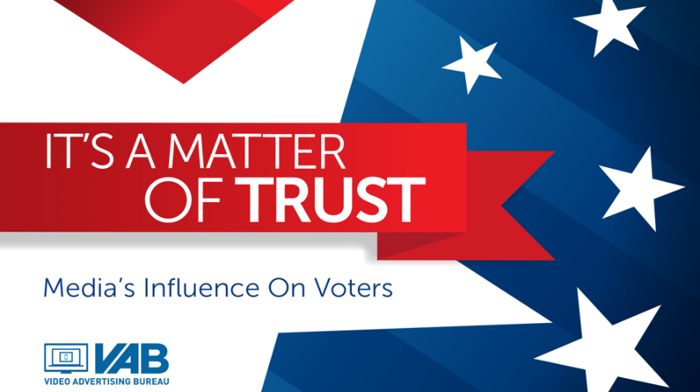
Creators
Jason Wiese
Reed Kiely
SVP, Director of Strategic Insights
jasonw@thevab.com
Insights Manager
reedk@thevab.com
The Halo Effect
TV as a Growth Engine
The Path to Victory
Understanding How ‘Share Of Voice’ Impacts Election Outcomes
Discover more
Looking for more data, insights and takeaways? Check out this related VAB content
A Matter of Principle
Reassessing Your Strategy in Today’s Environment
It’s A Matter of Trust
Media’s Influence On Voters
VAB Members, brand marketers and agencies get free and immediate access to VAB’s content library. Get access at theVAB.com
This information is exclusively provided to VAB members and qualified marketers. Further distribution is prohibited.
PAGE 10

Slide 11

About VAB
VAB is an insights-driven organization that inspires marketers to reimagine their media strategies resulting in fully informed decisions.
Drawing on our marketing expertise, we simplify the complexities in our industry and discover new insights that transform the way marketers look at their media strategy.
Discover
We keep you one step ahead with the latest thinking so you can create innovative, forward-looking strategies.
Simplify
We save you time by bringing you the latest data & actionable takeaways you can use to inform your marketing plans.
Transform
We help you build your brand by focusing on core marketing principles that will help drive tangible business outcomes.
We are committed to your business growth and proud to offer VAB members, brand marketers and agencies complimentary access to our continuously-growing Insights library. Get immediate access at theVAB.com.
This information is exclusively provided to VAB members and qualified marketers. Further distribution is prohibited.
PAGE 11

