Slide 1



Case Study Corner
xx
Pharma Category
Brand success stories highlighted through real-world multiscreen TV case studies

Slide 2





17 Pharma category ‘real world’ case studies showcasing how multiscreen TV drives business outcomes across the funnel
Upper Funnel Outcomes
Awareness
Multiscreen TV campaigns that expand reach and drive brand recall against a brand’s best customer prospects*
Sampling of ‘awareness-based’ outcomes that can be measured:
Reach / Reach Extension / Incremental Reach
Ad / Brand Recall
Cost Efficiencies (Reach / Targeted IMPs)
Mid-to-Lower Funnel Outcomes
Action
Multiscreen TV campaigns that increase the likelihood the intended audience will be motivated to act*
Sampling of ‘action-based’ outcomes that can be measured:
Conversion Rates (website traffic,
app downloads, prescription lifts, subscription sign-ups,
tune-in, foot traffic)
Sales / Revenues
Optimizations / ROI
Cost Efficiencies (Conversions)
Full-Funnel Outcomes
Awareness + Action
Multiscreen TV campaigns that expand reach and drive brand recall while also increasing the likelihood that the intended audience will be motivated to act*
Sampling of full-funnel outcomes:
Reach → Brand Recall → Conversion Rates → Sales → Optimizations →
Cost Efficiencies
*based on campaign KPIs
This information is exclusively provided to VAB members and qualified marketers.
PAGE 2

Slide 3


Upper Funnel
Case Studies
Awareness
Multiscreen TV campaigns expand reach
and drive brand recall against a brand’s
best customer prospects
Sampling of ‘awareness-based’ outcomes that can be measured:
    Reach / Reach Extension / Incremental Reach
    Ad / Brand Recall
    Cost Efficiencies (Reach / Targeted IMPs)
How Multiscreen TV drives
Awareness
This information is exclusively provided to VAB members and qualified marketers.
PAGE 3

Slide 4


Category:
Pharma
(Dermatology)
A dermatology drug brand used machine learning optimizations to grow verified patient reach and improve cost efficiencies
Challenge
A specialty dermatology drug brand wanted to raise awareness by growing verified patient reach while quantifying the efficacy and efficiency of Connected TV (CTV) and online video (OLV) to inform ongoing media mix strategies
Solution
Targeted patient modeled audiences across CTV and OLV, and used DeepIntent Outcomes™ optimizations to increase verified patient reach while reducing cost-per-verified-patient (CPVP)
Target Segment
Cord cutters with a high likelihood to suffer from a specified skin condition
Results
Combined CTV and OLV campaigns achieved 4X reach among verified patients while reducing CPVP -35%
CTV-only campaign delivered 3X verified patient reach and reduced CPVP -37%
Company / Platform / Media Type
DeepIntent Outcomes™ / Streaming + Multiscreen (non-linear) / Connected TV (CTV), Online Video (OLV)
Cumulative Campaign Performance
Before & after algorithmic optimizations
CTV + OLV
CTV Only
4X
-37%
-35%
3X
Source: DeepIntent, Case study: DeepIntent Outcomes™ In-Flight Optimizations Grow Verified Patient Reach for Specialty Dermatology Drug. Campaign time period: February 2021 – May 2021.
This information is exclusively provided to VAB members and qualified marketers.
PAGE 4

Slide 5

Category:
Pharma
(Plaque Psoriasis)
A pharmacy drug brand utilized machine learning optimizations to grow verified patient reach and maximize cost efficiencies
Challenge
A specialty pharmacy drug used to treat moderate-to-severe plaque psoriasis wanted to raise awareness by accelerating verified patient reach while maximizing efficiencies
Solution
Targeted patient modeled audiences across Connected TV (CTV), online video (OLV), and display media using DeepIntent’s healthcare-specialized DSP and CTV Marketplace
Performance was optimized using DeepIntent Outcomes™ machine learning algorithms that automatically adjust campaign parameters
in-flight to maximize outcomes
Target Segment
Individuals with a high likelihood to have a specified diagnosis and have also been prescribed the brand or specified competitive brands
Results
Machine learning optimizations delivered 5.7X average weekly verified patient reach while reducing cost-per-verified-patient (CPVP) -83%
Company / Platform / Media Type
DeepIntent Outcomes™ / Streaming + Multiscreen (non-linear) / Connected TV (CTV), Online Video (OLV), Display media
Total Campaign Performance
Impact of machine learning optimizations
Algorithms auto-optimize all campaign parameters in-flight, including inventory
5.7X
Partner Spotlight
Impact of optimizations on CPVP
-83%
-66%
Source: DeepIntent, Case study: DeepIntent Outcomes™ Machine Learning Optimizations Maximize Verified Patient Reach and Efficiency for Plaque Psoriasis Drug. Campaign time period: December 2020 – June 2021. ‘CPVP’ = cost-per-verified-patient.
This information is exclusively provided to VAB members and qualified marketers.
PAGE 5

Slide 6





Category:
Pharma
DIRECTV's Pause Ad strategy during the Masters Tournament secured 100% SOV, keeping the pharma brand top of mind
Challenge
DIRECTV took an innovative approach to get a pharma brand awareness and exposure around the Masters Tournament despite national sellout
Solution
100% Pause Ad SOV across DIRECTV & DIRECTV STREAM during Friday and Sunday of the Masters Tournament
Results
By taking over the TV screen with DIRECTV Advertising’s Pause Ad opportunity, the brand had 100% SOV during any pause event, including during The Masters
This high impact ad unit helped the brand stay top of mind for viewers, reaching consumers for over 3 minutes on average
Company / Platform
DIRECTV / Linear TV / Streaming
3:18
Average Time Spent
Pause Duration
2M
Unique Devices Reached
7M
Average Impressions
Delivered per day
Source: DIRECTV Advertising, Case study: Innovative Ad Formats: Pharma Pause Ads case study. 2Q’23.
This information is exclusively provided to VAB members and qualified marketers.
PAGE 6

Slide 7



Category:
Pharma
A pharma brand utilized a convergent TV strategy to deliver incremental reach and improve audience quality
Challenge
DeepIntent’s client utilized connected TV atop linear TV to effectively and efficiently reach a precise, clinically-relevant audience segment
Solution
DeepIntent conducted an analysis to compare the performance of connected TV (CTV) and linear TV
The study leveraged recent campaign data, ACR (automatic content recognition) data, and DeepIntent Outcomes™ to measure CTV’s ability to:
  Reach clinically-relevant patient audiences
  Provide qualified, incremental reach atop linear TV
Target Segment
Clinically-relevant patient audiences for the brand
Results
CTV proved to be effective at reaching clinically-relevant audiences, and delivered up to 30%* incremental reach to qualified patient audiences
Company / Platform
DeepIntent / DeepIntent Outcomes™, Connected TV (CTV)
Campaign Results
+82%
higher on-target reach
+50%
higher audience quality
Linear TV reach
CTV reach
CTV delivered up to 30%* incremental reach to qualified patient audiences
overlapping reach
Source: DeepIntent, Case study: CTV’s Pharmaceutical Marketers case study. Campaign time period: 7/1/2021 -9/30/2021.
*Varies by condition.
This information is exclusively provided to VAB members and qualified marketers.
PAGE 7

Slide 8
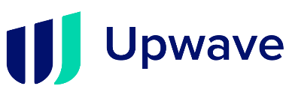
Category:
Pharma
A pharma & health care company leveraged Upwave’s Brand Optimization capability to drive lift across both TV and digital
Challenge
A leading pharmaceutical and health care company wanted to measure reach among both broad and niche audiences utilizing targeting criteria beyond age and gender
Audience Measurement Innovation
The brand utilized Upwave’s Analytics Platform for Brand Advertising, which enabled them to optimize and reallocate across channels and monitor reach, frequency and penetration rate within their specific target audience
Target Segment
HHI $100K+
High-Level Job Title / Industry in Healthcare, Finance, Government
Learnings
Upwave’s Brand Optimization capability revealed that Digital alone was not as effective, running both TV and Digital together helped drive lift
Campaign lifted awareness among 11.9MM people, with the highest lift seem among affluent audiences
Company / Viewing Source / Media Type
Upwave / ACR, Event Tags / Linear TV, Digital (Display, Mobile, Desktop)
11.9MM
People with Lift
in Awareness
521MM
Total Digital Impressions
4.2B
Total TV Impressions
2.5X
More likely to reach those in the Hospital Leadership sector
3X
More likely to
reach those in the Government sector
5X
More likely to
reach those in the Finance sector
1.5X
More likely to
reach VP-level audience via Linear TV
Source: Upwave. Campaign time period: May – December 2021. Comparisons based against a representative control group.
This information is exclusively provided to VAB members and qualified marketers.
PAGE 8

Slide 9




Category:
Pharma
(Migraines)
Healthcare company raised awareness of new medication by engaging qualified physicians in CTV
Challenge
Increase market share for a prescription migraine medication by raising awareness amongst physicians who prescribe competitive drugs
Solution
DeepIntent® matched the brand’s NPI (National Provider Identifier) list with their HCP universe to identify and target on a 1:1 basis on smart TVs, gaming consoles and streaming devices including Roku, Samsung and Apple TV
Target Segment
Highly Qualified Healthcare Professionals (HCP)
  75%+ of the 1.6MM HCP universe is addressable by DeepIntent’s platform daily
Results
A high-quality database mixed with 1st party data, fueled by constant optimization resulted in an on-target reach of over 60%
Company / Platform
DeepIntent® / DeepIntent Healthcare DSP / CTV
62%
on-target reach;
exceeding the brand’s expectations
99%+
exposed HCPs matched to NPI for physician-level measurement and reporting
Source: DeepIntent, Case study: CTV’s Pharmaceutical Marketers case study. *Varies by condition.
This information is exclusively provided to VAB members and qualified marketers.
PAGE 9

Slide 10








Category:
Pharma
A pharma & health care company leveraged Upwave’s Brand Optimization capability to drive lift across both TV and digital
Challenge
A leading pharmaceutical & health care company invested in an 8-month Digital (Display, Mobile and Desktop) and TV campaign, measuring and optimizing their brand spend. Increasing Brand KPIs, specifically brand awareness and brand reputation, with an end-goal of becoming a household name and measuring overall and on-target reach.
Measurement Solution
Upwave’s analytics solution is powered by exposed/control respondent data and includes reach capabilities that allow brands to measure against a broad, national audience, but also niche demographics, beyond age and gender.
Target Segment
Broad National Audience
HHI $100k+, High-Level Job Title/Industry in Healthcare, Finance, Government.
Learnings
Messaging on TV took time to gain momentum and the brand should utilize programmatic to hyper-target better performing audiences on TV.
The ability to refine their messaging throughout the campaign - optimizing creatives based on Outperformance indicators among the target audiences–led to spikes in key KPIs in the final month of the campaign.
In general, the campaign drove higher lift (comparing Control vs. Exposed) across all Brand Outcomes KPIs over time, based on the utilization of Brand Optimization and Brand Reach tools.
Viewing Source / Media Type
Linear TV, Streaming (CTV, OTT) and Digital Platforms (Display, Mobile and Desktop)
1.5X
2.5X
More likely to reach those in the Hospital Leadership sector
3X
More likely to reach those in the Government sector
5X
More likely to reach those in the Finance sector
More likely to reach VP-level audience via Linear TV
521MM
Total Digital Impressions
4.2B
Lift in Awareness on Digital
Lift in Awareness on Linear TV
Lift in Awareness Cross-Channel (Digital & Linear)
Lift in Awareness among Affluent Audience (HHI $100k+)
Total TV Impressions
11.9MM
People Lifted (Awareness)
Source: Upwave. Comparisons based against a representative control group.
This information is exclusively provided to VAB members and qualified marketers.
PAGE 10

Slide 11




Category:
Pharma
(Mental Health)
Swoop’s custom DTC audience facilitated improved reach and conversion for a leading Pharma brand
Challenge
A top pharmaceutical brand wanted to make patients aware of the benefits to its drug portfolio for the treatment of a sensitive, low-population mental health condition
Solution
Swoop leveraged its real-world data base to create a precision privacy-safe segment of those likely to be living with the target mental health condition and their caregivers, for increased efficiency and impact on CTV.
Target Segment
Swoop’s custom DTC audiences
Results
16.9 targeting multiple
Results outperformed the industry benchmark by 12X
~20% of the exposed ideal patients scheduled a visit with their healthcare provider within 3 months of the campaign, as measured by a third-party
Company / Platform
Swoop / CTV
16.9
Targeting multiple
12X
outperformed industry benchmark
~20%
of the exposed ideal patients scheduled
a visit with their healthcare provider within 3 months
of the campaign
Source: Crossix & Swoop, Case Study. All Swoop audiences are privacy-safe by design. Swoop never uses health data to build segments, ensuring 100% compliance with the most stringent federal and state policies, including HPAA and My Health My Data.
This information is exclusively provided to VAB members and qualified marketers.
PAGE 11

Slide 12
Category:
Pharma
(Women's Health)
IQVIA facilitated a women's health brand to increase their overall ad performance
Challenge
A top pharmaceutical brand wanted to make patients aware of the benefits to its drug portfolio for the treatment of a sensitive, low-population mental health condition
Solution
Swoop leveraged its real-world data base to create a precision privacy-safe segment of those likely to be living with the target mental health condition and their caregivers, for increased efficiency and impact on CTV.
Target Segment
Swoop’s custom DTC audiences
Results
16.9 targeting multiple
Results outperformed the industry benchmark by 12X
~20% of the exposed ideal patients scheduled a visit with their healthcare provider within 3 months of the campaign, as measured by a third-party
Company / Platform
Swoop / CTV
16.9
Targeting multiple
12X
outperformed industry benchmark
~20%
of the exposed ideal patients scheduled
a visit with their healthcare provider within 3 months
of the campaign
Source: Crossix & Swoop, Case Study. All Swoop audiences are privacy-safe by design. Swoop never uses health data to build segments, ensuring 100% compliance with the most stringent federal and state policies, including HPAA and My Health My Data.
This information is exclusively provided to VAB members and qualified marketers.
PAGE 12

Slide 13

Mid-To-Lower Funnel
Case Studies
Action
Multiscreen TV campaigns increase the likelihood that the intended audience will be motivated to act
(e.g., make a purchase, download an app, prescription lifts, sign-up for a subscription, make a booking, etc.)
Sampling of ‘action-based’ outcomes that can be measured:
    Conversion Rates (website traffic, app downloads, subscription sign-ups, tune-in, foot traffic)
    Sales / Revenues
    Optimizations / ROI
    Cost Efficiencies (Conversions)
How Multiscreen TV drives
Action
This information is exclusively provided to VAB members and qualified marketers.
PAGE 13

Slide 14

Category:
Pharma
NY Interconnect successfully drove patient conversion for a prescription drug through addressable TV
Challenge
NY Interconnect sought to drive patient conversion for a prescription drug
Solution
Utilizing addressable TV, two different creatives were shown to target households, according to audience segments chosen by client
Results
Symptomatic, OTC treaters
Diagnosed with specific condition
Competitive Rx
Results
Total incremental revenue: $226K
Exposed patients with no prior use of the drug demonstrated a 69% lift vs. the unexposed group
Conversion of 275 patients
Company / Platform
NY Interconnect / Addressable TV
Lift in Cumulative Conversion Rate
(no prior use of product)
+69%
Targeted Households
194,000
Total Impressions
6.3M
Source: NY Interconnect, Case study: Targeting is the Best Medicine case study.
This information is exclusively provided to VAB members and qualified marketers.
PAGE 14

Slide 15



Category:
Pharma
A pharma brand partnered with DIRECTV to drive visits and sales among new patients
Challenge
A pharmaceutical brand wanted to drive doctor visits and incremental prescriptions
Solution
13-week addressable campaign and conversion measurement
Target Segment
Patients who had no prior use of the Rx
Results
In a safe and privacy compliant way, the addressable campaign successfully reached those with the specific condition and drove doctor visits, especially in patients new to being treated and new to the specific brand
Company / Platform
Third-party data provider, Linear TV
+24%
Brand Conversion Lift
‘New to brand’
(target vs. control)
+54%
HCP Visitation Lift
‘New to category’
(target vs. control)
+51%
HCP Visitation Lift
‘New to brand’
(target vs. control)
Source: DIRECTV Advertising, Case study: Addressable Prescription Pharma. Campaign time period: Q1 ‘23.
This information is exclusively provided to VAB members and qualified marketers.
PAGE 15

Slide 16



Category:
Pharma
DIRECTV’s targeted addressable TV campaign successfully increased prescriptions and doctor’s visits for a pharma brand
Challenge
DIRECTV aimed to drive incremental prescriptions & doctor’s visits for a prescription pharma brand
Solution
9-week addressable TV media campaigns were utilized, along with conversion analysis
Target Segment
Those likely diagnosed with a specific respiratory condition
HHs exposed to competing brands’ TV ads in previous months
Results
Ensuring safety and privacy, the addressable campaign identified and reached the brand’s target audience
The campaign helped drive incremental new patient starts for the brand and was 1.5x more effective in targeting people with the specific condition than seen in the general pharmacy-going population.
Company / Platform
DIRECTV viewership data / third-party data provider / Linear TV
+179%
Brand Conversion Lift
‘New to brand’
(target vs. control)
+35%
Category Conversion Lift
‘New to category’
(target vs. control)
+24%
Allergist Visitation Lift
(target vs. control)
Source: DIRECTV Advertising, Case study: Addressable Precision Targeting: Prescription Pharma case study. Campaign time period: 2Q-3Q’22.
This information is exclusively provided to VAB members and qualified marketers.
PAGE 16

Slide 17




Category:
Pharma
(Neurological Movement Disorder)
A Pharma brand partnered with Swoop to reach ideal HCP audiences - resulting in new prescriptions and incremental patient lifetime value
Challenge
Increase brand awareness among healthcare professionals (HCPs) treating tardive dyskinesia – particularly those writing competitive treatments and practicing in low-access priority office locations
Solution
Swoop created a segment of HCPs who were diagnosing the target indication at high rates, allowing the brand to activate them with :60 promotion at the household level through CTV platforms.
Target Segment
Hard-to-reach healthcare professionals treating neurological movement disorders
Results
The campaign achieved a 10% script lift, increasing prescription activity among targeted HCPs
Within five months, the campaign generated 130 new-to-brand starts
$900k in incremental lifetime value was achieved from new prescriptions
The campaign delivered 12:1 ROI
Company / Platform
Swoop / CTV
10%
Script Lift
130
New-to-brand starts in 5 months
$900k
Incremental lifetime value
12:1
ROI
Source: Symphony & Swoop, Case study: Neurological Movement Disorder. All Swoop audiences are privacy-safe by design. Swoop never uses health data to build segments, ensuring 100% compliance with the most stringent federal and state policies, including HPAA and My Health My Data.
This information is exclusively provided to VAB members and qualified marketers.
PAGE 17

Slide 18

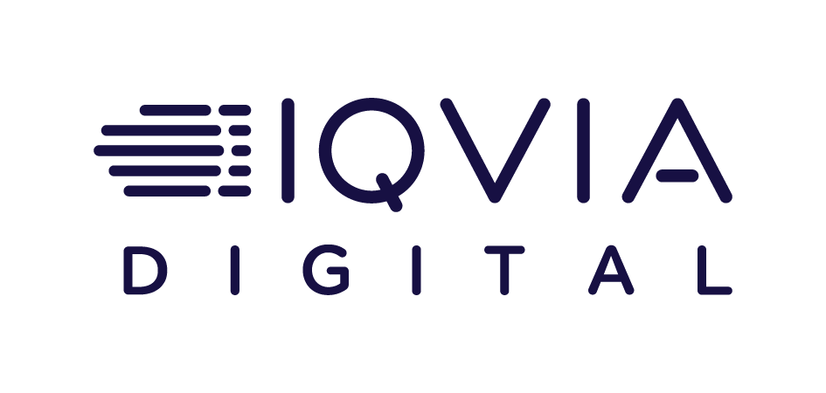
Category:
Pharma
IQVIA helps drive engagement and outcomes with incremental new patients for a healthcare brand
Challenge
Assess promotional impact of 2024 Linear TV buy in time to inform upfront buys for 2025.
Solution
IQVIA Digital's Linear TV platform provided comprehensive and timely updates on TV audience validity and promotional impact. Data updated through mid-year highlighted individual network performance and allowed for focus on those showing profitable acquisition.
Target Segment
Psoriasis Patients (de-identified) with and without prior prescription treatment.
Results
A combination of high reach broadcast networks and targeted niche cable networks proved successful.
While large scaled broadcast networks contributed the highest volume of incremental new patients, the highest relative promotional lift came from more niche, entertainment channels like CW and Hallmark.
Viewing Source / Media Type
Linear TV Exposure reported via iSpot STB/ACR data.
Measurement of Linear TV Impact to Support Strategic Campaign Goals
CBS
ABC
Inspire
Fox News
TV Land
GSN
History
Weather
Oxygen
Fox
CW
Hallmark
Science
Channel
Fox
My
Network TV
MeTV
Weather
GSN
Newsmax
TV ONE
Source: IQVIA, Case study: Measurement of Linear TV Impact to Support Strategic Campaign Goals.
This information is exclusively provided to VAB members and qualified marketers.
PAGE 18
PAGE 18

Slide 19


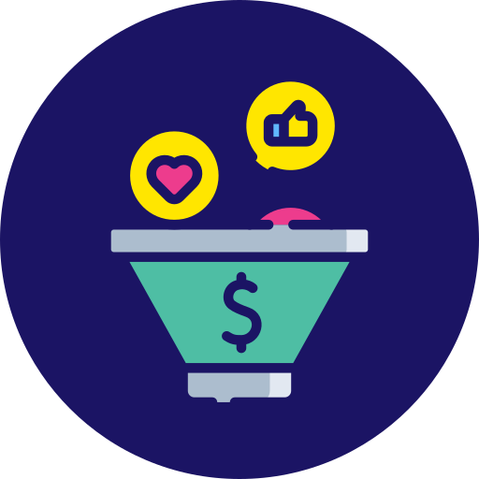
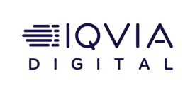
Category:
Pharma
(Women’s health products)
IQVIA Digital helps a women’s health brand drive mid-to-lower funnel results by converting high-quality audiences
Challenge
A global pharma brand sought to connect with the right customers to drive doctor visits and new-to-brand prescription starts for one of its women’s health products.
Solution
The brand identified two DTC audience segments for their programmatic advertising campaign and considered other vendors based on their ability to build scalable audiences
IQVIA Digital developed optimized versions of the two audiences by launching an advanced, new-to-healthcare, methodology.
Target Segment
Women in a certain age range with higher propensity for a specific health diagnosis
Women diagnosed for this condition and with addition risk factors that add treatment urgency
Results
The campaign delivered a +79% in measured audience quality for the diagnosed condition segment
+83% in measured audience quality for the diagnosed condition and additional risk factors segment
The campaign delivered a far better cost-per-target-reached.
Both the original and optimized audience versions achieved the highest efficiency ratings in comparison to other vendors considered.
Company / Platform
IQVIA Digital / Programmatic TV
+79%
Increase in measured audience quality for the diagnosed condition segment
+83%
Increase in measured audience quality for the diagnosed condition and additional risk factors segment
The enhanced audiences delivered a far better cost-per-target-reached
Source: IQVIA Digital, Case study: Women’s health brand increases ad campaign performance. Both audiences were created to match business rules provided by the client, based on client’s previous segmentation work. Audience quality is a metric that references the ability to more effectively reach the desired target consumer audience through advertising. The higher the AQ, the higher the ability to reach highly-qualified consumers with the greatest likelihood to engage in and act on health-related advertising messaging.
This information is exclusively provided to VAB members and qualified marketers.
PAGE 19

Slide 20

Awareness
How Multiscreen TV drives
Full-Funnel Outcomes
Multiscreen TV campaigns expand reach
and drive brand recall against a brand’s
best customer prospects
Action
Multiscreen TV campaigns increase the likelihood
that the intended audience will be motivated to act
(e.g., visit a website, download an app, prescription lifts,
sign-up for a subscription, make a purchase, etc.)
Case Studies
This information is exclusively provided to VAB members and qualified marketers.
PAGE 20

Slide 21




Category:
Pharma
(Type 2 Diabetes)
Swoop’s custom DTC audiences were leveraged to drive awareness and action for an addressable TV - resulting in increases in PCP visits and prescriptions
Challenge
A pharmaceutical brand wanted to increase reach, doctor visitation and prescription lift for their Type 2 Diabetes medication nationally in
the US.
Solution
Partnering with a top media planning agency,
the brand leveraged Swoop’s privacy safe, precision audiences to reach patients being treated with the brand and its competitors across linear addressable devices
The campaign was scaled across multiple MVPDs based on frequency and national reach brand objectives
Results
3.4 million households were reached
Campaign drove 297k PCP visits within three months of exposure
Campaign resulted in 16% script lift in endocrinologist specialist visits
Campaign saw a 49% lift over the control group
Company / Platform
Swoop / Linear Addressable TV
3.4M
Households reached
297k
PCP visits driven within 3 months
of exposure
16%
Script lift in endocrinologist specialist visits
49%
Lift over control group
Source: Crossix & Swoop, Case Study: Type 2 Diabetes. All Swoop audiences are privacy-safe by design. Swoop never uses health data to build segments, ensuring 100% compliance with the most stringent federal and state policies, including HPAA and My Health My Data.
This information is exclusively provided to VAB members and qualified marketers.
PAGE 21

Slide 22




Category:
Pharma
(Hepatitis)
Activated on addressable TV, Swoop audiences saw increased patients, screenings and conversions
Challenge
A leading pharmaceutical brand sought to further increase addressable results by testing and comparing Swoop against other data sources to understand if they could positively impact results and drive future performance improvements.
Solution
Using de-identified patient data and zero knowledge methodology, Swoop generated a targeted, privacy-safe segment comprised of currently diagnosed patients
This high-quality audience segment was executed against the provider’s universe running for six weeks at a twice-weekly frequency
Target Segment
Swoop custom-targeted patient audiences
Results
The campaign resulted in 1.8X more patients
20% increase in HCP visits
34% increase in patient-driven diagnostic screening
24% increase in brand conversion
Company / Platform
Swoop / Addressable TV
1.8X
More patients
20%
Increase in HCP visits
34%
Increase in patient-driven diagnostic screening
24%
Lift in brand conversion
Source: Crossix & Swoop, Case Study: Hepatitis. All Swoop audiences are privacy-safe by design. Swoop never uses health data to build segments, ensuring 100% compliance with the most stringent federal and state policies, including HPAA and My Health My Data.
This information is exclusively provided to VAB members and qualified marketers.
PAGE 22

Slide 23




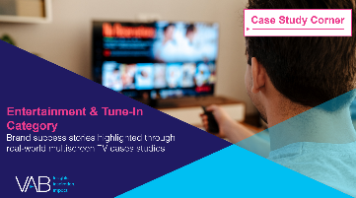

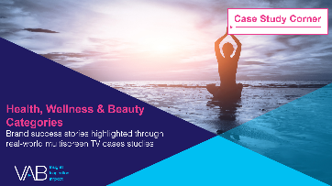


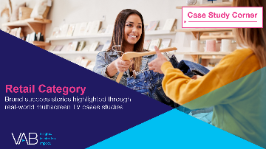

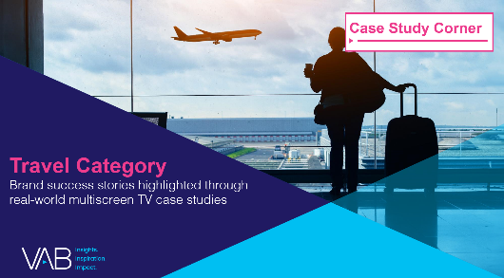
Want more? VAB has a wealth of case studies across additional categories
Automotive
Business-to-Business (B2B)
Consumer Packaged Goods (CPG)
Entertainment & Tune-In
Financial Services & Insurance
Health, Wellness & Beauty
Home
Restaurants
Retail
Technology
Travel
Access more case studies at www.thevab.com
This information is exclusively provided to VAB members and qualified marketers.
PAGE 23

Slide 24
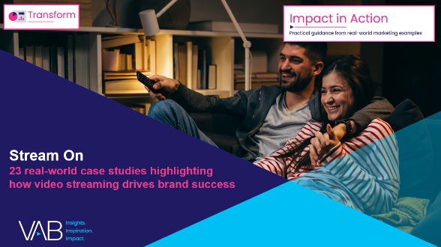


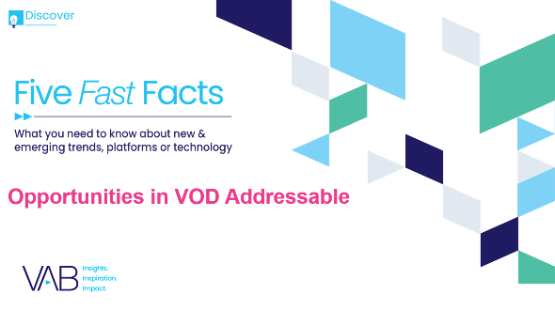



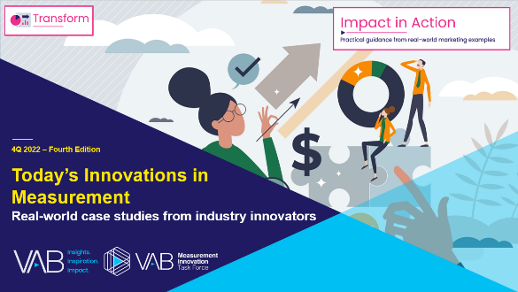
Want more? VAB also has case studies organized across multiscreen TV platforms including linear TV and streaming / CTV
Stream On
How can a convergent TV strategy drive business
results for my brand?
Proven Strategies & Tactics In Audience-Based TV Buying
Opportunities in VOD Addressable
Q1 ‘22 Today’s Innovations in Measurement
Q2 ‘22 Today’s Innovations in Measurement
Q3 ‘22 Today’s Innovations in Measurement
Q4 ‘22 Today’s Innovations in Measurement
Access more case studies at www.thevab.com
This information is exclusively provided to VAB members and qualified marketers.
PAGE 24

Slide 25


About VAB
VAB plays a dual role in the video advertising industry. We are leading the change to bring about a more innovative and transparent marketplace. We also provide the insights and thought leadership that enables marketers to develop business-driving marketing strategies.
Drawing on our marketing expertise, we simplify the complexities in our industry and discover new insights that transform the way marketers look at their media strategy.
We are committed to your business growth and proud to offer VAB members, brand marketers and agencies complimentary access to our continuously-growing Insights library. Get immediate access at theVAB.com.
This information is exclusively provided to VAB members and qualified marketers.
PAGE 25

