Slide 1





Dedicated to Your Good Health
How TV Drives Discovery & Encourages Education in the Pharma DTC Category

Slide 2

Multiscreen TV encourages ailment sufferers to educate themselves for better health
Although many American adults currently suffer from a medical condition of some sort, they are always looking for ways to better their physical and mental well-being and they view prescription remedies as an effective way to improve the quality
of their lives.
When it comes to ailments, most adults will conduct their own research on appropriate treatments and will also consult their doctor as well. TV advertising plays an outsized role in this process.
While TV accounts for approximately one-quarter of all direct-to-consumer prescription remedy (DTC) ad spend, it’s much more likely than any other media to drive brand discovery, inspire prospective patients to seek out more information online and encourage them to discuss treatments with their doctor so they can make more informed decisions about their health.
TV’s impact is even greater when advanced solutions such as audience-based buying and addressable TV are implemented within video campaigns to more precisely reach relevant patients and healthcare practitioners across multiscreen
TV platforms.
Continue reading to learn more about how multiscreen TV drives discovery
and encourages both exploration and education by ailment sufferers and
for pharma brands…
This information is exclusively provided to VAB members and qualified marketers.
PAGE 2

Slide 3

How multiscreen TV guides patients on their path to treatment
1
2
3
4
5
Scope of Ailments
in America
Most U.S. adults suffer from some sort of medical condition and are using prescription remedies for treatment
Adults Want to Live Healthier Lives
Most U.S. adults believe that prescription remedies have improved their lives
Dissecting Pharma TV Ad Investment
While adhering to strict advertising guidelines, brands are using TV to support remedies that combat serious, invasive diseases and other severe conditions
TV Drives Discovery & Encourages Education
No other media platform inspires ailment sufferers
to conduct further research and have discussions with their doctor so they can make more informed decisions about their
health like TV does
‘Advanced TV’ Enables Greater Precision
Audience-based TV buying and addressable TV solutions deliver precise targeting and outcomes throughout a patient’s path to treatment
This information is exclusively provided to VAB members and qualified marketers.
PAGE 3

Slide 4

1
Scope of Ailments in America
Most U.S. adults suffer from some sort of medical condition and are using prescription remedies for treatment

Slide 5
Over 200 million adults currently suffer, or have recently suffered, from some sort of medical ailment
Have/Had an Ailment* in the last 12 months
Adults 18+
in millions
+16.4 MM
(+9%)
vs. 2021
78%
of adults 18+ are currently suffering a medical ailment, or 200 million adults
%
of A18+ pop
73%
76%
77%
78%
Source: VAB analysis of MRI-Simmons, Spring USA Doublebase Studies: 2021, 2022, 2023 & 2024, Adults 18+. *See appendix (page 54) for a full list of ailments that are included in this universe.
This information is exclusively provided to VAB members and qualified marketers.
PAGE 5

Slide 6
The top 15 ailments include backaches and pain, allergies, high blood pressure, heartburn, high cholesterol, anxiety, Covid, headaches and more
Top 15 Ailments* That Adults Currently Have / Had in the last 12 months
Adults 18+
in millions
%
of A18+ pop
26%
19%
18%
17%
16%
14%
14%
14%
13%
13%
12%
12%
10%
10%
9%
Source: VAB analysis of MRI-Simmons, Spring USA Doublebase Study 2024, Adults 18+. *See appendix (page 53) for the full list of ailments. Arthritis represents ‘any,’ Diabetes represents ‘any.’
This information is exclusively provided to VAB members and qualified marketers.
PAGE 6

Slide 7
Three-quarters of ailment sufferers are using, or have recently used,
at least one prescription remedy for treatment
Treated Any Ailment with a Prescription Remedy*
in the last 12 months
Adults 18+
in millions
+20.3 MM
(+16%)
vs. 2021
74%
of adult 18+ ailment sufferers are using a prescription remedy as treatment, or nearly 150 million adults
%
of A18+ Ailment Sufferers
70%
72%
73%
74%
Source: VAB analysis of MRI-Simmons, Spring USA Doublebase Studies: 2021, 2022, 2023 & 2024, Adults 18+. *Prescription remedy includes both branded and generic remedies.
This information is exclusively provided to VAB members and qualified marketers.
PAGE 7

Slide 8
Many ailments with the highest usage of prescription remedies reflect serious, invasive diseases and other severe conditions
% of Ailment Sufferers that Used Prescription Remedies for Treatment
Adults 18+
in millions
Source: VAB analysis of MRI-Simmons, Spring USA Doublebase Study 2024, Adults 18+. *See appendix (page 55) for the full list by ailment. Diabetes represents ‘any.’ COPD = Chronic Obstructive Pulmonary Disease
This information is exclusively provided to VAB members and qualified marketers.
PAGE 8

Slide 9


Naturally, the incidence of ailments is higher for adults 50+ as over 100 million have an ailment and 80% use a prescription remedy for treatment
In the Last 12 months…
Adults 50+
Treated Any Ailment
with a Prescription Remedy*
Have/Had an Ailment
100.5 MM
81.0 MM
in millions
in millions
84%
81%
%
of A50+ pop
%
of A50+ Ailment Sufferers
Source: VAB analysis of MRI-Simmons, Spring USA Doublebase Study 2024, Adults 50+. *Prescription remedy includes both branded and generic remedies.
This information is exclusively provided to VAB members and qualified marketers.
PAGE 9

Slide 10

The importance of prescription remedies is obvious, as nine of the 10 leading causes of death are due to serious, invasive diseases
These nine ailments accounted for 1,968,960 deaths in 2023
The 10 Leading Causes of Death in the U.S.
2023
in thousands
Source: National Center for Health Statistics, National Vital Statistics System, mortality data file, data for 2023, December 2024.
This information is exclusively provided to VAB members and qualified marketers.
PAGE 10

Slide 11
Prescription remedies have certainly played a role in helping decrease recent mortality rates among the top causes of death in the U.S.
More ailment sufferers are getting relief from prescription remedies as eight of the nine ailments saw YoY declines
The 10 Leading Causes of Death in the U.S.
2022 vs. 2023
in thousands
Source: National Center for Health Statistics, National Vital Statistics System, mortality data file, data for 2022 & 2023, December 2024.
This information is exclusively provided to VAB members and qualified marketers.
PAGE 11

Slide 12
2
Adults Want to Live Healthier Lives
Most U.S. adults believe that prescription remedies have improved their lives

Slide 13



Most U.S. adults are always looking for ways to live healthier and improve their mental well-being
Health Attitudes
% any agree
‘I am always looking for new ways
to live a healthier life’
‘I make sure I exercise regularly’
‘I often look for products or services that can help improve my overall mental well-being’
P18+
77%
69%
59%
P18-49
76%
66%
63%
P50+
79%
71%
55%
Source: VAB analysis of MRI-Simmons, Spring USA Doublebase Study 2024. Any agree = agree completely or somewhat agree.
This information is exclusively provided to VAB members and qualified marketers.
PAGE 13

Slide 14

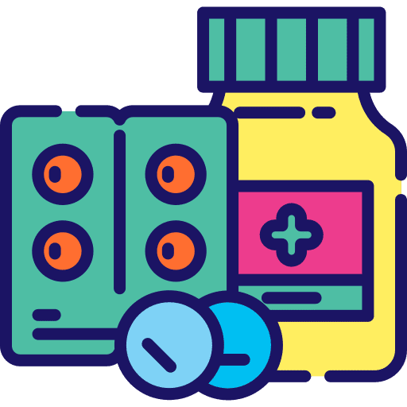

They also do their own thorough research on treatments and prescription remedies and will listen to their doctors as well
Health Attitudes
% any agree
‘I research treatment options on my own before asking my doctor about them’
‘Before I begin taking any drug, I look for as much information about it as possible’
‘I always do what my
doctor tells me to do’
P18+
60%
73%
70%
P18-49
61%
71%
65%
P50+
58%
75%
77%
Source: VAB analysis of MRI-Simmons, Spring USA Doublebase Study 2024. Any agree = agree completely or somewhat agree.
This information is exclusively provided to VAB members and qualified marketers.
PAGE 14

Slide 15
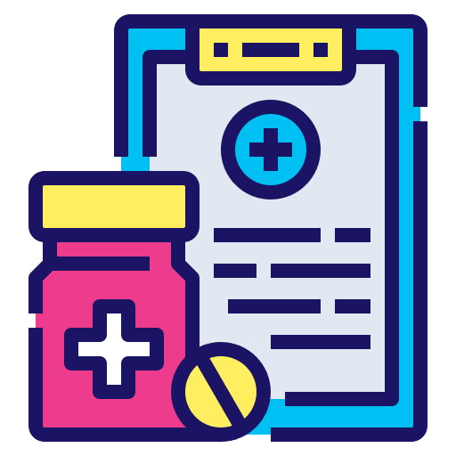

Most people, especially older adults, believe that prescription remedies are very effective, and that medicine has improved the quality of their lives
Health Attitudes
% any agree
‘Prescription drugs are more effective than over-the-counter remedies’
‘Medication has improved
the quality of my life’
P18+
57%
67%
P18-49
53%
61%
P50+
62%
75%
Source: VAB analysis of MRI-Simmons, Spring USA Doublebase Study 2024. Any agree = agree completely or somewhat agree.
This information is exclusively provided to VAB members and qualified marketers.
PAGE 15

Slide 16
3
Dissecting Pharma TV Ad Investment
While adhering to strict advertising guidelines, brands are using TV to support remedies that combat serious, invasive diseases and other severe conditions

Slide 17
Pharma DTC category spends over $26 billion annually across TV and digital, with approximately one-quarter of that ad spending going to TV
Pharmaceutical Category (DTC Prescription Remedies Only): TV & Digital Spending
in billions
+14%
vs. 2023
$26.5
$23.2
$20.7
+14%
vs. 2023
+15%
vs. 2023
Source: TV Spend = VAB analysis of Nielsen Ad Intel data, calendar year 2022-2024. TV media includes Cable TV, Network TV, Spanish Language Cable TV, Spanish Language Network TV, Spot TV, Syndication TV; excludes promos and PSAs. Pharma represents ‘Pharmaceutical Houses’ sub-group category. Digital Spend = eMarketer Forecast, August 2024; includes advertising that appears on desktop and laptop computers as well as mobile phones, tablets and other internet-connected devices (including CTV), and includes all the various formats of advertising on those platforms. Pharma DTC, or direct-to-consumer pharma advertising (DTCPA), refers to the marketing and advertising of pharmaceutical products directly to consumers as patients.
This information is exclusively provided to VAB members and qualified marketers.
PAGE 17

Slide 18



About $4 billion of digital ad spend is in social media, however there are no clear FDA guidelines on regulating influencers or comment sections
Unclear Guidelines
Out-of-Date Policies
Lack of Warnings
Beyond ads, there are no clear guidelines for regulating social media influencers, their comment sections, direct messages, or other ways they can communicate with their followers about prescription medicines.
The FDA has not updated its guidance on prescription drug promotion for social media since 2014. The social media landscape has evolved dramatically in the last 11 years, including the creation of TikTok in 2016.
Social media advertisements often lack clear side effect warnings, and consumers often have to navigate to
a different page to find them
Source: Bloomberg, The Dangers of Drug Ads on Social Media: Prognosis, December 2023. eMarketer Forecast, ‘Healthcare & Pharma Industry Social Network Ad Spending,’ August 2024.
This information is exclusively provided to VAB members and qualified marketers.
PAGE 18

Slide 19
This is in stark contrast to TV advertising which is required to adhere to strict advertising guidelines from the Food & Drug Administration (FDA)
In May 2024, incremental additions were made to a longstanding body of prescription drug advertising regulations for the TV industry
Five General Standards for Pharma DTC Advertising Introduced in the FDA’s New Rule
Consumer Friendly Language
Understandable Audio Information
No Distractions
Advertisements must clearly state the name of the drug and the major statement of side effects. Ads should not include technical or medical jargon familiar only to health care professionals.
Audio information must be understandable in terms of volume, articulation, and pacing, and should be at least as understandable as the rest
of the commercial. “Rapid fire” disclosures in advertisements are not permitted.
Television advertisements must present the major statement concurrently in the audio and visual portions of the ad
Textual Information Must Be
Easily Readable
Major Statement Must be Presented
Concurrently in Text and Audio
The on-screen text in television advertisements must be presented against a contrasting background for sufficient duration and in a font size and style that is easily readable.
Advertisements cannot have statements, text, images or sounds that detract from comprehension of the major statement. In particular, no other sounds, including music, should be in the audio during the side effect disclosure portion of the ad.
Source: Food and Drug Administration, Direct-to-Consumer Prescription Drug Advertisements: Presentation of the Major Statement in a Clear, Conspicuous, and Neutral Manner in Advertisements in Television and Radio Format, November 2023
This information is exclusively provided to VAB members and qualified marketers.
PAGE 19

Slide 20
Pharma DTC TV spend is now $7 billion annually, up 21% since 2021 which closely aligns with the increase of people taking prescription remedies
Pharmaceutical Category (DTC Prescription Remedies) TV Spending
in billions
+21%
vs. 2021
Source: VAB analysis of Nielsen Ad Intel data, calendar year 2019-2024. TV media includes Cable TV, Network TV, Spanish Language Cable TV, Spanish Language Network TV, Spot TV, Syndication TV; excludes promos and PSAs. Pharma represents ‘Pharmaceutical Houses’ sub-group category. Pharma DTC, or direct-to-consumer pharma advertising (DTCPA), refers to the marketing and advertising of pharmaceutical products directly to consumers as patients.
This information is exclusively provided to VAB members and qualified marketers.
PAGE 20

Slide 21
The top TV spending subcategories include remedies for serious, invasive diseases and other severe conditions
Top 20 DTC Prescription Remedy Subcategories by TV Investment Spend
CY 2024
in millions
Source: VAB analysis of Nielsen Ad Intel data, calendar year 2024. TV media includes Cable TV, Network TV, Spanish Language Cable TV, Spanish Language Network TV, Spot TV, Syndication TV; excludes promos and PSAs. Pharma represents ‘Pharmaceutical Houses’ sub-group category. COPD = Chronic Obstructive Pulmonary Disease; AMD = Age-related macular degeneration; RSV = Respiratory syncytial virus; HCM = Hypertrophic cardiomyopathy. Diabetes TV spending is specifically from Type 2 remedies; Cancer TV spending includes a mix of melanoma, lung, prostate, break head and neck cancer remedies.
This information is exclusively provided to VAB members and qualified marketers.
PAGE 21

Slide 22

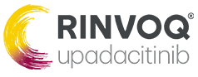
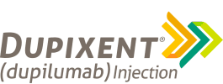
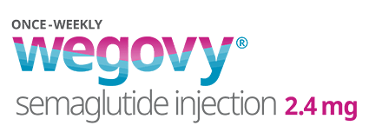

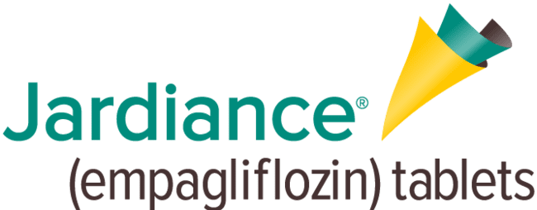
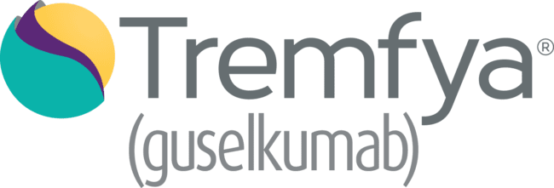
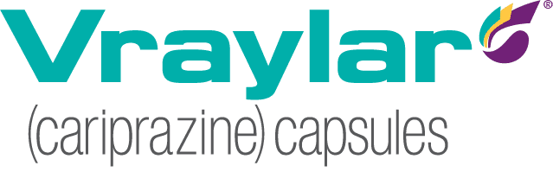
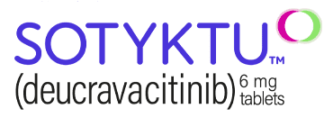
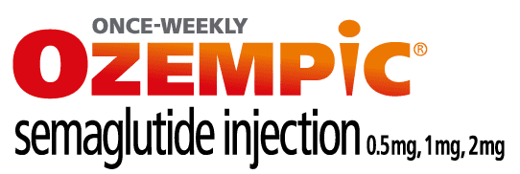


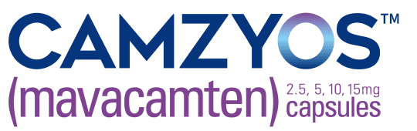

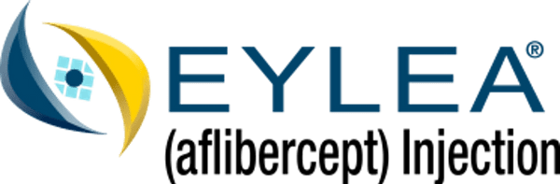
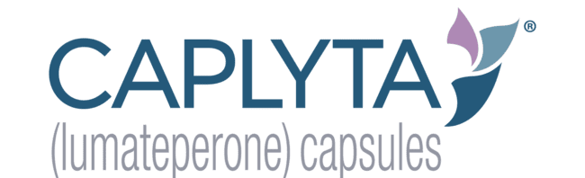

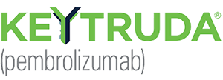
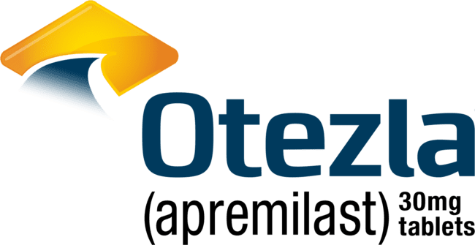

55% of the $7 billion in Pharma DTC TV advertising was from 20 brands that offer remedies to predominately combat serious, invasive diseases
Top 20 Prescription Remedy Brands by TV Investment Spend
CY 2024
Crohn’s Disease / Psoriasis / Ulcerative Colitis
Rheumatoid Arthritis Ulcerative Colitis / Eczema
Depression / Alzheimer’s
Psoriasis /
Ulcerative Colitis
Eczema / Asthma
Obesity
Diabetes
($501.5 MM)
($466.7 MM)
($389.1 MM)
($362.9 MM)
($272.7 MM)
($184.5 MM)
($163.5 MM)
Depression / Bipolar Disorder
Psoriasis
Diabetes
COPD
RSV
HCM
Migraines / Wrinkles
($155.7 MM)
($149.3 MM)
($143.1 MM)
($133.1 MM)
($130.7 MM)
($114.3 MM)
($106.3 MM)
AMD
Bipolar Disorder
Tardive Dyskinesia
Cancer
Psoriasis
Menopause
($104.1 MM)
($99.1 MM)
($97.3 MM)
($97.1 MM)
($96.5 MM)
($95.0 MM)
Source: VAB analysis of Nielsen Ad Intel data, calendar year 2024. TV media includes Cable TV, Network TV, Spanish Language Cable TV, Spanish Language Network TV, Spot TV, Syndication TV; excludes promos and PSAs. Pharma represents ‘Pharmaceutical Houses’ sub-group category. COPD = Chronic Obstructive Pulmonary Disease; AMD = Age-related macular degeneration; RSV = Respiratory syncytial virus; HCM = Hypertrophic cardiomyopathy. Diabetes TV spending is specifically from Type 2 remedies; Cancer TV spending includes a mix of melanoma, lung, prostate, break head and neck cancer remedies.
This information is exclusively provided to VAB members and qualified marketers.
PAGE 22

Slide 23
Remedies for chronic skin conditions, obesity, cancer, depression and colitis were among those with the biggest YoY increases in TV ad spend
Prescription Remedy Subcategories: Largest YoY Increases in TV Investment
CY 2023 vs. 2024
in millions (ranked by 2024 TV spending)
+40%
+2,223%
+24%
+74%
+32%
+47%
+181%
+135%
+119%
+229%
Source: VAB analysis of Nielsen Ad Intel data, calendar year 2023-2024. TV media includes Cable TV, Network TV, Spanish Language Cable TV, Spanish Language Network TV, Spot TV, Syndication TV; excludes promos and PSAs. Pharma represents ‘Pharmaceutical Houses’ sub-group category. COPD = Chronic Obstructive Pulmonary Disease; AMD = Age-related macular degeneration; RSV = Respiratory syncytial virus; HCM = Hypertrophic cardiomyopathy. Based on subcategories with $100MM+ TV spending in 2024. *See appendix (page 56) for a list of brands with the largest YoY TV investment increase.
This information is exclusively provided to VAB members and qualified marketers.
PAGE 23

Slide 24
4
TV Drives Discovery & Encourages Education
No other media platform inspires ailment sufferers to conduct further research and have discussions with their doctor so they can make more informed decisions about their health like TV does

Slide 25
Frequent TV viewers are much more likely than the average adult to have a variety of ailments which makes them a high value audience
‘Heavy’ TV Viewers over index the average adult population for 12 of the top 15 ailments
Top 15 Ailments: % of Adult 18 Population vs. % of ‘Heavy’ TV Viewers
in millions
Hypertension / High Blood Pressure
Sinus Congestion / Headache
Backache / Back Pain
Allergy /
Hay Fever
Heartburn / Acid Reflux
High Cholesterol
Anxiety / Panic
Obesity / Overweight
COVID-19
Arthritis
Dry Eyes
Depression
Acne
Constipation
Diabetes
%
of A18+ pop
26%
19%
18%
17%
16%
14%
14%
14%
13%
13%
12%
12%
10%
10%
9%
%
of ‘Heavy’ TV Viewers
31%
19%
28%
21%
24%
14%
12%
16%
21%
16%
16%
14%
7%
12%
16%
Index
117
101
153
123
152
96
88
115
154
128
128
111
70
118
174
*How to read: ‘Heavy’ TV viewers are 17% more likely to have a ‘backache / back pain’ ailment than the average adult 18+ population
Source: VAB analysis of MRI-Simmons, Spring USA Doublebase Studies: 2021, 2022, 2023 & 2024, P18+ Study Universe. Arthritis represents ‘any,’ Diabetes represents ‘any.’ ‘Heavy’ TV Viewer = Top 1 (Heavy) TV Quintile, includes men who watch 47.5+ hours weekly and women who watch 49.5+ hours weekly.
This information is exclusively provided to VAB members and qualified marketers.
PAGE 25

Slide 26
Frequent TV viewers are very responsive to pharma TV ads and therefore much more likely to take actions on their path to treatment
‘Heavy’ TV Viewers vs. Adults 18+
Actions taken in the last 12 months after seeing a healthcare ad
39%
+17%
more likely to have…
+21%
more likely to have…
Consulted a pharmacist
Visited a product or drug website
of ‘heavy’ TV viewers have taken an action after seeing a healthcare ad
(115 index vs. average adult 18+)
+56%
more likely to have…
+29%
more likely to have…
Discussed an ad with their doctor
Asked their doctor to prescribe a specific drug
Source: VAB analysis of MRI-Simmons, Spring USA Doublebase Study 2024, P18+ Study Universe. *Prescription remedy includes both branded and generic remedies. ‘Heavy’ TV Viewer = Top 1 (Heavy) TV Quintile, includes men who watch 47.5+ hours weekly and women who watch 49.5+ hours weekly.
This information is exclusively provided to VAB members and qualified marketers.
PAGE 26

Slide 27




Adults of all ages are much more likely to get information on ailment remedies from pharma TV ads than any other media
Although there are almost 3x more pharma ad dollars spent in digital than invested in TV, consumers are much more likely to get information from TV ads
How did you obtain information about an ailment or prescription drug?
Media platforms only
Adults were much more likely to get remedy information from TV ads than any other media
TV Ads vs…
Adults 18+
Adults 18-49
Adults 50+
5x
more likely than magazine ads
5x
more likely than magazine ads
4x
more likely than magazine ads
Magazine Ads
Brochures / Direct Mail
3x
more likely than direct mail
4x
more likely than direct mail
2x
more likely than direct mail
Social Media
2x
more likely than social media
2x
more likely than social media
2x
more likely than social media
Websites / Apps*
+47%
more likely than websites/apps
+51%
more likely than websites/apps
+43%
more likely than websites/apps
Source: VAB analysis of MRI-Simmons, Spring USA Doublebase Study 2024, P18+ Study Universe. Statement based on ‘in last 12 months.’ *excludes health information-related websites/apps.
This information is exclusively provided to VAB members and qualified marketers.
PAGE 27

Slide 28

To further prove TV’s ability to drive patient discovery and encourage further research, we conducted an analysis on how TV campaigns impacted branded online search across 58 first-time pharma DTC TV advertisers…
How to read the charts later in this section:
Google Search Index = represents search interest relative to the highest point during a specific time period for a given region, a value of 100 is the peak popularity for the term, a value of 50 means that the term is half as popular.
This information is exclusively provided to VAB members and qualified marketers.
PAGE 28

Slide 29
The average length of time between a prescription drug remedy receiving FDA approval and the launch of their first TV campaign is 23 months
# of Months Between FDA Approval & First-Time TV Campaign Launch
58 brand analysis
*based on an analysis of 58 prescription drug brand remedies that launched their first TV campaign between Jan 2021 – June 2024
Source: VAB analysis of Nielsen Ad Intel data, calendar year 2021 - June 2024. TV media includes cable TV, network TV, Spanish Language Cable TV, Spanish Language Network TV, Spot TV, Syndication TV; excludes promos and PSAs. Pharma represents brands within ‘Pharmaceutical Houses’ sub-group category.
This information is exclusively provided to VAB members and qualified marketers.
PAGE 29

Slide 30
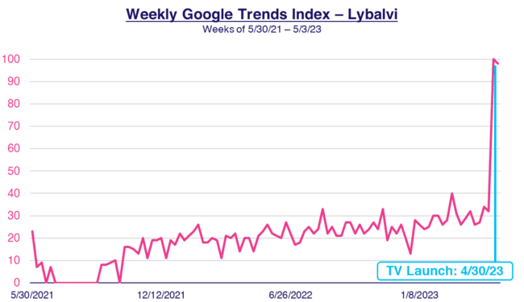
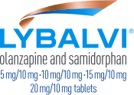
Lybalvi: This treatment for bipolar disorder saw its branded online search triple once their first TV campaign launched, 23 months after approval
3x
TV launch vs. prior week
23 months between FDA approval and TV launch
This Chart Plots:
The level of relative weekly Google search activity (for Lybalvi) prior to its high point in search activity (the spike at the end of TV launch week)
Level of Lybalvi search activity at the end of TV launch week
(100 index)
Level of Lybalvi search activity just before 4/30 TV campaign launch began
(32 index)
Source: VAB analysis of Google Trends, United States only, branded web search. Time period for each brand is based on their FDA approval date through TV campaign launch. Google Search Index represents search interest relative to the highest point on the chart for the given region and time period, a value of 100 is the peak popularity for the term, a value of 50 means that the term is half as popular. VAB analysis of Nielsen Ad Intel, TV spend includes national cable TV, broadcast TV, Spanish language cable TV, Spanish language broadcast TV, January 2021 – June 2024 (calendar months); Note: Light blue line marks the first day of TV spending.
This information is exclusively provided to VAB members and qualified marketers.
PAGE 30

Slide 31
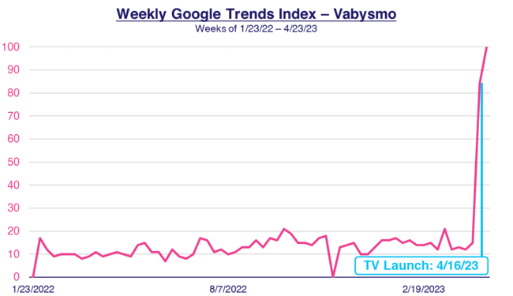
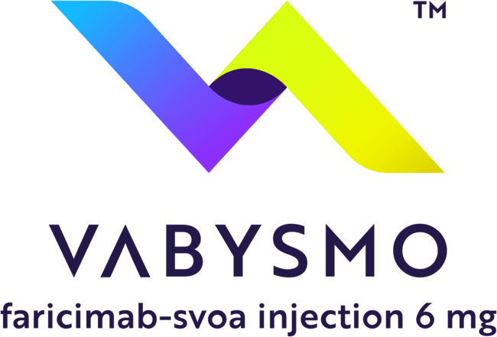


Vabysmo: This treatment for eye conditions saw more than a five-fold lift in branded search once TV launched, which continued through the campaign
5.6x
TV launch vs. prior week
This Chart Plots:
The level of relative weekly Google search activity (for Vabysmo) prior to its high point in search activity (the spike at the end of TV launch week)
14 months between FDA approval and TV launch
Level of Vabysmo search activity at the end of TV launch week
(84 index)
Level of Vabysmo search activity just before 4/16 TV campaign launch began
(15 index)
Source: VAB analysis of Google Trends, United States only, branded web search. Time period for each brand is based on their FDA approval date through TV campaign launch. Google Search Index represents search interest relative to the highest point on the chart for the given region and time period, a value of 100 is the peak popularity for the term, a value of 50 means that the term is half as popular. VAB analysis of Nielsen Ad Intel, TV spend includes national cable TV, broadcast TV, Spanish language cable TV, Spanish language broadcast TV, January 2021 – June 2024 (calendar months); Note: Light blue line marks the first day of TV spending.
This information is exclusively provided to VAB members and qualified marketers.
PAGE 31

Slide 32
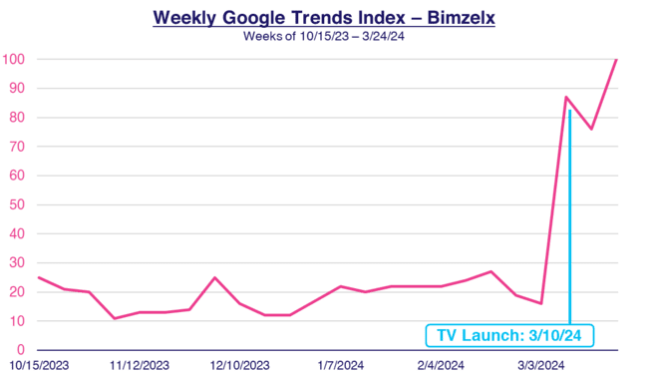
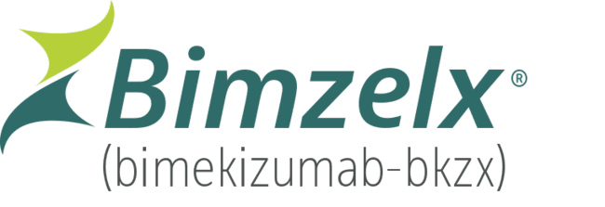
Bimzelx: This treatment for plaque psoriasis launched TV quicker and saw a five-fold lift in branded search, which continued through the campaign
5.4x
TV launch vs. prior week
This Chart Plots:
The level of relative weekly Google search activity (for Bimzelx) prior to its high point in search activity (the spike at the end of TV launch week)
4 months between FDA approval and TV launch
Level of Bimzelx search activity at the end of TV launch week
(87 index)
Level of Bimzelx search activity just before 3/10 TV campaign launch began
(16 index)
Source: VAB analysis of Google Trends, United States only, branded web search. Time period for each brand is based on their FDA approval date through TV campaign launch. Google Search Index represents search interest relative to the highest point on the chart for the given region and time period, a value of 100 is the peak popularity for the term, a value of 50 means that the term is half as popular. VAB analysis of Nielsen Ad Intel, TV spend includes national cable TV, broadcast TV, Spanish language cable TV, Spanish language broadcast TV, January 2021 – June 2024 (calendar months); Note: Light blue line marks the first day of TV spending.
This information is exclusively provided to VAB members and qualified marketers.
PAGE 32

Slide 33
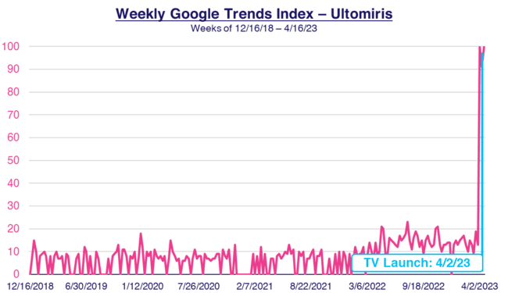
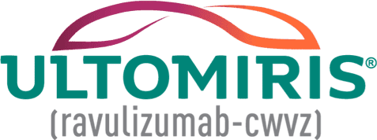
Ultomiris: This treatment for autoimmune conditions saw a similar spike in branded search even after launching TV 51 months after FDA approval
5.3x
TV launch vs. prior week
51 months between FDA approval and TV launch
This Chart Plots:
The level of relative weekly Google search activity (for Ultomiris) prior to its high point in search activity (the spike at the end of TV launch week)
Level of Ultomiris search activity at the end of TV launch week
(100 index)
Level of Ultomiris search activity just before 4/2/23 TV campaign launch began
(19 index)
Source: VAB analysis of Google Trends, United States only, branded web search. Time period for each brand is based on their FDA approval date through TV campaign launch. Google Search Index represents search interest relative to the highest point on the chart for the given region and time period, a value of 100 is the peak popularity for the term, a value of 50 means that the term is half as popular. VAB analysis of Nielsen Ad Intel, TV spend includes national cable TV, broadcast TV, Spanish language cable TV, Spanish language broadcast TV, January 2021 – June 2024 (calendar months); Note: Light blue line marks the first day of TV spending.
This information is exclusively provided to VAB members and qualified marketers.
PAGE 33

Slide 34
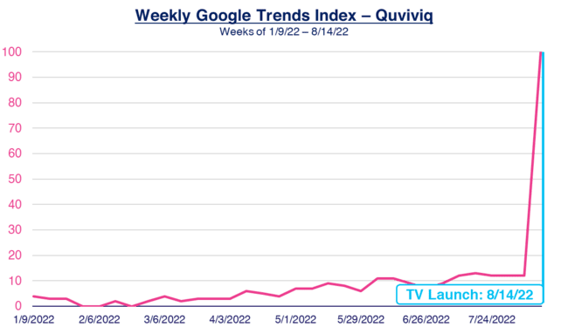
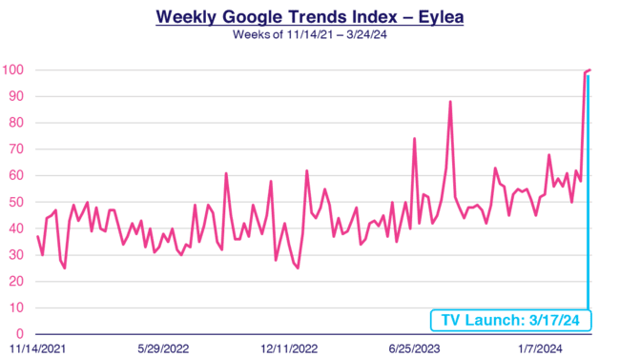
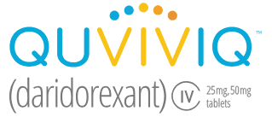
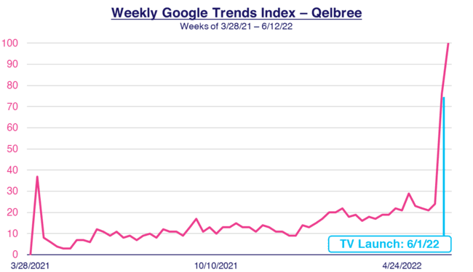
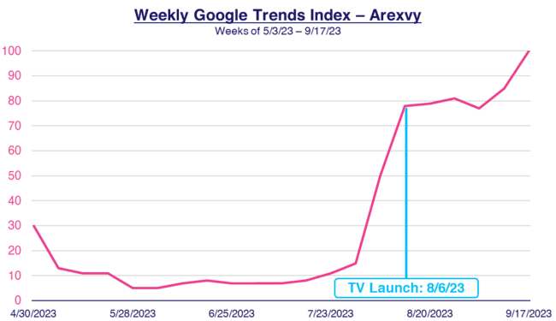
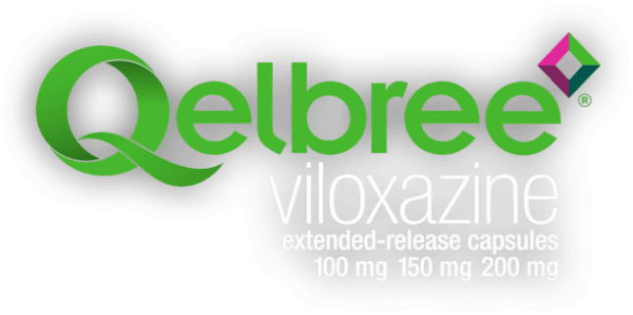
The ‘immediate spike’ effect of first-time TV campaigns on branded online search was mostly consistent across our full analysis of 58 pharma brands
First Time Pharma TV Advertisers - Weekly Google Trends Index
FDA Approval Date through TV Campaign Launch
7 months between FDA approval and TV launch
27 months between FDA approval and TV launch
14 months between FDA approval and TV launch
3 months between FDA approval and TV launch
Source: VAB analysis of Google Trends, United States only, branded web search. Time period for each brand is based on their FDA approval date through TV campaign launch. Google Search Index represents search interest relative to the highest point on the chart for the given region and time period, a value of 100 is the peak popularity for the term, a value of 50 means that the term is half as popular. VAB analysis of Nielsen Ad Intel, TV spend includes national cable TV, broadcast TV, Spanish language cable TV, Spanish language broadcast TV, January 2021 – June 2024 (calendar months); Note: Light blue line marks the first day of TV spending for each brand.
This information is exclusively provided to VAB members and qualified marketers.
PAGE 34

Slide 35


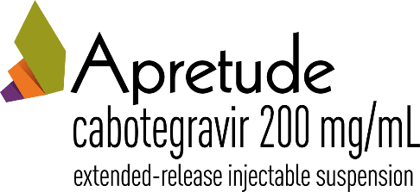

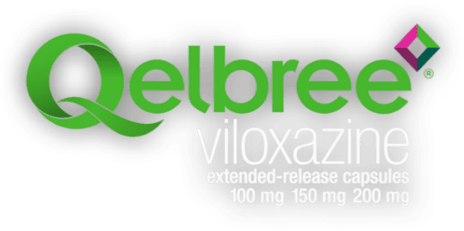
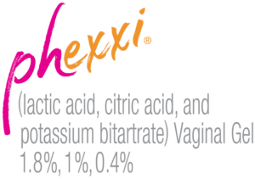

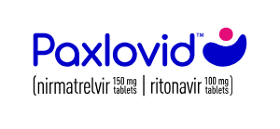
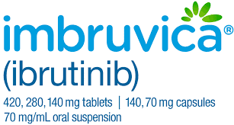
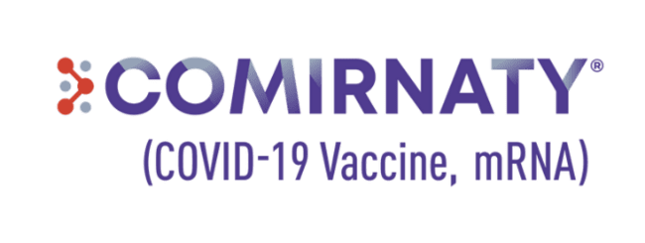
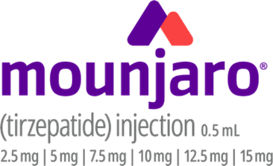
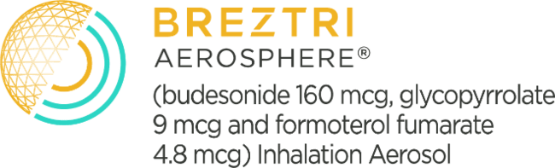
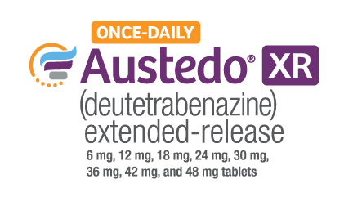
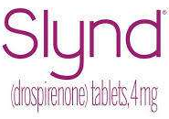
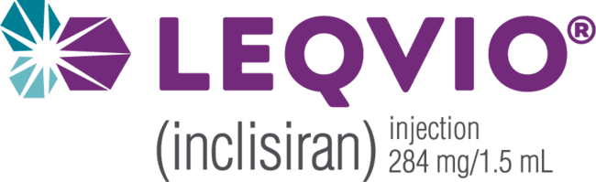


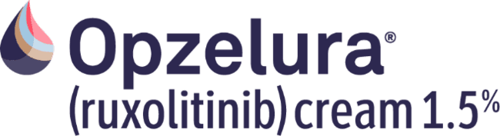
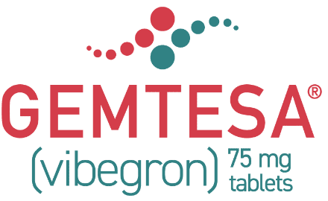
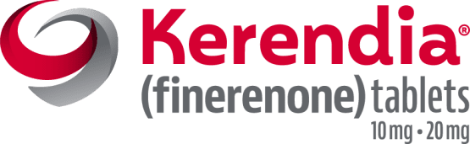

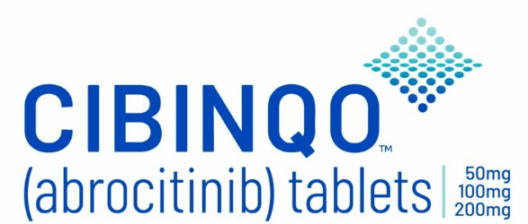

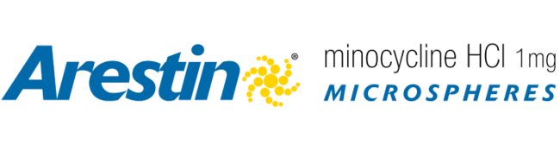
The impact of TV is evident as most new pharma TV advertisers saw their highest branded search volume occur once their first campaign launched
Sampling of the 58 Pharmaceutical Brands Analyzed*
85%
of 58 first-time pharmaceutical
TV advertisers saw their
highest brand search volume
once their TV campaign launched
Source: VAB analysis of Google Trends, United States only, branded web search. Google Search Index represents search interest relative to the highest point on the chart for the given region and time period. Note: Time period for each brand is their FDA approval date through 1/31/25. VAB analysis of Nielsen Ad Intel, TV activity based on reported spending across national cable TV, broadcast TV, Spanish language cable TV, Spanish language broadcast TV, January 2021 – June 2024 (calendar months). Analysis reflects 49 out of 58 brands with the highest brand search volume after they launched in TV. *See appendix (page 50) for a list of all 58 brands analyzed.
This information is exclusively provided to VAB members and qualified marketers.
PAGE 35

Slide 36
Then we looked at how increasing TV spend encourages more ailment sufferers to visit pharmaceutical parent company websites for more information…
This information is exclusively provided to VAB members and qualified marketers.
PAGE 36

Slide 37



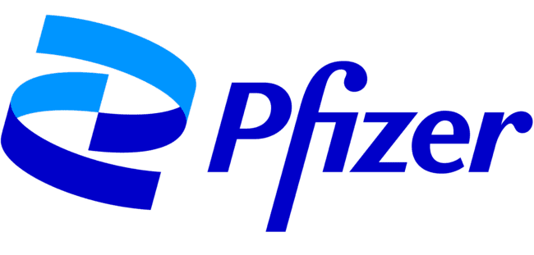

Increased TV investment by major pharma companies drove more website traffic from people interested in doing further research on remedies
Pharmaceutical Parent Company: Average Monthly TV Spend vs. Website Traffic Analysis
Four-Year Period: January 2021 – December 2024
24-month vs. 24-month comparison
Avg. Monthly TV Spend (MM):
Jan ‘21 - Dec ‘22:
$19.3
$15.1
$28.3
$36.9
$8.6
Jan ‘23 - Dec ‘24:
$28.4
$17.3
$36.5
$39.0
$14.8
% Difference:
+47%
+14%
+29%
+6%
+71%
Avg. Monthly Unique Visitors (000):
Jan ‘21 - Dec ‘22:
58
149
57
529
52
Jan ‘23 - Dec ‘24:
95
509
94
632
207
% Difference:
+65%
+242%
+66%
+19%
+295%
Source: VAB analysis of Comscore mediametrix multiplatform media trend data, P18+. January 2021 – December 2024 (calendar months), figures are based on monthly averages. VAB analysis of Nielsen Ad Intel, January 2021 – December 2024 (calendar months). TV media includes cable TV, network TV, Spanish Language Cable TV, Spanish Language Network TV, Spot TV, Syndication TV; excludes promos and PSAs.
This information is exclusively provided to VAB members and qualified marketers.
PAGE 37

Slide 38
5
‘Advanced TV’ Enables Greater Precision
Audience-based TV buying and addressable TV solutions deliver precise targeting and outcomes throughout
a patient’s path to treatment

Slide 39
Most top ailments have a limited number of potential patients, therefore precision targeting plays an important role in pharma brands’ media mix
Top 15 Ailments* That Adults Currently Have / Had in the last 12 months
% of Adults 18+
in millions
Source: VAB analysis of MRI-Simmons, Spring USA Doublebase Study 2024, P18+. Arthritis represents ‘any,’ Diabetes represents ‘any.’
This information is exclusively provided to VAB members and qualified marketers.
PAGE 39

Slide 40



Brands, especially those with finite targets, are utilizing audience-based TV buying to achieve the top priorities for their video ad campaigns
Most Important Priorities for Video Campaigns
% of respondents that ranked each between #1-3 in priority
Audience-Based TV Buying (ABB)
refers to the practice of segmenting viewers beyond traditional demographics to target a group of consumers based on behavioral, attitudinal, lifestyle and/or transactional data
Reaching
the Right Audience
Driving
Cost Efficiencies
Maximizing ‘Attention’
Among Target Audience
61%
43%
40%
Source: VAB / Spectrum Reach / Advertiser Perceptions ‘Audience-Based Buying Survey,’ February 2023 (n=210). Survey base: Advertising decision-makers who are involved in buying or planning digital video, cable / broadcast TV, or advanced TV. Q15. Please rank the 3 most important priorities for your [companies/main client’s] video campaigns (Rank 1-3; 1 = most important). Base = Total Respondents. To learn more, download VAB’s ‘Unlocking Brand Growth with Audience-Based Buying.’
This information is exclusively provided to VAB members and qualified marketers.
PAGE 40

Slide 41
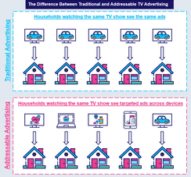
Within ABB, Addressable TV enables brands to show their ads to only
the targeted households that are watching a specific network and program
Addressable TV
Video advertising solution where a single message from an advertiser is precisely matched to an advertiser-defined audience segment. This enables different commercials to be targeted to different households on the same TV network at the same time when the viewer is watching.
Addressable TV uses authenticated data and advanced technology to facilitate the targeting of relevant messages to qualified audience segments
in adherence to business and consumer privacy compliance requirements.
To learn more, download VAB’s “What is Addressable TV?’
This information is exclusively provided to VAB members and qualified marketers.
PAGE 41

Slide 42
‘Audience-based TV buying’ target customization capabilities enables pharma brands to more precisely reach relevant patients and practitioners
Select examples of custom targets developed for audience-based TV campaigns
=consumer / patient target
=healthcare professional target
People diagnosed with a specific condition
Patients who had no prior use of the Rx brand
Clinically-relevant patient audiences for the brand
Highly qualified healthcare professionals (HCP)
HHs exposed to competing brands’ TV ads in previous months
OTC
treaters
Hard-to-reach healthcare professionals treating neurological movement disorders
Competitive Rx
remedy users
People with relevant symptoms
High-level job title / industry in healthcare, finance, government
HHI $100K+
Custom targeted DTC
patient-modeled audiences by buying platforms
This information is exclusively provided to VAB members and qualified marketers.
PAGE 42

Slide 43






‘Audience-based TV buying’ produces outcomes throughout a patient’s path to treatment, especially among remedy and relief actions
Select examples of outcomes achieved through audience-based TV campaigns
Greater Audience Quality
Higher On-Target Reach
HCP Visits
Increase in patient-driven diagnostic screening
Prescription Lifts
‘New to Brand’ Starts
This information is exclusively provided to VAB members and qualified marketers.
PAGE 43

Slide 44
Multiscreen TV encourages ailment sufferers to educate themselves for better health
Almost eight out of 10 adults suffer from some sort of medical condition, with three-quarters of these sufferers using at least one prescription remedy for treatments
Most adults conduct their own research and consult their doctor when it comes to their physical and mental well-being; and they find that prescription remedies are most effective
at improving their quality of life
Although many more dollars are spent in digital, TV ads are
the primary driver of brand discovery for patients by far and are also more likely to encourage ailment sufferers to conduct further research and consult their doctor for more information
More specifically, TV ads drive mid-funnel results within a patient’s path to treatment as 85% of new TV advertisers saw their highest branded search volume occur once they launched their first campaign
Advanced TV solutions like audience-based buying and addressability create greater precision and outcomes throughout a patient’s path to treatment
Key Marketer Takeaways
This information is exclusively provided to VAB members and qualified marketers.
PAGE 44

Slide 45






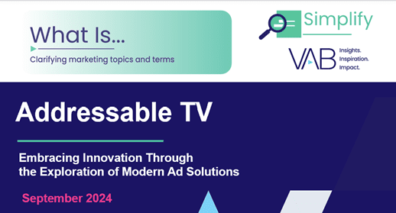


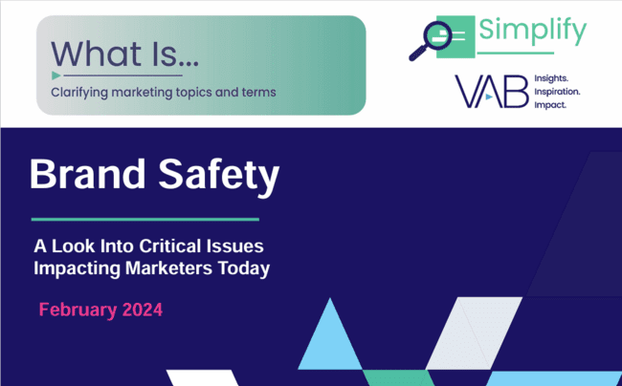
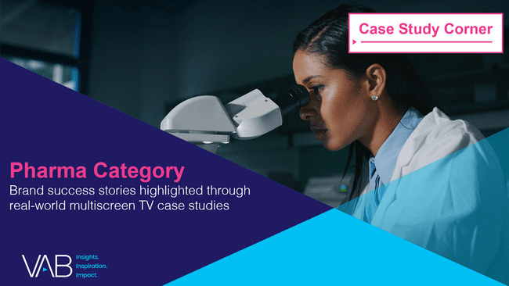

Discover more: Looking for more data, insights and takeaways?
Check out this related content
The Power of Premium Video
What It Means for Multiscreen TV
and Why It Matters to Marketers
Best in Show
Five Advantages of Multiscreen TV,
From Brand to Performance
Breaking Through
How New Advertisers Are Using TV To Ignite Interest & Turn Consumers Into Customers
A Commanding Presence
How Ad Continuity in Multiscreen TV Drives Incremental Growth for Brands
Disconnect to Reconnect
How Real-Life Shared Experiences Are the Antidote for Social Media Isolation Among Gen Z
What is Addressable TV?
Embracing Innovation Through
the Exploration of Modern Ad Solutions
Unlocking Brand Growth with Audience-Based Buying
A Fresh Look at How Marketers
Are Adopting Innovative TV Strategies
Reaching the Right Audiences
Why Brands and Agencies
are Increasing Their Adoption
of Audience-Based TV Buying
What is Brand Safety?
A Look Into Critical Issues Impacting Marketers Today
Pharma Category
Brand Success Stories Highlighted Through Real-World Multiscreen TV
Case Studies
This information is exclusively provided to VAB members and qualified marketers.
PAGE 45

Slide 46


About VAB
VAB plays a dual role in the video advertising industry. We are leading the change to bring about a more innovative and transparent marketplace. We also provide the insights and thought leadership that enables marketers to develop business-driving marketing strategies.
Drawing on our marketing expertise, we simplify the complexities in our industry and discover new insights that transform the way marketers look at their media strategy.
We are committed to your business growth and proud to offer VAB members, brand marketers and agencies complimentary access to our continuously-growing Insights library. Get immediate access at theVAB.com.
This information is exclusively provided to VAB members and qualified marketers.
PAGE 46

Slide 47

Appendix: Universes of sufferers by ailment
Composition % = ailment sufferers as a percent of the Adult 18+ population
Source: MRI-Simmons, Spring USA Doublebase Studies: 2021, 2022, 2023 & 2024, Adults 18+.
This information is exclusively provided to VAB members and qualified marketers.
PAGE 47

Slide 48

Appendix: Universes of prescription remedy users by ailment
Composition % = % of ailment sufferers that have used a prescription remedy for treatment
Source: MRI-Simmons, Spring USA Doublebase Studies: 2021, 2022, 2023 & 2024, Adults 18+.
This information is exclusively provided to VAB members and qualified marketers.
PAGE 48

Slide 49
Appendix: Brands with the largest YoY TV spend increase include remedies for obesity, depression, Alzheimer’s, chronic skin and heart conditions
Prescription Remedy Brands: Largest YoY Increases in TV Investment
CY 2023 vs. 2024
(ranked by increase in 2024 TV spending)
Psoriasis /
Ulcerative Colitis
Depression / Alzheimer’s
Obesity
HCM
AMD
RSV
(+$346.8 MM)
(+2,154%)
(+$131.1 MM)
(+245%)
(+$122.3 MM)
(+81%)
(+$114.3 MM)
(N/A; $0 in 2023)
(+$104.1 MM)
(N/A; $0 in 2023)
(+$71.1 MM)
(+119%)
Crohn’s Disease / Psoriasis / Ulcerative Colitis
COPD
Menopause
Psoriasis
Bipolar Disorder
Tardive Dyskinesia
(+$62.6 MM)
(+88%)
(+$53.8 MM)
(+12%)
(+$46.7 MM)
(+97%)
(+$29.5 MM)
(+44%)
($25.2 MM)
(+34%)
(+$20.5 MM)
(+27%)
Source: VAB analysis of Nielsen Ad Intel data, calendar year 2024. TV media includes Cable TV, Network TV, Spanish Language Cable TV, Spanish Language Network TV, Spot TV, Syndication TV; excludes promos and PSAs. Pharma represents ‘Pharmaceutical Houses’ sub-group category. COPD = Chronic Obstructive Pulmonary Disease; AMD = Age-related macular degeneration; RSV = Respiratory syncytial virus; HCM = Hypertrophic cardiomyopathy. Based on brands with $95MM+ TV spending in 2024 and 10%+ increase vs. 2023.
This information is exclusively provided to VAB members and qualified marketers.
PAGE 49

Slide 50

Appendix: Full list of the 58 brands included in the pharma DTC brand new TV advertisers’ search analysis
Source: VAB analysis of Nielsen Ad Intel data, calendar year 2021 - June 2024. TV media includes cable TV, network TV, Spanish Language Cable TV, Spanish Language Network TV, Spot TV, Syndication TV; excludes promos and PSAs. Pharma represents brands within ‘Pharmaceutical Houses’ sub-group category.
This information is exclusively provided to VAB members and qualified marketers.
PAGE 50

Slide 51
Appendix: The conditions with the highest ‘non-usage’ of any remedy or treatment includes obesity, Covid, anxiety, backache and depression
% of Ailment Sufferers That Haven’t Used Any Remedy or Treatment in the last 12 months
Adults 18+
in millions
%
of A18+ sufferers
54%
65%
21%
21%
10%
37%
19%
45%
72%
17%
37%
38%
20%
8%
18%
%
of A18+ pop
7%
5%
3%
3%
3%
3%
2%
2%
2%
2%
2%
2%
2%
1%
1%
Source: VAB analysis of MRI-Simmons, Spring USA Doublebase Study 2024, Adults 18+.
This information is exclusively provided to VAB members and qualified marketers.
PAGE 51

Slide 52

Appendix: Universes of sufferers by ailment who have not used any remedy or treatment
Composition % = % of ailment sufferers that have not used any remedy or treatment
Source: MRI-Simmons, Spring USA Doublebase Studies: 2021, 2022, 2023 & 2024, Adults 18+.
This information is exclusively provided to VAB members and qualified marketers.
PAGE 52

