Slide 1



2025 – 4th Quarter

Slide 2








In Q4 2025, VAB released insights covering holiday behaviors, FAST services, outcomes-based case studies, cinema fandom and more
Holidays with Heart
How Marketers Can Authentically Connect with Hispanic Shoppers
Free For All
Understanding The Growth of FAST Through Three Key Questions
What TV investment strategies are digital native brands implementing for the holiday season?
TV Means Business
How Premium Video Drives Sales in the Pharmaceutical Category
Welcome to TV
Meet the New Advertisers Who Are Creating Consumer Curiosity and Brand Consideration
Direct Momentum
10 Case Studies on How Multiscreen TV Drives Mid-Funnel Outcomes for DTC Brands
Fandom in Focus
How Cinema Will Captivate Passionate Audiences in 2026
4Q Currency Chasm
Instability & Unpredictability
Decimate the Demos
Keep reading to check out our top 10 ‘must read’ charts of the quarter…
This information is exclusively provided to VAB members and qualified marketers
PAGE 2

Slide 3






FAST Channel Usage: Viewers are exploring more broadly, watching an average of nine channels across a mix of genres
Click here for the full report
Breakdown of FAST Consumption by Channel Type
% of respondents who use Free AVOD / FAST to watch live TV channels
9
average number of
FAST channels watched
(vs. 5 in 2024)
Genre channels that air shows fitting a theme, like crime, reality, westerns, etc.
Binge channels that air the same show all day*
News channels
Source: TiVo, Video Trends Report Q2 2025. *e.g., Star Trek, Baywatch, Hell's Kitchen, etc.
This information is exclusively provided to VAB members and qualified marketers
PAGE 3

Slide 4
More Fresh Content to Stream: FAST services offer a higher share of the most recent titles available than SVOD platforms
Click here for the full report
Share of Available Video Content by Production Years
SVOD vs. FAST
Source: Gracenote as cited in a company blog, March 31, 2025. Note: includes TV shows and movies; SVOD includes Amazon Prime Video, Netflix, Disney+ / Hulu, Paramount+, and Apple TV+; numbers do not add up to 100% due to rounding read as 13.9% of all content available on FAST services was produced before 1990.
This information is exclusively provided to VAB members and qualified marketers
PAGE 4

Slide 5














Cinema Fandom: Passionate audiences drive outsized success, vastly overperforming experts’ box office revenue projections
Click here for the full report
Domestic Box Office Projections vs. Opening Weekend Box Office
$ in MM
+149%
+28%
+27%
+16%
+60%
+69%
Source: Projections based on VAB analysis of Screendollars, Wednesday Report Forecast, 1/15/25, 1/29/25, 4/2/25, 5/14/25, 8/6/25 & 9/10/25. Chart projections reflect a median of projection range (A Minecraft Movie’s 4/2 projection was $65MM to $70MM, with a median of $60MM). Opening Weekend Revenue based on finalized opening weekend box office per boxofficemojo.com, as of 11/21/25.
This information is exclusively provided to VAB members and qualified marketers
PAGE 5

Slide 6


Hispanic Consumers: Spending is amplified during the holiday season, creating opportunities for culturally resonant marketing
Click here for the full report
% of those who plan to do the following this holiday season*
$2,218
estimated average amount Hispanic consumers
spent on holiday expenses in 2024
Source: BMO Survey, U.S. Latinos plan to spend more on the holidays this year, November 2024. *CivicScience, 5 Key Holiday Insights Among Hispanic Americans, December 2024.
This information is exclusively provided to VAB members and qualified marketers
PAGE 6

Slide 7


Marketer Holiday Investment: 60% of TV advertisers are poised to boost Black Friday / Cyber Monday ad budgets this year
Click here for the full report
Compared to 2024, how will your Black Friday / Cyber Monday TV ad budget change this year?
Source: Tatari custom research, survey conducted over a 1-week period from August 14 – 21, 2025. 65 responses from Tatari clients across industries including Calm, Ariat, Vuori, Saatva, Nutrafol, Fabeletics, Breeo and more.
This information is exclusively provided to VAB members and qualified marketers
PAGE 7

Slide 8



New TV Advertisers: Initial investments range from launches by SMBs to immediate ‘big bets’ by larger brands
Click here for the full report
1H ’25 New National TV Advertisers by Spend Segment
% of brands within spend buckets
64% of brands invested $500K or less
Source: VAB analysis of Nielsen Ad Intel data as of 9/4/25, 1/1/25-6/30/25. TV spend includes national cable TV, broadcast TV, Spanish language cable TV, Spanish language broadcast TV, streaming TV. Brands reflect those with national TV spend over $50K.
This information is exclusively provided to VAB members and qualified marketers
PAGE 8

Slide 9

TV Drives Search: Royal Kingdom saw an immediate lift in branded online search once they launched a TV campaign
Click here for the full report
Royal Kingdom: Weekly Google Search Trends Index
Six Months Pre-TV Campaign vs. TV Campaign Launch
(Weeks of 11/10/24 – 4/27/25)
3x
vs. pre- TV launch
w/o 4/27
(100 index)
w/o 4/20
(94 index)
TV Launch Week
(59 index)
Week Before TV Launch
(33 index)
TV Campaign
TV Launch: 4/15/25
Source: VAB analysis of Google Trends, United States only, All Categories, Web Search, weeks of 11/10/24 – 4/27/25. Google Search Index represents search interest relative to the highest point on the chart for the given region and time period, a value of 100 is the peak popularity for the term, a value of 50 means that the term is half as popular. VAB analysis of Nielsen Ad Intel, TV launch month is based on the first activity reported across national cable TV, broadcast TV, Spanish language cable TV, Spanish language broadcast TV, January 2025 – June 2025 (calendar months). Royal Kingdom was launched in the U.S. on November 21, 2024. Note: Light blue line marks the first day of TV spending for each brand.
This information is exclusively provided to VAB members and qualified marketers
PAGE 9

Slide 10

TV Drives Website Traffic: After launching on TV, Factor saw double-digit traffic lifts ‘when on’ throughout 2024 and beyond
Click here for the full report
Click the report cover above to see nine other case studies across six strategies
Brand Website Traffic Analysis: Unique Website Visitors
Monthly Website Unique Visitors (000) Comparison
Time Period Analysis: Jan ’23 – Aug ‘25
A meal delivery service offering prepared, ready-to-eat meals (also known as Factor75)
+59%
+32%
+1.8MM monthly uniques
+973K monthly uniques
vs. six-month average prior to TV launch
vs. six-month average prior to TV launch
(monthly average)
(TV launch – August 2025)
Source: VAB analysis of Comscore mediametrix multiplatform media trend data, P18+. January 2023 – August 2025 (calendar months). VAB analysis of Nielsen Ad Intel, TV launch month is based on the first activity reported across national cable TV, national broadcast TV, Spanish language broadcast TV, Spanish language cable TV, spot TV, syndication TV, streaming TV. Spend is based on reported national cable TV, national broadcast TV, Spanish language broadcast TV, Spanish language cable TV, spot TV, syndication TV, streaming TV spend. ‘When on TV’ represents the monthly average for brands in months where they spent in TV as measured through Nielsen Ad Intel between January 2023 – August 2025 (10 months ‘when on TV’). $31.4MM spend reflects TV investment between July 2023 – August 2025. Factor brand launched in 2013.
This information is exclusively provided to VAB members and qualified marketers
PAGE 10

Slide 11




















TV Drives Sales: Continued investment in premium video has more than doubled the collective sales of 17 pharma brands
Click here for the full report
17 Pharmaceutical DTC Brands:
Annual U.S. Sales Revenue vs. TV Spend
‘24 vs ‘21
% Change
3-Year
CAGR*
2021
2022
2023
2024
U.S. Revenue
($ in B)
+131%
+32%
$37.6
$51.5
$70.2
$86.8
U.S. TV Spend
($ in B)
+106%
+27%
$1.6
$1.7
$2.4
$3.3
17 Pharmaceutical Brands Analyzed
Sources: Revenues are based on company filings (10-K) via SEC.gov (EDGAR). TV spend based on VAB analysis of Nielsen Ad Intel data (national cable TV, national broadcast TV, Spanish language broadcast TV, Spanish language cable TV, spot TV, syndication TV), Calendar years of 2021-2024. U.S. revenues for Ozempic & Wegovy were reported in Danish Krone, Dupixent & Arexvy were reported in Euros. *CAGR = compound annual growth rate (i.e., mean annual growth across the time period).
This information is exclusively provided to VAB members and qualified marketers
PAGE 11

Slide 12
Measurement Unpredictability: Over 20% audience variances are routinely seen among key buying demos on BD+P vs. PO
Click here for the full report
Differences in Average Audience (AA) by % of Hours
Big Data + Panel (BD+P) vs. Panel Only (PO)
4-week period (w/o 9/15 – w/o 10/6)
33 Network Total
+/- 20% AA Difference | HH | P2+ | P18-34 | P18-49 | P25-54 | P55+
% of Hours More Than +20% diff: | 12% | 15% | 31% | 24% | 19% | 20%
% of Hours More Than -20% diff: | 7% | 9% | 27% | 27% | 27% | 8%
+/- 20% Diff Total (% of Hours): | 18% | 24% | 58% | 51% | 45% | 28%
How to read: BD+P average audience was more than 20% higher than PO average audience on Households for 12% of the total measured hours in the 4-week period and more than 20% lower on P18-34 for 27% of total measured hours across the 33 networks.
Source: VAB analysis of Nielsen NPower Ratings Analysis Time Period Report data (as of 10/28/25). Live. 4-week period (672 total measured hours): w/o 9/15 – w/o 10/6 (9/15/25 – 10/12/25). Total Day (6a – 6a). Average Audience % Diff: Updated Big Data + Panel (BD+P) vs. National Panel (PO). Not all networks are measured across all 672 hours within a four-week period (see appendix for more detail), so the percentages in the above chart are based on only the measured hours across each of the 33 networks. Note: only hours with a reported audience for both BD+P & PO are included in the percentages by demo.
This information is exclusively provided to VAB members and qualified marketers
PAGE 12

Slide 13
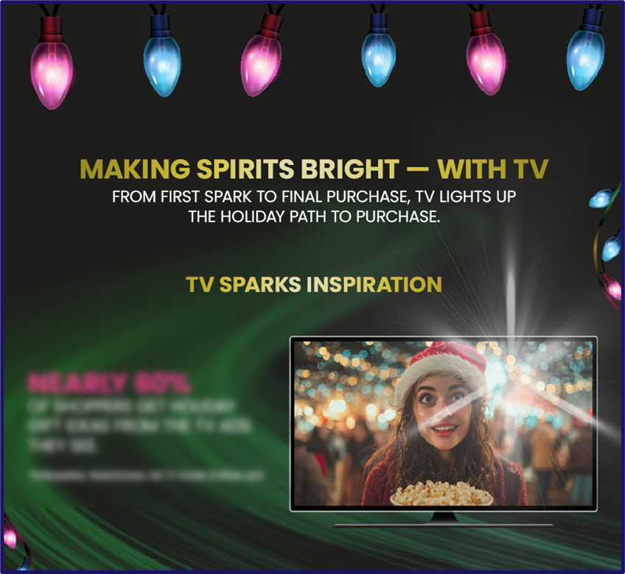
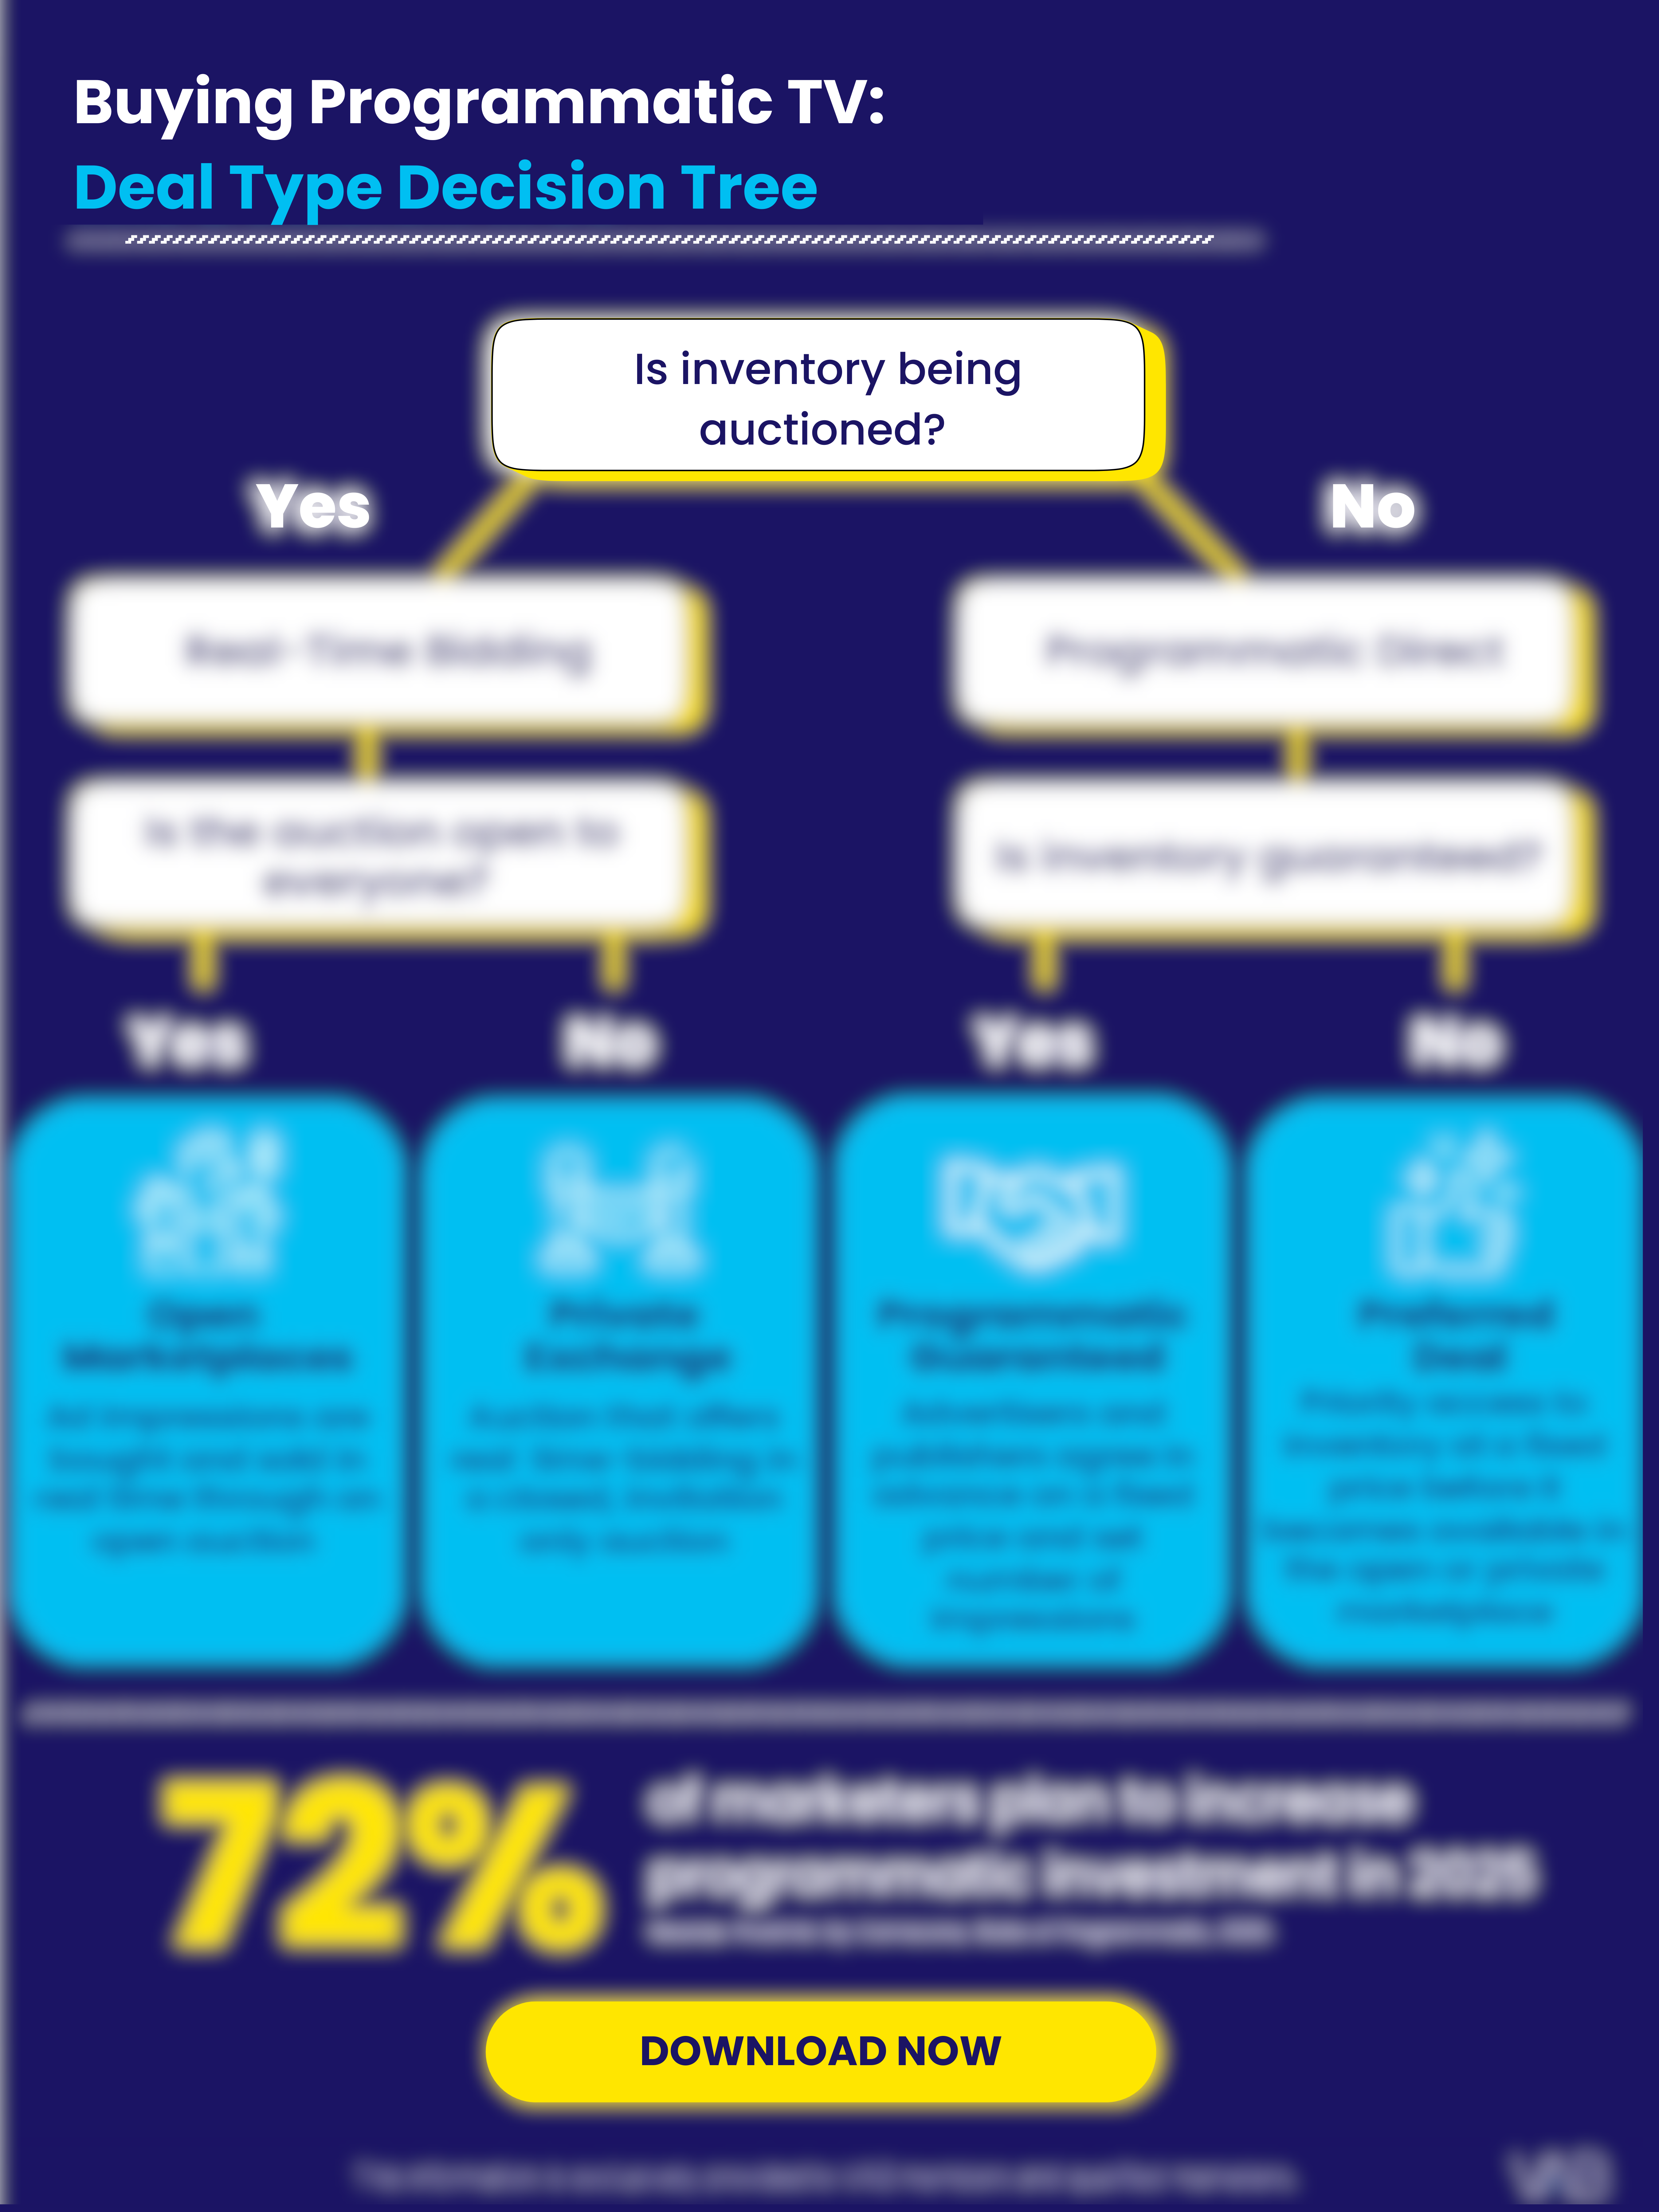
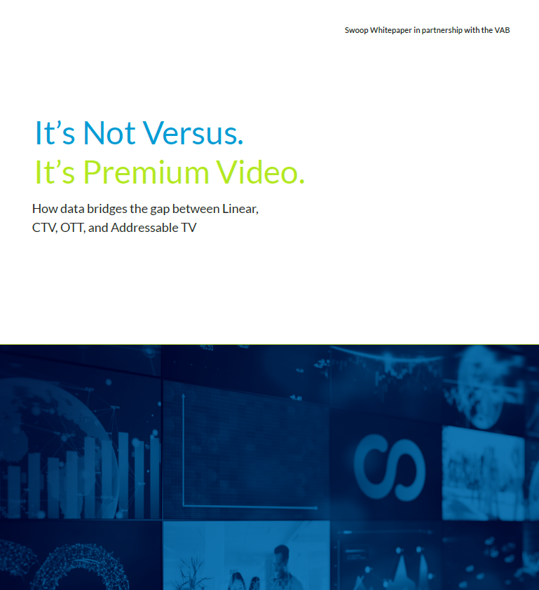
Inspiration & Intelligence: See how TV drives holiday decisions and how marketers can tap into modern TV data & buying practices. Download Now!
Bonus Slide!
Click to download the full infographic, featuring insights from LG Ad Solutions, and learn why TV lights up the holiday path to purchase
Click to download the full infographic which simplifies the Programmatic TV buying process
Click to download VAB’s whitepaper,
co-branded with Swoop, to learn why TV is a unique channel for pharma marketers
This information is exclusively provided to VAB members and qualified marketers
PAGE 13

Slide 14

Jason Wiese
Benjamin Vandegrift
EVP, Strategic Insights & Measurement
jasonw@thevab.com
SVP, Measurement Strategy & Innovation benjaminv@thevab.com
Q4 2025 Insights & Measurement Content Releases
Leah Montner-Dixon
Reed Kiely
VP, Audience & Behavioral Insights
leahm@thevab.com
VP, Data Insights & Trends
reedk@thevab.com
Karolina Guillen
Associate Director, Insights, Strategy & Analytics karolinag@thevab.com
Discover more
Looking for more data, insights and takeaways? Check out this related VAB content
VAB Members, brand marketers and agencies get free and immediate access to VAB’s content library. Get access at theVAB.com
This information is exclusively provided to VAB members and qualified marketers
PAGE 14

Slide 15


About VAB
VAB plays a dual role in the video advertising industry. We are leading the change to bring about a more innovative and transparent marketplace. We also provide the insights and thought leadership that enables marketers to develop business-driving marketing strategies.
Drawing on our marketing expertise, we simplify the complexities in our industry and discover new insights that transform the way marketers look at their media strategy.
We are committed to your business growth and proud to offer VAB members, brand marketers and agencies complimentary access to our continuously-growing Insights library. Get immediate access at theVAB.com.
This information is exclusively provided to VAB members and qualified marketers
PAGE 15

