Slide 1



2025 – 3rd Quarter

Slide 2

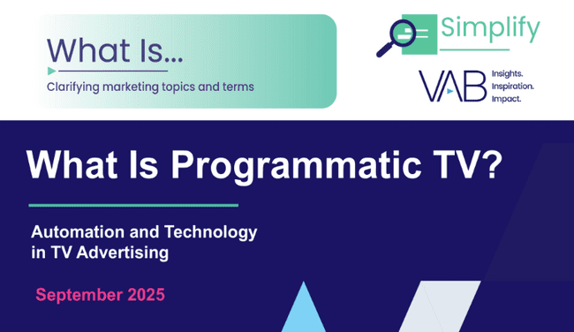
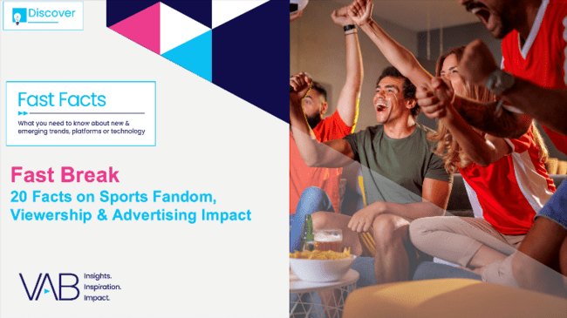

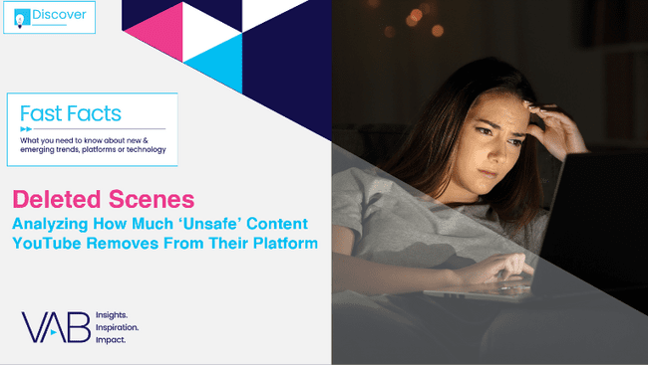

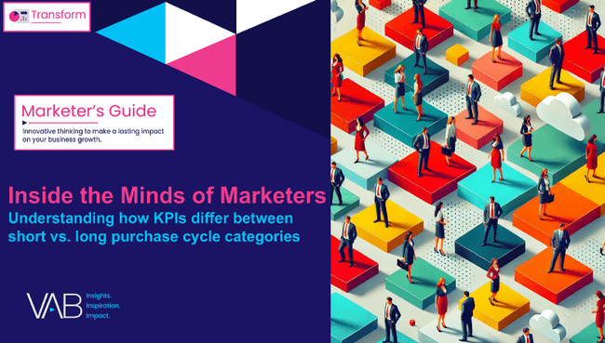
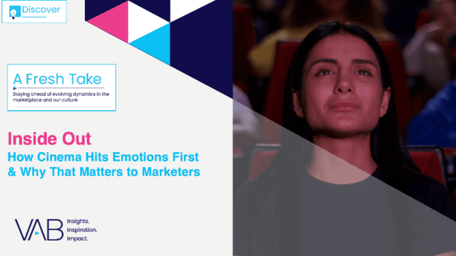
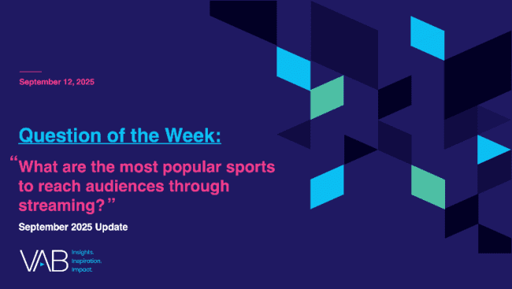
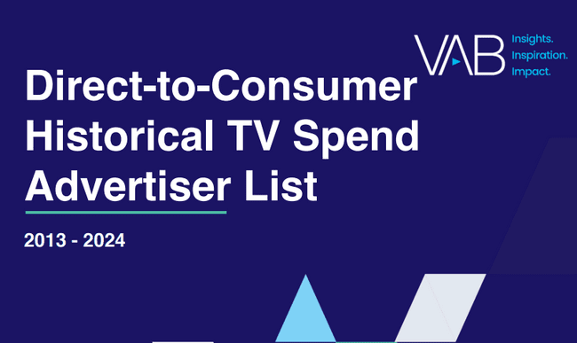
In Q3 2025, VAB released insights covering holiday shopping, sports, programmatic TV, brand marketer strategies, cinema and much more
Unwrapping the Holidays
5 Ways Multiscreen TV Brings
Festive Cheer to Retailers
What Is Programmatic TV?
Automation and Technology
in TV Advertising
Fast Break
20 Facts on Sports Fandom, Viewership & Advertising Impact
Performance Starts With Brand
How marketers are looking to balance short-term sales with long-term growth
Deleted Scenes
Analyzing How Much ‘Unsafe’ Content YouTube Removes From Their Platform
Why banning Pharma TV ads would disproportionately affect minority groups
Inside the Minds of Marketers
Understanding how KPIs differ between short vs. long purchase cycle categories
Inside Out
How Cinema Hits Emotions First
& Why That Matters to Marketers
What are the most popular sports to reach audiences through streaming?
Direct-to-Consumer Historical TV Spend Advertiser List
2013-2024
Keep reading to check out our top 10 ‘must read’ charts of the quarter…
This information is exclusively provided to VAB members and qualified marketers
PAGE 2

Slide 3





Holiday Shopping: TV sparks inspiration and drives purchase intent, with nearly 60% of shoppers finding gift ideas from ads
Click here for the full report
Sources for Helpful / Useful Information About Possible Holiday Gifts
(streaming, traditional
or TV home screen ads)
36%
of CTV viewers get holiday gift inspiration from TV ads*
Source: LG Ad Solutions, Season’s Streaming, June 2025. Note: Aided choices. *Streaming & traditional TV ads.
This information is exclusively provided to VAB members and qualified marketers
PAGE 3

Slide 4
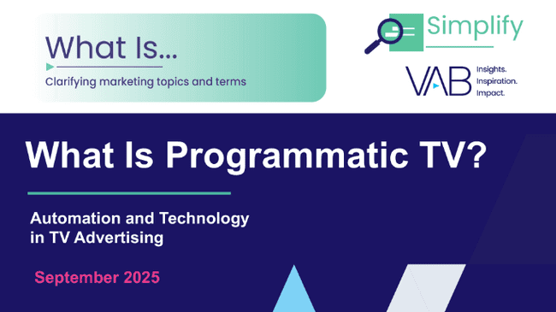

Programmatic TV Investment: Many advertisers are funding increased spending in programmatic CTV from new budgets
Click here for the full report
If you expect to increase investment in programmatic CTV in 2025, where is the budget coming from?
1in 5
of those increasing programmatic CTV budgets are able to garner a new budget
to support this growing media channel
Source: Proximic by Comscore, State of Programmatic, 2025.
This information is exclusively provided to VAB members and qualified marketers
PAGE 4

Slide 5
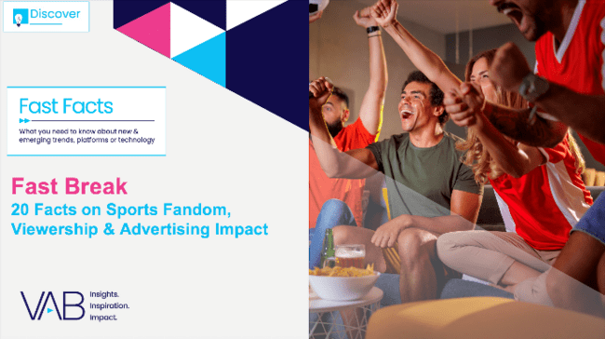







Passionate Fandom of Sports: Deep connections encourages obsessive emotion and creates high, habitual engagement
Click here for the full report
% of sports fans that…
Nearly 60%
say rituals (like wearing their lucky jersey) and superstitions play some role in their fandom
56%
watch some type of sporting event at
least once a week
51%
reported that their
favorite team or athlete’s performance affects their overall mood at least moderately
46%
say they show off their fandom by getting together with friends
and family
(Sports fans spend 3.2 hours watching sports content weekly on average)*
Source: PMG, State of Sports Report - Beyond the Game: Connecting with the Modern Sports Fan, May 2025. *Comcast Advertising, Behind the Remote: A Deep Dive into Sports Viewership & Fandom, October 2024. Base: Watched sports content (game, highlights, talk show, etc.) in the past six months.
This information is exclusively provided to VAB members and qualified marketers
PAGE 5

Slide 6



Defining Brand Success: Marketers view customer satisfaction, trust, loyalty and identity as top business drivers
Click here for the full report
Top 5 Factors That Contribute to the Success of a Brand
% of brand marketers
‘Small-Sized’ Businesses
‘Medium-Sized’ Businesses
‘Large-Sized’ Businesses
Source: VAB / Advertiser Perceptions ‘Marketer KPI Survey,’ February 2025, fielded January 27 – February 7, 2025 (n=200). Survey base: Brand marketers directly involved in influencing or executing video advertising. Q10. How does your brand contribute to your company's overall growth strategy? [Rank 1-5]. ‘Small-Sized’ Businesses: Less than $1MM in annual ad spend, ‘Medium-Sized’ Businesses: $1MM to less than $25MM in annual ad spend, ‘Large-Sized’ Businesses: $25MM or more in annual ad spend.
This information is exclusively provided to VAB members and qualified marketers
PAGE 6

Slide 7

Unsafe Content on YouTube: Over the last six years, the platform has had to remove nearly 179MM videos for violations
Click here for the full report
YouTube Videos Removed by Year
Based on a rough estimation,
YouTube potentially removed
837 years
worth of video content from
their platform in 2024*
Source: VAB analysis of Google Transparency Report, YouTube Community Guidelines enforcement, as of 7/8/25 & Analyzify.com, StatsUp – YouTube Statistics, as of 7/14/25. *Calculation based on the total number of videos removed from YouTube (35.4MM) and the average length of YouTube videos (12m26s).
This information is exclusively provided to VAB members and qualified marketers
PAGE 7

Slide 8



Education of Pharma Ads: Minority groups are more likely to
take an action after seeing an ad, like consulting a doctor
Click here for the full report
% Who Have Taken An Action After Seeing a Healthcare Ad
Adults 18+
Non-Hispanic White
32%
Hispanic
40%
Black
39%
Asian
35%
Source: VAB analysis of MRI-Simmons, Spring USA Doublebase Study 2024, Non-Hispanic White Adults 18+, Hispanic Adults 18+, Non-Hispanic Black Adults 18+, Non-Hispanic Asian Adults 18+. *Prescription remedy includes both branded and generic remedies. Note: ‘an action’ represents: Bought a non-prescription product, refilled a prescription, made an appointment to see a doctor, Discussed an ad with your doctor, discussed an ad with a friend or relative, asked your doctor for a specific vaccine, asked your doctor to prescribe a specific drug, consulted a pharmacist, visited health information website, visited a product or drug website, visited another website, requested a free sample, requested a specific test/procedure, called a toll-free number for information, or other.
This information is exclusively provided to VAB members and qualified marketers
PAGE 8

Slide 9



Top KPIs for Video Ad Campaigns: Short cycle products focus on sales while longer purchase cycles prioritize brand building
Click here for the full report
Top 5 KPIs Used to Measure Effectiveness of Video Ad Campaigns
% of brand marketer respondents
‘Short Purchase Cycle’ Products
‘Long Purchase Cycle’ Products
Source: VAB / Advertiser Perceptions ‘Marketer KPI Survey,’ February 2025, fielded January 27 – February 7, 2025 (n=200). Survey base: Brand marketers directly involved in influencing or executing video advertising. Q12. What are the main KPIs you currently use to measure the effectiveness of your company’s video advertising? Based on respondents selecting up to 3 choices. See slide 3 for definitions of ‘short purchase cycle’ products and ‘long purchase cycle’ products.’ *Perception, memorability, favorability, consideration, etc. Dotted line across chart denotes the top 3.
This information is exclusively provided to VAB members and qualified marketers
PAGE 9

Slide 10
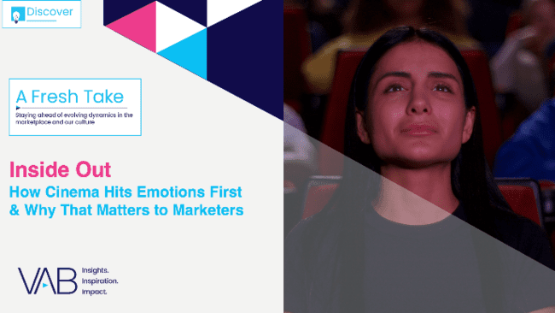

Impact of Cinema Ads: The movie theater environment evokes emotions which enables brands to connect with audiences
Click here for the full report
84%
of moviegoers agree that watching movies in a theater is an emotionally powerful experience
+20%
Increase in brand favorability after exposure to cinema ad*
Source: Screenvision and Alter Agents, Cinema’s Emotional Resonance, 2024. *Screenvision, Custom Research Study Norms 2024-2025.
This information is exclusively provided to VAB members and qualified marketers
PAGE 10

Slide 11


Top Sports Streamed: NFL, WNBA and NBA have the largest streaming audience growth among the top sports since 2023
Click here for the full report
Which of the following sports have you streamed live in the last 12 months?
% of sports streamers
Source: VAB analysis of MRI-Simmons Cord Evolution August 2023 (fielded June 15, 2023–July 7, 2023) & August 2025 (fielded June 17, 2025-July 2, 2025) studies, Base: has streamed live sports in the last 30 days
This information is exclusively provided to VAB members and qualified marketers
PAGE 11

Slide 12

DTC TV Spend: Discover the brands driving the largest DTC TV investment ever – now available to marketers & agencies!
Click here for the full report
Digital-Native, Direct-to-Consumer (DTC) Brands U.S. Total TV* Spend
$ in millions
+9%
vs. 2023
For the first time, the full DTC advertiser list (789 brands in total) is available to download for qualified marketers and agencies!
# of Brands:
41
63
90
113
143
181
259
332
428
424
411
435
Source: VAB analysis of Nielsen AdIntel as of 7/14/25 (*includes all six measured TV media: nat'l cable TV, nat'l broadcast TV, Spanish language broadcast TV, Spanish Language cable TV, spot TV, syndication TV; and streaming as of 2022-2024); excludes promos and PSAs.
Direct to Consumer – a company that sells their product or service online directly to end customers without involving third-party retailers, wholesalers or other parts of the traditional consumer supply chain. Number of DTC brands reflect active on U.S. TV each year.
This information is exclusively provided to VAB members and qualified marketers
PAGE 12

Slide 13
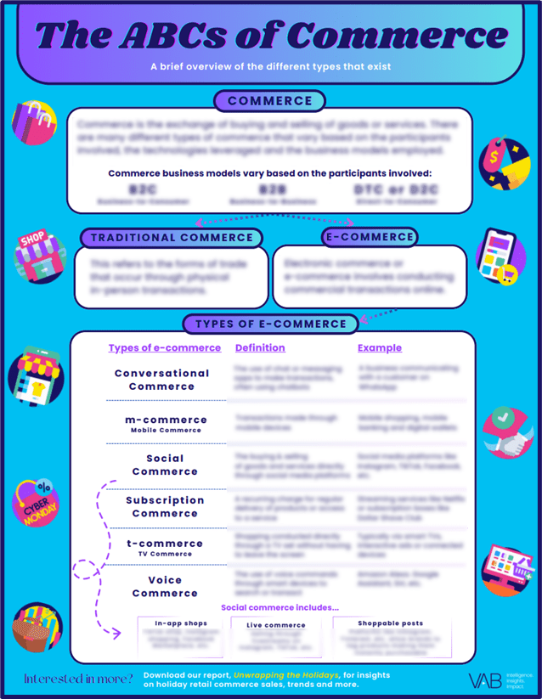
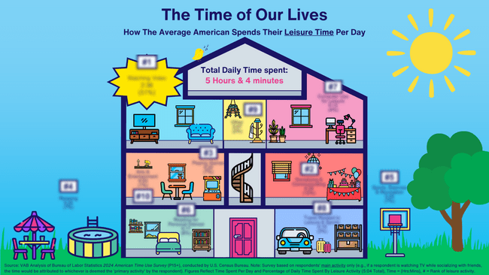
Essential infographics: VAB explores how consumers spend their leisure time and simplifies the different types of commerce. Download Now!
Bonus Slide!
Click to download for an updated look at how Americans spend their leisure time each day
Click to download to get an overview of the different types of commerce and key definitions
This information is exclusively provided to VAB members and qualified marketers
PAGE 13

Slide 14










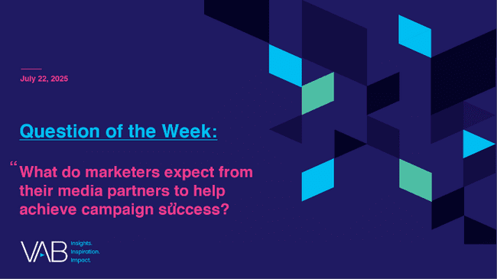
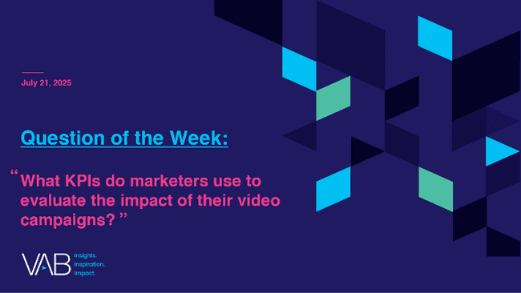
Jason Wiese
Benjamin Vandegrift
Q3 2025 Insights & Measurement Content Releases
EVP, Strategic Insights & Measurement
jasonw@thevab.com
VP, Measurement Strategy & Innovation benjaminv@thevab.com
Leah Montner-Dixon
Reed Kiely
Director, Audience & Behavioral Insights
leahm@thevab.com
Director, Data Insights & Trends
reedk@thevab.com
Karolina Guillen
Associate Director, Insights, Strategy & Analytics karolinag@thevab.com
Discover more
Looking for more data, insights and takeaways? Check out this related VAB content
VAB Members, brand marketers and agencies get free and immediate access to VAB’s content library. Get access at theVAB.com
This information is exclusively provided to VAB members and qualified marketers
PAGE 14

Slide 15


About VAB
VAB plays a dual role in the video advertising industry. We are leading the change to bring about a more innovative and transparent marketplace. We also provide the insights and thought leadership that enables marketers to develop business-driving marketing strategies.
Drawing on our marketing expertise, we simplify the complexities in our industry and discover new insights that transform the way marketers look at their media strategy.
We are committed to your business growth and proud to offer VAB members, brand marketers and agencies complimentary access to our continuously-growing Insights library. Get immediate access at theVAB.com.
This information is exclusively provided to VAB members and qualified marketers
PAGE 15

