Slide 1



2025 – 2nd Quarter

Slide 2


About VAB
VAB plays a dual role in the video advertising industry. We are leading the change to bring about a more innovative and transparent marketplace. We also provide the insights and thought leadership that enables marketers to develop business-driving marketing strategies.
Drawing on our marketing expertise, we simplify the complexities in our industry and discover new insights that transform the way marketers look at their media strategy.
We are committed to your business growth and proud to offer VAB members, brand marketers and agencies complimentary access to our continuously-growing Insights library. Get immediate access at theVAB.com.
This information is exclusively provided to VAB members and qualified marketers.
PAGE 2

Slide 3


Brand is performance: Building customer satisfaction, trust and loyalty is the most vital factor in creating brand success
Click here for the full report
Top Factors That Contribute to the Success of a Brand
% of brand marketers
Source: VAB / Advertiser Perceptions ‘Marketer KPI Survey,’ February 2025, fielded January 27 – February 7, 2025 (n=200). Survey base: Brand marketers directly involved in influencing or executing video advertising. Q10. Which of the following factors contribute to the success of a brand? [Rank up to 3].
This information is exclusively provided to VAB members and qualified marketers.
PAGE 3

Slide 4
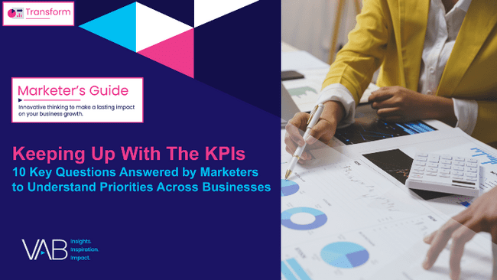









Top KPI influences: Measurability and strategic alignment are driving a reliance on short-term performance by businesses
Click here for the full report
Top 5 Factors Influencing KPI Selection
% of brand marketers
‘Small-Sized’ Businesses
‘Medium-Sized’ Businesses
‘Large-Sized’ Businesses
Measurability
60%
Alignment with strategic goals
62%
Alignment with strategic goals
66%
Alignment with strategic goals
48%
Measurability
48%
Measurability
55%
Customer focus
30%
Data availability & data quality
35%
Data availability & data quality
31%
Relevance to key operations
30%
Industry Benchmarks
28%
Relevance to key operations
30%
Data availability & data quality
23%
Achievability
26%
Customer focus
26%
Source: VAB / Advertiser Perceptions ‘Marketer KPI Survey,’ February 2025, fielded January 27 – February 7, 2025 (n=200). Survey base: Brand marketers directly involved in influencing or executing video advertising. Q13. What factors influenced your organization’s decision in selecting your KPIs? [Rank 1-3]. Based on respondents ranking up to 3 choices. ‘Small-Sized’ Businesses: Less than $1MM in annual ad spend, ‘Medium-Sized’ Businesses: $1MM to less than $25MM in annual ad spend, ‘Large-Sized’ Businesses: $25MM or more in annual ad spend. Dotted line across chart denotes the top 3.
This information is exclusively provided to VAB members and qualified marketers.
PAGE 4

Slide 5



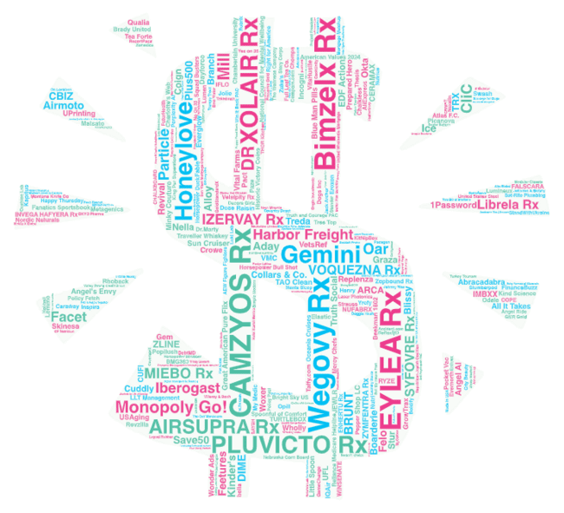




Welcome to TV: 2024 represented the highest investment by first-time multiscreen TV advertisers since our analysis began
Click here for the full report
New TV Advertisers
New National Multiscreen TV Advertisers
2019 – 2024
Year | # of New Advertisers | # of Categories | New TV $$$
2019 | 114 | 61 | $840MM
2020 | 283 | 95 | $1.28B
2021 | 315 | 74 | $1.32B
2022 | 303 | 71 | $1.33B
2023 | 313 | 56 | $1.36B
2024 | 344 | 54 | $1.48B
For a full list of the 344 brands with spend click here
Source: VAB analysis of Nielsen Ad Intel data as of 2/10/25, 1/1/24-12/31/24. Prior years based on VAB analysis of Nielsen Ad Intel Data from the following periods: 1/1/2019-12/31/2019, 1/1/2020-12/31/2020, 1/1/2021-12/31/2021, 1/1/2022-12/31/2022, 1/1/2023-12/31/2023. TV spend includes national cable TV, broadcast TV, Spanish language cable TV, Spanish language broadcast TV, streaming TV (streaming TV as of 2024). 2024 national TV spend, excluding streaming TV, reflects $1.479B. Brands reflect those with TV spend over $100K.
This information is exclusively provided to VAB members and qualified marketers.
PAGE 5

Slide 6
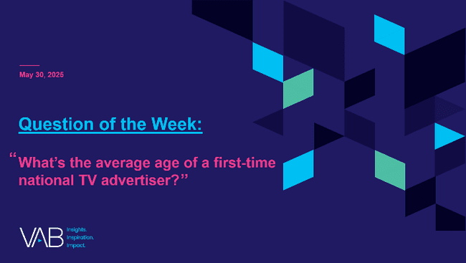
TV is for all lifestages: Nearly 40% of new TV advertisers in 2024 entered national TV within 5 years of product launch
Click here for the full report
Brand Lifestage When First National TV Campaign Launched
344 New TV Advertisers
8 years old
Median Age
36% of brands
entered TV less than 5 years after product launch
Source: VAB analysis of Nielsen Ad Intel data, 1/1/22-12/31/22 , 1/1/23-12/31/24 , 1/1/24-12/31/24. TV spend includes national cable TV, broadcast TV, Spanish language cable TV, Spanish language broadcast TV, streaming TV. Brands reflect those with TV spend over $100K.
This information is exclusively provided to VAB members and qualified marketers.
PAGE 6

Slide 7


Longer TV campaigns create bigger results: While all lengths drive web traffic, a sustained presence sees the biggest lifts
Click here for the full report
38 Brands: Average Monthly Website Unique Visitors
Monthly Website Unique Visitors (000) Comparison
based over a four-year time period: Jan ‘21 – Dec ‘24
Pre-TV Launch
‘When On TV’
+70%
+548K
monthly uniques
+16%
+32%
vs. monthly average prior to TV launch
+12%
+232K
monthly uniques
+130K
monthly uniques
+93K
monthly uniques
vs. monthly average prior to TV launch
vs. monthly average prior to TV launch
vs. monthly average prior to TV launch
Under 6 Months
6-12 Months
13-18 Months
19+ Months
(avg. 3 months on TV)
(avg. 9 months on TV)
(avg. 15 months on TV)
(avg. 25 months on TV)
Source: VAB analysis of Comscore mediametrix multiplatform media trend data, P18+. January 2021 – December 2024 (calendar months), figures are based on monthly averages for the brands analyzed in each segment. VAB analysis of Nielsen Ad Intel, TV activity based on reported spending across national cable TV, national broadcast TV, Spanish language broadcast TV, Spanish language cable TV, spot TV, syndication TV. ‘When On TV’ represents the monthly average for brands in months where they spent in TV as measured through Nielsen Ad Intel between January 2021 – December 2024 (calendar months), across the brands analyzed in each segment. During this four-year analysis, the average advertiser was on TV for 13 months and spent $10.8MM.
This information is exclusively provided to VAB members and qualified marketers.
PAGE 7

Slide 8

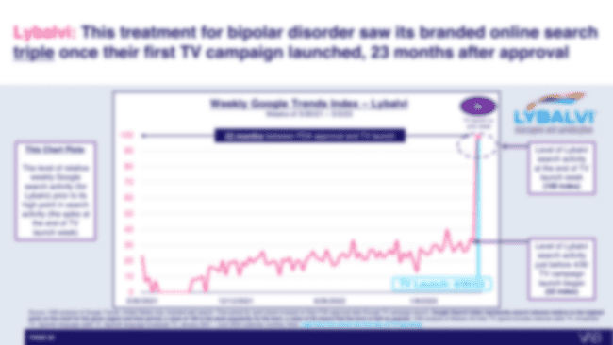
Pharma ads encourage education: Prescription drug remedies launch TV 23 months after FDA approval, on average
Click here for the full report
# of Months Between FDA Approval & First-Time TV Campaign Launch
58 brand analysis
Click here to see what happens immediately after brands launch their first TV campaign
*based on an analysis of
58 prescription drug brand remedies that launched their first TV campaign between Jan 2021 – June 2024
Source: VAB analysis of Nielsen Ad Intel data, calendar year 2021 - June 2024. TV media includes cable TV, network TV, Spanish Language Cable TV, Spanish Language Network TV, Spot TV, Syndication TV; excludes promos and PSAs. Pharma represents brands within ‘Pharmaceutical Houses’ sub-group category.
This information is exclusively provided to VAB members and qualified marketers.
PAGE 8

Slide 9



Streaming demographics: Higher HHI homes are just as likely to subscribe to ad-supported streaming as they are to ad-free
Click here for the full report
Plan Tier by Household Income
$100K+: 38%
$100K+: 37%
Source: Antenna, State of Subscriptions Adds and Ads, May 2025, U.S. only. Note: Excludes free tiers, MVPD + Telco Distribution, and select Bundles. Subscriptions as of March 2025. Premium SVOD includes 9 services.
This information is exclusively provided to VAB members and qualified marketers.
PAGE 9

Slide 10





Size matters for viewing experience: More people are buying larger TVs, as 40% of recent sales are for sets over 55 inches
Click here for the full report
% of A18+ who recently purchased a TV with the following screen size
Small
Under 27"
Medium
27” – 35”
Large
36” – 42”
X-Large
43” – 54”
-5%
vs. ‘23
-1%
vs. ‘23
+3%
vs. ‘23
+9%
vs. ‘23
4%
11%
16%
21%
XX-Large
55” – 69”
XXX-Large
70”+
+6%
vs. ‘23
+21%
vs. ‘23
30%
10%
Source: VAB analysis of MRI-Simmons 2023 vs. 2025 Winter USA study, A18+. Based on most recent purchase.
This information is exclusively provided to VAB members and qualified marketers.
PAGE 10

Slide 11
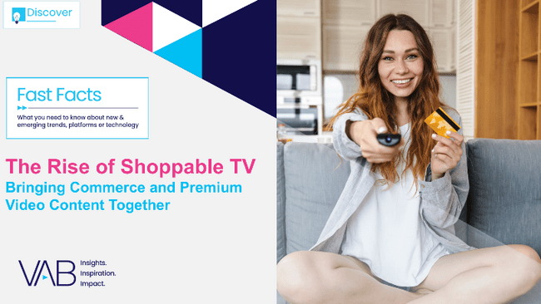




Seamless path to purchase: Shoppable TV ads offer full-funnel conversion through an easy, consumer-friendly buying journey
Click here for the full report
How Shoppable TV Impacts the Purchase Funnel
C
C
C
C
Awareness
Intent
Purchase
Loyalty
63%
often discover new brands and products through TV ads*
79%
are influenced
by TV ads in
their shopping decisions*
47%
Have made a purchase after seeing a TV ad
(last 3 months)*
40%
Will spend more on shoppable TV products over the next 12 months than the currently do**
Source: *LG Ad Solutions, ‘Shoppable TV Report 2025’, March 2025. **eMarketer | Shopsense, ‘Turning TV into a Retail Powerhouse’, Sept 2024 (33% will spend the same amount over the next 12 months).
This information is exclusively provided to VAB members and qualified marketers.
PAGE 11

Slide 12







Driving the ‘going out’ economy: Moviegoers are a vital target for brands across dining, entertainment and sports
Click here for the full report
Leisure Activities Participated in the Last 12 Months
+36%*
+100%
+86%*
+85%*
+180%*
+55%*
Attend Musical Performance
Source: VAB analysis of MRI-Simmons Winter Study, 2025. ‘Non-Moviegoer’ = Has not gone to the movies in the last 12 months, ‘Moviegoer’ reflects people who have gone to the movies at least once in the last year. Musical performances include rock, country, classical music/opera, R&B/Hip-Hop/Rap, and other. *% difference of moviegoers against non-moviegoers. **Using rideshare apps is based on usage in the last 30 days.
This information is exclusively provided to VAB members and qualified marketers.
PAGE 12

Slide 13

The epidemic of fake accounts: Facebook routinely bans the equivalent of more than half the world’s population each year
Click here for the full report
Banned Fake Facebook Accounts’ Share of Global Population
Bonus Slide!
2018
2019
2020
2021
2022
2023
2024
Fake Accounts Banned by Facebook
3.34B
6.50B
5.80B
6.50B
5.80B
2.62B
4.33B
7.73B
7.81B
7.89B
7.95B
8.02B
8.09B
8.16B
Global Population*
Fake Accounts Banned % Share of Global Population
43%
83%
74%
82%
72%
32%
53%
Source: VAB analysis of Meta Transparency Center, Fake Accounts – Facebook, Accounts Actioned, as of 5/15/25. *VAB analysis of United Nations, Department of Economic and Social Affairs, Population Division (2024), World Population Prospects: The 2024 Revision, custom data acquired via UN Data Portal – Population Division website. ‘Accounts Actioned’ refers to fake accounts banned.
This information is exclusively provided to VAB members and qualified marketers.
PAGE 13

Slide 14

For this quarter, we’re including an additional section highlighting even more thought leadership content that VAB has released recently which is available for download

Slide 15
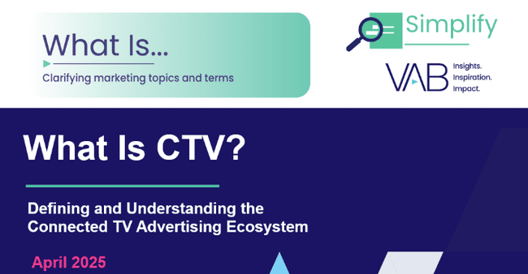

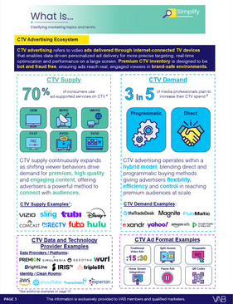
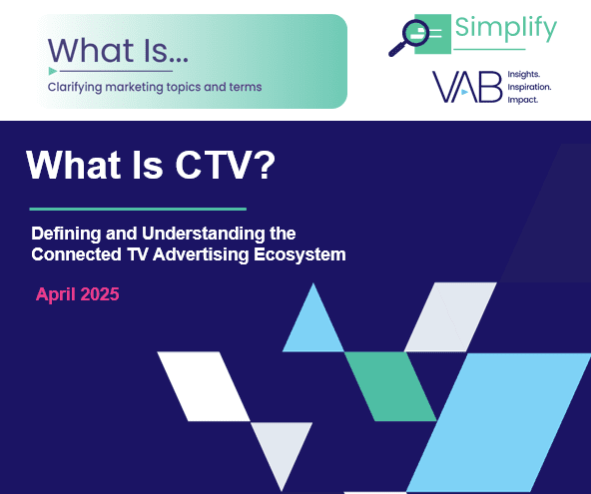
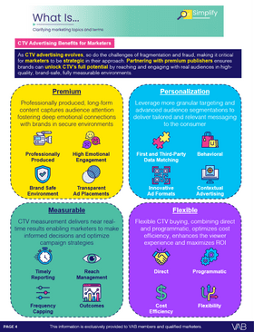
Amidst rapid growth, this guide seeks to define what CTV is and explore the benefits of premium inventory to marketers
Click here for the full report
This information is exclusively provided to VAB members and qualified marketers.
PAGE 15

Slide 16

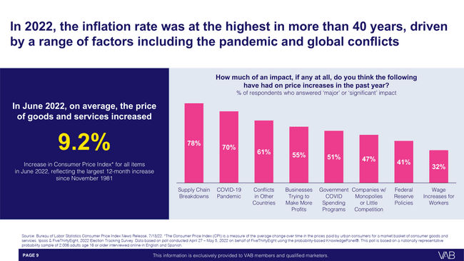
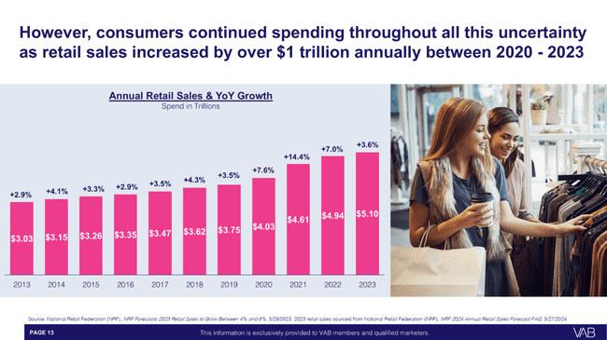
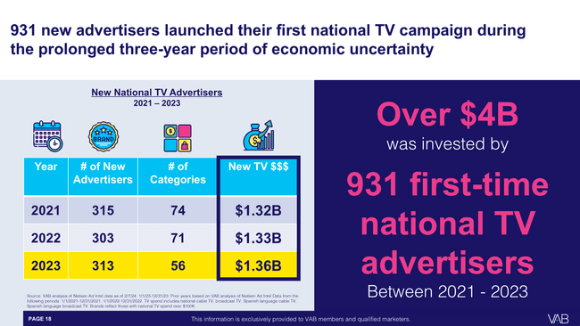
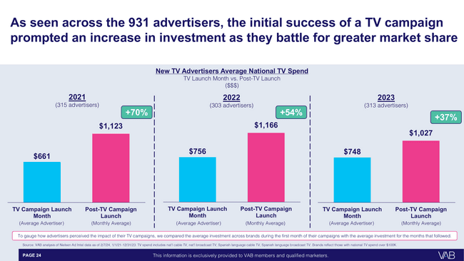
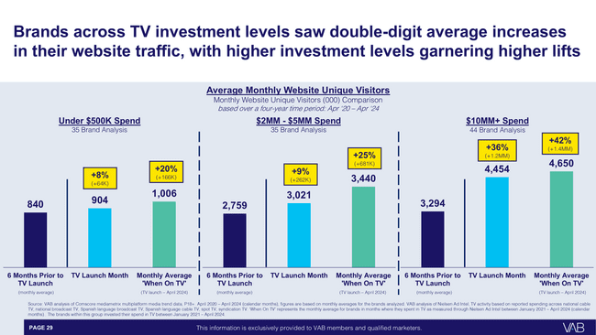
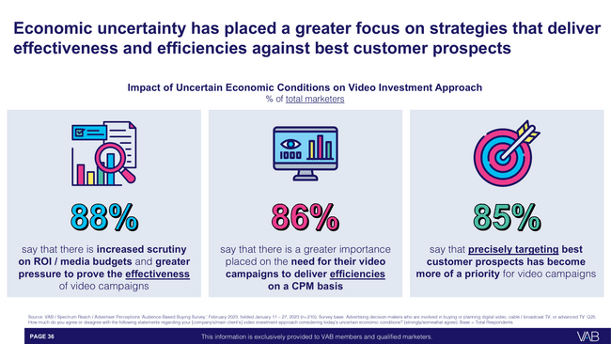
An analysis of the last period of economic uncertainty between 2021 – 2023 proves the business value of advertising continuity
Click here for the full report
This information is exclusively provided to VAB members and qualified marketers.
PAGE 16

Slide 17
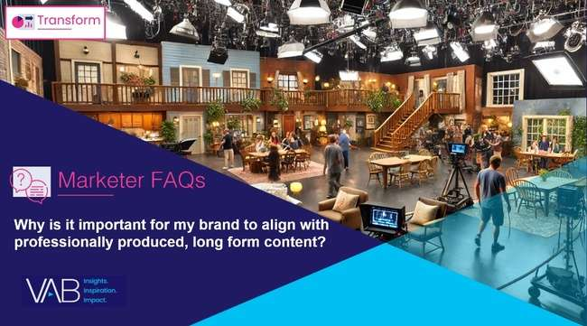




Five marketer FAQs each focusing on a core pillar of premium video, based on our full marketer’s guide The Power of Premium Video
Why is it important for my brand to align with professionally produced, long form content?
Why is it important for my brand to align with emotionally engaging content?
Why is it important for my brand
to align with brand safe environments?
Why is it important for my brand
to align with partners that offer cross-platform accessibility?
Why is it important for my brand
to align with trusted and transparent media partners?
Click the report covers to download
This information is exclusively provided to VAB members and qualified marketers.
PAGE 17

Slide 18

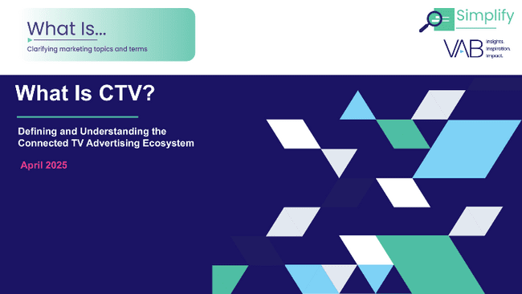




2Q 2025 Insights & Measurement Content Releases
Jason Wiese
Benjamin Vandegrift
EVP, Strategic Insights & Measurement
jasonw@thevab.com
VP, Measurement Strategy & Innovation benjaminv@thevab.com
Leah Montner-Dixon
Reed Kiely
Director, Audience & Behavioral Insights
leahm@thevab.com
Director, Data Insights & Trends
reedk@thevab.com
Karolina Guillen
Associate Director, Insights, Strategy & Analytics karolinag@thevab.com
Discover more
Looking for more data, insights and takeaways? Check out this related VAB content
VAB Members, brand marketers and agencies get free and immediate access to VAB’s content library. Get access at theVAB.com
This information is exclusively provided to VAB members and qualified marketers.
PAGE 18

