Slide 1



March 2020
Online Content Destinations

Slide 2


About VAB
VAB is an insights-driven organization that inspires marketers to reimagine their media strategies resulting in fully informed decisions.
Drawing on our marketing expertise, we simplify the complexities in our industry and discover new insights that transform the way marketers look at their media strategy.
Simplify
We save you time by bringing you the latest data & actionable takeaways you can use to inform your marketing plans.
Discover
We keep you one step ahead with the latest thinking so you can create innovative, forward-looking strategies.
Transform
We help you build your brand by focusing on core marketing principles that will help drive tangible business outcomes.
This information is exclusively provided to VAB members and qualified marketers. Further distribution is prohibited.
PAGE 2

Slide 3
















Ad-supported TV brands represent some of the most popular digital content
Ad-Supported TV Brands That Rank In The Top 5 Digital Platforms By Major Content Genre
Media
Sports
News
Business & Financial News
Kids
Weather
Home
Comedy
Total Audience
P18-24
P25-34
P35-49
P50+
Source: VAB analysis of Comscore Media Metrix Key Measures multi-platform (desktop + mobile) data, March 2020, based on categories (top 5 rankings based on “Total Minutes Viewed”). Total Audience = (Desktop P2+, Mobile 18+)
This information is exclusively provided to VAB members and qualified marketers. Further distribution is prohibited.
PAGE 3

Slide 4
Ad-supported TV brands represent some of the most popular digital content
Ad-Supported TV Brands That Rank In The Top 5 Digital Platforms By Major Content Genre
Media
Sports
News
Business & Financial News
Kids
Weather
Home
Comedy
P18-34
P18-49
P25-54
Source: VAB analysis of Comscore Media Metrix Key Measures multi-platform (desktop + mobile) data, March 2020, based on categories (top 5 rankings based on “Total Minutes Viewed”). Total Audience = (Desktop P2+, Mobile 18+)
This information is exclusively provided to VAB members and qualified marketers. Further distribution is prohibited.
PAGE 4

Slide 5

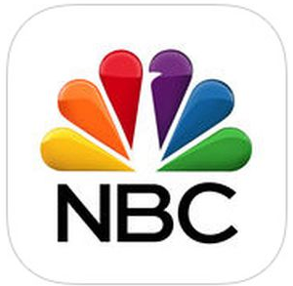













Ad-supported TV brands rank among the top 5 downloaded apps across the most popular categories as well
From 2,000,000 Apps:
Ad-Supported TV Brands That Rank In The Top 5 Apple Store Mobile Apps Downloaded
Sports
News
Weather
Finance
Long-Form Video
Food
Home
Travel
Kids 5 & Under
Comedy
Source: Apple app store 5/1/2020; Most popular apps by category search term. The Travel category reflects editorial apps and excludes both service apps and non-media, company-branded apps.
This information is exclusively provided to VAB members and qualified marketers. Further distribution is prohibited.
PAGE 5

Slide 6


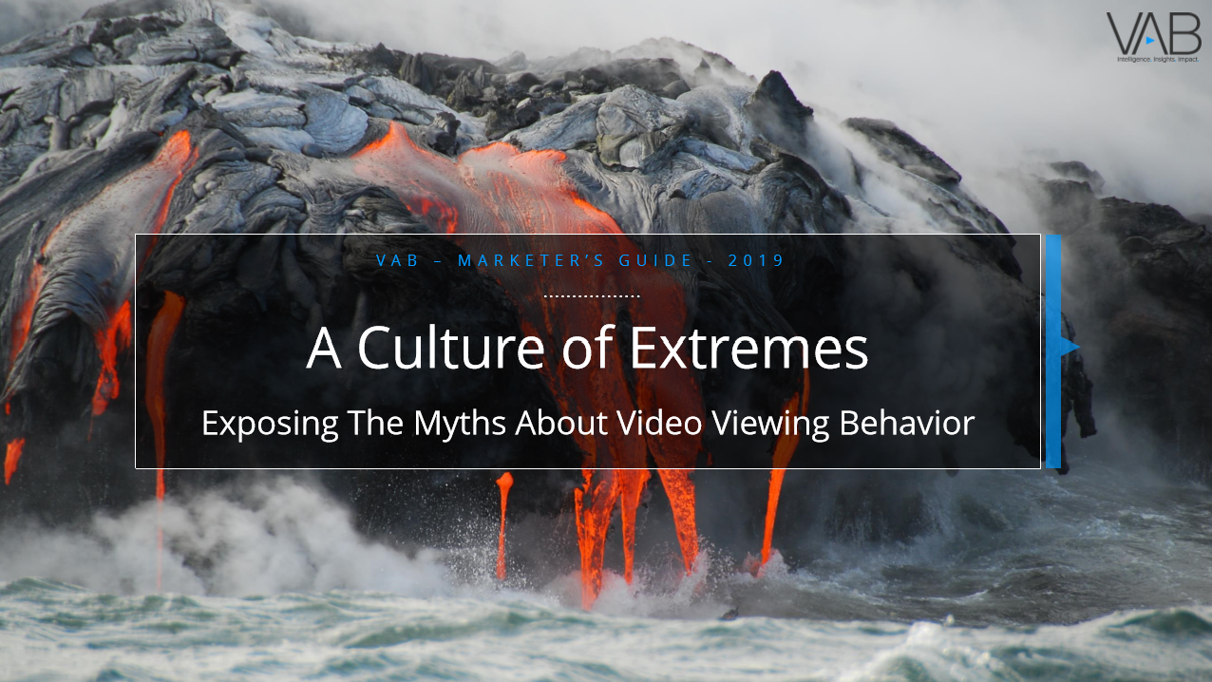

Thank You
Creators
Reed Kiely
Karolina Guillen
Insights Manager
reedk@thevab.com
Senior Insights Analyst
karolinag@thevab.com
Interested in learning more? Check out this related content:
A Matter of Principle
The Disconnect Between Proven Marketing Tenets and Marketing Behavior
Left to Your Own Devices
Understanding Consumption In Today’s Connected World
A Culture of Extremes
Exposing The Myths About Video Viewing Behavior
This information is exclusively provided to VAB members and qualified marketers. Further distribution is prohibited.
PAGE 6

Slide 7

Get immediate access to the VAB Insights library
We’ve answered hundreds of marketers’ questions.
Our guides, reports, webinars and videos provide actionable insights to help marketers navigate today’s video landscape and think differently about their strategy.
We are committed to your business growth and proud to offer brand marketers and agencies complimentary access to our continuously-growing Insights library.
Get Access at theVAB.com or visit us here
This information is exclusively provided to VAB members and qualified marketers. Further distribution is prohibited.
PAGE 7

