Slide 1

Members Center

Slide 2
Lineup
Game Plan 3
The Passion For Sports Never Rests 4-11
“Wide World Of Sports” Omnichannel Ecosystem 12-16
TV Is The Heart Of The Sports Ecosystem 17-24
Sports TV’s Current Winning Streak 25-36
Complementary Content Through Supplementary Screens 37-43
Collective Experiences Through Online & Offline Socializing 44-52
Sports Wrap Up 53-56
Contact Information 57

Slide 3
Game Plan
To some, sports is life. To many others, it’s a central passion point. And to almost all, it represents compelling, engaging and consistent content fueled by the combination of real-life action and drama (the intersection of which we colloquially refer to as “score-ylines”) unfolding before their eyes.
With almost 11,000 national live sporting events airing annually, TV viewers have the opportunity to indulge in one of their favorite passions – sports - literally every single day of the year. Whether it’s football, baseball, basketball or international cricket, there is always something live on TV with an average of 8 major sports, along with countless niche ones, active in any month.
It’s the “No Days Off” programming calendar that places TV at the heart of the sports ecosystem. Television feeds a virtually never-ending stream of content to mobile apps and alternative devices; it creates limitless conversations on social media, blogs and sports-related websites; and it brings friends, soon-to-be friends, family, fellow alumni and people who share common interests together in a communal experience where passion elicits emotion on any given day.
People have an insatiable appetite for content of any kind that surrounds their passions and, for sports, it all begins with TV and multi-screen TV brands.
No days off!

Slide 4
The Passion For Sports Never Rests

Slide 5
Sports Are Almost Universally Watched & Followed, To At Least Some Extent, By Most Of The Population
Within this universe, almost one-quarter (24%) of respondents consider themselves an
“intense” sports fan
No days off!
Source: #SCORE 2016 Sports Fan Behavior Study 2016; Center for the Digital Future at Annenberg/ThePostGame.

Slide 6
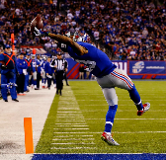
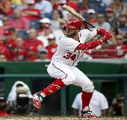
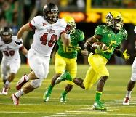
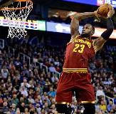
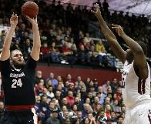
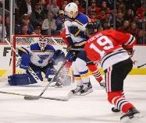
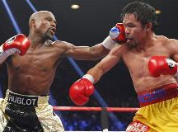
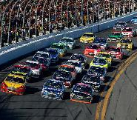
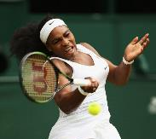
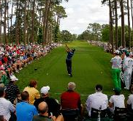


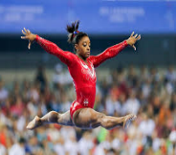
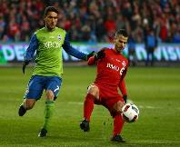
Although The NFL Remains King, Several Other Sports Draw A Rather Significant Following
Eight different sports are followed regularly by at least 20% of American sports fans
Which Sports Do You Follow?
(NFL Football)
(Baseball)
(College Football)
(NBA Basketball)
(College Basketball)
(Ice Hockey)
(Boxing)
81%
54%
48%
46%
35%
23%
22%
(NASCAR)
(Tennis)
(Golf)
(Extreme Sports)
(MMA)
(Gymnastics)
(MLS Soccer)
20%
17%
17%
16%
16%
13%
11%
No days off!
Source: #SCORE 2016 Sports Fan Behavior Study 2016; Center for the Digital Future at Annenberg/ThePostGame. Excludes Olympics.

Slide 7
















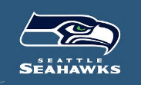


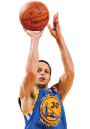


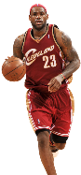

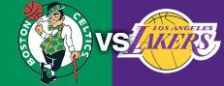



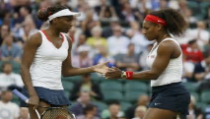



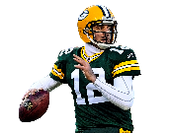


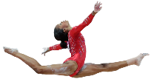
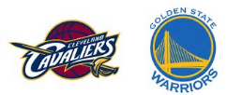


People Are Passionate About Sports And Fans’ Passion Is Driven By Several Factors
Traditional Powerhouses
Contemporary Winners
Wily Veterans & Dynamic Youngsters
Team, School & Athlete Rivalries
vs.
No days off!

Slide 8
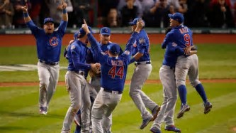
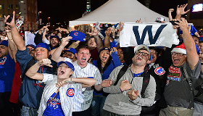
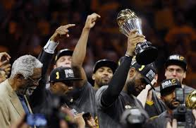
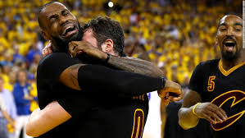
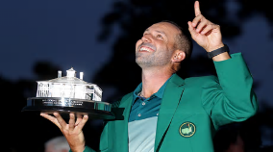

This Passion Around Sports Is Further Fueled By “Score-ylines” Which Engage Viewers Well Beyond Just The Numbers
“Score-ylines” sit at the intersection of outcomes and interests; they humanize an event’s results to engage even the most casual of sports fans (i.e., “the masses”)
Scores
Storylines
Chicago Cubs win Game 7 of the World Series 8-7 in extra innings
The victory ended 108 years of championship futility for one of the most iconic pro teams
Cleveland Cavaliers defeat Golden State in Game 7 of the NBA Finals 93-89
Cleveland, led by returning hometown star Lebron James, came back from down 3-1 against the winningest regular season team ever
Sergio Garcia wins the 2017 Masters in a one-hole playoff
Garcia’s win finally ends his 0-73 drought in majors tournaments
No days off!

Slide 9
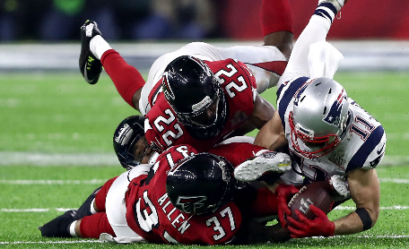
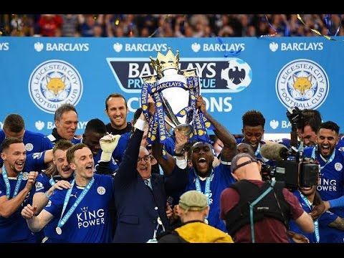
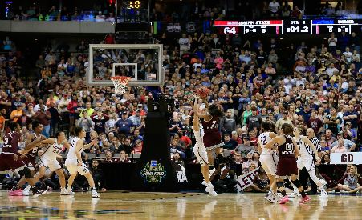
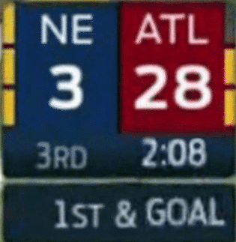
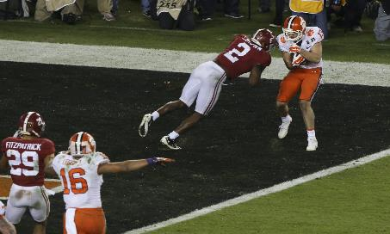
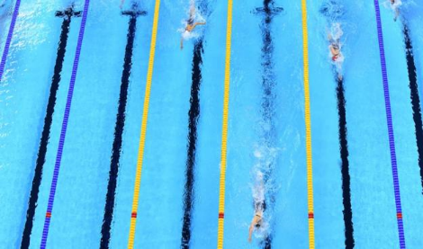
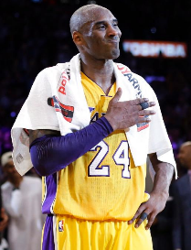
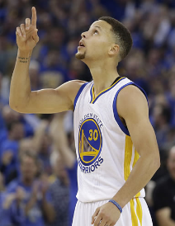
Beyond The Historic World Series Or Epic NBA Finals, The Past Year Has Featured A Never Ending Stream Of “Score-ylines”
Patriots overcomes the largest deficit in Super Bowl history to defeat the Atlanta Falcons
Leicester City’s beats 5000-1 odds to win the English Premier League
Mississippi State stuns UCONN in the Final Four, ending their 111 game winning streak
Former walk-on wide receiver scores winning TD in Clemson’s thrilling National Championship victory over Alabama
American swimmer Katie Ledecky obliterates the competition at the Summer Olympics, winning the 800m freestyle by almost 12 seconds
Kobe Bryant scores 60 points in his final game on the same night that Golden State wins their record-breaking 73rd game
No days off!

Slide 10
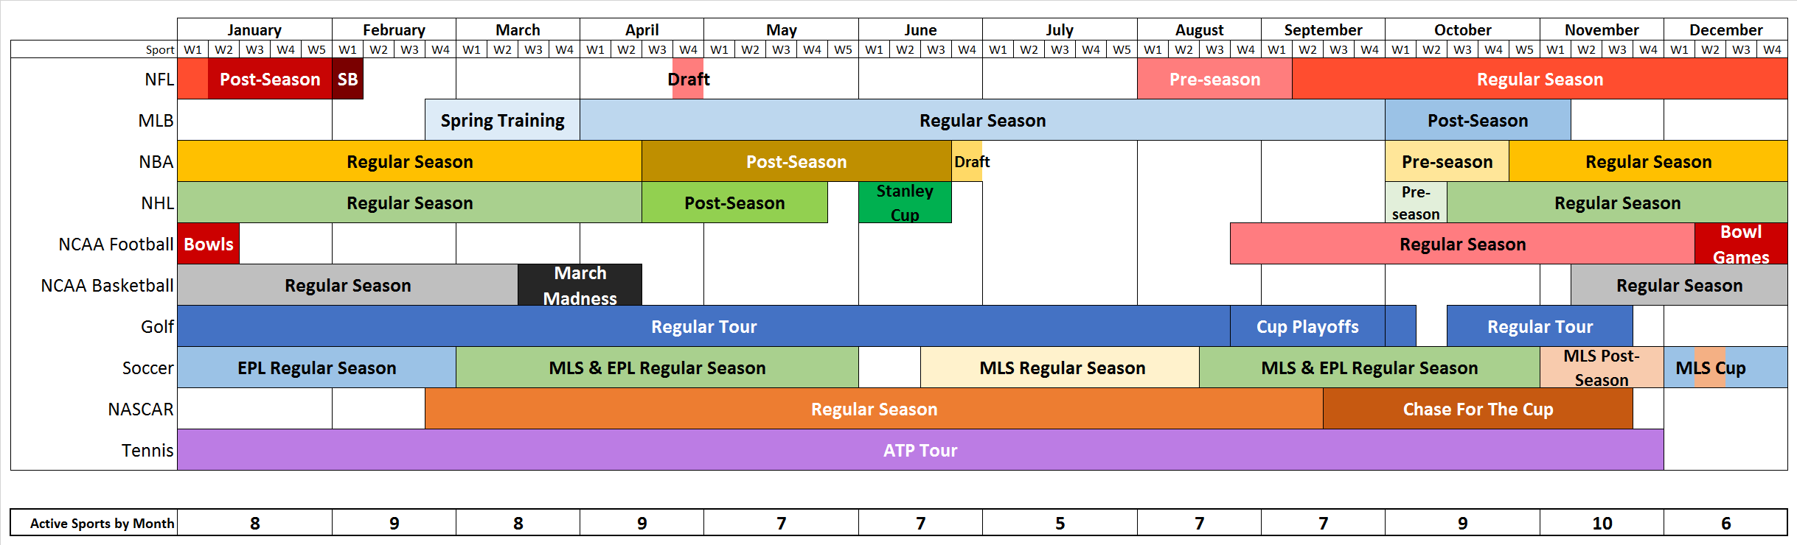
Looking At This Year’s Sports Calendar, Memorable
“Score-ylines” Can, And Will, Happen On Any Day Of The Year
Several major sports overlap each other throughout the year, culminating in November when all the top sports are active.
Calendar For 10 Major Sports
Since 89% of sports fans follow more than one team and 88% follow more than one sport, there’s plenty of action to keep a fan satisfied no matter the month.
No days off!
Source: #SCORE 2016 Sports Fan Behavior Study 2016; Center for the Digital Future at Annenberg/ThePostGame.

Slide 11
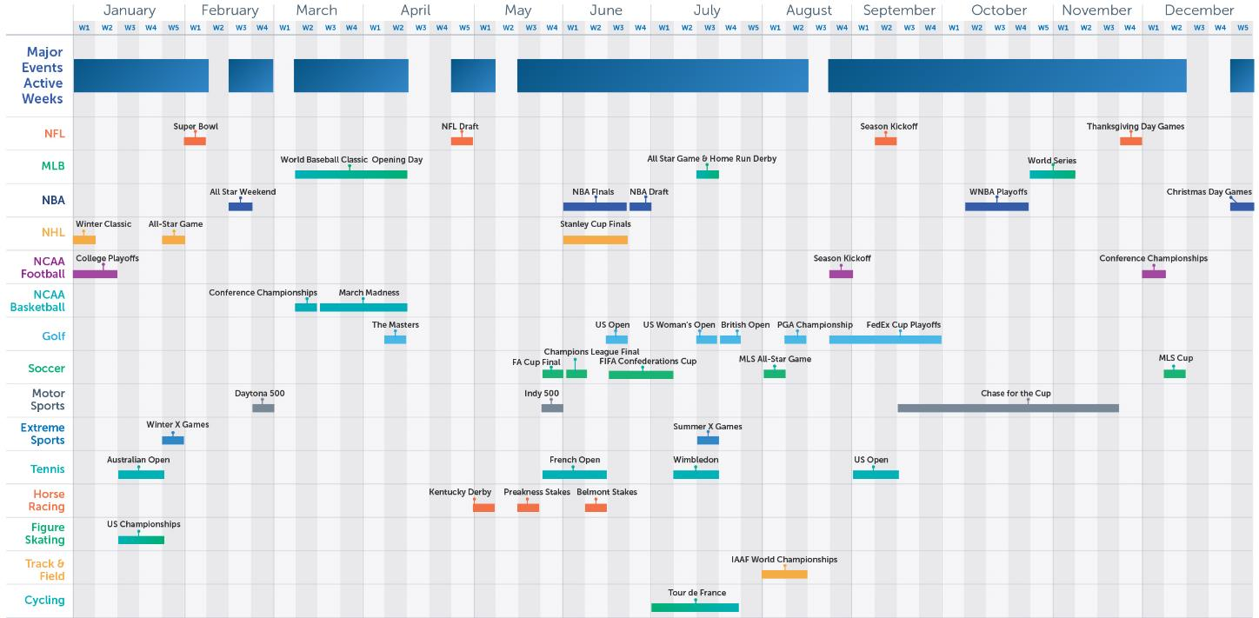
Especially When You Consider That Almost Every Week Features A Premier, Signature Event From A Major Sport
Signature events in major sports are scheduled during at least 45 weeks of the 2017 broadcast calendar
No days off!
Note: Some post-season dates are still tentative

Slide 12
“Wide World Of Sports”: Omnichannel Ecosystem

Slide 13
Fans Predominately Watch Sports Live At Home, Although About One-Quarter Will Catch Games At A Bar Or On The Go
No days off!
Source: #SCORE 2016 Sports Fan Behavior Study 2016; Center for the Digital Future at Annenberg/ThePostGame.

Slide 14
It’s No Surprise That Television Dominates Sports, But Half The Population Also Gets Content From Alternate Devices
No days off!
Source: #SCORE 2016 Sports Fan Behavior Study 2016; Center for the Digital Future at Annenberg/ThePostGame.

Slide 15
But Still, Television Is The Overwhelming Preference For People To Consume Sports Video Content
No days off!
Source: #SCORE 2016 Sports Fan Behavior Study 2016; Center for the Digital Future at Annenberg/ThePostGame.

Slide 16























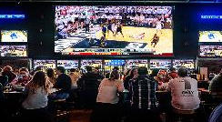

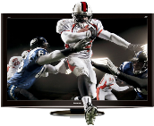

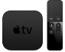















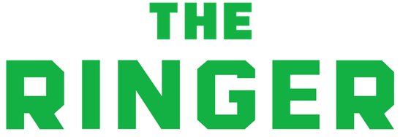




“Wide World of Sports”: The Omnichannel Ecosystem
Sports Ecosystem
Center Ring: Live TV
Second Ring: second-screen viewing, streaming players & time-shifted devices
Third Ring: TV-branded digital platforms & websites
Fourth Ring: social media platforms & secondary sports websites
Outer Ring: Out-Of-Home Viewing
No days off!

Slide 17
TV Is The Heart Of The Sports Ecosystem

Slide 18
TV Networks Spent Over $20 Billion On Sports Programming In 2016; A $6 Billion Increase Over The Last Four Years
Programmers are projected to spend almost another $6 billion more on sports in the next four years in order to deliver consumers even more live sporting events.
No days off!
Source: SNL Kagan, 2017: programming cost estimates reflect ad-supported cable TV, broadcast TV & RSNs

Slide 19
Almost 11,000 Live Sporting Events Are Shown On National TV Annually, With 86% Of Them Airing On Ad-Supported Cable
No days off!
Source: Nielsen NPower, Total Day, live originals/premieres only, January 1, 2016 – December 31, 2016; excludes Regional Sports Networks and local broadcast airings.

Slide 20
No Days Off: There Were At Least Two Live Sporting Events Airing Every Single Day of The Year On National TV In 2016
A live sporting event aired on ad-supported cable TV every day (366 days) in 2016 while national broadcast TV aired live sports on 221 days.
How to read: In 2016, 16 days featured between 2-9 live sporting events airing on national TV.
No days off!
Source: Nielsen NPower, Total Day, live originals/premieres only, January 1, 2016 – December 31, 2016; includes Spanish language networks; excludes Regional Sports Networks and local broadcast airings.

Slide 21
In Fact, On Average There Are At Least Ten Live Sporting Events Airing On National TV Each Day Throughout The Year
Average # of Live Sporting Events Each Day
2016
60
42
30
21
23
19
14
No days off!
Source: Nielsen NPower, Total Day, live originals/premieres only, January 1, 2016 – December 31, 2016; excludes Regional Sports Networks and local broadcast airings.

Slide 22




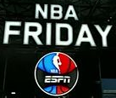











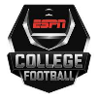

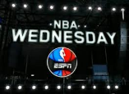




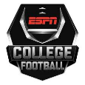





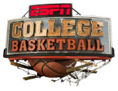











Each Day Is Anchored By Several Signature Sports Series Airing On National TV Throughout The Year
Sampling of Signature Sports Series
Monday
Tuesday
Wednesday
Thursday
Friday
Saturday
Sunday
No days off!

Slide 23
Live Sports On National TV Is Rather Consistent While Having Slight Peaks In Spring & Fall Months
# of Live Sporting Events Per Month
2016
992
983
1,021
931
891
923
941
924
879
848
790
751
Note: Summer is dominated by the MLB, a sport that has the vast majority of its games airing on RSNs which are not reflected in the above chart.
No days off!
Source: Nielsen NPower, Total Day, live originals/premieres only, January 1, 2016 – December 31, 2016; includes Olympics and excludes Regional Sports Networks and local broadcast airings.

Slide 24














































Complementing National Sports Are RSNs Which Air In-Market Sports & Provide Comprehensive Coverage Of Local Teams
RSNs, which consist of live professional & collegiate sports broadcast and ancillary programming, cover all major DMAs and also key, sports-fanatical “college town” markets
NO DAYS OFF!

Slide 25
Sports TV’s Current Winning Streak

Slide 26
Sports Are Ubiquitous Among The TV Viewer Given The Daily Availability Of Live Events & Related Programming
Annual Cume National Sports TV Reach (Live)
CY 2016
No days off!
Source: Nielsen NPower R&F Program Report, Total Day, Live, P2+ & P18-34, ad-supported cable TV + broadcast TV, January 1st – December 31st 2016; excludes Regional Sports Networks and local broadcast airings. Sports-related programming includes live sports, sports news, sports commentary, etc.

Slide 27
National Sports TV Monthly Reach Is Fairly Consistent But Has
A Slight Increase During The Football Season
On average, almost 80% of P2+ watch sports-related TV programming live each month
Monthly Cume National Sports-Related Programming Live TV Reach
CY 2016
Note: Summer is dominated by the MLB, a sport that has the vast majority of its games airing on RSNs which are not reflected in the above chart.
No days off!
Source: Nielsen NPower R&F Program Report, Total Day, Live, P2+ & P18-34, ad-supported cable TV + broadcast TV, based on calendar months; includes Olympics and excludes Regional Sports Networks and local broadcast airings. Sports-related programming includes live sports, sports news, sports commentary, etc.

Slide 28
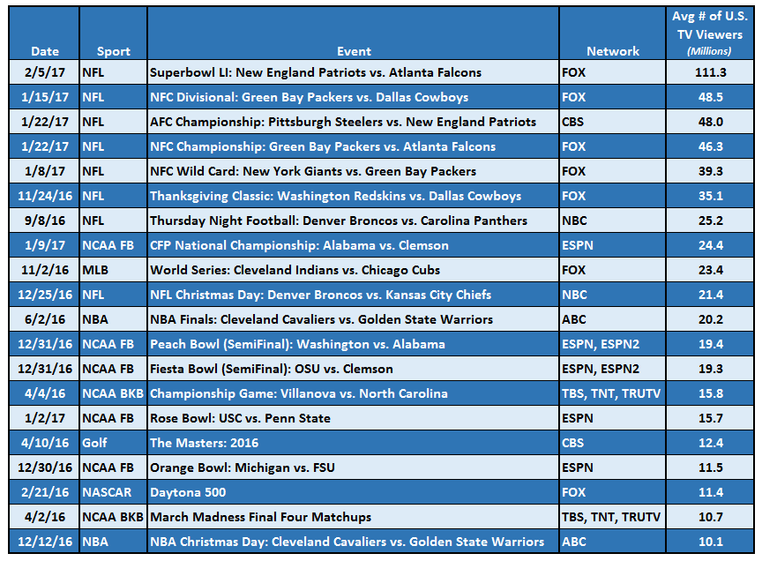
Sports Also Delivers Significant Simultaneous Reach For Many Events Throughout The Year
In the last year, there were 20 live sporting events that delivered an average audience of over 10 million TV viewers, spanning across seven different sports
No days off!
Source: Nielsen Year In Sports Media Report 2016, based on 2/21/16 – 2/5/17 time period. For the Masters, the figure is based on the final day of the tournament (Sunday).

Slide 29
Average Time Spent Watching TV Sports Has Increased For
The Total Population & Millennials Over The Last Eight Years
Sports-Related National TV Programming: Average Annual Minutes Viewed Comparison
CY 2008 vs. CY 2016
+14%
+2%
No days off!
Source: Nielsen NPower R&F Program Report, Total Day, Live+7, P2+ & P18-34, ad-supported cable TV + broadcast TV, based on calendar year; excludes Regional Sports Networks and local broadcast airings. Sports-related programming includes live sports, sports news, sports commentary, etc. Comparison based on years with Summer Olympics.

Slide 30
There Has Been An 8% Increase In The Total Sports Audience During Any Given Minute Over The Last Eight Years
Sports-Related National TV Programming: Average P2+ Audience (000)
CY 2008 vs. CY 2016
+8%
Note: “Average Audience” based on the average audience per minute for sports programming during the full calendar year (total day).
No days off!
Source: VAB analysis based on data from Nielsen NPower R&F Program Report, Total Day, Live+7, P2+, ad-supported cable TV + broadcast TV, based on calendar year; excludes Regional Sports Networks and local broadcast airings. Sports-related programming includes live sports, sports news, sports commentary, etc. Comparison based on years with Summer Olympics.

Slide 31
Over 33 Billion Hours Of Sports-Related Programming Were Collectively Viewed On Ad-Supported National TV In 2016
93% of total viewing of sports-related programming was done live
Sports-Related National TV Programming: Total Cume P2+ Hours Viewed
CY 2016
Hours
Hours
Hours
No days off!
Source: Nielsen NPower R&F Program Report, Total Day, P2+, ad-supported cable TV + broadcast TV, based on calendar year; excludes Regional Sports Networks and local broadcast airings. Sports-related programming includes live sports, sports news, sports commentary, etc.

Slide 32
Total TV Sports Viewing Has Also Collectively Increased Across Each Major Stream Over The Last Eight Years
Sports-Related National TV Programming: Total Cume P2+ Hours Viewed Comparison
2008 vs. 2016
+7%
+8%
+3%
Billion
Hours
Billion
Hours
Billion
Hours
No days off!
Source: Nielsen NPower R&F Program Report, Total Day, P2, ad-supported cable TV + broadcast TV, based on calendar year; excludes Regional Sports Networks and local broadcast airings. Sports-related programming includes live sports, sports news, sports commentary, etc.

Slide 33
Even With The Increase In DVR Penetration, Sports Remains Almost Exclusively A “Live” Or “Near Live” Viewing Experience
Sports-Related National TV Programming: Viewership By Stream
% of Total Viewing Hours
P2+
P18-34
No days off!
Source: Nielsen NPower R&F Program Report, Total Day, P2+ & P18-34, ad-supported cable TV + broadcast TV, based on calendar year; excludes Regional Sports Networks and local broadcast airings. Sports-related programming includes live sports, sports news, sports commentary, etc.

Slide 34
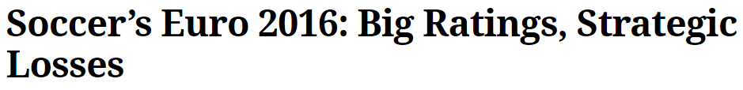
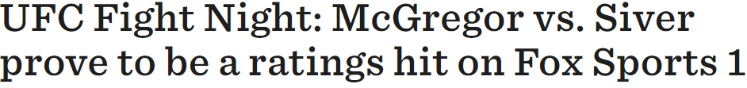
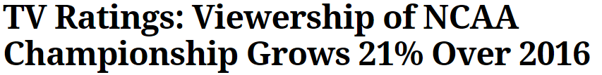
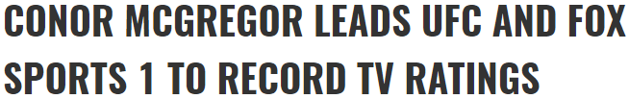
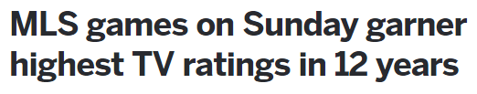








Along With The Increase In Average Audience & Hours Viewed Has Come Many Ratings Victories For Big Sporting Events
No days off!

Slide 35
Commercial Inventory Available Within Sports Programming Increased 7% In 2016 vs. Four Years Ago
National Sports TV Genre P2+ GRP Comparison
CY 2012 vs. CY 2016
382,425
+7%
356,166
261,578
+7%
243,393
No days off!
Source: Nielsen Ad Intel, Total Day, Live+7. Activity reflects calendar year comparison for 2012 vs. 2016. GRPs are equivilized. Data includes Spanish language networks. Sports-related programming includes live sports, sports news, sports commentary, etc. Olympics are excluded.

Slide 36

A Majority Of The Growing Commercial Inventory For Major Sports, Besides NFL, Lives on Ad-Supported Cable TV
National GRPs On Ad-Supported Cable TV By Sports Genre: A Snapshot
No days off!
Source: Nielsen Ad Intel, Total Day, Live+7. Activity reflects calendar year comparison for 2012 vs. 2016. GRPs are equivilized. Data includes Spanish language networks. Sports-related programming includes live sports, sports news, sports commentary, etc. Olympics are excluded.

Slide 37
Complementary Content Through Secondary Screens

Slide 38





















TV Brands Extend Their Reach & Engagement Through Live Streaming Which Allows Additional Sports Viewing Everywhere
Live event streaming from sports programmers & providers gives flexibility to cable subscribers, allowing them to view content across devices.
Sampling of Live Streaming Mobile Apps
No days off!

Slide 39
TV-Branded Sports Platforms Reach A Majority Of The Digital Population & Almost Everyone Within The Online Sports Universe
TV-Branded Sports Platform Cume Unique Visitors Coverage
Dec ‘16
No days off!
Source: comScore Audience Duplication; multiplatform (web+mobile), December 2016, unduplicated unique visitors based on a custom created Sports TV Branded Website subcategory which includes digital platforms such as ESPN.com, Fox Sports, CBS Sports & NBC Sports. comScore MediaMetrix, multiplatform media trend data, December 2016, total digital population & sports category.

Slide 40
A Vast Majority Of Time Spent Online With Sports Content Is Through TV-Branded Digital Platforms
Sports Category: % of Total Minutes Viewed Online
2016
P2+
P18-34
Note: “All The Rest” reflects non-premium TV-related websites like USA Today Sports, SB Nation, Scout.com, Reddit Sports, Deadspin.com, Big Lead Sports, etc
No days off!
Source: comScore MediaMetrix, multiplatform media trend data, January-December 2016; comScore-defined sports category vs. custom created Sports TV Branded Website subcategory which includes digital platforms such as ESPN.com, Fox Sports, CBS Sports & NBC Sports.

Slide 41
Millennials’ Time Spent On Sports TV-Branded Digital Platforms Have Increased By Double Digits Over The Last Two Years
Sports TV-Branded Digital Platforms: Average Monthly Minutes Spent Per Visitor
+16%
+5%
No days off!
Source: ComScore Audience Duplication; multiplatform (web+mobile), unduplicated Avg Mins per Visitor based on a custom created Sports TV Branded Website subcategory which includes digital platforms such as ESPN.com, Fox Sports, CBS Sports & NBC Sports.

Slide 42

TV-Related Brands Make Up The Top 5 Most Trafficked Digital Platforms In The Sports Category Throughout The Year
Top 5 Sports Digital Platform Rank By Total Minutes Viewed (P2+)
No days off!
Source: comScore MediaMetrix, multiplatform media trend data, January-December 2016; sports category, P2+, excludes non-sports media brands.

Slide 43

TV-Related Brands Also Make Up Almost All Of The Top 5 Monthly Digital Sports Platforms Among Millennials
Top 5 Sports Digital Platform Rank By Total Minutes Viewed (P18-34)
No days off!
Source: comScore MediaMetrix, multiplatform media trend data, January-December 2016; sports category, P18-34, excludes non-sports media brands.

Slide 44
Collective Experiences Through Online & Offline Socializing

Slide 45
Facebook Is The Most Popular Social Media Platform For Fans To Get Sports-Related Content & Information
No days off!
Source: #SCORE 2016 Sports Fan Behavior Study 2016; Center for the Digital Future at Annenberg/ThePostGame.

Slide 46










TV Sports Brands Have A Large Social Presence To Provide Fans With Extra Content & Keep Conversations Going Online
No days off!

Slide 47
There’s A Consistent Stream Of Heavy Social Conversation Centered Around Televised Sporting Events
Social TV Interaction Highlights By Major Sporting Event
1/1
NHL Winter Classic (NBC)
55K interactions*
3/17-3/18
March Madness – Round of 64
(CBS, TBS, TNT, TruTV)
2.0MM interactions*
5/15–5/25
NHL Eastern Conference Finals (NBCSN)
710K interactions*
7/10
UEFA Euros Final (ESPN, ESPND)
681K interactions*
9/20
World Cup of Hockey: USA vs. Canada
(ESPN)
146K interactions
11/24
NFL Thanksgiving Classic
(FOX)
11.4MM interactions
1/15
NFC Divisional Playoff Game
(FOX)
52.9MM interactions
2/14
NBA All-Star Game (TNT, TBS)
1.4MM interactions*
4/4
March Madness – Champ. Game (TBS, TNT, TruTV)
1.8MM interactions*
5/30–6/12
Stanley Cup Finals
(NBC, NBCSN)
1.34MM interactions*
8/27
UFC Fight Night (FOX)
227K interactions
10/25-11/2
World Series (FOX)
31.6MM interactions*
12/31
Fiesta Bowl (ESPN, ESPN2)
5.7MM interactions
2/5
Super Bowl LI (FOX)
190.8MM interactions
Jan ‘16
Feb ‘16
Mar ‘16
Apr ‘16
May ‘16
Jun ‘16
Jul ‘16
Aug ‘16
Sep ‘16
Oct ‘16
Nov ‘16
Dec ‘16
Jan ‘17
Feb ‘17
2/21
Daytona 500 (FOX)
439K interactions*
4/10
The Masters (CBS)
385K interactions*
6/2-6/19
NBA Finals (ABC)
18.9MM interactions*
8/21
Boxing
(NBC)
34K interactions
10/2
Ryder Cup
(NBC)
1.1MM interactions
12/25
NBA Christmas Day (ABC)
4.9MM interactions
1/22
AFC Champ. Game (CBS)
26.4MM interactions
1/31
NHL All-Star Game (NBCSN)
326K interactions*
4/3
MLB Opening Day (ESPN, ESPN2)
266K interactions*
5/16–5/30
NBA Western Conference Finals (TNT)
7.2MM interactions*
7/12
MLB All-Star Game
(FOX)
370K interactions*
9/8
NFL Thursday Night Kickoff
(NBC)
6.8MM interactions
11/20
NASCAR: Homestead-Miami Speedway
(NBC, NBCSN)
1.4MM interactions
1/9
CFP National Championship Game
(ESPN)
18.7MM interactions
No days off!
Source: Nielsen Year In Sports Media Report 2016. For series, social interactions were added up across all games. *Reflects Twitter social interactions only, excludes Facebook.

Slide 48
Sports Typically Accounts For Over Two-Thirds Of Total Ad-Supported TV Topics That Trend In The Top 10 On Twitter During Primetime
Genre % Breakout of Top 10 Ad-Supported TV Trending Twitter Topics
Four-Week Time Period (Primetime: Oct-Nov ‘16)
Note: 79% of Top 10 Primetime Twitter Topics overall were TV-related
No days off!
Excerpted from the VAB’s #TVisSocial report: http://www.thevab.com/wp-content/uploads/2017/01/TVisSocial-Report.pdf
Source: VAB custom analysis of Top 10 trending Twitter Topics each night (8:15p, 9:15p, 10:15p, 11:15p) aggregated during 4-week time period (10/10-2016 – 11/6/2016). Results include both “direct” and “related” TV topics.

Slide 49
At Least One Ad-Supported TV Sporting Event Tends To Trend In The Twitter Top 10 At Some Point During Each Night
# of Sporting Events Trending In The Top 10 During Each Night
Four-Week Time Period (Primetime: Oct-Nov ‘16)
No days off!
Excerpted from the VAB’s #TVisSocial report: http://www.thevab.com/wp-content/uploads/2017/01/TVisSocial-Report.pdf
Source: VAB custom analysis of Top 10 trending Twitter Topics each night (8:15p, 9:15p, 10:15p, 11:15p) aggregated during 4-week time period (10/10-2016 – 11/6/2016). Results include both “direct” and “related” TV topics.

Slide 50
Sports Conversations Tend To Trend Equally Between Weeknights & Weekends
In terms of trends throughout the night, online sports conversation is particularly strong at the beginning of the night (8:15p), when the games in the eastern time zone get underway and towards the end of the night (11:15p) with the beginning of west coast games.
Top 10 Ad-Supported TV Sports Trending Twitter Topics By Day
Four-Week Time Period (Primetime: Oct-Nov ‘16)
No days off!
Excerpted from the VAB’s #TVisSocial report: http://www.thevab.com/wp-content/uploads/2017/01/TVisSocial-Report.pdf
Source: VAB custom analysis of Top 10 trending Twitter Topics each night (8:15p, 9:15p, 10:15p, 11:15p) aggregated during 4-week time period (10/10-2016 – 11/6/2016). Results include both “direct” and “related” TV topics.

Slide 51












Nationally Televised Sports Almost Automatically Spur Some Of The Top Online Social Conversations During Their Airings
Almost 9 out of 10 nationally televised NFL, MLB, NBA and evening college football games across the major TV networks trend in the top 10 primetime Twitter topics on their respective nights during the monitoring period
NFL: 100% (12 out of 12 games)
MLB: 91% (21 out of 23 games)
Four-Week Time Period
(Primetime: Oct-Nov ‘16)
88%
(53 out of 61 games)
Top 10 Trending Topics
NBA: 71% (10 out of 14 games)
NCAA Football: 83% (10 out of 12 games)
Excerpted from the VAB’s #TVisSocial report: http://www.thevab.com/wp-content/uploads/2017/01/TVisSocial-Report.pdf
Source: VAB custom analysis of Top 10 trending Twitter Topics each night (8:15p, 9:15p, 10:15p, 11:15p) during 4-week time period (10/10-2016 – 11/6/2016). Results include both “direct” and “related” TV topics. NFL: Sunday Night Football on NBC – 10/16, 10/23, 10/30, 11/6; ESPN Monday Night Football – 10/10, 10/17, 10/24, 10/31; Thursday Night Football – 10/13, 10/20, 10/27, 11/3. NCAA Football: ESPN Friday Night Football – 10/14, 10/21, 10/28, 11/4; ABC Saturday Night Football – 10/15, 10/22, 10/29, 11/5; ESPN 10/15, 10/22, 10/29, 11/5. NBA: ESPN – 10/26, 10/28, 11/2, 11/4; TNT – 10/25, 10/27, 11/3. MLB: MLBN – 10/10; TBS – 10/10, 10/14, 10/15, 10/17, 10/18, 10/19; FS1 – 10/10, 10/11, 10/13, 10/15, 10/16, 10/18, 10/19, 10/20, 10/22; FOX – 10/25, 10/26, 10/28, 10/29, 10/30, 11/1, 11/2

Slide 52


In The “Physical” Social Realm, Sports Is A Big Driver Of Out-Of-Home TV Viewing Which Can Add Substantial Reach
Whether it’s to:
  Just get out of the house and go to a local establishment for the game
    51% go to a bar or restaurant on a regular basis
  Meet up with friends for the “social camaraderie” aspect
    More people participate in March Madness brackets for social camaraderie (42%) than to win money (39%)
  Socialize with your sports fanatic friends or alumni away from your home
    10% of people (6% of males / 15% of females) who don’t identify as a sports fan are a “friend of a sports fan”
  Have the opportunity to watch live action “out-of-market” games
    A large number of traditional powerhouses and contemporary winners’ fanbases are located out of their home market; for instance 61% of the Golden State Warriors fans’ are outside the West Region; 54% of the Cleveland Cavaliers’ fans are outside the Midwest
    60% of Daily Fantasy Sports participants watch games involving teams they don’t usually follow because they are following their fantasy players
Out-Of-Home Viewing can significantly extend the reach of televised live sporting events:
  ABC received a 17% lift in average P6+ viewership across the seven games of the 2016 NBA Finals between Golden State & Cleveland; the lift jumped to 25% among P18-34
  Among March Madness bracket participants, 12% said their top way of following the games was viewing on TV in a public location
No days off!
Source: MRI GfK 2016 Doublebase; Nielsen Year In Sports Media Report 2016; #SCORE 2016 Sports Fan Behavior Study 2016; Center for the Digital Future at Annenberg/ThePostGame; DraftKings company reports.

Slide 53
Sports Wrap-Up

Slide 54
As The Catalyst For Sports, It’s No Surprise That National Advertisers Are Spending Almost $20 Billion Annually On TV
Excluding Olympics, advertisers have spent 33% more on sports-related TV programming annually over the last four years.
No days off!
Source: Nielsen Ad Intel, reflects national cable TV, Spanish language cable TV, broadcast TV, Spanish language broadcast TV. Excludes Olympics.

Slide 55



































Sports TV’s Ubiquitous Reach Makes The Genre Truly Desirable For Advertisers In Any Category
With major categories including automotive, telco, QSRs, financial / insurance and home; advertisers turn to sports to reach any desired lifestage from youth to mature adults.
Top 5 Advertisers By Major Sport
NFL
NBA
MLB
NHL
MLS
Golf
UFC
NCAA Basketball
NCAA Football
No days off!
Source: Nielsen Year In 2016 Sports Media Report. NFL reflects Q4’15 – Q3’16; all other sports reflect advertiser spend in their last full season.

Slide 56














The Highly Engaged Sports Ecosystem Allows Brands To Implement Successful & Innovative TV-Heavy 360 Integrations
Dr. Pepper & College Football Playoffs
Taco Bell & NBA / Taco Bell & MLB
Bud Light & NFL
Buffalo Wild Wings & March Madness
AT&T & March Madness
Audi & MLS Playoffs
No days off!

Slide 57


For More Information Visit Us Online
TheVAB.com
Follow us:
@VideoAdBureau
Like us:
facebook.com/VideoAdvertisingBureau

