Slide 1




Nielsen TV Measurement
During COVID

Slide 2
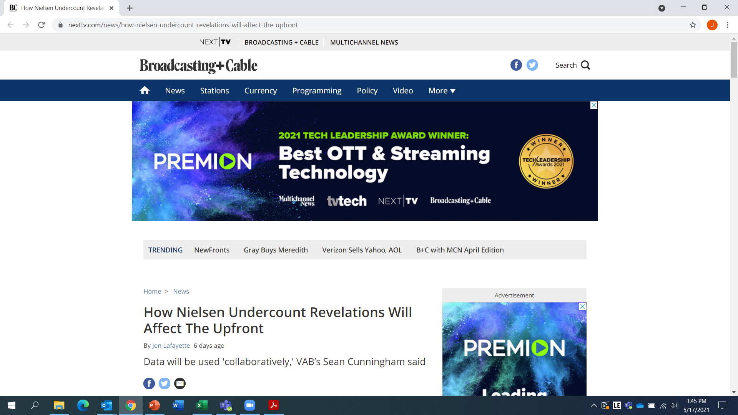
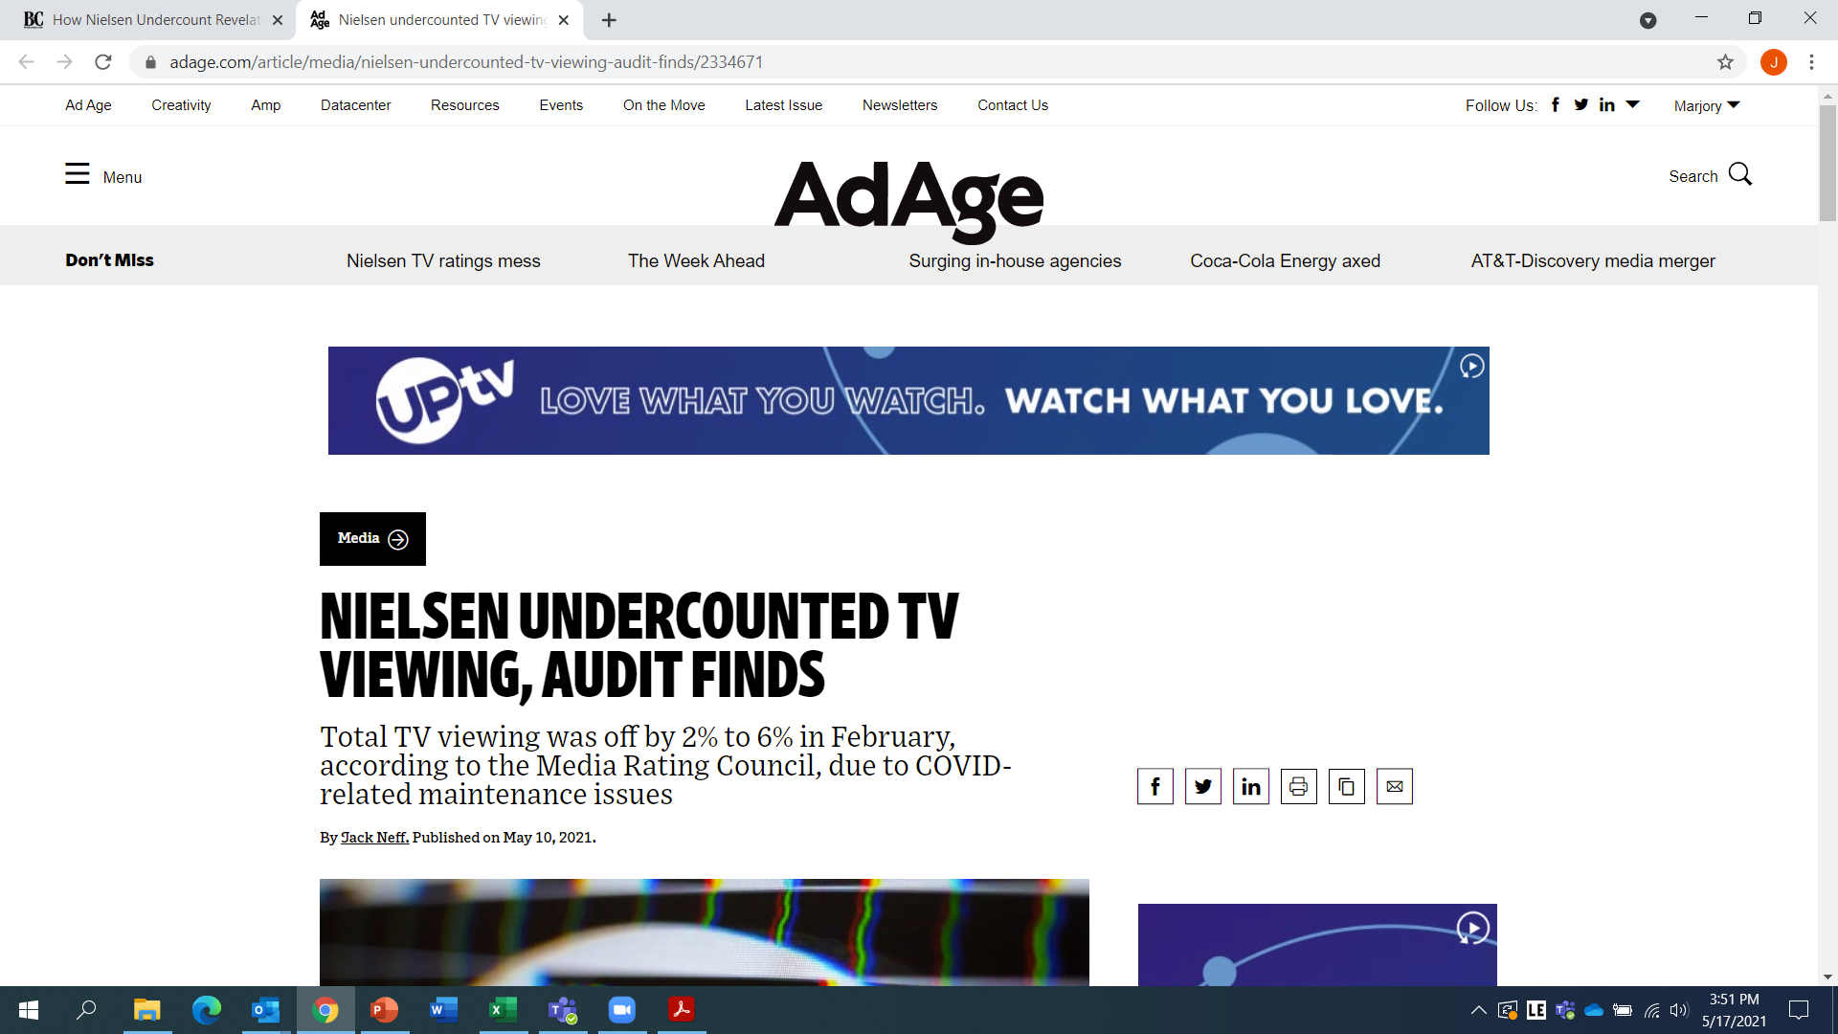
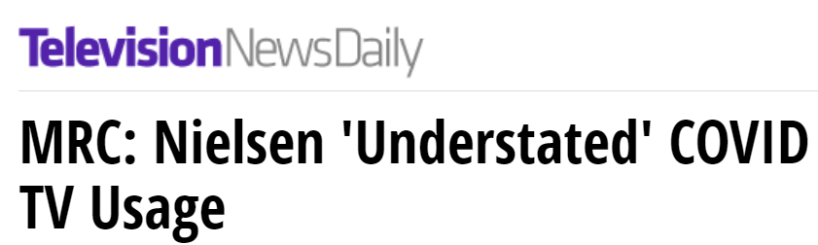
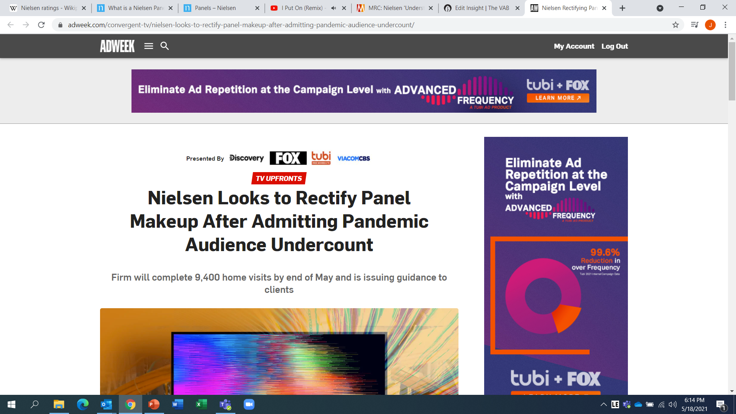

What is the issue?
Why is the industry talking about it?
When the pandemic began in early 2020, Nielsen suspended in-person maintenance of their television panel and allowed homes that had been flagged for potential metering or other problems, which would have otherwise been withheld or removed under Nielsen’s ‘normal’ rules,
to remain in their sample.
As this suspension continued for nearly a year through March 2021, it became critical to understand the implications behind Nielsen’s inability to provide in-home maintenance during an extended period, particularly around three main questions:
  How did this suspension affect the size of Nielsen’s television panel?
  Did Nielsen’s procedural changes affect the make-up of their TV panel sample and total TV usage?
  What was the impact to total TV usage once Nielsen resumed in-person panel maintenance in late-March 2021?
As negotiations begin for the 2021-2022 TV Upfront marketplace, full transparency on the impact of any underlying changes to panel methodology is critical.
As the standard trading currency to a $70 billion industry,
it is imperative for marketers to understand the implications behind any changes and apply the correct adjustments to their planning estimates as they enter negotiations with media partners.
May 11, 2021
May 10, 2021
May 10, 2021
May 11, 2021
PAGE 1

Slide 3






What is a panel and why is it important to marketers?
What is a panel sample?
How is a panel built?
How is panel data used?
Glossary of TV usage terms
A group recruited to represent a larger universe of people in order to understand the behavior of a specific population.
Since it’s not feasible to include everyone in a specific geographic area – like a country or city – Nielsen uses sampling and advanced statistics to ensure that the sample used is representative of the larger population.
Utilizing U.S. Census data as a statistically reliable data set, Nielsen utilizes a random, probability-based sampling to isolate much smaller populations of the total.
Once a smaller dataset is established, statistical modeling, weighting and other scientific techniques are used to ensure the characteristics of the sample accurately reflect those of the larger population.
Panel data is used to understand viewing behavior - such as who is watching what, when and for how long - in order to provide an accurate picture of how consumers are engaging with media.
Data from the TV panel is considered the standard currency that the TV industry uses for buying and selling advertising.
TUT (Total Use of Television): the sum of live + time-shifted TV, DVD/Blu-ray devices, game consoles and internet connected device usage. Combining all these sources provides the total usage on the TV screen.
PUT (Persons Using Television): viewing of live + time-shifted TV across cable, satellite, over-the-air and vMVPDs
This information is exclusively provided to VAB members and qualified marketers. Further distribution is prohibited.
PAGE 3

Slide 4

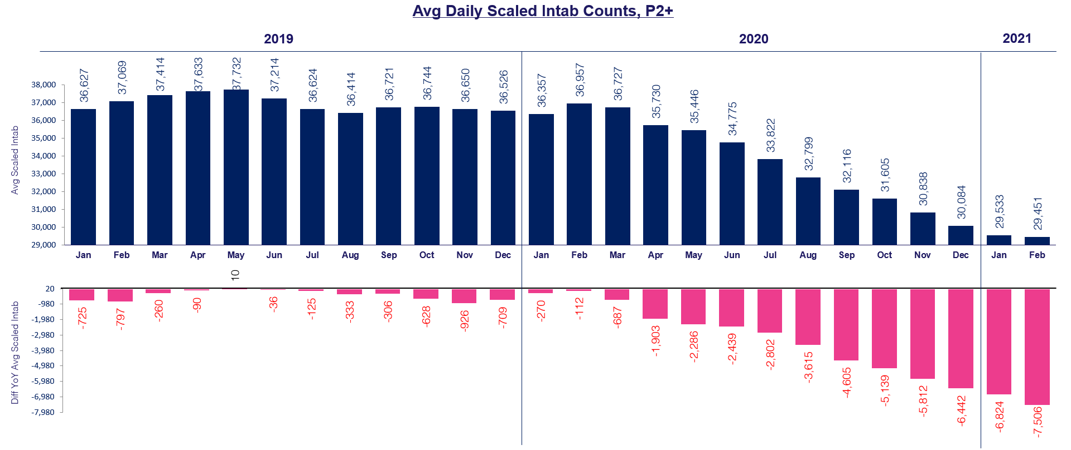
1
Between February 2020 - February 2021, Nielsen lost 20% of its panel sample with successive decreases each month
At the onset of the pandemic, Nielsen suspended in-person maintenance of their television panel and modified other procedures which impacted the way they recruited, installed and maintained homes.
This suspension of in-home field management correlated with the drop in panel size which continued through 1Q ‘21.
Source: Nielsen NPower, Universe Estimate, UE and Sample Information Report, P2+. Reflects broadcast months from January 2019 – February 2021. 2019 YoY comparisons vs. 2018 broadcast month data. Magenta box reflects time period included within Nielsen’s suspension of in-person panel maintenance.
This information is exclusively provided to VAB members and qualified marketers. Further distribution is prohibited.
PAGE 4

Slide 5
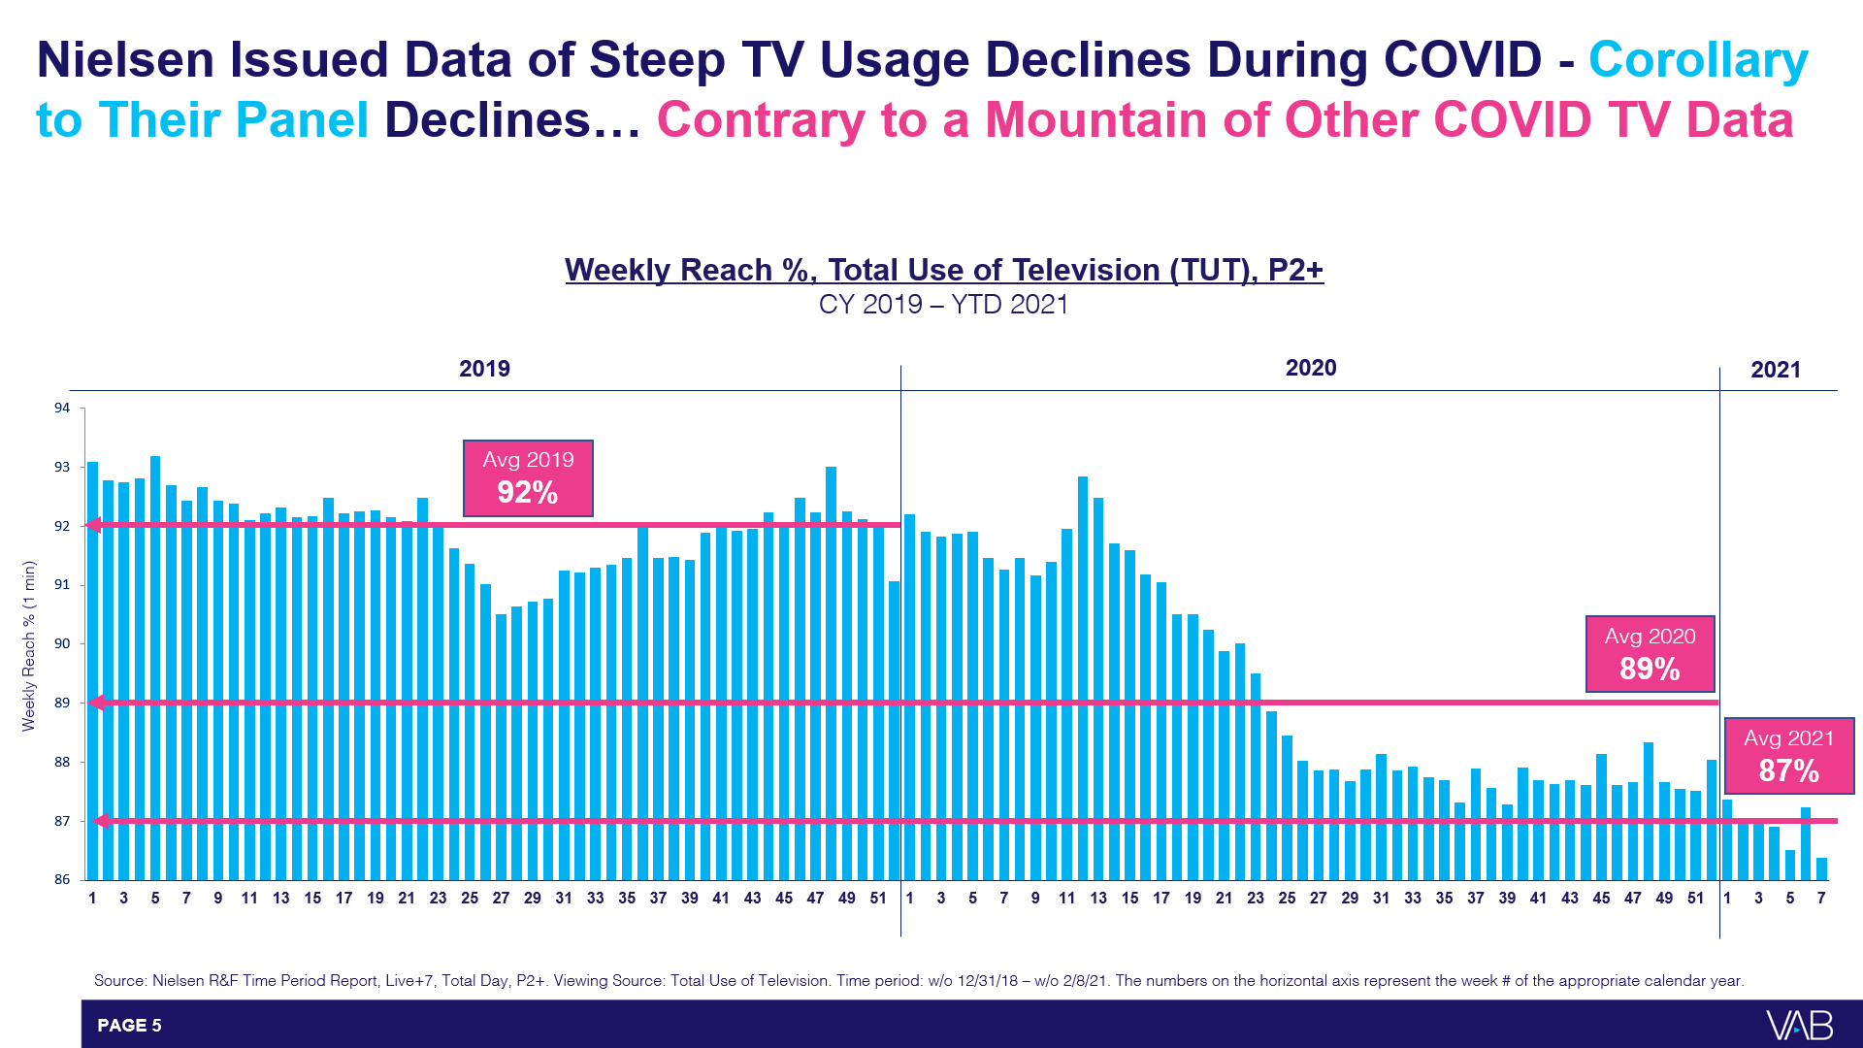
2
During the same period, Nielsen reported total TV usage (linear, streaming, etc) declined even as many communities were in lockdown and under ‘stay-at-home’ orders due to the pandemic
Bearing in mind that ‘TUT’ includes linear TV viewing, streaming, game consoles, etc, this trend is contrary to other TV usage data sources regarding COVID-related viewership and consumption habits through 2020
Source: Nielsen R&F Time Period Report, Live+7, Total Day, P2+. Viewing Source: Total Use of Television. Time period: w/o 12/31/18 – w/o 2/8/21. The numbers on the horizontal axis represent the week # of the appropriate calendar year.
This information is exclusively provided to VAB members and qualified marketers. Further distribution is prohibited.
PAGE 5

Slide 6
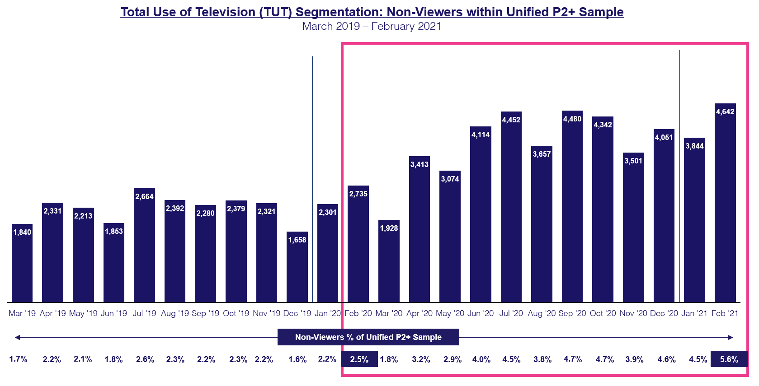
3
Due to the lack of in-person maintenance, there was a 120% increase in the share of homes ‘not watching television of any kind’ within the panel sample during the first 12 months of the pandemic
With Nielsen not conducting
in-home maintenance during COVID, ‘non-viewers of TV’
began increasing within the
first few weeks of the pandemic, therefore a high share of presumably empty, or non-responding homes, were factored into TV audience measurement
Year-over-Year Comparison
Non-Viewers of TV as a % of Nielsen unified P2+ sample
February 2020: 2.5%
February 2021: 5.6%
Source: Nielsen NPower, Number of Minutes Time Period Segmentation Report, P2+. Reflects broadcast months. % = non-viewers as a % of total unified sample.
This information is exclusively provided to VAB members and qualified marketers. Further distribution is prohibited.
PAGE 6

Slide 7
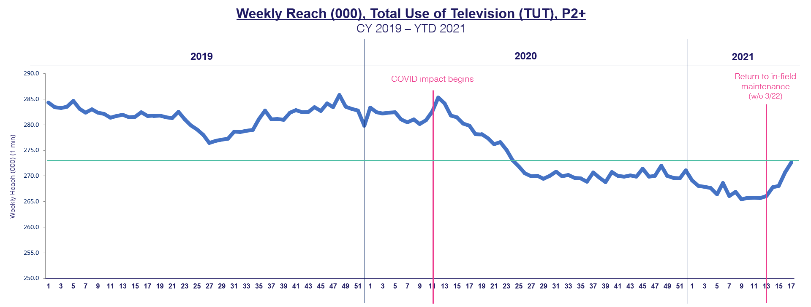
4
In March ‘21 when Nielsen returned to in-home maintenance, ‘Total Use of Television’ began to immediately recover - achieving its highest level in 10 months (June 2020) after just five weeks
Nielsen announced that they would return to in-home service w/o March 22nd with 9,400 homes within the existing sample identified as priorities requiring maintenance (projected completion date: end of May).
The recent TUT growth reflected
in the chart occurred within the context of work being completed on only half of the 9,400 homes requiring in-person maintenance.
As of w/o 4/22
4,681 HHs completed work (50%)
3,625: maintenance performed
582: temporarily removed
474: removed from sample
w/o 4/19
w/o 6/8
Source: Nielsen R&F Time Period Report, Live+7, Total Day, P2+. Viewing Source: Total Use of Television. Time period: w/o 12/31/18 – w/o 4/19/21. The numbers on the horizontal axis represent the week # of the appropriate calendar year.
This information is exclusively provided to VAB members and qualified marketers. Further distribution is prohibited.
PAGE 7

Slide 8
5
On May 10th, MRC took the unprecedented step of establishing TUT and PUT adjustment factors for Nielsen’s data acknowledging they underrepresented TV viewing during COVID
An independent analysis performed by MRC, overseen by E&Y, of Nielsen’s February 2021 data confirmed the TV audience was undercounted due to the instability of the sample. Based on this one-month time period, MRC recommended utilizing adjustment factors for this data:
TUT rating changes*
P2+: 1% - 4%
P18-49: 2% - 6%
P25-54: 1% - 5%
PUT rating changes*
P2+: 1% - 3%
P18-49: 1% - 5%
P25-54: 1% - 4%
The analysis to the right is based on the PUT adjustment factor for P18-49
Estimated Nat’l TV P18-49 IMPs (equiv)
Feb 2021 Nat’l TV P18-49 IMPs Estimate | Range of TV Adjustment Factors | Theoretical 1-Month Loss due to Undercounted Audience | Theoretical 12-Month Loss due to Undercounted Audience
142.9 B | +1.0% | 1.4 B | 17.2 B
142.9 B | +3.5% | 5.0 B | 60.0 B
142.9 B | +5.0% | 7.1 B | 85.8 B
Theoretically, over the last
12 months, the undercounting
of TV audiences due to continuing panel maintenance issues may have cost the national TV marketplace:
Between 17 – 86 billion in P18-49 ad impressions (estimated)
Between $468 MM - $2.3 billion in ad spend (estimated)
Estimated Nat’l TV Spend
Feb 2021 Nat’l TV Ad Spend Estimate | Range of TV Adjustment Factors | Theoretical 1-Month Loss due to Undercounted Audience | Theoretical 12-Month Loss due to Undercounted Audience
$3.9 B | +1.0% | $39 MM | $468 MM
$3.9 B | +3.5% | $137 MM | $1.6 B
$3.9 B | +5.0% | $195 MM | $2.3 B
Source: Nielsen Ad Intel, February 2021, broadcast months. Cable TV, Network TV (broadcast), Spanish language cable TV, Spanish language network TV (broadcast), includes all dayparts, excludes promos and PSAs. Impressions are P18-49 equivalized, Live +7 and includes Spanish language networks, excludes promos and PSAs. 12-month estimation based on 1-month theoretical estimate x 12.
*The adjustment factors are based on only one month of data (February 2021), however the MRC believes the undercounting could be higher during the affected measurement period: March ‘20 – March ‘21.
This information is exclusively provided to VAB members and qualified marketers. Further distribution is prohibited.
PAGE 8

Slide 9
Nielsen data utilized from March 2020 to date should be used with caution. Review the MRC guidance and apply adjustment factors to planning estimates while working collaboratively with your media partners
Continually, and rigorously, analyze multiple third-party data sources to ensure greater transparency, accuracy and accountability
In order to analyze the impact of adjustment factors by demo, daypart or program for future planning, Nielsen clients can access the February 2021 simulation analysis that re-calculated audience estimates based on the removal of homes with data collection issues by selecting the ‘National Panel – COVID Simulation’ sample through Program / Time Period Ratings Analysis or R&F reports in NPower
What does this mean for marketers?
This information is exclusively provided to VAB members and qualified marketers. Further distribution is prohibited.
PAGE 9

Slide 10

Discover more
Looking for more data, insights and takeaways? Check out this related VAB content
Nielsen in COVID
TV Measurement Defects and Systemic Under-Counting
VAB Members, brand marketers and agencies get free and immediate access to VAB’s content library. Get access at theVAB.com
This information is exclusively provided to VAB members and qualified marketers. Further distribution is prohibited.
PAGE 10

Slide 11

About VAB
VAB is an insights-driven organization that inspires marketers to reimagine their media strategies resulting in fully informed decisions.
Drawing on our marketing expertise, we simplify the complexities in our industry and discover new insights that transform the way marketers look at their media strategy.
Discover
We keep you one step ahead with the latest thinking so you can create innovative, forward-looking strategies.
Simplify
We save you time by bringing you the latest data & actionable takeaways you can use to inform your marketing plans.
Transform
We help you build your brand by focusing on core marketing principles that will help drive tangible business outcomes.
We are committed to your business growth and proud to offer VAB members, brand marketers and agencies complimentary access to our continuously-growing Insights library. Get immediate access at theVAB.com.
This information is exclusively provided to VAB members and qualified marketers. Further distribution is prohibited.
PAGE 11

