Slide 1



June – 2020
Navigating the Flood
Charting Your Way Through
Today’s Streaming Ecosystem

Slide 2

About VAB
VAB is an insights-driven organization that inspires marketers to reimagine their media strategies resulting in fully informed decisions.
Drawing on our marketing expertise, we simplify the complexities in our industry and discover new insights that transform the way marketers look at their media strategy.
Simplify
We save you time by bringing you the latest data & actionable takeaways you can use to inform your marketing plans.
Discover
We keep you one step ahead with the latest thinking so you can create innovative, forward-looking strategies.
Transform
We help you build your brand by focusing on core marketing principles that will help drive tangible business outcomes.
This information is exclusively provided to VAB members and qualified marketers. Further distribution is prohibited.
PAGE 2

Slide 3
Contents
1
5
Indicators of What Lies Ahead for Consumer Behavior & Advertiser Opportunity
What You’ll Learn
2
How COVID-19 Has Impacted Video
Streaming Behaviors
6
Key Takeaways For Marketers
3
Streaming Smart: Exploring Growth in
TV-Tech & Services
7
Members Exclusive Section
Video Streaming Services Directory
4
Content As The Driving Force For Video Streamers

Slide 4
What You’ll Learn…
How COVID-19 has changed the mindset of viewers when it comes to video
The most up-to-date coverage of the current video streaming ecosystem, including the newest services and the impact they have had on the streaming landscape
Discover unique opportunities for marketers looking to expand their video campaigns within ad-supported streaming video
This information is exclusively provided to VAB members and qualified marketers. Further distribution is prohibited.
PAGE 4

Slide 5
Prior to the outbreak, video streaming had been experiencing rapid growth for some time as viewing migrated across screens and devices
With the release of even more streaming options like, Disney+, Quibi and Apple TV+, the video streaming ecosystem was already on track to continue growing significantly
Source: Conviva, Q4 2019 State of Streaming, Feb 2020. Reflects overall growth in global streaming viewing hours.
This information is exclusively provided to VAB members and qualified marketers. Further distribution is prohibited.
PAGE 5

Slide 6






With so many options available, the industry was already unsure which services viewers would be willing to devote their time and money to
In less than a year, several major new services have launched, causing the largest disruption within on-demand video since the introduction of Netflix streaming & Hulu 10+ years ago
Streaming Services Launch Dates
Nov. 1, 2019
Nov. 12, 2019
Apr. 6, 2020*
May 27, 2020
Jul. 15, 2020
Jan. 4, 2021
← 2019
2020-2021 →
Source: TV Time and United Talent Agency, Beyond The Big Three: The Streaming Wars Are Upon Us, October 2019. Discovery Inc, 12/2/2020. *Company closed as of 12/1/2020.
This information is exclusively provided to VAB members and qualified marketers. Further distribution is prohibited.
PAGE 6

Slide 7

How COVID-19 Has Impacted Video Streaming Behaviors

Slide 8




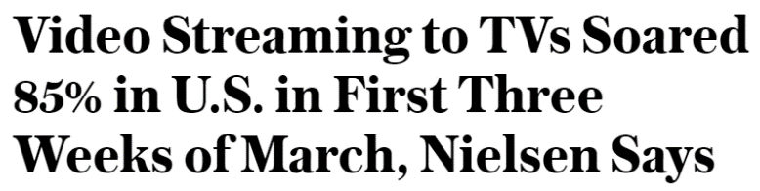
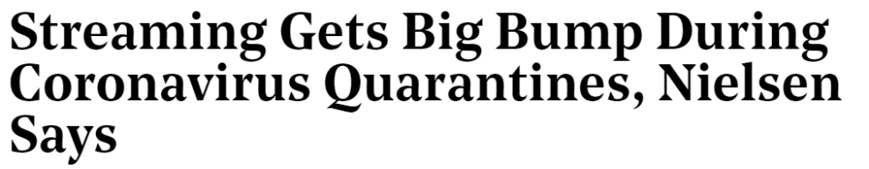
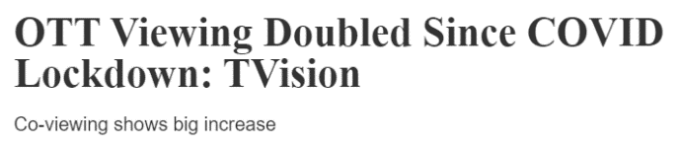


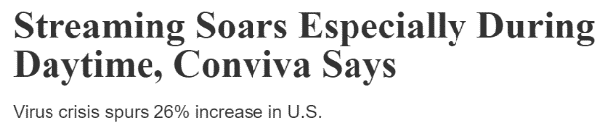







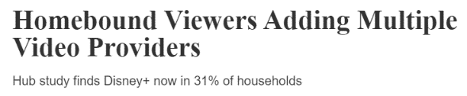

Since the COVID-19 outbreak began in earnest, viewers confined to their homes have turned to in-home entertainment to fill their time, leading to significant increases in video streaming
This information is exclusively provided to VAB members and qualified marketers. Further distribution is prohibited.
PAGE 8

Slide 9
With video streaming following similar viewership patterns as live TV and VOD, spiking in late March followed by a leveling off in April
Streaming Minutes Per Week
P2+ Weekly Total Streaming Minutes (billions)
+23%
vs. 2/24
168.7
161.4
169.9
156.1
154.6
147.2
150.4
145.2
141.7
116.4
127.6
115.0
Source: Nielsen, Streaming Meter Homes, sum of daily streaming minutes (weighted), P2+, Total Day, Others calculated as the difference between total streaming and the sum of the major four digital publishers.
This information is exclusively provided to VAB members and qualified marketers. Further distribution is prohibited.
PAGE 9

Slide 10


According to a recent VAB custom study, viewers have been binging more than ever & ramping up their streaming viewing via both SVOD & AVOD
As entertainment options have been primarily contained to the home, people have had more time to watch video, with 70% saying they have been binge-wanting more TV shows and movies during the COVID-19 outbreak
% Of Respondents Who Increased Usage By Platform Since COVID-19 Outbreak
P18+
54%
31%
SVOD
Service
AVOD
Service
Source: VAB’s 'As Time Goes By: How Media Consumption Is Helping America Cope’. VAB / Lucid ‘Media Usage In The Time of COVID-19 Survey,’ April 2020. Survey base: P18+ & household subscribes to cable, telco, internet TV or satellite TV (n=1,004). Q2: When thinking about how you’ve spent your time during the COVID-19 Pandemic, have you increased, decreased or spent the same amount of time with the following media? SVOD: Subscription Video On Demand (e.g. Netflix, Amazon Prime Video), AVOD: Ad-Supported Video On Demand (e.g. Tubi, Roku). Q7: Thinking of your behavior since the start of COVID-19, please indicate below how much you agree or disagree with the following statements & Q9: Thinking of your behavior during the COVID-19 Pandemic, please indicate below how much you agree or disagree with the following statements.
This information is exclusively provided to VAB members and qualified marketers. Further distribution is prohibited.
PAGE 10

Slide 11
Life stage appears to be a driving force across much of the platform usage growth, as Gen X & households with children increase their use
of both SVOD and AVOD services
Increase In Platform Usage Since COVID-19 Outbreak
% of respondents who increased usage
Source: VAB’s 'As Time Goes By: How Media Consumption Is Helping America Cope’. VAB / Lucid ‘Media Usage In The Time of COVID-19 Survey,’ April 2020. Survey base: P18+ & household subscribes to cable, telco, internet TV or satellite TV (n=1,004). Q2: When thinking about how you’ve spent your time during the COVID-19 Pandemic, have you increased, decreased or spent the same amount of time with the following media? SVOD: Subscription Video On Demand (e.g. Netflix, Amazon Prime Video), AVOD: Ad-Supported Video On Demand (e.g. Tubi, Roku).
This information is exclusively provided to VAB members and qualified marketers. Further distribution is prohibited.
PAGE 11

Slide 12
Multicultural viewers have also increased their streaming service usage
This is due to the wide variety of content offerings featuring and produced by diverse talent across video streaming services
Increase In Platform Usage Since COVID-19 Outbreak
% of respondents who increased usage
Source: VAB’s 'As Time Goes By: How Media Consumption Is Helping America Cope’. VAB / Lucid ‘Media Usage In The Time of COVID-19 Survey,’ April 2020. Survey base: P18+ & household subscribes to cable, telco, internet TV or satellite TV (n=1,004). Q2: When thinking about how you’ve spent your time during the COVID-19 Pandemic, have you increased, decreased or spent the same amount of time with the following media?
This information is exclusively provided to VAB members and qualified marketers. Further distribution is prohibited.
PAGE 12

Slide 13

And engaging with video-streaming-related content on social media has become a haven for isolated viewers seeking a sense of community and connection
Social media has become the new water cooler when it comes to discussing the latest episode of your favorite show, as we see a 50% increase in social interactions with TV programming
Streaming Services
Dates | No. of Programs | Total Social Interactions
3/1/19 – 4/15/19 | 125 | 71,841,480
3/1/20 – 4/15/20 | 125 | 108,992,501
% Change |  | +52%
Source: Nielsen Social Content Ratings. Live/new, linear and 24/7, 3/1/19-4/15/19 and 3/1/20-4/15/20. Interactions are a measure of total relevant social media activity on Facebook, Instagram Business Accounts, and Twitter. Social activity is measured from three hours before through three hours after broadcast, local time. Owned engagements for Facebook include comments, shares, and likes. Owned engagements for Instagram business accounts include comments and likes. Owned engagements for Twitter include retweets, quotes, replies, and likes.
This information is exclusively provided to VAB members and qualified marketers. Further distribution is prohibited.
PAGE 13

Slide 14

Summary: How COVID-19 Has Impacted Video Streaming Behaviors
Streaming video, which was already experiencing significant growth ahead of the COVID-19 pandemic, has seen major spikes in viewership since stay-at-home directives took effect
While time spent streaming video has since leveled off, video devices and programming, in addition to streaming-related online interactions, has given viewers something to center around and find community in while isolated
This information is exclusively provided to VAB members and qualified marketers. Further distribution is prohibited.
PAGE 14

Slide 15
Streaming Smart: Exploring Growth in TV-Tech & Services

Slide 16



With more time in their day, consumers have expanded their options by utilizing new platforms and discovering the full functionality of their existing devices
% of respondents who agree with the statement
P18+
84%
66%
54%
“I have more time to watch/listen/read media”
“I am more open to trying new types of media”
(e.g. new streaming services, podcasts, social media platforms, etc)
“I have learned how to use more features on my smart TV or a TV related device/platform”
Source: VAB’s 'As Time Goes By: How Media Consumption Is Helping America Cope’. VAB / Lucid ‘Media Usage In The Time of COVID-19 Survey,’ April 2020. Survey base: P18+ & household subscribes to cable, telco, internet TV or satellite TV (n=1,004). Q9: Thinking of your behavior during the COVID-19 Pandemic, please indicate below how much you agree or disagree with the following statements.
This information is exclusively provided to VAB members and qualified marketers. Further distribution is prohibited.
PAGE 16

Slide 17







As multiple people confined together at home seek to watch their own programming, cross-platform viewing has led to growth across devices
Some of the biggest increases in use have occurred on Smart TVs and streaming boxes / sticks, which makes sense as more than two-thirds (67%) of U.S. broadband households own and use at least one Internet-connected video device
Percent Change in Average Monthly In-Home Data Usage by Device
2019 vs 2020 – Gigabytes Received
Streaming Box / Stick
Gaming Console
Smart Speaker
Phone
Smart TV
Tablet
PC / Mac
Grand Total
January
+21%
+26%
+24%
+18%
+6%
+7%
-3%
+16%
February
+27%
+22%
+21%
+15%
+12%
-4%
-5%
+16%
March
+43%
+41%
+36%
+24%
+15%
+12%
+9%
+28%
Source: Parks Associates via Advanced Television, May 20, 2020. Comscore, April 2020. Comscore Total Home Panel Custom Reporting, March 2019 – March 2020.
This information is exclusively provided to VAB members and qualified marketers. Further distribution is prohibited.
PAGE 17

Slide 18




However, the largest screen in the home continues to be a preferred video device, with homes watching 100 hours of content a month on average via their Connected TV
Advertisers have become very aware of the amount of time viewers are spending with CTV, with ad spend on CTV projected to reach an estimated $10.8 billion by 2021, a 56% increase over 2 years
64.6 MM
66%
72.4 MM
homes used CTV
72% Reach
among homes with Wi-Fi
85 Hours
17.4 Days
The average home viewed
100 Hours
of CTV content across the month
…this was spread across
19 average
viewing days
= April 2019
Source: Comscore, April 2020. Comscore OTT Intelligence, March 2020, U.S. Business Insider Intelligence via LinkedIn, 5/22/20.
This information is exclusively provided to VAB members and qualified marketers. Further distribution is prohibited.
PAGE 18

Slide 19
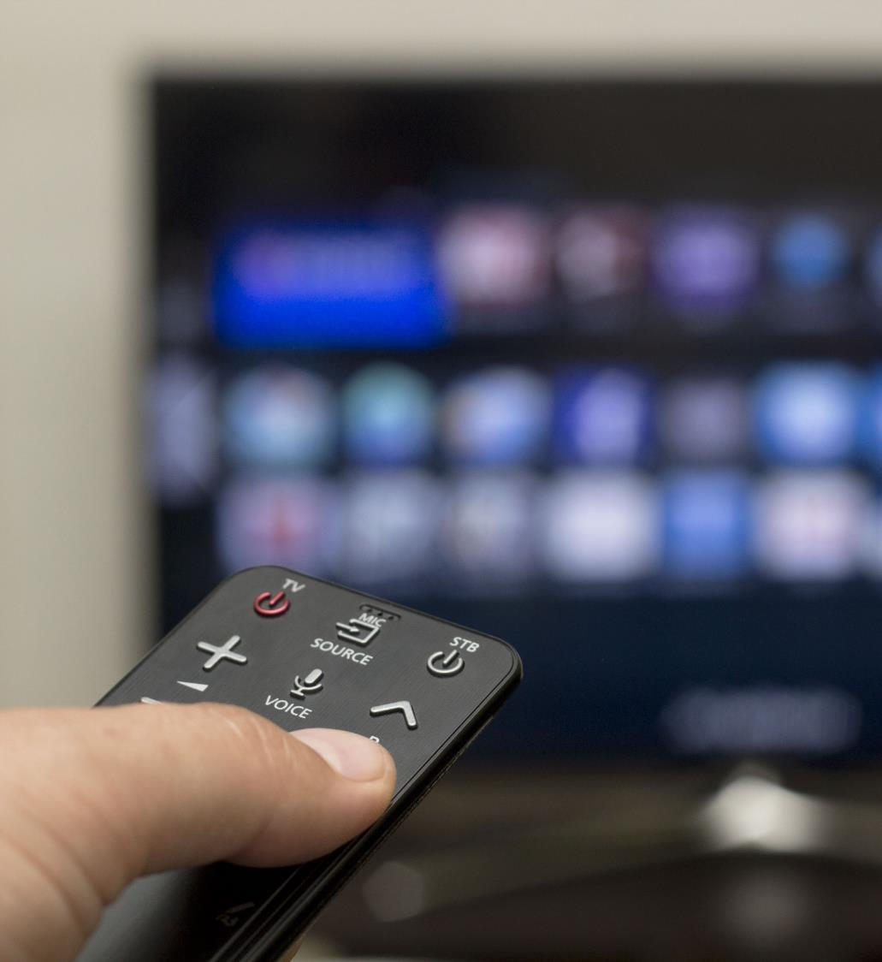
Many people are spending time learning about new features on their smart TVs and connected devices
“I have learned how to use more features on my
smart TV or a TV related device/platform”
Top 2 Box (Agree Completely or Agree Somewhat)
Source: VAB’s 'As Time Goes By: How Media Consumption Is Helping America Cope’. VAB / Lucid ‘Media Usage In The Time of COVID-19 Survey,’ April 2020. Survey base: P18+ & household subscribes to cable, telco, internet TV or satellite TV (n=1,004). Q9: Thinking of your behavior during the COVID-19 Pandemic, please indicate below how much you agree or disagree with the following statement, top 2 box (agree completely or agree somewhat).
This information is exclusively provided to VAB members and qualified marketers. Further distribution is prohibited.
PAGE 19

Slide 20
Rising interest in TV-related tech may be attributed to video streaming services increasing their reach, growing 11% from January to March 2020
+11%
+11%
Source: Comscore, April 2020.
This information is exclusively provided to VAB members and qualified marketers. Further distribution is prohibited.
PAGE 20

Slide 21



With more time at their disposal, viewers have been taking the time to sample both ad-supported and subscription streaming services
Since the COVID-19 Pandemic, have you done any of the following?
P18+
37%
36%
9%
Watched a free streaming service
Added a new streaming service
Unsubscribed from a streaming service
(e.g. Roku, Pluto or Tubi)
(i.e., Apple TV+, Disney+, Netflix, etc.)
(i.e., Apple TV+, Netflix, etc.)
Source: VAB’s 'As Time Goes By: How Media Consumption Is Helping America Cope’. VAB / Lucid ‘Media Usage In The Time of COVID-19 Survey,’ April 2020. Survey base: P18+ & household subscribes to cable, telco, internet TV or satellite TV (n=1,004). Q10: Since the COVID-19 Pandemic, have you done any of the following? Note: Percentages don’t add to 100% because it excludes “none of the above” response.
This information is exclusively provided to VAB members and qualified marketers. Further distribution is prohibited.
PAGE 21

Slide 22
Young adults, along with households with kids desperately in need of entertainment, have been the key drivers behind the growth of video streaming services
Since the COVID-19 Pandemic, have you done any of the following?
% of respondents who done the following
(i.e. Roku, Tubi, or PlutoTV)
(i.e., Apple TV+, Disney+, Netflix, etc.)
Source: VAB’s 'As Time Goes By: How Media Consumption Is Helping America Cope’. VAB / Lucid ‘Media Usage In The Time of COVID-19 Survey,’ April 2020. Survey base: P18+ & household subscribes to cable, telco, internet TV or satellite TV (n=1,004). Q10: Since the COVID-19 Pandemic, have you done any of the following? Note: Percentages don’t add to 100% because it excludes “none of the above” response.
This information is exclusively provided to VAB members and qualified marketers. Further distribution is prohibited.
PAGE 22

Slide 23
Multicultural audiences have been even more inclined to add new streaming services, including ad supported video streaming services
Behavior During COVID-19 Outbreak
% of respondents who done the following
(i.e. Roku, Tubi, or PlutoTV)
(i.e., Apple TV+, Disney+, Netflix, etc.)
Source: VAB’s 'As Time Goes By: How Media Consumption Is Helping America Cope’. VAB / Lucid ‘Media Usage In The Time of COVID-19 Survey,’ April 2020. Survey base: P18+ & household subscribes to cable, telco, internet TV or satellite TV (n=1,004). Q10.Since the COVID-19 Pandemic, have you done any of the following? Note: Percentages don’t add to 100% because it excludes “none of the above” response.
This information is exclusively provided to VAB members and qualified marketers. Further distribution is prohibited.
PAGE 23

Slide 24







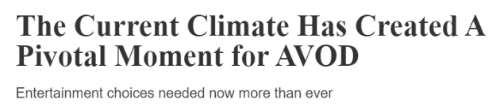





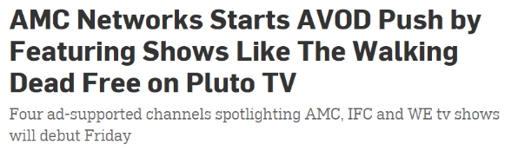

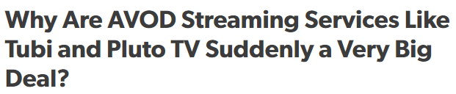
The current climate has led to indicators that COVID may put AVOD services’ growth at a faster pace than previously expected
This information is exclusively provided to VAB members and qualified marketers. Further distribution is prohibited.
PAGE 24

Slide 25


During the COVID-19 outbreak, AVOD app usage on Smart TVs has seen significant growth, especially when compared to overall use
VIZIO SmartCast Platform Viewership Trends:
Week of 4/6/20 vs. Week of 3/9/20
+20%
+74%
Increase in all App Usage
Increase in AVOD App Usage
Source: Inscape, VIZIO Ads, 2020. Data courtesy of VIZIO Ads, using anonymous panel of 10+ million SmartCast users and Inscape’s panel of 14+ million opt-in TVs, comparing usage the week of 3/9/20 vs. 4/6/20. VIZIO SmartCast products are smart devices but there are no built-in applications. Instead you "cast" or "fling" the content to the display.
This information is exclusively provided to VAB members and qualified marketers. Further distribution is prohibited.
PAGE 25

Slide 26
The majority of AVOD viewers are not deterred from using the service by the presence of ads
While the majority of those surveyed would continue to use a service regardless of commercial breaks, many prefer fewer interruptions with longer commercials
Likelihood To Continue Using AVOD Services Under Different Ad Scenarios
Among AVOD Users
57% would continue to use
66% would continue to use
73% would continue to use
Source: Hub Entertainment Research via Cynopsis Media, 4/29/2020. Data based on Hub Entertainment Research survey of 2,000 TV consumers. Base = AVOD Users (n=799).Q. Think again about the free online TV services with ads you said you use. Assume you were watching a half hour show on one of these services. And assume that there would be 3 commercial breaks in the show. Below we’ve listed different possibilities for the length and number of specific commercials in each commercial break. For each, tell us how you feel.
This information is exclusively provided to VAB members and qualified marketers. Further distribution is prohibited.
PAGE 26

Slide 27
This holds true among younger AVOD users, although they prefer more ads of shorter lengths within a break
Likelihood To Continue Using AVOD Services Under Different Ad Scenarios, By Demo
Among AVOD Users
10 Commercials / Break, Each 6 Seconds Long
2 Commercials / Break, Each 30 Seconds Long
Source: Hub Entertainment Research via Cynopsis Media, 4/29/2020. Data based on Hub Entertainment Research survey of 2,000 TV consumers. Base = AVOD Users (n=799).Q. Think again about the free online TV services with ads you said you use. Assume you were watching a half hour show on one of these services. And assume that there would be 3 commercial breaks in the show. Below we’ve listed different possibilities for the length and number of specific commercials in each commercial break. For each, tell us how you feel.
This information is exclusively provided to VAB members and qualified marketers. Further distribution is prohibited.
PAGE 27

Slide 28
As viewers turn to ad-supported video streaming options, advertisers are expected to make significant investments in AVOD over the next 5 years
AVOD revenues are projected to increase 120% by 2025
+120%
Source: Digital TV Research via Cynopsis Media (North American AVOD Revenues), May 19, 2020.
This information is exclusively provided to VAB members and qualified marketers. Further distribution is prohibited.
PAGE 28

Slide 29
Summary: Streaming Smart: Exploring Growth in TV-Tech & Services
With more time to spare, many have been spending their quarantine exploring new forms of media and learning about new features on their video devices
Usage is up across most devices, with Smart TVs and connected devices seeing the biggest jumps as people devote even more time to video streaming
Consumers have ramped up viewing on both paid SVOD services and free AVOD services, giving advertisers the opportunity to reach consumers in this increasingly relevant format
This information is exclusively provided to VAB members and qualified marketers. Further distribution is prohibited.
PAGE 29

Slide 30
Content As The Driving Force For Video Streamers

Slide 31
Content has long been a powerful driving factor for subscribers looking to add a paid streaming service to their lineup
The top 4 reasons people say they will add additional services all relate to content
Content-related Reason
Other Reason
Source: Nielsen Total Audience Report, Q3 2019.
This information is exclusively provided to VAB members and qualified marketers. Further distribution is prohibited.
PAGE 31

Slide 32
Despite the amount of buzz that original programming generates, across all streaming services over half of subscribers most enjoy watching TV series and movies
When looking at content preferences among some of the top paid streaming services, original content accounts for less than half
Content Most Enjoyed On…
Source: VAB analysis of S&P Global Market Intelligence; Netflix – Kagan U.S. Consumer Insights survey, March 2019, Q: Of the content you view on Netflix Streaming which would you say is the content you most enjoy viewing? Base: Netflix users, 2017 – 1,480; 2018 – 1,447. *Network TV show episodes added to Netflix after a season conclusion. Original TV program examples include Queer Eye, The Crown, Marvel's Luke Cage; Amazon Prime Video – Kagan U.S. Consumer Insights survey, September 2018, Q: You indicated that you currently have a subscription to Amazon Prime Video. Which of the following types of video content do you view from the service? Base: Amazon Prime Video users, 2018 – 952. *In previous surveys original content was only presented as one selection for original TV programs. Original TV program examples include The Man in the High Castle, Sneaky Pete; Hulu - Kagan U.S. Consumer Insights survey, September 2018, Q: Of the content you view on Hulu which would you say is the content you most enjoy viewing? Base: Hulu users, 2017 – 549; 2018 – 588. *In previous surveys original content was only presented as one selection for original TV programs. Original TV program examples include The Handmaid's Tail, Castle Rock, Difficult People. ‘Oriignal Content’ includes original TV programs (i.e., Tiger King), original movies, documentaries, comedy specials, etc. ‘Network TV Series’ includes prior seasons of Network TV series and current seasons of Network TV episodes. ‘Movies’ includes recent movies (released w/in past 2 years) and older movies (released 2+ years ago).
This information is exclusively provided to VAB members and qualified marketers. Further distribution is prohibited.
PAGE 32

Slide 33
And with many new productions on hold, acquired content on streaming services could have a long shelf-life as many are watching older seasons of popular programs for the very first time while in quarantine
Netflix Original Program
Broadcast / Cable Original Program
HBO Original Program
Note: 100% = total number of times these 20 shows were tracked for the first time by Reelgood users between March 16 – April 26, 2020.
Source: VAB analysis of Reelgood data, 2020. Reflects use over period of March 16 – April 26, 2020. Data based on ‘tracks’ = measurement markers created when a streaming video user watches a show for the first time. *’Money Heist’ first aired on Spanish-language network Antena 3 in 2017 before Netflix acquired global streaming rights.
This information is exclusively provided to VAB members and qualified marketers. Further distribution is prohibited.
PAGE 33

Slide 34
Knowing this, many of the top services devote a sizable portion of their programming expenses to acquired content rather than their own original productions
Source: S&P Global Market Intelligence, 2020. ‘Acquisitions’ refers to programming that originally aired on another network / platform, but is now owned / bought by a streaming service. Disney+ data as of November 2019. Apple TV+ data compiled December 2019, Hulu data as of March 2019. Amazon Prime data as of April 2019, includes global content costs. Netflix data as of August 2019. Represents amortized programming costs.
This information is exclusively provided to VAB members and qualified marketers. Further distribution is prohibited.
PAGE 34

Slide 35
Summary: Content As The Driving Force For Video Streamers
Content is a powerful driving factor for consumers when considering adding a paid streaming service to their lineup
While original programming is a big draw, viewers often turn to classic favorites, and during quarantine people are watching older seasons of popular shows for the very first time, indicating the enduring appeal of acquired TV programs
With so much existing content that continues to draw in new viewers, major streaming players still devote the majority of their programming budget to acquired content
This information is exclusively provided to VAB members and qualified marketers. Further distribution is prohibited.
PAGE 35

Slide 36
Indicators of What Lies Ahead for Consumer Behavior & Advertiser Opportunity

Slide 37



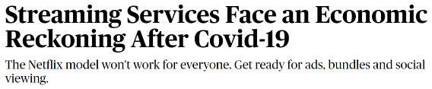
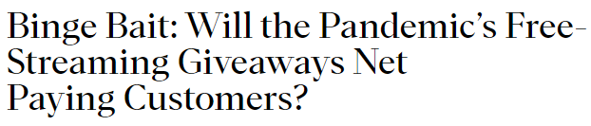





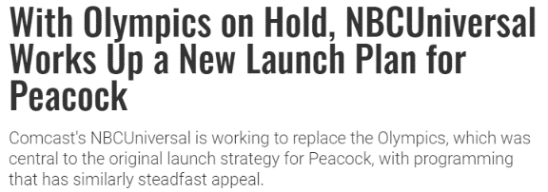

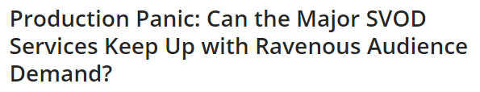




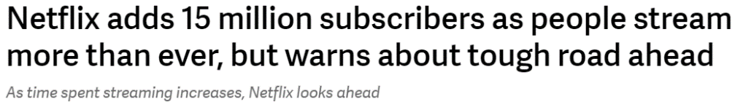
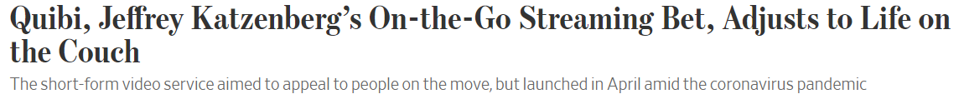

At present, the future of video streaming is unclear although there is plenty of speculation, with major companies beginning to pivot their strategy in response
This information is exclusively provided to VAB members and qualified marketers. Further distribution is prohibited.
PAGE 37

Slide 38



Use of streaming services has increased significantly among consumers who are actively social distancing, and these viewers expect to continue this behavior in the foreseeable future
68%
63%
66%
56%
66%
52%
58%
48%
57%
47%
18%
46%
Source: Hub Entertainment Research, TV and Social Distancing, March 2020. Survey of 1,276 TV consumers in the U.S. about how the Coronavirus and social distancing are changing their entertainment needs and choices. Q: Are you doing this more or less now vs. a month ago? Base: people who are social distancing.
This information is exclusively provided to VAB members and qualified marketers. Further distribution is prohibited.
PAGE 38

Slide 39
However, the OTT / SVOD industry is known to have a relatively high churn rate, with cost being the number one reason for cancelling a service
Factors such as seasonal sports or interest in a limited-run series initially drive sign-ups, but can play a big role in why people cancel
35%
Churn Rate Among
All OTT Services
(2019)
Source: Parks Associates, Driving Engagement and Reducing Churn in OTT, March 2020. Base = U.S. Broadband households who canceled at least one OTT service in past 12 months.
This information is exclusively provided to VAB members and qualified marketers. Further distribution is prohibited.
PAGE 39
Notes:
Pair with reasons for subscribing +

Slide 40

Record unemployment levels and reduced income could threaten to increase churn for many paid streaming services
In fact, over 1/3 (37%) of surveyed U.S. adults would
cancel a streaming subscription
if they lost their job and were looking to reduce household expenses
Source: 2020 S&P Global Market Intelligence, Kagan U.S. Coronavirus survey completed March 29, 2020. Base = 974 Internet adults (excluding “no answers”). Q: If you lost your job and were looking to reduce household expenses, please rank in order of most likely to cancel to least likely to cancel.
This information is exclusively provided to VAB members and qualified marketers. Further distribution is prohibited.
PAGE 40

Slide 41









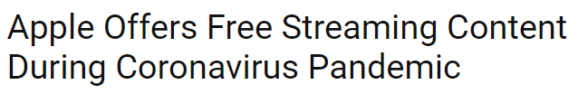
Cash-strapped consumers in need of entertainment have turned to free trials, with many services providing free access to draw in new subscribers
However, whether those who have signed up for a free trial end up subscribing later remains a question
Source: Morning Consult, Poll conducted 4/16/20 – 4/18/20 among 923 U.S. adults who have signed up for a streaming service in the past month, with a margin of error of +/-3%. *’Other streaming services’ include ESPN+, Quibi, YouTube TV, Apple TV+, Showtime Now, CBS All Access and Sundance Now. Figures do not add up to 100 as the shares with paid subscriptions and free trials were calculated separately to avoid double-counting respondents who have signed up for multiple services.
This information is exclusively provided to VAB members and qualified marketers. Further distribution is prohibited.
PAGE 41

Slide 42








In response, video streaming services have been pouring money into TV ad spend in hopes of attracting new subscribers
According to iSpot, the ‘Video Streaming Service’ industry increased their TV spend by 145% since the start of the COVID-19 outbreak vs. the same time period in 2019, for a total of $185MM
Video Streaming Services’ National TV Spend*
March 16th – May 24th, 2020
+136%
+216%
$63MM
$38.5MM
$37.5MM
$30MM
$24.7MM
+39%
+138%
+113%
$16.6MM
$12MM
$8.8MM
$5MM
$3MM
$1MM
$24K
$21K
%
= % change vs. YAG
Source: VAB analysis of iSpot.tv data, 3/18/2019 – 5/24/2019 vs. 3/16/2020 – 5/26/2020. *The above brands represent a sampling of those included in iSpot’s ‘Video Streaming Services’ industry. Brands with no % change vs. YAG did not exist during measurement period in 2019.
This information is exclusively provided to VAB members and qualified marketers. Further distribution is prohibited.
PAGE 42

Slide 43

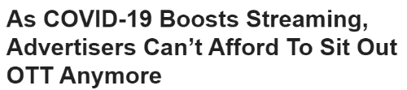



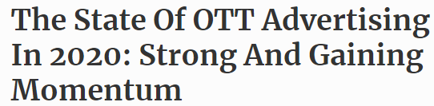
And advertisers have reallocated or reconsidered their budgets in response to these changes in consumer behavior
43% of surveyed advertisers have added to their OTT / CTV budget during the COVID-19 Pandemic, on par with cable TV
Source: ‘Advertiser Perceptions, Coronavirus Effect on Advertising’ Report. Q13b1. Have any media types retained their budgets, had budget added or were the beneficiaries of any budgeting reallocation due to the Coronavirus (Covid-19) outbreak?Q13bN. And which media types, if any, retained their budgets/usage or were the beneficiaries of any budgeting reallocation due to the Coronavirus (Covid-19) outbreak?. Survey fielded April 1-4, 2020, 152 interviews conducted.
This information is exclusively provided to VAB members and qualified marketers. Further distribution is prohibited.
PAGE 43

Slide 44
In fact, OTT is expected to reap double the revenue by 2025 as advertisers seek to follow viewing trends among target audiences
+94%
Source: Digital TV Research via Cynopsis Media, May 19, 2020.
This information is exclusively provided to VAB members and qualified marketers. Further distribution is prohibited.
PAGE 44

Slide 45
Summary: Indicators for What Lies Ahead
Viewers are willing to pay for quality content; however, they are also open to cutting expenses and turning to ad-supported entertainment options
An industry that is already predisposed to a high rate of churn will need to fight hard for cash-strapped subscribers - balancing consumer needs with superior user experience, content and viewing options could hold the key to success
Even in this current crisis, advertisers appear to be following the trends in viewing behaviors, as they devote more ad dollars to the streaming space hoping to break through the cluttered landscape and win the loyalty of consumers
This information is exclusively provided to VAB members and qualified marketers. Further distribution is prohibited.
PAGE 45

Slide 46




Key Takeaways for Marketers
Everything else might be in flux, but video streaming has been consistently on the rise. As viewers spend time exploring their options and trying out different types of services, both paid and ad-supported, marketers will need to adapt in real time to their behavioral shifts in order to make a significant impact
Exploration Leads to More Opportunity
Expand Reach Through AVOD
Content Key to Growth
Focus on the Future
36% of viewers have added a new streaming service during the COVID-19 Pandemic. New audiences trying out different services translates to more ways to connect with consumers.
With people out of work and adopting free ad-supported services, advertisers should follow the eyeballs to these new and expanding platforms.
While new productions might be on hold, there is much existing content available on streaming services. With a vast supply of programming, opportunity to reach an engaged audience can withstand the current challenges.
No one is sure how long current trends will last beyond the pandemic, but the focus should always be on the audience. While viewing continues to shift, the ability to adapt and evolve along with your audience is the goal.
This information is exclusively provided to VAB members and qualified marketers. Further distribution is prohibited.
PAGE 46

Slide 47

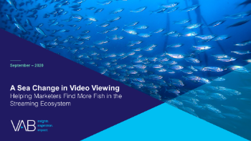
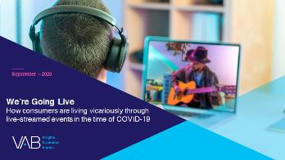
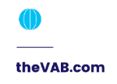


Thank You
Creators
Kathy Grey
Leah Montner-Dixon
SVP, Research Innovation kathyg@thevab.com
Insights Manager
leahm@thevab.com
Interested in learning more? Check out this related content:
VAB Inspire Virtual Learning Series:
Streaming Trends & Insights
A Sea of Change in Video Viewing:
Helping Marketers Find More Fish in the Streaming Ecosystem
We’re Going Live:
How Consumers Are Living Vicariously Through Live-streamed Events in the Time of COVID-19
This information is exclusively provided to VAB members and qualified marketers. Further distribution is prohibited.
PAGE 47

Slide 48

Get immediate access to the VAB Insights library
We’ve answered hundreds of marketers’ questions.
Our guides, reports, webinars and videos provide actionable insights to help marketers navigate today’s video landscape and think differently about their strategy.
We are committed to your business growth and proud to offer brand marketers and agencies complimentary access to our continuously-growing Insights library.
Get Access at theVAB.com or visit us here
This information is exclusively provided to VAB members and qualified marketers. Further distribution is prohibited.
PAGE 48

Slide 49
Members Exclusive Section Video Streaming Services Directory

Slide 50


A vast library of exclusive content that is no longer available on more established streaming platforms is a big draw for many of the new streaming services
Vendor | Ad Supported | Non-Ad Supported | Price | Audience Size | Overview
 |  | ✓ | $7.99 / month ; $79.99 / Year | 116MM* | Delivers vast majority of content Disney owns w/ features such as 4K streaming, offline downloads & personalized recommendations.
 | ✓ | ✓ | $9.99 / mo (inc. ads) $14.99 / mo (no ads) | 47MM** | Has combination of HBO content, new original series, new & existing shows & movies from CNN, Cartoon Network, Warner Bros.
 |  | ✓ | $4.99/mo | 40MM*** | Apple TV+ only includes Apple’s original shows and movies.
 | ✓ | ✓ | Free, Premium $4.99/mo (inc. ads) $9.99/mo (no ads) | 54MM | Comcast’s NBCUniversal streaming service includes Spanish language content, news & sports.
 | ✓ | ✓ | $4.99 / month (ad-supported) / $6.99 / month (no ads) | 18MM**** | Discovery Inc’s streaming platform offers a massive number of shows from traditional cable channels such as Animal Planet, Food Network, HGTV, OWN, TLC, Travel Channel, and many more.
Source: Adweek, Appleworld Today, CNBC, CNN, Consumer Reports, Forbes, Fox Business, MediaPost, Motley Fool, New York Times, Next TV, Observer, PC Mag, Tech Crunch, The Hollywood Reporter, TheWrap, Variety, Yahoo! Finance. Kagan, S&P Global Market Intelligence 2021. Please note above is based on most recent available information as of 9/10/21. *Reflects global subscribers **U.S. only, reflects combined HBO and HBO Max subscribers. ***Estimated by Statista: The number of Apple TV Plus users was estimated to rise from 33.6 million users at the end of 2019 to a projected value of 40 million by 2020. Figures do not reveal how many paying subscribers use the service, as Apple TV Plus is available for free for one year with the purchase of many new Apple devices.****Reflects global subscribers.
This information is exclusively provided to VAB members and qualified marketers. Further distribution is prohibited.
PAGE 50

Slide 51

Established, non-ad supported services keep engaged audiences with a vast library of acquired content, as well as original programming
Vendor | Ad Supported | Non-Ad Supported | Price | Audience Size | Overview
 |  | ✓ | $13.99 per month (2 screens HD); $17.99 per month (4 screens HD & UHD); $8.99 per month (1 screen SD) | 73MM* | Reliable core catalog and best original programming.
 |  | ✓ with the exception of Amazon’s in-house, pre-roll ads, which are skippable | $119.00 per Year for Amazon Prime membership; $12.99 per month for Amazon Prime membership; $8.99 per month for Prime Video membership | 175MM** | Benefitting from the Amazon Prime name, Prime Video has popular & prestigious content and features up-to-date tech capabilities like 4K HDR streaming & offline viewing.
Source: Adweek, Appleworld Today, CNBC, CNET, CNN, Consumer Reports, Forbes, Fox Business, MediaPost, Motley Fool, New York Times, Next TV, PC Mag, Tech Crunch, The Hollywood Reporter, TheWrap, Variety. Kagan, S&P Global Market Intelligence 2021. Please note above is based on most recent available information as of 9/10/21. *Reflects U.S. and Canada subscribers. **Reflects global Amazon Prime subscribers.
This information is exclusively provided to VAB members and qualified marketers. Further distribution is prohibited.
PAGE 51

Slide 52


While other established services offer subscribers the option of paid vs. ad-supported with hybrid subscription models
Vendor | Ad Supported | Non-Ad Supported | Price | Audience Size | Overview
 | ✓ | ✓ | $6.99 /mo with commercials, $12.99 /mo ad-free, Hulu + Live TV - $64.99 /mo, Hulu (no ads) + Live TV - $70.99 /mo | 42.8MM* | Service for streaming new and classic shows as well as live TV on nearly every platform.
 | ✓ | ✓ | $4.99 / mo with limited commercials, $9.99 / mo ad-free | 42MM** | Formerly CBS All Access, Paramount+ offers a unique combination of on-demand streaming shows & movies, alongside live sports & local CBS broadcast stations.
 | ✓ | ✓ | Purchase movies and TV shows ($1.99 - $29.99), Rent movies ($0.99 - $19.99) | N/A | A Fandango Media owned publisher, VUDU distributes full-length movies on OTT CTV via an ad-supported model.
 | ✓ | ✓ | Free with commercials, 3 paid tiers: $7.99, $9.99, $14.99 / mo – premium ad-free; higher tiers offer more features, i.e., ability to stream on multiple devices at once, access to offline viewing, HD viewing options, etc. | 5MM*** | Focused on streaming anime, manga and drama.
Source: Adweek, Android Authority, ARS Technica, CNBC, CNET, CNN, Consumer Reports, Deadline, Digiday, Fierce Video, Forbes, Fox Business, MediaPost, Media Play News, Motley Fool, New York Times, Next TV, PC Mag, Tech Crunch, The Verge, TheWrap, Variety. Kagan, S&P Global Market Intelligence 2021. Please note above is based on most recent available information as of 9/10/21. *U.S. only. **Note: ViacomCBS does not breakout subscription projections between Paramount+ (formerly CBS All Access), Showtime OTT and BET+ in their financial reporting nor will they be breaking out domestic vs. international subscriber figures or projections moving forward. ***Reflects paid subscribers.
This information is exclusively provided to VAB members and qualified marketers. Further distribution is prohibited.
PAGE 52

Slide 53




Ad-supported streaming services are emerging as strong competition to paid services
Vendor | Ad Supported | Non-Ad Supported | Price | Audience Size | Overview
 | ✓ |  | Free | 52MM | Although Pluto TV started mainly with video content curated from around the web, the service has been expanding its repertory since being acquired by Viacom/CBS.
 | ✓ |  | Free | 40MM | Owned by Scripps, Newsy is a national OTT news network to provide perspective on world news, policy, politics, science and health, entertainment, technology, business, and sports.
 | ✓ |  | Free | 10MM | Hosts a library of mainstream titles including popular older TV shows and movies. It's now mainly owned by Chicken Soup for the Soul, a company that also operates the free Popcornflix and Frightpix streaming services.
 | ✓ |  | Free | 33MM | With over 40,000 TV and movie titles, tubi.tv has seven times more free content than any other connected TV app.
 | ✓ |  | Free | 120MM* | IMDb TV is an American ad-supported streaming service owned by Amazon. The service first launched in January 2019 as IMDb Freedive.
Source: Adweek, CNBC, CNN, Consumer Reports, Deadline, Fox Business, MediaPost, Motley Fool, New York Times, Next TV, PC Mag, Tech Crunch, The Verge, TheWrap, Variety. Kagan, S&P Global Market Intelligence 2021. Please note above is based on most recent available information as of 9/10/21. *Inclusive of Amazon live sports, Fire TV, Twitch and IMDb TV.
This information is exclusively provided to VAB members and qualified marketers. Further distribution is prohibited.
PAGE 53

Slide 54



vMVPDs have risen in popularity over the last few years as many existing TV and video brands have expanded their portfolio of services
Vendor | Ad Supported | Non-Ad Supported | Price | Audience Size | Overview
 | ✓ | ✓ | $10.00 per month for Best of Spanish packages; $35.00 per month for Sling Blue; $35.00 per month for Sling Orange; $50.00 per month for Sling Orange + Sling Blue | 2.44MM | Lets you tune into dozens of live television channels for a moderate monthly fee and offers extensive programming options.
 | ✓ | ✓ | $39.98 - $98.95 per month ($4.99 - $19.99 per month for add-ons) | 682K | Video streaming service that focuses on live TV.
 | ✓ | ✓ | $65 / mo | 3MM | Over 70 channels of news, sports and entertainment in one package. It's a top choice for cord cutters who want to replicate the cable TV experience.
 | ✓ | ✓ | $20/mo | 800K | Offers a good mix of entertainment & lifestyle channels at a reasonable price, but it includes few news networks & no sports.
Source: Adweek, ARS Technica, Consumer Reports, Cord Cutters News, Deadline, Fierce Video, Leichtman Research, MediaPost, NextTV, PC Mag, The Verge, TVTechnology, The Streamable. Variety. Kagan, S&P Global Market Intelligence 2021. Please note above is based on most recent available information as of 9/10/21.
This information is exclusively provided to VAB members and qualified marketers. Further distribution is prohibited.
PAGE 54

