Slide 1





Navigating Marketing in a Privacy Focused Landscape
Actionable Tactics to Planning and Personalizing Ad Campaigns

Slide 2


Navigating data privacy & security is
crucial for brands to forge consumer trust.
Data is the fuel that powers the advertising economy. Considered one of the most important assets a business can hold, the right data leveraged in the right way enables a better understanding of customers, and how to serve them more effectively and efficiently.
As the creation and collection of data expands, businesses have an inherent responsibility in how they collect, store and process personal data.
As marketers navigate the privacy-focused landscape, keep in mind…
How businesses request consent to keep personal data, abide by their privacy policies and manage the data that they’ve collected – is vital to building trust with customers who naturally expect privacy as a basic right.
By taking a consumer first mindset, marketers can build stronger relationships with their audiences, while still reaching them effectively with relevant messaging.
In this third piece of our three-part series, we seek to provide guidance on how to NAVIGATE the marketing landscape with actionable tactics to
help you better plan and personalize media in a privacy forward manner.
This information is exclusively provided to VAB members and qualified marketers.
PAGE 2

Slide 3


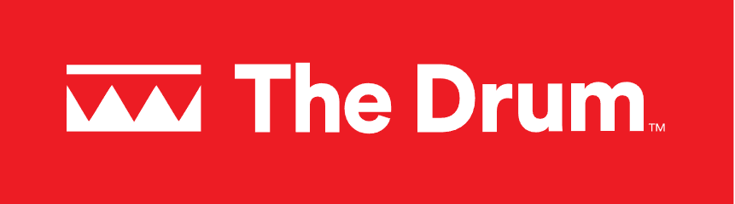





Data privacy is reshaping the conversation within the advertising landscape on how to ethically connect with consumers
April 8, 2024
July 10, 2023
April 4,2024
U.S. and E.U. Complete Long-Awaited Deal on Sharing Data
Privacy, platforms & power shifts: 3 trends reshaping marketing and measurement
US lawmakers unveil a plan to give all Americans a right to online privacy
How to Navigate the Complexities of Data Ownership
April 4,2024
December 8, 2023
HOW AD TRANSPARENCY AND PRIVACY ARE THE INDUSTRY’S NEW TABLE STAKES
You've Met Data Privacy Guidelines. But What About Data Ethics?
April 19, 2024
Navigating The Complexity Of The Latest Data Privacy Regulations
December 8, 2023
January 3, 2024
September 6, 2023
Data Privacy Tops Concerns For Americans – Who Is Responsible For Better Data Protections?
MOST PUBLISHERS SHARE CONSUMER DATA BEFORE GETTING CONSENT, COMPLIANT STUDY FINDS
Research covering 150,000 publishers and billions of impressions finds data usually flows before consent windows pop up
Most major companies admit they may be selling your personal information, a new study finds
This information is exclusively provided to VAB members and qualified marketers.
PAGE 3

Slide 4
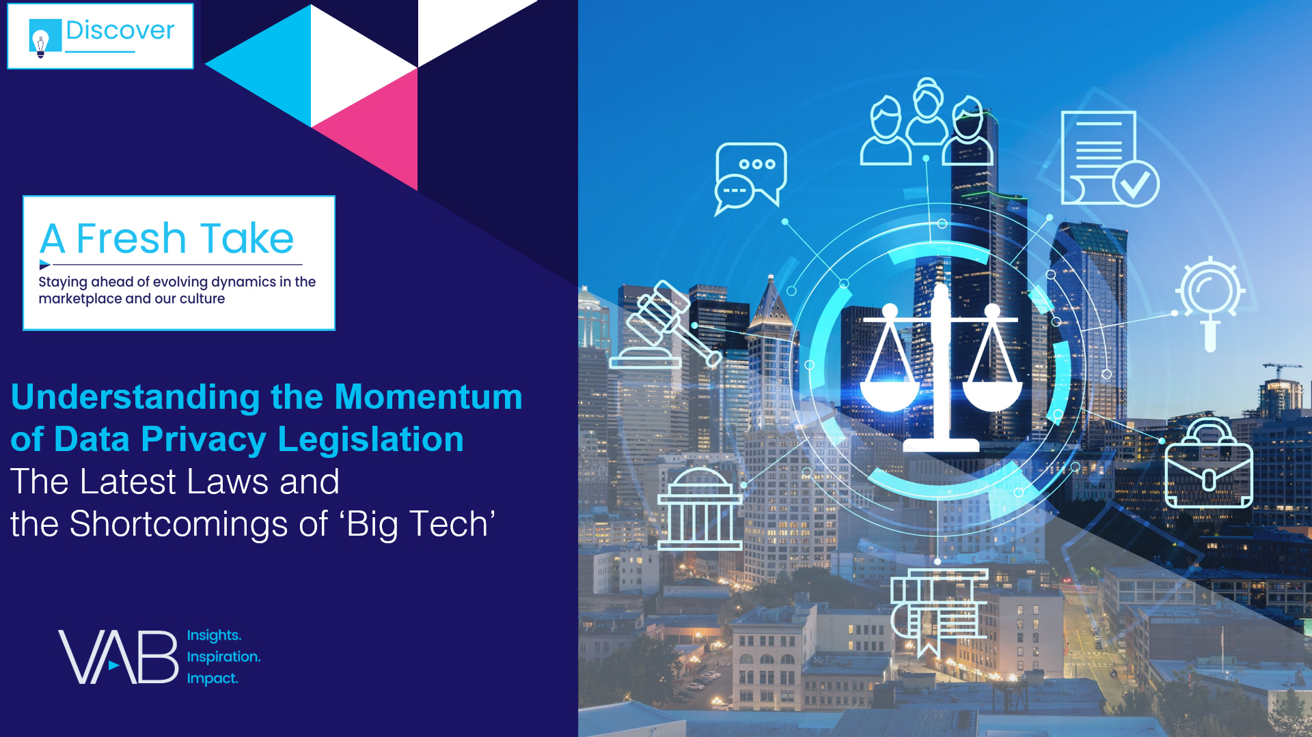



Our three-part series will help you understand, decode and navigate data privacy and security
UNDERSTAND
The momentum of data privacy & security legislation
click here to download
DECODE
data privacy and security
click here to download
NAVIGATE
Marketing in privacy focused landscape
This information is exclusively provided to VAB members and qualified marketers.
PAGE 4

Slide 5
What You’ll Learn…
It’s important to understand why data privacy and security is such a critical topic for the advertising industry today, what are the key actions marketers can take to implement a privacy-first approach and what strategies can be employed to reach customers ethically and legally in a privacy minded landscape
1
2
3
4
5
What is data privacy & security and why is it important?
What is the
‘value exchange’ for consumers’ data?
How do consumers
feel about personalized ads?
How can personalized ads be privacy safe?
How can
marketers reach audiences in a privacy focused manner?
Click through a box above to be brought directly to the appropriate section
This information is exclusively provided to VAB members and qualified marketers.
PAGE 5

Slide 6
Understanding data privacy and security is central to advertising in the current and future media landscape
1
2
3
4
5
What is data privacy & security and why is it important?
What is the
‘value exchange’ for consumers’ data?
How do consumers
feel about personalized ads?
How can personalized ads be privacy safe?
How can
marketers reach audiences in a privacy focused manner?
Click through a box above to be brought directly to the appropriate section
This information is exclusively provided to VAB members and qualified marketers.
PAGE 6

Slide 7


Data privacy and security work together to ensure customer’s safety and anonymity while protecting from identity theft, fraud and other cybercrimes
Data Privacy
Data Security
The principle that individuals should have control over their personal data, including the ability to decide how organizations collect, store and use their data.
The principle that any entity collecting data, has an ethical and legal obligation to protect the data they collect from unauthorized access and misuse.*
Source: IBM, What is Data Privacy?, December 2023. *Harvard Business School, ”Data Privacy: 4 Things Every Business Professional Should Know”, March 2021.
This information is exclusively provided to VAB members and qualified marketers.
PAGE 7

Slide 8




Marketers need to be aware of the potential business ramifications of not complying with data privacy and security regulations
Financial
Risk
Brand Reputational
& Corporate Risk
Legal
Risk
Click here to learn more about ‘Understanding the Momentum of Data Privacy Legislation’
This information is exclusively provided to VAB members and qualified marketers.
PAGE 8

Slide 9
The importance of consumers’ data is playing a growing role in today’s media landscape
1
2
3
4
5
What is data privacy & security and why is it important?
What is the
‘value exchange’ for consumers’ data?
How do consumers
feel about personalized ads?
How can personalized ads be privacy safe?
How can
marketers reach audiences in a privacy focused manner?
Click through a box above to be brought directly to the appropriate section
This information is exclusively provided to VAB members and qualified marketers.
PAGE 9

Slide 10

Responsible and secure treatment of consumer data is extremely important in shaping the customer experience for brands
Assurance that my personal data is being used responsibly and securely by the brand
% of respondents
98%
!!!
!!
!
63%
Critically Important
28%
Important
7%
Somewhat Important
Source: Adobe and Econsultancy, ‘2024 Digital Trends,’ April 9, 2024, via eMarketer. N = 6,649, ages 18-74, U.S. and Europe.
This information is exclusively provided to VAB members and qualified marketers.
PAGE 10

Slide 11



Brands build trust with customers by being upfront about how they intend to use data and provide them the ability to control how it is used
Three components of ethical data collection
Transparency
Consent
Value Exchange
Communicate what data
is being collecting and how you intend to use it
Gain user permission for data collection whenever possible
Provide clear benefits and details on what a user gets in return for sharing their data
Source: Harvard Business Review: “Customer Data: Designing for Transparency and Trust”. May 2015
This information is exclusively provided to VAB members and qualified marketers.
PAGE 11

Slide 12

The Value Exchange: Consumers are much more likely to share their information with a business when the value of doing so is made clear
Common Components of a Fair Value Exchange
Clear Opt-in Language
Clear Opt-Out Opportunities
Clear Benefits
of Providing Data
Adhere to Data Privacy & Security Regulations
This information is exclusively provided to VAB members and qualified marketers.
PAGE 12

Slide 13

Consumers are more willing to share their personal information when receiving value (like deals and access) from brands and retailers in return
Top Reasons for Sharing Personal Information
74%
of consumers are willing to share personal information with brands and retailers when prompted
Click here to learn more about Personal Information in
‘What Is…Data Privacy and Security’
Source: The Trade Desk Intelligence and YouGov Consumer CPG/Apparel Buying Behaviors Study, January 2024.
This information is exclusively provided to VAB members and qualified marketers.
PAGE 13

Slide 14
Marketers use personalized ads to drive deeper connections and stronger engagement with customers
1
2
3
4
5
What is data privacy & security and why is it important?
What is the
‘value exchange’ for consumers’ data?
How do consumers
feel about personalized ads?
How can personalized ads be privacy safe?
How can
marketers reach audiences in a privacy focused manner?
Click through a box above to be brought directly to the appropriate section
This information is exclusively provided to VAB members and qualified marketers.
PAGE 14

Slide 15


Consumers want the advertisements they receive from brands and retailers to be more relevant to their needs and interests
Ad Personalization
71%
A marketing strategy that uses known information about a consumer’s interests and behaviors to serve relevant ads to a specific user. This enables marketers to tailor the ad to a user’s preferences, needs and stage within the customer journey.
of consumers expect companies to deliver personalized interactions
Source: McKinsey & Company, ‘The value of getting personalization right—or wrong—is multiplying’, November 2021.
This information is exclusively provided to VAB members and qualified marketers.
PAGE 15

Slide 16




Data collected ethically and securely can be leveraged to provide value to customers through personalized ads
Common Benefits of Ad Personalization
Consumers
Marketers
Relevant Ads
Receive ads relevant
to interests and needs
Product Discovery
Find needed products
faster and easier
Targeting
Reach target audiences more effectively
Ad Engagement
More likely to capture consumer attention and drive engagement
This information is exclusively provided to VAB members and qualified marketers.
PAGE 16

Slide 17



Consumers who receive personalized ads from brands and retailers are more likely to take action
% of consumers that are more likely to engage with brands that connect in personalized ways
Purchase
76%
Repurchase
78%
Recommend
78%
Source: McKinsey & Company, ‘The value of getting personalization right—or wrong—is multiplying’, November 2021.
This information is exclusively provided to VAB members and qualified marketers.
PAGE 17

Slide 18
Privacy Enhancing Technologies (PETs) enable marketers to reach consumers in a personalized way while remaining privacy focused
1
2
3
4
5
What is data privacy & security and why is it important?
What is the
‘value exchange’ for consumers’ data?
How do consumers
feel about personalized ads?
How can personalized ads be privacy safe?
How can
marketers reach audiences in a privacy focused manner?
Click through a box above to be brought directly to the appropriate section
This information is exclusively provided to VAB members and qualified marketers.
PAGE 18

Slide 19

Across the media landscape, there is a need for privacy focused solutions that aid the gathering, accessing and sharing of data
“Each of the publishers who we work with today have such rich first-party data at their hands. They need control, they need
a way to be able to provision access to that data in
privacy-safe ways. And there is so much benefit to doing that.”
Brittany Slattery
Chief Marketing Officer, OpenAP
Source: TVRev, ‘OpenAP’s Brittany Slattery Discusses The Future Of Data Privacy In Advertising’, 2/21/24
This information is exclusively provided to VAB members and qualified marketers.
PAGE 19

Slide 20



What are Privacy-Enhancing Technologies (PETs)?
Hardware or software solutions that ensure data privacy and protection while allowing organizations to extract value from data.
How can PETs address marketing privacy concerns and regulations?
Offer products and services without accessing
person level data.
Utilize analytics and research without
person level data.
Allow for data sharing between two parties without disclosing sensitive data.
Note: PETs should not be considered as a complete solution to privacy compliance.
It is suggested that they are used within a legal framework, and not as a substitute.
Source: FTC, “Keeping Your Privacy Enhancing Technology (PET) Promises”, February 2024
This information is exclusively provided to VAB members and qualified marketers.
PAGE 20

Slide 21



Encryption: It is essential that sensitive data is protected to ensure the confidentiality of consumer information is never jeopardized
How does Encryption preserve privacy?
Keeps data secure by scrambling data so that it can only be read by authorized personnel
What are the Benefits of Encryption
Enables two parties to exchange sensitive data without leaking or exposing data
Can be leveraged to meet compliance standards in sensitive industries such as healthcare and finance
Deter or mitigate the severity of data breaches
Has applications in retaining and managing the authenticity and integrity of data
What is Encryption?
  The mathematical process of transforming readable plain text into unreadable ciphertext to mask sensitive information from unauthorized users.
  A ‘key’ is a cryptographic tool that is used to scramble (encrypt) or unscramble (decrypt) data.
How Does Encryption Work?
Original Data
Jane Doe
45 years old
1 Main St.
Encryption
Encrypted Data
P1*&%sdf
R4$2Xd9p1
9#!FR#4fy
Decryption
Original Data
Jane Doe
45 years old
1 Main St.
Data should be encrypted because it is virtually impossible to decipher without the key
This information is exclusively provided to VAB members and qualified marketers.
PAGE 21

Slide 22

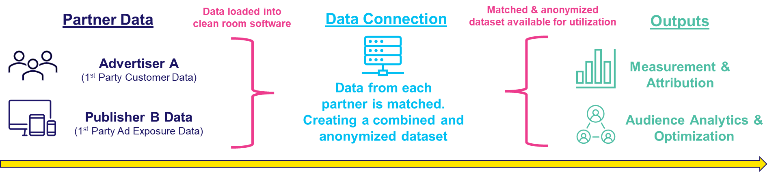




Data Clean Rooms: Leveraging privacy preserving data collaboration methods ensures all parties involved protect and secure their sensitive data
How do Data Clean Rooms preserve privacy?
Prevent access to user-level data and aggregate
outputs into groupings.
How are Data Clean Rooms used in advertising?
What are Data Clean Rooms?
  A secure software environment that enables data collaboration between two or more parties, which allows sensitive customer data to be shared, and/or matched for joint analysis in a secure and privacy compliant manner.
Examples of companies that offer Data Clean Room solutions
Click here to learn more about Data Clean Rooms
in ‘What’s the Deal With Identity’
This information is exclusively provided to VAB members and qualified marketers.
PAGE 22

Slide 23




Universal IDs: Their use backed by opted-in data has increased as marketers become more privacy minded and signal loss grows
How do Universal IDs preserve privacy?
When hashed, UID’s prevent a user’s raw data such as
an email address from being used or traced back to them.
How can Universal IDs can help marketers?
What are Universal IDs?
Eliminate dependency on 3rd party cookies
More seamlessly partner with publishers and data providers to match first-party data on PII in a privacy compliant and secure manner
Achieve greater precision in audience targeting
Increases accuracy of cross-channel measurement
Unique identifier that allows publishers and advertisers to recognize and authenticate users across publishers, platforms & devices, which provides a holistic view of audiences.
Examples of companies that offer Universal ID solutions
Click here to learn more about Universal IDs in
‘What’s the Deal With What’s Next in Measurement’
BlockGraph ID
UID 2.0
Open ID
Ramp ID
This information is exclusively provided to VAB members and qualified marketers.
PAGE 23

Slide 24




Synthetic Data: By embracing AI that preserves privacy, brands are poised to meet future legal and customer demands
How does Synthetic Data preserve privacy?
Since synthetic datasets do not maintain a 1:1 relationship
with the original data, audiences are impossible to reidentify.
What is an example of Synthetic Data?
VID (Virtual People Identifiers) Models
VIDs are synthetic individuals that can be grouped together to mimic the general population through the assignment of probabilistic demographics
A way to label impression data consistently across all data providers enabling de-duplicated cross platform reach and frequency
  Can be used to complement and enhance calibration panels
What is Synthetic Data?
Utilizes known information about
a population to train a model to make accurate predictions about others in the population that you don’t have a full set of data for.
Examples of companies that offer Synthetic Data solutions
Click here to learn more about Synthetic Data in
‘What’s the Deal With What’s Next in Measurement’
This information is exclusively provided to VAB members and qualified marketers.
PAGE 24

Slide 25





Micro-Cohort Measurement: Through this, marketers can accurately measure audience exposure in a privacy focused methodology
How does Micro-Cohort Measurement preserve privacy?
By leveraging exposure probability through a small groups,
there is no 1:1 viewer data identified in the measurement.
How does Micro-Cohort Measurement work?
What is Micro-Cohort Measurement?
Small Measured Group
Exposure Calculation
Scaled Measurement
Campaign measurement through
exposure probability of small defined groups with demographic and/or behavioral data without individual users being identified.
Examples of companies that offer Micro-Cohort Measurement solutions
Click here to learn more about Advanced Measurement in
‘What’s the Deal With What’s Next in Measurement’
This information is exclusively provided to VAB members and qualified marketers.
PAGE 25

Slide 26
Signal loss and privacy concerns are driving marketers to leverage innovative marketing strategies
1
2
3
4
5
What is data privacy & security and why is it important?
What is the
‘value exchange’ for consumers’ data?
How do consumers
feel about personalized ads?
How can personalized ads be privacy safe?
How can
marketers reach audiences in a privacy focused manner?
Click through a box above to be brought directly to the appropriate section
This information is exclusively provided to VAB members and qualified marketers.
PAGE 26

Slide 27
New legislation, significant industry changes, and an increased rate of consumer opt-out have led to greater signal loss
Signal Loss
The diminishing availability of data points directly tied to campaigns or individual users that allow marketers to
acquire, measure and retarget customers.
One of the most common examples of signal loss today is the deprecation of third-party
cookies, which have serious privacy concerns associated with them.
Signal loss also occurs when consumers decide to opt-out of sharing their personal data.
Source: Digiday, ‘Why connectivity is critical for clean rooms to turn signal loss into signal gain’, April 2024.
This information is exclusively provided to VAB members and qualified marketers.
PAGE 27

Slide 28
Signal loss of 3rd party cookies underscores the importance of Connected TV advertising
“In response to the loss of 3rd party signals, marketers have turned to a slew of new solutions and tools
to help them maintain ways to connect with their audiences. Marketers can better connect and activate more of their first-party data and engage parts of the ecosystem that no longer use 3rd party cookies, this includes premium platforms like connected TV, where 3rd party cookies were never the answer.”
“With the ad industry increasingly prioritizing consumer privacy and moving away from third-party cookies,
the Connected TV space, specifically, finds itself a unique position. CTV as a medium has never relied
on cookies, making it an attractive option for advertisers looking to shift their spend from web
and mobile to reach new audiences.”
Travis Clinger
Chief Connectivity and Ecosystem Officer, LiveRamp
Peter Crofut
VP, Business Development – Agencies & Brands, WURL
Source: Digiday, ‘Why connectivity is critical for clean rooms to turn signal loss into signal gain’, 4/11/24.
This information is exclusively provided to VAB members and qualified marketers.
PAGE 28

Slide 29

Marketers are shifting media investments into CTV more than any other platform as privacy legislation and signal loss increases
% of US ad buyers who plan on increasing spending in 2024
due to legislation and signal loss, by channel
Source: eMarketer, ‘Make Sense of TV Ad Measurement in 2024: What You Need to Know,’ February 2024.
This information is exclusively provided to VAB members and qualified marketers.
PAGE 29

Slide 30
Contextual advertising is growing due to its ability to serve ads that are personalized to audiences’ interests without personal data
“Privacy considerations have become central to digital interactions, leading to a demand for future-proof targeting solutions that respect user privacy. By reaching users based on their real-time interests, contextual advertising operates without personal data.”
Brian Danzis
President, Seedtag
This information is exclusively provided to VAB members and qualified marketers.
PAGE 30

Slide 31


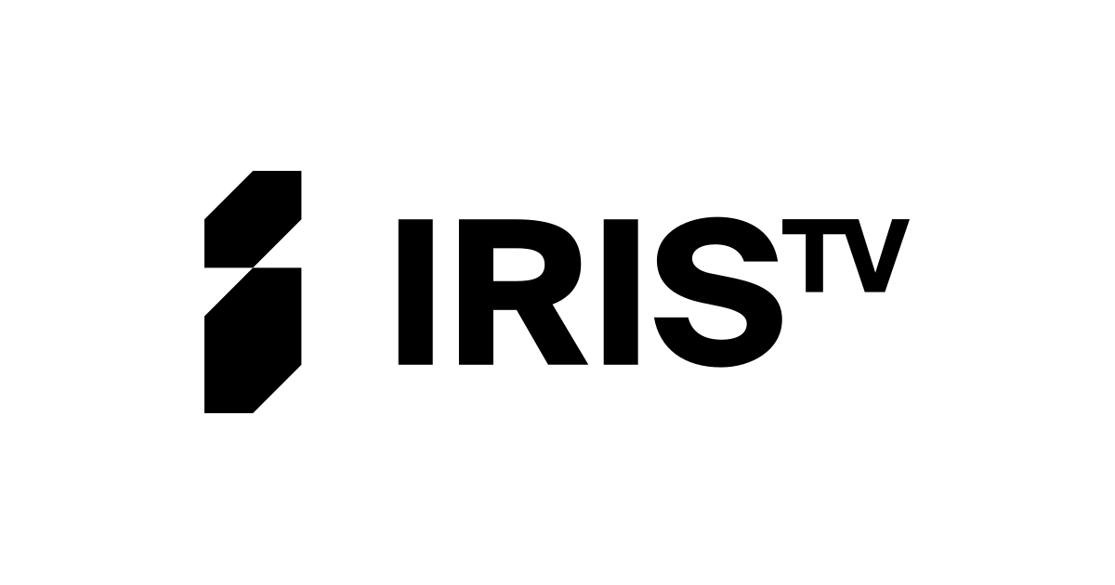




Adopting contextual targeting strategies allows marketers to address signal loss and reach customers on CTV in a privacy minded manner
Two Examples of Targeting Focused Data Privacy Strategies for Marketers
Contextual Targeting
Semantic Targeting
Ad placements that are based on the type of content within the media environment, implemented by identifying and matching categories or keywords
that are relevant to the brand/product advertising.
A more advanced form of contextual targeting which involves the use of machine learning to understand
the meaning of content rather than just identifying matching keywords on a page.
Examples of Contextual & Semantic Targeting Companies
This information is exclusively provided to VAB members and qualified marketers.
PAGE 31

Slide 32
Marketer Takeaways: Protect your brand by taking a ‘privacy by design’ approach to your marketing strategies
Three Actions You Can Take Now to Protect Your Customers and Your Brand
1
2
3
Establish a Value Exchange
with Your Customers
Take a ‘Privacy by Design’
Approach
Be Proactive Against Signal Loss
Prioritize privacy centric data collection methods to ensure privacy centric measurement. Gathering consent from consumers while collecting information will enable you to identify them accurately in a privacy complaint way throughout your campaign lifecycle.
A ‘privacy by design’ approach means that privacy is embedded at every step of your marketing process. Privacy is a priority for consumers; therefore, it is critical that marketers approach data privacy ethically.
Embrace new technology and platforms that enable you to connect with consumers in a privacy conscious manner. Doing so allows marketers to build durable marketing strategies that are no longer tied to deprecating, and privacy concerned, data signals.
This information is exclusively provided to VAB members and qualified marketers.
PAGE 32

Slide 33


Explore our full three-part series to understand, decode and navigate data privacy and security, with actionable insights
Understand the momentum behind
data privacy legislation and explore
the continued shortcomings of ‘Big Tech’ in this area.
Decode data privacy and security
to learn about the key topics, concepts and terms and why it matters to your customers.
Navigate marketing strategies in a privacy-focused landscape, with actionable tactics to reach audiences with personalized ads.
Download Here
Download Here
This information is exclusively provided to VAB members and qualified marketers.
PAGE 33

Slide 34
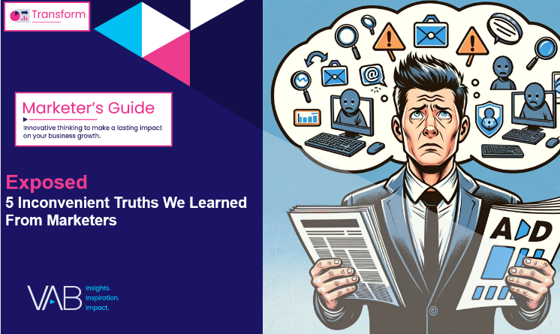

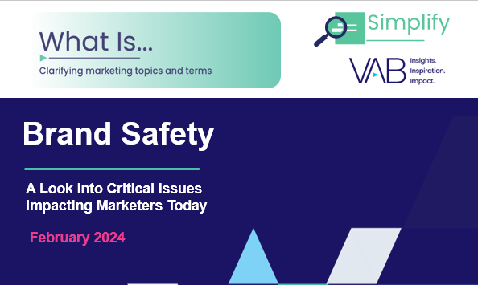
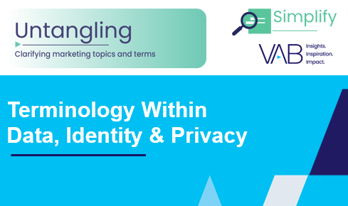
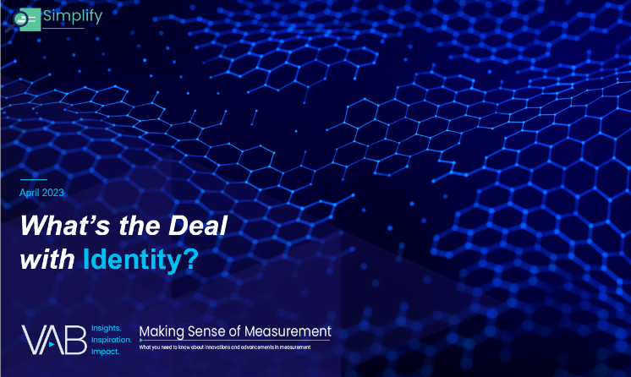

Creators
Jason Wiese
Benjamin Vandegrift
SVP, Director of Strategic Insights
jasonw@thevab.com
VP, Measurement Solutions
benjaminv@thevab.com
Reed Kiely
Kaileen Cain
Exposed
5 Inconvenient Truths We Learned From Marketers
Hidden Costs
Three critical business ramifications of digital ad fraud
Director, Data Insights & Trends
reedk@thevab.com
Senior Insights Analyst
kaileenc@thevab.com
Discover more
Looking for more data, insights and takeaways? Check out this related VAB content
What is Brand Safety?
Untangling Terminology in
Data, Identity & Privacy
What’s the Deal With… Identity?
What is The Digital Video
Supply Chain
This information is exclusively provided to VAB members and qualified marketers.
PAGE 34

Slide 35


About VAB
VAB plays a dual role in the video advertising industry. We are leading the change to bring about a more innovative and transparent marketplace. We also provide the insights and thought leadership that enables marketers to develop business-driving marketing strategies.
Drawing on our marketing expertise, we simplify the complexities in our industry and discover new insights that transform the way marketers look at their media strategy.
We are committed to your business growth and proud to offer VAB members, brand marketers and agencies complimentary access to our continuously-growing Insights library. Get immediate access at theVAB.com.
This information is exclusively provided to VAB members and qualified marketers.
PAGE 35

