Slide 1

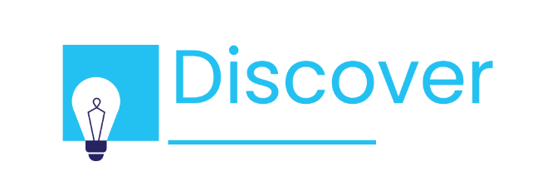
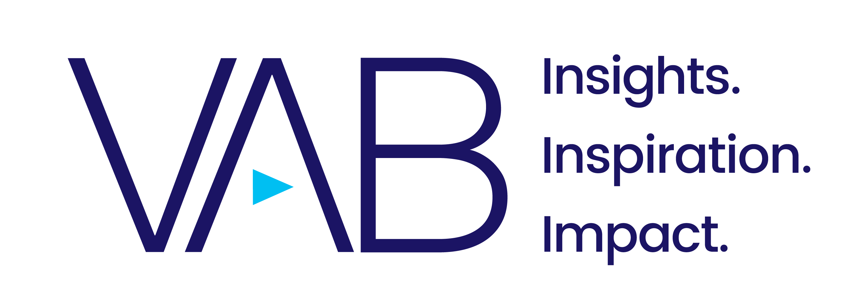
Mind, Body & Media
How Consumers and Brands Are Addressing Mental Health Together During COVID-19

Slide 2

About VAB’s Young Leaders
The VAB Young Leaders is a group of rising professionals keenly focused on enrichment, growth and learning through teamwork. These bold thinkers are valued for their unique perspectives and insight.
Mind, Body & Media
This piece explores an important topic that has impacted both consumers and marketers during the COVID-19 pandemic: mental health and wellness. An issue that has been discussed frequently over the last year, Young Leaders decided to dig further and look at it through a media-driven lens.
Read on to learn more about how consumers have turned to media to cope with mental health challenges during the pandemic and how marketers have learned to adapt and engage authentically in these trying times.
This information is exclusively provided to VAB members and qualified marketers. Further distribution is prohibited.
PAGE 2

Slide 3
What You’ll Learn…
How mental health has declined during COVID-19 and the implications for marketers
Which platforms and programs consumers are turning to during trying times and why
What marketers are doing to meaningfully connect with consumers around mental health
How marketers can leverage the right messaging and platforms to build brand favorability and establish long-term trust with consumers
This information is exclusively provided to VAB members and qualified marketers. Further distribution is prohibited.
PAGE 3

Slide 4

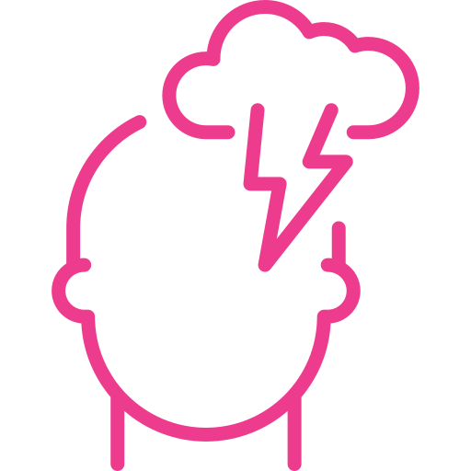

The rapidness with which COVID-19 upended our daily lives, combined with the need to quarantine and social distance, has made mental health and wellbeing a top concern for both consumers and brands
Lockdowns, social distancing, changing norms and working from home have led to an increase of social isolation during trying times, which has led to increasing mental health concerns.
67% of workers are reporting higher stress levels during the COVID-19 pandemic than before.
31% of Internet users are concerned about COVID-19’s effect on their mental health, more than their concern about access to a vaccine (29%).
Source: Statista, Percentage of workers reporting higher, equal or lower levels of stress since the coronavirus outbreak in 2020, 12/15/2020; Global Web Index, 10 mental health campaigns that are making a difference, 11/4/2020.
This information is exclusively provided to VAB members and qualified marketers. Further distribution is prohibited.
PAGE 4

Slide 5
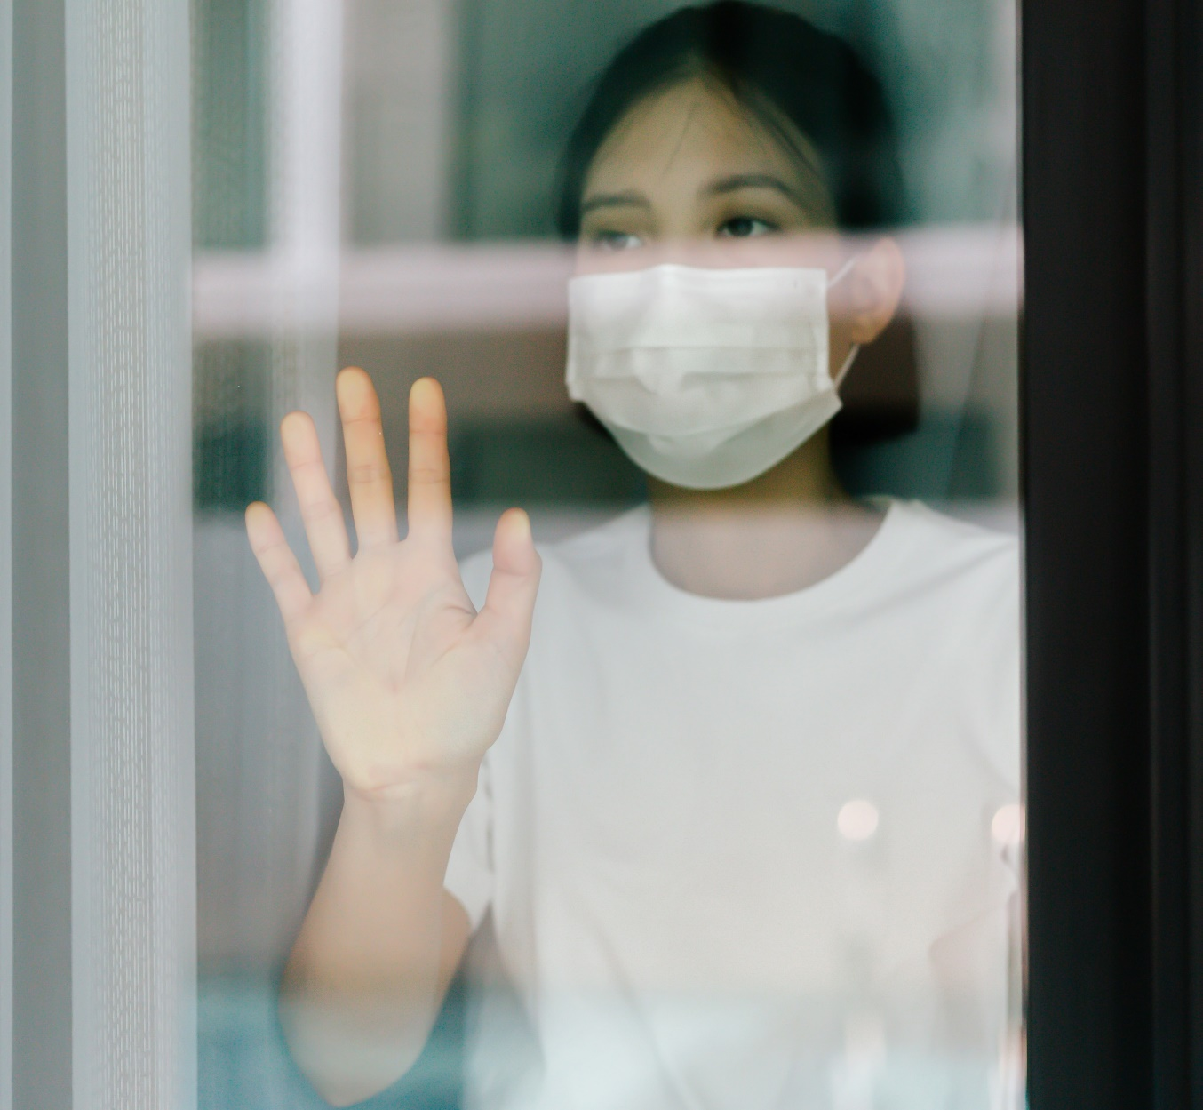

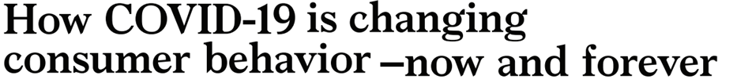

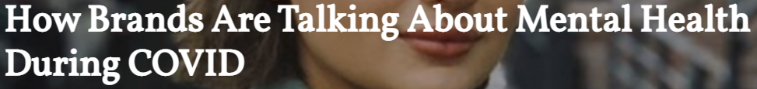

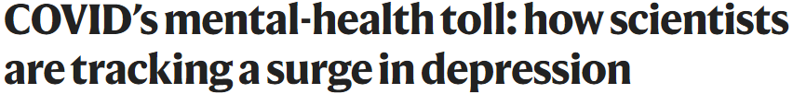

A greater mental health crisis could potentially have a deep effect on consumer behavior and how brands approach creative messaging moving forward
June 2020
May 13, 2020
Feb 3, 2021
Oct 16, 2020
This information is exclusively provided to VAB members and qualified marketers. Further distribution is prohibited.
PAGE 5

Slide 6

Coping Devices
Understanding Where People
Turn During COVID-19

Slide 7
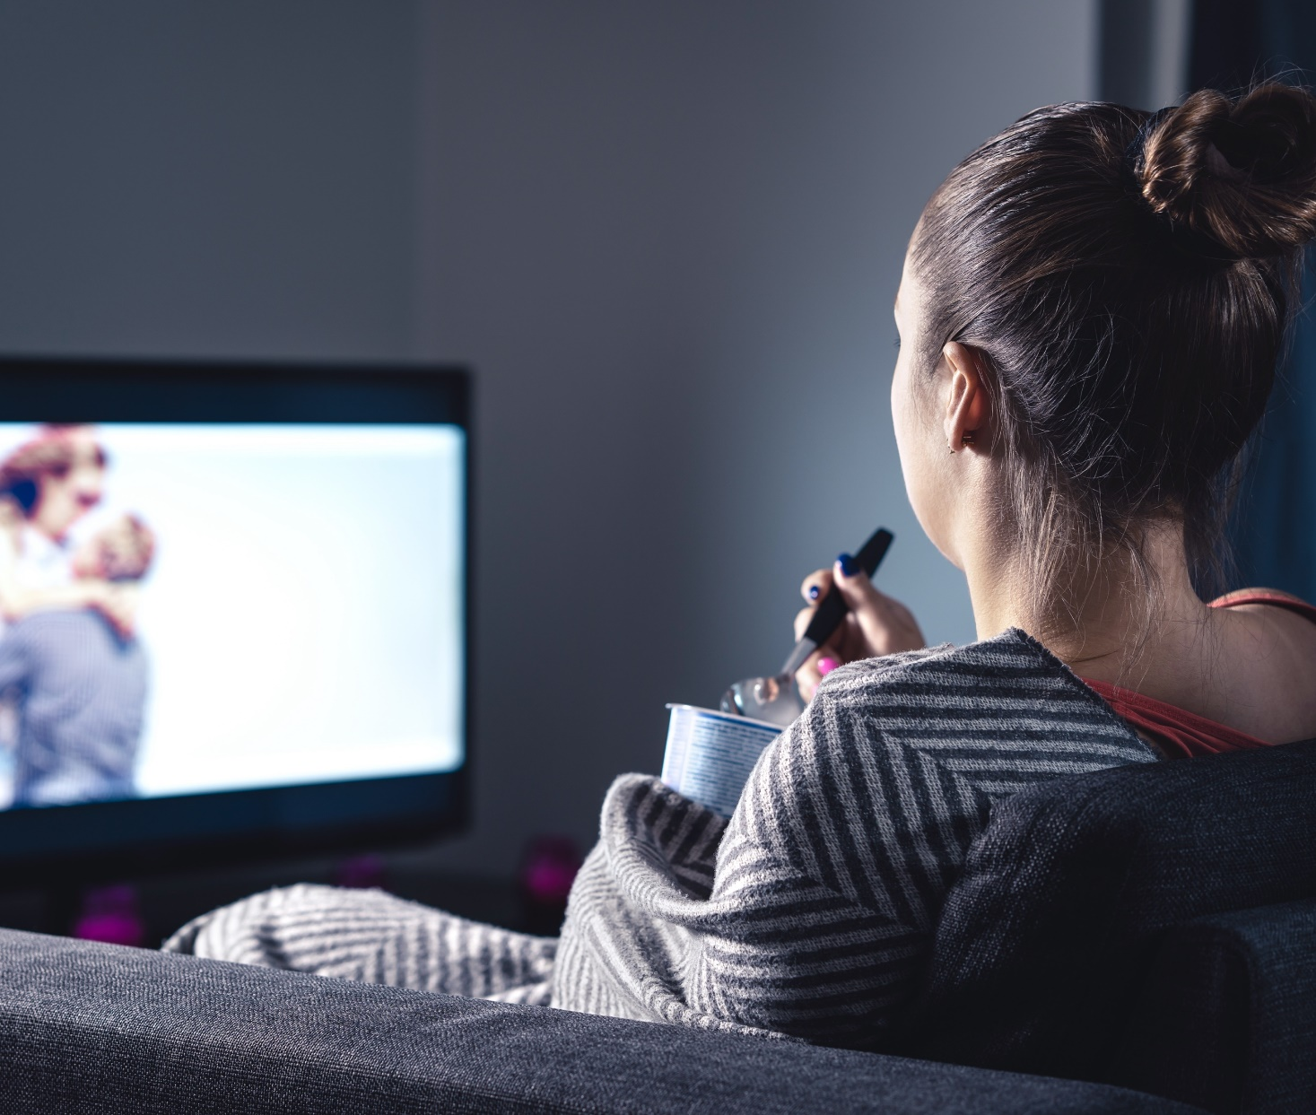

The pandemic has caused mental crises among people across generations, with Gen Z and Millennials having the hardest time coping with the impact
As people look for ways to handle COVID-related restrictions, 72% have increased their media usage since COVID-19 began
Source: VAB’s 'As Time Goes By: How Media Consumption Is Helping America Cope’. VAB / Lucid ‘Media Usage In The Time of COVID-19 Survey,’ April 2020. Survey base: P18+ & household subscribes to cable, telco, internet TV or satellite TV (n=1,004). Q1: Overall, please choose the statement below that best describes your media usage since the outbreak of the COVID-19 Pandemic. Edward Jones, Wave, The Harris Poll, The Four Pillars of the New Retirement, 2020. Base: U.S. adults by generation: Gen Z (18-23), Millennial (24-39), Gen X (40-55), Boomer (56-74), Silent Gen (75+).
This information is exclusively provided to VAB members and qualified marketers. Further distribution is prohibited.
PAGE 7

Slide 8


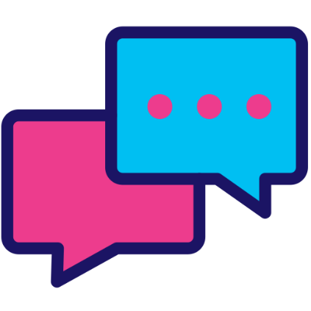

Increased media usage during COVID-19 brought TV to the center of the home, providing an escape and keeping people connected
Overall, 84% of respondents say they have more time to watch/listen/read media since the COVID-19 outbreak
% of respondents who agree with the statement
P18+
83%
82%
78%
72%
“I couldn't imagine not having a television set right now”
“Watching TV helps me escape and cheer up”
“Watching TV helps me keep in contact”
“Watching TV or movies together as a family has become more common”
Source: VAB’s 'As Time Goes By: How Media Consumption Is Helping America Cope’. VAB / Lucid ‘Media Usage In The Time of COVID-19 Survey,’ April 2020. Survey base: P18+ & household subscribes to cable, telco, internet TV or satellite TV (n=1,004). Q1: Overall, please choose the statement below that best describes your media usage since the outbreak of the COVID-19 Pandemic, Q2: When thinking about how you’ve spent your time during the COVID-19 Pandemic, have you increased, decreased or spent the same amount of time with the following media? & Q9: Thinking of your behavior during the COVID-19 Pandemic, please indicate below how much you agree or disagree with the following statements. Q7: Thinking of your behavior since the start of COVID-19, please indicate below how much you agree or disagree with the following statements & Q9: Thinking of your behavior during the COVID-19 Pandemic, please indicate below how much you agree or disagree with the following statements; VAB analysis of MRC ‘COVID-19: Tracking the Impact on the Entertainment Landscape’, 2020.
This information is exclusively provided to VAB members and qualified marketers. Further distribution is prohibited.
PAGE 8
PAGE 1

Slide 9


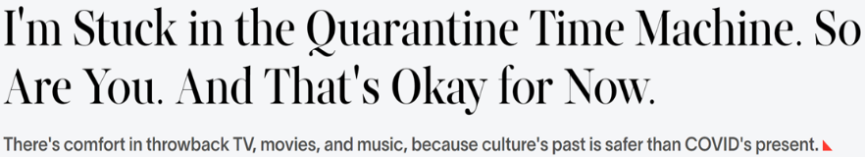
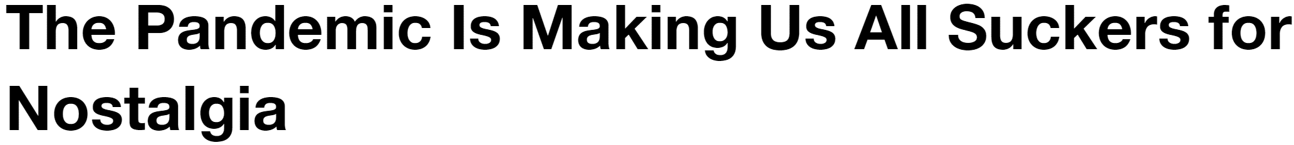



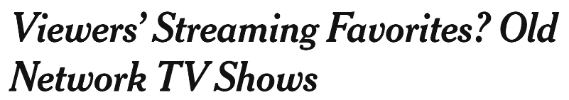
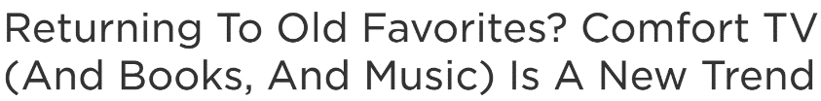

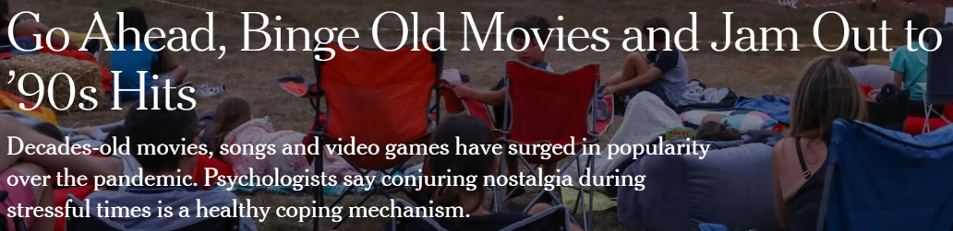



To help cope with stress and isolation brought on by the pandemic, people have turned to familiar, classic programs for nostalgic comfort
There was a significant increase in ‘throwback’ TV shows and movies as people found an escape through media that made them feel like they were back in older, more ‘normal’, times
May 15, 2020
November 18, 2020
January 12, 2021
April 15, 2020
54%
November 10, 2020
August 1, 2020
of consumers re-watched episodes of an old favorite show
Source: MRC, COVID-19: Tracking the Impact on the Entertainment Landscape, 2020.
This information is exclusively provided to VAB members and qualified marketers. Further distribution is prohibited.
PAGE 9

Slide 10
People have also found ways to stay connected and gather safely via online communities to discuss their shared passion for video content
Video content had people convening together online, with over 144 different pieces of content trending across genre, life stage and interests
% of Top 10 Trending Programs / Content by Platform
Our analysis of the top 10 trending U.S. Twitter topics in primetime across six weeks during COVID-19 found that…
Video content accounted for 75% of the top 10 Twitter trending topics
Source: VAB’s #AloneTogether: Culture in the Time of COVID-19, based on a VAB custom analysis of Top 10 trending Twitter Topics each night (9:30p &11p) (3/16/2020 – 4/26/2020). Results include both ‘direct’ and ‘related’ topics. Various Video Platforms include Epic Games, and various concert streaming partners.
This information is exclusively provided to VAB members and qualified marketers. Further distribution is prohibited.
PAGE 10

Slide 11

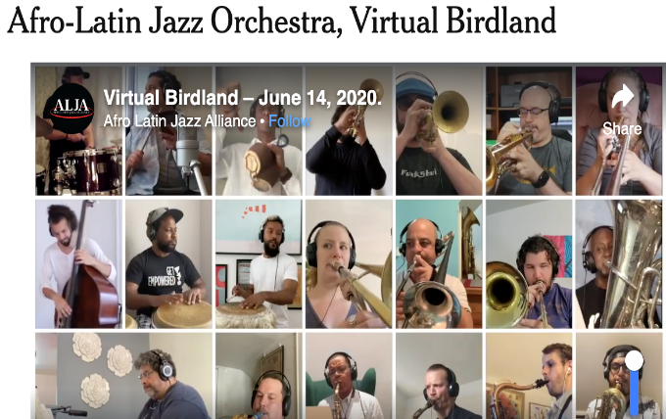
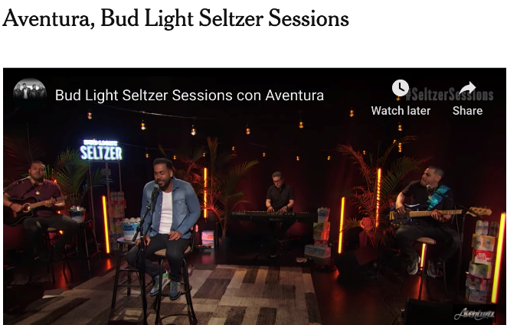
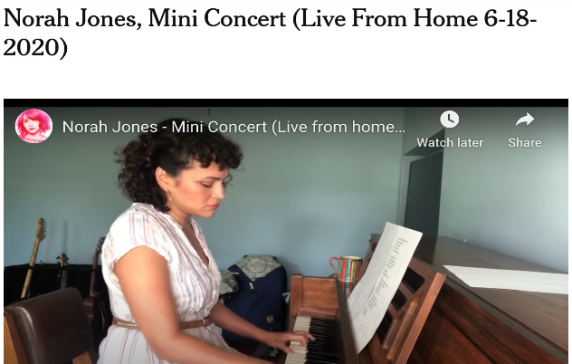
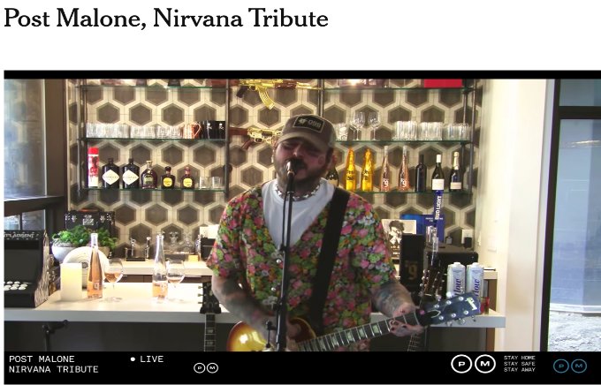

In addition to gathering online via social media, virtual concerts and events have become a haven for fans looking for ways to cope with feeling alone
With live events canceled, people have turned to virtual events to get back the feeling of attending a live event and regain a sense of normalcy
31%
of people Livestreamed Concerts / Events
Source: VAB’s We're Going Live. VAB / Lucid ‘COVID-19 Streaming Behavior Survey,’ June 2020. Survey base: P18+ in households with access to streaming services and have viewed content on streaming services within the past seven days (n=1,000). Q14.When thinking about livestreaming, by which we mean: streaming a program online live as it happens (e.g., Concert - One World: Together at Home, Sporting Event - Virtual NFL Draft) - which of the following statements do you feel apply to you?
This information is exclusively provided to VAB members and qualified marketers. Further distribution is prohibited.
PAGE 11

Slide 12

Summary: Coping Devices
Video has become the center of the home as people seek distractions to help them cope and destress from the pandemic
TV, especially programs that elicit notes of nostalgia, is growing in popularity among viewers
Virtual events, such as concerts, provide people with a way to gather safely and gain a sense of community
This information is exclusively provided to VAB members and qualified marketers. Further distribution is prohibited.
PAGE 12

Slide 13
Exercise In Empathy
Exploring the Impact of Compassionate Brand Purpose and Messaging

Slide 14
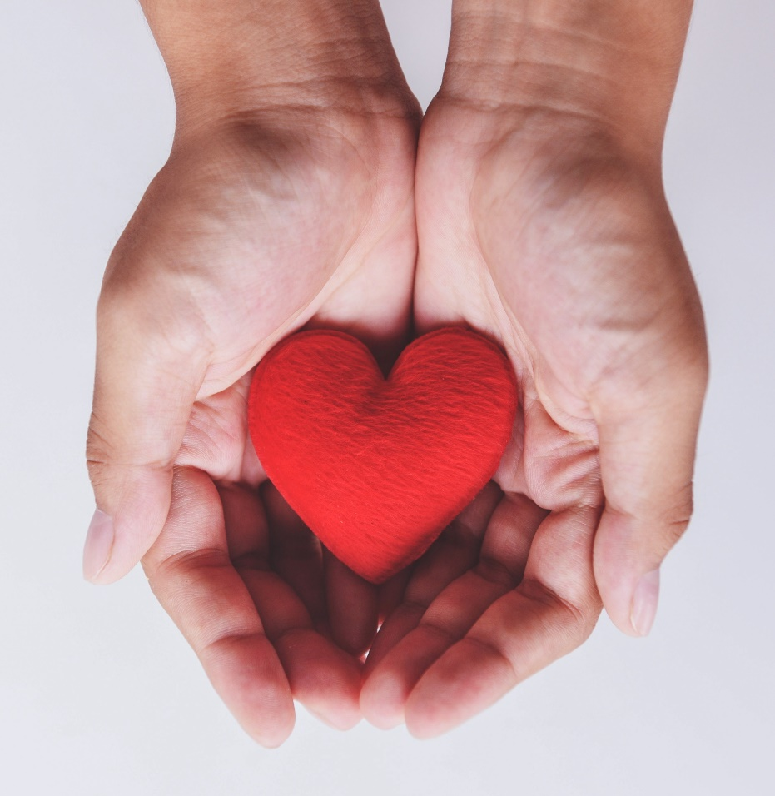
Aside from turning to their favorite programs and platforms to help keep them upbeat, audiences are looking to brands to aid in fighting their quarantine blues
From updated products to more compassionate brand messaging, there is a clear desire for brands to provide comfort and show that they understand the struggles consumers are facing, especially among younger consumers
83%
75%
of consumers want compassionate connection, including brand messaging that communicates empathy and support with the struggles they face
say they are more likely to buy from companies that are concerned about their mental health and well-being
Two in five young consumers appreciate brands that provide ideas to improve mental health during COVID
Source: Edelman, 2020 Edelman Trust Barometer Special Report: Brands and the Coronavirus. Q5. In the face of this coronavirus outbreak, how do you expect brands to react when it comes to the nature and tone of their communications with the public? 3-point scale; code 1, brands must do this; code 2, I hope brands will do this. Question shown to those who have heard of the virus (Q1/1). 12-mkt avg. Data collected between March 23 and March 26, 2020. Morning Consult, Favorited or Forgotten? A Look at If & How Consumer Behavior Will change Post-Pandemic, April23, 2020. Ypulse, COVID-19 Special Report: Marketing During COVID-19, 2020.
This information is exclusively provided to VAB members and qualified marketers. Further distribution is prohibited.
PAGE 14

Slide 15


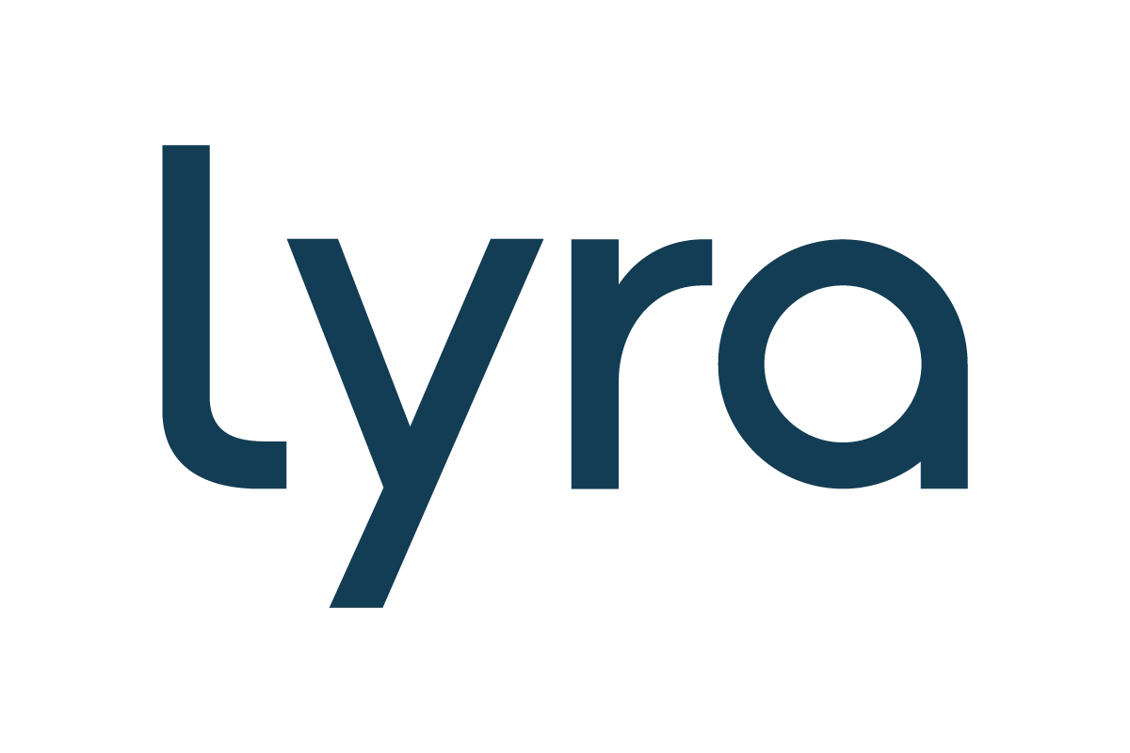
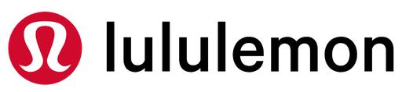
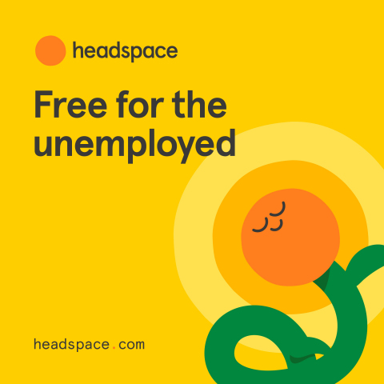
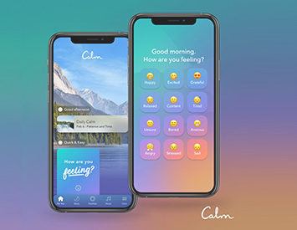
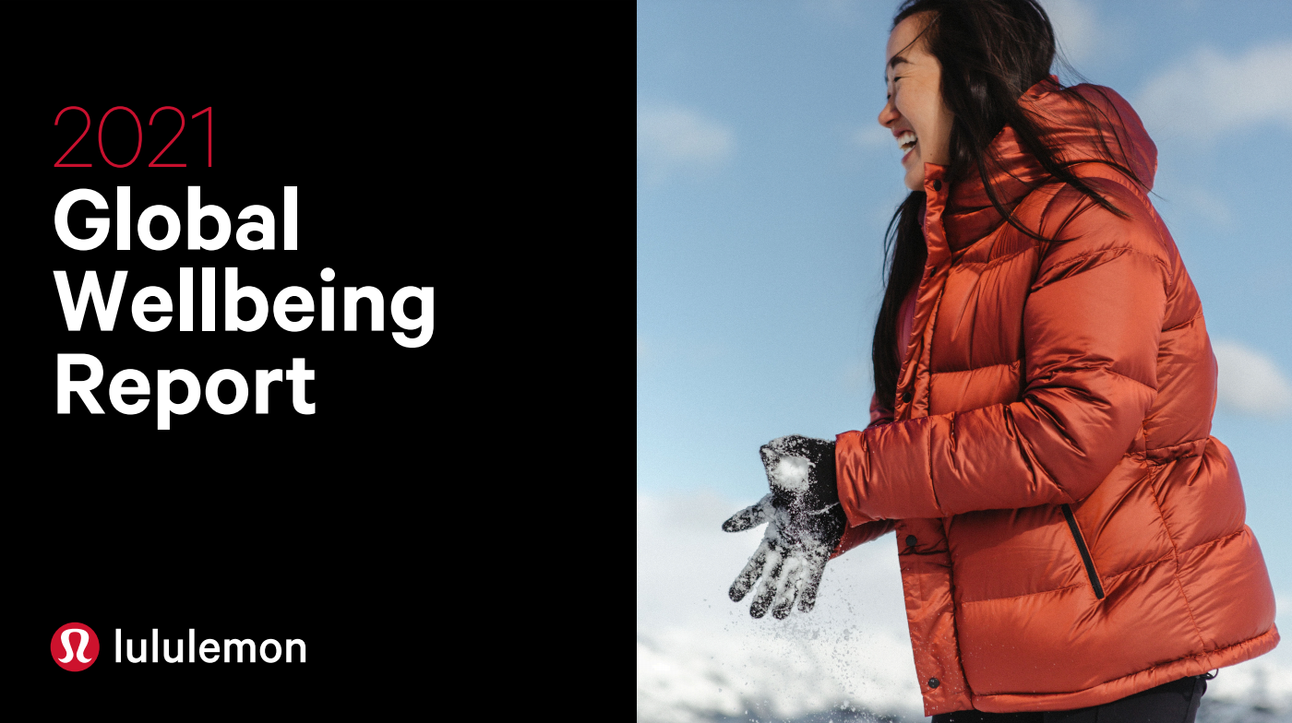
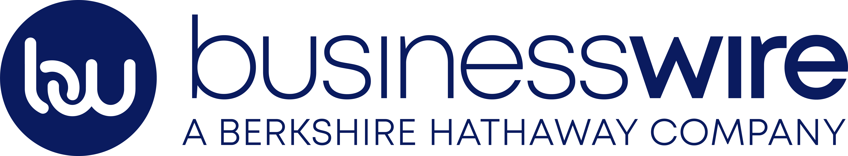

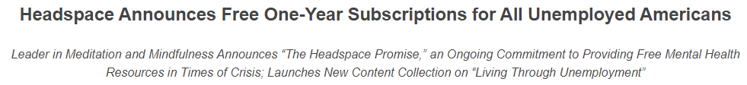
Brands within the health and wellness space have worked to provide relief for those facing mental health struggles that were either brought on or worsened by the pandemic
The surge in demand for mental health resources at the onset of the pandemic motivated companies to act with meaningful authenticity– some provided free access to their services, or partnered with brands to make it easier for burnt out employees to access proper resources, while others put out their own research to bring attention to the scale of the mental health crisis
May 14, 2020
October 20, 2020
February 1, 2021
“While meditation and mindfulness can’t change our circumstances in life, it can help us change our perspective on those circumstances…
As a company dedicated to improving the health and happiness of the world, we take our responsibility to help support people’s mental health very seriously.”
- Rich Pierson, CEO & Co-Founder, Headspace
"Partnering with Lyra is a huge step in accelerating accessibility to mental health and mindfulness tools to employees everywhere. With Calm’s robust content library and Lyra’s unmatched evidence-based clinical support, together, we’ll foster a stronger, more resilient workforce.”
- Alexander Will, Chief Strategy Officer, Calm
“The events of the past year brought unprecedented challenges to the physical, mental, and social wellbeing of people worldwide…this research accelerates our efforts to support the wellbeing of the guests, employees and the communities we serve.”
- Calvin McDonald, CEO, Lululemon
This information is exclusively provided to VAB members and qualified marketers. Further distribution is prohibited.
PAGE 15

Slide 16



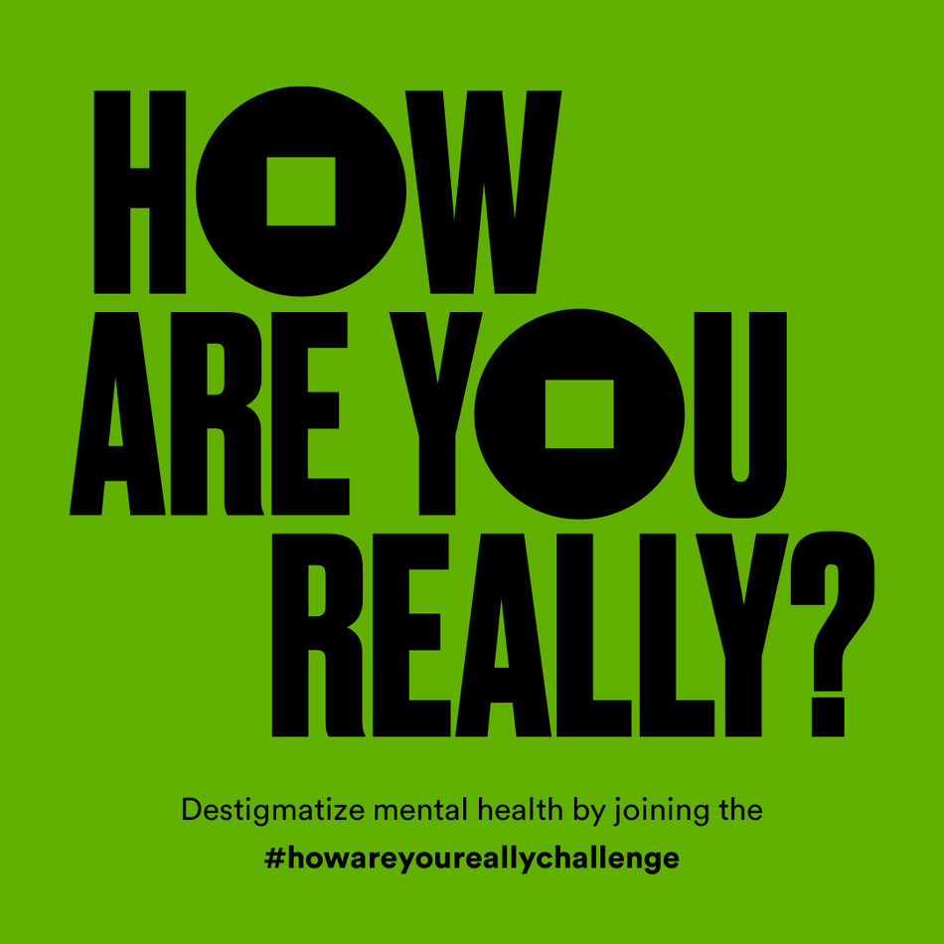
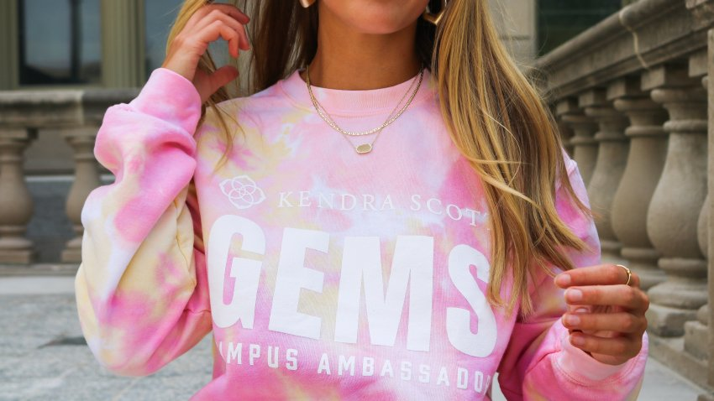
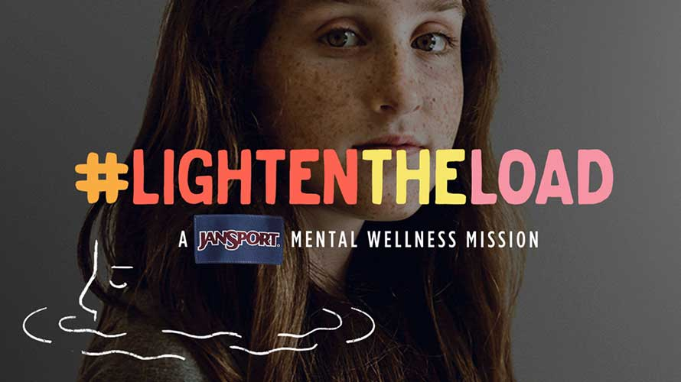

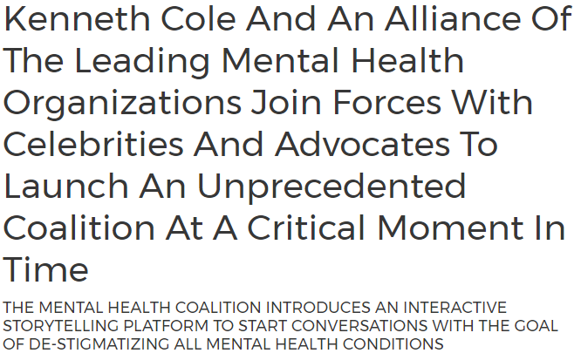

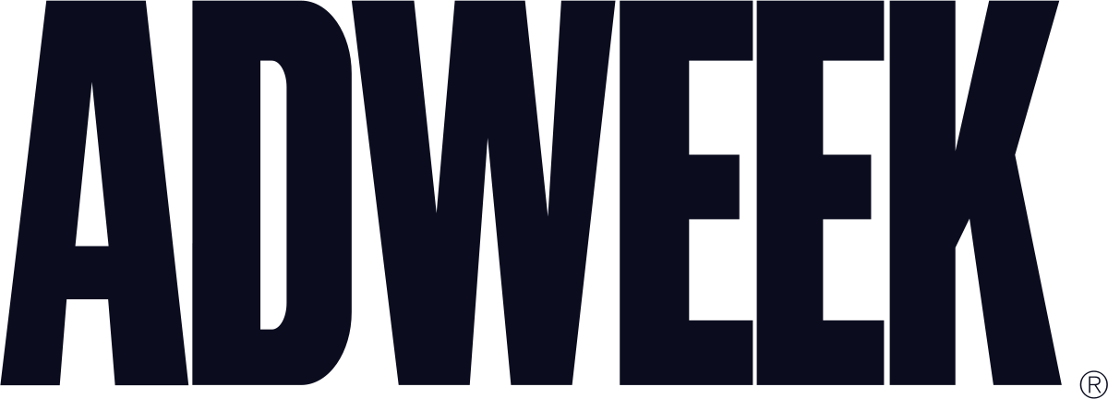
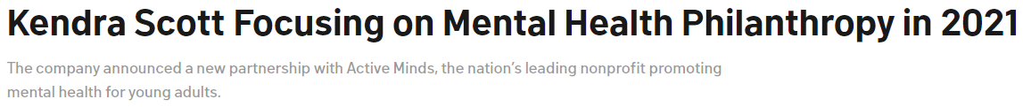
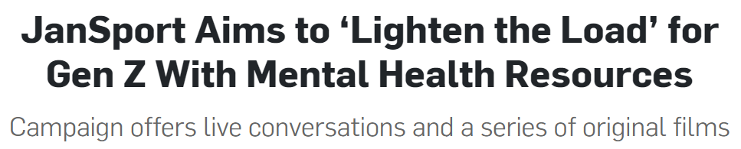
Additionally, brands across a range of categories, from backpacks to fashion and jewelry, are actively working to end the stigma around mental health by sharing resources, forming devoted coalitions and investing in relevant organizations
Using the scale of their platforms, brands like JanSport, Kenneth Cole and Kendra Scott are helping to bring mental health to the forefront, regardless of industry, and using their power to advance the conversation at a critical time
May 15, 2020
July 10, 2020
February 10, 2021
"This is a critical moment in time. The collective consciousness from the pandemic has created an unprecedented urgency to address the crisis now,“
- Kenneth Cole, Chairman & Chief Creative Officer, Kenneth Cole Productions Inc.
Founder & Chairman, The Mental Health Coalition
“We really didn’t want to come out again and tell [consumers] that we have durable backpacks in every color of the spectrum. It was really important for us to let Gen Z know that we want to hear about them, we want to know what they’re going through, and we want to be an ally.”
- Monica Rigali, Senior Director of Marketing, JanSport
“We know that mental health challenges have grown in number and severity for many of us in recent months and years. Isolation worsens already-existing mental health conditions and causes new ones to emerge…
we are investing in this grant with Active Minds to support mental wellness at the college level,”
- Kendra Scott, Founder & CEO, Kendra Scott
This information is exclusively provided to VAB members and qualified marketers. Further distribution is prohibited.
PAGE 16

Slide 17

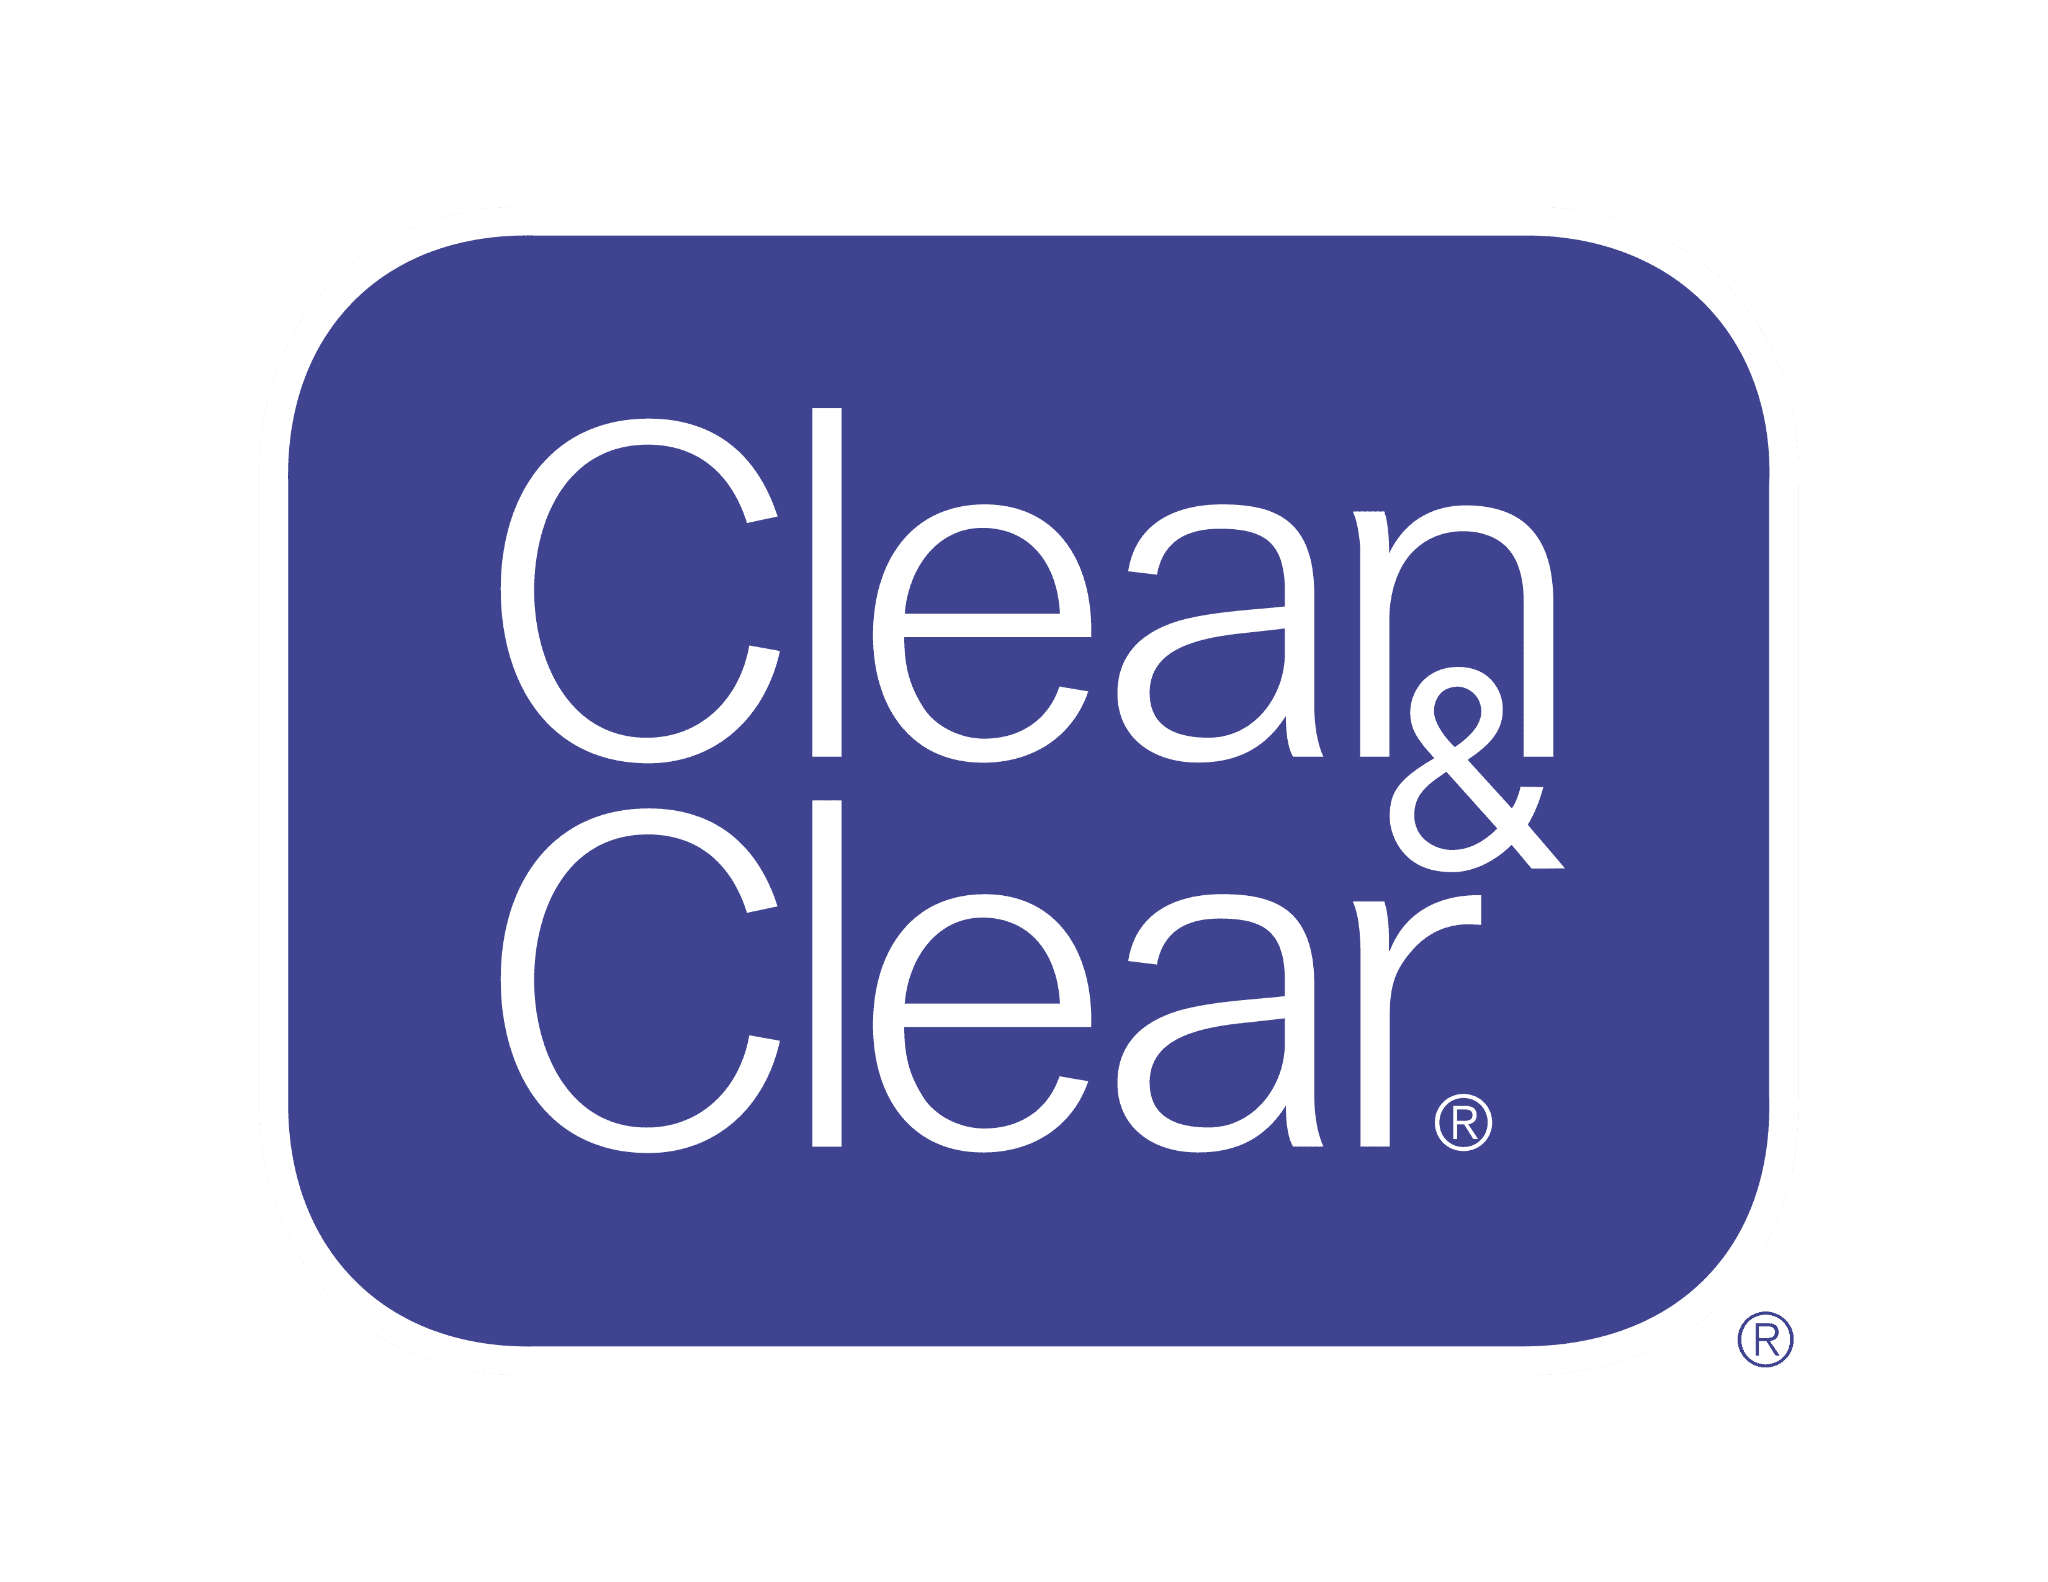


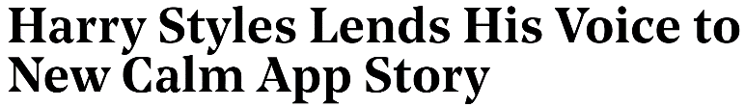
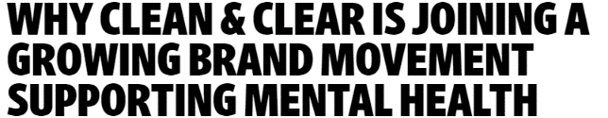


Celebrities and influencers alike have also joined in the battle to destigmatize mental health and promote self care via brand partnerships
Health influencers have proved especially popular among younger generations, with 76% of generation Z and 57% of millennials found value in health influencers
Traditional Mental Health
Self Care as Mental Health
July 8, 2020
Sept 9, 2020
"It's changed my life. I'm so happy to be collaborating with Calm at a time when the world needs all the healing it can get.“
- Harry Styles
"The response on Instagram was a sure sign the timing was right… we really wanted to bring resources to learn how mental health and well-being can be beneficial self-care during these unprecedented times”
- Amrika Ganness, Group Brand Director of Clean & Clear
Estimated total ad spend on influencer marketing was expected to increase to $5-$10 Billion dollars in 2020
Source: The Hollywood Reporter, Harry Styles Lends His Voice to New Calm App Story, July 8,2020; The Advertising Research Foundation (ARF), The Power of Influencer Marketing, Nov 12,2020; Forbes, Social Media Health Influencers Continue To Be Resource During Covid-19 Pandemic, July 16 2020; Ad Age, Why Clean and Clear is joining a growing brand movement supporting mental health, Sept 9, 2020.
This information is exclusively provided to VAB members and qualified marketers. Further distribution is prohibited.
PAGE 17

Slide 18
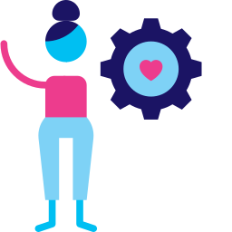

Overall, consumers’ awareness of brands who were pivoting with purpose in mind is leading to greater long-term brand trust and loyalty
Among nearly 1/3 of consumers (34%), knowing that a brand has pivoted their strategy to help during COVID instilled long-term trust that a brand will work to keep them safe
58%
of respondents could recall at least one brand that quickly pivoted to better respond to their needs during the pandemic
82%
said this led to them doing more business with the brand
Source: Deloitte Insights, 2021 Global Marketing Trends. The Global Marketing Trends Consumer Pulse Survey polled 2,447 global consumers, ages 18 and above, in April 2020. This survey was launched in the United States, the United Kingdom, Mexico, China, South Africa, Qatar, the United Arab Emirates, and the Kingdom of Saudi Arabia. Forrester’s Consumer Energy Index Online Survey, U.S. Consumers, March 2020.
This information is exclusively provided to VAB members and qualified marketers. Further distribution is prohibited.
PAGE 18

Slide 19
Summary: Exercise in Empathy
Brands who have adapted their products and messaging to showcase empathy are generating greater engagement among audiences
Brands from across a multitude of categories, including fashion and retail, are getting involved in the mental health fight by working to provide relief for those struggling and by helping fight the stigma against mental health
Influencers have been particularly helpful as a tool to reach Gen Z and millennial audiences because they create the feeling of ‘one-on-one’ personal interaction and human connection
During the pandemic, brands that pivoted their messaging and campaigns to address mental health establish long term trust and loyalty from their audience
This information is exclusively provided to VAB members and qualified marketers. Further distribution is prohibited.
PAGE 19

Slide 20


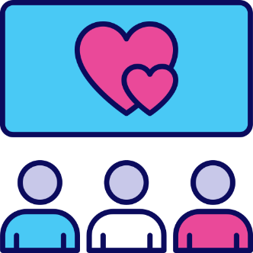
Key Takeaways For Marketers
Connecting Virtually
With in person events canceled, the consumer need for connection has grown.
A rise in video viewing and live events has allowed more like-minded people to gather in one place making it easy for brands to reach their target audience in an organic way.
Prioritize the Consumer
Incorporating relevant messaging and updating products and / or services that correlate to societal issues consumers may be facing can create long-term brand trust and loyalty.
Sending an Authentic Message
Addressing mental health by utilizing platforms and applications in an authentic and empathetic manner can not only build upon your current audience but also tap into a previously unknown audience across screens.
This information is exclusively provided to VAB members and qualified marketers. Further distribution is prohibited.
PAGE 20

Slide 21

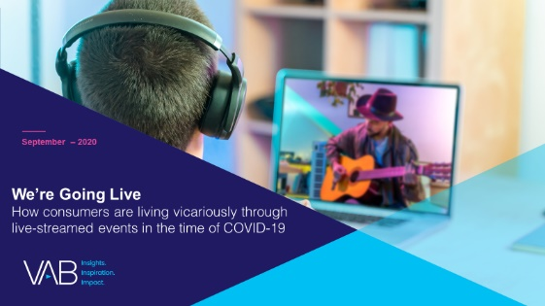
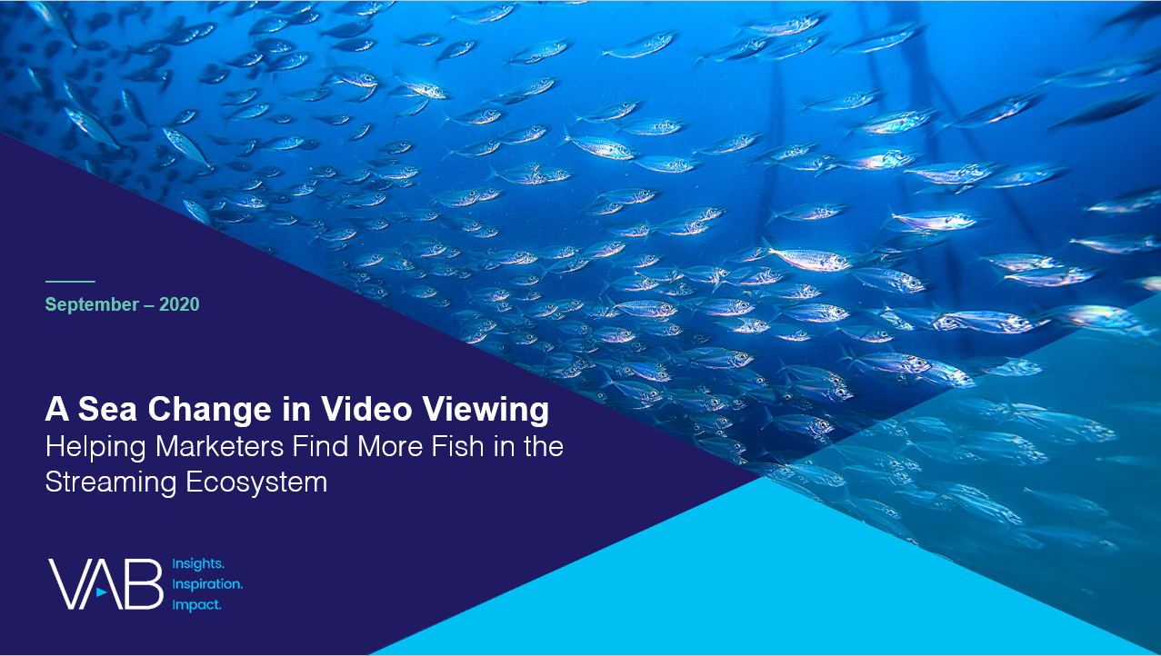
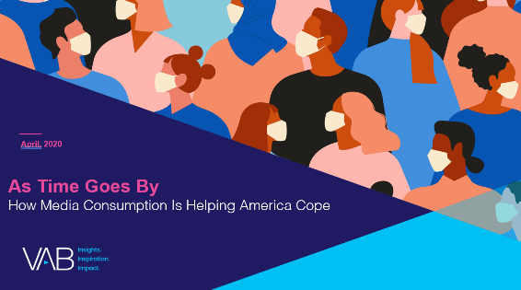
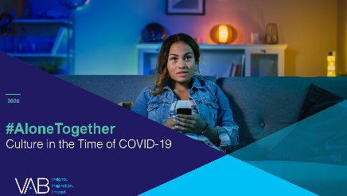
Toniece Brown
Marjory Duran
Executive Assistant to the President & CEO and EVP
toniece@thevab.com
Junior Marketing Associate
marjoryd@thevab.com
Karolina Guillen
Reed Kiely
Senior Insights Analyst
karolinag@thevab.com
Insights Manager
reedk@thevab.com
Leah Montner-Dixon
Insights Manager
leahm@thevab.com
We’re Going Live
How Consumers are Living Vicariously Through Live-Streamed Events in the Time of COVID-19
A Sea of Change in Video Viewing
Helping Marketers Find More Fish in the Streaming Ecosystem
Discover more
Looking for more data, insights and takeaways? Check out this related VAB content
As Time Goes By
How Media Consumption
is Helping America Cope
#AloneTogether
Culture in the Time of COVID-19
VAB Members, brand marketers and agencies get free and immediate access to VAB’s content library. Get access at theVAB.com
This information is exclusively provided to VAB members and qualified marketers. Further distribution is prohibited.
PAGE 21

Slide 22

About VAB
VAB is an insights-driven organization that inspires marketers to reimagine their media strategies resulting in fully informed decisions.
Drawing on our marketing expertise, we simplify the complexities in our industry and discover new insights that transform the way marketers look at their media strategy.
Discover
We keep you one step ahead with the latest thinking so you can create innovative, forward-looking strategies.
Simplify
We save you time by bringing you the latest data & actionable takeaways you can use to inform your marketing plans.
Transform
We help you build your brand by focusing on core marketing principles that will help drive tangible business outcomes.
We are committed to your business growth and proud to offer VAB members, brand marketers and agencies complimentary access to our continuously-growing Insights library. Get immediate access at theVAB.com.
This information is exclusively provided to VAB members and qualified marketers. Further distribution is prohibited.
PAGE 22

