Slide 1

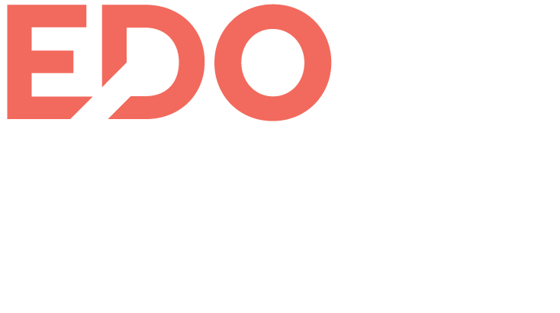

Success Stories
November 2022

Slide 2

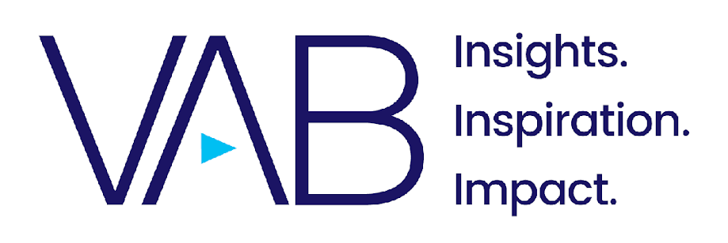
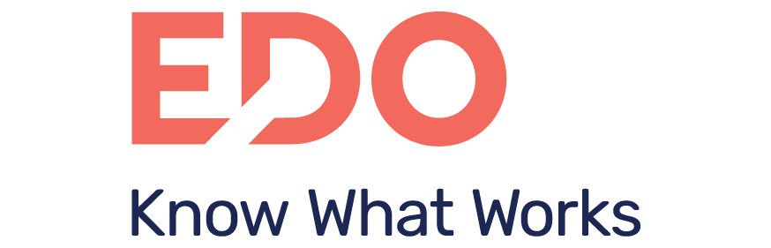
SUCCESS STORIES
Introduction
At VAB, we understand that modern measurement can be complex – and that the right measurement can maximize every investment.
However, with new possibilities come uncertainty, as modern marketers may ask themselves how to measure most effectively, and where to begin.
One of the best ways to inspire trial of new solutions is through real-world examples of how advertisers are leveraging video measurement innovations to drive success. When you can tap into real-time, predictive outcomes data, brands can plan and optimize campaigns – and even individual creatives – for increased ROI.
We partnered with EDO, the TV outcomes company, to highlight such case studies.

Slide 3

EDO CASE STUDY: CREATIVE OPTIMIZATION
Lincoln Auto’s Creative Rotation to Increase ROI
BRAND CHALLENGE
Luxury automaker Lincoln created four TV spots for its end-of-year Wish List Sales Event. Given the end of the year’s importance for auto sales, Lincoln knew that using the most productive spots would drive more consumers from brand awareness to consideration, therefore generating more sales leads and digital KPIs. To this end, Lincoln wanted to re-allocate airings to the two most productive spots.
PREDICTIVE DATA
EDO analyzed the performance of all four Lincoln Sales Event spots and found that a consumer who saw Snow Globe or Holiday Mayhem was more likely to immediately search online for Lincoln than someone who saw Art of Flight or Goat Yoga.
But while the best performer (Snow Globe) was driving 16.8% more consumer Search Engagement than the lowest performer (Goat Yoga), Snow Globe had the lowest airing allocation (17%) while Goat Yoga had the highest (40%).
ROI ACHIEVED
By optimizing off of EDO’s data, Lincoln generated 5.9% more total Search Engagement for the remainder of the campaign than if it had not altered its rotation.
We estimate these changes allowed Lincoln to gain additional consumer Search Engagement equal to 59 ad airings, or $354k in media value, with no extra media spend.
Reallocate airings to the most productive spots and increase consumer engagement with no extra media spend
ALLOCATION Before Dec 17 / After Dec 17
Creative # AIRINGS % ALLOCATION
Snow Globe. 376 / 455 17% / 50%
Holiday Mayhem 389 / 469 19% / 50%
Art of Flight 472 / 0 24 / 0%
Goat Yoga 758 / 0 40% / 0%
Lincoln used EDO’s data to
perform a creative rotation
optimization and divert a
higher proportion of its
airings toward its
best-performing creatives
within the campaign.

Slide 4

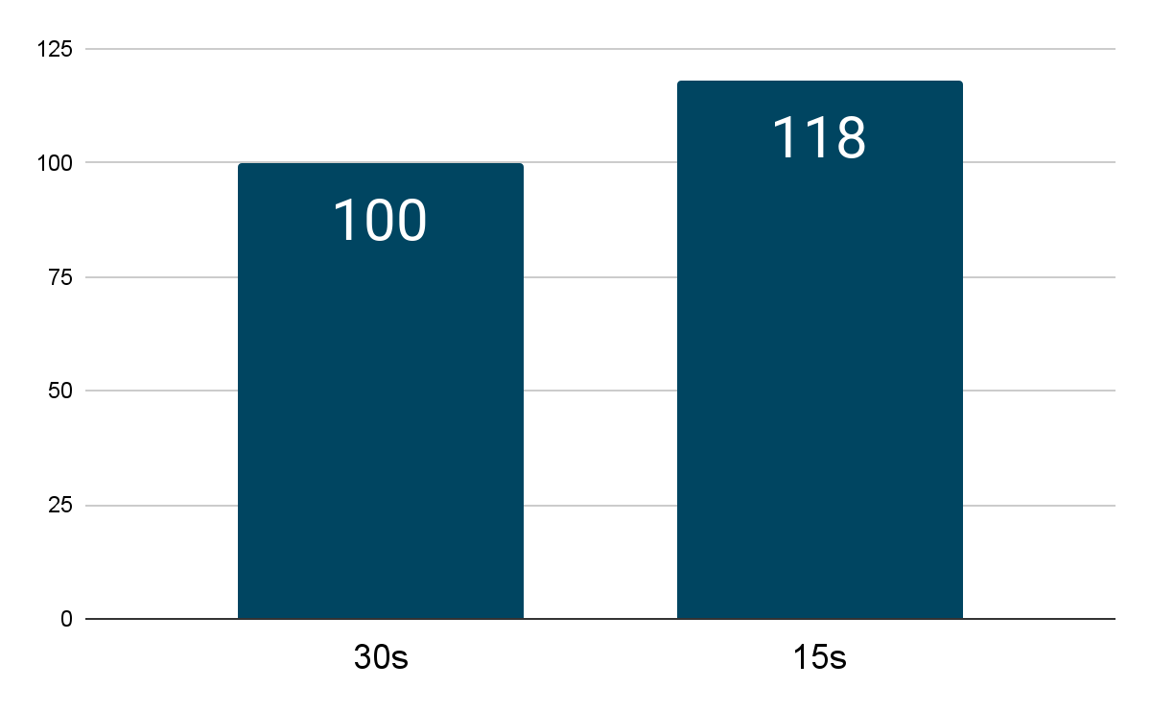
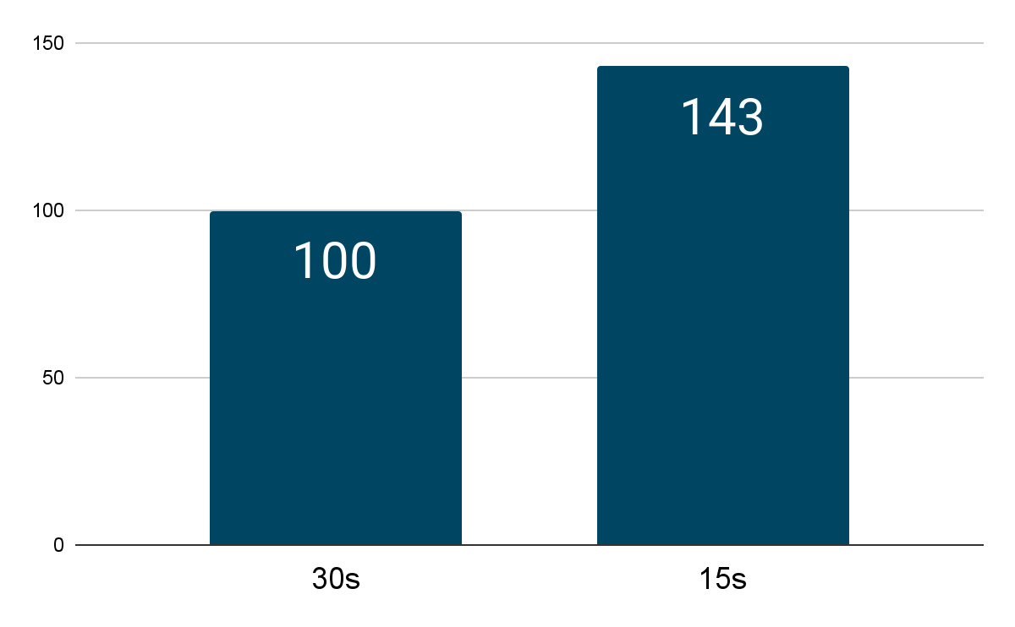
EDO CASE STUDY: CREATIVE OPTIMIZATION
Intelligent Insurance brand bets on
the right :15s mix
BRAND CHALLENGE
A Fortune 500 insurance company was not airing any :15s ads, but noticed that competitors relied heavily on them. They wanted to better understand the impact of :15s versus :30s ads to inform their creative strategy.
PREDICTIVE DATA
EDO measured Search Engagement driven by :15s versus :30s in the category on a per-person, per-second basis. We found that :15s ads perform 18% better, on average, than :30s ads in the insurance category.
ROI ACHIEVED
The company shifted their media strategy as a result of EDO’s recommendation and immediately saw an outsized impact on Search Engagement, with the company’s new :15s ads driving a 43% increase in branded searches.
Optimize media mix to increase weights towards strongest performing creatives
Category
Search Engagement Rate by Ad Duration
Company
Search Engagement Rate by Ad Duration After Investing in :15s Ads
SER is EDO’s Search Engagement Rate, measures the relative likelihood that a consumer searched for a brand after seeing an ad.

Slide 5

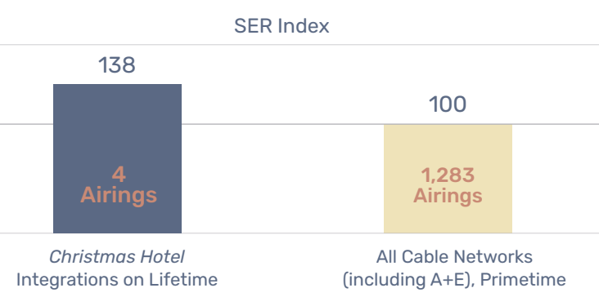
EDO CASE STUDY: PRODUCT INTEGRATION
Etsy sees 38% Increase in TV Engagement
BRAND CHALLENGE
A+E had planned a custom integration for Etsy in a highly anticipated holiday movie on its subsidiary network, Lifetime. A+E sought a partner to help them identify and understand the impact of Etsy’s integration. Traditionally, marketers have not had a viable method to measure whether custom integration placements actually work, as isolating the impact of a specific placement is extremely difficult.
PREDICTIVE DATA
By precisely aligning the custom integration with incremental search activity in the minutes following, EDO illuminated the immediate consumer response to Etsy’s contextual promotional placement. For this integration, EDO benchmarked the Etsy integration against traditional TV ads on Lifetime and on other similar drama-genre programming.
ROI ACHIEVED
EDO’s analysis found that a viewer who saw an Etsy integration during the Lifetime holiday movie was 38% more likely to engage online with the brand as compared to someone who saw a standard ad airing during the average cable primetime program.
Further, on average, Etsy would have required nearly two ads on cable primetime to generate the same impact as a single product integration during the holiday movie on Lifetime.
Align TV integrations with engagement activity to identify real-time response to contextual promos
EDO’s data highlighted that the integrations on Lifetime led to almost 40% more consumer online searches than standard TV ad airings for the brand on the average primetime cable network.
SER is EDO’s Search Engagement Rate, measures the relative likelihood that a consumer searched for a brand after seeing an ad.

Slide 6

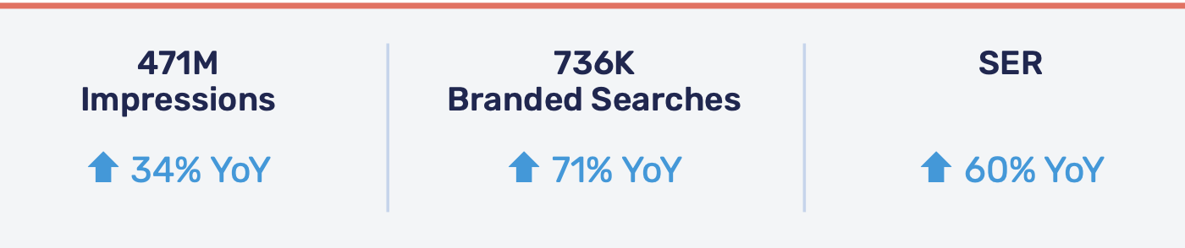
EDO CASE STUDY: MEDIA ENGAGEMENT
Leading Golf Brand’s 60% TV Engagement Increase
BRAND CHALLENGE
A leading golf equipment manufacturer and its ad agency set a goal to completely redesign their TV media plan to drive higher levels of consumer engagement and sales. The advertiser’s major challenge was its uncertainty around how to even evaluate how effective their existing TV advertising was.
PREDICTIVE DATA
EDO’s search data indicated the team should shift their investment away from studio shows and toward live golf programming. EDO’s historical data predicted the brand would achieve the desired results by running ads during broadcast programming on Saturdays and Sundays, specifically during the last two hours of golf tournaments.
Though it required more investment for less airings, EDO justified the price premium for live golf programming as the ads during live sports programming drove considerably more branded search than during studio based programming.
ROI ACHIEVED
Since December 2020, EDO has helped the golf brand achieve considerably more online search, significantly outpacing increases in impressions and spend. The brand generated a 60% higher Search Engagement Rate (SER) year-over-year, meaning the brand’s ads drove 60% more consumer search on a per person basis in the last year because of changes to the programming schedule driven by EDO data.
Shift media towards programming that predictive outcomes data shows will achieve the highest results
SER is EDO’s Search Engagement Rate, measures the relative likelihood that a consumer searched for a brand after seeing an ad.

Slide 7
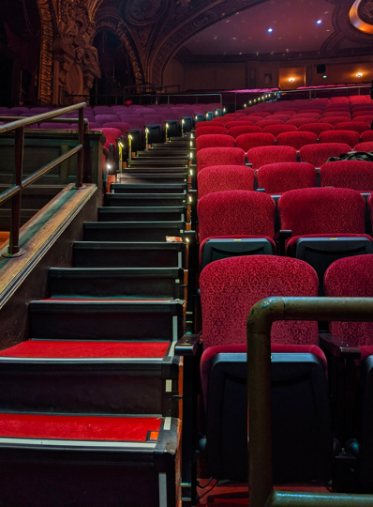
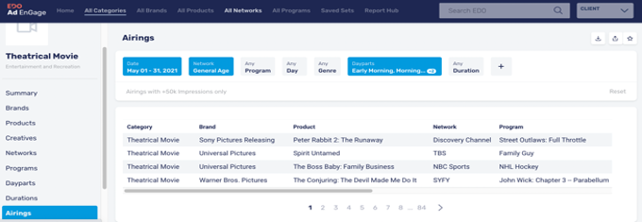
EDO CASE STUDY: MEDIA EFFICIENCY
Auditing Network Buy for Entertainment Brand
BRAND CHALLENGE
An entertainment brand set linear TV network buying guidelines for an upcoming movie campaign, that excluded programs with sensitive content and programs that didn’t contextually align with the theme of their ads’ message. However, due to the large lag time that exists between when a linear TV ad airs and when post-logs are available, monitoring if a network adheres to the brand’s approved schedule typically occurs months after the campaign flight is over.
PREDICTIVE DATA
To ensure all networks followed the agreed upon programming “do not air” list the entertainment brand partnered with EDO to monitor the 4-week campaign.
In the first 3 weeks of monitoring the campaign EDO found that multiple ad airings had run in programming that was included within the clients “do not air” list and was able to identify what networks those ad airings occurred on.
ROI ACHIEVED
Through this audit EDO estimated that the total media value for network infractions equated to about $240,000.
The entertainment client leveraged the audits findings to negotiate make-goods from the various networks that had not met the guaranteed programming restrictions. Due to EDO’s real-time monitoring capabilities the client was able to apply those make-goods to each network’s schedule before the campaign flight had ended.
Confirm in real time that networks are adhering to your brand’s agreed-on buying guidelines

Slide 8
EDO: KNOW WHAT WORKS
Best Practices to Improve TV Outcomes
Measure and optimize multiple aspects of creative. Specific creative messaging, ad unit length and rotation can all be leveraged to increase efficiency and drive greater outcomes. Granular creative measurement empowers advertisers to maximize investment – keeping costs low while still seeing increases in engagement.
Monitor and measure campaigns in real time. Brands should know when and where their linear TV spots air in real time for immediate confirmation that networks are meeting campaign planning guidelines. This enables marketers to make campaign optimizations while still in flight. The isolation of custom ads also facilitates marketers’ ability to measure the success of a unique placement – such as how much consumer engagement a product integration generates.
Leverage historical search data to develop more intelligent campaigns. Adopting a data-driven approach can enable advertisers to pinpoint which dayparts, programs, and even in which pod positions during those programs they will see the greatest engagement. This leads to overall increases in the relative likelihood that a consumer searched for a brand after seeing an ad.

