Slide 1


July 2020
A Matter of Principle
Reassessing Your Strategy in Today’s Environment

Slide 2

About VAB
VAB is an insights-driven organization that inspires marketers to reimagine their media strategies resulting in fully informed decisions.
Drawing on our marketing expertise, we simplify the complexities in our industry and discover new insights that transform the way marketers look at their media strategy.
Simplify
We save you time by bringing you the latest data & actionable takeaways you can use to inform your marketing plans.
Discover
We keep you one step ahead with the latest thinking so you can create innovative, forward-looking strategies.
Transform
We help you build your brand by focusing on core marketing principles that will help drive tangible business outcomes.
This information is exclusively provided to VAB members and qualified marketers. Further distribution is prohibited.
PAGE 2

Slide 3
Introduction – Reassessing Your Strategy in Today’s Environment
How do proven marketing principles apply today?
When we published A Matter of Principle in November 2019, we couldn’t imagine how the world would change in just a handful of months. In addition to a frightening health crisis and the ensuing global battle against COVID-19, the deep-rooted issue of systemic racism has come to the forefront of not only society, but also our industry. Faced with so much social and economic uncertainty, we are all seeking answers.
As a result, marketers are calling into question everything - budgets, media strategy, messaging - and wondering
how the current environment will impact their upcoming strategic marketing and communication plans. Furthermore, brands and agencies are all looking for guidance on how to meaningfully address racial inequality within our own industry and beyond.
The spirit behind A Matter of Principle was to equip marketers with 10 principles proven to drive business and brand growth. Given the sheer volume of matters that need to be addressed as quickly as possible, we feel a responsibility to help the community that has increasingly looked to us for information and guidance to forge their own paths ahead.
In our ongoing mission of providing marketers with real, actionable insights, we have reviewed these principles in the context of the current climate and offer guidance on how you can apply them to your decision-making today.
As always, we’re here to support you, your business growth and the overall betterment of our industry as best we can.
This information is exclusively provided to VAB members and qualified marketers. Further distribution is prohibited.
PAGE 3

Slide 4
What you’ll learn
A refresher on the marketing principles proven to grow brands, inspire consumer action, and drive business growth
How those principles have heightened relevance in today’s uncertain climate
As in the original A Matter of Principle, we will show how these principles can drive impact at each stage of the consumer funnel: Awareness, Consideration, and Purchase
This information is exclusively provided to VAB members and qualified marketers. Further distribution is prohibited.
PAGE 4

Slide 5

Awareness:
Potential consumers are introduced to the brand and begin to form the impressions that may predispose them to consider
that brand later in their journey
PRINCIPLE NO. 1
Balance Broad-Based Reach With Hyper-Targeting to Grow Market Share, a Key Driver of Profit
PRINCIPLE NO. 2
Virality Tactics Should Be a Part of an Integrated Campaign, Not the Sole Focus
PRINCIPLE NO. 3
Protect Your Brand by Investing in Only Premium, Viewable Content
This information is exclusively provided to VAB members and qualified marketers. Further distribution is prohibited.
PAGE 5

Slide 6
Awareness: Principle No. 1
PRINCIPLE NO. 1
Balance Broad-Based Reach With Hyper-Targeting to Grow Market Share, a Key Driver of Profit
APPLYING TO TODAY’S ENVIRONMENT
Heightened interest in both the pandemic and Black Lives Matter movement has resulted in all demographic groups turning to video as they search for both news and a welcome distraction.
For marketers re-evaluating their media strategies, video offers scale to reach all potential customers during this uncertain economic time, and precision through audience-based buying or addressable targeting, ensuring no ethnicity is left underrepresented.
The current video environment offers marketers more scale and more targetability.
This information is exclusively provided to VAB members and qualified marketers. Further distribution is prohibited.
PAGE 6

Slide 7

At a time when the need for both information and distraction is of utmost importance, media usage has increased, fulfilling many roles for overwhelmed Americans
Media Usage Since COVID-19 Outbreak
P18+
Source: VAB’s 'As Time Goes By: How Media Consumption Is Helping America Cope’. VAB / Lucid ‘Media Usage In The Time of COVID-19 Survey,’ April 2020. Survey base: P18+ & household subscribes to cable, telco, internet TV or satellite TV (n=1,004). Q1: Overall, please choose the statement below that best describes your media usage since the outbreak of the COVID-19 Pandemic.
This information is exclusively provided to VAB members and qualified marketers. Further distribution is prohibited.
PAGE 7

Slide 8


During the COVID-19 outbreak, the TV itself has become the centerpiece of our homes, providing viewers with easy access to content across platforms
% of respondents who agree with the statement
P18+
83%
67%
“I couldn't imagine not having a television set right now”
“TV has become the central focus of our home”
Source: VAB’s 'As Time Goes By: How Media Consumption Is Helping America Cope’. VAB / Lucid ‘Media Usage In The Time of COVID-19 Survey,’ April 2020. Survey base: P18+ & household subscribes to cable, telco, internet TV or satellite TV (n=1,004). Q7: Thinking of your behavior since the start of COVID-19, please indicate below how much you agree or disagree with the following statements & Q9: Thinking of your behavior during the COVID-19 Pandemic, please indicate below how much you agree or disagree with the following statements.
This information is exclusively provided to VAB members and qualified marketers. Further distribution is prohibited.
PAGE 8

Slide 9

By expanding a brand’s presence to Hispanic media, advertisers build a stronger connection with multilingual audiences
A targeted brand presence can increase relevancy by coming to meet your audience where they are
58%
57%
65%
47%
Source: VAB’s ‘Bridging the Gap: Utilizing Addressable TV To Extend Hispanic-Targeted Reach’. Horowitz Research, State of Consumer Engagement 2018.
This information is exclusively provided to VAB members and qualified marketers. Further distribution is prohibited.
PAGE 9

Slide 10
Awareness: Principle No. 2
PRINCIPLE NO. 2
Virality Tactics Should Be a Part of an Integrated Campaign, Not the Sole Focus
APPLYING TO TODAY’S ENVIRONMENT
We’ve consistently seen strong real-time TV viewer engagement on social platforms, especially among the multicultural community.
But now, in our physical and emotional isolation, social media has been a lifeline to connect with others. TV offers the conversation fuel while social media provides the real-time platform for viewers to actively discuss their shared passion.
Marketers should consider how their TV and social strategies complement each other to maximize their voice in the conversation and amplify their engagement with multicultural audiences.
This information is exclusively provided to VAB members and qualified marketers. Further distribution is prohibited.
PAGE 10

Slide 11



When stress is high, people turn to entertainment like TV, movies and social media to cope, increasing the interplay between video & social even more than prior to the pandemic
Ways To Deal With Stress During the COVID-19 Pandemic
% of respondents who agree
P18+
77%
41%
TV & Movies
Social Media
Source: VAB’s 'As Time Goes By: How Media Consumption Is Helping America Cope’. VAB / Lucid ‘Media Usage In The Time of COVID-19 Survey,’ April 2020. Survey base: P18+ & household subscribes to cable, telco, internet TV or satellite TV (n=1,004). Q8: During this Pandemic, are any of the following helping you deal with stress?
This information is exclusively provided to VAB members and qualified marketers. Further distribution is prohibited.
PAGE 11

Slide 12

Of all social trending topics, video content inspired the most conversation, accounting for three-quarters of the top 10 Twitter trends
% of Video Topics in Twitter Top 10
(Primetime, during the first 6 weeks of lockdown)
(March 16th – April 26th)
Source: VAB’s ‘#AloneTogether: Culture in the Time of COVID-19’. VAB custom analysis of Top 10 trending Twitter Topics each night (9:30p & 11p) aggregated during the analysis time period (3/16/2020 – 4/26/2020). Results include both ‘direct’ and ‘related’ topics.
This information is exclusively provided to VAB members and qualified marketers. Further distribution is prohibited.
PAGE 12

Slide 13
Multicultural audiences have significant influence on online conversation - 27% of total trending topics were related to subjects, content and programming that specifically featured people of color or a diverse cast
% of Top 10 ‘Diversity-Focused’ Trending Topics by Platform
(March 16th – April 26th)
86% of total topics were video-based
Source: VAB’s ‘#AloneTogether: Culture in the Time of COVID-19. VAB custom analysis of Top 10 trending Twitter Topics each night (9:30p & 11p) aggregated during the analysis time period (3/16/2020 – 4/26/2020). Results include both ‘direct’ and ‘related’ topics. Other video platforms include Facebook Live, HBO, Netflix, Twitter and YouTube. NFL is excluded from the count of topics due to the mainstream nature of the sport and online conversations.
This information is exclusively provided to VAB members and qualified marketers. Further distribution is prohibited.
PAGE 13

Slide 14
Awareness: Principle No. 3
PRINCIPLE NO. 3
Protect Your Brand by Investing in Only Premium, Viewable Content
APPLYING TO TODAY’S ENVIRONMENT
With many companies cutting budgets and every marketing dollar scrutinized, brand leaders need to fiercely protect their investment by making sure campaigns run in 100% viewable, fraud-free content.
Drive more ROI by ensuring your messaging is seen by your audience, as designed.
This information is exclusively provided to VAB members and qualified marketers. Further distribution is prohibited.
PAGE 14

Slide 15

At a time when budgets are being even more heavily scrutinized, it is crucial to make sure your campaign reaches the right audience in a brand-safe environment
The right environment isn’t just about brand safety either – depending on where you allocate your ad dollars, the intended audience might never even receive a brand’s messaging
According to a recent report:
49%
of online ad spend never arrives in front of the intended audience
15%
of online ad spend, representing ~1/3 of supply chain costs, could not be attributed
Source: ISBA and PwC via MediaVillage, 5/8/20. Based on survey data from 15 advertisers, 12 agencies, five DSPs, six SSPs and 12 publishers, representing approximately £0.1bn of UK programmatic ad spend and nearly two-thirds of AOP (premium publisher) digital ad revenues. Data collection ran from 1/1/2020 – 3/20/2020;
This information is exclusively provided to VAB members and qualified marketers. Further distribution is prohibited.
PAGE 15

Slide 16

Consideration
Consumers evaluate choices, drawing largely on their perceptions of brands and their emotional connection to them as well as rational messages and information to help inform choice
PRINCIPLE NO. 4
Brand Building Leads to Increased Long-Term Profitability
PRINCIPLE NO. 5
In an Information-Heavy, Opinion-Saturated Environment, Brand Building Is Essential to Support Brand Perception and Foster the Loyalty That Protects Pricing and Profits
PRINCIPLE NO. 6
Brand Building Media, Such As Premium Video, Fosters a Deep Emotional Connection
PRINCIPLE NO. 7
Content Environment Matters Everywhere
This information is exclusively provided to VAB members and qualified marketers. Further distribution is prohibited.
PAGE 16

Slide 17
Consideration: Principle No. 4
PRINCIPLE NO. 4
Brand Building Leads to Increased Long-Term Profitability
APPLYING TO TODAY’S ENVIRONMENT
Brands play an essential role in a crisis. We look to them for reassurance and to help us navigate (in an authentic way) our new normal.
In times of economic downturn, many marketers question whether they should be spending. Both history and marketing principles prove unequivocally that brands that maintain or increase their spending reap significantly greater long-term benefits than those who cut spending.
Furthermore, brands have proven investing in multicultural targeting leads to financial reward. Many multicultural campaigns have resulted in the launch of successful brands and increased business outcomes.
Marketers should remember that maintaining SOV now will cost you less in the long-term and brands that invest in multicultural marketing typically experience positive financial returns.
This information is exclusively provided to VAB members and qualified marketers. Further distribution is prohibited.
PAGE 17

Slide 18
Academic scholars who have analyzed the historical relationship between Share of Voice (SOV) and Share of Market (SOM) have found there’s a rather clear equilibrium that exists between the two
SOV vs. SOM
Market share is a function of many things. But one of the biggest drivers of sales is a brand’s share of voice.
The more a brand spends on advertising vs. its competitors, the more it will grow. This proven relationship is called ‘Excess Share of Voice (ESOV).’
If a brand has a 20% share of market but a 30% share of voice, it has an ESOV of +10.
In almost every recorded instance, a brand with a positive ESOV will gradually grow its share of the market to a level that will eventually match its share of voice.
-Mark Ritson (4/6/20)
Source: VAB’s ‘Keep Calm and Advertise On: How to Successfully Navigate Your Brand Through an Economic Downturn’.
This information is exclusively provided to VAB members and qualified marketers. Further distribution is prohibited.
PAGE 18

Slide 19

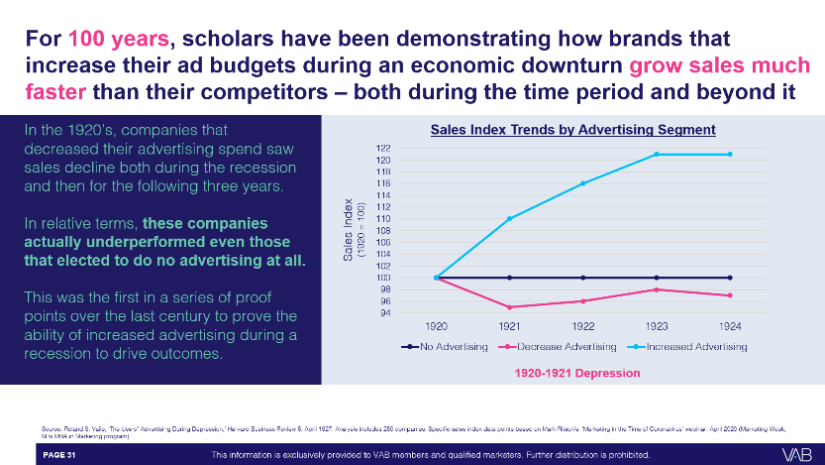
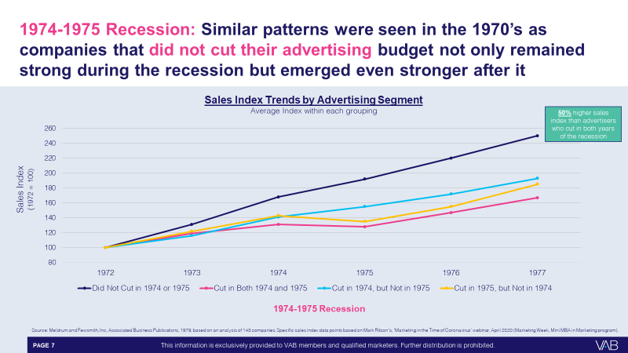
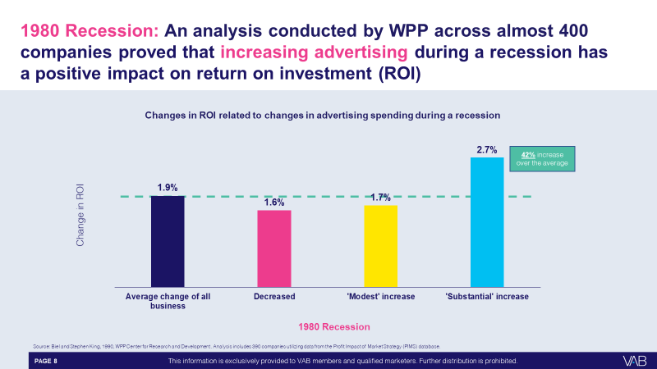
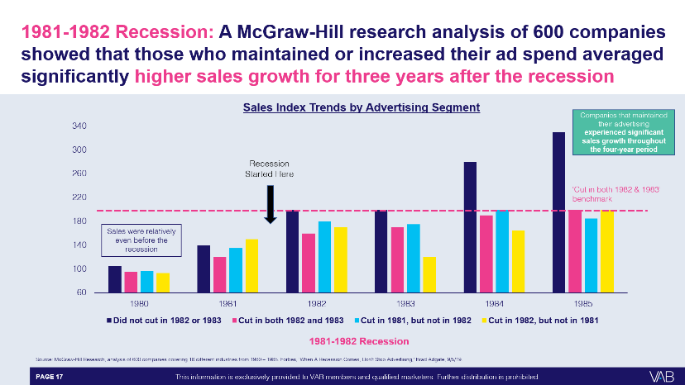
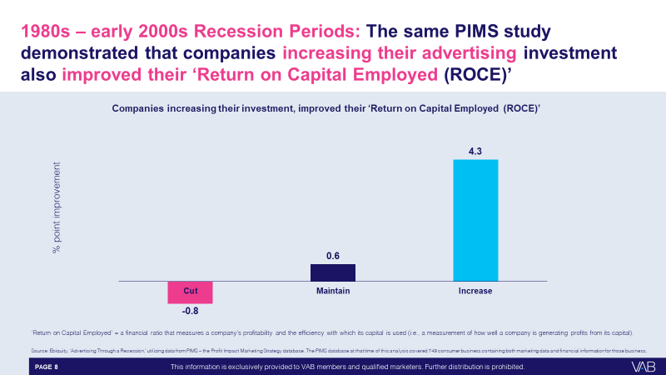
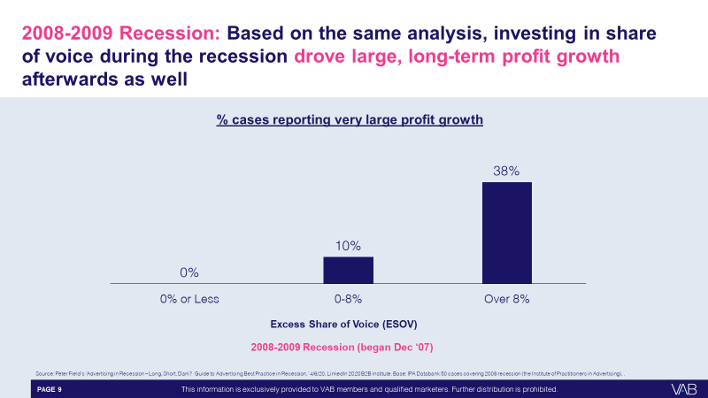
There are 100 years of analyses conducted during recessions that proves marketers need to at least maintain their share of voice to grow market share and avoid a prolonged and expensive recovery afterwards
Source: VAB’s ‘Keep Calm and Advertise On: How to Successfully Navigate Your Brand Through an Economic Downturn’.
This information is exclusively provided to VAB members and qualified marketers. Further distribution is prohibited.
PAGE 19

Slide 20

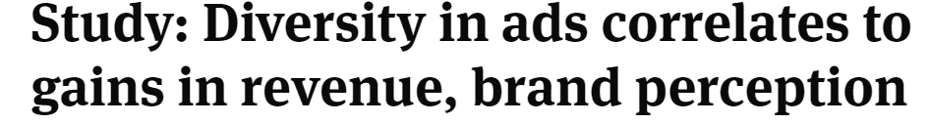


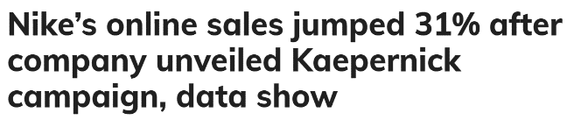



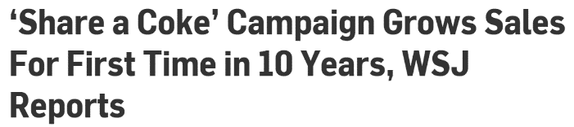

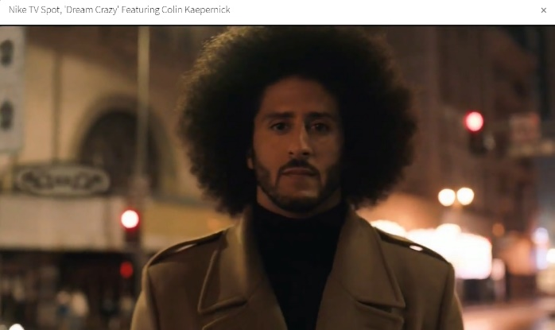

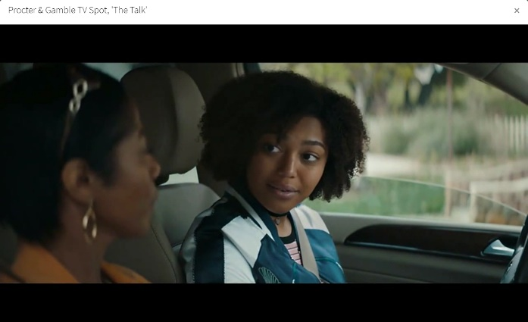

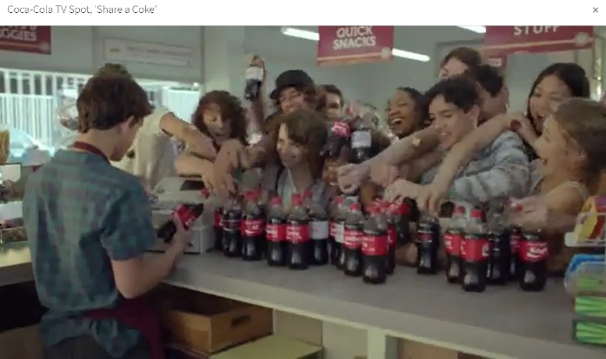
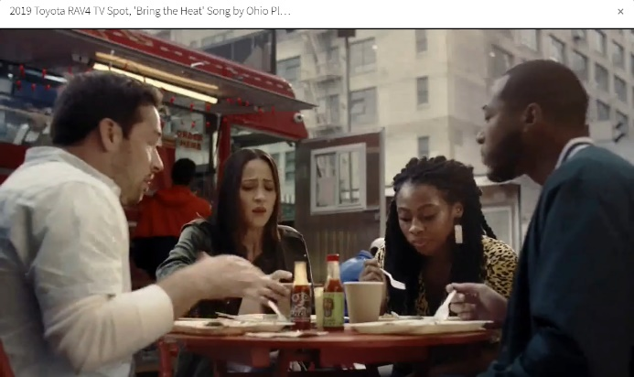
Recently, brands that have increased diversity within their ads or have launched inclusivity-specific campaigns have seen significant sales growth
This information is exclusively provided to VAB members and qualified marketers. Further distribution is prohibited.
PAGE 20

Slide 21
Consideration: Principle No. 5
PRINCIPLE NO. 5
In an Information-Heavy, Opinion-Saturated Environment, Brand Building Is Essential to Support Brand Perception and Foster the Loyalty That Protects Pricing and Profits
APPLYING TO TODAY’S ENVIRONMENT
Building an emotional connection has always been a critical component to influencing consideration. This emotional connection has a deep impact on brand perception, especially among multicultural consumers.
Particularly in times of uncertainty or unrest, purpose-driven, emotional messaging helps to nurture the relationship with consumers.
These brands will set themselves up for increased consideration as they will be more top-of-mind in the future. This also builds an ‘equity bank’ with the consumer that helps to defend against any conflicting ‘rational’ or ‘practical’ message that may threaten consideration in the future – for example, negative reviews, competitive landscape or pricing disparities.
Marketers have a unique opportunity to build brand love with consumers to increase consideration in the short- and long-term.
This information is exclusively provided to VAB members and qualified marketers. Further distribution is prohibited.
PAGE 21

Slide 22




Consumers look to brands to address uncertainty and offer authentic help, and when they do it, it positively impacts how they feel about
those brands
“Companies with specific COVID-19 related advertising messages positively impacts my perception of the brand”
% that agree with the statement
52%
of all respondents
Source: VAB’s 'As Time Goes By: How Media Consumption Is Helping America Cope. VAB / Lucid ‘Media Usage In The Time of COVID-19 Survey,’ April 2020. Survey base: P18+ & household subscribes to cable, telco, internet TV or satellite TV (n=1,004). Q14: Some companies have created specific COVID-19 related advertising messages (e.g. Guinness, Ford, Burger King, Verizon). How do these types of advertisements typically impact your perception of a brand?
This information is exclusively provided to VAB members and qualified marketers. Further distribution is prohibited.
PAGE 22
PAGE 1

Slide 23
Among multicultural consumers, companies that share positive messaging and actively seek to help communities during this crisis are positively impacted
% of respondents who agree with the statement
Source: VAB’s 'As Time Goes By: How Media Consumption Is Helping America Cope. VAB / Lucid ‘Media Usage In The Time of COVID-19 Survey,’ April 2020. Survey base: P18+ & household subscribes to cable, telco, internet TV or satellite TV (n=1,004). Q14. Some companies have created specific COVID-19 related advertising messages (e.g. Guinness, Ford, Burger King, Verizon). How do these types of advertisements typically impact your perception of a brand? & Q15. Some companies are lending resources (e.g. Comcast donating free internet, Ford, 3M and GE Healthcare making healthcare equipment), or helping local communities during the crisis (Miller Lite starts ‘virtual tip jar’ to support out-of-work bartenders). How does this affect your likelihood to purchase a product or service from this company?
This information is exclusively provided to VAB members and qualified marketers. Further distribution is prohibited.
PAGE 23

Slide 24
Consideration: Principle No. 6
PRINCIPLE NO. 6
Brand Building Media, Such As Premium Video, Fosters a Deep Emotional Connection
APPLYING TO TODAY’S ENVIRONMENT
At this time, many brands have a dual need to show empathy, but also provide real, practical help or action. This is seen in the “we’re here for you” COVID-19 messaging coupled with offers of contactless-delivery, curbside pick-up, or financing options and the companies who supported Black Lives Matter and then joined the #StopHateForProfit Facebook boycott.
Marketers should reflect on the current climate and re-consider their messaging to determine the appropriate way to engage with their consumer moving forward.
This information is exclusively provided to VAB members and qualified marketers. Further distribution is prohibited.
PAGE 24

Slide 25


From an advertising perspective, consumers are turning to brands
for reassurances during these uncertain times and want to hear how companies are responding to the pandemic crisis
What Consumers Want
What Kind of Messaging Resonates?
56% are ‘pleased to hear brands taking action like making donations of goods and services’
Viewers show strongest resonance towards
uplifting themes of unity & resilience
43% say they want messages that are ‘reassuring from the brands I know and trust’
A strong connection between the brand and message must be apparent
40% want to know what brands are doing in response to the pandemic
Ads should be driven by relevance and information, but viewers are still looking for entertainment and storytelling
Source: VAB’s ‘Make Yourself at Home: Video Viewing in the Time of COVID-19’. MediaPost, American Association of Advertising Agencies (4As) survey conducted via Suzy on March 18, 2020, A18+ respondents = 1,000; Ace Metrix,
How Brands are Navigating the COVID-19 Pandemic, 3/19/2020.
This information is exclusively provided to VAB members and qualified marketers. Further distribution is prohibited.
PAGE 25

Slide 26




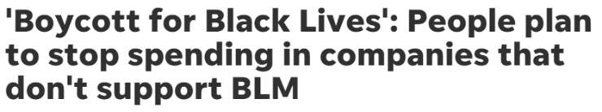
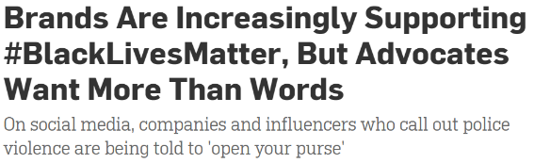
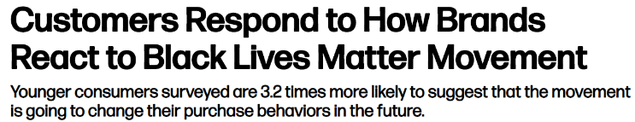






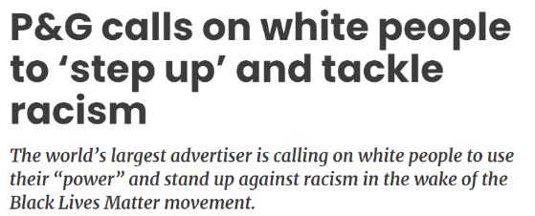
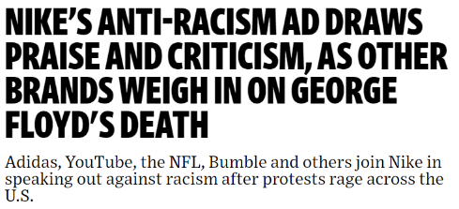
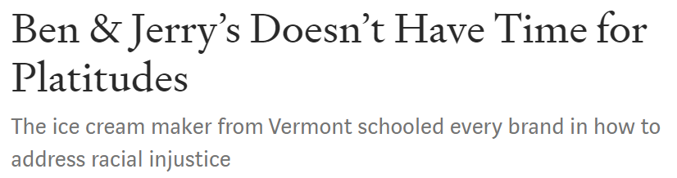


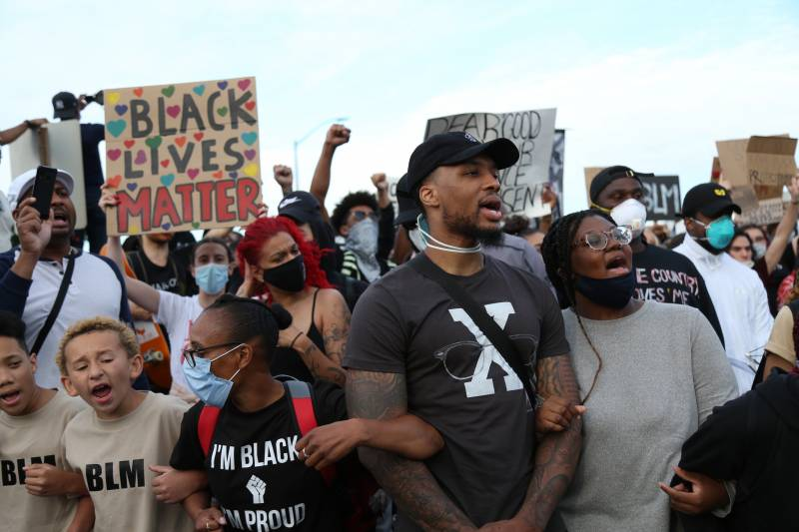


As emotions run high surrounding current social unrest and the Black Lives Matter movement, brands’ responses can elicit strong reactions, both positive and negative, from consumers
Consumers take notice of the brands that take a genuine, active role in addressing current issues, and they also pay attention to those who miss the mark in their messaging or those who stay silent all together
This information is exclusively provided to VAB members and qualified marketers. Further distribution is prohibited.
PAGE 26

Slide 27
Consideration: Principle No. 7
PRINCIPLE NO. 7
Content Environment Matters Everywhere
APPLYING TO TODAY’S ENVIRONMENT
To truly connect with multicultural audiences, savvy brands look to borrow from the equity of the content environments they appear in.
Aligning your brand with trusted, culturally relevant content is an essential element to building brand equity and driving sales.
As marketers seek to convey trust, authority, and reassurance among diverse consumers,
they need to ensure they are placing those messages in culturally relevant environments.
This information is exclusively provided to VAB members and qualified marketers. Further distribution is prohibited.
PAGE 27

Slide 28

People crave familiarity, and for multicultural viewers that plays a big role in the content they connect with
% vs. Non-Hispanic White 18+
Black A18+
Hispanic A18+
Asian A18+
‘I’m more likely to watch a TV show if it is relevant to my own cultural identity’
+68%
+40%
+20%
31%
26%
22%
XX%
= % of Respondents
Source: VAB’s ‘Discover the Difference: How Culturally Relevant Video Content Drives Action By Multicultural Audiences’. VAB / Dynata ‘Multicultural Video Engagement Survey,’ August 2019. Q7: What qualities make you more likely to watch a TV program? Select any or all that apply . African American/Black/Caribbean American = 302 Respondents, Hispanic = 300 Respondents, Asian American/Pacific Islander = 100 Respondents, Non-Hispanic White = 300 Respondents.
This information is exclusively provided to VAB members and qualified marketers. Further distribution is prohibited.
PAGE 28

Slide 29

By building a strong emotional connection through powerful storytelling, brands can have a lasting impact on multicultural consumers’ behavior
% vs. Non-Hispanic White 18+
Black A18+
Hispanic A18+
Asian A18+
‘I have purchased a product I saw while watching a TV program or endorsed by a favorite TV personality / actor’
+65%
+59%
+52%
68%
66%
63%
XX%
= % of Respondents
Source: VAB’s ‘Discover the Difference: How Culturally Relevant Video Content Drives Action By Multicultural Audiences’. VAB / Dynata ‘Multicultural Video Engagement Survey,’ August 2019. Q10: Please indicate how often you do the following. Respondents Answer = Always, Frequently or Occasionally. African American/Black/Caribbean American = 302 Respondents, Hispanic = 300 Respondents, Asian American/Pacific Islander = 100 Respondents, Non-Hispanic White = 300 Respondents.
This information is exclusively provided to VAB members and qualified marketers. Further distribution is prohibited.
PAGE 29

Slide 30

Purchase
As a results of emotional conditioning over time, as well as their current need state, consumers ultimately make a purchase decision
PRINCIPLE NO. 8
Success Should Be Measured and Evaluated Against Both Short- and Long-Term KPIs
PRINCIPLE NO. 9
Brand Leaders Need to Equip Themselves With the Data to Defend Decisions Based on Core Marketing Trends
PRINCIPLE NO. 10
The Balance of Brand Building and Short-Term Tactics Drives Both Immediate Demand and Long-Term Equity
This information is exclusively provided to VAB members and qualified marketers. Further distribution is prohibited.
PAGE 30

Slide 31
Purchase: Principle No. 8
PRINCIPLE NO. 8
Success Should Be Measured and Evaluated Against Both Short- and Long-Term KPIs
APPLYING TO TODAY’S ENVIRONMENT
The determination of how successful a campaign is should be based on its short and long-term impact.
While certain metrics can be measured in the short term, history proves that as brands advertise through an economic downturn, they overwhelmingly see an impact in the years after the event. For example, brands like Uber (“Thank you for not riding with us”) and Hotels.com (“Just stay home”) are messaging and measuring for impact in the long-term.
With so much uncertainty, marketers should design campaigns that can be measured for impact today, but also in 3, 6, 12+ months.
This information is exclusively provided to VAB members and qualified marketers. Further distribution is prohibited.
PAGE 31

Slide 32
It’s important to understand that the full impact of advertising’s effect is not seen immediately which helps explain how brands that spend during a recession continue to see significant share gains in the years after it
Share of Sales Impact by Timeframe
Hours / Days
Weeks / Months
Months / Years
100%
42%
18%
(via digital attribution)
(via marketing mix modeling)
(via brand equity modeling)
How to read: 18% of sales derived from advertising occurs within hours/days of exposure
Source: VAB’s ‘Keep Calm and Advertise On: How to Successfully Navigate Your Brand Through an Economic Downturn’. Ebiquity, ‘Advertising Through a Recession,’ April 2020.
This information is exclusively provided to VAB members and qualified marketers. Further distribution is prohibited.
PAGE 32

Slide 33
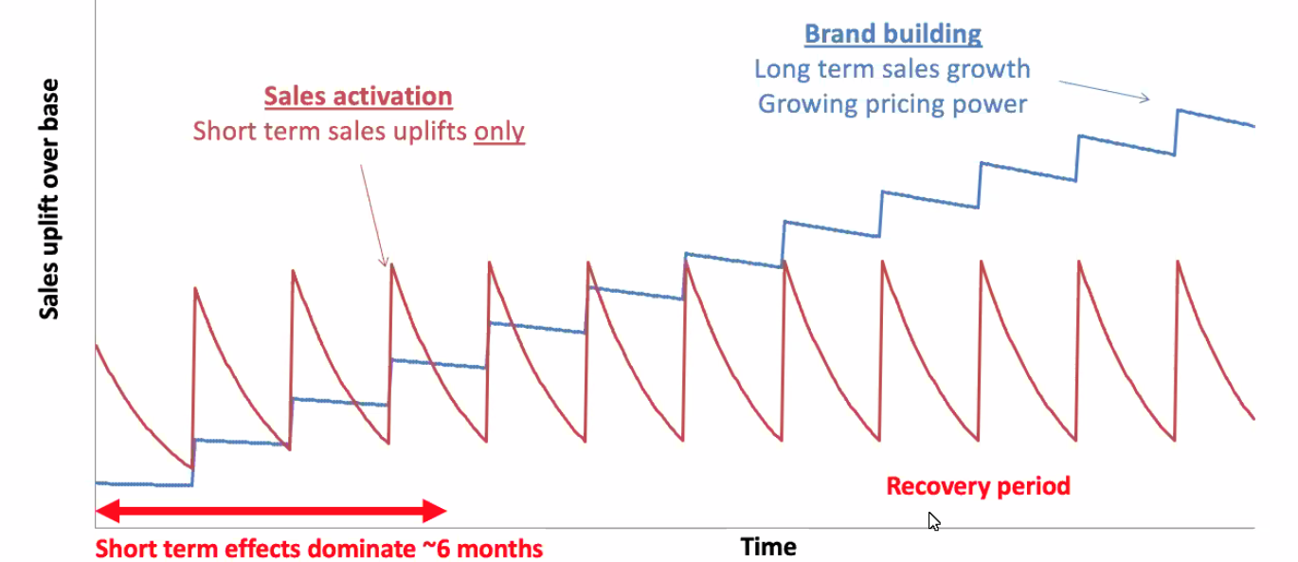
Brand building strategies particularly matter during a recession
as they provide long-term sales growth and increased pricing power
Source: VAB’s ‘Keep Calm and Advertise On: How to Successfully Navigate Your Brand Through an Economic Downturn’. Binet & Field, 2013. ‘The Long and the Short of It: Balancing Short and Long-Term Marketing Strategies.
This information is exclusively provided to VAB members and qualified marketers. Further distribution is prohibited.
PAGE 33

Slide 34
Purchase: Principle No. 9
PRINCIPLE NO. 9
Brand Leaders Need to Equip Themselves With the Data to Defend Decisions Based on Core Marketing Principles
APPLYING TO TODAY’S ENVIRONMENT
With so much upheaval – change in consumer and media behaviors, uncertain economic conditions, social unrest - it’s incumbent upon marketers to have the information they need to develop & defend their strategies.
This can range from brand health measures like awareness, favorability, consideration, to lower funnel metrics like sales and site visits. With increased budget scrutiny, this creates a true picture of the advertising impact and enables more informed future decisions.
In times of intense plan scrutiny, data and proven marketing principles are a marketer’s best friend in defending budgets to a CFO.
This information is exclusively provided to VAB members and qualified marketers. Further distribution is prohibited.
PAGE 34
Notes:
Equip yourself with knowledge read these reports
Data to defend your plan
Data and marketer principles are your best friend
Followed by resource where they can do that

Slide 35
Now, more than ever, it is crucial for brand leaders to collaborate – it is up to CMOs to leverage their company’s data and develop KPIs in order to better justify ad investment to their CFOs
“We’re getting so much data so quickly that we need to make decisions much faster than in the past. But it allows us to understand customers and their journeys in ways we couldn’t before.”
Barbara Goose
CMO, John Hancock
Deloitte Insights, 9/18/19
Source: VAB EVP Danielle DeLauro via Chief Marketer, CFOS: THE MARKETER’S KEY TO THE C-SUITE, 3/10/20.
This information is exclusively provided to VAB members and qualified marketers. Further distribution is prohibited.
PAGE 35

Slide 36










As brands push to stay relevant to consumers’ shifting needs, marketers should look to DTC brands who are adept at using data to their advantage
DTC brands enable consumers to easily purchase a wide variety of products from the comfort of home; performance is their currency and their ability to know what media works is a driving force behind the $425MM+ collective national TV investment by 75 new DTC advertisers in 2019
Essential DTC Brands During the COVID-19 Pandemic
Doordash provides door-to-door food delivery helping customers stay at home and restaurants stay in business.
Postmates provides online deliveries from restaurants, retailers, grocers and more enabling anyone to have anything delivered on-demand..
With ecommerce growing during this time of physical distancing, Honey automatically finds and applies coupon codes to online shopping carts.
From groceries to household essentials, Shipt simplifies life with deliveries from local stores right to your door.
Robinhood is a financial services mobile app and website that offers the ability to invest in stocks and options, commission-free with no minimum deposit.
Hinge is a mobile-first dating app designed for people who want to get off dating apps.
Dave provides online banking services including overdraft protection, automated budgeting, no-interest cash advances and un-bounceable checks.
Pray is an interfaith mobile app that helps religious leaders stay connected with their congregants and provide daily prayers, bible stories, etc.
A modern twist on the neighborhood butcher, ButcherBox is a subscription service that delivers beef, chicken & pork directly to your door.
ServiceNow is a cloud-based computing platform that delivers digital workflows for companies. They transform the IT experience and automate HR services.
Source: VAB’s ‘Direct Effect: Driving Intent For Emerging DTC Brands’. VAB analysis of Nielsen Ad Intel data, total TV spend based on a two-year period: Feb’18 – Jan ‘20. TV spend includes national cable TV, broadcast TV, Spanish language cable TV, Spanish language broadcast TV. Brands reflect those with total TV spend over $500K.
This information is exclusively provided to VAB members and qualified marketers. Further distribution is prohibited.
PAGE 36

Slide 37
Data-driven DTC brands advertising on TV see an immediate surge
of monthly unique visitors upon their campaign launch and this audience only continues to grow through the duration of these brands’ TV flight
36 ‘Emerging’ DTC Brands*
Average Monthly Website Unique Visitors (000)
Based Over a Four-Year Time Period: Jan ‘16 – Jan ‘20
+85%
(+1.6MM monthly uniques)
+56%
(+1.0MM monthly uniques)
vs. monthly average prior to TV launch
vs. monthly average prior to TV launch
(monthly average)
(TV launch – January 2020)
Source: VAB’s ‘Direct Effect: Driving Intent For Emerging DTC Brands’. VAB analysis of Nielsen Ad Intel data, TV spend (national cable TV, national broadcast TV, Spanish language broadcast TV, Spanish language cable TV, spot TV, syndication TV), Feb ‘18 – Jan ‘20 (calendar months). VAB analysis of Comscore mediametrix multiplatform media trend data, total audience (Desktop P2+, Mobile 18+), Jan ‘16 – Jan ‘20 (calendar months). ‘Prior to TV Launch’ reflects the average monthly unique visitors based on when each brand’s website began being measured by Comscore, or starting from January 2016 if measurement began before that month. *Reflects the 36 brands that are measured in Comscore and had reported monthly unique visitors in at least one month prior to their campaign launch.
This information is exclusively provided to VAB members and qualified marketers. Further distribution is prohibited.
PAGE 37

Slide 38
Purchase: Principle No. 10
PRINCIPLE NO. 10
The Balance of Brand Building and Short-Term Tactics Drives Both Immediate Demand and Long-Term Equity
APPLYING TO TODAY’S ENVIRONMENT
As many brands struggle under economic distress, they are seeking ways to include tactics that will drive short-term demand, but also impact the long-term.
One way brands have done this has been by altering their message to balance an empathetic tone, with more practical, tangible immediate help. Other brands are evaluating their channel mix to select platforms that can do ‘double duty’ – drive equity, but also action.
In order to maximize spend, marketers should select media vehicles and platforms that offer the scale and immediacy to drive short term demand, but also the equity-building, storytelling abilities to create a longer-term impact.
This information is exclusively provided to VAB members and qualified marketers. Further distribution is prohibited.
PAGE 38

Slide 39




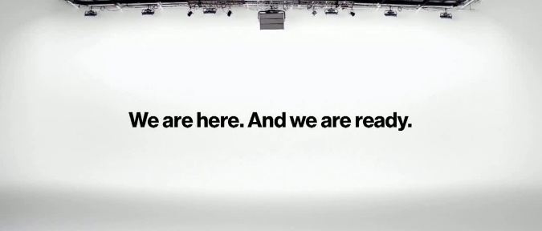
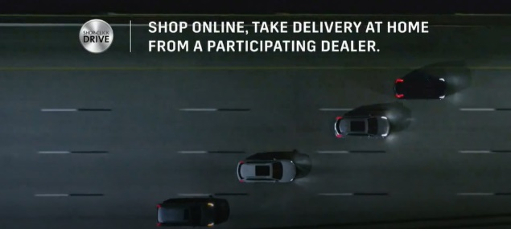
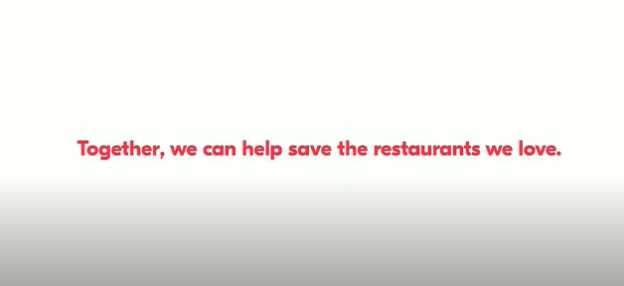

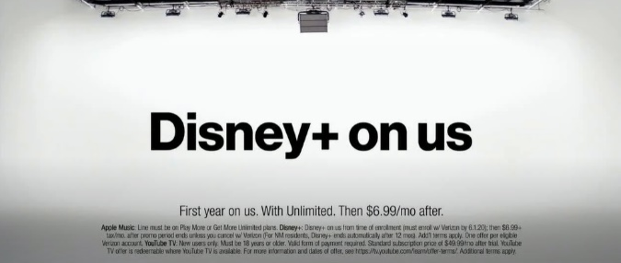



Marketers are utilizing TV to emotionally connect with consumers by emphasizing purpose over product to build long-term brand equity while also driving short-term, rational benefits
*Reflects new creative launched between 3/16 – 6/16
This information is exclusively provided to VAB members and qualified marketers. Further distribution is prohibited.
PAGE 39

Slide 40
Marketers, remember to stay principled, especially in a time of economic uncertainty
PRINCIPLE NO. 1
PRINCIPLE NO. 2
PRINCIPLE NO. 3
Awareness
Balance Broad-Based Reach With Hyper-Targeting to Grow Market Share, a Key Driver of Profit
Virality Tactics Should Be a Part of an Integrated Campaign, Not the Sole Focus
Protect Your Brand by Investing in Only Premium, Viewable Content
PRINCIPLE NO. 4
PRINCIPLE NO. 5
PRINCIPLE NO. 6
PRINCIPLE NO. 7
Consideration
In an Information-Heavy, Opinion-Saturated Environment, Brand Building Is Essential to Support Brand Perception and Foster the Loyalty That Protects Pricing and Profits
Content Environment Matters Everywhere
Brand Building Leads to Increased Long-Term Profitability
Brand Building Media, Such As Premium Video, Fosters a Deep Emotional Connection
PRINCIPLE NO. 8
PRINCIPLE NO. 9
PRINCIPLE NO. 10
Purchase
Success Should Be Measured and Evaluated Against Both Short- and Long-Term KPIs
Brand Leaders Need to Equip Themselves With the Data to Defend Decisions Based on Core Marketing Trends
The Balance of Brand Building and Short-Term Tactics Drives Both Immediate Demand and Long-Term Equity
This information is exclusively provided to VAB members and qualified marketers. Further distribution is prohibited.
PAGE 40

Slide 41
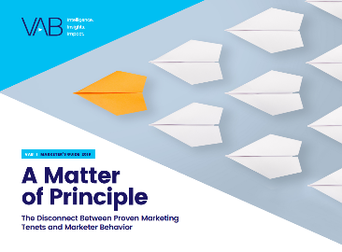
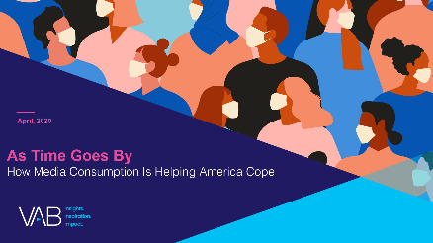
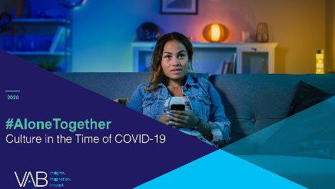
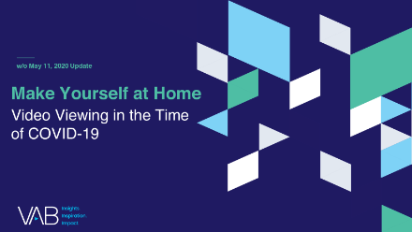

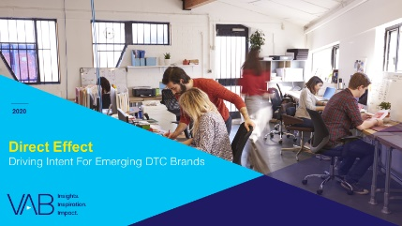
Looking for more analysis and guidance?
To learn more about how the 10 marketing principles can be applied in today’s environment of economic uncertainty, we offer these additional resources:
As a reminder, brand marketers and agencies get immediate and complimentary access
to VAB’s continuously updated Insights library. You can learn more here.
A Matter of Principle
The Disconnect Between Proven Marketing Tenets and Marketer Behavior
As Time Goes By
How Media Consumption Is Helping America Cope
#AloneTogether
Culture in the Time of COVID-19
Make Yourself at Home
Video Viewing in the Time
of COVID-19
Discover The Difference
How Culturally Relevant Video Content Drives Action By Multicultural Audiences
Direct Effect
Driving Intent For Emerging DTC Brands
This information is exclusively provided to VAB members and qualified marketers. Further distribution is prohibited.
PAGE 41

Slide 42
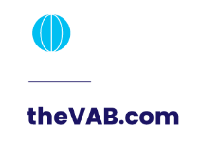


Thank You
Creators
Marianne Vita
Kathy Grey
SVP, Director of Integrated Strategy & Marketing mariannev@thevab.com
SVP, Research Innovation kathyg@thevab.com
Jason Wiese
Leah Montner-Dixon
SVP, Director of Strategic Insights
jasonw@thevab.com
Insights Manager
leahm@thevab.com
This information is exclusively provided to VAB members and qualified marketers. Further distribution is prohibited.
PAGE 42

Slide 43

Get immediate access to the VAB Insights library
We’ve answered hundreds of marketers’ questions.
Our guides, reports, webinars and videos provide actionable insights to help marketers navigate today’s video landscape and think differently about their strategy.
We are committed to your business growth and proud to offer brand marketers and agencies complimentary access to our continuously-growing Insights library.
Get Access at theVAB.com or visit us here
This information is exclusively provided to VAB members and qualified marketers. Further distribution is prohibited.
PAGE 43

