Slide 1





Keeping Up With The KPIs
10 Key Questions Answered by Marketers
to Understand Priorities Across Businesses

Slide 2


Inside how brand marketers set their strategic priorities
Amid continuing conversations across the ad industry around investment in branding and performance marketing, we sought to understand what KPIs matter most to businesses of all sizes – and how are they determined?
To explore what drives brand marketers’ thinking and planning, we partnered with Advertiser Perceptions on a custom survey of 200 marketers.
Our goal was to examine organizational priorities, uncover internal disconnects and identify new opportunities for media partners to deliver on what marketers really need.
This guide answers 10 essential questions that offer a clearer view into how marketers set strategic priorities. Additionally,
we provide playbooks on how businesses can work with the
right media partners who can help deliver on what matters most.
Note: see appendix for full details on methodology behind the custom survey
This information is exclusively provided to VAB members and qualified marketers.
PAGE 2

Slide 3
We analyzed three segments based on total ad spend to understand how marketing priorities and decision-making differs by business size
For the purposes of this custom study analysis, we created these three ‘brand marketer’ segments:
‘Small-Sized’ Businesses
Brand marketer respondents working for a brand that spent less than $1MM in total on advertising over the
past 12 months
‘Medium-Sized’ Businesses
Brand marketer respondents working for a brand that spent $1MM to less than $25MM in total on advertising over the past 12 months
‘Large-Sized’ Businesses
Brand marketer respondents working for a brand that spent $25MM or more in total on advertising over the
past 12 months
Source: VAB / Advertiser Perceptions ‘Marketer KPI Survey,’ February 2025, fielded January 27 – February 7, 2025 (n=200). Survey base: Brand marketers directly involved in influencing or executing video advertising. ‘Small-Sized’ Businesses: Less than $1MM in annual ad spend (n=65), ‘Medium-Sized’ Businesses: $1MM to less than $25MM in annual ad spend (n=70), ‘Large-Sized’ Businesses: $25MM or more in annual ad spend (n=65).
This information is exclusively provided to VAB members and qualified marketers.
PAGE 3

Slide 4
We answered 10 key questions to help understand how businesses
of different sizes set strategy, define success and plan for growth
1
2
3
4
5
How well do business and marketing objectives align?
Who are the key decision-makers guiding marketing strategy?
How do marketers balance short-term sales with long-term brand growth?
What factors influence an organization’s selection of marketing KPIs?
Are there organizational disconnects between KPIs and overarching business goals?
6
7
8
9
10
What KPIs do marketers use to evaluate the impact
of their video campaigns?
Which media channels do marketers believe are the most effective in achieving KPIs throughout the funnel?
What do marketers expect from their
media partners to help achieve campaign success?
Would marketers shift their strategy if they could develop longer-term plans?
What KPIs would marketers be focused on for future growth?
Click through any question box to be brought directly to the appropriate section
This information is exclusively provided to VAB members and qualified marketers.
PAGE 4

Slide 5

1
How well do business and marketing objectives align?

Slide 6
Brand awareness is a top business objective for smaller businesses while revenue and profitability become more important for larger companies
Top 5 Overall Business Objectives/Goals
% of brand marketer respondents
‘Small-Sized’ Businesses
‘Medium-Sized’ Businesses
‘Large-Sized’ Businesses
Source: VAB / Advertiser Perceptions ‘Marketer KPI Survey,’ February 2025, fielded January 27 – February 7, 2025 (n=200). Survey base: Brand marketers directly involved in influencing or executing video advertising. Q1. Which of the following would you consider to be your overall business objectives/goals? Based on respondents selecting up to 3 choices. Small-Sized’ Businesses: Less than $1MM in annual ad spend, ‘Medium-Sized’ Businesses: $1MM to less than $25MM in annual ad spend, ‘Large-Sized’ Businesses: $25MM or more in annual ad spend. *Consideration, favorability, memorability, interest, etc. Dotted line across chart denotes the top 3.
This information is exclusively provided to VAB members and qualified marketers.
PAGE 6

Slide 7
For marketing, increasing sales is the most important objective for brands of all sizes, with investment optimization also key for larger ones
Top 5 Overall Marketing Objectives/Goals
% of brand marketer respondents
‘Small-Sized’ Businesses
‘Medium-Sized’ Businesses
‘Large-Sized’ Businesses
Source: VAB / Advertiser Perceptions ‘Marketer KPI Survey,’ February 2025, fielded January 27 – February 7, 2025 (n=200). Survey base: Brand marketers directly involved in influencing or executing video advertising. Q2. Which of the following would you consider to be your overall marketing objectives/goals? Based on respondents selecting up to 3 choices. ‘Small-Sized’ Businesses: Less than $1MM in annual ad spend, ‘Medium-Sized’ Businesses: $1MM to less than $25MM in annual ad spend, ‘Large-Sized’ Businesses: $25MM or more in annual ad spend. Dotted line across chart denotes the top 3.
This information is exclusively provided to VAB members and qualified marketers.
PAGE 7

Slide 8
2
Who are the key decision-makers guiding marketing strategy?

Slide 9
Strategy is most often led by senior leaders in small & medium-sized businesses while marketing takes the lead role in the largest companies
Company size can mean more specialization and layers, giving marketing departments greater control over KPI and budget decisions
Key Stakeholders / Primary Decision-Makers Responsible For Marketing Strategy (Budget & Guiding Direction)
% of brand marketer respondents
‘Small-Sized’ Businesses
‘Medium-Sized’ Businesses
‘Large-Sized’ Businesses
Source: VAB / Advertiser Perceptions ‘Marketer KPI Survey,’ February 2025, fielded January 27 – February 7, 2025 (n=200). Survey base: Brand marketers directly involved in influencing or executing video advertising. Q3. Who are the key stakeholders or primary decision-makers in your company responsible for budget and guiding direction (such as brand, goals, etc.)? Based on respondents selecting up to 3 choices. ‘Small-Sized’ Businesses: Less than $1MM in annual ad spend, ‘Medium-Sized’ Businesses: $1MM to less than $25MM in annual ad spend, ‘Large-Sized’ Businesses: $25MM or more in annual ad spend. *C-Suite, Regional Heads. **Investors, franchisees. Learn more about who the external partners responsible for budget and guiding direction are here. Box around chart denotes the top 3.
This information is exclusively provided to VAB members and qualified marketers.
PAGE 9

Slide 10
3
How do marketers balance short-term sales with long-term brand growth?

Slide 11

Under pressure to grow revenue, marketers of all sizes feel their KPIs favor short-term performance over long-term brand building
% of brand marketers who believe their marketing KPIs reflect a prioritization
to achieve short-term sales over long-term branding results
‘Small-Sized’ Businesses
‘Medium-Sized’ Businesses
‘Large-Sized’ Businesses
74%
63%
70%
Source: VAB / Advertiser Perceptions ‘Marketer KPI Survey,’ February 2025, fielded January 27 – February 7, 2025 (n=200). Survey base: Brand marketers directly involved in influencing or executing video advertising. Q15. Do you feel your KPIs reflect a prioritization to achieve short-term sales over long-term branding results? ‘Small-Sized’ Businesses: Less than $1MM in annual ad spend, ‘Medium-Sized’ Businesses: $1MM to less than $25MM in annual ad spend, ‘Large-Sized’ Businesses: $25MM or more in annual ad spend.
This information is exclusively provided to VAB members and qualified marketers.
PAGE 11

Slide 12
Smaller brands are more split between short-term performance and long-term branding, while larger brands have more resources to balance both
Marketing Strategy’s Primary Focus
% of brand marketer respondents
‘Small-Sized’ Businesses
‘Medium-Sized’ Businesses
‘Large-Sized’ Businesses
Source: VAB / Advertiser Perceptions ‘Marketer KPI Survey,’ February 2025, fielded January 27 – February 7, 2025 (n=200). Survey base: Brand marketers directly involved in influencing or executing video advertising. Q4. Which best describes your marketing strategy's primary focus? ‘Small-Sized’ Businesses: Less than $1MM in annual ad spend, ‘Medium-Sized’ Businesses: $1MM to less than $25MM in annual ad spend, ‘Large-Sized’ Businesses: $25MM or more in annual ad spend. *Generating leads and driving immediate sales. **Building awareness and long-term customer relationships. ***Balance performance and brand building to achieve both short-term and long-term goals.
This information is exclusively provided to VAB members and qualified marketers.
PAGE 12

Slide 13
4
What factors influence an organization’s selection of marketing KPIs?

Slide 14







Top KPI factors like measurability and strategic alignment are driving the reliance on short-term performance KPIs across businesses of all sizes
Top 5 Factors Influencing KPI Selection
% of brand marketers
‘Small-Sized’ Businesses
‘Medium-Sized’ Businesses
‘Large-Sized’ Businesses
Measurability
60%
Alignment with strategic goals
62%
Alignment with strategic goals
66%
Alignment with strategic goals
48%
Measurability
48%
Measurability
55%
Customer focus
30%
Data availability & data quality
35%
Data availability & data quality
31%
Relevance to key operations
30%
Industry Benchmarks
28%
Relevance to key operations
30%
Data availability & data quality
23%
Achievability
26%
Customer focus
26%
Source: VAB / Advertiser Perceptions ‘Marketer KPI Survey,’ February 2025, fielded January 27 – February 7, 2025 (n=200). Survey base: Brand marketers directly involved in influencing or executing video advertising. Q13. What factors influenced your organization’s decision in selecting your KPIs? [Rank 1-3]. Based on respondents ranking up to 3 choices. ‘Small-Sized’ Businesses: Less than $1MM in annual ad spend, ‘Medium-Sized’ Businesses: $1MM to less than $25MM in annual ad spend, ‘Large-Sized’ Businesses: $25MM or more in annual ad spend. Dotted line across chart denotes the top 3.
This information is exclusively provided to VAB members and qualified marketers.
PAGE 14

Slide 15
5
Are there organizational disconnects between KPIs and overarching business goals?

Slide 16
Marketers in larger, more layered companies are almost three times more likely than small businesses to believe there is an internal ‘KPI disconnect’
% of brand marketers who believe there is a disconnect between the KPIs and the goals their management has communicated for the organization
‘Small-Sized’ Businesses
‘Medium-Sized’ Businesses
‘Large-Sized’ Businesses
Source: VAB / Advertiser Perceptions ‘Marketer KPI Survey,’ February 2025, fielded January 27 – February 7, 2025 (n=200). Survey base: Brand marketers directly involved in influencing or executing video advertising. Q16. Do you believe there is a disconnect between the KPIs and the goals your management has communicated for the organization? ‘Small-Sized’ Businesses: Less than $1MM in annual ad spend, ‘Medium-Sized’ Businesses: $1MM to less than $25MM in annual ad spend, ‘Large-Sized’ Businesses: $25MM or more in annual ad spend.
This information is exclusively provided to VAB members and qualified marketers.
PAGE 16

Slide 17









Marketers across sizes cite short-term pressures, misaligned priorities and measurement gaps as key drivers of KPI disconnects
Small brands face tactical hurdles, while large brands grapple with structural misalignment and resistance to long-term brand investment
Why do you think there is a disconnect between the KPIs and the goals your management has communicated for the organization?
Based on summary of verbatim responses
Category | Common Responses
Short-Term vs. Long-Term Focus | KPIs prioritize short-term sales over long-term brand building Leadership reluctant to invest in brand if it doesn’t show immediate revenue
Misalignment Between Departments | Finance, sales, and marketing have different priorities Quarterly reporting doesn’t align with customer buying cycles
Measurement Challenges | KPIs focus on media efficiency rather than actual sales outcomes Metrics prioritize attention and attribution over brand health and customer experience
Leadership & Organizational Gaps | Leadership doesn’t fully understand brand marketing Marketing is seen as a cost center rather than a growth driver
Unrealistic Goals & Budget Cuts | KPIs are set without considering real business needs Budgets get cut when business slows, even if brand building is needed
Technology & Data Limitations | Difficulty integrating new technology effectively Lack of long-term data retention for measuring brand impact
Compensation & Incentives | Employee incentives are tied to short-term performance, discouraging long-term thinking
Consumer Buying Behavior | Decision-makers don’t account for the long conversion timelines and multiple touchpoints needed to convert customers
Source: VAB / Advertiser Perceptions ‘Marketer KPI Survey,’ February 2025, fielded January 27 – February 7, 2025 (n=200). Survey base: Brand marketers directly involved in influencing or executing video advertising.
Q16a. Why do you think there is a disconnect?. ‘Small-Sized’ Businesses: Less than $1MM in annual ad spend, ‘Medium-Sized’ Businesses: $1MM to less than $25MM in annual ad spend, ‘Large-Sized’ Businesses: $25MM or more in annual ad spend.
This information is exclusively provided to VAB members and qualified marketers.
PAGE 17

Slide 18

“The disconnect for me is not just with the CEO, it’s the whole organization. I’m sitting in a company that is very tech-driven. In the past, a lot of the work was a balance between short-term results and investing in the future
of the brand. Now everyone’s focus is on the short term."
Maria Garrido, CMO, Deezer
(Ad Age, 9/30/2024)
This information is exclusively provided to VAB members and qualified marketers.
PAGE 18

Slide 19
6
What KPIs do marketers use to evaluate the impact of their video campaigns?

Slide 20
Smaller businesses prioritize lower-funnel KPIs to drive immediate returns, while larger brands focus on upper-funnel metrics to build brand equity
Top 5 KPIs Used to Measure Effectiveness of Video Ad Campaigns
% of brand marketer respondents
‘Small-Sized’ Businesses
‘Medium-Sized’ Businesses
‘Large-Sized’ Businesses
Source: VAB / Advertiser Perceptions ‘Marketer KPI Survey,’ February 2025, fielded January 27 – February 7, 2025 (n=200). Survey base: Brand marketers directly involved in influencing or executing video advertising. Q12. What are the main KPIs you currently use to measure the effectiveness of your company’s video advertising? Based on respondents selecting up to 3 choices. ‘Small-Sized’ Businesses: Less than $1MM in annual ad spend, ‘Medium-Sized’ Businesses: $1MM to less than $25MM in annual ad spend, ‘Large-Sized’ Businesses: $25MM or more in annual ad spend. *Perception, memorability, favorability, consideration, etc. Dotted line across chart denotes the top 3.
This information is exclusively provided to VAB members and qualified marketers.
PAGE 20

Slide 21
7
Which media channels do marketers believe are the most effective in achieving KPIs throughout the funnel?

Slide 22
Small-sized businesses: Social media is seen as the most effective at driving outcomes throughout the funnel, with multiscreen TV second
Top media channels that are effective at achieving the following KPIs
based on % of respondents that ranked the respective KPI within the top three KPIs of each media channel
Brand Awareness
Attention
Brand Health Metrics*
Revenue /
Sales Growth
Market Share
Social Media
63%
Social Media
51%
Social Media
60%
Social Media
55%
Social Media
53%
Multiscreen TV**
57%
Multiscreen TV**
41%
Multiscreen TV**
51%
Multiscreen TV**
41%
Multiscreen TV**
48%
Online Search
31%
Online Search
32%
Digital Video***
44%
Online Search
37%
Online Search
29%
Digital Video***
23%
Digital Display
27%
Online Search
37%
Digital Video***
27%
Digital Display
19%
Out-of-Home
17%
Digital Video***
25%
Print
13%
Print
20%
AM / FM Radio
17%
Source: VAB / Advertiser Perceptions ‘Marketer KPI Survey,’ February 2025, fielded January 27 – February 7, 2025 (n=200). Survey base: Brand marketers directly involved in influencing or executing video advertising. Q19. Which of the following media channels is effective in achieving the listed KPIs? Based on respondents selecting up to 3 choices. ‘Small Business’ Brand Marketers: Less than $1MM in annual ad spend. *Perception, memorability, favorability, consideration, etc. **Broadcast / Cable TV, Advanced TV (Addressable TV, Data Driven Linear TV), CTV / Streaming. ***Online video, non-CTV. Dotted line across chart denotes the top 3.
This information is exclusively provided to VAB members and qualified marketers.
PAGE 22

Slide 23
Medium-sized businesses: Multiscreen TV is seen as an effective channel for both upper and lower funnel metrics, with search a key driver of sales
VAB has conducted several analyses highlighting multiscreen TV’s ability to drive online search including Breaking Through, Dedicated to Your Good Health and Welcome to TV
Top media channels that are effective at achieving the following KPIs
based on % of respondents that ranked the respective KPI within the top three KPIs of each media channel
Brand Awareness
Attention
Brand Health Metrics*
Revenue /
Sales Growth
Market Share
Multiscreen TV**
61%
Multiscreen TV**
47%
Multiscreen TV**
53%
Online Search
51%
Multiscreen TV**
59%
Social Media
55%
Social Media
41%
Social Media
53%
Multiscreen TV**
46%
Social Media
43%
Digital Video***
34%
Digital Video***
37%
Digital Video***
38%
Social Media
40%
Digital Display
30%
Digital Display
24%
Online Search
24%
Digital Display
24%
Digital Display
26%
Online Search
27%
Online Search
15%
Digital Display
19%
Direct Mail
16%
Digital Video***
17%
Print
18%
Source: VAB / Advertiser Perceptions ‘Marketer KPI Survey,’ February 2025, fielded January 27 – February 7, 2025 (n=200). Survey base: Brand marketers directly involved in influencing or executing video advertising. Q19. Which of the following media channels is effective in achieving the listed KPIs? Based on respondents selecting up to 3 choices. ‘Medium-Sized’ Businesses: $1MM to less than $25MM in annual ad spend. *Perception, memorability, favorability, consideration, etc. **Broadcast / Cable TV, Advanced TV (Addressable TV, Data Driven Linear TV), CTV / Streaming. ***Online video, non-CTV. Dotted line across chart denotes the top 3.
This information is exclusively provided to VAB members and qualified marketers.
PAGE 23

Slide 24
Large-sized businesses: Multiscreen TV is seen as most effective in upper funnel metrics, although it is a close second to search for lower funnel
VAB has conducted several analyses highlighting multiscreen TV’s ability to drive online search including Breaking Through, Dedicated to Your Good Health and Welcome to TV
Top media channels that are effective at achieving the following KPIs
based on % of respondents that ranked the respective KPI within the top three KPIs of each media channel
Brand Awareness
Attention
Brand Health Metrics*
Revenue /
Sales Growth
Market Share
Multiscreen TV**
64%
Multiscreen TV**
59%
Multiscreen TV**
58%
Online Search
49%
Online Search
50%
Social Media
34%
Online Search
33%
Online Search
42%
Multiscreen TV**
46%
Multiscreen TV**
47%
Online Search
28%
Social Media
31%
Social Media
37%
Social Media
42%
Social Media
31%
Digital Display
23%
Digital Video***
26%
Digital Video***
27%
Digital Display
21%
Digital Display
21%
Digital Audio
22%
Digital Display
20%
Digital Display
22%
Digital Video***
21%
Digital Video***
15%
Source: VAB / Advertiser Perceptions ‘Marketer KPI Survey,’ February 2025, fielded January 27 – February 7, 2025 (n=200). Survey base: Brand marketers directly involved in influencing or executing video advertising. Q19. Which of the following media channels is effective in achieving the listed KPIs? Based on respondents selecting up to 3 choices. ‘Large-Sized’ Businesses: $25MM or more in annual ad spend. *Perception, memorability, favorability, consideration, etc. **Broadcast / Cable TV, Advanced TV (Addressable TV, Data Driven Linear TV), CTV / Streaming. ***Online video, non-CTV. Dotted line across chart denotes the top 3.
This information is exclusively provided to VAB members and qualified marketers.
PAGE 24

Slide 25
8
What do marketers expect from their media partners to help achieve campaign success?

Slide 26





Businesses of all sizes expect their media partners to deliver precision, attribution and innovation in trusted, transparent, high-quality content
Top 5 Criteria Brand Marketers Expect Their Media Partners to Deliver on
% of brand marketer respondents
‘Small-Sized’ Businesses
‘Medium-Sized’ Businesses
‘Large-Sized’ Businesses
Effective targeting
64%
Effective targeting
58%
Effective targeting
43%
High quality content / brand safe ad environment
45%
Campaign measurement / attribution
37%
Campaign measurement / attribution
38%
Innovative solutions*
34%
Innovative solutions*
36%
Innovative solutions*
34%
Campaign measurement / attribution
32%
High quality content / brand safe ad environment
35%
High quality content / brand safe ad environment
32%
Transparency**
27%
Transparency**
29%
Transparency**
31%
Source: VAB / Advertiser Perceptions ‘Marketer KPI Survey,’ February 2025, fielded January 27 – February 7, 2025 (n=200). Survey base: Brand marketers directly involved in influencing or executing video advertising. Q11. As a brand marketer, which of the following criteria do you expect your media partners to deliver on the most? Based on respondents selecting up to 3 choices. ‘Small-Sized’ Businesses: Less than $1MM in annual ad spend, ‘Medium-Sized’ Businesses: $1MM to less than $25MM in annual ad spend, ‘Large-Sized’ Businesses: $25MM or more in annual ad spend. *Media, creative, measurement, etc. **Buying, placements, reporting, etc. Dotted line across chart denotes the top 3.
This information is exclusively provided to VAB members and qualified marketers.
PAGE 26

Slide 27
9
Would marketers shift their strategy if they could develop longer-term plans?

Slide 28
Many marketers would enact a different marketing approach if they could implement a longer-term strategy that is free from short-term pressures
“If you had three years to enact a marketing/advertising strategy and plan vs. quarterly output, would you do anything differently?”
% of brand marketer respondents
‘Small-Sized’ Businesses
‘Medium-Sized’ Businesses
‘Large-Sized’ Businesses
Source: VAB / Advertiser Perceptions ‘Marketer KPI Survey,’ February 2025, fielded January 27 – February 7, 2025 (n=200). Survey base: Brand marketers directly involved in influencing or executing video advertising. Q14. If you had three years to enact a marketing/advertising strategy and plan vs. quarterly output (to satisfy short-term goals and investors), would you do anything differently? ‘Small-Sized’ Businesses: Less than $1MM in annual ad spend, ‘Medium-Sized’ Businesses: $1MM to less than $25MM in annual ad spend, ‘Large-Sized’ Businesses: $25MM or more in annual ad spend.
This information is exclusively provided to VAB members and qualified marketers.
PAGE 28

Slide 29






Long-term planning without short-term pressures is seen as key to building stronger brands, improving retention and driving higher ROI
Given more time, small brands would build greater awareness, medium brands would balance brand and performance better, and large brands would optimize with automation and strategic refinement
If you had three years to enact a marketing/advertising strategy and plan vs. quarterly output, what would you do differently and how would that affect your KPIs?
Based on summary of verbatim responses
Category | Common Responses | Expected KPI Impact
Brand Strategy | Invest in brand awareness, long-term equity | Higher brand recognition & trust Improved customer retention
KPIs & Measurement | Shift from quarterly to 3-year goals | More accurate success measurement Stronger alignment with long-term growth
Marketing Mix | Balance upper and lower funnel investments | Increased reach & engagement Improved cost efficiency over time
Customer Focus | Improve segmentation, retention strategies | Higher customer lifetime value (LTV) Better conversion & engagement rates
Budget & Resources | Increase budget for brand-building efforts | Stronger brand presence More efficient content and ad production
Innovation & Testing | Pilot more, adjust based on insights | Optimized campaigns with higher ROI Faster adaptation to market shifts
Source: VAB / Advertiser Perceptions ‘Marketer KPI Survey,’ February 2025, fielded January 27 – February 7, 2025 (n=200). Survey base: Brand marketers directly involved in influencing or executing video advertising. Q14a. What would you do differently and how would that affect your KPIs? ‘Small-Sized’ Businesses: Less than $1MM in annual ad spend, ‘Medium-Sized’ Businesses: $1MM to less than $25MM in annual ad spend, ‘Large-Sized’ Businesses: $25MM or more in annual ad spend.
This information is exclusively provided to VAB members and qualified marketers.
PAGE 29

Slide 30
10
What KPIs would marketers be focused on for future growth?

Slide 31







Moving forward, marketers believe their business should focus on KPIs that strengthen brand equity and deepen customer relationships
Top 5 KPIs That Brand Marketers’ Think Their Company Should Focus On Over The Next 12 Months & Beyond
% of brand marketers
‘Small-Sized’ Businesses
‘Medium-Sized’ Businesses
‘Large-Sized’ Businesses
Brand Awareness
52%
Brand Awareness
50%
Revenue / Sales Growth
54%
Revenue / Sales Growth
50%
Revenue / Sales Growth
44%
Brand Awareness
49%
Customer Acquisition
43%
Brand health metrics lift*
41%
Brand health metrics lift*
37%
Brand health metrics lift*
40%
Customer Lifetime Value
32%
Customer Acquisition
36%
Cost efficiencies and / or savings
24%
Customer Acquisition
29%
Customer Lifetime Value
35%
Source: VAB / Advertiser Perceptions ‘Marketer KPI Survey,’ February 2025, fielded January 27 – February 7, 2025 (n=200). Survey base: Brand marketers directly involved in influencing or executing video advertising. Q18. Which of the following KPIs should your company focus on over the next 12 months or beyond? Based on respondents selecting up to 3 choices. ‘Small-Sized’ Businesses: Less than $1MM in annual ad spend, ‘Medium-Sized’ Businesses: $1MM to less than $25MM in annual ad spend, ‘Large-Sized’ Businesses: $25MM or more in annual ad spend. *Perception, memorability, favorability, consideration, etc. Dotted line across chart denotes the top 3. See how this compares to the top 5 KPIs used to measure effectiveness of video ad campaigns on slide 20.
This information is exclusively provided to VAB members and qualified marketers.
PAGE 31

Slide 32
10 Questions Answered by Brand Marketers
1
2
3
4
5
Q: How well do business and marketing objectives align?
Q: Who are the key decision-makers guiding marketing strategy?
Q: How do marketers balance short-term sales with long-term brand growth?
Q: What factors influence an organization’s selection of marketing KPIs?
Q: Are there organizational disconnects between KPIs and overarching business goals?
A: Business and marketing goals generally align around growth,
with some shifts by company size. Smaller companies prioritize brand awareness, while larger ones focus more on profitability and efficiency. However, driving sales is the top marketing goal across all sizes.
A: As companies scale, strategic decision-making shifts from centralized executive leadership control to more specialized roles, with marketing departments in larger organizations gaining greater authority over budgets and KPIs.
A: Larger brands are better equipped to strike a balance between immediate results and long-term brand-building, thanks to greater resources, while smaller businesses often prioritize short-term gains to meet urgent growth demands.
A: Measurability is a
key factor for smaller businesses as they look to optimize their limited investments while larger organizations prioritize KPIs that align with strategic goals and
are supported by data; operational relevance plays a stronger role as company size increases.
A: Disconnects are almost three times more likely to exist in large companies, which are driven by layered structures, misalignment between departments, measurement challenges and short-term pressures.
This information is exclusively provided to VAB members and qualified marketers.
PAGE 32

Slide 33
10 Questions Answered by Brand Marketers
6
7
8
9
10
Q: What KPIs do marketers use to evaluate the impact
of their video campaigns?
Q: Which media channels do marketers believe are the most effective in achieving KPIs throughout the funnel?
Q: What do marketers expect from their media partners to help achieve campaign success?
Q: Would marketers shift their strategy if they could develop longer-term plans?
Q: What KPIs would marketers be focused on for future growth?
A: Smaller businesses prioritize lower-funnel KPIs to drive immediate results which aligns with their overall marketing goals, while larger businesses use video to deliver on upper-funnel, brand equity metrics.
A: Smaller businesses see social media as the most effective at driving outcomes with multiscreen TV a close second, confidence in multiscreen TV’s ability to build brands grows as businesses grow while online search is considered the top sales driver for larger businesses.
A: Marketers across all business sizes seek media partners who can deliver precise targeting and innovation in trusted, transparent, high-quality ad environments with clear attribution as proof of campaign performance grows in importance.
A: At least one-third of marketers across all business sizes would enact a different approach if they could implement a longer-term strategy. Long-term planning without short-term pressures is seen as key to building stronger brands, improving retention and driving higher ROI.
A: Moving forward, marketers believe their business should prioritize long-term growth by focusing on KPIs that build brand equity and deepen customer relationships that lead to increased acquisitions, sales and higher lifetime value.
This information is exclusively provided to VAB members and qualified marketers.
PAGE 33

Slide 34

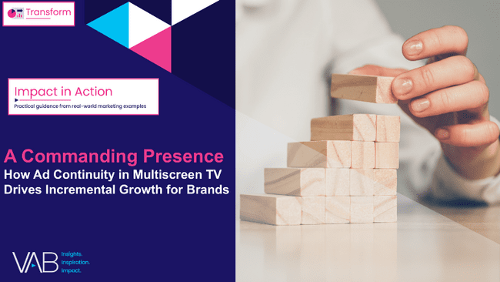

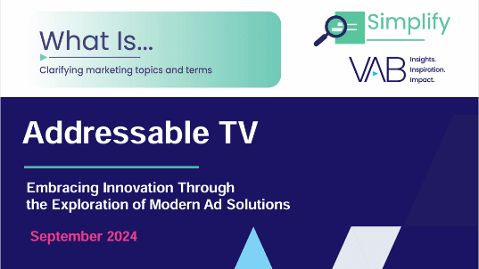
VAB playbooks for ‘Small-Sized’ Businesses
How Multiscreen TV Helps Small Businesses Achieve Their KPIs
What They Care About Most:
Building brand and awareness through customer engagement
Immediate growth outcomes like revenue, sales, leads and new customer acquisition
Tangible, measurable KPIs like reach and conversions to understand brand awareness impact
Key Media Expectations:
Effective targeting, high-quality content and campaign measurement
Solutions that drive cost efficiencies and performance
Value simplicity, speed and ROI
Click to Download
Click to Download
Click to Download
Click to Download
This information is exclusively provided to VAB members and qualified marketers.
PAGE 34

Slide 35

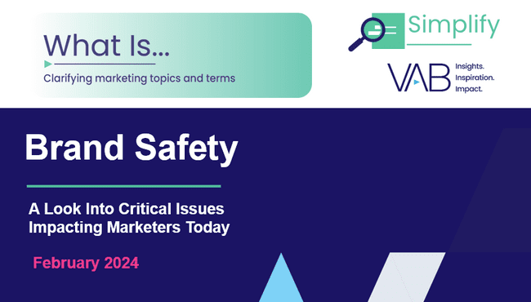

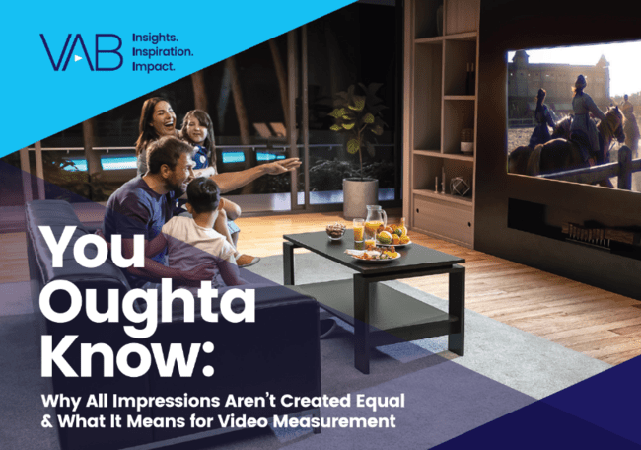
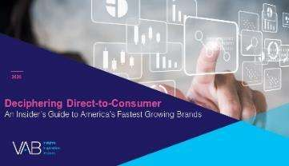
VAB playbooks for ‘Medium-Sized’ Businesses
How Multiscreen TV Helps Medium-Sized Businesses Achieve Their KPIs
What They Care About Most:
Balancing brand health and growth
Rising focus on customer lifetime value,
market share and ROI / ROAS
KPI selections reflect growing maturity –
brand-focused and performance-minded
Key Media Expectations:
High-quality content environments with strong brand safety
Strong mix of efficiency (cost, optimization) and equity (awareness, health metrics)
Seek adaptability: partners who can help them scale both perception and performance
Click to Download
Click to Download
Click to Download
Click to Download
This information is exclusively provided to VAB members and qualified marketers.
PAGE 35

Slide 36


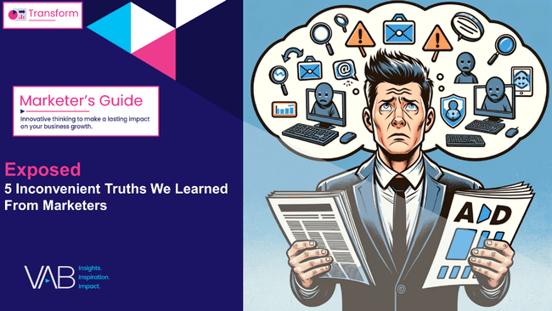
VAB playbooks for ‘Large-Sized’ Businesses
How Multiscreen TV Helps Large Businesses Achieve Their KPIs
What They Care About Most:
Long-term brand value and profitability
Sophisticated metrics: brand health, customer lifetime value and ROI
Pressure to align with executive and financial expectations
Key Media Expectations:
Transparency and accountability in delivery and reporting
Partners who support strategic brand building
at scale
Premium environments with high attention, viewability and content alignment
Click to Download
Click to Download
Click to Download
Click to Download
This information is exclusively provided to VAB members and qualified marketers.
PAGE 36

Slide 37
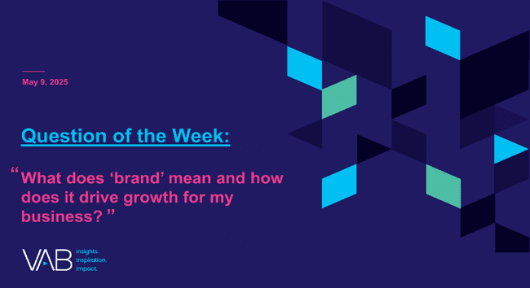

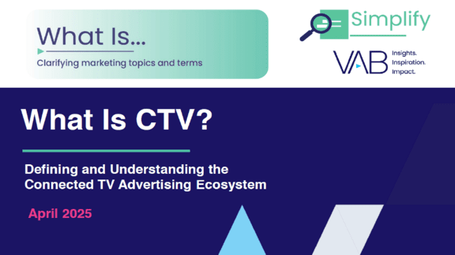
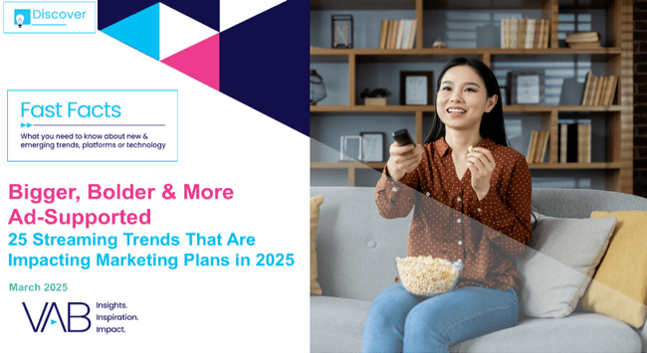
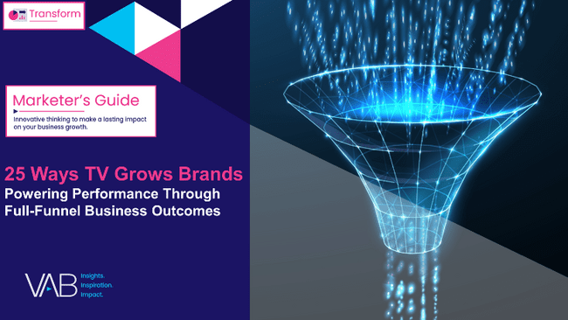

Creators
Jason Wiese
Leah Montner-Dixon
EVP, Strategic Insights & Measurement
jasonw@thevab.com
Director, Audience & Behavioral Insights
leahm@thevab.com
“What does ‘brand’ mean and how does it drive growth for my business?”
Welcome to TV – Full Year 2024
The Billion and a Half Dollar Investment from New Advertisers
Discover more
Looking for more data, insights and takeaways? Check out this related VAB content
What Is CTV?
Defining and Understanding the Connected TV Advertising Ecosystem
Bigger, Bolder & More Ad-Supported
25 Streaming Trends That Are Impacting Marketing Plans in 2025
Through Upfront season, marketers are making important decisions about their video investment strategy.
We’re here to help.
Visit our Upfront Planning Resource Center
for a curated a list of resources filled with the data, analysis and insights needed to make informed investment decisions.
25 Ways TV Grows Brands
Powering Performance Through Full-Funnel Business Outcomes
Show Me The Money
Highlighting the Value of Moviegoers Across 20 Major Categories
VAB Members, brand marketers and agencies get free and immediate access to VAB’s content library. Get access at theVAB.com
This information is exclusively provided to VAB members and qualified marketers.
PAGE 37

Slide 38


About VAB
VAB plays a dual role in the video advertising industry. We are leading the change to bring about a more innovative and transparent marketplace. We also provide the insights and thought leadership that enables marketers to develop business-driving marketing strategies.
Drawing on our marketing expertise, we simplify the complexities in our industry and discover new insights that transform the way marketers look at their media strategy.
We are committed to your business growth and proud to offer VAB members, brand marketers and agencies complimentary access to our continuously-growing Insights library. Get immediate access at theVAB.com.
This information is exclusively provided to VAB members and qualified marketers.
PAGE 38

Slide 39
Appendix

Slide 40

Custom Study Methodology
VAB commissioned Advertiser Perceptions to conduct an online survey between January-February 2025.
The results are based on 200 U.S. brand marketer respondents from Advertiser Perceptions’ survey panel with a wide range of annual total advertising budgets ($10K - $250 MM+) across a variety of market sectors (e.g., CPG, retail, financial, auto, food / B2B, technology, entertainment, etc.)
Respondent Qualifications:
  Brand marketer decision maker involved in influencing or executing video advertising
  National / Regional sales focus
  Mix of job titles (junior, mid, senior level)
This information is exclusively provided to VAB members and qualified marketers.
PAGE 40

Slide 41
Respondents across all business sizes were primarily senior and mid-level decision-makers, with junior roles more common at larger companies
Estimated Annual Ad Spend
% of brand marketer respondents
Respondents by Job Title*
‘Small-Sized’ Businesses
‘Medium-Sized’ Businesses
‘Large-Sized’ Businesses
Source: VAB / Advertiser Perceptions ‘Marketer KPI Survey,’ February 2025, fielded January 27 – February 7, 2025 (n=200). Survey base: Brand marketers directly involved in influencing or executing video advertising. QS25. Approximately, how much in total advertising spending (all media types including: digital, mobile, TV, print, radio, out of home, etc.) did your company spend in the past 12 months? *Q25. What is your current job title/level? ‘Small-Sized’ Businesses: Less than $1MM in annual ad spend, ‘Medium-Sized’ Businesses: $1MM to less than $25MM in annual ad spend, ‘Large-Sized’ Businesses: $25MM or more in annual ad spend. ‘Junior level’ includes Manager, Strategist, Associate, Analyst, Buyer, Planner. ‘Mid level’ includes Director, Supervisor/Department Head/Group Manager. ‘Senior level’ includes C-Level, President, EVP, SVP, VP.
This information is exclusively provided to VAB members and qualified marketers.
PAGE 41

Slide 42
Respondents were geographically diverse, with large businesses strongest in the eastern U.S. and small businesses in the central region
Respondents by Region
‘Small-Sized’ Businesses
‘Medium-Sized’ Businesses
‘Large-Sized’ Businesses
Source: VAB / Advertiser Perceptions ‘Marketer KPI Survey,’ February 2025, fielded January 27 – February 7, 2025 (n=200). Survey base: Brand marketers directly involved in influencing or executing video advertising. QS1. In which state are you currently employed? ‘Small-Sized’ Businesses: Less than $1MM in annual ad spend, ‘Medium-Sized’ Businesses: $1MM to less than $25MM in annual ad spend, ‘Large-Sized’ Businesses: $25MM or more in annual ad spend.
This information is exclusively provided to VAB members and qualified marketers.
PAGE 42

Slide 43






For marketers with external influence on decisions, those stakeholders range from investors and consultants to co-owners and hybrid teams
Click to return to slide 9
You mentioned that external partners are responsible for budget and guiding direction. Please specify which type of external partners
Based on summary of verbatim responses
Category | Examples of External Partners
Board & Stakeholders | Board of Directors (BOD), Stakeholders, Shareholders, Former Executives
Investors & Financial Partners | Angel Investors, External Investors, Bank & Financial Institutions, Donors
Agencies & Consultants | Marketing Agencies, SEO Agencies, Consultants, Auditing Firms
Business Partners | Vendors, Data Support Providers, Business Individuals, Co-Owners
Internal-External Hybrid | Marketing Department (partially outsourced)
Source: VAB / Advertiser Perceptions ‘Marketer KPI Survey,’ February 2025, fielded January 27 – February 7, 2025 (n=200). Survey base: Brand marketers directly involved in influencing or executing video advertising. Q3a. You mentioned that external partners are responsible for budget and guiding direction. Please specify which type of external partners. ‘Small-Sized’ Businesses: Less than $1MM in annual ad spend, ‘Medium-Sized’ Businesses: $1MM to less than $25MM in annual ad spend, ‘Large-Sized’ Businesses: $25MM or more in annual ad spend.
This information is exclusively provided to VAB members and qualified marketers.
PAGE 43

Slide 44
Though not widely cited, internal and external pressures, from leadership or market forces, also shape some marketers’ KPI decisions
Type of Pressure* | Details / Examples
Organizational Goals | Growth goals; The pressures of making sure organization makes money
Leadership & Stakeholder Influence | Input from senior leaders, board members, and industry organizations
Post-Merger Integration | Post-merger operationalization
Internal Reporting & Data Issues | Issues with internal reporting and attribution; need to sync data with members for client information
Historical Consistency | Pressure to align or match back to previous results and methods used
Market & Competitive Forces | Competitive pressure, inflation, pricing, distribution partnerships
Resource & Effectiveness Considerations | The price and effectiveness
External Stakeholder Demands | To address needs of various stakeholders from industry to government
Technology Evaluation | Whether organization should turn to AI for marketing
% of brand marketers who say internal / external pressures influence their organization’s KPI decisions
‘Small-Sized’ Businesses
‘Medium-Sized’ Businesses
8%
7%
‘Large-Sized’ Businesses
3%
Source: VAB / Advertiser Perceptions ‘Marketer KPI Survey,’ February 2025, fielded January 27 – February 7, 2025 (n=200). Survey base: Brand marketers directly involved in influencing or executing video advertising. Q13. What factors influenced your organization’s decision in selecting your KPIs? [Rank 1-3] (n=200). *Q13a. You mentioned that internal/external pressures influenced your organization’s decision in selecting your KPIs. What kind of pressures are you facing? ‘Small-Sized’ Businesses: Less than $1MM in annual ad spend, ‘Medium-Sized’ Businesses: $1MM to less than $25MM in annual ad spend, ‘Large-Sized’ Businesses: $25MM or more in annual ad spend.
This information is exclusively provided to VAB members and qualified marketers.
PAGE 44

