Slide 1



Marketing & Advertising Terminology
Deciphering 112 industry-related terms

Slide 2

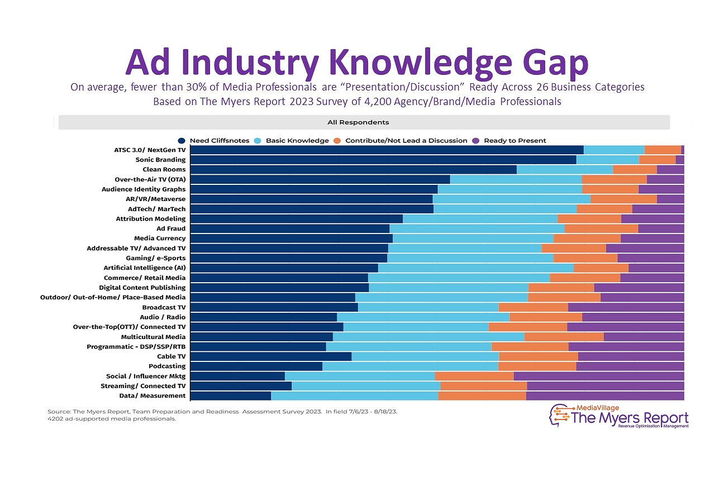
Untangling Terminology within Marketing & Advertising
Why is it important for everyone in marketing and advertising to understand the common terminology used in the industry?
Have you ever been in a meeting where someone mentions a term during a presentation and you're too embarrassed to ask what it means? Or found yourself frantically searching the meaning of a word or phrase online that you read in a trade article but were unfamiliar with?
We've all been there - nodding along sagely while secretly wondering if everyone else was issued a secret marketing decoder. Fear not! This glossary will simplify the complex and decipher the world of marketing and advertising lingo. Say goodbye to awkward smiles and vague "mm-hmms" - it's time to join the conversation with confidence.
Ad Industry Knowledge Gap:
Knowing terminology is important because, on average, fewer than 30% of Media Professionals are “Presentation/Discussion” Ready
According to The Myers Report 2023 Survey of 4,200 Agency / Brand / Media Professionals, covering 26 business categories¹
PAGE 2
This information is exclusively provided to VAB members and qualified marketers.

Slide 3


Terminology Sections:
Campaign Strategy, Planning & Buying
Metrics & Measurement
Campaign Strategy, Planning & Buying:
Ad Exchange: A marketplace that allows advertisers and publishers to buy and sell advertising space in real-time. It connects multiple ad networks and Demand-Side Platforms (DSPs) with Supply Side Platforms (SSPs), automating the process of buying and selling digital ads.
Added Value: Refers to additional advertising inventory, media activity or associated benefits provided at no extra cost based on a campaign buy.
Addressable TV: Video advertising experiences where a single message from an advertiser is matched to an advertiser-defined audience segment that shares one or more common characteristics, enabling different commercials to be targeted to different households on the same TV network at the same time.
  Related Terms: Addressable Advertising
Ad-ID: Similar to how your driver’s license number can be used to pull your driving record, an Ad-ID code can be used to pull additional information about the advertisement, like the title, length, and product information. ²
Advanced TV: Any TV advertising that goes beyond traditional buying practices to deliver more efficiency and measurability. ‘Advanced TV’ is often used as an umbrella term when talking about data-driven TV capabilities, encompassing Connected TV, OTT / Streaming, Addressable TV, and Programmatic TV.
Affiliate Links: Unique URLs given to affiliates to track traffic and sales from their promotions. When a user clicks on an affiliate link and makes a purchase, the affiliate earns a commission
Affiliate Marketing: A digital strategy where companies compensate third-party publishers, or affiliates, to promote their products or services. Affiliates can be bloggers, YouTubers, or influencers who use their networks to advertise a business's goods or services in exchange for commissions or rewards.
Arbitrage / Advertising Arbitrage: A type of strategy where a media buyer (agency or platform) will purchase advertising space at a lower price and will sell it at a higher price through another platform.
Audience-Based Buying: Refers to the practice of segmenting viewers beyond traditional demographics to target a group of consumers based on behavioral, attitudinal, lifestyle and/or transactional data.
PAGE 3
This information is exclusively provided to VAB members and qualified marketers.

Slide 4
Campaign Strategy, Planning & Buying (cont’d):
Audience Networks: A way to expand the reach of a digital campaign with a single publisher by using cookies to identify and track user’s activity on other websites/apps and then serving ads to the same audiences on those 3rd party websites/apps. Examples include Google Video Partners Network, Meta Audience Network, Pangle (TikTok), LinkedIn Audience Network and Microsoft Audience Network.
  Related Terms: Audience Extensions
Bid Stacking: A technique used by an ad exchange to increase its chance of winning a bid for an impression by placing multiple bids on the same piece of inventory.
Contextual Advertising: Ad placements that align with the type of content within a media environment, implemented by identifying and matching categories or keywords that are relevant to the brand/product advertising.
  Related Terms: Contextual Targeting
Deal ID: A unique identifier for programmatic ad deals that enables specific terms and conditions between buyers and sellers.
Header Bidding: A programmatic advertising technique where publishers offer ad inventory to multiple exchanges simultaneously, maximizing ad value through real-time auctions which leads to higher CPMs.
Interoperability: The ability of a system or a product to work with other systems or products — with no special effort required on the part of the user. With video viewing now so fragmented, cross-platform measurement would function best in an environment that enables data interoperability from multiple sources.
Log-Level Data: Refers to detailed, impression-level information about each ad transaction, providing granular insights into performance and audience behavior.
Machine Learning: A process that uses ad technology to analyze data and draw conclusions to improve a task. It allows marketers to use software programs and other technologies to analyze large data sets and extract insights. Machine learning can also help automate processes and aid in personalization, media planning and buying, audience targeting and enhanced analytics.
Makegoods: A credit or adjustment that an advertiser receives from a publisher when an ad underperforms or has other issues. This can occur when a media platform fails to meet the guaranteed delivery of ad impressions, clicks, or metrics outlined in the original agreement. Reasons for include fewer people seeing an ad than estimated or a mistake was made in the delivery or placement of an ad.
Programmatic Types:
Programmatic Advertising
The automated process of buying and selling advertising that uses advanced audience data and automation to efficiently target consumers at a granular level by serving ads to the right audience at the right time.
Programmatic Guaranteed
A type of programmatic advertising where advertisers and publishers agree in advance on a set number of ad impressions at a fixed price, ensuring inventory is reserved and eliminating bidding.
Programmatic Direct
An arrangement between a publisher and an advertiser conducted via a programmatic ad buying system where ad space is directly sold and assured.
PAGE 4
This information is exclusively provided to VAB members and qualified marketers.

Slide 5
Campaign Strategy, Planning & Buying (cont’d):
Open Auction: A type of real-time bidding (RTB) mechanism that allows multiple advertisers to bid on ad inventory in an open marketplace. In an open auction, this ad inventory is made available to all advertisers who want to participate which they use demand-side platforms (DSPs) to bid on this inventory.
Open Exchanges: A digital marketplace where publishers list their ad inventory for real-time bidding by any advertiser, allowing broad access and automated transactions between buyers and sellers.
Open ID: a unique identifier that enables resolution of both linear and digital viewership to a single identity framework.
Optimization: A process that involves continuously analyzing and monitoring ad campaigns to identify media placements and/or platforms that are underperforming and making improvements.
  Related Terms: Creative Optimization
Outcomes-Based Buying: The practice of going beyond traditional metrics like audience count, impressions or clicks and utilizing performance-based metrics (i.e. awareness, conversions, sales, etc.) to measure the success of a media campaign.
Pay-TV: A subscription-based linear TV service (wired cable, satellite, telco, vMVPD) where users will pay a monthly subscription fee to access a bundle of channels.
Place-based Media: Advertising and content delivered to specific outdoor locations such as restaurants, bars, retail stores, airports, public transit or major pedestrian areas.
Principal Media Buying: When agencies buy advertising inventory from media owners or vendors at bulk (or discounted) rates and then resell it to clients at a markup. In this process, agencies become the ‘principal’ or owner of the media rather than acting as independent agents for clients. ³
Private Auction: A type of deal within the private marketplace where select advertisers / publishers / providers can participate to bid on publisher inventory. Unlike open auctions where any advertiser can bid on inventory, private auctions are invitation-only.
Have You Ever Wondered What The Three Tiers of the Automotive Industry Mean?
Tier 1:
OEM Or Manufacturer
National advertising from the perspective of the Original Equipment Manufacturer (OEM). OEMs are major automotive companies that design, produce, and distribute vehicles, and Tier 1 advertising is at the top of the automotive marketing hierarchy. The goal of Tier 1 advertising is to build brand awareness, shape the company's image, and promote specific models
Tier 2:
Regional / Dealer Ad Associations
A collaboration between an auto manufacturer and their dealers to promote their brand in a specific region. The goal is to connect with the local community and make the car brand a top choice in the area. Tier 2 advertising can include regional deals, industry accolades, and other initiatives to drive
local sales.
Tier 3:
Retail Dealer Advertising
A local marketing campaign run by individual dealerships to promote a specific location and drive sales and foot traffic. The goal is to attract potential customers to the dealership and encourage them to choose that location over other competitors. Tier 3 advertising is highly personalized and can include a variety of traditional, digital marketing and media, promotions, events and other community activations.
PAGE 5
This information is exclusively provided to VAB members and qualified marketers.

Slide 6


Campaign Strategy, Planning & Buying (cont’d):
Private Marketplace (PMP): A programmatic auction that offers real-time-bidding in a closed, invitation only auction. When handled appropriately by responsible sell-side partners, it can offer assurance to buyers that they are not buying fraudulent inventory and it can also offer a "first look" opportunity into quality – and sometimes exclusive or rare - inventory that cannot be found in the open auction.
Scatter Marketplace: Ad inventory that is sold by TV networks after the upfront season. It offers advertisers flexibility to buy spots closer to airtime, often at different prices. This typically allows networks to optimize revenue while allowing advertisers the ability to adjust their strategies throughout the year.
Search Engine Results Page (SERP): Displays information in response to a user's query. It combines organic website listings, paid ads, featured snippets and AI-generated summaries. This mix aims to provide the most relevant and comprehensive results, balancing algorithmic rankings with sponsored content and quick-access information features.
Shoppable TV Ads: Interactive ad formats that are designed to inspire viewers to engage directly with brands using elements like scannable QR codes, ‘send to phone’ notifications, tune-in reminders for programs, and more. They can also allow viewers to make a purchase directly from an ad on their TV. Viewers can engage with these ad types on their TV set using their remote or internet-connected device.
Upfronts vs. Newfronts
Upfronts: Annual event held by multiscreen TV networks and streamers in the Spring to present their upcoming programming and tech capabilities to advertisers and media buyers.
Newfronts: Annual event where digital media companies showcase their latest content and advertising formats to potential advertisers and marketers.
The purpose of these events is to secure advertising commitments for the upcoming programming schedule and to fund new content.
Sonic Branding: The strategic use of sound elements like jingles, voice, and audio motifs in advertisements to reinforce brand identity, trigger emotional responses, enhance recall, and build a stronger connection with consumers.
  Related Terms: Audio Branding, Sound Branding
Standardization: The process of creating uniform metrics and methods to ensure consistent and accurate evaluation of video campaign performance across platforms and measurement providers.
Video-on-Demand Dynamic Ad Insertion (VOD DAI): Allows MVPDs and programmers to insert ads into on-demand TV shows and movies through MVPD platforms (e.g., Xfinity, Spectrum TV, Optimum TV). As users watch content at home or on the go, ads are dynamically inserted before, during or after the program
Walled Gardens: A closed ecosystem in which all the operations, technology, information, and user data are controlled by the ecosystem operator. In the advertising technology space, companies like Meta (Facebook) and Alphabet (Google) own each step of their advertising process and have come under scrutiny for a lack of transparency.
PAGE 6
This information is exclusively provided to VAB members and qualified marketers.

Slide 7

Campaign Strategy, Planning & Buying (cont’d):
Understanding the differences in TV terminology
Distribution Types:
Streaming: Long-form video content delivered via an internet connection including movies, TV shows and live events.
Traditional TV: Programming content delivered via wired cable or telcos, satellite or over-the-air signals
Multiscreen TV: TV and long-form video content that can be viewed across multiple devices and screens in all its forms. In addition to the more traditional methods, multiscreen TV leverages internet connectivity and streaming technology to deliver content seamlessly across different platforms.
Convergent TV
From the viewer’s perspective:
The idea that people seamlessly watch linear TV and various forms
of digital / streaming TV.
From the marketplace perspective: The idea of selling and buying video holistically through an interoperable way of executing and measuring linear and digital buys.
Connected TV
A television set that has built-in Internet capabilities (e.g., Smart TV) or is connected to the Internet via a streaming device such as a streaming box/stick, gaming console or Blu-ray player; all of which can access a variety of
long-form and short-form content.
Linear TV
Programming that airs on a set schedule, requiring viewers to tune in at a specific time to watch. This can include programming on 'traditional TV' and streaming platforms such
as FAST (free ad-supported streaming TV).
PAGE 7
This information is exclusively provided to VAB members and qualified marketers.

Slide 8









Measurement
Counting
Reporting of ad delivery that enables the evaluation of campaign success, analysis and optimization
Common Measurement Metrics
  Reach, Frequency, Impressions, Awareness, Attention, Brand Recall, Website Visits, Sales
Examples:
Currency
Trading
The financial unit of value for buying and selling TV ads based on Measurement Data
Common Currency Metrics
  GRPs, CPMs, Impressions, Sales
Examples:
Alternative / Multi-Currency: Marketers have the power to choose the linear TV currency that best meets their KPIs which can vary by campaign. The TV marketplace is no longer solely based on one source for trading (i.e., Nielsen panel) but is instead now based on optionality (i.e., multiple sources).
(e.g., Nielsen Big Data + Panel, VideoAmp, Comscore, iSpot, etc.)
Metrics & Measurement:
Ad Recall: Measures the effectiveness of a campaign by how well the audience remembers the advertisement.
Ad Tag: A piece of code or pixel (typically JavaScript or HTML) that is implemented on the ad creative delivered via an ad server used to track and measure the placement and effectiveness of the ad on the publisher content.
‘Advanced’ Audience: An audience target that is informed by data (e.g., first-party, third-party) and based on consumer behaviors and characteristics (i.e., fitness enthusiasts, new homeowners) rather than traditional demo-based audience targets based on age and gender for more effective reach.
Attention: A metric that measures how engaged a user is with an ad. It's an important factor because it determines if a consumer notices and interacts with the ad. Attention metrics are a shift away from traditional metrics like impressions and views and can provide insight into the quality of engagement and campaign effectiveness. Attention metrics can range from loose proxies like viewability to more exact measures like eye-tracking.
Attribution: The ability to tie an ad campaign to performance-based metrics / outcomes, such as website visits, app downloads, or sales.
Benchmark: A point of reference used as a basis for comparison for new measurements, using the same methodologies. Usually based on a historical average but can also be a current value or threshold value associated with previous success.
Census Level Data: Refers to platforms where every viewer in a specific advertising environment universe is counted. Census level data can allow for greater flexibility in the geographies measured and it creates opportunities for more precise measurement at the local, regional and national level.
PAGE 8
This information is exclusively provided to VAB members and qualified marketers.

Slide 9



Metrics & Measurement (cont’d):
Churn: The rate at which customers stop doing business with a company over a given period. It is a critical metric for subscription-based businesses and any company that relies on repeat customers. High churn rates can indicate dissatisfaction with a product or service, increased competition, value exchange imbalance, or other issues that need to be addressed to maintain a stable customer base.
Cookies: Unique identifiers that can assign a given Internet browser or device to an individual which allows a website to recognize a specific user and their shopping behaviors as well as remember information that the user may have previously entered. The term ‘cookie deprecation’ relates to the gradual phasing out of third-party cookies used by external companies for advertising and analytical purposes.
Co-Viewing: Consuming the same video content with multiple members of a household, or with a group of people, on the same screen at the same time.
Cross-Platform Measurement: The process of evaluating and analyzing the performance and impact of advertising campaigns across multiple media channels and platforms. This approach is crucial for understanding the overall effectiveness of a marketing strategy that spans different types of media, (Linear, CTV, desktop mobile etc.)
  Related Terms: Cross-Screen Measurement, Cross-Media Measurement
Cross-Channel Attribution: A process that measures the impact of a marketing campaign across multiple offline and/or online media platforms/channels and assigns credit to specific platforms/channels for that impact.
Data Asymmetry: Refers to when one party (such as a media platform or media seller) has significantly more information than the other party (such as an advertiser or media buyer). This imbalance can occur in various forms including consumer data vs. advertiser data, transparency of information, ad performance data and market power.
  Related Terms: Information Asymmetry
Data Clean Rooms: A secure software environment that enables data collaboration between two or more parties (such as an advertiser and a media publisher), which allows sensitive customer data to be shared, and/or matched for joint analysis in a secure and privacy compliant manner.
The stages of the purchase funnel (before sales)
Awareness
When potential customers are introduced to a brand and begin to form perceptions that may predispose them to consider that brand later in their journey.
Consideration
When potential customers evaluate choices, drawing largely on their perceptions of brands and their emotional connection to them as well as rational messages and information to help inform their intentions.
Intent
The likelihood that a potential customer will take action on a product of service.
PAGE 9
This information is exclusively provided to VAB members and qualified marketers.

Slide 10




Metrics & Measurement (cont’d):
Data Privacy: The principle that individuals should have control over their personal data, including the ability to decide how organizations collect, store and use their data.
Deduplicated Reach: A metric that counts unique individuals or households reached across various media channels, like TV and digital video. It prevents duplicate counting, allowing marketers to accurately track a user's journey across devices and locations throughout the day, ensuring precise audience reach measurement in multi-channel campaigns.
Device Graph: Data structures that anonymously link individuals to their personal devices. Device graphs collect continuous inputs from many different data streams, and this data is categorized, organized, and validated to provide a more complete picture of each household—and the multiple devices in it. ⁴
Effectiveness: The extent to which an advertising campaign achieves its intended goals and objectives. This can include a variety of outcomes, such as increasing brand awareness, generating leads, driving sales or improving customer loyalty.
Efficiency: A key metric that measures how well an advertising campaign meets its desired goals and outcomes while minimizing costs and resources. It focuses on maximizing the return on investment (ROI) and ensuring that the advertising spend generates the highest.
Engagement: Level of interaction and involvement that an audience has with an ad or marketing content. It measures how actively people are responding to, participating with, and being influenced by the ad.
Types of data:
Zero-Party Data
First-Party Data
Information that a customer intentionally shares with a business or media owner, also known as explicit or solicited data. It can include information like preferences, purchase intentions, and how the customer wants to be recognized by the brand.
Data that a brand or media owner has collected directly from its customers and audiences, with their permission, through interactions with them like sales, website forms, subscriptions, surveys, and social media.
Second-Party Data
Third-Party Data
Data that comes from another company’s collection of its own first party data but with a defined set of rights usage and permissions.
Data that is purchased or obtained from a variety of sources by entities that do not have a direct relationship with the end user.
PAGE 10
This information is exclusively provided to VAB members and qualified marketers.

Slide 11


Metrics & Measurement (cont’d):
Equivalized Impressions: Guaranteed and delivered impressions that are based on a standard benchmark of a 30-second equivalent. For example, impressions delivered against a 15-second unit are halved, while impressions delivered against a 60-second unit are doubled.
Frequency: the number of times a person, or target audience, is exposed to an ad, or ad campaign, over a specific time period.
  Equation: Average Frequency= Gross Rating Points (GRPs) / Reach %
Full-Funnel Outcomes: Refers to the range of results achieved at various stages of the marketing and sales funnel, from initial awareness to final purchase and beyond. The funnel is typically divided into several stages, each with specific objectives and key performance indicators (KPIs.)
Gross Rating Points (GRPs): A standard measurement of how many people within a target audience saw an ad, or an ad campaign, and how often they saw it.
  Equation: Gross Rating Points (GRPs) = Reach % x Frequency
  Related Terms: Target Rating Points (TRPs)
Identifiers: Enables marketers to achieve a comprehensive, consistent, and privacy compliant view of audiences throughout the customer journey (e.g., personal identifiers like name, address, email, etc.; digital identifiers like IP address, device ID, etc.)
Outcome approaches:
Deterministic Approach
Outcomes that are known to be true
One-to-one matches are applied using confirmed identifiers such as authenticated logins to measure & report outcomes
.
Benefit: Authenticated and highly accurate
Challenge: Limited in scalability
Probabilistic Approach
Outcomes that are likely to be true
Matches are probable and based on pieces of information. Models are applied to measure & report outcomes
Benefit: Scalable and likely accurate
Challenge: Not guaranteed to 100% be accurate
PAGE 11
This information is exclusively provided to VAB members and qualified marketers.

Slide 12


Metrics & Measurement (cont’d):
Identity Graph: Database of common identifiers matched with privacy protected customer profiles.
This enables more targeted and effective marketing efforts while maintaining compliance with data privacy regulations.
Identity Resolution: Process of matching common identifiers across devices and interactions to a single profile.
Impressions (IMPs): The estimated number of viewers exposed to an advertisement or other content. The length of exposure to be counted as an impression can vary by platform.
Incrementality: A way to measure the impact of a campaign or activity on sales or other desired outcomes and analyze the difference between having and not having implemented a campaign, tactic, or channel (i.e., an event that wouldn't have occurred without a specific interaction, such as an ad view, and that resulted in the desired outcome, such as a conversion).
Incremental Reach: A metric that measures the number of new users who are exposed to an ad campaign over a specific period of time (such as a day, week, or month) and who have not been exposed to the ad in a previous time period. Incremental reach can be used to identify and measure additional audiences who have not yet seen a brand's advertisements on TV or digital platforms, such as those who are reached via a brand’s CTV/OTT campaign but not their traditional TV buy.
Media Transparency: Full disclosure of relevant information related to the purchase of ads including placement, placement type, context, platform, landing pages, media type and other relevant information which is fully disclosed or not intentionally obscured . This information is required for informed and intelligent decision-making so that an advertiser has full access to the information necessary to assess the value of a media purchase and the associated margin.
Accreditation vs. Certification
Accreditation
Official recognition given by the Media Rating Council (MRC) to assure the industry that a measurement provider is in compliance with relevant industry standards for quality measurement
by an independent third-party organization.
Certification
Formal approval granted to a measurement provider, indicating that they meet the quality and accuracy standards established by Open AP’s Joint Industry Committee (JIC).
PAGE 12
This information is exclusively provided to VAB members and qualified marketers.

Slide 13
Metrics & Measurement (cont’d):
Optionality: Refers to the flexibility marketers have with selecting from a variety of measurement solutions that best align with their specific campaign goals and key performance indicators (KPIs). This flexibility enables them to tailor their approach to effectively assess and optimize their marketing strategies.
Privacy Sandbox: Google initiative to develop web technologies that enhance online privacy while supporting digital businesses. This is aiming to replace third-party cookies and limit tracking across sites and apps without compromising free online content and services.
Reach: The number of people exposed to a single ad served.
  Equation: Reach = Impressions / Frequency; = Gross Ratings Points (GRPs) / Average Frequency
Signal Loss: The diminishing availability of data points directly tied to campaigns or individual users that allow marketers to acquire, measure and retarget customers. This describes when you lose the ability to attribute where your customers are coming from. One of the most common examples of signal loss today is the deprecation of third-party cookies, which have serious privacy concerns associated with them. Signal loss also occurs when consumers decide to opt-out of sharing their personal data.
Syndicated Data: Data that is collected, compiled, and sold by unbiased/verified third-party organizations or research firms. This type of data is not exclusive to any one buyer; instead, it is available to multiple clients or subscribers who are interested in gaining insights into market trends, consumer behavior, media consumption, and other relevant metrics. Examples: Nielsen, Comscore, etc.
Synthetic Data: Utilizes known information about a population to train a model to make accurate predictions about others in the population that you don’t have a full set of data for.
Tag Management: The practice of using a centralized system to manage and deploy the various tags or code snippets that are used for tracking, analytics and ad serving.
Tech Stacks: A collection of technologies, tools and platforms that advertisers, publishers and ad agencies use to manage, deliver and optimize their advertising campaigns. Tech stacks can aid in targeting, personalization, performance analysis and reporting.
Time-Shifted Viewing: Refers to watching video content at a time outside of the original airing date. This is typically associated with content recorded on DVRs (Digital Video Recorders) or accessed through other digital means that allow for delayed viewing.
What is ‘Section 230?’
Section 230 is a part of the U.S. Communications Decency Act that shields online platforms from liability for user-generated content. It states that these platforms are not considered publishers or speakers of third-party content, enabling the growth of social media and other user-driven sites.
PAGE 13
This information is exclusively provided to VAB members and qualified marketers.

Slide 14



Metrics & Measurement (cont’d):
U.S. Census Data: Utilized by measurement companies as a reference when creating or determining their total measurement footprint / universe to ensure they are nationally representative. U.S. Census data is based on a survey designed to count every person living in the United States and takes place every ten years.
Viewability: A metric that measures the number of impressions viewed by real, human users. A served impression does not necessarily count as a viewed impression, as it could be served outside a live window or served to a bot. The Media Rating Council publishes an official industry definition of what should be counted as a viewable ad, based on the percentage of the creative and the duration in seconds that it is in an active browser or screen. The current industry standard requires that 100% of an ad must be in view for a minimum of two seconds for video ads and a display ad is considered viewable if at least 50% of its area is visible on a user's screen for a minimum of one second.
  Related Terms: Viewable Impression
Watermarking: Adding a hidden or visible mark to content like images, photos, videos or audio. It's used to show who owns the content, protect it from being copied, and track how it's used.
What are the main types of viewership data collection?
Big Data
Census level data that is comprised of blending viewership data from multiple sources, which can be used for determining insights, ratings, outcomes, etc.
Can include data from (but not limited to) ACR (Smart TV), Set Top Box (STB), Panels and Streaming Services.
Panel
Viewing habits, behaviors and demographic info collected from an opt-in sample of a small group of people to represent a larger group.
When stable, panels can be used to provide person-level data and a common view of the TV landscape.
Related Terms – ‘Survey’,
‘Local People Meter’
Big Data + Panel
When a service, such as Nielsen, combines big data from set-top-boxes (STB) and/or ACR data from Smart TV devices with their panel data.
This is meant to enhance audience measurement in effort to provide more accurate and comprehensive insights into viewing behaviors for national and/or local markets.
PAGE 14
This information is exclusively provided to VAB members and qualified marketers.

Slide 15
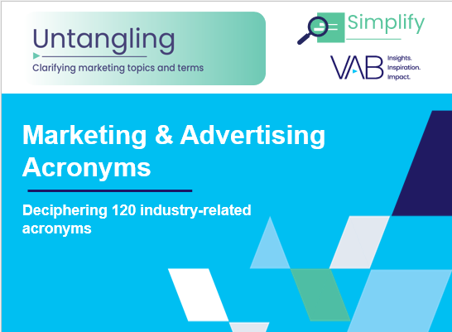
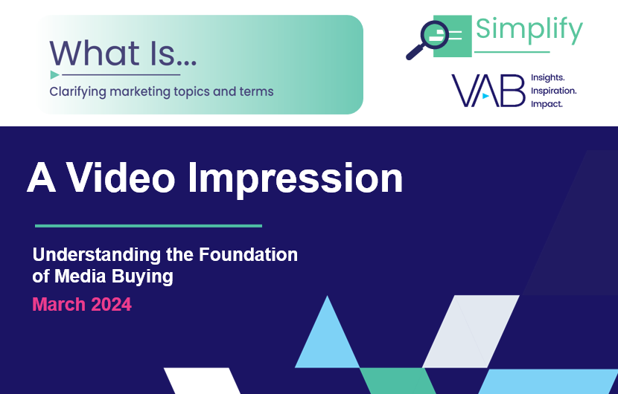

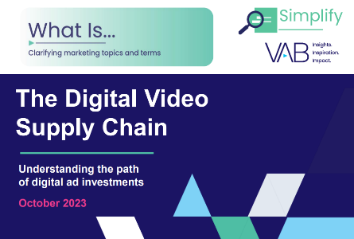
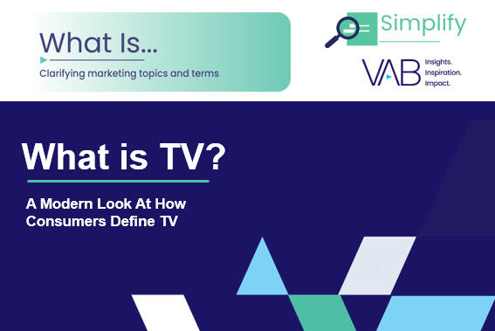
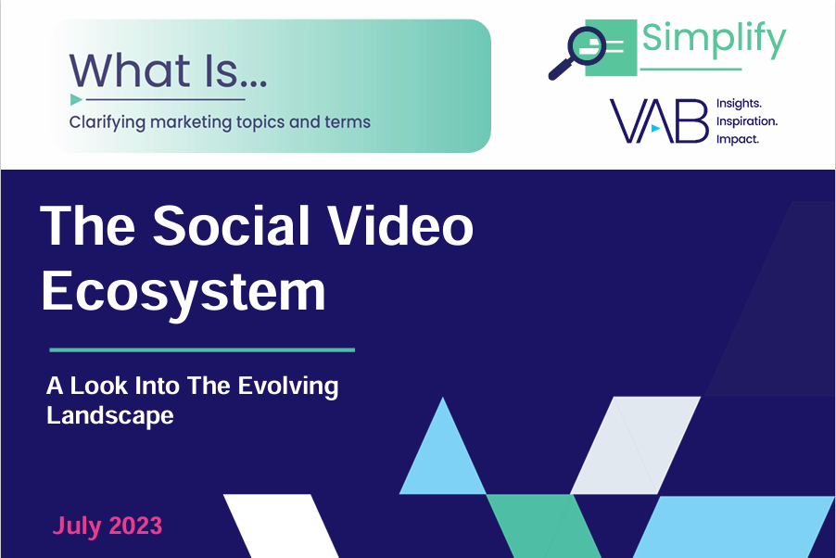

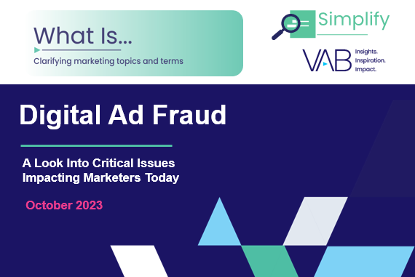

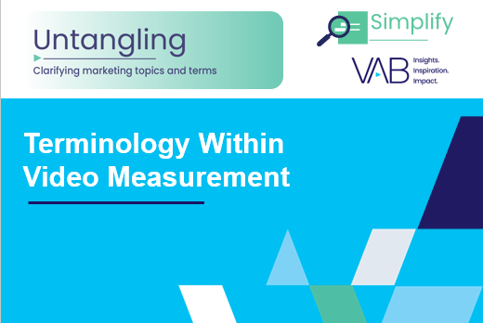
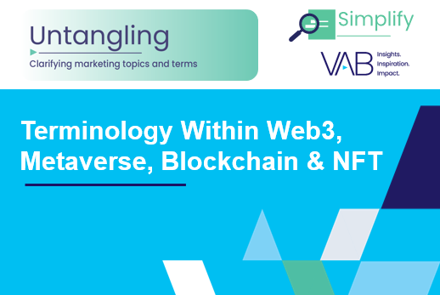
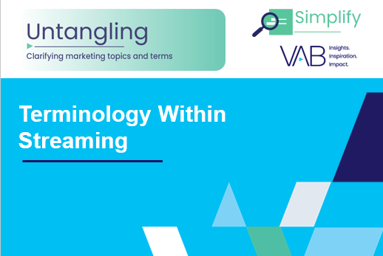

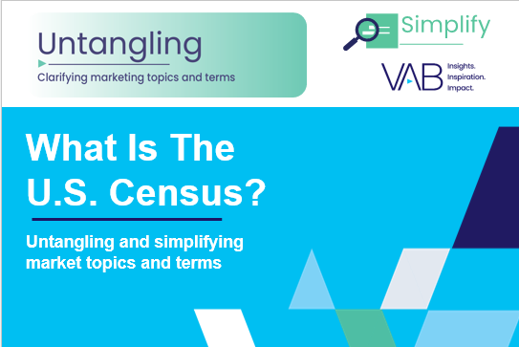
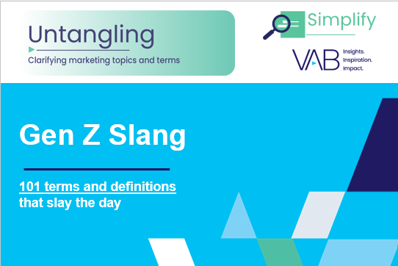


Looking for more industry terminology?
Click on the images below to download
VAB’s advertising glossaries cover topics like generative AI & machine learning, video measurement, data / identity / privacy, audience-based buying, TV ecosystem and streaming.
PAGE 15
This information is exclusively provided to VAB members and qualified marketers.

Slide 16
About VAB
VAB is an insights-driven organization that inspires marketers to reimagine their media strategies resulting in fully informed decisions.
Drawing on our marketing expertise, we simplify the complexities in our industry and discover new insights that transform the way marketers look at their media strategy.
We are committed to your business growth and proud to offer VAB members, brand marketers and agencies complimentary access to our continuously-growing Insights library.
Get immediate access at theVAB.com.
Sources
The Myers Report 2023 Survey of 4,200 Advertising Agency and Brand Media Decision-Makers and Influencers; 4,200 respondents. Fieldwork August/September 2023.
Ad-ID, How AD-ID’s Work, June 2024.
ANA, With Principal Media on The Rise, ANA Report Seeks To Educate Marketers On Best Practices, February 2024.
Comcast, What is Premium Video, 2023.
Madhive, What is a Device Graph? The Details for TV Advertisers, 4/11/2023.
Definition Sources (reference pieces used in the development of several definitions)
Digiday, WTF is Bid Stacking?, 10/25/2018.
Publift, What is Header Bidding?, 4/15/2024.
Digiday, WTF is Log-Level Data, 10/18/2018.
Placebased, The Rise of Place-Based Advertising, 6/18/2024.
Niselen, Ad Intel TV User Guide, 2024.
Google Privacy Sandbox, What is the Privacy Sandbox, June 2024.
Plaid, Synthetic Identity Fraud: How to Detect and Prevent It, 5/1/2024.
AdExchanger, AdExplainer: What Is Return-Path Data (RPD)?, 9/28/2023.
Emarketer, Retail media networks: What they are and why they matter to marketers and retailers, 11/14/2023.
Digiday, WTF is a Financial Media Network?, 6/4/2024.
PAGE 16
This information is exclusively provided to VAB members and qualified marketers.

