Slide 1



Marketing & Advertising Acronyms
Deciphering 120 industry-related acronyms

Slide 2

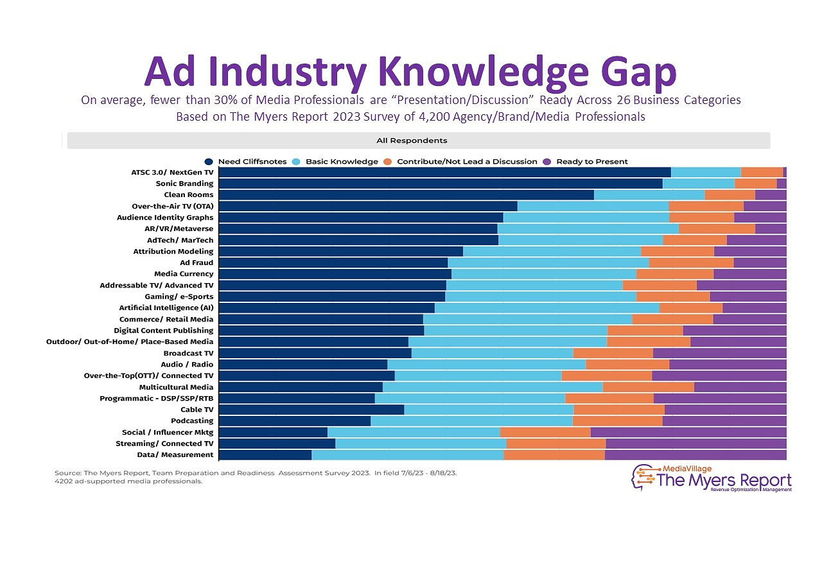
Untangling Acronyms within Marketing & Advertising
Why is it important for everyone in marketing and advertising to understand the common acronyms used in the industry?
Have you ever been in a meeting where someone drops an acronym and you're too embarrassed to ask what it means? Or have you found yourself quietly using the search engine on your phone to learn more about the acronym that was just casually mentioned by a speaker during their presentation? Perhaps you've witnessed colleagues volleying acronyms back and forth like a high-stakes tennis match, leaving you feeling like a spectator at a foreign language tournament.
We've all been there - nodding along sagely while secretly wondering if everyone else was issued a secret marketing decoder. Fear not! This glossary will simplify the complex and decipher the crazy acronyms that are used daily. Say goodbye to awkward smiles and vague "mm-hmms" - it's time to join the conversation with confidence.
Ad Industry Knowledge Gap:
Knowing terminology is important because, on average, fewer than 30% of Media Professionals are “Presentation/Discussion” Ready
According to The Myers Report 2023 Survey of 4,200 Agency / Brand / Media Professionals, covering 26 business categories¹
PAGE 2
This information is exclusively provided to VAB members and qualified marketers.

Slide 3






Acronym Sections:
Campaign Strategy, Planning & Buying
Metrics & Measurement
Data Privacy & Identity
Innovations
Category-Related
Industry Organizations
Campaign Strategy, Planning & Buying:
ABB (Audience Based Buying): Refers to the practice of segmenting viewers beyond traditional demographics to target a group of consumers based on behavioral, attitudinal, lifestyle and/or transactional data.
CTV (Connected TV): A television set that has built-in Internet capabilities (e.g., Smart TV) or is connected to the Internet via a streaming device such as a streaming box/stick, gaming console or Blu-ray player; all of which can access a variety of long-form and short-form content.
DAI (Dynamic Ad Insertion): The process of inserting targeted ads into a content stream, allowing for different ads to be served to relevant households / audiences within the same ad break.
  Related Terms: Server-Side Ad Insertion (SSAI)
DDL (Data Driven Linear): Targeted linear TV advertising that is based on consumer data beyond just age and gender. By combining demographic data with viewing behaviors and consumer interests, marketers can target specific networks and dayparts to enhance their ability to reach a specific audience segment.
DDV (Data-Driven Video): Data-driven video is an advertising strategy that uses audience data and analytics to optimize ad placements across TV, streaming and digital platforms. It combines audience profiling, cross-platform planning and performance measurement to maximize reach and efficiency, enabling more targeted and effective video campaigns in today's complex media landscape.
DMP (Data Management Platform): A platform that unifies and centralizes collecting, organizing, and activating large sets of data from disparate sources. Any audience built within the DMP can be defined and analyzed using audience profile reporting.
DPO (Demand Path Optimization): A strategy publishers use to examine how advertisers and agencies buy their ad inventory. This process helps publishers identify effective areas in their media supply chain and spots needing improvement. By analyzing DPO data, publishers gain insights to boost ad revenue, enhance yield, cut AdTech costs, and improve user experience on their digital properties.
PAGE 3
This information is exclusively provided to VAB members and qualified marketers.

Slide 4
Campaign Strategy, Planning & Buying (cont’d):
DSP (Demand Side Platform): A technology platform that provides centralized & aggregated media buying from multiple sources - including ad exchanges, ad networks and sell-side platforms - which often leverages the real-time bidding capabilities of these sources (e.g., Amobee, VideoAmp).
  Related Terms: Buy-Side Platform
FAST (Free Ad-Supported Streaming TV): Streaming services that have content pre-programmed into linear TV-like channels with ad breaks, which the user can choose from to watch without needing a subscription. (e.g., Pluto TV, Tubi, Xumo, Samsung TV Plus).
FMN (Financial Media Network): An advertising platform built by financial institutions like banks (e.g. Chase) or digital payment companies (e.g. PayPal, Revolut) that leverages their data to target personalized ads to customers. These companies can monetize the first-party data they have on their customers' incomes, spending habits and interests across retailers and industries to create advertising opportunities for brands.
MCN (Multi-Channel Network): A third-party company that partners with creators, or multiple channels, on a video platforms to help them grow their audience and monetize their content.
MFA (Made For Advertising): Websites that operate with the sole purpose of maximizing ad profits, leaving the actual content and user experience as afterthoughts. They are often filled with spam, clickbait, and stolen content.
MVPD (Multichannel Video Programming Distributor): Media distribution companies that provide multiple television channels to subscribers either through cable, satellite or telco (e.g., Comcast, DirecTV, Verizon Fios).
OEM (Original Equipment Manufacturers): TV set manufacturers like Samsung, LG and Vizio. Historically, TV OEMs’ focus has typically been on selling hardware (i.e., Smart TVs) to consumers, however advancements in Smart TV capabilities now also enables them to provide TV viewing data and utilize dynamic ad insertion (DAI) for advertisers.
OLV (Online Video): Video content that is streamed via the internet and accessible on various devices, including computers, smartphones, and tablets.
OOH (Out-of-Home): Advertisements that you see outside of your home. This includes billboards, bus stops, benches and more.
OTA (Over-the-Air): Video delivery system of TV broadcasts from local stations that does not involve a paid service like cable or satellite transmission.
OTT (Over the Top): Video content that is delivered over an Internet connection through an app or connected video device (TV, PC, Tablet, or Smartphone).
PMP (Private Marketplace): A programmatic auction that offers real-time-bidding in a closed, invitation only auction. When handled appropriately by responsible sell-side partners, it can offer assurance to buyers that they are not buying fraudulent inventory and it can also offer a "first look" opportunity into quality – and sometimes exclusive or rare - inventory that cannot be found in the open auction.
  Related Terms: Preferred Deal, Private Auction and Automated Guaranteed
RMN (Retail Media Network): An advertising platform where retailers sell ad space using their first-party customer data to advertisers who can target their audience based on actual shopping behavior. These ads can appear on the retailer's own platforms (like their website or app), in their stores, or on outside channels (like social media).
PAGE 4
This information is exclusively provided to VAB members and qualified marketers.

Slide 5
Campaign Strategy, Planning & Buying (cont’d):
RTB (Real-Time Bidding): Dynamic form of programmatic advertising where digital ad space is bought and sold instantly. As a user accesses a website or app, an automated auction occurs immediately. Advertisers compete for the available ad slot, with the highest bidder winning the opportunity to display their ad to the user. This process happens in milliseconds, allowing for highly targeted and efficient ad placement based on user data and advertiser preferences.
SEO (Search Engine Optimization): The process of maximizing the number of visitors to a particular website by ensuring that the site appears high on the list of results returned by a search engine. This is used so consumers can naturally find and visit the website when they search something related to that site’s content.
SERP (Search Engine Results Page): Displays information in response to a user's query. It combines organic website listings, paid ads, featured snippets, and AI-generated summaries. This mix aims to provide the most relevant and comprehensive results, balancing algorithmic rankings with sponsored content and quick-access information features.
SPO (Supply Path Optimization): A strategy that aims to simplify the supply chain between advertisers and publishers by reducing redundancies and removing unnecessary intermediaries. The goal is to find the most efficient and profitable path to ad inventory for demand-side platforms (DSPs).
SSP (Supply Side Platform): A technology platform that provides outsourced media selling and ad network management services for publishers. The business model resembles that of an ad network in that it aggregates ad inventory, however they serve publishers exclusively and do not provide services for advertisers (e.g., FreeWheel, SpotX).
TVE (Television Everywhere): The ability for a viewer to watch TV and film content whenever and wherever across devices (Smart TV, Connected Device, Tablet, Mobile Device or PC) and accessed through either a broadcast or cable programmer (via MVPD authentication/user log-in) or an MVPD app (like Comcast Xfinity & Spectrum TV).
UGC (User Generated Content): Original videos or streams that have been created and posted by users of digital websites or social media platforms like Instagram, TikTok and YouTube.
USP (Unique Selling Point): The essence of what makes your product or service better than competitors. In marketing, communicating your USP clearly and quickly is one of the keys to getting potential customers to convert on your site. Also referred to as ‘unique selling proposition.
vMVPD (Virtual Multichannel Video Programming Distributor): A subscription service that allows users to stream live and on-demand TV channels online through a broadband connection without a cable or satellite subscription (e.g., Sling TV, fuboTV).
VOD (Video-on-Demand): Enables users to select and watch video content whenever they choose to, rather than at a specific broadcast time.
Video-on-Demand Dynamic Ad Insertion (VOD DAI): Allows MVPDs and programmers to insert ads into on-demand TV shows and movies through MVPD platforms (e.g., Xfinity, Spectrum TV, Optimum TV). As users watch content at home or on the go, ads are dynamically inserted before, during or after the program.
PAGE 5
This information is exclusively provided to VAB members and qualified marketers.

Slide 6
Metrics & Measurement:
Metrics:
AA (Average Audience): Average Audience reflects viewing for an average minute to a program and is an average of the audience at the specific minute (Min. 1, Min. 2, Min. 3, etc…) and can be expressed as a rating % or projected audience. Note: Impressions can be added together across demos, dayparts or stations/sources (ex: M18-49 + F18-49 = A18-49).
C3 (Commercial Live + 3 Days Rating): A measure of the viewership of commercials watched in a program by a target demo both live and up to three days of DVR playback, which is the metric that much of primetime TV advertising is bought and sold on.
C7 (Commercial Live + 7 days Rating): A measure of the viewership of commercials watched in a program by a target demo both live and up to seven days of DVR playback, which is another metric that primetime TV advertising is bought and sold on.
CAC (Customer Acquisition Cost): The total amount a company spends to gain a new customer. This metric includes all expenses related to attracting customers, such as marketing campaigns, sales team costs and related overhead expenses.
  Equation: CAC = (Cost of sales + cost of marketing) / Number of new customers.
CPA (Cost Per Acquisition): Measures how much money a company spends to acquire a new customer through a specific action like a click, lead, purchase or other action depending on the business's performance marketing goals.. CPA helps businesses evaluate the efficiency of their marketing efforts and determine which strategies are most cost-effective for gaining new customers.
CPC (Cost Per Click): A paid advertising term where an advertiser pays a cost to a publisher for every click on an ad. CPC is used to determine costs of showing users ads on search engines, Google Display Network for AdWords, social media platforms and other publishers.
  Related Terms: PPC (pay per click)
CPM (Cost Per Mile / Thousand): The average cost per one thousand advertising impressions.
CPP (Cost Per Point): The cost to deliver a single rating point (1% of the defined target population).
DAU (Daily Active Users): Refers to the number of unique individuals who engage with a digital platform (website or app) within a 24-hour period.
GRPs (Gross Rating Points): A standard measurement of how many people within a target audience saw an ad, or an ad campaign, and how often they saw it.
  Equation: Gross Rating Points (GRPs) = Reach % x Frequency
  Related Term: TRP (Target Rating Points)
HUT (Households Using Television): The percentage of TV households in a market where at least one television is on at a specific time.
MAU (Monthly Active Users): Refers to the number of unique individuals who engage with a digital platform (website or app) within a 30-day period.
MRP (Meaningful Rating Point): A measure that combines the reach of an ad (how many people saw it) with its impact (how well it resonated with viewers). This not only considers how many people were exposed to an ad, but also how meaningful or relevant that exposure was to the audience.
PAGE 6
This information is exclusively provided to VAB members and qualified marketers.

Slide 7
Metrics & Measurement (cont’d):
Metrics (cont’d):
MMM (Marketing Mix Modeling / Media Mix Modeling): A data analysis method that helps companies understand how their various marketing efforts impact their return on investment. It looks at data from different marketing channels - both digital and traditional - and considers outside factors like seasonal trends or promotions. This analysis helps marketers figure out which marketing activities are most effective and how to best spend their budget.
  Related Terms: MMM (Media Mix Modeling)
LTV (Lifetime Value): Estimates the total revenue a business can reasonably expect from a single customer throughout their relationship with the company.
PUT (Persons Using Television): The percentage of people in a particular target audience that are watching Television during a given time period.
ROAS (Return on Advertising Spend): Measures the revenue generated for every dollar spent on advertising. It is calculated by dividing the total revenue by the total advertising cost. A higher ROAS indicates more effective advertising.
ROI (Return on Investment): A business metric that measures the profitability of a marketing campaign by comparing the amount of money spent on the campaign to the amount of revenue it generates. A positive ROI means that the campaign is profitable, as the revenue from customers attracted by the campaign more than covers the cost of the campaign. ROI can help marketers determine if a campaign is successful or if they need to try a different approach.
  Related Terms: ROMI (Return on Marketing Investment)
SoS (Search of Search): A metric that measures how many organic searches a brand receives on Google Search compared to the total number of searches for all brands in its industry over a specific time period. SoS can help businesses assess their brand health, market share while answering questions about a brand's current momentum and identifying opportunities for growth.
SOV (Share of Voice): Measures a brand's presence in the market compared to competitors. It reflects how visible and dominant a brand is in conversations within the category and/or advertising share. This metric helps brands understand their market position, identify challenges and develop strategies for growth and increased customer engagement.
VPVH (Viewers per Viewing Household): A measure of a program’s audience composition (or profile) based on the number of people within a demographic watching the program per household that is tuned in. VPVH is used to estimate a program's target audience and can show the audience skew of a network or program.
  Equation: VPVH = Persons or Demographic Projection (000) / Household Projection (000)
PAGE 7
This information is exclusively provided to VAB members and qualified marketers.

Slide 8
Metrics & Measurement (cont’d):
KPI
(Key Performance Indicator)
A measurable value that shows how effectively a company or individual is achieving key business objectives. KPIs help organizations evaluate their success at reaching targets and are used across different levels to assess performance over time.
OKR
(Objectives and Key Results):
A goal-setting system used by businesses which consists of two parts: Objectives (clear, specific goals a company wants to achieve) and Key Results (measurable outcomes used to track progress towards those objectives). This framework helps organizations set concrete targets and provides a way to measure their advancement towards these goals.
KPIs are metrics that reflect your current state, while OKRs
are a framework for setting and achieving your goals
Measurement:
ACP (Audience Calibration Panel): a tool used in TV viewership measurement that works alongside other data sources (like big data) to identify and understand potential gaps or biases within a dataset. Its main benefit is helping to provide accurate demographic, geographic, and household type representation in TV audience measurement.
ACR (Automatic Content Recognition): Identifies ads and programming content across Internet enabled TV-connected devices via audio or video fingerprints; capturing both linear and OTT viewing.
ADUs (Audience Deficiency Unit): Contractual allocation of advertising slots offered to an advertiser or advertising agency at no cost. This allocation compensates for a shortfall in viewership that occurs during and/or after the initial contract period of a guaranteed deal. ²
AOT (All Other Tuning): Reports TV tuning to a distributor that could not be identified due to a lack of encoding and/or monitoring.
BBO (Broadband Only): Households that receive TV programming exclusively through a broadband internet connection, without access to traditional cable, satellite or OTA services.
DMA (Designated Market Area): A geographic region in the United States that defines television and radio markets. They are based on the television viewing habits of people living in a specific area and are usually defined by metropolitan areas, with suburbs often included. DMAs can also include rural regions with few population centers, or very large metropolitan areas that are subdivided into multiple segments.
LPM (Local People Meter): A Nielsen device that tracks TV viewing habits in households, providing demographic and viewing data to help broadcasters and advertisers understand local trends.
PAGE 8
This information is exclusively provided to VAB members and qualified marketers.

Slide 9
Metrics & Measurement (cont’d):
Measurement (cont’d):
MRUE (Media-Related Universe Estimate): Refers to the total number of individuals who have access to a particular media service or device to help determine the potential audience.
NPM (National People Meter): Nielsen device that is hooked up to each TV set in a Nielsen National TV household panel home, a 24/7 electronic measurement system monitors the channel a TV set is tuned to, as well as the individuals present in the room while the TV set is switched on. Individuals are identified by having them manually ‘check in’ using a remote control when they are watching.
PPM (Portable People Meter): A pager-like device a Nielsen panel participant physically carries around that permits the measurement of an individual's overall exposure to Radio and TV (and possibly print media) both inside and outside the home. Designed to be worn or carried by selected individuals, personal meters can potentially capture viewing/listening in all types of out of home locations.
RPD (Return Path Data): Information about what is being watched on a TV device, such as a cable or satellite set-top box. It provides details on the viewing sessions, including which programs and advertisements were displayed. Measurement companies analyze this RPD to help advertisers and TV networks understand where their ads were shown and who the audience was based on the viewing data.
STB (Set-Top Box): Audience based viewing data that comes from calibrated set-top boxes installed at the subscribers' home which can provide more granular data for the insights on audience behavior across a large footprint.
UE (Universe Estimate): Total persons, demographics or homes in a given population, e.g., TV HHs in the U.S.
Data Privacy & Identity:
CDP (Customer Data Platform): A type of software that collects and organizes first-party customer data from various sources to create a complete view of each customer. This data includes behavioral data, transactional data and demographic data to analyze, track and manage customer interactions.
ID5: A digital identity solution designed for the advertising industry, prioritizing data protection and privacy compliance across global regulations.
IP (Internet Protocol): A set of rules governing the format of data sent over the internet or other networks. It ensures the correct routing and delivery of packets from the sender to the recipient by assigning unique IP addresses to devices on a network.
IPv4 / IPv6: Both are versions of the Internet Protocol (IP). IPv4 uses 32-bit addresses, allowing for about 4.3 billion unique addresses, and is the most widely deployed Internet protocol. In contrast, IPv6 uses 128-bit addresses, providing a vastly larger address space (approximately 340 undecillion addresses), which is essential given the increasing number of devices connected to the internet. IPv6 also includes enhancements for security and routing efficiency compared to IPv4.
PETs (Privacy Enhancing Technologies): Hardware or software solutions that ensure data privacy and protection while allowing organizations to extract value from data.
UID (Universal ID): Unique identifier that allows publishers and advertisers to recognize and authenticate users across publishers, platforms & devices, providing a holistic view of audiences. Universal ID examples include UID 2.0 from The Trade Desk, Open ID from OpenAP and Ramp ID from /LiveRamp.
PAGE 9
This information is exclusively provided to VAB members and qualified marketers.

Slide 10
Data Privacy & Identity (cont’d):
VID (Virtual People Identification): Synthetic individuals that mimic the general population through the assignment of probabilistic demographics. This is a way to label impression data consistently across all data providers enabling deduplicated cross platform reach and frequency and can be used to complement and enhance calibration panels.
Data Privacy Legislation:
ARPA (American Privacy Rights Act 2024): New bi-partisan national legislation introduced covering data minimization and security, consumer rights, restrictions on data brokers and an enforcement regime.
CCPA (California Consumer Privacy Act): A California law that provides residents the right to know what data is being collected about them, where/if it is sold, the right of refusal, personal data access, data deletion and anti-discrimination. Any business that conducts business with California residents must adhere to this law.
  Related Terms: Virginia Consumer Data Protection Act (CDPA)
COPPA (Children's Online Privacy Protection Act 2000): Created to impose requirements on website operators to protect and inform data collection and usage for children under the age of 13.
GDPR (General Data Protection Regulation 2018): Europe’s data privacy and security law, affecting global companies, that covers the transparency, accuracy, storage, integrity and accountability.
VPPA (Virtual Power Purchase Agreement 1988): Created to preserve personal privacy with respect to the rental, purchase, or delivery of video tapes or similar audio-visual materials.
To learn more about data privacy legislation, click here to download VAB’s Data Privacy 101
Types of identifiers:
PII (Personal Identifiable Information)
Information that can be used to distinguish or trace an individual’s identity, either alone or when combined with other information that is linked or linkable to a specific individual.
Sensitive Data (Direct PII)
Data that can be directly linked
to an individual's identity and can vary by state ³
Non-Sensitive Data (Indirect PII)
Data that can’t be used to directly
identify an individual ³
Information commonly considered as sensitive
Information commonly considered as non-sensitive
Full Name
Social Security Number
Telephone number
Fingerprints
Driver’s License
Credit Card Information
Medical Records
Passport Info
Precise Geolocation
Zip code
Country code
Race
Gender
Date of birth
Place of birth
Employer
Mother’s Maiden Name
PAGE 10
This information is exclusively provided to VAB members and qualified marketers.

Slide 11



Innovations:
AI & Machine Learning:
AGI (Artificial General Intelligence): Artificial intelligence that possesses human-like cognitive abilities, like the ability to learn, reason, solve problems and communicate in natural language.
AI (Artificial Intelligence): Machines or computers that can learn and make decisions in a human-like way through intelligence simulation. A common example would be text prediction on your cellphone.
GPT (Generative Pre-training Transformer): An AI/ML learning architecture used for language tasks like text generation, summarization and answering questions. It utilizes a neural network to break down and understand each word’s context in a text. An example of a GPT platform is OpenAI’s GPT-4, the fourth iteration of the popular tool.
  Related Terms: Conversational AI, Transformer
LLM (Large Language Model): A type of neural network that learns skills — including generating prose, conducting conversations and writing computer code — by analyzing vast amounts of text from across the internet. The basic function is to predict the next word in a sequence, but these models have surprised experts by learning new abilities.
ML (Machine Learning): The practice of teaching computers to recognize patterns through data and algorithms. Machine learning systems can be prescriptive or allow for self-learning and evolution.
Type of ‘Realities’:
AR (Augmented Reality)
XR (Extended Reality)
Definition: Technology that adds digital components to a real-life view, commonly used on smartphones. Examples: Pokémon Go and filters on Snapchat.
Definition: A category of multiple technologies — including virtual reality (VR), augmented reality (AR), and mixed reality (MR) — which, in various ways, blend virtual worlds with physical reality.
MR (Mixed Reality)
VR (Virtual Reality)
Definition: Technology that fuses virtual reality with physical reality and allows for the interaction between those two worlds. In other words, in mixed reality, input from the physical environment directly affects the output that the user receives from the virtual world.
Definition: Technology that fully immerses the viewer in a completely digital experience. Common uses are gaming, entertainment and many industrial solutions. VR experiences are commonly engaged with on Meta Quest / Oculus headsets and Sony’s PlayStation VR.
PAGE 11
This information is exclusively provided to VAB members and qualified marketers.

Slide 12
Innovations (cont’d):
NextGen TV:
Advanced Television Systems Committee Standards 3.0 (ATSC 3.0): Built on the same Internet Protocol backbone as today's streaming media platforms, this next generation terrestrial broadcast system is designed to bring together OTA with OTT content to deliver better video quality and immersive audio to viewers.
  Related Terms: Next Gen TV
Software:
API (Application Programming Interface): A tool that allows different software programs to interact. It defines a set of methods and standards for requesting and exchanging information between applications, enabling them to share data and features seamlessly.
SDK (Software Development Kit): A collection of tools and resources that help developers create applications for a specific platform or operating system, including code libraries, debuggers, compilers, and documentation.
Category-Related:
B2B (Business to Business): Refers to companies that primarily sell products or services to other businesses rather than to individual consumers. B2B transactions typically involve larger volumes, longer sales cycles and more complex decision-making processes compared to consumer-focused businesses.
B2C (Business to Consumer): Refers to companies that sell products or services to individual consumers for personal use. B2C businesses typically focus on retail sales, customer experience and marketing to the public.
BNPL (Buy Now, Pay Later): A type of transaction where consumers or businesses can purchase a product good and service immediately and will pay back over time in fixed installments.
CPG (Consumer Packaged Goods): Products that consumers use regularly and need to replace often which are often produced on a large scale. Examples include food, beverages, cosmetics, cleaning products, personal care products, medications and clothes.
DNVB (Digitally Native Vertical Brands): Brands that sells their products and services directly to consumers online. DNVB have complete control of their distribution processes, which differentiates them from e-commerce companies.
D2C / DTC (Direct to Consumer): Companies that bypass traditional sales models by selling their product directly to end customers without being encumbered by third-party retailers, wholesalers or other parts of the legacy infrastructure / supply chain.
DTCPA / DTCA / DTC (Direct to Consumer Pharmaceutical Advertising): When a pharmaceutical company promotes prescription drugs directly to patients, typically through media channels. The FDA has several requirements around major statement, audio information and risk information for DTC prescription drug advertising to ensure that the ads are fair, truthful, and balanced.
ESG (Environmental, Social and Governance): A company's practices around environmental sustainability, treatment of people and communities and organizational ethics and leadership. ESG investing aims to put money into companies that perform well in these areas.
PAGE 12
This information is exclusively provided to VAB members and qualified marketers.

Slide 13










Category-Related (cont’d):
FMCG (Fast-Moving Consumer Goods): Low-cost products with high turnover rates due to their perishable nature or strong consumer demand, requiring frequent restocking by retailers. Examples include milk, gum, fruits and vegetables, soda and beer.
OTC (Over the Counter): Pharmaceuticals drugs that can be sold in pharmacies without a prescription.
SMB/SME (Small and Medium Sized Business / Enterprise): Refers to businesses that maintain revenues, assets, or a number of employees below a certain threshold. The exact criteria for what constitutes an SMB or SME can vary but they are often defined by having fewer employees and lower annual revenue than large companies.
VC (Venture Capital): A form of private equity investment funding provided to startups and early-stage companies that are expected to experience high growth in areas like revenue and scale of operations.
Industry Organizations:
Video Advertising Bureau
American Association of Advertising Agencies
(4A’s / AAAA’s)
Alliance for Inclusive and Multicultural Marketing (AIMM)
Association of National Advertisers
Advertising Research Foundation
Coalition for Innovative Media Measurement
Digital Place-Based Advertising Association
Interactive Advertising Bureau
Media Rating Council
Mobile Marketing Association
Television Bureau of Advertising
World Federation of Advertisers
JIC (Joint Industry Committee): A collaborative organization formed by multiple stakeholders in an industry to establish and oversee standardized practices, measurements and data reporting.
MOC (Media Owned Committee): An organization established by media owners to coordinate and standardize practices, measurement, and reporting within their media properties.
PAGE 13
This information is exclusively provided to VAB members and qualified marketers.

Slide 14
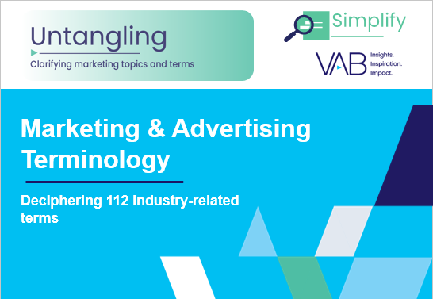
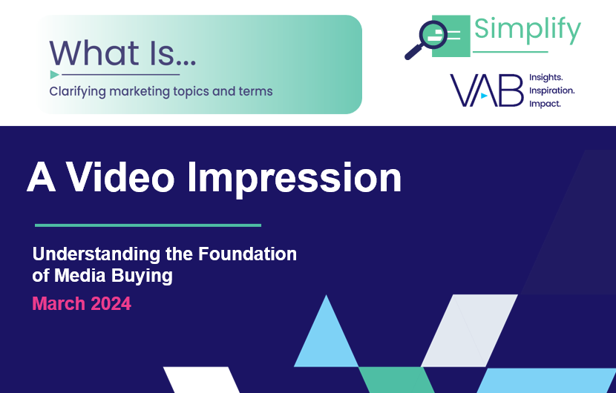

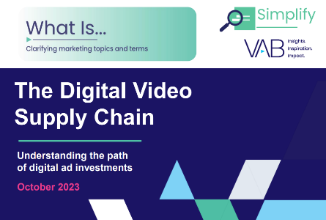
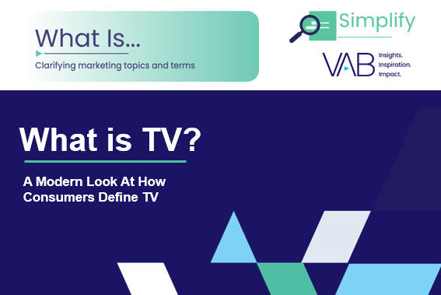
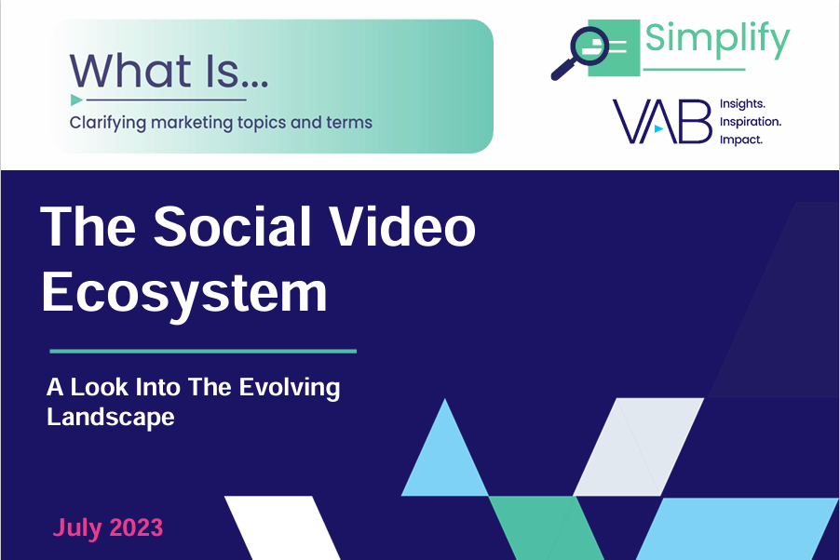
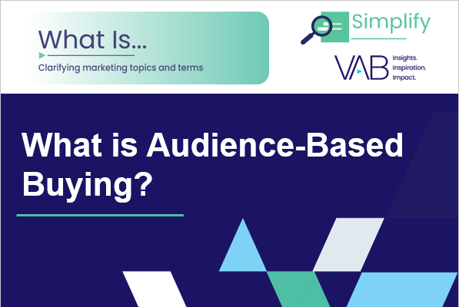
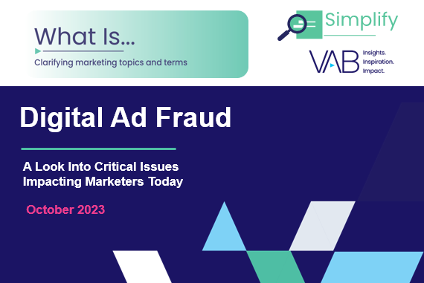

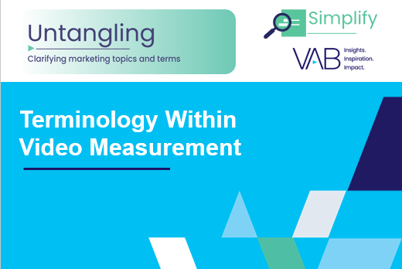

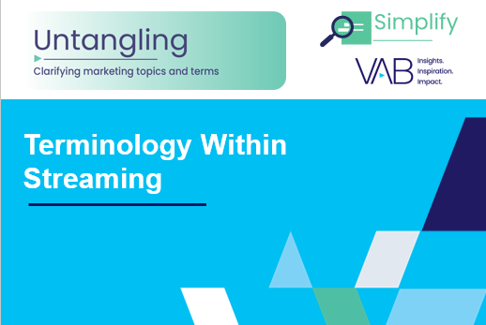

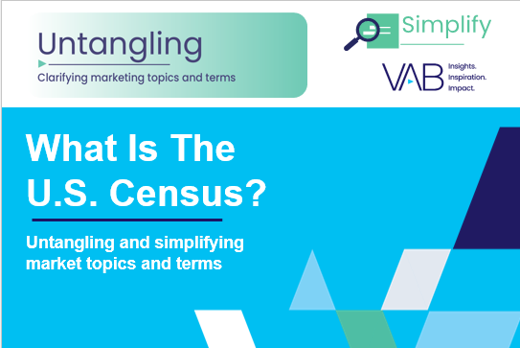
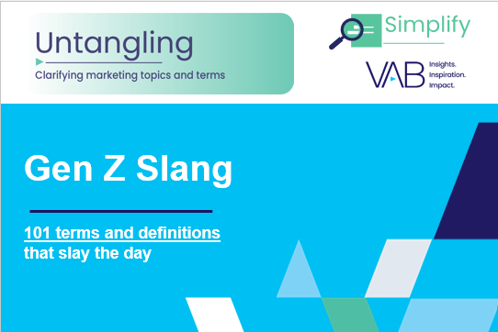


Looking for more industry terminology?
Click on the images below to download
VAB’s advertising glossaries cover topics like generative AI & machine learning, video measurement, data / identity / privacy, audience-based buying, TV ecosystem and streaming.
PAGE 14
This information is exclusively provided to VAB members and qualified marketers.

Slide 15
About VAB
VAB is an insights-driven organization that inspires marketers to reimagine their media strategies resulting in fully informed decisions.
Drawing on our marketing expertise, we simplify the complexities in our industry and discover new insights that transform the way marketers look at their media strategy.
We are committed to your business growth and proud to offer VAB members, brand marketers and agencies complimentary access to our continuously-growing Insights library.
Get immediate access at theVAB.com.
Sources
The Myers Report 2023 Survey of 4,200 Advertising Agency and Brand Media Decision-Makers and Influencers; 4,200 respondents. Fieldwork August/September 2023.
Simulmedia, Audience Deficiency Unit (ADU), June 2024.
Department of Homeland Security, ‘Handbook for Safeguarding Sensitive PII’, December 2017. *ARF (Advertising Research Foundation), ‘6th Annual Privacy Study (2023).’CMO Council via eMarketer, Cracking Tomorrow’s CK Code, 12/8/2022.
Definition Sources (reference pieces used in the development of several definitions)
IBM, What is an API (application programming interface)?, 4/9/2024.
IBM, SDK versus. API: What’s the difference?, 7/13/2021.
Hubspot, Confused about Customer Acquisition Cost? I Asked Experts About CAC to Help, 6/20/2024.
Sprout Social, CPC (Cost per click), 2024.
Adjust, What is Media Mix Modeling?, 2024.
Mailchimp, SERP, 2024.
Ahrefs, What Is IMC? Integrated Marketing Communications Explained, 3/7/2024.
PAGE 15
This information is exclusively provided to VAB members and qualified marketers.

