Slide 1




5 Reasons Why Marketers Invest Billions in Linear TV

Slide 2






5 Key Reasons Marketers Invest Billions in Linear TV
As multiscreen TV continues to deliver full-funnel outcomes, marketers are poised once again to invest billions of dollars to secure premium video inventory for the upcoming TV season.
1
2
3
4
5
Fuels the customer pipeline faster resulting in more conversions and sales
Inspires trial among more new customers
Turns brands into household names, leading to more revenue
Increases customer loyalty and repeat purchase
Protects and strengthens your brand
This information is exclusively provided to VAB members and qualified marketers. Further distribution is prohibited.
PAGE 2

Slide 3

1
Linear TV fuels the customer pipeline faster resulting in
more conversions & sales

Slide 4
Ad-supported TV offers immediate scale, reaching 8 out of 10 homes in an average month
Source: VAB analysis of Nielsen NPower R&F Time Period, ad-supported TV (broadcast TV & cable TV), total day, live+SD, April broadcast month (3/28/22 – 4/24/22). Average daily reach is based on the average of daily reach for each day across the broadcast month, average weekly reach is based on the average of weekly reach for each week across the broadcast month.
This information is exclusively provided to VAB members and qualified marketers. Further distribution is prohibited.
PAGE 4

Slide 5


As a result of this scale, TV campaigns ignite immediate consumer impact and action which drives significant lifts in website traffic, especially for younger brands
Click here for the full report
“When On TV” Monthly Average vs. Three-Month Average Prior To TV*
Average Website Unique Visitors
Brands Three Years Old or Younger
Brands Between
Four – Seven Years Old
Brands Eight Years or Older
+138%
+72%
+23%
Unique Visitors % increase:
Unique Visitors increase:
+811K
+1,383K
+803K
Regardless of life stage, brands see a double-digit increase in unique visitors to their digital platforms during active TV campaign months
Source: VAB analysis of Nielsen Ad Intel data, TV spend (national cable TV, national broadcast TV, Spanish language broadcast TV, Spanish language cable TV, spot TV, syndicated TV), Jun ‘16 – Jun ’20 (calendar months). VAB analysis of Comscore mediametrix multiplatform (desktop + mobile) media trend data; P18+, Jun ’16 – Jun ‘20 (calendar months). *Reflects the 140 ‘direct-to-consumer’ brands analyzed within 'The Halo Effect: TV As A Growth Engine.'
This information is exclusively provided to VAB members and qualified marketers. Further distribution is prohibited.
PAGE 5

Slide 6
2
Linear TV inspires trial among more new customers

Slide 7

Prioritizing immediate consumer response and conversion,
the escalating investment by data-driven DTC advertisers illustrates linear TV’s ability to trial
Click here for the full report
30 ‘Direct-to-Consumer’ Brands*: Total Rolling Cume TV Spend
(spending aggregated across years within time period)
in millions
Annual TV Spend (MM):
$28
$36
$158
$337
$395
$554
$495
$803
$1,040
$811
$141
Sources: VAB analysis of Nielsen Ad Intel data, CY 2010 – Q1 2021. TV spend includes national broadcast TV, cable TV, Spanish language broadcast TV, Spanish language cable TV, spot TV, syndication TV. Reflects the total annual TV spend across the 30 brands analyzed. Cume TV spend = the rolling totals aggregated across each year. Recent TV spend reflects a 31% compound annual growth rate (CAGR) of cume TV spend between calendar years 2016 – 2020 (i.e., mean annual growth of TV spend across the time period). Impact on advertising figures based on data from Ebiquity, ‘Advertising Through a Recession,’ April 2020. *Reflects the 30 ‘direct-to-consumer’ brands analyzed within ‘The Secret of My Success.’
This information is exclusively provided to VAB members and qualified marketers. Further distribution is prohibited.
PAGE 7

Slide 8


The exposure to a broader audience from TV results in the influx of new customers through a brand’s ‘digital storefront’
Click here for the full report
Unique Website Visitors: 30 Brand Average*
1Q ’17**
(Monthly Avg)
1Q ‘21
(Monthly Avg)
1Q ‘21 vs. 1Q ‘17
(Monthly Avg)
Median Age
43.2
49.9
+6.7 years
Total U.S. Internet Avg
44.3
45.2
+0.9 years
P50+ Comp %
37.6%
51.7%
+14.1% pp
Total U.S. Internet Avg
39.7%
42.2%
+2.5 pp
By targeting their best potential customers, regardless of age or other demographic buying restrictions, brands can tap into additional sources of volume such as older Americans
Source: VAB analysis of Comscore mediametrix multiplatform media trend data, P18+. 1Q ’17: January – March ‘17, 1Q ‘21: January – March ‘21 (calendar months), monthly average within each quarter, P50+ comp% is based on monthly unique visitors; figures are based on monthly averages for each 3-month time period across the 30 brands analyzed. **1Q ‘17 (Jan-Mar ‘ 17) is reflective of the first 3-month measurement period available and is inclusive of a few brands that were first measured after this time period, based on their first 3-month measurement period. Note: Comscore did not begin measuring ‘median age’ as a reported metric until February ‘17, therefore the first time period reflects Feb-Apr ‘17.
PP = percentage points. *Reflects the 30 ‘direct-to-consumer’ brands analyzed within ‘The Secret of My Success.’
This information is exclusively provided to VAB members and qualified marketers. Further distribution is prohibited.
PAGE 8

Slide 9



By optimizing their TV campaigns against the best performing target segments, brands drive clear business results through increased digital engagement
Click here for the full report
Key Website Metrics: 30 Brand Average*
Jan-Mar ‘21 vs. Jan-Mar ’17: Three-Month Avg Comparison
Unique Visitors (000)
Total Visits (000)
Total Minutes (MM)
# Difference
+3,156
+22,184
+95
% Difference
+63%
+135%
+89%
Total U.S. Internet Avg
% Difference
+10%
+26%
+34%
Source: VAB analysis of Comscore mediametrix multiplatform media trend data, P18+. January – March ’17, January – March ‘21 (calendar months), figures are based on averages across the 30 brands analyzed. *Jan-Mar ’17 is reflective of the first 3-month measurement period and is inclusive of brands that were not Comscore measured until later into 2017. *Reflects the 30 ‘direct-to-consumer’ brands analyzed within ‘The Secret of My Success.’
This information is exclusively provided to VAB members and qualified marketers. Further distribution is prohibited.
PAGE 9

Slide 10
3
Linear TV turns brands into household names, leading
to more revenue

Slide 11















New brands looking to disrupt a category and steal share from the incumbent rely on the authority implied by a TV campaign to legitimize themselves with consumers
iSpot.tv: ‘Direct-to-Consumer’ Custom Category Nat’l TV Spend
(in millions)
Top 15 DTC TV Advertisers
cume spend 2018 – 2021 (in millions)
+17%
+19%
($413.4)
($319.9)
($319.7)
+5%
($304.1)
($266.8)
($185.3)
($180.9)
($180.5)
($175.7)
($175.6)
($163.8)
($160.3)
# of Brands:
151
187
193
249
($151.3)
($142.5)
($126.9)
Source: VAB analysis of iSpot.tv national TV spending data (broadcast TV & cable TV), calendar years 2018 – 2021, custom ‘direct-to-consumer’ category.
This information is exclusively provided to VAB members and qualified marketers. Further distribution is prohibited.
PAGE 11
PAGE 11

Slide 12
























In the last 3 years, 700+ new advertisers invested over
$3.4 billion in national TV during their launch year to establish their unique brand identities and value to consumers
Click here for the full report
New National TV Advertisers
2019 - 2021 Comparison
 | 2019 | 2020 | 2021
# of New Advertisers | 114 | 283 | 315
Total $$$ (in millions) | $843.4 | $1,279.1 | $1,320.2
New Brand Entrants to National TV
(in millions)
($92.7)
($60.3)
($12.5)
($46.9)
($34.9)
($11.6)
($9.0)
($16.5)
($12.8)
($8.8)
($17.0)
($6.8)
($24.9)
($6.1)
($5.9)
($9.0)
($7.0)
($6.5)
($5.8)
($5.5)
($3.8)
($3.4)
($2.7)
Source: VAB analysis of Nielsen Ad Intel data, 1/1/19-12/31/19 vs. 1/1/20-12/31/20 vs. 1/1/21-12/31/21. TV spend includes national cable TV, broadcast TV, Spanish language cable TV, Spanish language broadcast TV. Brands reflect those with national TV spend over $100K. MM = millions. TV spend by brand reflects $$$ invested in their national TV launch year, in millions. For more information, download: Welcome to TV 2019, Welcome to TV 2020, Welcome to TV 2021.
This information is exclusively provided to VAB members and qualified marketers. Further distribution is prohibited.
PAGE 12
PAGE 12

Slide 13






By establishing themselves as household names, these brands have experienced significant sales growth in line with their investment
Click here for the full report
Time Period
CAGR*
Brand
2017
2020
U.S. Revenue (000)
$230,106
$485,028
+28%
Rolling Cume TV Spend (000)
$18,777
$119,923
+86%
U.S. Revenue (000)**
$26,679
$148,757
+136%
Rolling Cume TV Spend (000)**
$18,192
$89,899
+122%
U.S. Revenue (000)**
$285,791
$648,471
+51%
Rolling Cume TV Spend (000)**
$140,422
$289,878
+44%
U.S. Revenue (000)
$370,036
$886,093
+34%
Rolling Cume TV Spend (000)
$10,080
$72,878
+93%
U.S. Revenue (000)
$4,153,057
$11,900,658
+42%
Rolling Cume TV Spend (000)
$105,794
$450,889
+62%
U.S. Revenue (000)
$1,076,794
$3,339,817
+46%
Rolling Cume TV Spend (000)
$44,180
$155,449
+52%
Sources: Revenues are based on company filings (S-1 & 10-K) via sources such as SEC.gov (EDGAR) and S&P Global Market Intelligence. TV spend based on VAB analysis of Nielsen Ad Intel data (national cable TV, national broadcast TV, Spanish language broadcast TV, Spanish language cable TV, spot TV, syndication TV). For comparison purposes, rolling cume TV spend based only on the time period between CY 2017-2020, with 2020 cume TV spend based on aggregated spending across the time period beginning in CY 2017. Casper revenues are based on North America (except when noted otherwise**). *CAGR = compound annual growth rate (i.e., mean annual growth across the time period). **hims and Purple launched their first measured TV campaign in 2018, therefore rolling cume TV spend and U.S. revenues are based on the time period between CY 2018-2020, with 2020 cume TV spend based on aggregated spending across the time period beginning in CY 2018.
This information is exclusively provided to VAB members and qualified marketers. Further distribution is prohibited.
PAGE 13
PAGE 13

Slide 14
4
Linear TV increases customer loyalty and repeat purchase

Slide 15



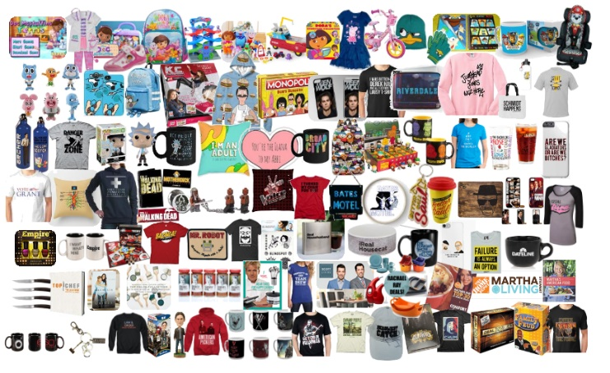

The deep relationship that viewers have with TV programming instills loyalty which inspires and influences their purchasing decisions
Click here for the full report
“I purchased a product that has been shown / featured on a TV show”
“I have eaten at a restaurant because it, or its chef / owner, was featured on a TV show”
“Purchase a product I saw while watching a TV program (either a product I saw in an ad or in the actual program)”
“I have visited a location / vacationed at a place because it was featured on a TV show”
43% / 40%
43% / 37%
43% / 25%
40% / 33%
Millennials
Adults
Source: VAB / Dynata “Program Engagement” Survey, April 2018. Q9: Please indicate how often you do the following. Purchase a product I saw while watching a TV program (either a product I saw in an ad or in the actual program). Respondents Answer = Always/Frequently. Q10: Which of the following statements are true for you? Check any that apply. Adults = A18+, Millennials = A18-34. Total Respondents=1,001. For more information, download: Committed.
This information is exclusively provided to VAB members and qualified marketers. Further distribution is prohibited.
PAGE 15
PAGE 15

Slide 16





TV has such a strong influence on consumers because it
fosters a highly emotional connection for viewers of all ages
Click here for the full report
“I Have Laughed Out Loud Because Of Something That Happened On A TV Program”
“I Sat Through An Episode Of A TV Program In Anticipation / Worry About What's Going To Happen Next”
“A Cliffhanger Ending Has Shocked Me”
“I Have Cried Because Of A Character's Death On A TV Program”
“I Have Gotten Angry Or Upset About A Plot Twist On A TV Program”
Millennials
73%
65%
54%
53%
51%
Adults
78%
59%
52%
45%
43%
Millennials
Adults
Source: VAB / Dynata, “Program Engagement” Survey, April 2018. Q8: Which of the following statements are true for you? Check any that apply. Adults = A18+, Millennials = A18-34. Total Respondents=1,001. For more information, download: Committed.
This information is exclusively provided to VAB members and qualified marketers. Further distribution is prohibited.
PAGE 16
PAGE 16

Slide 17


Savvy brands can harness this engagement and loyalty
to create an audience-based TV buying target, which will positively impact their KPIs throughout the purchase funnel
Click here for the full report
Most Impactful KPIs of Audience-Based Buying of TV Advertising
% who answered ‘very impactful’ or ‘extremely impactful’
Full-Funnel
Full-Funnel
Full-Funnel
Source: VAB / Advertiser Perceptions ‘Audience-Based Buying Survey,’ fielded March 23 – 31, 2021. Survey base: Advertising decision-makers who are involved in buying or planning digital video, cable / broadcast TV, or advanced TV (n=211). Q150. To what extent do you believe audience-based buying of TV advertising can impact each of the following KPIs? (extremely impactful / very impactful). Base: Total Respondents. *such as site visits, sign ups, login ins, downloads. For more information, download: The VAB Top 10.
This information is exclusively provided to VAB members and qualified marketers. Further distribution is prohibited.
PAGE 17
PAGE 17

Slide 18
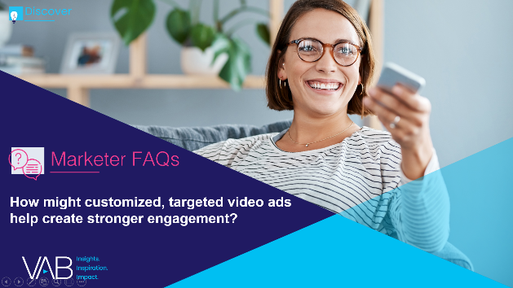



The relevant, personalized messaging delivered through audience-based TV buying is more likely to lead consumers
to become purchasers and brand advocates
Click here for the full report
% of consumers who are more likely to…
Purchase
Repurchase
Recommend
76%
78%
78%
Consider purchasing from brands that engage with them in a personalized and tailored way
Repurchase from brands that offer personalized communications and products / services
Recommend brands to their friends and family that offer personalized communications and products / services
Source: McKinsey & Company, Next in Personalization 2021 Report. Based on consumer survey fielded 9/7/2021-9/8/2021 (n=1,013), sampled and weighted to match the US general population 18+. Question: “Please indicate how much you agree or disagree with the statements below when it comes to personalized communications and products/services from brands/businesses.”; Purchase: “I am more likely to consider buying from brands/businesses that engage with me in a personalized and tailored way.”; Repurchase: “I am more likely to repurchase from brands/businesses that offer personalized communications and products/services.”; Recommend: “I am more likely to recommend brands/businesses to my friends and family that offer personalized communications and products/services.” Numbers shown indicate respondents that selected “somewhat agree”, “agree” and “strongly agree”.
This information is exclusively provided to VAB members and qualified marketers. Further distribution is prohibited.
PAGE 18
PAGE 18

Slide 19
5
Linear TV protects and strengthens your brand

Slide 20
Consumers rank Television as one of the top, most trusted, advertising formats for making purchasing decisions, well above other digital media
Source: Harvard Business Review, 'Why Marketers Are Returning to Traditional Advertising, April 29, 2022. Survey conducted with 1,200 U.S. consumers by MarketingSherpa in October 2016.
This information is exclusively provided to VAB members and qualified marketers. Further distribution is prohibited.
PAGE 20
PAGE 20

Slide 21

With its trust, brand safe environment and ability to drive outcomes through the funnel, more than half of advertisers identify linear TV as their single most valuable video tactic today
Click here for the full report
All Video Advertising Tactics Used
Summary of Top Rank
Any Linear TV:
51%
Source: Advertiser Perceptions, Video Advertising Convergence Report, Wave 9, 2H 2020, released February 2021. For more information, download: Beyond the Headlines.
This information is exclusively provided to VAB members and qualified marketers. Further distribution is prohibited.
PAGE 21
PAGE 21

Slide 22









During times of economic uncertainty, marketers that focus on long-term branding efforts by increasing (or at least maintaining) TV ad investment achieve positive business outcomes
Click here for the full report
Business outcome examples of brands who increased their TV spend during the 2008-2009 recession
Ecommerce
Retail
Telecommunications
Restaurants
Amazon launched its first TV campaign in the middle of the recession in 2008 and saw a compound annual growth rate of 34% between 2008-2012
Walmart significantly increased their TV investment in both 2008 & 2009 and saw high single digit sales increases
in each year with continued growth after the recession
T-Mobile had a moderate increase in their TV investment in both 2008 & 2009 and saw a compound annual growth rate of 21% between 2008-2011
Darden increased their TV investment in both 2008 & 2009 and increased their sales by an average of 14%
over those two years
Source: VAB’s ‘Keep Calm and Advertise On: How to Successfully Navigate Your Brand Through an Economic Downturn.’ U.S. TV spend based on VAB analysis of Nielsen Ad Intel data, national TV spend (national cable TV, national broadcast TV, Spanish language broadcast TV, Spanish language cable TV), CY 2007-2012. U.S. revenues are based on company filings (10-K) for U.S. revenue via SEC.gov (EDGAR). Darden’s was for Olive Garden. For more information, download: Keep Calm and Advertise On.
This information is exclusively provided to VAB members and qualified marketers. Further distribution is prohibited.
PAGE 22
PAGE 22

Slide 23

In 2021, the Tech Giants collectively spent over $3 billion on TV, their highest level ever, as they aggressively defended their SOV from competitors and supported new product launches
Click here for a related report
MAAMA U.S. TV Spend
($$$ in Millions)
$2,989.0
$3,128.1
+18%
$2,660.9
+18%
$2,530.2
+33%
-11%
$2,049.8
$1,904.5
$1,551.3
+32%
-7%
Source: VAB analysis of Nielsen AdIntel, calendar year 2015-2021, as of February 2022. TV spend includes cable TV, broadcast TV, Spanish language cable TV, Spanish language broadcast TV, spot TV, and syndicated TV. U.S. TV spend only.
This information is exclusively provided to VAB members and qualified marketers. Further distribution is prohibited.
PAGE 23
PAGE 23

Slide 24
Key Takeaways For Marketers
TV Fuels The Customer Pipeline Faster
TV Inspires Trial Among More New Customers
TV Turns Brands Into Household Names
TV Increases Loyalty and Repeat Purchases
TV Protects and Strengthens Your Brand
The immediate scale of TV allows brands to ignite consumer action. This impact creates a halo effect on the performance of other marketing channels, improving overall campaign effectiveness and efficiency.
By embracing a ‘total audience’ buying mindset against best prospects, brands can bring an influx of new customers to their online and offline storefronts.
Many brands are investing significantly in TV to legitimize their products or services, establish their identity in consumers’ minds and gain fame to drive sales growth.
TV programming elicits a strong emotional reaction, which halos on to the advertising resulting in increased brand attention, loyalty and likelihood to purchase. That loyalty can be further monetized through audience-targeted TV buying of best customer prospects.
TV is one of the most trusted advertising formats and, as such, is an important platform for marketers to connect with consumers, especially in economically challenging or competitive environments.
This information is exclusively provided to VAB members and qualified marketers. Further distribution is prohibited.
PAGE 24

Slide 25











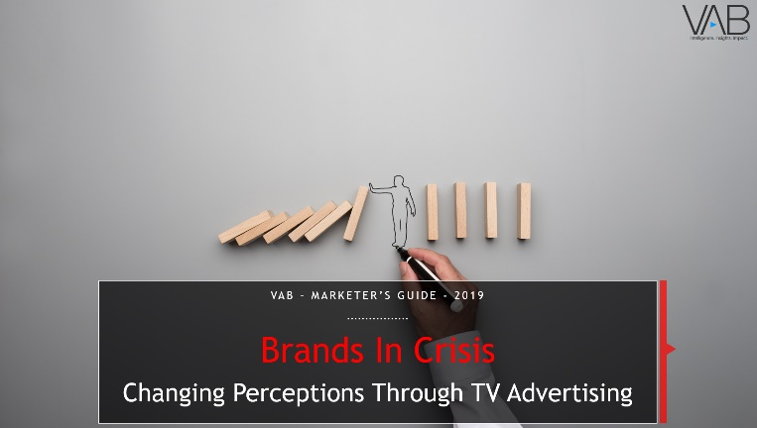
Jason Wiese
Reed Kiely
SVP, Director of Strategic Insights
jasonw@thevab.com
Associate Insights Director
reedk@thevab.com
Leah Montner-Dixon
Karolina Guillen
Associate Insights Director
leahm@thevab.com
Insights Manager
karolinag@thevab.com
Discover more
Looking for more data, insights and takeaways? Check out this related VAB content
VAB Members, brand marketers and agencies get free and immediate access to VAB’s content library. Get access at theVAB.com
This information is exclusively provided to VAB members and qualified marketers. Further distribution is prohibited.
PAGE 25

Slide 26


About VAB
VAB is an insights-driven organization that inspires marketers to reimagine their media strategies resulting in fully informed decisions.
Drawing on our marketing expertise, we simplify the complexities in our industry and discover new insights that transform the way marketers look at their media strategy.
We are committed to your business growth and proud to offer VAB members, brand marketers and agencies complimentary access to our continuously-growing Insights library. Get immediate access at theVAB.com.
Curious to learn more about VAB? Check out this quick video to see what we do and how we can help you develop business-driving marketing strategies.
This information is exclusively provided to VAB members and qualified marketers. Further distribution is prohibited.
PAGE 26

