Slide 1
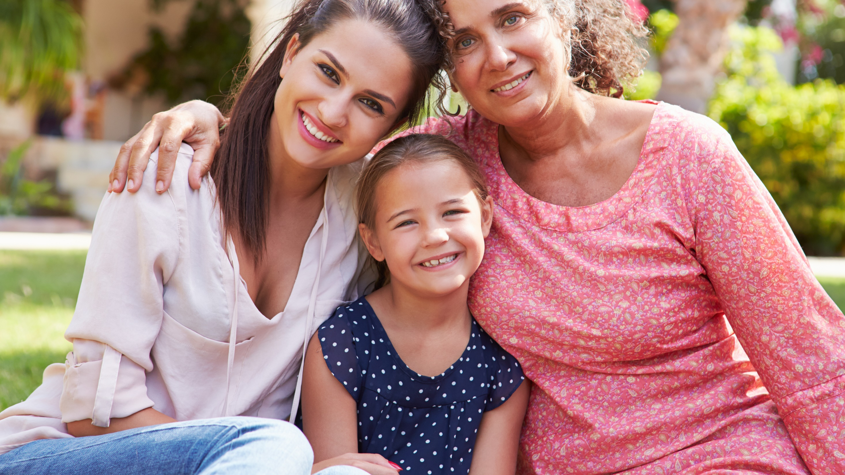




Marketer FAQs
How can my brand leverage the strength
of the rising Latina consumer through video?

Slide 2
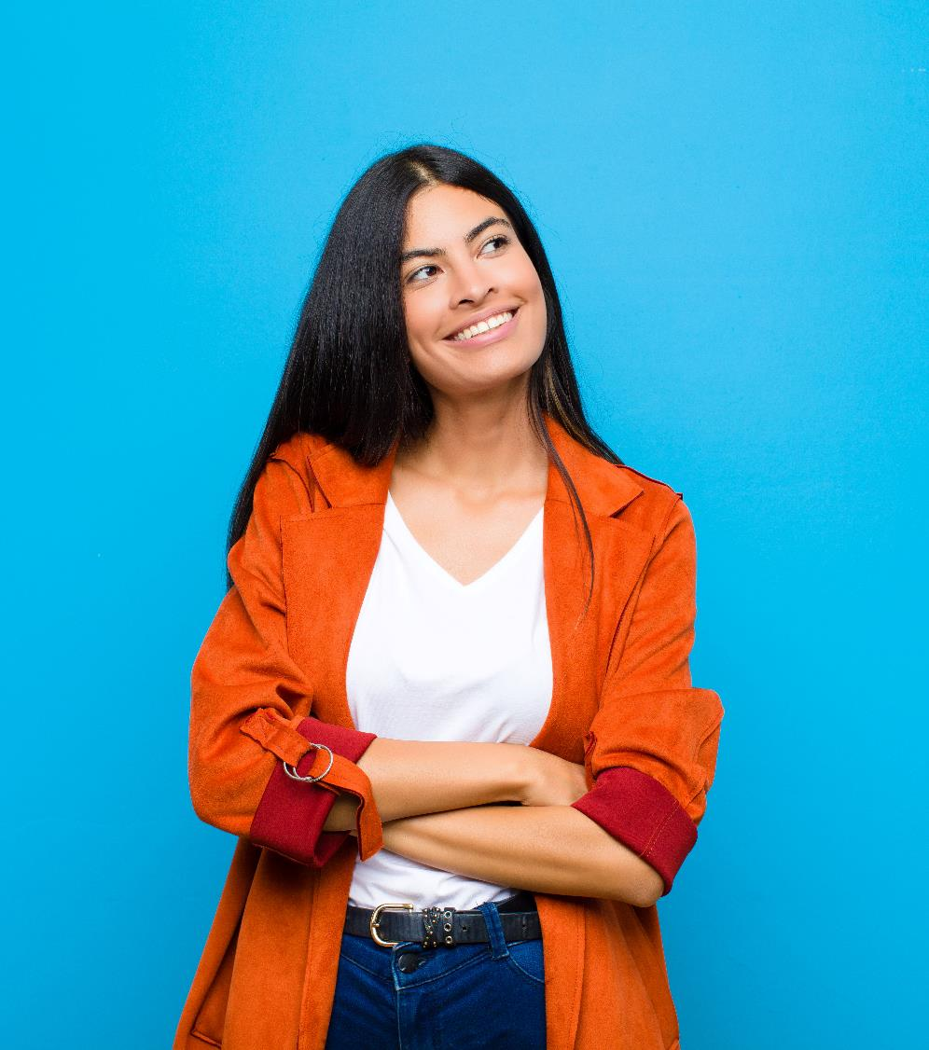
Adults over 50 account for 36% of the total population and nearly half of all adults
Marketer FAQs
Latina Americans are established influencers and household decision-makers. Today, nearly one in five U.S. women is Hispanic, and their buying power is growing, fueled by higher education and a robust workforce.
Driven by their voracious appetite for content and love for their heritage, Latinas crave more programming with characters and stories that accurately reflect their experiences and are more attentive to brands who also embrace their cultural duality.
We explore how marketers can connect authentically through relevant video content and advertising that conveys relatable stories to gain the trust of the highly influential Latina consumer while driving positive business results for their brand.
*Please note in this report, we use the terms ‘Latina’ and ‘Hispanic women’ interchangeably.
This information is exclusively provided to VAB members and qualified marketers. Further distribution is prohibited.
PAGE 2

Slide 3





From their household finances to their rising wealth, Latinas hold major influence and are a highly desirable consumer for marketers looking to engage with a loyal, culturally-minded audience
Latinas are a major influence on their household’s finances
Their buying power is rising, fueled by greater education and employment
They are growing at a fast rate and making up for a larger portion of the population
As voracious video viewers, they crave more in-language content & greater representation
They are more loyal to brands who advertise with their cultural diversity in mind
44% of Hispanic women make decisions about household savings and investments
(vs. 36% of non-Hispanic women)
Average income for Hispanic women has grown +38%
(2010 vs. 2020)
Employment has increased +65% (2002 vs 2020)
The number of Hispanic women 18+ with a bachelor’s degree or higher has increased +108%
(2002 vs 2020)
Nearly 1 in 5 women in the U.S. is Hispanic
U.S. Hispanic female pop increased +78%
(2000 vs 2020)
(Non-Hispanic White female pop: +0.3% b/t 2000 and 2020)
52% of Latinas wish there was more Spanish-language content to stream
59% of Latinas are more likely to be loyal to a company that advertises in Spanish
(+93% increase b/t 2018 and 2021)
Source: Telemundo, Latinas Powering Forward, 2019. VAB analysis of U.S. Census Bureau Data, Current Population Survey, 2011 & 2021 Annual Social and Economic Supplement; reflects income for Hispanic women 15+. VAB analysis of Bureau of Labor Statistics data, Employment Status of the Hispanic or Latino population by age and sex, 2002, 2020; reflects employment among Hispanic women 16+. VAB analysis of U.S. Census Bureau data, Current Population Survey, 2010 & 2020 Annual Social and Economic Supplement. VAB analysis of MRI-Simmons November 2021 Cord Evolution study & MRI Fall Study 2018 & 2021, Base = any agree.
This information is exclusively provided to VAB members and qualified marketers. Further distribution is prohibited.
PAGE 3

Slide 4








As ‘Super Shoppers,’ Latinas are more likely to act as household decision-makers, and typically live in larger households compared to non-Hispanic women, presenting an outsized opportunity for marketers across categories
Latina buyer growth by category
2018 vs. 2014
3.8
Investments
+247%
vs. +78% of NH women
Alcoholic Beverages
+26%
vs. +6% of NH women
Bottled Water
+21%
vs. +9% of NH women
Mobile
+18%
vs. +13% of NH women
Average household size among Hispanic women
(vs. 2.8 among
non-Hispanic women)
Automotive
+15%
vs. +1% of NH women
Casual Dining
+13%
vs. +3% of NH women
Makeup
+12%
vs. +4% of NH women
Department Store
+9%
vs. +1% of NH women
Source: VAB analysis of MRI-Simmons Fall 2021 Doublebase (average household size). Telemundo, Latinas Powering Forward, 2019 (buyer growth by category).
This information is exclusively provided to VAB members and qualified marketers. Further distribution is prohibited.
PAGE 4

Slide 5

“Latinas support companies who are vested in priorities and values that matter most to them… Businesses have a unique opportunity to stand for something that genuinely matters to the lives of Latinas as they go through challenging times. If a brand wants to gain her admiration, respect and dollar, then there are important actions that can have a lasting effect on brand reputation.”
Monica Gil, EVP, Chief Administrative and Marketing Officer at NBCUniversal Telemundo Enterprises
(NextTV’s Latinas Powerful But Still Underrepresented in Media, 11/19/19)
This information is exclusively provided to VAB members and qualified marketers. Further distribution is prohibited.
PAGE 5

Slide 6
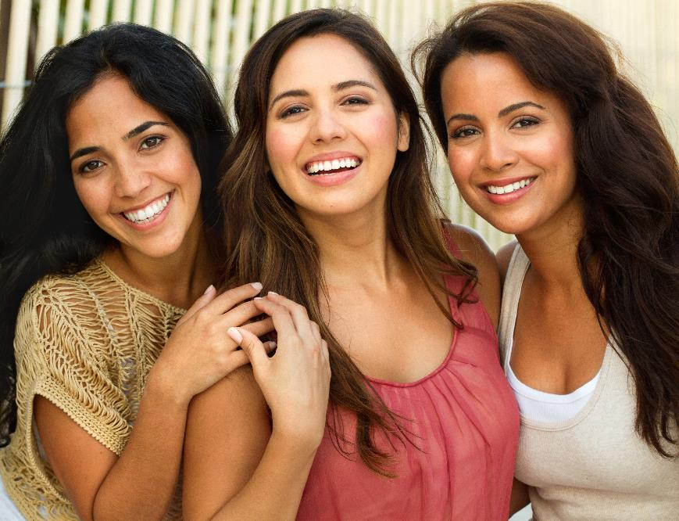


It’s crucial for brands to appeal to Hispanic women who are loyal consumers and value authentic campaigns with their individuality in mind
79% of Latinas believe that their cultural / ethnic heritage is an important part of who they are, and by implementing culturally diverse messaging into their campaigns, brands can gain their trust and loyalty more authentically
79%
of Hispanic women 18+ believe
‘It is important for companies to create advertising that is culturally diverse in order to stay relevant’
Source: VAB analysis of MRI-Simmons Fall 2021 Doublebase. Base = Any agree.
This information is exclusively provided to VAB members and qualified marketers. Further distribution is prohibited.
PAGE 6

Slide 7



As Latinas have grown into an established consumer segment,
they appreciate when brands cater to their diversity and embrace
their cultural roots
% of Hispanic women who agree with the following statements
53%
‘When a product or service is advertised in Spanish, I am more likely to pay attention to the advertisement and remember it later’
+97% growth in % of Latinas who agree
(2018 vs. 2021)
69%
‘I believe that companies who advertise in Spanish respect my culture and want my business’
+97% growth in % of Latinas who agree
(2018 vs. 2021)
59%
‘I am more likely to be loyal to a company that makes an effort to advertise in Spanish’
+93% growth in % of Latinas who agree
(2018 vs. 2021)
Source: VAB analysis of MRI-Simmons Fall Study 2018 & 2021. Base = Hispanic women 18+, any agree.
This information is exclusively provided to VAB members and qualified marketers. Further distribution is prohibited.
PAGE 7

Slide 8

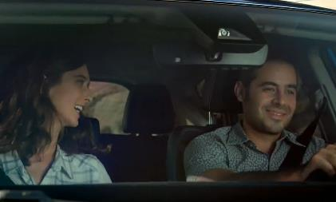
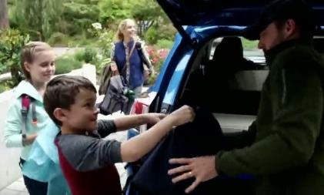
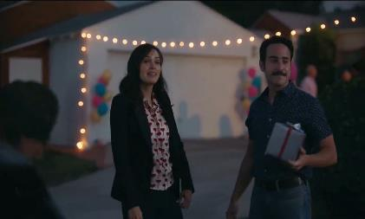
For example, a combination of Spanish-language ads and messaging surrounding female empowerment aided Toyota RAV4 in becoming the best-selling SUV in America
RAV4 is now not only Toyota’s highest selling nameplate in the U.S. but it’s the best-selling SUV in America and, during their ascendancy, diversity and inclusion has been featured prominently in their advertising campaigns. The brand casts people of all ethnicities within their spots and have created a host of Spanish-language ads.
Results: 2019 was Toyota RAV4’s highest annual unit sales ever and marked their eighth straight year of successive unit growth. In fact, RAV4 sold 130K+ units more than they did five years ago in 2015. Their Hybrid model is doing particularly well, posting a 92% increase YoY.
13 Spanish-Language TV spots - $22.6 MM
Various Flights: 1/12/16 – 3/29/20
7,018 Airings / 933.8 MM HH IMPs
Business Outcomes
Annual U.S. Unit Sales: +42% increase
in RAV4 vehicles sold annually in the U.S. over the last five years between 2015 and 2019 (315,142 vs. 448,071).
click image above to watch spot
click image above to watch spot
click image above to watch spot
Source: VAB analysis of iSpot.tv TV occurrence data, time period: 1/1/16 – 6/30/20, estimated media spend. Impressions represent US TV HHs and include activity within measured national broadcast and cable TV linear, national time-shifted, local, VOD and OTT. Revenues are based on Toyota Motor North America’s U.S. Sales Annual Summaries available through their online news pressroom portal. To learn more, download Do The Right Thing: How diversity & inclusion drives brand outcomes.
This information is exclusively provided to VAB members and qualified marketers. Further distribution is prohibited.
PAGE 8

Slide 9

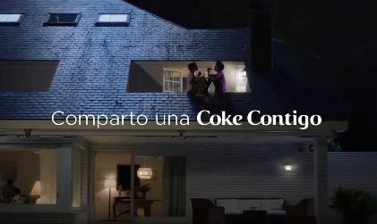
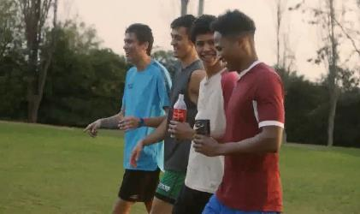

Another successful campaign saw Coca Cola achieve immediate and prolonged sales lift upon the reintroduction of the brand’s inclusivity-focused ‘Share a Coke’ program with multiple Spanish-language ads
Leading into the summer of 2017, Coca-Cola reintroduced its successful ‘Share a Coke’ program, rebranded ‘Share an ICE COLD Coke,’ by featuring a diverse mix of last names (including Garcia, Rodriguez, Lopez) in addition to bringing back even more first names on 20-ounce bottles across their portfolio. The supporting ad campaign, in both English and Spanish, was targeted towards millennials and featured younger, more multicultural, people across all ethnicities with a message focus of inclusivity (i.e., sharing a coke).
Results: Coca-Cola saw an immediate +7% lift in quarterly sales once the new campaign launched during 2Q ’17 and average quarterly sales growth (based on percentage) almost doubled in Year Two of the campaign, even with a higher sales base from the previous year.
Business Outcomes
North America Net Revenues:
1Q ‘17 vs PY: +2%
2Q ‘17 (‘Share an ICE COLD Coke’ launches ) vs. PY: +7%
3Q ‘17 vs. PY: +4%
4Q ‘17 vs. PY: +5%
1Q ‘18 vs. PY: +10%
2Q ‘18 vs. PY: +6%
3Q ‘18 vs. PY: +11%
4Q ‘18 vs. PY: +8%
‘Share A Coke’ campaign (two Spanish-language TV spots) - $7.5 MM
Airings Throughout 15 Months: 4/27/17 – 7/30/18
1,299 Airings / 278.2 MM HH IMPs
click image above to watch spot
click image above to watch spot
click image above to watch spot
Source: VAB analysis of iSpot.tv TV occurrence data, time period: 1/1/16 – 6/30/20, estimated media spend. Impressions represent US TV HHs and include activity within measured national broadcast and cable TV linear, national time-shifted, local, VOD and OTT. Revenues are based on quarterly company filings (10-Q) for North American revenue (Coca-Cola does not report at the United States geographical level) via SEC.gov (EDGAR). Click each image to watch spot. To learn more, download Do The Right Thing: How diversity & inclusion drives brand outcomes.
PY = Previous Year (same quarter)
This information is exclusively provided to VAB members and qualified marketers. Further distribution is prohibited.
PAGE 9

Slide 10
Similar to how they feel about representation in advertising, as Latinas rise in influence, they desire more accurate and relatable portrayals
of themselves in the content they love

Slide 11
“I yearn for the day that Latinas will be represented in the media,
at least, as often as we are a part of real life. When that day comes, we will have more opportunities to offer varied and authentic portrayals of who we are. But because we’re not there yet, it becomes all the more important to make sure that the ways we are actually being portrayed are accurate, authentic, multi-layered, and have the depth and nuance that Latinas embody.”
- Gloria Estefan
Write Her Right: ANA SeeHer movement & NBCUniversal Telemundo Enterprises, 2021
This information is exclusively provided to VAB members and qualified marketers. Further distribution is prohibited.
PAGE 11

Slide 12


Living in larger households, Latinas experience more active, social and dynamic lives, making TV viewing a communal experience centered around engaging content they can enjoy and talk about with their families
% of Hispanic women who agree with the following statements
‘Latinas enjoy group-viewing experiences that bring together family and friends around soccer matches, boxing, novellas and movies.’
– Telemundo: Latinas Powering Forward, 2019
72%
‘I typically stream shows with others (family or friends)’
+15% more likely than
non-Hispanic women (62%)
49%
‘I like to stream live sports’
+34% more likely than
non-Hispanic women (37%)
Source: VAB analysis of MRI-Simmons November 2021 Cord Evolution Study. Base = any agree. Telemundo, Latinas Powering Forward, 2019.
This information is exclusively provided to VAB members and qualified marketers. Further distribution is prohibited.
PAGE 12

Slide 13
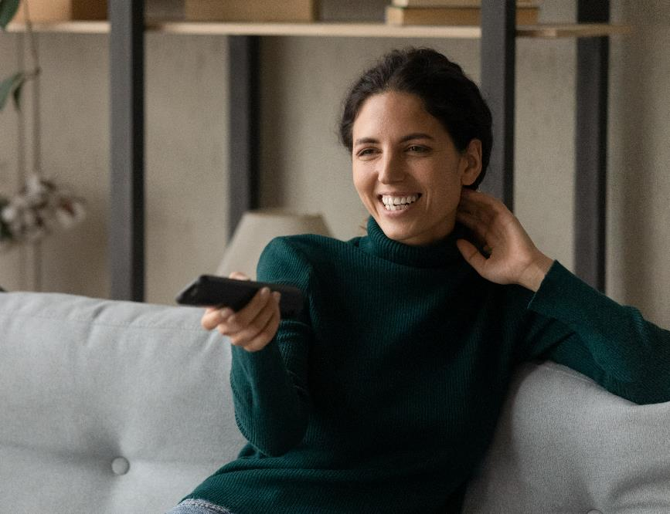
Latinas typically seek content that appeals to their values and traits of family, hard work, language, faith, ‘cultural bothness’ and empathy with other immigrant cultures
As voracious video viewers, Hispanic women spend a substantial amount of time with content across platforms and crave programming that is more representative of themselves and their diverse culture
% of Hispanic women who agree with the following statements
Hispanic women spend 30+ hours watching TV and 22 hours viewing videos, using apps or surfing the internet on smartphones
&
88% of Hispanic women have streamed in the past 12 months
65%
‘Having shows that highlight issues / stories that are important to racial diverse communities available on a streaming service makes it more valuable to me’
52%
‘I wish there was more Spanish-language content to stream’
Source: Telemundo, Latinas Powering Forward, 2019. VAB analysis of MRI-Simmons November 2021 Cord Evolution Study. Base = Any agree. ‘Cultural bothness’ refers to the equal integration of two cultures and languages into one.
This information is exclusively provided to VAB members and qualified marketers. Further distribution is prohibited.
PAGE 13

Slide 14
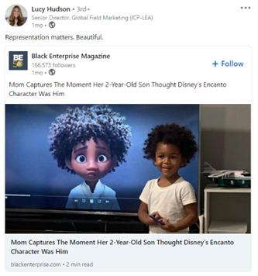
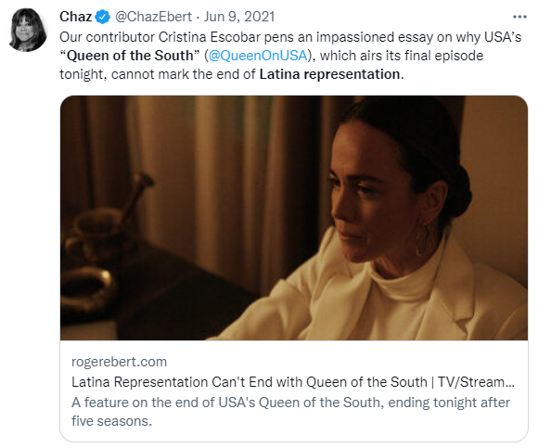
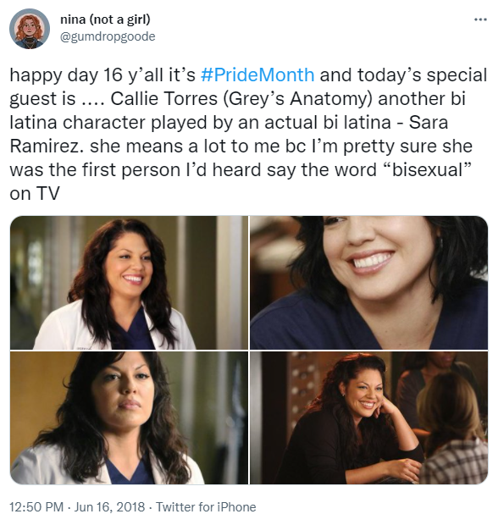


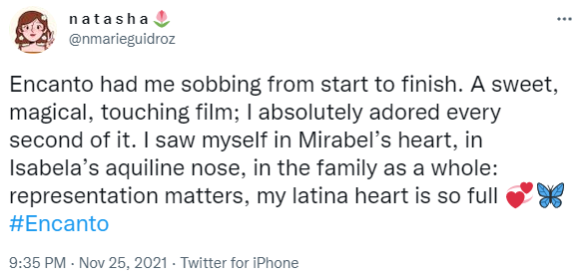
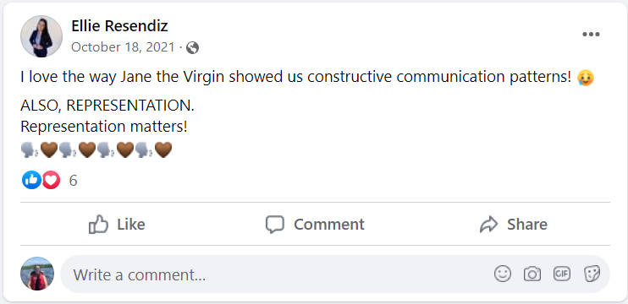
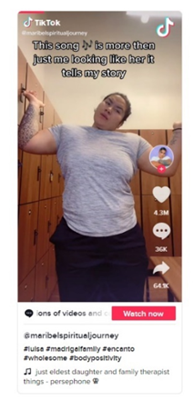
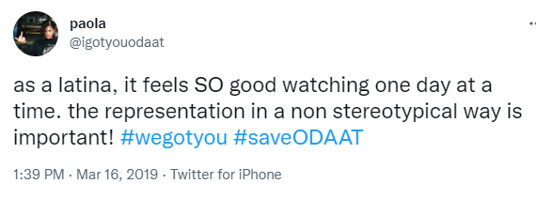
Inherently communal even online, Hispanic women use their favorite social media platforms to share their love and excitement about TV shows and movies that feature accurate on-screen representation
Hispanic women will celebrate the positive representation they see on-screen when marketers make an effort to connect with this audience through relevant video content that accurately portrays their diverse culture
% of Hispanic women who agree with the following statements
Examples of reactions to on-screen Latina representation from social networks
32%
‘I am more likely to watch a TV show that is active on social media’
+79% more likely than
non-Hispanic women (18%)
26%
‘I use social media to talk about shows I watch’
+55% more likely than
non-Hispanic women (17%)
Source: VAB analysis of MRI-Simmons Fall 2021 Doublebase. Base = any agree.
This information is exclusively provided to VAB members and qualified marketers. Further distribution is prohibited.
PAGE 14

Slide 15

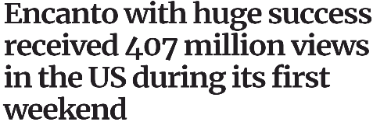





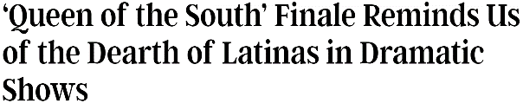

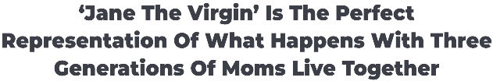


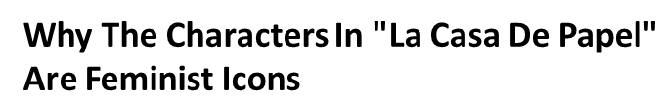

Authentic Latina characters and stories have moved more into the mainstream, with hits like Encanto, One Day At a Time and Jane the Virgin seeing major success by providing Latina audiences with accurate portrayals of themselves
This information is exclusively provided to VAB members and qualified marketers. Further distribution is prohibited.
PAGE 15

Slide 16
Adults over 50 account for 36% of the total population and nearly half of all adults
Hispanic women are a booming consumer segment that has grown in size and buying power influence.
As the demographic makeup of the U.S. continues to shift, marketers can grow their brand by targeting this highly engaged and loyal audience to build positive sentiment and gain market share within their respective category.
Rather than trying to fit in, Latinas are immensely proud of their heritage and appreciate advertisers who embrace their diversity and connect with them through authentic messaging. Marketers can build trust with this loyal consumer segment by aligning with relevant programming that features accurate portrayals and creating culturally diverse advertising campaigns.
Key Implications for Marketers
This information is exclusively provided to VAB members and qualified marketers. Further distribution is prohibited.
PAGE 16

Slide 17

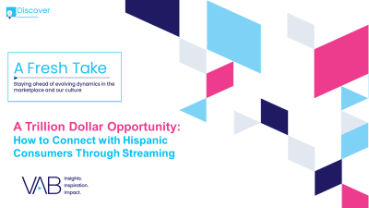
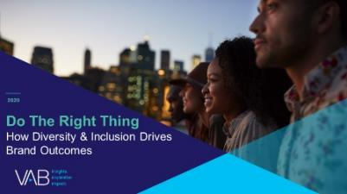
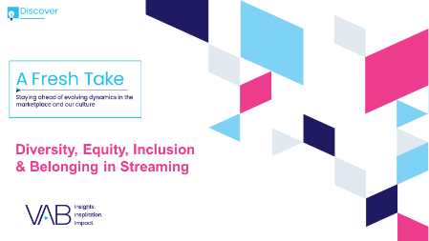
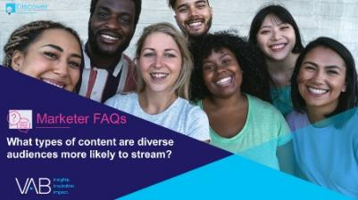
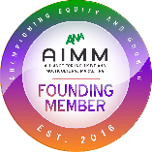
Adults over 50 account for 36% of the total population and nearly half of all adults
Creators
Leah Montner-Dixon
Karolina Guillen
Associate Insights Director
leahm@thevab.com
Insights Manager
karolinag@thevab.com
Discover more
Looking for more data, insights and takeaways? Check out this related VAB content
A Trillion Dollar Opportunity
How to Connect with Hispanic Consumers Through Streaming
Do The Right Thing
How Diversity & Inclusion Drives Brand Outcomes
We are committed to providing marketers with the data and insights they need to develop thoughtful, inclusive campaigns & strategies. To find out more on the unique media consumption behaviors and cultural trends of multicultural consumers, visit the VAB’s Multicultural Marketing Resource Center.
A Fresh Take
Diversity, Equity, Inclusion & Belonging in Streaming
Marketer FAQs
What types of content are diverse audiences more likely to stream?
VAB Members, brand marketers and agencies get free and immediate access to VAB’s content library. Get access at theVAB.com
This information is exclusively provided to VAB members and qualified marketers. Further distribution is prohibited.
PAGE 17

Slide 18


About VAB
VAB is an insights-driven organization that inspires marketers to reimagine their media strategies resulting in fully informed decisions.
Drawing on our marketing expertise, we simplify the complexities in our industry and discover new insights that transform the way marketers look at their media strategy.
We are committed to your business growth and proud to offer VAB members, brand marketers and agencies complimentary access to our continuously-growing Insights library. Get immediate access at theVAB.com.
Curious to learn more about VAB? Check out this quick video to see what we do and how we can help you develop business-driving marketing strategies.
This information is exclusively provided to VAB members and qualified marketers. Further distribution is prohibited.
PAGE 18

