Slide 1


VIDEO ADVERTISING BUREAU - REPORT 2018
Linear TV and OTT:
Living Together in Harmony
Notes:
https://www.istockphoto.com/photo/concept-of-harmony-and-balance-balance-stones-against-the-sea-gm802785470-130151899

Slide 2
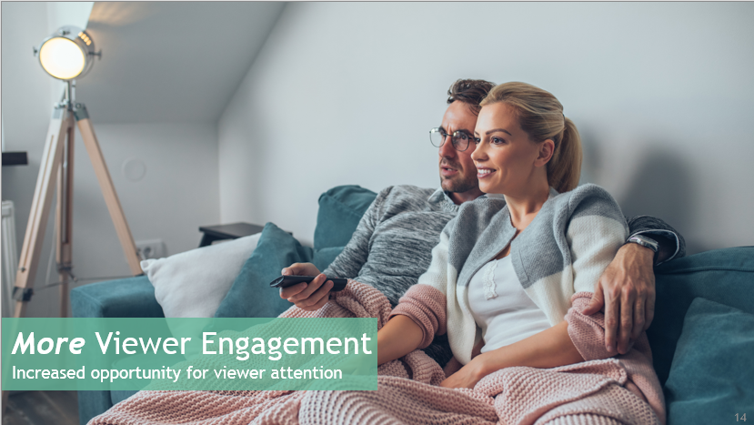


Contents
1
Delivering More To Marketers
2
Linear and OTT Dynamics
3
More Viewer Engagement
4
More Audience Reach
and Reinforcement
5
More Premium Ad Opportunities & Outcomes
6
Summary: Need We Say More?

Slide 3




Delivering More To Marketers
The face of the video ecosystem is evolving. One particular area of growth is ad-supported OTT, the professionally-produced video programming that is accessed without an MVPD subscription.
At the same time, Ad-Supported Linear TV dominates the way Americans view programming. Seventy-three percent of households hold an MVPD subscription and each week adults spend 81% of their ‘video time’ with Television.
The convergence of consumer demand for premium content + advancing technology means that consumers have more choices than ever of how to view the ad-supported programming they love.
It follows then that an advertising campaign that utilizes both Linear TV and OTT is greater than the sum of its parts.
Ad-supported OTT should be considered as part of a campaign’s overall video mix, as it offers the same engaging, premium, brand-safe programming found on linear TV.
The synergy of Linear TV + ad-supported OTT provides MORE to advertisers:
More Viewer Engagement
More Audience Reach and Message Reinforcement
More Premium Ad Opportunities & Outcomes
Join us as we explore how the harmony of linear TV + ad-supported OTT can deliver a stronger campaign for advertisers.
In our previous insights report, You Down With OTT?, released in early 2018, we showed that the growth of OTT means MORE opportunities – for both consumers and marketers. It provides more content, choice, and convenience to consumers. It also provides marketers with new platforms on which to reach and engage their audiences.

Slide 4





























































Definitions
Linear TV: Ad-supported cable or broadcast TV programming viewed live as it airs or time-shifted
OTT (over-the-top): Premium long form video content that is streamed over the internet through an app or device onto a TV (or PC, Tablet, or Smartphone) without requiring users to subscribe to a wired cable, telco, or satellite TV service
Ad-Supported OTT: Services or devices featuring professionally produced video programming that is accessed without an MVPD subscription. Such as:
Ad-Supported TV OTT Services
OTT Devices
Ad-Supported TV Network Platforms
No MVPD authentication needed
Ad-Supported OTT Aggregators
Connected TV
Internet Streaming Player
Game Console
vMVPDs are not included in this report as the focus is on ad-supported content that can be accessed directly from a programmer/aggregator through a connected TV device,
not via a subscription platform (e.g. Directv Now, Sling)
Source: SNL Kagan OTT Services % Devices, U.S. market. Note: Does not include full listing of OTT services

Slide 5



A Campaign Utilizing Both Linear TV and OTT Offers More To Marketers
More Viewer Engagement:
Improves brand health metrics and advertising impact
More Audience Reach and Message Reinforcement : Drives incremental reach across all age groups and among a variety of target audiences/content areas; also provides increased message reinforcement and brand relevance with consumers
More Premium Ad Opportunities & Outcomes:
Stirs the consumer interaction and interest that drives business growth

Slide 6

Linear TV & OTT Dynamics
Notes:
https://www.istockphoto.com/vector/abstract-technology-with-gear-background-vector-illustration-gm692919634-127934435

Slide 7

Within Video, Linear TV Is The #1 Reach and Engagement Vehicle
Most Consumers Receive TV Through An MVPD Subscription…
…And It Follows Then, That The Greatest Audience Reach Is Found In Linear TV…
…Driven By Their Linear MVPD Subscriptions, Consumers Dedicate The Majority Of Their Viewing Time To Linear TV
% Share of Weekly “Time Spent” by Video Device
Q1 2018, Adults 18+ (hrs:mins)
73%
of Homes are Multi-channel Subscribers
The reach and engagement in a premium, brand safe environment is why advertisers invest in ad-supported TV - over $64 Billion in 2018
Source: 2018 S&P Global Market Intelligence, Kagan. As of June 2018: Multichannel HHs - Residential multichannel household count excludes DBS overlap created by households taking multiple multichannel subscriptions. Includes cable, DBS, telco and other multichannel platforms. Excludes commercial subs; Weekly Video Reach & Time Spent – Nielsen Total Audience Report, Q1 ’18. Internet Connected Devices = Devices connected to the TV that are used to stream content such as Apple TV, Roku, Chromecast, Fire TV, Smartphone, Computers, etc.; MAGNA US Advertising Revenue Forecast – National TV + Local TV, September 2018, including cyclical events
Notes:
https://www.istockphoto.com/photo/sunset-suburbia-gm840037850-236252449

Slide 8
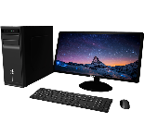



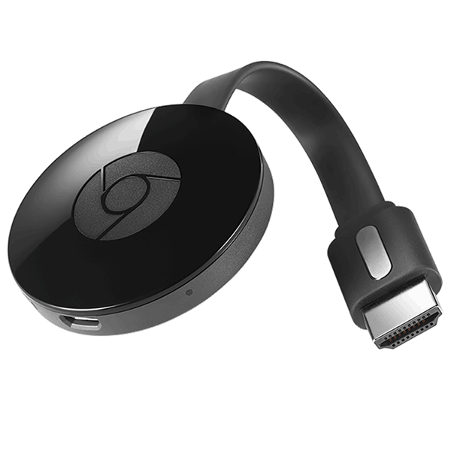
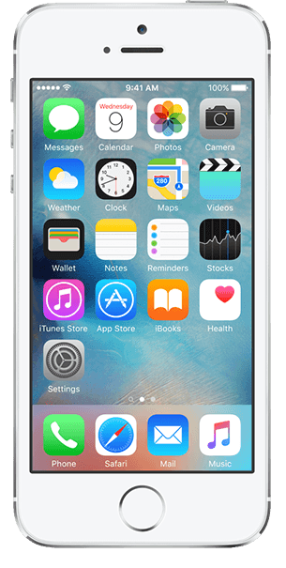
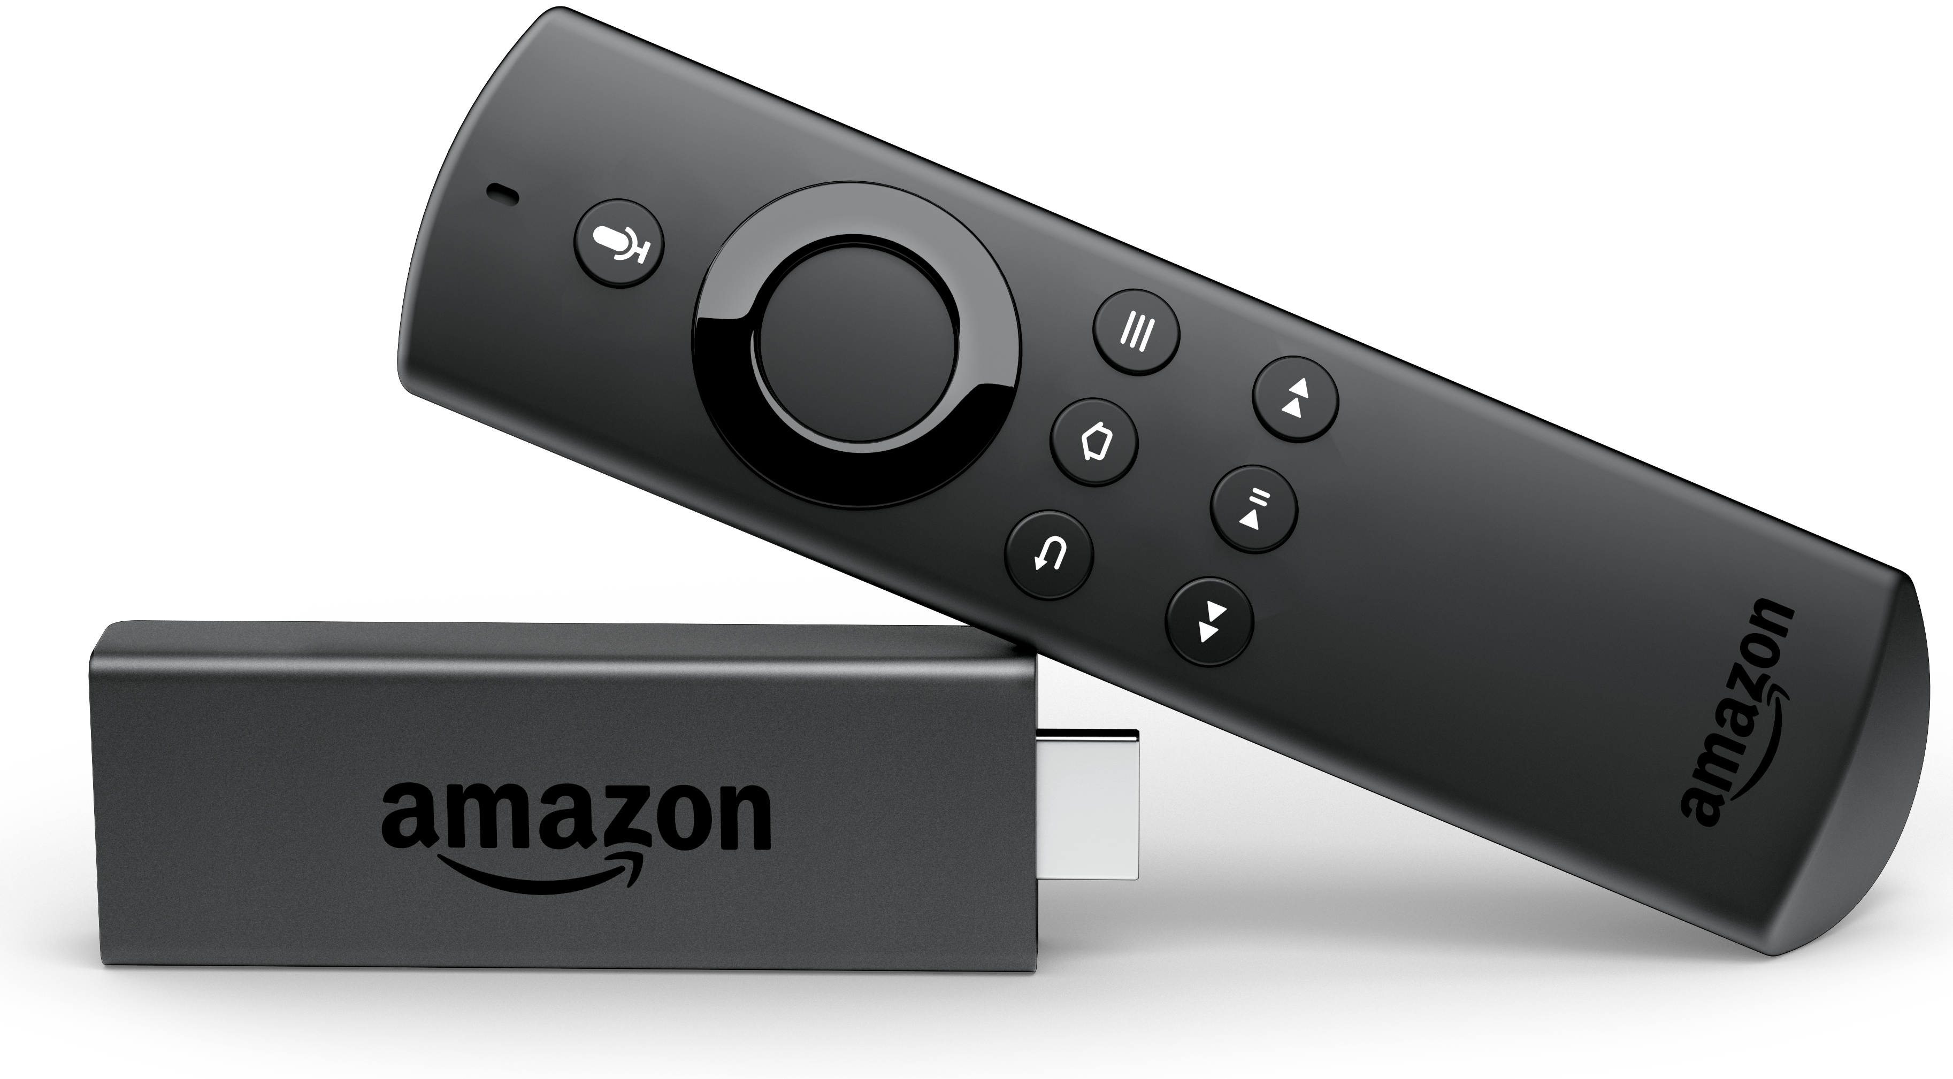

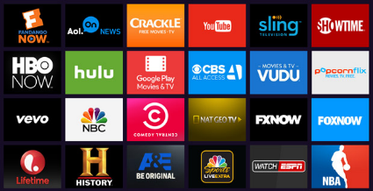



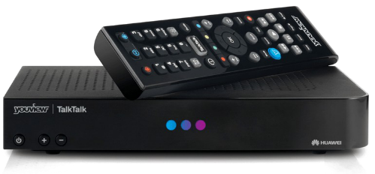
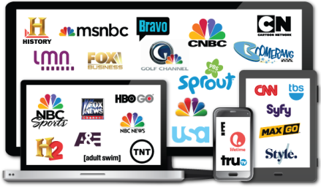
At The Same Time, The Face Of Television Is Evolving
Proliferation of Viewing Devices
Watching premium multi-screen video
Over-the-Top
DVR/Time Shifting
VOD
(Set Top Box)
TV Everywhere
(MVPD authentication)
Notes:
https://www.istockphoto.com/photo/young-unrecognisable-couple-at-home-watching-television-and-texting-gm845992924-138515747

Slide 9
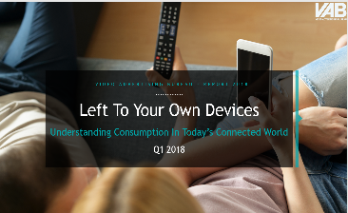
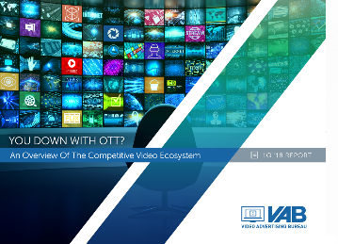
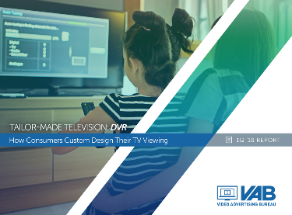
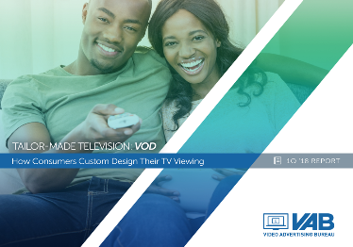
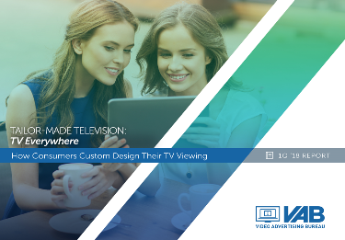
And We’ve Addressed This Expanding TV Ecosystem With In-Depth Insights
Proliferation of Viewing Devices
The convergence of
Consumer Demand +
Technological Advancement
has resulted in more opportunities for consumers… and marketers
Over-the-Top
DVR/Time Shifting
VOD
(Set Top Box)
TV Everywhere
(MVPD authentication)

Slide 10


It’s Clear That Many Consumers Have Expanded Their Viewing To Include Over-the-Top Platforms And Devices
Increased Access
Increased Interest
67% of Households now have access to an internet-enabled TV-connected device¹
An increase of +10% vs 2017
Total time spent streaming OTT is up 28% vs. YA⁵
90% of Adults 25-34 stream video³ An increase of +18% vs. 2 years ago
38% of Households own an enabled Smart TV²
An increase of +27% vs. 2017
73% of adults who watch streaming video say they watch ad-supported OTT video⁶
78% of Adults 35-49 stream video⁴
An increase of +20% vs. 2 years ago
Sources: 1 - Nielsen Total Audience Report, Q1 2018, Internet enabled TV-Connected Device = game console, internet connected devices and smart TVs, 2 – Nielsen Total Audience Report, Q1 2018, enabled Smart TV = TV that is capable and enabled to access the internet, 3 & 4- PwC Consumer Intelligence Services video survey, 2017 from “Consumer Intelligence Series: I stream, you stream” Report. 5- comScore State of OTT: 2018; 6 – Ad Receptivity and the Ad-Supported OTT Video Viewer, IAB / Maru Matchbox / Spot X, October 2018
Notes:
https://www.istockphoto.com/photo/fingerprint-authentication-biometric-authentication-concept-mixed-media-gm851960194-139940545
https://www.istockphoto.com/photo/plant-seeding-growing-step-with-sunlight-with-vintage-tone-filter-gm912882270-251303347

Slide 11


And So Savvy Marketers Have Begun To Follow Their Consumers Cross-Platform…
Ad spending on over-the-top TV is expected to increase 40% to $2B in 2018
Most digital ad views are now within OTT,
which are double that of smartphones
vs. YA
+54%
62% of marketers now take an omni-channel, end-point agnostic approach to planning vs. only 29% just four years ago
+76%
+14%
+15%
+16%
Sources MAGNA US Ad Revenue Forecasts, September 2018, 8/14/18; Nielsen CMO Report 2018 via Freewheel Q2 ‘18 Video Monetization Report; Ad View Composition and Growth by Device – Freewheel Q2 ‘18 Video Monetization Report
Notes:
https://www.istockphoto.com/vector/paper-airplane-with-form-of-graph-gm896052976-247487727
https://www.istockphoto.com/photo/business-development-to-success-and-growing-growth-concept-businessman-pointing-arrow-gm884650780-245914092

Slide 12



…But There Is Still Significant Opportunity For Marketers To Explore
only 15%
of advertisers regularly include connected TV in their media plans
Source: emarketer, 10/30/18, “Advertisers shouldn’t choose between linear tv and ctv they need to do both”

Slide 13

How Can A Plan Utilizing Linear TV + OTT Deliver More To Marketers?

Slide 14

More Viewer Engagement
Increased opportunity for viewer attention
Notes:
https://www.istockphoto.com/photo/our-favorite-tv-show-is-just-about-to-start-gm874799298-244247968

Slide 15
Viewers Who Watch Both Linear And OTT Television Are A More Committed, Engaged Audience Relative To The Average Adult
They are highly invested in their video viewing experience, so they are more likely to be attentive to it
They are particularly knowledgeable and influential about entertainment, indicating they are more attentive, lean-in viewers to programming
They are attractive to advertisers as they consider themselves knowledgeable across a variety of product categories, making them opinion-makers and advocates
Linear + OTT viewer
Index vs. Average Adult
Linear + OTT viewer
“Category Influential” Index vs. Average Adult
“Category Influential”
Linear + OTT viewer – Index vs. Average Adult
Source: 2018 GfK MRI Doublebase – ‘Linear TV Viewer + OTT Viewer’ = HH has a cable/telco/satellite subscription and owns Smart TV or Owns Internet Video Device or Watches video in one of the following ways - Through TV service provider app or Through a TV network app or via Another online streaming service; “Category Influentials” = “I have a great deal of knowledge/experience in this topic” and “My family/friends often ask for and trust my advice on this topic.”

Slide 16
The Vast Majority of Linear TV and OTT Viewing is Long-Form and / or Live
As a Result, These Formats Increase the Opportunity for Engagement
Ad Views - Format Composition by Device
86%
Linear TV – Live vs. Time-Shifted in Primetime
Source: Freewheel Q2 ‘18 Video Monetization Report, “Live” OTT = TVE, vMVPD live viewing, and live events; Linear TV - Nielsen NPower R&F Time Period Report, Primetime, Live vs. Live+7, Ad-supported Cable & Broadcast TV, 1/1/18-9/30/18.

Slide 17

To Enhance Their Viewing Experience, They Prefer Enjoying This Long-Form, Live Content On A
Television Screen…
89% of adults “highly enjoy” viewing TV programs on a Television
75% of Streamers prefer to watch OTT content on a Connected TV than on a smartphone/tablet
Source: Connected Devices: The Changing TV Experience, May 2017, iab + maru/matchbox; TV: CRE/Hub; Nielsen Total Audience Report, Q1 2018, Adults 18+

Slide 18




…Which Results in An Advertising Environment That Offers Increased Attention to Brands
Ad Recall on a TV screen is +32% higher than next closest device
Attention Paid to a TV screen is +26% higher than next closest device
Source: CRE and Hub Research custom study. “New study finds that TV outperforms Digital platforms in viewer ad attention & recall” 6/26/16

Slide 19
In Fact, The Combination Of Linear + OTT Drives Brand Health And Advertising Impact
99%
Viewing an ad on both platforms leads to more than two-fold increase in brand favorability lift
Source: Under The Hood of Over-The-Top Measurement, Roku / MAGNA / IPG Media Lab

Slide 20

This Engagement Inspires Action
There is Strong Second-Screen
Interaction for both Linear and OTT Content
86%
34%
29%
of OTT Streaming viewers say their second-screen activity is completely or mostly related to the program or commercials
of Linear TV viewers
say their second-screen activity is completely or mostly related to the program or commercials
Source: Connected Devices: The Changing TV Experience, May 2017, iab + maru/matchbox; TV

Slide 21
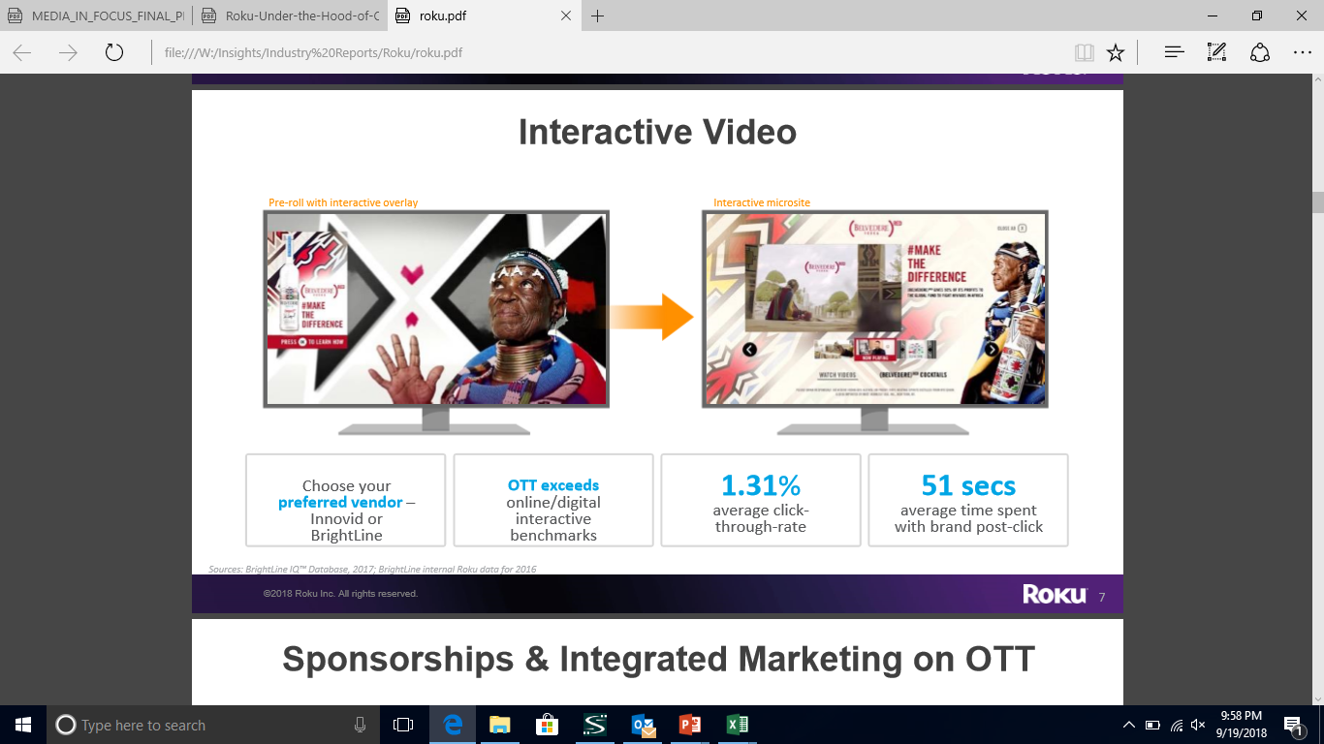
Viewers of
Ad-Supported OTT Are Particularly Receptive To Advertising And Take Action
56% like being able to interact with video ads
(vs. 39% for SVOD viewers)
36% use video ads to learn about new products / brands / services
(vs. 30% for SVOD viewers)
Source: Ad Receptivity and the Ad-Supported OTT Video Viewers, IAB / Maru/Matchbox, Spot X, October 2018; Ad-Supported OTT: Those who watch video through a free streaming service with ads (e.g. Crackle, Pluto), through a vMVPD (e.g. DirecTV Now), through a streaming app that requires an MVPD login (e.g. WatchESPN, Xfinity), or through a streaming service charging a monthly fee with ads (e.g. Hulu with limited ads)

Slide 22


Viewers spend an average of 2x longer
engaging on connected TV vs. similar ads online
The Video Completion Rate for CTV is 25% higher than it is for Desktop and Mobile
As A Result, Viewers Are Much More Engaged With Connected TV Ads Than With Ads Online
Source: www.brightline.tv/why-connected-tv; Extreme Reach Q2 ‘18 Video Benchmarks, CTV = Connected TV such as Roku, Apple TV, Playstation
22

Slide 23


More Engagement
Exposure to both linear TV and OTT drives brand favorability among consumers
The combination of Linear TV and OTT provides a synergy that increases consumer interaction, attention, and brand relevance
This deeper engagement drives strong lifts in brand health metrics when linear TV and OTT are deployed together
23
Notes:
https://www.istockphoto.com/photo/watching-tv-and-using-remote-control-gm638224864-114309045

Slide 24

More Audience Reach and Reinforcement
The combination of Linear + OTT extends campaign reach, reinforces message, and increases brand relevance with consumers
Notes:
https://www.istockphoto.com/photo/eyelash-extension-procedure-woman-eye-with-long-eyelashes-close-up-selective-focus-gm943394348-257764811

Slide 25




73% of U.S. households are Cable+ subscribers
Strong Overlap Between MVPD Subscribers and OTT Viewers Results In Message Reinforcement
…and 80% of those cable HHs also watch video via streaming apps
Similarly, 66% of OTT HHs also have Cable+ Subs
OTT Households
Source: 2018 S&P Global Market Intelligence, Kagan 6/2018; CMO by Adobe TV Advertising Calls For a Cross-Channel Strategy, 10/16/18; comScore, State of OTT September 2018

Slide 26

Video HH Method of Delivery
2018
While MVPD subscriptions dominate, OTT-only homes comprise 10% of video HHs
Additionally, Campaigns Can Deliver Incremental Reach Of OTT-only Homes
(no MVPD subscription)
Video HH Method of Delivery Projection
OTT-only growth trend, 2016-2018
While a small segment of total US HHs, OTT-only homes are growing (+15% over the last 2 years)
Source: 2018 S&P Global Market Intelligence, Kagan. As of June 2018.
Multichannel HHs - Residential multichannel household count excludes DBS overlap created by households taking multiple multichannel subscriptions. Includes cable, DBS, telco and other multichannel platforms. Excludes commercial subs. (2) Online video-only households (OTT or multichannel substitutes) are HHs that rely on unmanaged broadband delivery to view television shows or movies in lieu of a traditional multichannel subscription. Figure does not include subscribers to virtual multichannel providers such as Sling TV, PlayStation Vue or DIRECTV NOW. (3) Virtual multichannels (vMVPD) characterized by unmanaged (Internet/OTT) broadband delivery of aggregated live, linear networks and on-demand content similar to a traditional multichannel offering for a monthly subscription. (4) Households that receive broadcast network signals using an antenna and do not subscribe to a traditional or virtual multichannel service, includes HHs with an antenna that also access online video.
Notes:
https://www.istockphoto.com/photo/cutting-the-cord-on-cable-tv-gm855977378-239894495

Slide 27
We examined Nielsen’s omni-channel planning tool, Media Impact, to gauge the potential incremental reach of OTT within a plan.
This analysis includes all ad-supported TV networks and streaming platforms except Amazon and Netflix, the two biggest SVOD platforms. Through this cross-platform analysis, we can determine the percentage of an audience that can be reached by:
Quantifying The Opportunity For Incremental Reach And Message Reinforcement
Linear TV Only
Primary Reach Driver
Linear TV + OTT
Reinforcement & Relevance Opportunity
Those reached with both Linear TV and OTT
OTT-Only
Incremental Reach Opportunity
Those reached only with OTT
Those reached only with Linear TV

Slide 28
The data below for Adults 18+ indicates that 73% of reach is derived from linear TV alone, 22% is derived from those reached by a combination of linear TV + OTT, and 6% is derived from those reached by the OTT-alone
Reach Duplication, Adults 18+
Linear TV, Linear TV + OTT, OTT-only
Analysis Applied: Quantifying The Opportunity For Incremental Reach And Message Reinforcement
OTT-
Only
6%
Linear TV Only
Primary Reach driver
Linear TV + OTT
Reinforcement & Relevance Opportunity
OTT-Only
Incremental Reach Opportunity
Reach duplication expressed another way:
Reach Duplication – Adults 18+
Linear TV only
73%
OTT- only 6%
Linear TV + OTT 22%
Source: Nielsen Media Impact; A18+. 4/1-4/30/18, Linear TV = Include Cable and Broadcast TV Programs, Live viewing plus 7 days after the broadcast; OTT = Desktop and laptop video streaming, does not include the two major subscription (non-ad supported) video platforms, Netflix and Amazon; TV + OTT = those reached on OTT and Linear TV

Slide 29
While the vast majority of reach is achieved through Linear TV, OTT provides an opportunity to drive incremental reach, as well as message reinforcement cross-platform
Reach Duplication, by Demo
Linear TV, Linear TV + OTT, OTT-only
The Analysis Confirms That An OTT Schedule Delivers Incremental Audience Across Buying Targets, Particularly Younger Demos
Linear TV Only
Primary Reach Driver
Linear TV + OTT
Reinforcement & Relevance Opportunity
OTT-Only
Incremental Reach Opportunity
Source: Nielsen Media Impact; A18+. 4/1-4/30/18, Linear TV = Include Cable and Broadcast TV Programs, Live viewing plus 7 days after the broadcast; OTT = Desktop and laptop video streaming, does not include the two major subscription (non-ad supported) video platforms, Netflix and Amazon; TV + OTT = those reached on OTT and Linear TV

Slide 30
While all genres offer some degree of incremental reach, the opportunities are varied. Music and Family content offer the most, while Comedy, Sports, and News genres are more limited in their ability to drive unique audiences.
Similarly, Plans Inclusive Of OTT Can Deliver Additional Audiences Across A Variety Of Content Genres, Particularly Within Family, Music, and Film Content
Linear TV Only
Primary Reach Driver
Linear TV + OTT
Reinforcement & Relevance Opportunity
OTT-Only
Incremental Reach Opportunity
Source: Nielsen Media Impact; A18+. 4/1-4/30/18, Linear TV = Include Cable and Broadcast TV Programs, Live viewing plus 7 days after the broadcast; OTT = Desktop and laptop video streaming, does not include the two major subscription (non-ad supported) video platforms, Netflix and Amazon; TV + OTT = those reached on OTT and Linear TV. Each genre includes tv networks and websites that are included in that subject area.
Notes:
https://www.istockphoto.com/photo/mom-with-daughter-on-kitchen-gm883109876-245663463
https://www.istockphoto.com/photo/old-movie-camera-gm691467238-127513461

Slide 31



A Closer Look At Three Consumer Segments Where A Supplementary Layer Of OTT Can Expand Reach
Millennials
(A18-34)
Households with Children
Affluent
Households
(HHI $100K+)
Largely digital natives open to adopting new devices and methods of viewing
Their on-the-go lifestyle and need for a diverse set of programming demands connectivity options
They own it all.
Time-pressed, they want the most choice & convenience
31
Notes:
https://www.istockphoto.com/photo/multi-ethnic-supporters-watch-sports-game-on-tv-4k-slow-motion-diverse-football-fans-gm969839024-264291553
https://www.istockphoto.com/photo/happy-family-watching-television-together-gm849603938-139459699
https://www.istockphoto.com/photo/portrait-of-successful-businesswoman-wearing-elegant-formal-suit-sitting-on-leather-gm903417904-249167684

Slide 32
Millennials
Millennials are reached in greater numbers on
linear TV than other methods of video viewing, however they are more likely than the average adult to be streaming video using connected devices
Though they devote the majority of their video viewing to linear TV, younger audiences spend over 12 hours a week watching video on alternate devices
Average Weekly Reach by Video Device
A18-34
% Share of Weekly “Time Spent” by Video Device
A18-34
Although Linear TV Is Their Preferred Way Of Watching Video, Millennials Spend A Significant Amount Of Time With OTT Viewing
Incremental scenarios?
Source: Nielsen Total Audience Report, Q1 ’18, Internet Connected Devices =Devices connected to the TV that are used to stream content such as Apple TV, Roku, Chromecast, Fire TV, Smartphone, etc

Slide 33
A custom analysis of the reach delivered by ad-supported TV vs. video streaming platforms (excluding Netflix and Amazon) demonstrates the incremental reach potential of Millennials.
Millennials
Millennials
Adults 18-34
A Supplementary OTT Schedule Provides An Incremental Reach Opportunity For Millennials
36% of Adults 18-34 can be reached via OTT-alone or in combination with Linear TV; 13% via OTT-only
There is particular incremental opportunity within Family, Music, and Film genres, reflective of their lifestage and interests.
Given the minimal overlap in audiences watching family programming on both TV and OTT, ad-supported OTT programming helps brands extend reach and relevance to Millennial parents/families.
Linear TV Only
Primary Reach Driver
Linear TV + OTT
Reinforcement & Relevance Opportunity
OTT-Only
Incremental Reach Opportunity
Source: Media Impact; A18+. 4/1-4/30/18 Linear TV = Cable and Broadcast TV Programs, Live viewing plus 7 days after the broadcast; OTT = Desktop and laptop video streaming, does not include the two major subscription (non-ad supported) video platforms, Netflix and Amazon TV + OTT = those reached on OTT and Linear TV. Each genre includes digital sites and tv networks that are found within that genre.

Slide 34

What Are They Watching When They Stream?
64% of Millennial Streamers Look For Shows Previously Watched or Listened to on “Traditional” media
Source: Nielsen Total Audience Report, Q1 ’18, “traditional media” includes television and radio
Notes:
https://www.istockphoto.com/photo/group-of-friends-watching-tv-at-home-gm628595216-111642189

Slide 35

Households
with Children
Households with kids are 38% more likely to stream OTT content than households without children
Streaming households with children spend 42% more time viewing OTT content than streaming HHs without kids
36% of HHs with children said they streamed more content in the last year (via network app / website / streaming service)
+29% more than HHs without kids
Households with Children Are Heavier Viewers of OTT Content
Households with children have spending power: 21% of households with kids spend $700+/month on their debit cards, 38% higher than households without children
Source: comScore State of OTT; 2018 GfK MRI Doublebase (Any Kids in HH)
Notes:
https://www.istockphoto.com/photo/smiling-family-watching-television-gm699381304-129523975

Slide 36
Households
with Children
A custom analysis of the reach delivered by ad-supported TV vs. video streaming platforms (excluding Netflix and Amazon) demonstrates opportunity to reach and reinforce message among households with kids.
Households with Children
Busy Families Demand The Flexible Entertainment Options That OTT Provides
38% of HHs with children can be reached via OTT-alone or in combination with Linear TV
Not surprisingly, they rely upon OTT for family entertainment, as well as for programming that suits parents, such as Film and Music.
Given the minimal overlap in audiences watching family programming on both TV and OTT, ad-supported OTT programming helps brands increase their reach and relevance with families.
Linear TV Only
Primary Reach Driver
Linear TV + OTT
Reinforcement & Relevance Opportunity
OTT-Only
Incremental Reach Opportunity
Source: Media Impact; A18+. 4/1-4/30/18, Linear TV = Cable and Broadcast TV Programs, Live viewing plus 7 days after the broadcast; OTT = Desktop and laptop video streaming, does not include the two major subscription (non-ad supported) video platforms, Netflix and Amazon. TV + OTT = those reached on OTT and Linear TV.; Each genre includes digital sites and tv networks that are found within that genre.
Notes:
https://www.istockphoto.com/photo/electric-bass-guitar-black-and-white-photo-gm911329282-250931646

Slide 37

Affluent
Households
While the majority of Affluent HHs (74%) have an MVPD subscription, they are 20% more likely than the average HH to also have OTT streaming capabilities
They are significantly more likely than the average HH to own Connected TV Devices:
Smart TVs +35%, Apple TV +87%, Roku +40%, Google Chromecast +51% vs. the average HH
They are 10% more likely than the average household to have streamed more content last year
They own it all.
Time-pressed, they want the most choice & convenience
Source: MVPD subscription - Nielsen Universe Estimate, 12/1/17-12/31/17, A18+ & HHI $100k+;comScore State of OTT, 2018 GfK MRI Doublebase (Affluent HH, HHI $100k+)
Notes:
https://www.istockphoto.com/photo/smiling-family-watching-television-gm699381304-129523975

Slide 38

Affluent
Households
A custom analysis of the reach delivered by ad-supported TV vs. video streaming platforms (excluding Netflix and Amazon) demonstrates opportunity to reach and reinforce message among affluent households.
Affluent HHs ($100K+)
As Affluent HHs are 15% more likely to have children at home (vs. the average HH), family programming shows strong OTT viewership. Similarly, film and music are also opportunity areas as they are top Affluent interests.
Their Ability To Own A Variety of Devices, Coupled with Demands on Their Time, Results In A Significant Supplementary Reach Opportunity
44% of Affluent HHs can be reached via OTT-alone or in combination with Linear TV
Similar to the Millennial and HHs with Kids audiences, the Affluent show minimal overlap in watching family programming on both TV and OTT. An OTT buy will extend reach and brand-relevance among the Affluent.
Linear TV Only
Primary Reach Driver
Linear TV + OTT
Reinforcement & Relevance Opportunity
OTT-Only
Incremental Reach Opportunity
Source: Media Impact; A18+. 4/1-4/30/18 Linear TV = Cable and Broadcast TV Programs, Live viewing plus 7 days after the broadcast; OTT = Desktop and laptop video streaming, does not include the two major subscription (non-ad supported) video platforms, Netflix and Amazon. TV + OTT = those reached on OTT and Linear TV. Each genre includes digital sites and tv networks that are found within that genre.
Notes:
https://www.istockphoto.com/photo/best-design-of-global-news-gm1040872968-278638920
https://www.istockphoto.com/photo/decorative-star-with-lamps-on-a-background-of-wall-modern-grungy-interior-gm873928690-244040462

Slide 39

As the majority of HHs hold MVPD subscriptions, linear TV remains to be the primary video reach driver across audiences.
More Reach
However, OTT represents a growing reach opportunity as more consumers have access to, and interest in, viewing OTT. Coupled with linear TV, it offers incremental plan reach, message reinforcement, and increased brand-relevance to consumers.
A complementary schedule in OTT programming provides additional exposure to groups likely to stream OTT content such as Millennials, the Affluent, and Households with Children, as well as across several targeted content areas like family, music, and film programming.
39

Slide 40

More Premium Ad Opportunities & Outcomes
Deeper consumer engagement creates greater interest and intent

Slide 41












































Ad-Supported OTT is Simply An Extension Of The Premium, Engaging, 100% Verifiable, Brand-Safe Content Embraced By Advertisers On Linear TV

Slide 42





Linear TV Spend Drives Website Traffic Across All Categories, For Advertisers Of All Sizes
12 Analyses in Total → 40+ Categories → 500+ Brands
“A Look Under The Hood”
(Automotive)
“The Market Changer’s Playbook”
(Category Disruptors)
“What’s Appn’ing”
(Mobile Apps)
“Ignition Point”
(Call-To-Action Categories*)
“Direct Impact”
(Direct-Disruptors)
50 Brands
25 Brands
35 Brands
60 Brands
125 Brands
80%
76%
90%
77%**
82%
TV Spend Vs. Website Traffic Correlation
*Ignition Point – “Call-To-Action” categories include restaurants, retail, travel, telco, financial & insurance. **What’s Appn’ing – 86% correlation for gaming app subcategory. % reflect that percentage of brands that saw a correlation between their TV spend & website traffic
42

Slide 43


Connected Device Ads see an average +13.5% lift in purchase intent
Similarly, The Engagement These Connected Viewers Have With OTT Programming Increases Their Purchase Intent
Viewers of ad-supported OTT are 39% more likely than SVOD viewers to buy products directly from the brand online
Source: https://www.brightline.tv/why-connected-tv/; Ad Receptivity and the Ad-Supported OTT Video Viewers, IAB / Maru/Matchbox, Spot X, October 2018
43
Notes:
https://www.istockphoto.com/photo/everything-you-need-is-online-gm842971872-137684065
https://www.istockphoto.com/photo/woman-is-shopping-online-with-laptop-computer-and-credit-card-gm894464248-247292093

Slide 44


Data-Fueled OTT Buys Can Add Valuable Incremental Reach in the Form of a Brand’s Best Prospective Customers, Thus Improving Business Outcomes
samsung.com/samsungads
Case Study: Auto Manufacturer
Supplementing a linear TV buy with targeted OTT to drive incremental
reach of the brand’s best potential customers
1
Using ACR technology, it was determined that the brand’s linear ads were reaching 50% of the Smart TV Audience
2
Samsung Ads was able to identify & target the best prospective customers of that brand. This included ‘vehicle intenders,’ the affluent, and sports fans.
Use of Data-Fueled OTT Increased Total Plan Reach By 20%
12% of total plan reach was incremental (targeted-OTT only) and comprised of the brand’s best prospective customers
Consequently, not only did the buy
deliver incremental reach, but that of higher-value as it exposed the campaign
to more likely buyers.
Source: Samsung Ads. Note, the Samsung universe is nationally representative, with 32 MM TVs, approximated to 27MM households and equivalent to 40% of market share of Smart TVs

Slide 45



The Impact of Targeting These Lucrative Customer Segments Is Quantified By Examining Attributable Store Traffic and ROAS
samsung.com/samsungads
Case Study: Luxury Auto Brand
Supplementing a linear TV buy with targeted OTT to drive incremental reach of the brand’s best potential customers and quantifying the impact via offline footfall traffic to dealership
Targeted OTT ads shown to the desired target audience across Samsung devices/apps/Smart TVs, inclusive of a segment of viewers unexposed to linear TV ads to determine incremental lift.
Provided geolocation data & analysis.
Connected Samsung Ads exposure to offline footfall dealership data.
Results:
55x
3% of the daily footfall traffic was attributable to those who were exposed to the Samsung ads, generating incremental revenue and an estimated 55x return on ad spend
Incremental reach increased by +26%, comprised of best prospective customers
Source: Samsung Ads and factual. ROAS based upon average used car deal size for category and brand and average conversion rate of visits/sale

Slide 46

When OTT Complements a Linear TV Schedule, Conversion Increases
Roku Tune-in Insights:
Conversion is greatest for campaigns using a combination of OTT and Linear TV.
In this case, automatic content recognition technology directly measures whether a network’s tune-in promotion led to an increase in linear viewership.
Source: Roku Internal Data, October 2017; Tune in conversion - linear

Slide 47

Ad-supported OTT programming is simply an extension of the same premium, popular content found on linear TV
More Premium Ad Opportunities & Outcomes
Linear TV & OTT are proven to stir the consumer interactivity and purchase intent that drive business growth
When used in conjunction, they can drive incremental conversions for a campaign especially as advanced targeting capabilities are implemented
47

Slide 48

Ad-supported OTT should be considered as an element to the overall video mix – it is simply an extension of the brand safe, engaging, premium content found within linear Television.
Need we say More?
In combination, Linear TV and ad-supported OTT increase the consumer engagement of a campaign, driving up the interactivity and attention that influences business outcomes.
While Linear TV is the primary video reach driver, the growth of OTT provides incremental reach/reinforcement opportunities, particularly among high-value audiences (younger viewers, HHs with children, the affluent).
All together, the expanded & data-fueled reach, heightened engagement, and more premium ad opportunities result in increased opportunities to drive brand growth.
Notes:
https://www.istockphoto.com/photo/people-cross-busy-intersection-on-23rd-street-in-manhattan-new-york-city-gm1016246132-273420307

Slide 49



Contact Us
Jason Wiese
SVP, Director of Strategic Insights
jasonw@thevab.com
Marianne Vita
VP, Strategic Insights
mariannev@thevab.com
Reed Kiely
Senior Multi-Platform Video Analyst reedk@thevab.com

