Slide 1

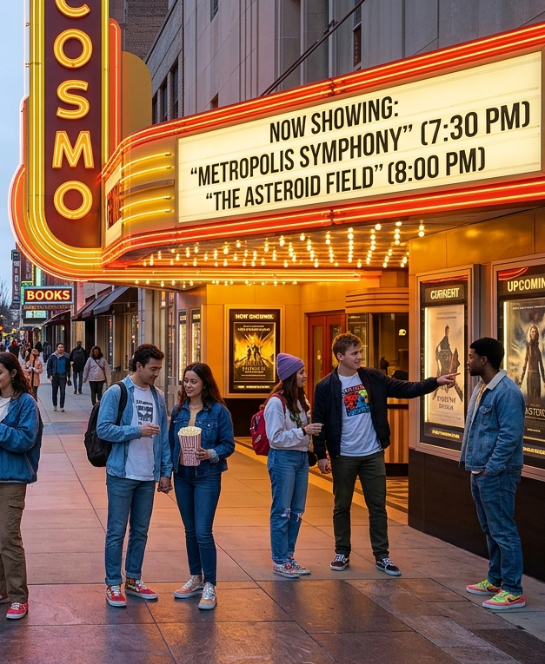


Lights, Camera, Commerce
How Cinema Drives Consumers to Action

Slide 2



Cinema lives at the center of commerce and ignites consumer action for brands
Over 80% of retail sales in the U.S. are made at physical store locations, accounting for more than six trillion dollars annually.
Cinema is a vital anchor in key retail areas and commerce destinations within cities and towns across America:
75% of cinemas are within 1 mile of a clothing store
55% of cinemas are within 1 mile of a shopping mall
80% of cinemas are within 5 miles of a grocery store
73% of cinemas are within 5 miles of a home improvement store
Going to the movies also involves one of the most deliberate consumer acts of seeking out entertainment, with the average journey being over 11 miles from home. This motion turns into emotion among a target-rich audience of ‘savvy shopper’ and ‘super spender’ moviegoers.
And that emotion turns into action due to the intersection of cinema’s highly desirable audience, the high-impact advertising in a captive environment and cinema’s proximity to commerce.
This information is exclusively provided to VAB members and qualified marketers.
PAGE 2

Slide 3




In this report, we explore how the proximity of cinema to trillions of dollars of retail sales turns motion into emotion and emotion into action
Sizing the Retail Opportunity
The Cinema Solution
1
2
3
4
In-Person Purchasing
Powers Retail Commerce
Movie Theaters Attract
‘Savvy Shoppers’ &
‘Super Spenders’ In Motion
The Cinema Turns Motion
Into Emotion, and This Emotion Ignites Action
Cinema’s Commerce Impact – Coming Soon FROM a Theater Near You
This information is exclusively provided to VAB members and qualified marketers.
PAGE 3

Slide 4

1
Sizing the Retail Opportunity:
In-Person Purchasing Powers Retail Commerce

Slide 5
Even in this age of digital, over 80% of retail sales are done at physical locations, which is projected to continue through the rest of the decade
U.S. Retail Sales by Type
Source: EMARKETER, US Physical Retail Sales vs. Retail Ecommerce Sales as % of Total Retail Sales - 2020-2030, February 2026. Note: Excludes travel and event tickets, payments such as bill pay, taxes, or money transfers, restaurant sales, food services and drinking place sales, gambling and other vice goods sales.
This information is exclusively provided to VAB members and qualified marketers.
PAGE 5

Slide 6
In-person physical retail sales equate to $6.4 trillion annually and will grow to over $7 trillion by the end of the decade
U.S. Physical Retail Sales
$ in Trillions
+53%
vs 2020
Source: EMARKETER, U.S. Physical Retail Sales - 2020-2030, February 2026. Note: Includes products or services purchased via physical channels (e.g., stores, infomercials, printed catalogs, vending machines); excludes products or services ordered using the internet; excludes travel and event tickets, payments such as bill pay, taxes, or money transfers, restaurant sales, food services and drinking place sales, gambling and other vice goods sales
This information is exclusively provided to VAB members and qualified marketers.
PAGE 6

Slide 7








Physical retail sales are the main driver of retail for many large categories, including automotive, food, home improvement and household goods
U.S. Physical Retail Sales: % of Total Category & Sales
2026
Auto & Auto Aftermarket
Food & Beverage
Home Improvement
Cosmetic & Beauty
94% / $1.8T
91% / $1.2T
85% / $575B
77% / $89B
Household Goods
Furniture
Apparel & Accessories
Pet Products
68% / $207B
66% / $171B
62% / $650B
61% / $63B
Source: EMARKETER, U.S. Physical Retail Sales & Sales Penetration, by Product Category - 2026, February 2026.
This information is exclusively provided to VAB members and qualified marketers.
PAGE 7

Slide 8





Hundreds of millions of adults regularly visit a wide variety of brick-and-mortar stores and restaurants ranging from QSRs to fine dining
Visitations by Store & Restaurant Category
A18+, % and # who have visted
‘Big Box’ Stores & Clubs
Last 12 months
Department Stores
Last 3 months
QSRs
Last 6 months
Appliance & Hardware Stores
Last 12 months
96% / 252MM
94% / 248MM
91% / 239MM
76% / 201MM
Casual Dining
Last 6 months
Shopping Malls & Centers
Last 6 months
Furniture Stores
Last 12 months
Fine Dining
Last 6 months
72% / 190MM
50% / 131MM
26% / 69MM
16% / 43MM
Source: VAB analysis of MRI-Simmons Winter 2026 Study. Base: A18+. ‘Big Box’ Stores & Clubs = Grocery & Warehouse Clubs; QSRs = fast food & drive-ins; Casual Dining = family dining & steakhouses.
This information is exclusively provided to VAB members and qualified marketers.
PAGE 8

Slide 9

2
The Cinema Solution:
Movie Theaters Attract ‘Savvy Shoppers’ & ‘Super Spenders’ In Motion

Slide 10
Movies are the most popular ‘outside the home’ entertainment activity, drawing larger audiences than concerts, live sports and theme parks
Entertainment/Leisure Activities Participated In The Last 12 Months
% of A18+
Source: VAB analysis of MRI-Simmons Winter 2026 Study. Base: A18+
This information is exclusively provided to VAB members and qualified marketers.
PAGE 10

Slide 11

Going to the movie theater is one of the most deliberate consumer acts, which involves a journey of over 11 miles on average
Moviegoers travel an average of
11.2 miles
to their local movie theater
Source: The People Platform, 2025 average.
This information is exclusively provided to VAB members and qualified marketers.
PAGE 11

Slide 12


Cinemas are typically located in the center of commerce destinations,
very close to retail stores of all types
100,000+ businesses are within a 1-mile radius of cinemas across dining, retail and service categories*
10 miles
% of Cinemas that are within 1 mile of:
5 miles
Convenience Stores: 77%
Shopping Malls: 55%
Home Improvement Stores: 30%
Clothing Stores: 75%
Grocery Stores: 40%
‘Big Box’ Retail: 30%
1 mile
% of Cinemas that are within 5 miles of:
Convenience Stores: 97%
Grocery Stores: 80%
Home Improvement Stores: 73%
Clothing Stores: 85%
Shopping Malls: 76%
‘Big Box’ Retail: 65%
% of Cinemas that are within 10 miles of:
Convenience Stores: 99%
Grocery Stores: 86%
Home Improvement Stores: 80%
Clothing Stores: 90%
Shopping Malls: 80%
‘Big Box’ Retail: 70%
Source: Screenvision & Maptitude, The Heart of Commerce, 2026. Note: Grocery Stores include Kroger, Aldi, Publix & Walmart. Home Improvement Stores include Home Depot & Lowe’s. ‘Big Box’ Retail includes Walmart, Target & Costco.
*NCM, Custom Proximity Analysis, 2026.
This information is exclusively provided to VAB members and qualified marketers.
PAGE 12

Slide 13


Most moviegoers don’t just go to the cinema when they leave the home, they make dining and shopping a habitual part of their overall experience
Locations Typically Visited Before/After the Cinema by Moviegoers*
85%
74%
68%
Restaurant,
QSR or Bar
Convenience Store
Retail Store or Shopping Mall
Source: VAB analysis of MRI-Simmons, 2026 Custom Video Study. *‘Moviegoers’ reflects people who have gone to the movies at least once in the last year.
This information is exclusively provided to VAB members and qualified marketers.
PAGE 13

Slide 14


The cinema is a target-rich environment for brands as frequent moviegoers are both ‘savvy shoppers’ and ‘super spenders’
‘Savvy Shoppers’
‘Super Spenders’
Frequent moviegoers love shopping and
enjoy the experience of exploring and experimenting as part of their routine
Frequent moviegoers are early adopters and tastemakers that will spend their money to get what they want to buy
This information is exclusively provided to VAB members and qualified marketers.
PAGE 14

Slide 15
‘Savvy Shoppers’: Frequent moviegoers love shopping and enjoy the experience of exploring and experimenting as part of their routine
‘Savvy Shoppers’
Frequent Moviegoers vs. A18+
“I have great experience
when it comes to shopping ”
(+37% vs. A18+)
“I like to experiment with
new clothing styles”
(+22% vs. A18+)
“When I shop, I usually visit
a variety of stores”
(+14% vs. A18+)
“I prefer to shop at stores that specialize in a specific type or style of product”
(+13% vs. A18+)
“I prefer shopping at specialty stores because the employees are knowledgeable about products”
(+9% vs. A18+)
“I enjoy wandering the store looking for new, interesting products”
(+9% vs. A18+)
“I think shopping is a great way to relax”
(+8% vs. A18+)
Source: VAB analysis MRI-Simmons Winter 2026 Study, A18+. Base: Frequent Moviegoers (visited theater in the past 30 days). % vs. A18+ means the ‘frequent moviegoer is x% more likely to agree with the statement than A18+.
This information is exclusively provided to VAB members and qualified marketers.
PAGE 15

Slide 16
‘Super Spenders’: Frequent moviegoers are also early adopters and tastemakers that will spend their money to get what they want to buy
‘Super Spenders’
Frequent Moviegoers vs. A18+
“My family/friends trust my advice on shopping”
(+40% vs. A18+)
“I am usually the first among my friends to try new clothing styles”
(+37% vs. A18+)
“I am willing to spend more than I can really afford, to get the clothes that I want”
(+29% vs. A18+)
“I'm always one of the first of my friends to try new products or services”
(+20% vs. A18+)
“I often spend more money than I expected to on my fashion purchases”
(+15% vs. A18+)
“I'm a ‘spender’ rather
than a ‘saver’”
(+15% vs. A18+)
“I tend to make impulse purchases”
(+7% vs. A18+)
Source: VAB analysis MRI-Simmons Winter 2026 Study, A18+. Base: Frequent Moviegoers (visited theater in the past 30 days). % vs. A18+ means the ‘frequent moviegoer is x% more likely to agree with the statement than A18+.
This information is exclusively provided to VAB members and qualified marketers.
PAGE 16

Slide 17
These ‘savvy shopper’ and ‘super spender’ frequent moviegoers are constantly in motion, visiting retail stores and restaurants at scale
Frequent Moviegoers: Visitations by Store & Restaurant Category
% who have visted & index against A18+
‘Big Box’ Stores & Clubs
Last 12 months
Department Stores
Last 3 months
QSRs
Last 6 months
Casual Dining
Last 6 months
98% / 102 index
96% / 102 index
95% / 105 index
81% / 113 index
Appliance & Hardware Stores
Last 12 months
Shopping Malls & Centers
Last 6 months
Furniture Stores
Last 12 months
Fine Dining
Last 6 months
77% / 101 index
64% / 128 index
30% / 116 index
24% / 147 index
How to read index: Frequent moviegoers are 13% more likely than A18+ to have visited a casual dining restaurant in the last 6 months.
Source: VAB analysis MRI-Simmons Winter 2026 Study, A18+. Base: Frequent Moviegoers (visited theater in the past 30 days). ‘Big Box’ Stores & Clubs = Grocery & Warehouse Clubs; QSRs = fast food & drive-ins; Casual Dining = family dining & steakhouses.
This information is exclusively provided to VAB members and qualified marketers.
PAGE 17

Slide 18
3
The Cinema Solution:
Cinema Turns Motion Into Emotion, and This Emotion Ignites Action

Slide 19
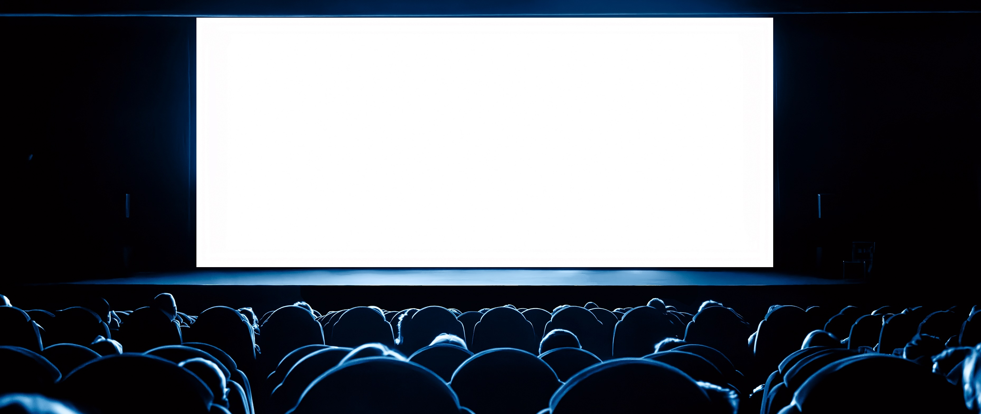
Moviegoing is a shared experience with family and friends that creates valuable co-viewing engagement opportunities for advertisers
93%
3.4
people
of moviegoers
attend with at least one other person
average moviegoing group size*
Source: Screenvision, Custom Research, 2026. *Screenvision & The People Platform, 2025 average.
This information is exclusively provided to VAB members and qualified marketers.
PAGE 19

Slide 20
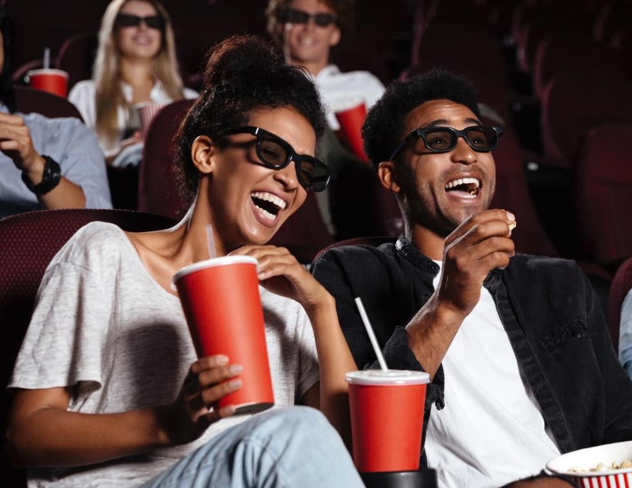
Cinema fosters a sense of connection within the theater, which is important for people’s well-being and sense of community with others
60%
of people always or often experience a sense of connection to others at the movies
Source: Digital Cinema Media (DCM), Maxmising Cultural Power with Cinema, 2024. DCM / Burst Your Bubble 2024. Base: Cinema goers last 4 weeks; P16-54 (n = 884).
This information is exclusively provided to VAB members and qualified marketers.
PAGE 20

Slide 21
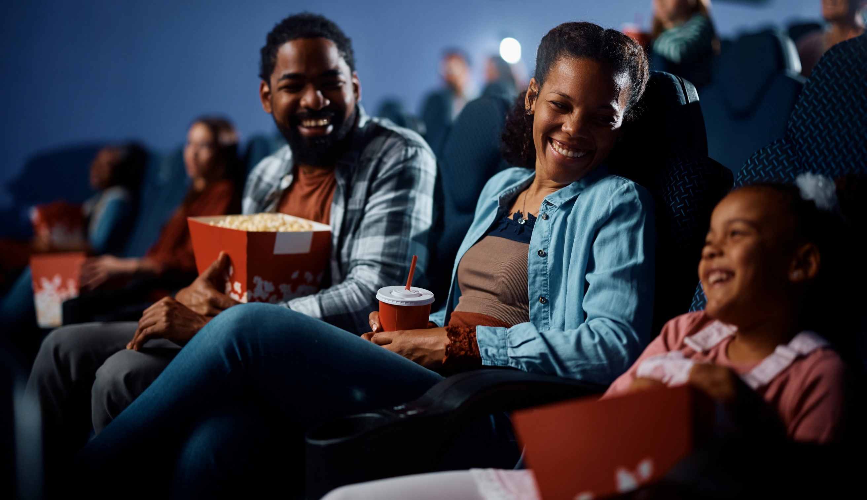
The engaging and communal experience of cinema puts audiences in a good mood, much more so than the internet or social media
78%
of people who visit a movie theater spend their time in a good mood
(vs. 62% of people using the internet)
(vs. 61% of people using social media)
Source: Digital Cinema Media (DCM), Cinema Effectiveness Roadmap, 2023. IPA Touch Points.
This information is exclusively provided to VAB members and qualified marketers.
PAGE 21

Slide 22

The ‘good vibes’ at movie theaters evokes powerful emotional experiences that advertisers can leverage to increase brand favorability
84%
of moviegoers agree that watching movies in a theater is an emotionally powerful experience
+20%
Increase in brand favorability after exposure to cinema ad*
Source: Screenvision and Alter Agents, Cinema’s Emotional Resonance, 2024. *Screenvision, Custom Research Study Norms 2024-2025.
This information is exclusively provided to VAB members and qualified marketers.
PAGE 22

Slide 23
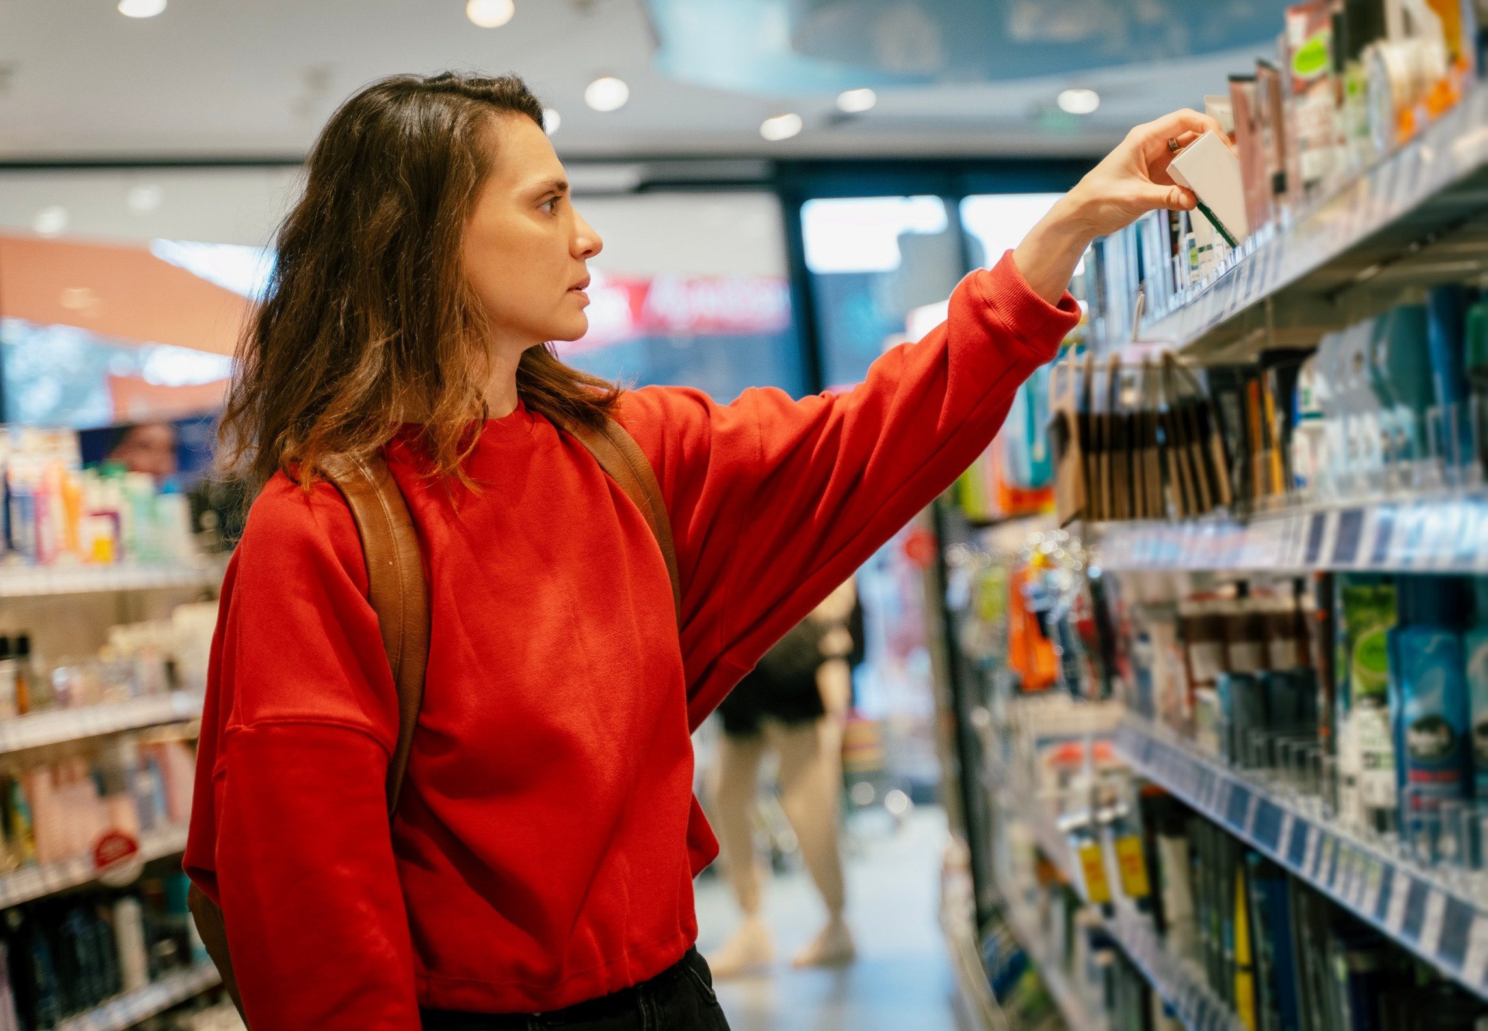
Mood & emotion play a crucial role in the buying process, as people in a positive mindset are more likely to purchase products they see advertised
A positive mindset drives a
+35%
increase in purchase intent
Source: Hearst, Power of Positivity, 2023.
This information is exclusively provided to VAB members and qualified marketers.
PAGE 23

Slide 24
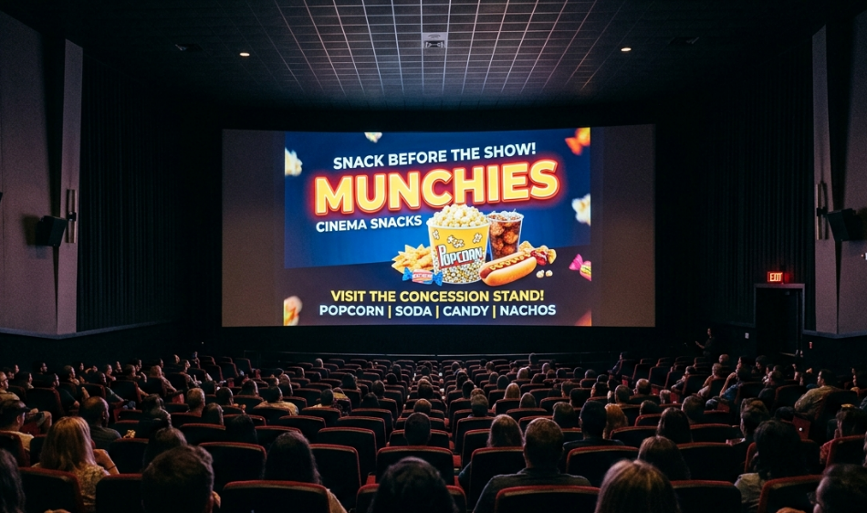
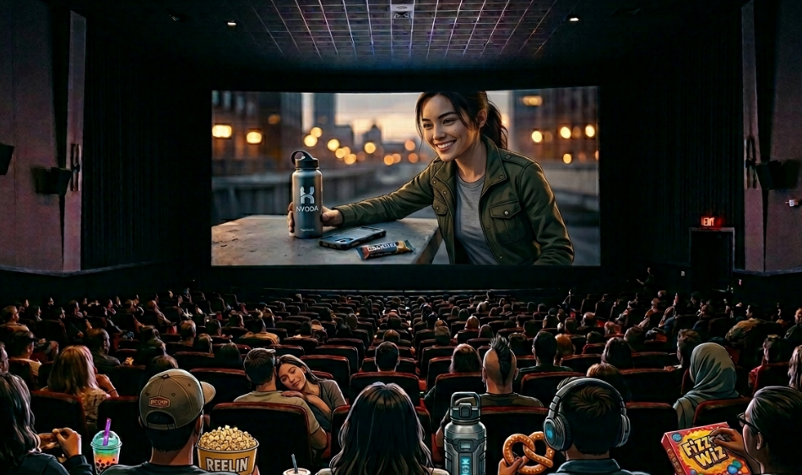
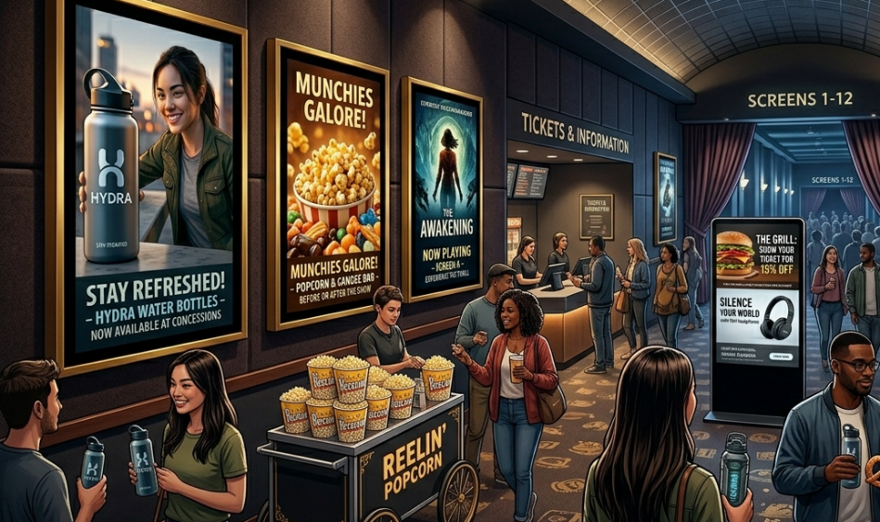
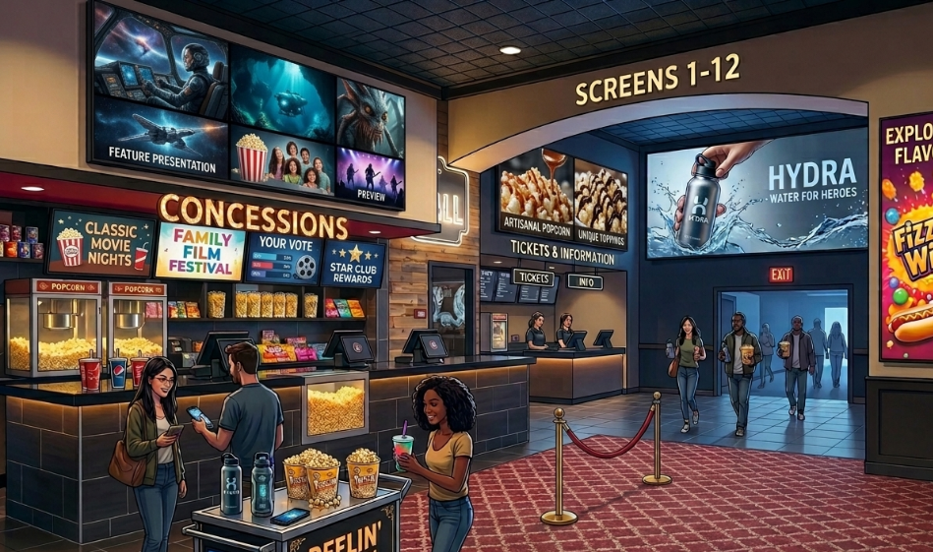
Cinema doesn’t just attract ‘savvy shoppers’ and ‘super spenders,’
it reaches them in a positive, memorable ad environment in the theater
Types of Cinema Advertising Seen in Last 30 Days by Frequent Moviegoers*
54%
Ads shown on-screen
prior to start of movie
(+2% vs. 2022)
51%
Product placement
in movies
(+11% vs. 2022)
46%
Ads on posters at
movie theaters
(+5% vs. 2022)
30%
Video ads in movie theater lobbies
(+7% vs. 2022)
Source: VAB analysis of MRI-Simmons Winter 2026 & Winter 2022 Studies. Base: A18+. *‘Frequent moviegoer’ reflects people who have gone to the movies at least once in the last month.
This information is exclusively provided to VAB members and qualified marketers.
PAGE 24

Slide 25
‘Real-World’ Case Studies:
See how the cinema drives incremental foot traffic and transactions

Slide 26




Case Study: Cinema positions brands at the center of attention and inspires action within close proximity to conversion at retail and dining
Cinema Advertising Drives Significant Incremental Visits to Restaurants & Store Locations
(Based on Screenvision foot traffic studies of moviegoers between July – September 2025)
+66%
+30%
+23%
Casual Dining Restaurants
Home Improvement Stores*
Quick-Service Restaurants*
Source: Screenvision & In-Market, The Heart of Commerce. *Screenvision & Foursquare, The Heart of Commerce, store visit lifts based on July – September 2025 time period.
This information is exclusively provided to VAB members and qualified marketers.
PAGE 26

Slide 27

Case Study: Moviegoers are a highly active consumer segment who are much more likely to make purchases across categories
Moviegoer Transactions vs. Average U.S. Consumer
(Based on Affinity Solutions transaction data between July – October 2025)
+93%
+53%
more transactions at QSRs
from moviegoers vs. average U.S. consumer
more transactions at grocery stores
from moviegoers vs. average U.S. consumer
2.1x
+92%
more transactions at restaurants
from moviegoers vs. average U.S. consumer
more likely to make a purchase at specialty retail stores
moviegoers vs. average U.S. consumer
Source: NCM & Affinity Solutions, Moviegoer Transaction Analysis, 2026. Transaction data based on Jul–Oct 2025 data from Affinity Solutions’ credit / debit card panel.
This information is exclusively provided to VAB members and qualified marketers.
PAGE 27

Slide 28
4
The Cinema Solution:
Cinema’s Commerce Impact –
Coming Soon FROM a Theater Near You

Slide 29



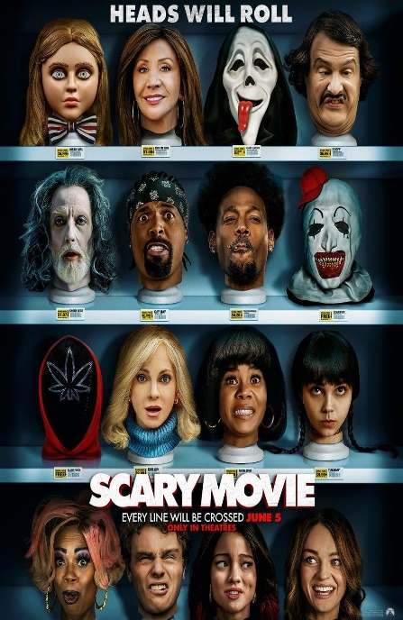













Upcoming high-profile movies offer opportunities for brands to engage ‘savvy shoppers’ and ‘super spenders’ within the heart of commerce areas
5/1/26
5/22/26
5/29/26
6/12/26
6/19/26
7/1/26
7/10/26
7/17/26
7/31/26
8/14/26
10/2/26
10/16/26
10/23/26
11/20/26
12/18/26
12/18/26
Source: IMDb, Upcoming Releases, 2026. Note: Release dates planned as of 4/7/2026 and subject to change.
This information is exclusively provided to VAB members and qualified marketers.
PAGE 29

Slide 30
Cinema lives at the center of commerce and ignites consumer action for brands
Retail sales are primarily made in-store, accounting for over 80% of total sales, with some major categories like auto, food and home improvement much higher than that
Cinema is at the heartbeat of commerce because it lives
in close proximity to thousands of retail stores, QSRs, shopping centers, department stores and ‘Big Box’ retail
in cities and towns across America
Moviegoers are ‘savvy shoppers’ and ‘super spenders,’ making cinema an emotionally engaging platform for marketers to reach valuable consumers in motion
Cinema turns motion and emotion into action due to the intersection of its highly desirable audience, its high-impact advertising opportunities in a captive environment and its proximity to commerce
A constant pipeline of high-profile theatrical releases provides marketers with year-round advertising opportunities ‘close to purchase’ in key commerce areas
Key Marketer Takeaways
This information is exclusively provided to VAB members and qualified marketers.
PAGE 30

Slide 31
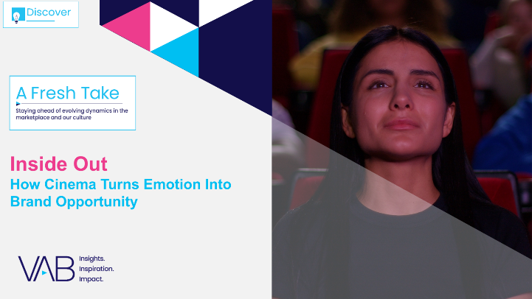
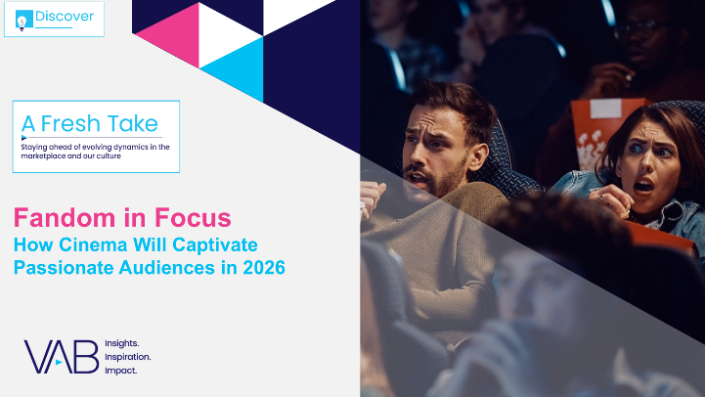

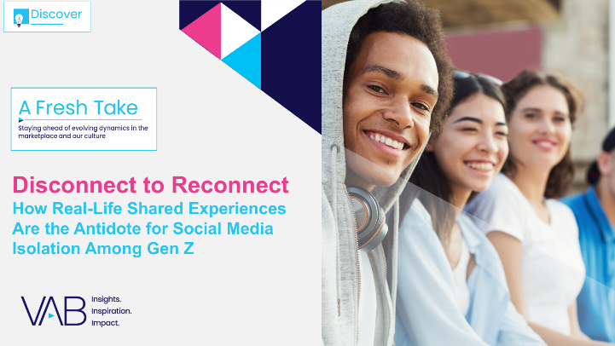
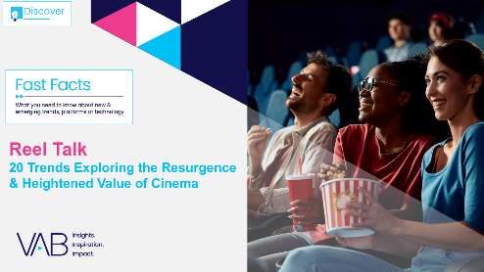
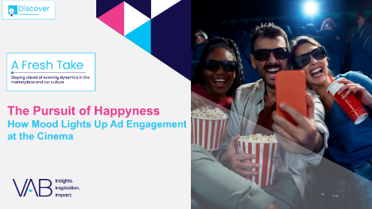

Creators
Jason Wiese
Reed Kiely
EVP, Strategic Insights & Measurement
jasonw@thevab.com
VP, Data Insights & Trends
reedk@thevab.com
Inside Out
How Cinema Turns Emotion
Into Brand Opportunity
Fandom in Focus
How Cinema Will Captivate Passionate Audiences in 2026
Amanda Cashman
Insights Analyst
amandac@thevab.com
Discover more
Looking for more data, insights and takeaways? Check out this related VAB content
Show Me the Money
Highlighting the Value of Moviegoers Across 20 Major Categories
Disconnect to Reconnect
How Real-Life Shared Experiences Are the Antidote for Social Media Isolation Among Gen Z
Visit VAB’s Upfront Planning Resource Center
for a curated a list of resources filled with the data, analysis and insights needed to make informed investment decisions.
Reel Talk
20 Trends Exploring the Resurgence & Heightened Value of Cinema
The Pursuit of Happyness
How Mood Lights Up
Ad Engagement at the Cinema
VAB Members, brand marketers and agencies get free and immediate access to VAB’s content library. Get access at theVAB.com
This information is exclusively provided to VAB members and qualified marketers.
PAGE 31

Slide 32


About VAB
VAB plays a dual role in the video advertising industry. We are leading the change to bring about a more innovative and transparent marketplace. We also provide the insights and thought leadership that enables marketers to develop business-driving marketing strategies.
Drawing on our marketing expertise, we simplify the complexities in our industry and discover new insights that transform the way marketers look at their media strategy.
We are committed to your business growth and proud to offer VAB members, brand marketers and agencies complimentary access to our continuously-growing Insights library. Get immediate access at theVAB.com.
This information is exclusively provided to VAB members and qualified marketers.
PAGE 32

