Slide 1
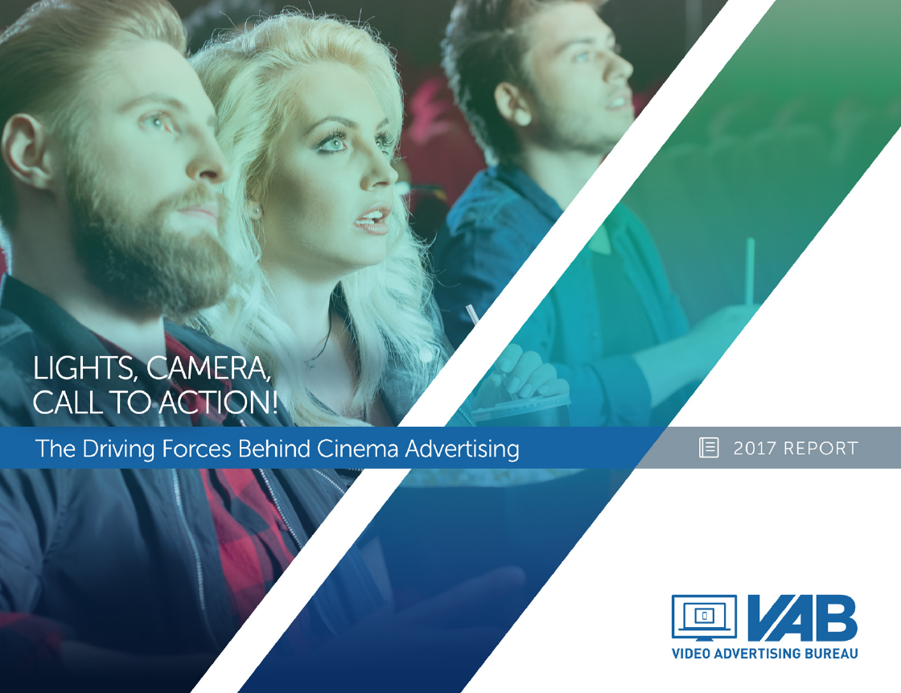
Lights, Camera, Call To Action!
The Driving Forces Behind Cinema Advertising
Members Center

Slide 2
Opening Credits
Summary 3
How Is The Movie Industry Doing? 4-11
  Box Office Trends 5
  Movie Milestones 6
  Seasonality 7
  Millennial Reach 8
  Comparative Reach & Composition 9-11
Why is Business Booming? 12-20
Top Grossing Movies 13
Generational Attitudes 14-15
Cineplex Innovations 16
Macroeconomic Trends 17-19
Leisure Activities 20
Who’s Driving Movie Attendance? 21-25
“Heavy” Movie-Going Audience Demographics 22
Key Segment: “Magnetic Millennials” Archetype 23
Key Segment: “Family Focuseds” Archetype 24
Heavy” Movie-Going Audience Vs. “Heavy” Internet User 25
What Key Categories Are Advertising In Cinema? 26-31
Cinema Advertising Footprint 27
Cinema Advertising Growth 28-29
Cinema Advertisers 30-31
How Does Cinema Advertising Drive Consumer Action? 32-36
Cinema Re-allocation 33
“Primary” Cinema Advertisers Correlation 34
Branded Content 35
Cinema & TV Working Together 36
What’s Next? 37-39
Coming Soon! 38
Box Office Projections 39

Slide 3
Cinema: A Force Awakened
It is a period of heavy disruption and device proliferation across the nation with mass fragmentation permeating every corner of the video ecosystem. Within this challenging landscape, a bright star shines – CINEMA. With increased attendance and record box office sales, Cinema’s success is being driven by POWERFUL STORYTELLING and consumers’ desire to temporarily unplug, relax and share experiences with friends and family.
While advertisers pursue elusive MILLENNIALS across devices within this new world order, this group can easily be found – undistracted, attentive and engaged – at the local Cineplex, which has become the new living room away from the home.
Beyond just Millennials, advertisers have been flocking to cinema as a way to further engage captive, desirable audiences and the powerful force of cinema advertising has made it hard for consumers to resist taking ACTION after seeing an advertisers’ message on the big screen. Read on to discover more….

Slide 4

How Is The Movie Industry Doing?

Slide 5
2016 Marked A Record Year In U.S. Box Office Revenues And Attendance Was Also Up
3-Year Trend
+11% vs ‘14
Lights, Camera, Call To Action!
Source: SNL Kagan 2016 and Box Office Mojo (referenced for 2016 box office revenue)

Slide 6








Beyond The Record Box Office, Cinema Also Hit Several Other Milestones During 2016
Biggest R-rated movie opening weekend ever; Biggest February opening weekend ever
Highest-grossing original animated film ever
Biggest domestic opening weekend for and any animated film
Biggest worldwide opening weekend ever for a superhero film
Highest domestic opening weekend
for an original film of any kind
First time ever two animated films earned over $1 Billion worldwide in the same year
Highest-grossing Marvel single
character debut worldwide
Lights, Camera, Call To Action!

Slide 7
Box Office Revenues Are More Equitably Divided Across Quarters Now Than They Were Fifteen Years Ago
Box Office Revenue % By Quarter
2016 Box Office Revenue Splits:
1st Half: 45% / 2nd Half: 55%
1Q & 3Q: 46% / 2Q & 4Q: 54%
Lights, Camera, Call To Action!
Source: Box Office Mojo

Slide 8
More Millennials Are Going To The Movies As Unique Reach Grew By Double Digits YOY in 2016
Cinema Unique Reach By Demo
August 2015 vs. August 2016
+14%
+15%
+14%
Lights, Camera, Call To Action!
Source: Nielsen Media Impact, August 2015 vs. August 2016 (8/1-8/31) for cinema unique reach.

Slide 9
Cinema Has The Size…If It Was A Cable TV Network, Cinema Would Rank #1 On Monthly Reach Against Millennials
P18-34 Monthly Cume Reach (000)
Lights, Camera, Call To Action!
Source: Nielsen Media Impact, August 2016 for cinema unique reach. Nielsen NPower R&F Time Period Report, Live+SD; Total Day (August 1-31, 2016); P18-34

Slide 10
Cinema Has The Composition…Generation Z & Millennials Make Up A Greater Portion Of The Audience Than The Internet
P6-34 Audience Composition
Cinema vs. Total Internet
Lights, Camera, Call To Action!
Source: Nielsen Cinema Audience Report, August 2016 for cinema audience composition. comScore August 2016, mediametrix multiplatform for Total Internet based on unique visitors. Composition for both cinema and digital based on P2+.

Slide 11
Cinema Provides Both Scale & High Concentration Of
Young People Vs. Targeted Digital Platforms
Cinema ranks #2 on composition vs. digital platforms with 50MM+ monthly unique visitors
P6-34 Audience Composition
Cinema vs. Select Digital Platforms (50MM+ UVs)
Lights, Camera, Call To Action!
Source: Nielsen Media Impact, August 2016 for unique cinema reach (50MM+); Nielsen Cinema Audience Report, August 2016 for cinema audience composition. comScore August 2016, mediametrix multiplatform for digital platforms. Composition for both cinema and digital based on P2+.

Slide 12

Why Is Business Booming?
A Look At Category, Consumer & Macroeconomic Trends

Slide 13




















Powerful Storytelling, Fantastic Franchises, Family Fun & Big Stars Are Driving The Box Office During The Digital Age
Top 20 Movies Released In 2016
$529.5MM
$486.3MM
$408.1MM
$368.4MM
$364.0MM
$363.1MM
$341.3MM
1
2
3
4
5
6
7
$330.4MM
$325.1MM
$267.6MM
$246.0MM
$233.3MM
$232.5MM
$162.4MM
8
9
10
11
12
13
14
$158.8MM
$155.4MM
$153.4MM
$152.8MM
$143.5MM
$140.9MM
15
16
17
18
19
20
Lights, Camera, Call To Action!
Source: Box Office Mojo, U.S. domestic grosses as of 2/27/17

Slide 14
People, Specifically Millennials, Value A Work-Life Balance Which Enables Them To Enjoy More Experiences
Millennials’ have a new definition of career success where salary takes a backseat to work-life balance and, thus, material goods take a backseat to shared experiences with friends
How Millennials Define Career Success
Lights, Camera, Call To Action!
Source: KPMG; Mindshare’s 2017 Culture Vulture Report

Slide 15
In This World Of Device Overload, People Across Generations Are Looking To “Unplug” For At Least A Little Bit
“How Often Do You Make An Attempt To Unplug”
Once a week or more
Of those who attempt to unplug, 48% of Millennials and 58% of Gen Xers say they do it to spend more quality time with their family
Lights, Camera, Call To Action!
Source: The Harris Poll. 2,193 U.S. adults surveyed online between January 13-18, 2016. “Unplug” refers to disconnecting / avoiding the internet, social media, email, text messages, etc

Slide 16

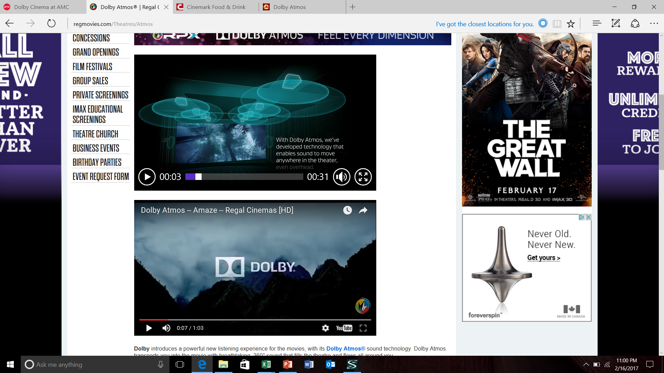
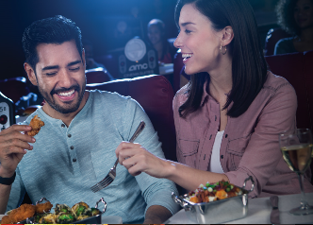

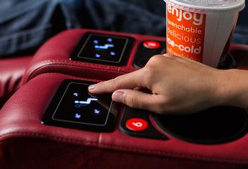
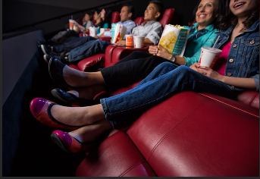
The Local Cineplex Has Become A Home Away From Home And Their Screens Have Become The New Living Room
Recent cinema innovations rival, and oftentimes exceed, the creature comforts of even the most advanced home theaters
Crisper Screens With Immersive Visuals
State-Of-The-Art Dolby Surround Sound
Upgraded Food Options With Dine-In Experience
Reserved Seating So You Can Sit In Your Favorite Seat In The “House”
Fully-Stocked Bars
Sit Back & Relax In Recliners!
Lights, Camera, Call To Action!

Slide 17
From An Economic Standpoint, Median Household Income Is The Highest It’s Been Since 2007
With a rising median HHI, more adults (85%) say that they are satisfied with their personal life, up from 78% in 2011
Median U.S. HHI
Lights, Camera, Call To Action!
Source: U.S. Census Bureau data; Mindshare’s 2017 Culture Vulture Report

Slide 18
With A Higher Median HHI Comes Greater Average Disposable Income Which Increases Overall Consumer Spending
6-Year Trend
Lights, Camera, Call To Action!
Source: Trading Economics via U.S. Bureau of Economic Analysis; based on December statistics of each year

Slide 19
Flushed With Increased Spending Cash, Adults Can Afford To Go Out More Than In Recent Years
U.S. Restaurant Industry Sales
(billions)
Lights, Camera, Call To Action!
Source: Statista (restaurant industry food and drink sales in the U.S. 1970 – 2016)

Slide 20
Based On Recent Trends, It’s Not Surprising That Movies Are The Most Popular “Away From Home” Entertainment
Leisure Activities - Participated In Last 12 Months
Adults 18+
Lights, Camera, Call To Action!
Source: GfK MRI 2016 Doublebase

Slide 21
Who’s Driving Movie Attendance?

Slide 22
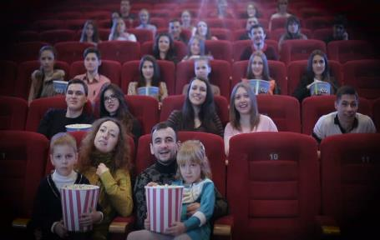
The “Heavy” Movie-Going Audience Is Young, Multicultural, Affluent, Educated, & Professional Urban/Suburbanites
Although EVERYONE goes to the movies, there are certain characteristics among the “heavy” movie-going audience, which is defined here as “have gone to the movie theater at least once in the last month” and accounts for 18% of
the A18+ population according to GfK MRI
M/F Split
Female: 51% (99)
Men: 49% (101)
Marital Status
Never Married: 35% (125)
Married: 51% (96)
Engaged: 6% (126)
Age
18-24: 20% (157)
25-34: 20% (114)
35-44: 18% (108)
18-34: 40% (132)
18-49: 66% (114)
Employment
Employed: 67% (111)
Not Employed: 32% (83)
Student: 12% (153)
Retired: 13% (71)
Education
Bachelor’s Degree Only: 22% (119)
Graduated College or More: 33% (118)
Occupation
Professional/Technical: 17% (119)
Sales: 9% (124)
Office/Administrative: 7% (116)
MGMT/Business/Financial Operations: 11% (112)
Construction / Maintenance: 5% (95)
Other: 18% (102)
Household Income
$50K+: 68% (114)
$75K+: 49% (118)
$100K+: 35% (123)
Own / Rent Home
Own: 64% (96)
Rent: 35% (117)
Geographic Skew
Lives in “A” County: 47% (112)
Lives in “B” County: 31% (105)
Lives in “C” County: 13% (88)
Lives in “D” County: 12% (67)
Race
White: 61% (90)
Black: 13% (113)
Hispanic: 20% (131)
Asian: 4% (125)
Other: 1% (92)
Presence of Children At Home
Any: 52% (132)
2+: 31% (131)
Lights, Camera, Call To Action!
Source: GfK 2016 MRI Doublebase; Base = 18+. % = composition of “heavy” movie-going audience target; Index (in parenthesis) = composition index vs. A18+ population. Red reflects indices below 90. “Heavy” movie-going target = “gone to the movie theater at least once in the last month.”

Slide 23

Key Heavy Movie-Going Audience Segment:
“Magnetic Millennials” Archetype
Connected Collectives
Technology is their lifeline and their smartphone (114) is their connector. They strive to be accessible (111) to their friends and family whenever and wherever they are. Magnetic Millennials enjoy connecting with their circle of friends across social networks (122), are heavy Instagrammers (140) and love sharing their thoughts and opinions about their favorite TV programs in real-time on Twitter (132).
Savvy Sophisticates
Career-oriented (112) and driven (114) while maintaining a strong work-life balance, they pride themselves on their sophistication (112) and indulge in finer interests like the arts (116) in their spare time. They strive to be the first one in their peer group to try a new product or service (117) and the knowledge they accumulate from this leads people to come to them for advice before making purchases (116).
With a median age of 25, Magnetic Millennials value their friendships and are (almost) always connected. They’re much more than just movie-goers as they explore a variety of interests to better themselves and maintain a very active lifestyle in both their community and throughout their travels with their strong circle of friends or partner.
Active Acolytes
Much more than just movie goers, they’re beach-going (128), bar-hopping (127), video game-playing (152), karaoke-singing (180), museum- visiting (160), concert-going (149), sport event-attending (140), live theater-going (170) foodies (118).
Stamp My Passport!
They’re not just content with doing activities in their community either, these adventurous frequent fliers (127) and passport owners (127) are active foreign travelers (139) who select vacations that offer a variety of activities to do (114).
Lights, Camera, Call To Action!
Source: GfK 2016 MRI Doublebase. Index (in parenthesis) = composition index vs. A18+ population. Based on “heavy” movie-going target = “gone to the movie theater at least once in the last month.”

Slide 24

Key Heavy Movie-Going Audience Segment:
“Family Focuseds” Archetype
Curious Connectors
Technology is a huge part of their lives and they are always connected and reachable to their family (114). They use social media to follow the activities of their family & friends (122) and network with professional contacts (136). They have a habit of turning their “brand curiosity” into “brand activism” by not only connecting with brands through social platforms (121) but also sharing their opinions of services and products online (114).
Saving Spenders
Although “Family Focuseds” are savvy with their finances (111), are moderate risk-takers looking to maximize their investments (116) and are willing to share their financial advice with others (114) while carefully monitoring their 401K to prepare for their future (117), they also enjoy living in the now and are free spenders in “family” categories like clothing/apparel (114), automotive (117), groceries (132), home entertainment and furnishings (120).
With an adult median age of 39 who have children in the 6-12 age range, Family Focuseds are always connected to their family, either through technology or through shared bonding experiences both in and out of the home that goes well beyond movie matinees. The duality of being both savers and spenders is in direct relation to the needs of their family.
Home Sweet Home!
Home is truly where their heart is as these home decorators (117) value quality family bonding time through TV nights (130) and board games (145) with their children while occasionally entertaining friends (116) with some wine & a home-cooked dinner (119).
Exuberant Experiencers
They’re not just home bodies either, whether it’s a picnic in the park (122), a trek to the zoo (141), a fun weekend dinner out at a local restaurant (139) or a week-long domestic vacation (140) or cruise (146), the family values collective experiences together.
Lights, Camera, Call To Action!
Source: GfK 2016 MRI Doublebase. Index (in parenthesis) = composition index vs. A18+ population. Based on “heavy” movie-going target = “gone to the movie theater at least once in the last month.”

Slide 25
In Many Categories, The “Heavy” Movie-Going Audience Is More Desirable Target Than Even The “Heavy” Internet User
Heavy movie-goers are more likely to be energetic Millennials that engage in a variety of activities beyond their devices and also families that seek out memorable bonding experiences. Because of this, movie-goers are a more attractive audience for top advertiser categories than heavy internet users.
Key Category Indices: “Heavy” Movie-Going Audience vs. “Heavy” Internet User
Travel
Restaurant / QSR
Clothing / Apparel
Outside Activities
Lights, Camera, Call To Action!
Source: GfK 2016 MRI Doublebase. Charts reflect “index” = composition index vs. A18+ population. “Cinema” is based on “heavy” movie-going target - “gone to the movie theater at least once in the last month” – and reflects 18% of U.S. A18+ pop. “Internet” is based on “heavy” internet user – quintile 1 (heaviest) consumption – and reflects 20% of U.S. 18+ pop.

Slide 26
What Key Categories Are Advertising In Cinema?

Slide 27
Cinema Advertising Has Nationwide Coverage On Almost
36,000 Screens, But Can Also Be Hyper-Local Targeted
Coverage in 209 Out of 210 DMAs
Lights, Camera, Call To Action!
Source: VAB Cinema Market Representation Report, 4Q 2016. Excludes Glendive, #210 ranked DMA. Cinema advertising coverage based on market representation for NCM CIneMedia, Screenvision & Spotlight Cinema.

Slide 28
Cinema Advertising Has Shown Consistent Growth Over The Last Ten Years
Cinema Advertising Revenues
(millions)
Lights, Camera, Call To Action!
Source: SNL Kagan, as of 7/18/16, reflects on-screen advertising revenues only

Slide 29
There’s Been A 14% Increase Of Cinema Advertisers Over Just The Last Three Years
# of Cinema Advertisers
Lights, Camera, Call To Action!
Source: Nielsen Ad*Intel, based on brand level advertisers; includes both national & regional cinema advertising

Slide 30





































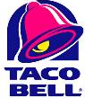


























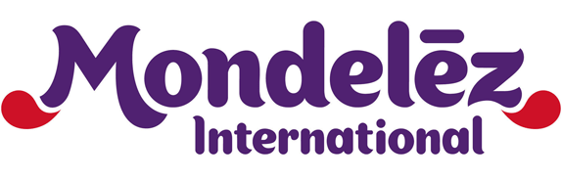
Top Advertisers Are Drawn To The Captive, Engaged & Desirable Audiences That Cinema Provides
Video Entertainment
Communications
Gaming
Apparel
Retail
Restaurants
Food
Beverage Alcohol
Lights, Camera, Call To Action!
Source: Nielsen Ad*Intel. Chart reflects an abbreviated list of select advertisers by category.

Slide 31



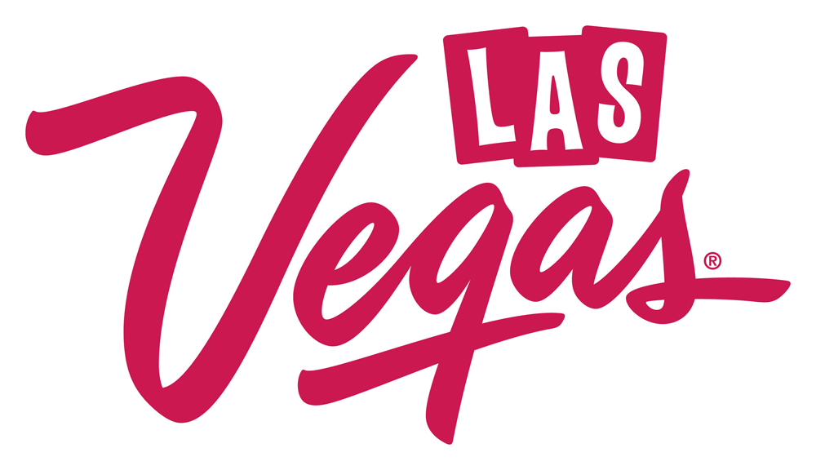

























































Cinema Advertising Runs The Spectrum Across
Millennial- & Family-Focused Categories & Brands
Live Events & Amusements
Travel
Personal Care
Home Goods
Auto
Financial
Insurance
Military
Lights, Camera, Call To Action!
Source: Nielsen Ad*Intel. Chart reflects an abbreviated list of select advertisers by category.

Slide 32
How Does Cinema Advertising Drive Consumer Action?

Slide 33
Cinema Can Increase Unique Reach As A Partial Digital Video Replacement Within An Advertiser’s Media Mix
$1MM Plan Schematics Example: “Digital Video To Cinema” Re-allocation
Est. A18+ Unique Reach (000):
22,292.3
25,744.2
+3,451.9
Budget:
$1MM
$1MM
Unique reach increases by almost 3.5MM A18+ in the revised “cinema addition” plan option
*Plan schematics based on estimated average marketplace costs for top digital video websites and cinema
Lights, Camera, Call To Action!
Source: Nielsen Media Impact based on Nielsen total media fusion data. Plan schematics and optimizations within Nielsen Media Impact are based on 5/30/16 – 6/26/16 data for the one-month 2017 projection reflected in above chart. Adults 18+.

Slide 34







Many “Primary” Cinema Advertisers See Their Monthly Website Traffic Increase When They’re Active On The Big Screen
“Primary” cinema advertisers reflect those brands who spend very little-to-no dollars on TV support and rely primarily on cinema for their targeted video adjacencies with premium, professional content
Select Examples:
“When On” / “When Off” Comparison (Jan ‘15 – Dec ‘16)
Avg Mnthly Unique Website Visitors (000):
“When On” Cinema Advertising:
1,238
278
19,646
142
“When Off” Cinema Advertising:
1,151
207
18,695
115
% Difference:
+8%
+34%
+5%
+24%
Avg Mnthly Cinema Spend “When On” (000):
+$287
+$630
+$2,366
+$499
Avg Mnthly Unique Website Visitors (000):
“When On” Cinema Advertising:
183
282
238
276
“When Off” Cinema Advertising:
110
254
129
233
% Difference:
+67%
+11%
+85%
+19%
Avg Mnthly Cinema Spend “When On” (000):
+$421
+$4,750
+$406
+$374
Lights, Camera, Call To Action!
Source: comScore mediametrix multiplatform media trend; Total audience (P2+), Jan ‘15 – Dec ‘16. Nielsen AdIntel, Cinema spend (national & regional cinema), Jan ‘15 – Dec ‘16. Reflected brands had at least two months of active comScore measurement between Jan ‘15 – Dec ’16, at least $750K in Nielsen AdIntel reported total cinema spend between 2015-2016 and at least one month each of “When On” & “When Off” activity during comScore measured months for comparison purposes. For AEG, December 2014 was included in the analysis to satisfy the minimum “when off” requirement.

Slide 35
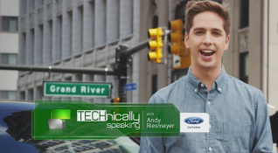
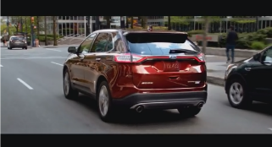

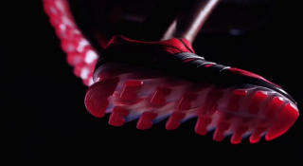
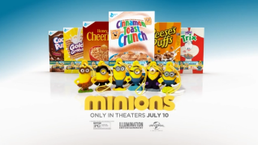
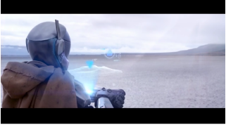
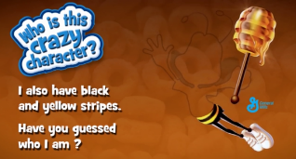
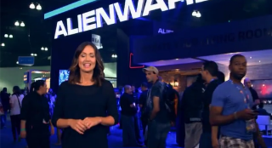
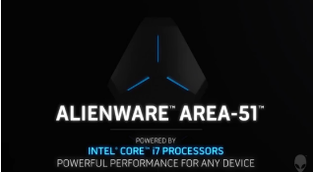
Many Advertisers Develop Branded Content For The Big Screen
That Complements Their Existing Creative Executions
Premium, long-form branded content & storytelling developed for cinema that complements existing, short-form commercials on TV, cinema and other digital platforms drives deep engagement with consumers
Ford Edge
Adidas Springbade
1:00 custom segment for cinema + :30 ad
1:00 custom integration spot with “The Wolverine” for cinema + :30 ad
:30 TV commercial
:30 TV commercial
General Mills
Alienware
Custom branded trivia segments for cinema + :15 ad
:15 TV commercial
“Exclusive footage” custom branded content segment + :30 ad
:30 TV commercial
Lights, Camera, Call To Action!

Slide 36





Cinema And TV Complement Each Other And Together Drive Consumers To Advertisers’ Websites
Select Examples:
“When On” / “When Off” Comparison (Jan ‘15 – Dec ‘16)
“When On” TV Only Months:
Avg Mnthly Unique Website Visitors (000):
2,843
11,887
1,917
3,833
611
555
Avg Monthly TV Spend (000):
$9,473
$3,392
$7,046
$3,352
$19,863
$5,344
“When On” TV + Cinema Months:
Avg Mnthly Unique Website Visitors (000):
4,274
16,242
2,527
4,462
730
861
Avg Monthly TV Spend (000):
$9,802
$3,499
$8,975
$3,710
$20,205
$8,930
Avg Monthly Cinema Spend (000):
$995
$690
$560
$477
$2,554
$486
Average Monthly % Change:
% Change – Unique Visitors:
+50%
+37%
+32%
+16%
+19%
+55%
% Change – TV Spend:
+14%
+3%
+27%
+11%
+2%
+67%
Lights, Camera, Call To Action!
Source: comScore mediametrix multiplatform media trend; Total audience (P2+), Jan ‘15 – Dec ‘16. Nielsen AdIntel, Cinema spend (national & regional cinema), TV spend (cable TV, broadcast TV, SLN cable TV, SLN broadcast TV, syndication TV, spot TV), Jan ‘15 – Dec ‘16. Selection criteria: brands had to have spent $1MM+ in cinema & $1MM+ in TV between Jan’15-Dec’16; % of cinema spend as a ratio to TV spend must have indexed over 200 vs. total market average, their brand website had to be comScore measured each month, and they must have had at least one month of “TV only” and “TV + cinema” activity.

Slide 37
What’s Next?

Slide 38












Coming Soon To A Theater Near You!
Advertisers can expect even more in 2017 – more powerful storytelling,
more films from fantastic franchises, more family fun and more big stars
Lights, Camera, Call To Action!
38

Slide 39
The Movie Industry Is Projected To Continually Break Box Office Records Over The Next Five Years
Projected Box Office Ticket Sales
(millions)
Lights, Camera, Call To Action!
Source: SNL Kagan 2016

Slide 40


Closing Credits
For More Information Visit Us Online
TheVAB.com
Follow us:
@VideoAdBureau
Like us:
facebook.com/VideoAdvertisingBureau

