Slide 1





2023
Let’s Get Down to Business
How Brand-Building Drives Outcomes for Innovative B2B Advertisers

Slide 2
What You’ll Learn…
Understand the importance of brand-building for niche advertisers in categories like business-to-business
Explore how strong brand-building strategies drive outcomes through real world examples and inspiration from 25 innovative B2B advertisers, many of which are
digital-first companies
  What are the six key strategies that successful brands are employing within their video creative to develop greater emotional connections with their customers and best prospects?
  How are advertisers balancing the branding power of marquee TV events with the targetability of audience-based buying TV to engage their best prospects across TV programming?
  What kind of business outcomes are B2B TV campaigns achieving across the purchase funnel –
  from awareness to sales - and beyond to advocacy?
This information is exclusively provided to VAB members and qualified marketers. Further distribution is prohibited.
PAGE 2

Slide 3

Why is brand-building so important
for brands with niche audiences,
like ‘business-to-business’ (B2B)?
Click here to download ‘Let it Grow’ to learn more about the importance of branding for niche marketer

Slide 4









A key challenge for B2B marketers is their need to effectively reach very niche audiences of business decision makers, regardless of category
U.S. Business Decision Maker Universes
% of Adults 18+
Total Business Decision Makers
14.8%
(38MM)
Business Decision Makers by Purchase Category
Business Decision Makers by Business Size
Banking Services
Telco / Communications
Computer Software
2.4%
(6.2MM)
2.4%
(6.2MM)
2.2%
(5.6MM)
Small Business
(<$10K spend)
Medium Business
($10k-$100k spend)
Large Business
(>$100k spend)
Temporary Help
Consultation Services
Comm. Real Estate
7.2%
(18MM)
4.7%
(12MM)
2.9%
(7MM)
1.8%
(4.5MM)
1.6%
(4.0MM)
0.7%
(1.9MM)
Source: MRI-Simmons Summer 2022 USA Study, Business Decision Makers represent respondents that have made business purchases in the last 12 months. Base = Adults 18+. Purchase categories reflects a sampling of business categories. Business size spend is based on last 12 months.
This information is exclusively provided to VAB members and qualified marketers. Further distribution is prohibited.
PAGE 4

Slide 5





Additionally, B2B brands face a set of unique challenges that most ‘consumer-facing’ brands don’t have to overcome
The average B2B purchase decision for a complex solution can involve between 6-10 people*
Business-to-Business Purchase Decision Challenges
Stakeholders
Rationality
High Stakes / High Costs
Purchase Journey
Multiple stakeholders, including decision-makers, procurement, influencers and analysts
Individual stakeholders who
are discouraged from acknowledging the role
that emotion plays, instead focusing on data and analysis
Higher stakes decisions often impact future success of business and careers due to the high cost and commitment
Longer customer journeys during which emotions and biases may evolve
Source: ARF, ‘Professionals are People Too’ webinar including HawkPartners data in the panel discussion, 7/20/22. *Gartner, ‘The B2B Buying Journey: The B2B buying process has changed, has your sales strategy?’, 2021.
This information is exclusively provided to VAB members and qualified marketers. Further distribution is prohibited.
PAGE 5

Slide 6
Establishing ‘top-of-mind’ awareness is important for B2B marketers due to the greater likelihood they will be included in a customer prospects’ consideration set even before they start their research process
95%
90%
of business clients are
not in the market for many
goods and services
at any one time
of B2B decision makers ultimately choose a vendor they had in mind before beginning the search process*
Source: ‘How B2B Brands Grow,’ The B2B Institute at LinkedIn with Ehrenberg-Bass Institute for Marketing Science (The University of South Australia), August 2021. *Harvard Business Review, ‘What B2Bs Need to Know About Their Buyers’, September 2022, survey by Bain and Google of 1,208 people at U.S. companies who are involved in buying software, cloud hosting, hardware, telecommunications, logistics, marketing, and industrial equipment
This information is exclusively provided to VAB members and qualified marketers. Further distribution is prohibited.
PAGE 6

Slide 7



With most of the research process for B2B solutions taking place through online channels now, it’s imperative for marketers to develop branding strategies that drive qualified prospects to their brands’ digital storefronts
88%
52%
41%
of B2B buyers/sellers transact via online channels
of B2B buyers
prefer online transactions to buy from B2B sellers
of B2B buyers
choose vendors that provide relevant information that makes purchase decisions easier
Source: GoodFirms, ‘B2B Services: Intelligence, Competition, and Future’, September 2022, Survey of 410 B2B buyers and sellers across comprise of ecommerce, SaaS, IT, logistics, fashion, healthcare, finance, and more.
This information is exclusively provided to VAB members and qualified marketers. Further distribution is prohibited.
PAGE 7

Slide 8






Brand-building is increasingly important for B2B companies as marketers are using it to drive key business outcomes from awareness to advocacy
81% of B2B marketing leaders say brand marketing is critical or very important to their organization’s revenue growth*
What Are Your Top Five Brand Marketing Objectives for the Next 12 Months?
% of B2B Marketers
71%
43%
42%
41%
40%
40%
of B2B marketing leaders say brand marketing has
increased in importance
in the last 12 months
Growing brand awareness
and familiarity
Improving creative stand out and creative identity
Strengthening brand
strategy and positioning
Improving
brand experience
(digitally and physically)
Growing
brand loyalty
and advocacy
Source: Transmission, ‘The State of B2B Brand Building 2022’, Base: 500 B2B senior marketing leaders, Question: Summary of Top 5 - “Looking ahead to the next 12 months, what are your top five brand marketing objectives or priorities?” *Question: “How important are brand building programs compared to demand/lead generation programs in terms of contribution to your marketing goals?”
This information is exclusively provided to VAB members and qualified marketers. Further distribution is prohibited.
PAGE 8

Slide 9







When it comes to brand-building and establishing ‘top-of-mind’ awareness while fostering customer action, advertisers of all sizes and life stages are capitalizing on the key benefits of TV to accelerate their growth
7 key reasons brands launch TV campaigns
Availability & Accessibility
Greater product availability creates greater TV accessibility both on the national and local level
Legitimizer
Creates, builds and enhances brand reputation while legitimizing their product or
service offerings
Targetability
Scalable data-driven targeting solutions like addressable TV and data-enabled TV create efficiency and limit wastage
Full-Funnel Outcomes
Through greater measurement and enhanced attribution capabilities, TV has shown its ability to drive brand results
Inclusivity
Enhanced targeting capabilities through advanced TV solutions creates efficiencies which lowers the traditional cost of entry
Storytelling
Sight, sound and motion a TV ad can convey brand identity and further humanizes the brand and what it stands for
Halo Effect
TV significantly improves the performance and ROI of all other digital channels as well as a brand’s online platforms
Click here to download ‘The Halo Effect: TV as a Growth Engine’ to learn more about why and how brands are accelerating their path to TV
This information is exclusively provided to VAB members and qualified marketers. Further distribution is prohibited.
PAGE 9

Slide 10
How do brand-building TV campaigns drive outcomes for niche advertisers in
categories like B2B?
To understand this, we analyzed 25 B2B brands that launched their first TV campaign within the last four years and explored how they are utilizing TV and audience-based buying to fuel business outcomes

Slide 11










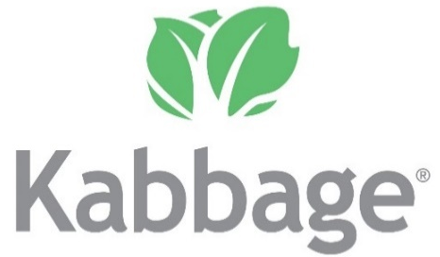





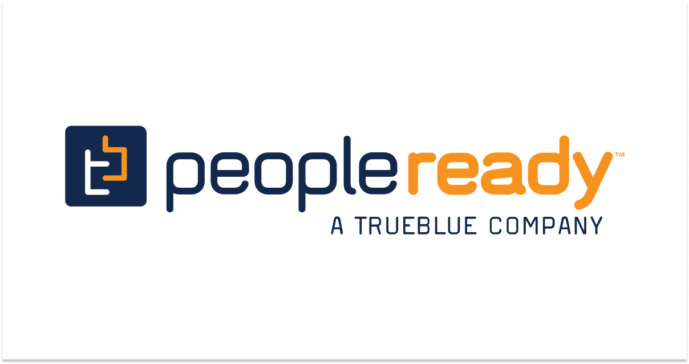








Our analysis includes 25 B2B advertisers, across 14 categories, that recently launched their first TV campaign in the last four years
The 14 categories include banking/finance, commercial real estate, consulting, expense management, security, software, staffing and more with the analysis time period spanning between April ’18 – April ‘22
AAPC
(Healthcare)
AON Consulting
(Consulting)
Avira
(Software)
Blue Vine
(Banking/Finance)
Canva
(Graphic Design)
ABM Industries
(Commercial Real Estate)
Clear
(Security)
EY-Parthenon
(Consulting)
Fiverr
(Freelancing)
Kabbage
(Banking/Finance)
Kajabi
(Software)
Expensify
(Expense Management)
Leviton Manufacturing
(Manufacturing)
Loopnet
(Commercial Real Estate)
Palo Alto Networks
(Security)
Patriot Software
(Software)
Paychex
(Payroll)
Peopleready
(Staffing)
ServiceNow
(Software)
Ten-X Realtors
(Comm. Real Estate)
Twilio
(Communications)
Workhuman
(Human Resources)
Upwork
(Freelancing)
Webflow
(Software)
Smartsheet
(Software)
This information is exclusively provided to VAB members and qualified marketers. Further distribution is prohibited.
PAGE 11

Slide 12


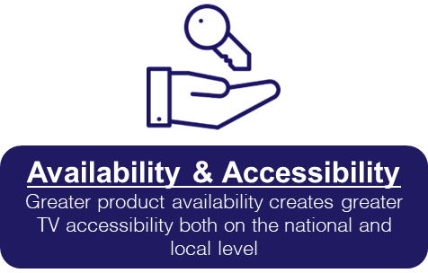
Most of these B2B brands have a strong digital component to their business, which increases their product availability and creates more opportunities to use TV as a driver for growth

Slide 13
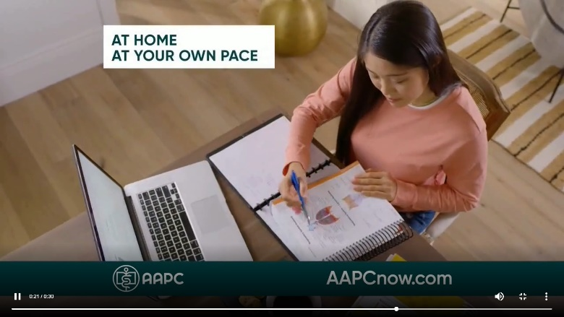
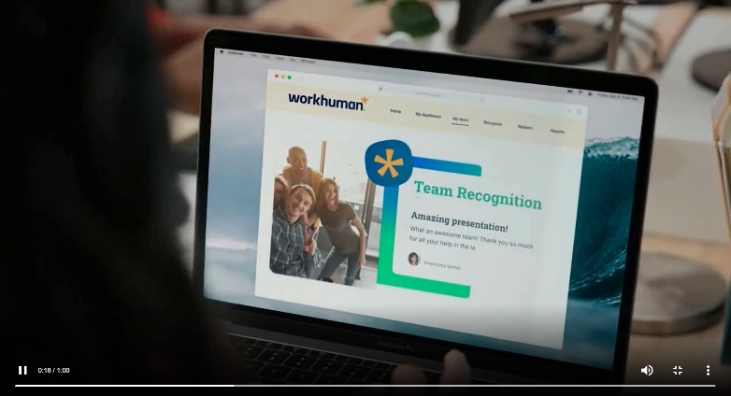
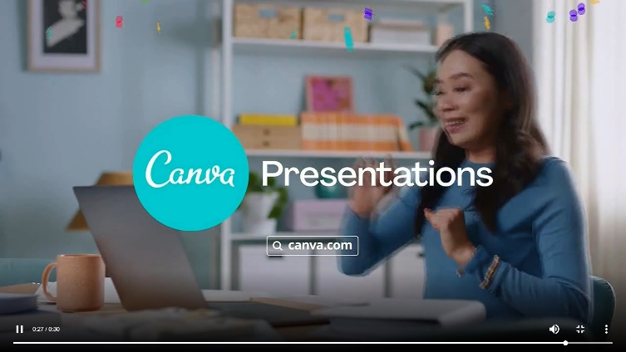
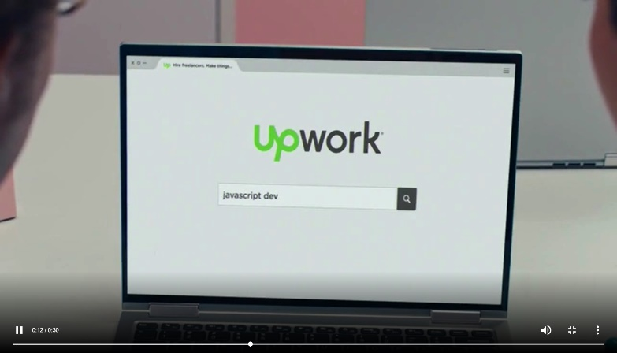
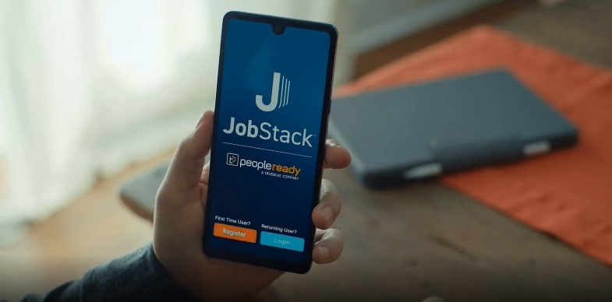
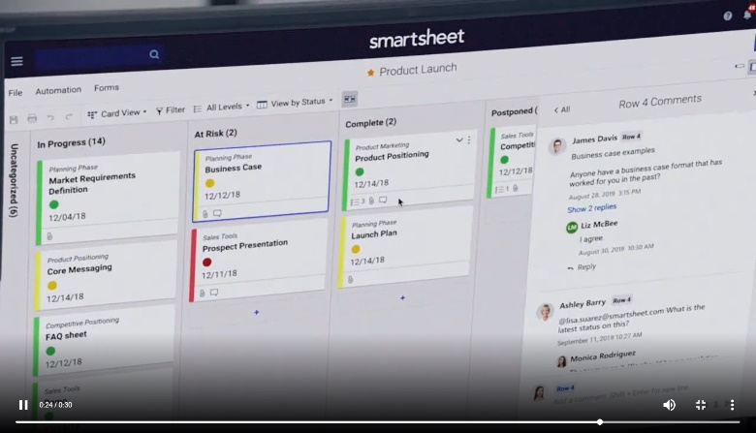
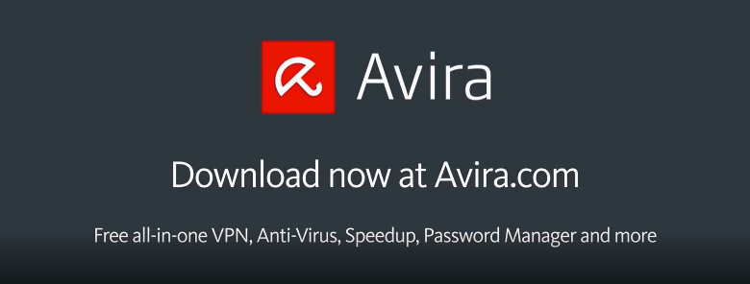
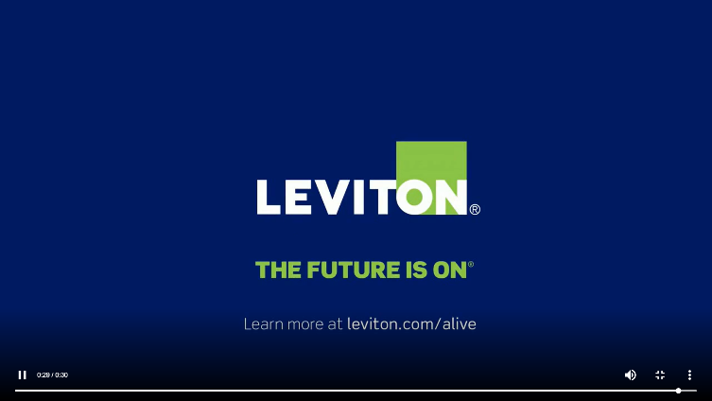
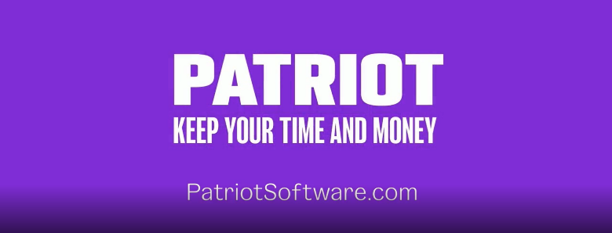
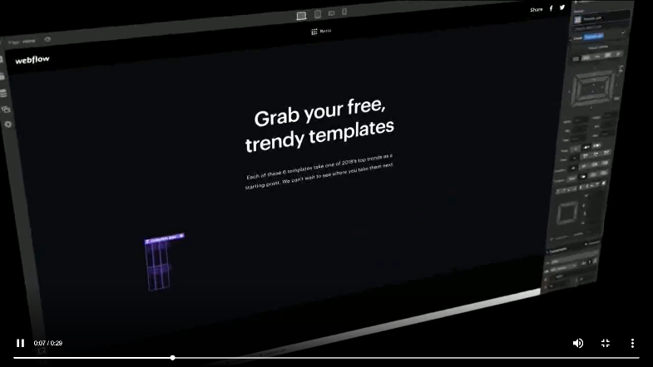
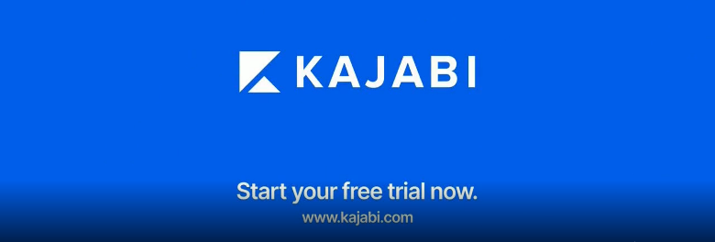
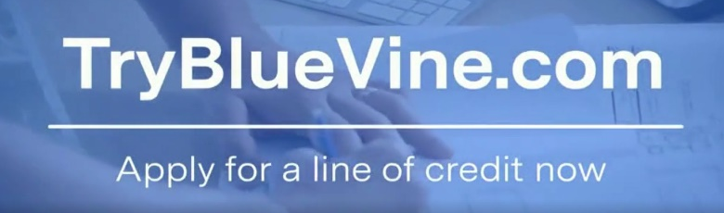
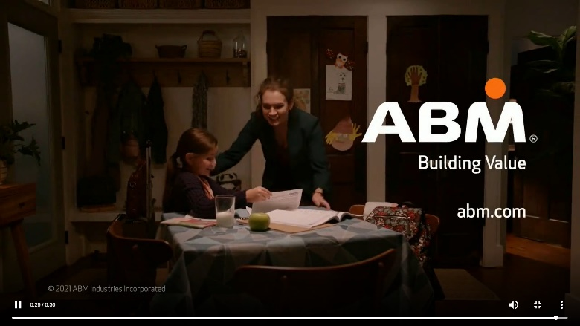

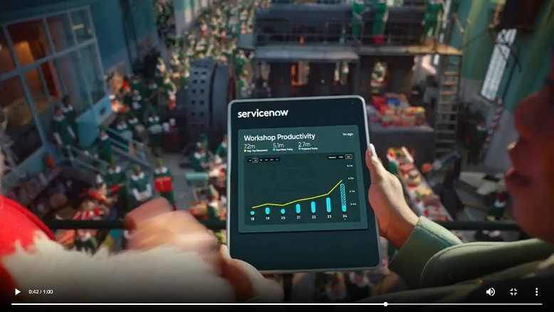

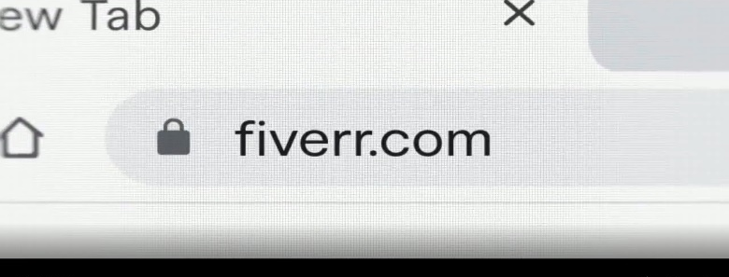
B2B brands are promoting their online capabilities, which enables greater accessibility and flexibility to meet customer needs, by showcasing either their URL or digital platform within their advertising
Examples of B2B creatives showcasing their URL or digital platforms
Source: Creative from iSpot.tv, time period of airing 4/1/18 – 4/30/22.
This information is exclusively provided to VAB members and qualified marketers. Further distribution is prohibited.
PAGE 13

Slide 14



Although digital-driven, B2B executives credit their TV campaigns for establishing their brands as a household name and market leader
86% of B2B brand marketing leaders say ‘brand marketing’ is very high or high importance for their CEO and board
“The world's first music video you can expense is basically the greatest and most fun product demonstration ever, and even better with legendary "Expensivest" 2 Chainz. We want everyone to experience Expensify, so they can get back to what they truly set out to do.”
“Fiverr has gone through some dramatic changes these past ten years and this brand evolution reflects the advancement and sophistication of the company while simultaneously embodying its purpose of providing opportunities for anyone, anywhere, to build their business, brand or dreams. Every detail, down to the font sizes and intricate color palette, was examined and reviewed to ensure that this shows the boldness of who we are as a company.”
Hannes Ciatti, Executive Creative Director of JohnXHannes NY
(PRNewswire, Expensify Teams Up with 2 Chainz and Adam Scott for World's First Music Video You Can Expense and Super Bowl Campaign, 1/24/2019)
Duncan Bird, Vice President of Brand and Digital, Fiverr
(Fiverr Unveils New Brand Campaign “It Starts Here”, Spotlights
Three Real Businesses on Their Path to Digital Transformation, 9/9/2020)
“This is an important opportunity for ABM to raise our profile and continue to position ourselves as a leader with diverse capabilities to create healthier spaces. The spotlight on essential workers and essential services is here to stay and celebrated in this commercial and across our business. It is our hope that people will feel more confident in returning to the places and spaces they love when they recognize the ABM logo.”
“As we expand the scope and reach of CLEAR’s offerings, we’re excited about the potential of “You Get You Places” [campaign] and other investments we’re making in our brand, to elevate awareness about the benefits of membership,
and to help establish CLEAR into a household name.”
Cary Bainbridge, Chief Marketing Officer, ABM
(CleanLink, ABM Launches First Ever National TV Commercial, 2/24/21)
Pamela Catlett, Chief Brand & Strategy Officer, CLEAR
(BusinessWire, CLEAR Launches First Nationwide Brand Campaign, 10/9/2018)
Source: Transmission, ‘The State of B2B Brand Building 2022”, Base: 500 B2B senior marketing leaders, Question: How much importance is placed on brand marketing by your board and/or leadership team of your company?
This information is exclusively provided to VAB members and qualified marketers. Further distribution is prohibited.
PAGE 14

Slide 15


“For a while, there was a lot of buzzworthy conversation about TV being a dying channel. The reality is that TV is anything but that.
It continues to show up, deliver eyeballs and show interest.
We found a more engaged audience. That coupled with what’s happening on the digital front with rising CPMs … in many cases we weighed out higher efficiencies on TV.”
Orlando Baeza, Chief Marketing Officer, Kajabi
(Digiday, ‘We found a more engaged audience’: Why Kajabi is increasing its media spending on TV now, 7/29/2021)
This information is exclusively provided to VAB members and qualified marketers. Further distribution is prohibited.
PAGE 15

Slide 16
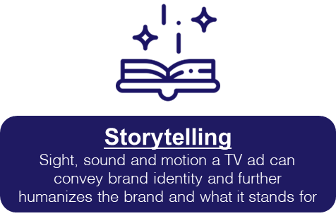
These new B2B TV advertisers launched with fresh, dynamic creative messaging that moved beyond most of the ‘traditional norms’ of what business-
to-business advertising was

Slide 17
B2B brands are evolving their video creative with more dynamic messaging by employing six key strategies to develop a greater emotional connection with their customers and best prospects
Utilizing the credibility
of premium video to establish themselves
as a trusted brand
Highlighting the value proposition of their product or service through
strong visual branding
Humanizing their brand through emotional messaging and
personal stories
Becoming more approachable with lighthearted, humorous messaging
Leveraging celebrities
with wide appeal
Reflecting authentic representation by incorporating greater diversity & inclusion
This information is exclusively provided to VAB members and qualified marketers. Further distribution is prohibited.
PAGE 17

Slide 18

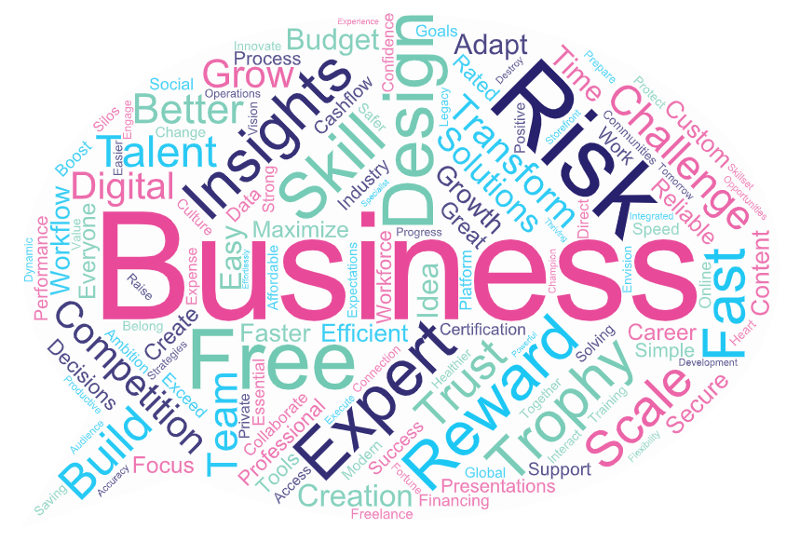

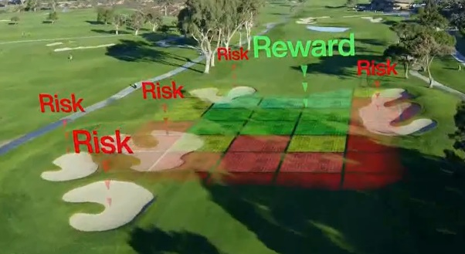





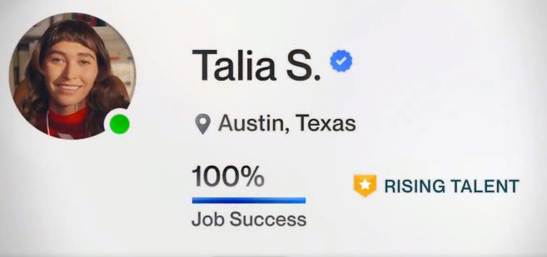

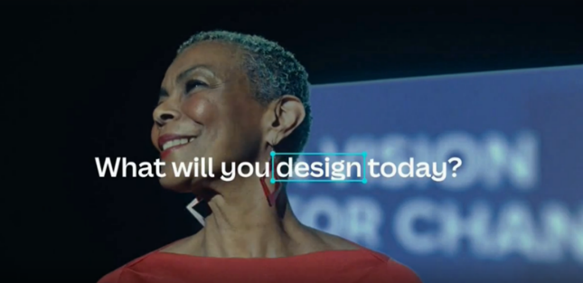

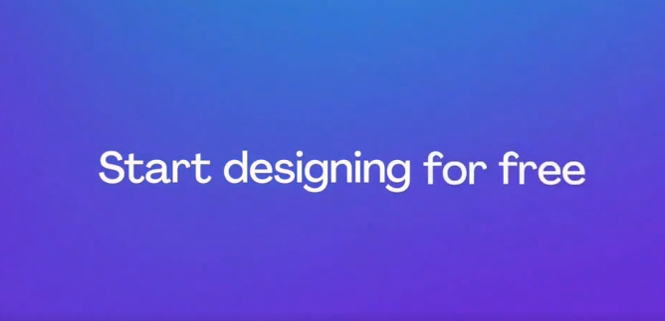
Brands are aligning with the credibility of premium video programming
to position themselves as established, trustworthy experts
B2B brands’ creative messaging focuses on themes and keywords like ‘trustworthy,’ ‘risk,’ ‘talent,’ ‘scale,’ ‘transform’ and ‘expert’
Common key words used in TV campaigns
across the 25 B2B brands analyzed
Examples of B2B campaigns with consistent messaging
Source: Creative from iSpot.tv, time period of airing 4/1/18 – 4/30/22, note: each creative execution had to launch before 4/30/22 so some may still be actively airing on TV. Click images to watch TV spots.
This information is exclusively provided to VAB members and qualified marketers. Further distribution is prohibited.
PAGE 18

Slide 19

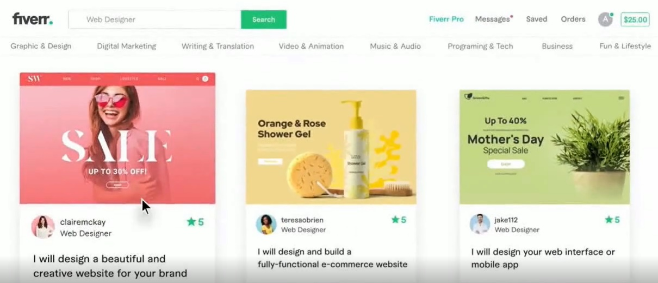
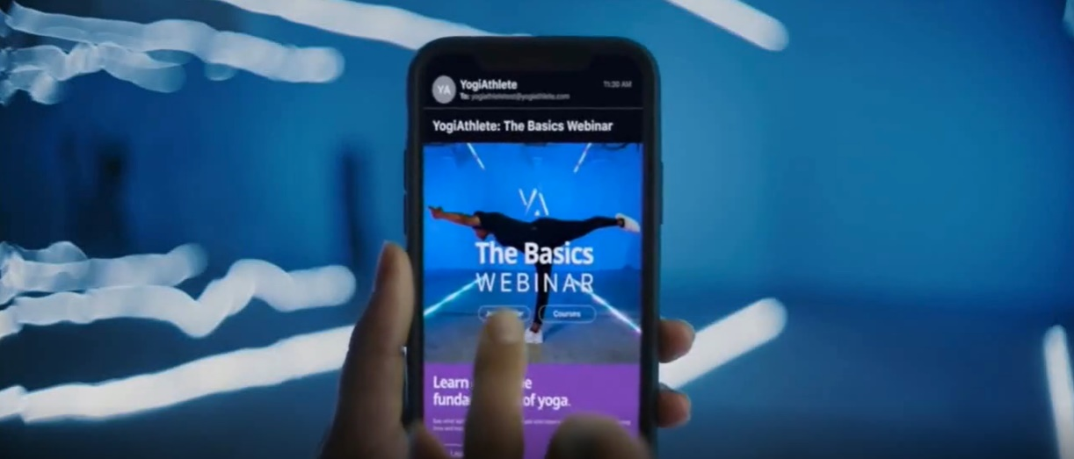



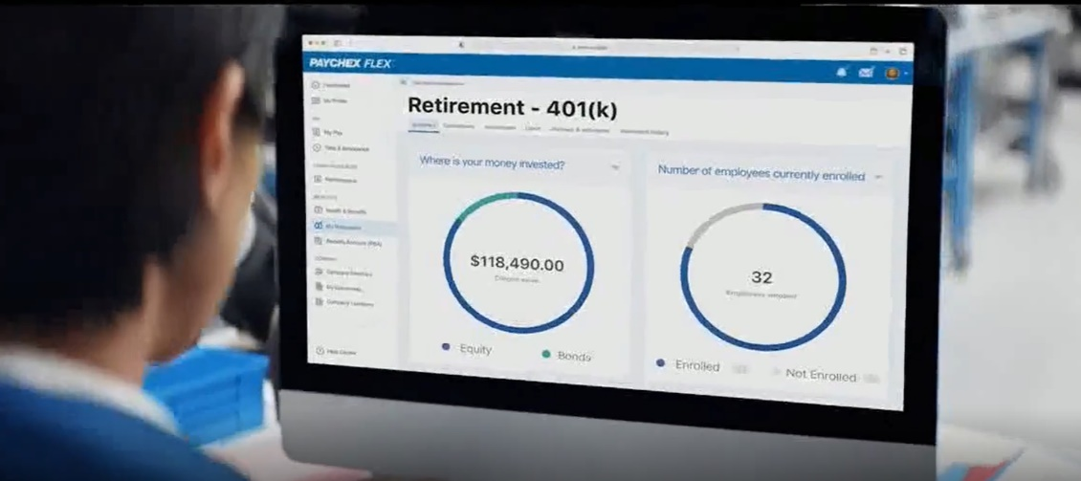
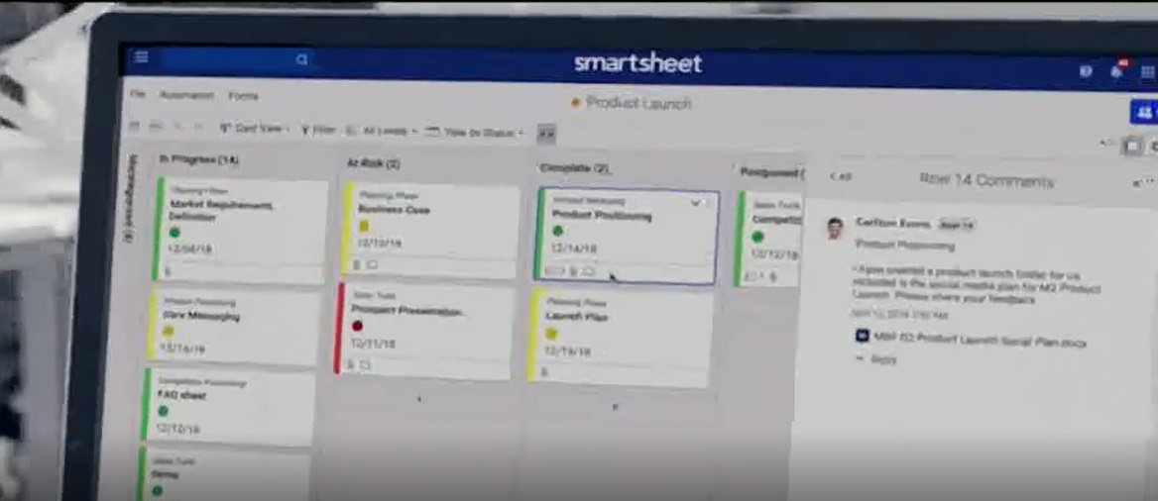
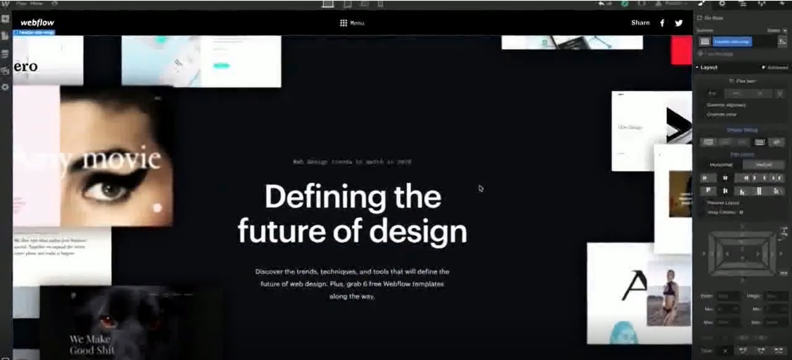
B2B brands are utilizing strong visual branding to demonstrate their products and services – which often includes showcasing their digital user interfaces and software design
‘Patina & Co.: Digital Presence’ TV Spot
(TV spot first aired: 9/14/2020)
‘What Will You Create: Yoga’ TV Spot
(TV spot first aired: 6/24/2021)
‘Use Your Voice with Decora Smart’ TV Spot
(TV spot first aired: 11/26/2018)
‘HR Can Be Hard. Paychex HR Technology Makes It Simple’ TV Spot
(TV spot first aired: 11/23/2021)
‘Achieve More With Smartsheet’ TV Spot
(TV spot first aired: 9/16/2019)
‘Design Tool From the Future’ TV Spot
(TV spot first aired: 8/4/2020)
Source: Creative from iSpot.tv, time period of airing 4/1/18 – 4/30/22, note: each creative execution had to launch before 4/30/22 so some may still be actively airing on TV. Click above images to watch TV spots.
This information is exclusively provided to VAB members and qualified marketers. Further distribution is prohibited.
PAGE 19

Slide 20


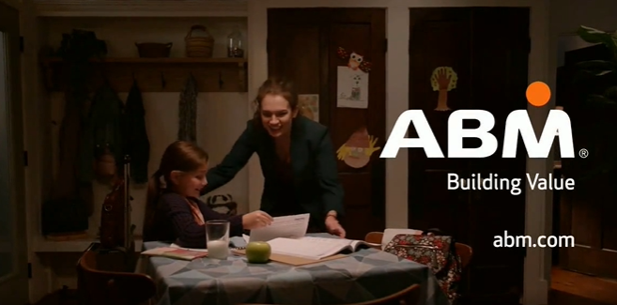
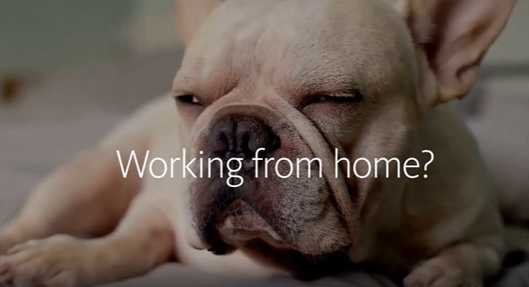
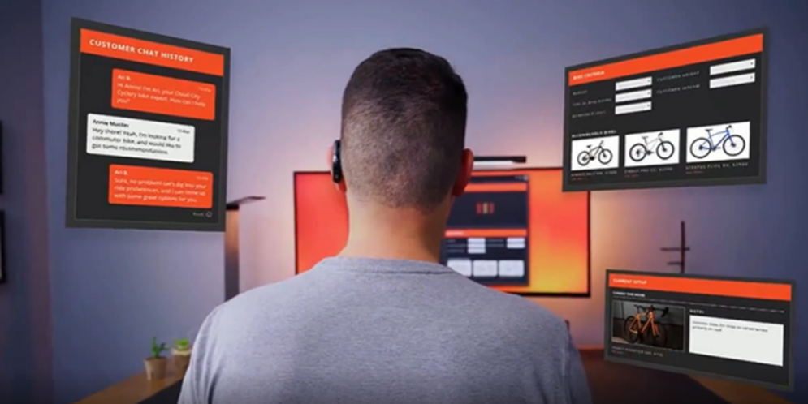
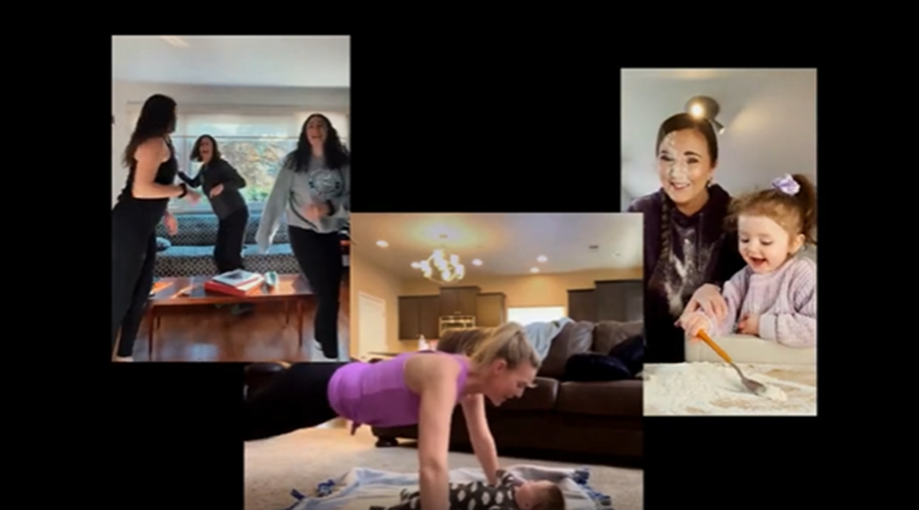
Beyond showcasing the functional product benefits, marketers are humanizing their brands through emotional messaging by integrating personal stories to better connect with best prospects and stakeholders
B2B campaigns targeting professionals who work from home and / or have families
Business purchase decision makers are people too.
Through personal stories and emotional messages, brands
are engaging their customers by showing they understand their goals as well as their daily challenges, like working from home and balancing their professional and personal lives.
(TV spot first aired: 2/22/21)
(TV spot first aired: 4/13/20)
(TV spot first aired: 9/7/20)
(TV spot first aired: 4/29/22)
Source: Creative from iSpot.tv, time period of airing 4/1/18 – 4/30/22, note: each creative execution had to launch before 4/30/22 so some may still be actively airing on TV. Click above images to watch TV spots.
This information is exclusively provided to VAB members and qualified marketers. Further distribution is prohibited.
PAGE 20

Slide 21
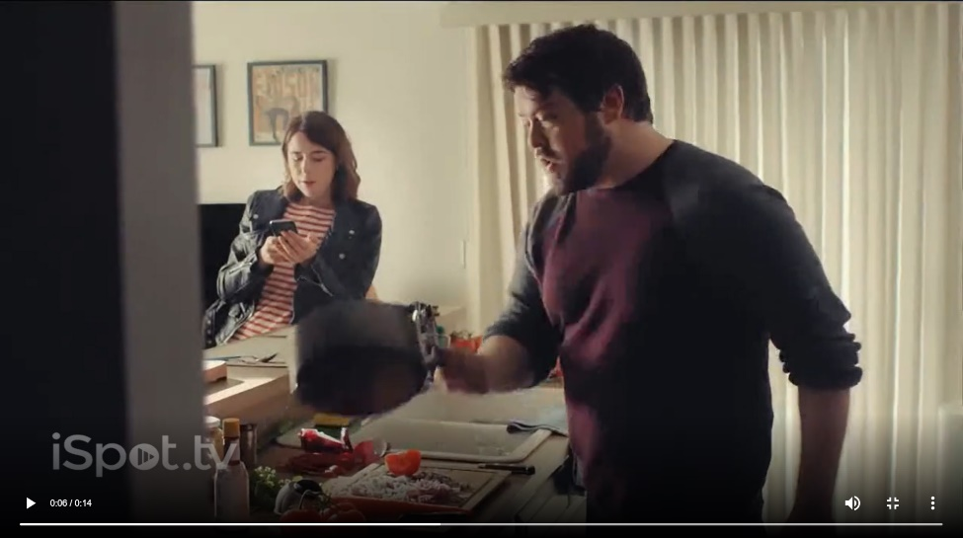

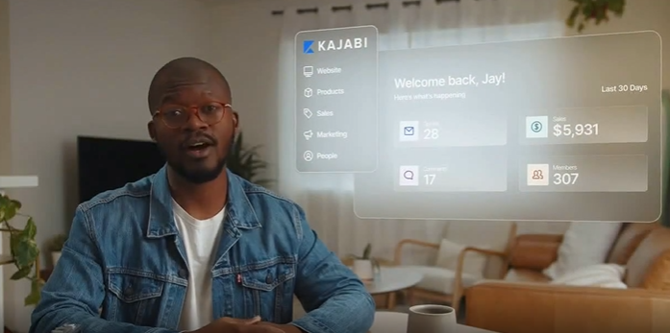
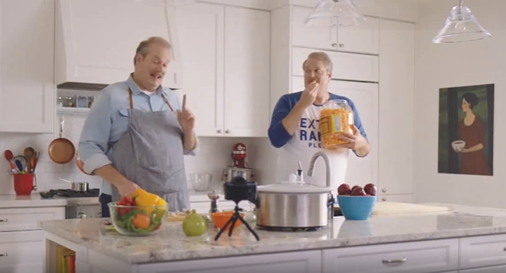


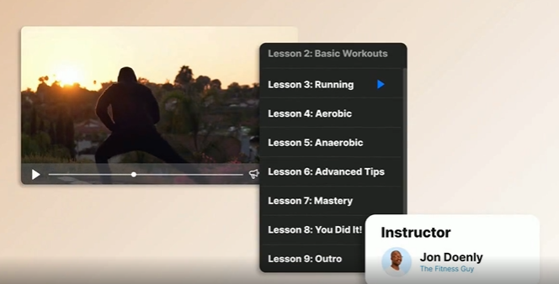
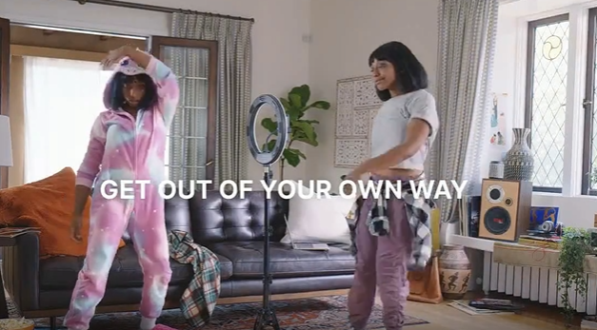
Brands are also emotionally connecting with stakeholders by becoming more approachable through lighthearted, humorous and fun messaging
42% of B2B brand marketing leaders state that improving creative stand out and creative identity is an important brand building focus area for the year ahead*
‘Digital Workflows Are Just the Ticket to Help Wonka’s Fantastical Factory’
‘All in One Platform: Free Trial’
‘Get Out Of Your Own Way With Carl: FroYo Machine’
‘Experiences without Barriers’
(TV spot first aired: 3/30/2020)
(TV spot first aired: 4/26/2021)
(TV spot first aired: 4/19/2019)
(TV spot first aired: 10/5/2020)
‘Sound Effects’
‘Even Santa Needs a Holiday From Complexity’
‘Get Out Of Your Own Way With Kim: The Dougie’
‘Digital Product Creation’
(TV spot first aired: 3/13/2020)
(TV spot first aired: 1/18/2021)
(TV spot first aired: 9/22/2020)
(TV spot first aired: 9/29/2020)
Source: Creative from iSpot.tv, time period of airing 4/1/18 – 4/30/22, note: each creative execution had to launch before 4/30/22 so some may still be actively airing on TV. Click above images to watch TV spots. *Transmission, ‘The State of B2B Brand Building 2022”, Base: 500 B2B senior marketing leaders.
This information is exclusively provided to VAB members and qualified marketers. Further distribution is prohibited.
PAGE 21

Slide 22

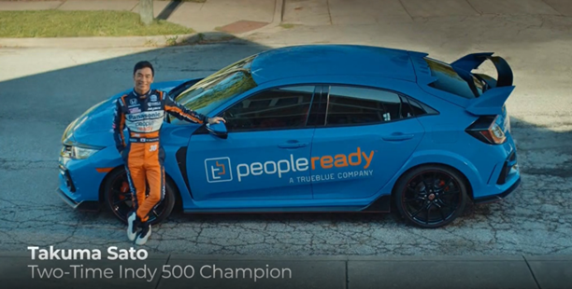
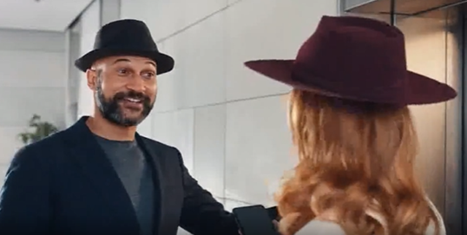







Successful B2B brands are also standing out by leveraging celebrities with wide appeal – such as actors, athletes, musicians, comedians
‘Ride to Work’ TV Spot
(TV spot first aired: 5/22/2021)
‘Elevator’ TV Spot
Featuring Keegan-Michael Key
(TV spot first aired: 4/19/2021)
‘PGA Tour: Risk Reward Challenge’ TV Spot
(TV spot first aired: 1/26/2019)
Super Bowl 2019 ‘Expensify This’ TV Spot
Featuring 2 Chainz and Adam Scott
(TV spot first aired: 2/3/2019)
‘We Got Next’ TV Spot
Featuring Lena Waithe, Gustavo Dudamel, Robin Frijns
(TV spot first aired: 8/30/2021)
2019 Cannes Lions
2 Gold Lion Awards
2 Silver Lion Awards
3 Bronze Lion Awards
2022 SC Awards
Winner for Security Marketing Campaign of the Year
Source: Creative from iSpot.tv, time period of airing 4/1/18 – 4/30/22, note: each creative execution had to launch before 4/30/22 so some may still be actively airing on TV. Click above images to watch TV spots. The SC Awards are the cybersecurity industry’s most prestigious and competitive honor from SC Magazine.
This information is exclusively provided to VAB members and qualified marketers. Further distribution is prohibited.
PAGE 22

Slide 23



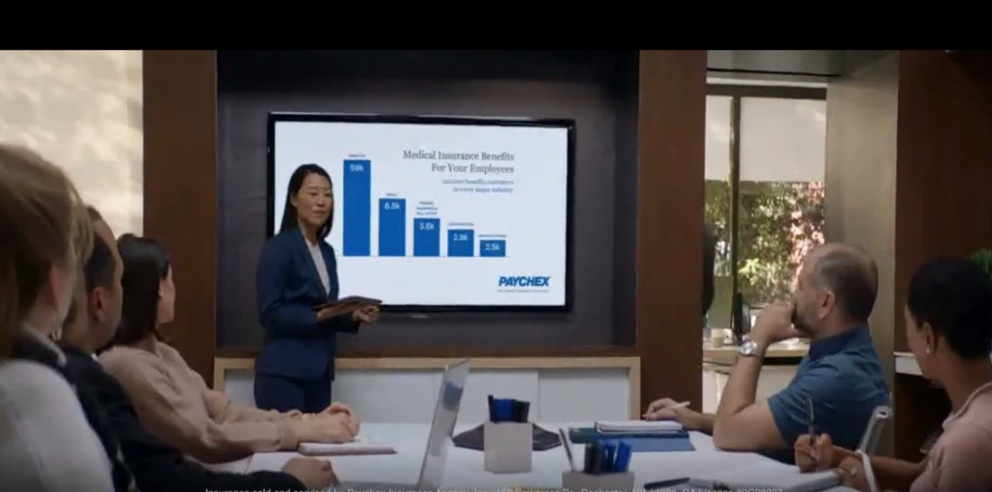




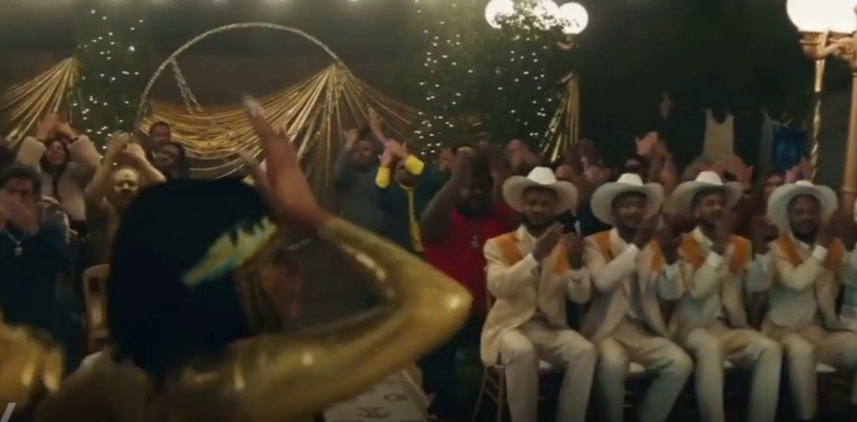

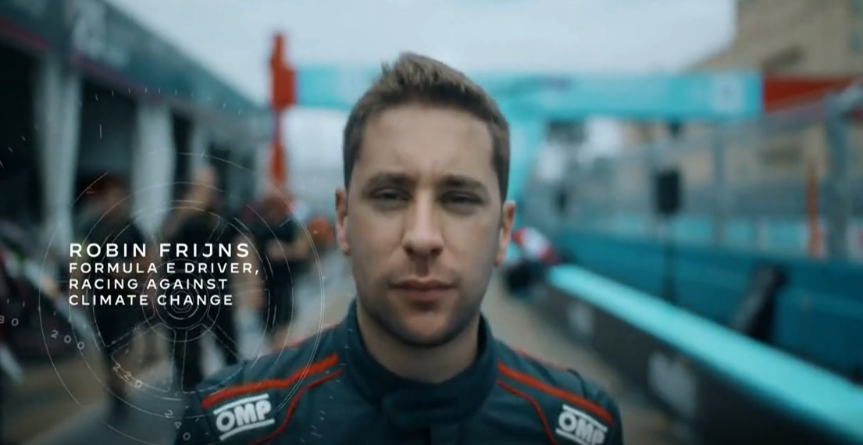
Understanding the importance of authentic representation, B2B brand messaging is increasingly reflective of inclusive stories and casting
Going beyond diverse casting, B2B campaigns are seen appealing to audiences from all ages, genders and family structures
(TV spot first aired: 9/26/2019)
(TV spot first aired: 9/21/2020)
(TV spot first aired: 10/6/2020)
(TV spot first aired: 2/3/2019)
(TV spot first aired: 8/20/2021)
(TV spot first aired: 9/20/2021)
Source: Creative from iSpot.tv, time period of airing 4/1/18 – 4/30/22, note: each creative execution had to launch before 4/30/22 so some may still be actively airing on TV. Click above images to watch TV spots.
This information is exclusively provided to VAB members and qualified marketers. Further distribution is prohibited.
PAGE 23

Slide 24
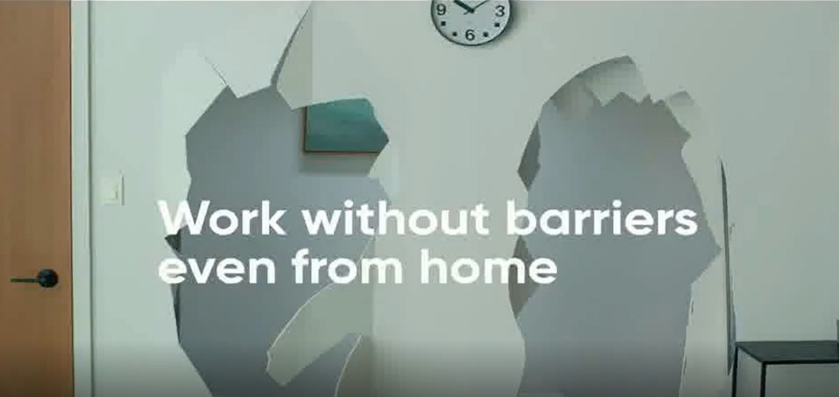
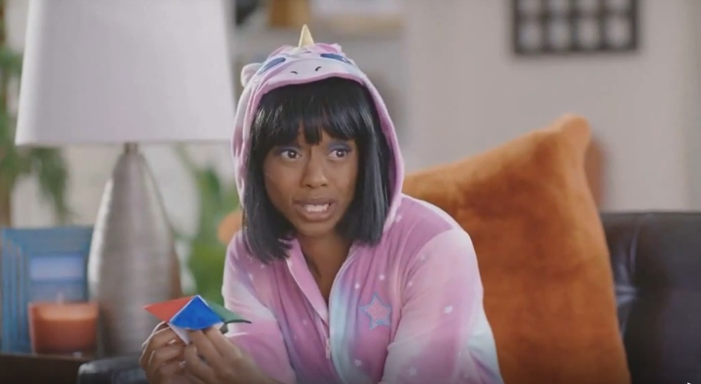
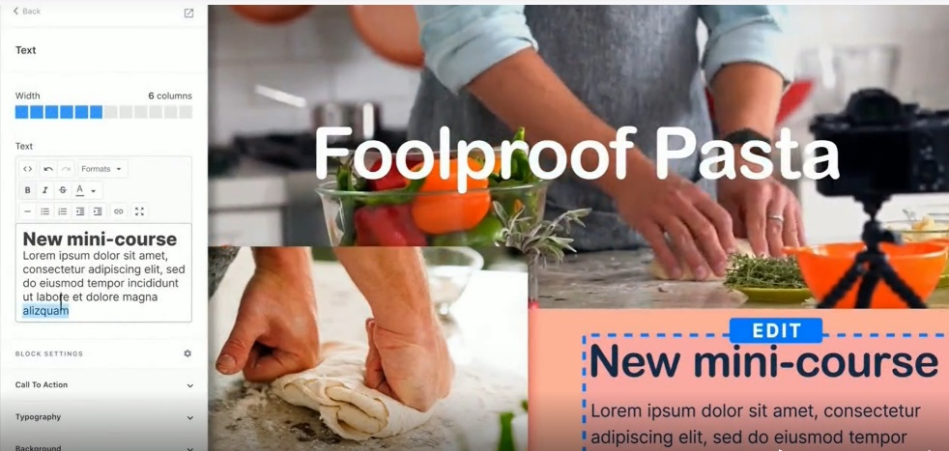
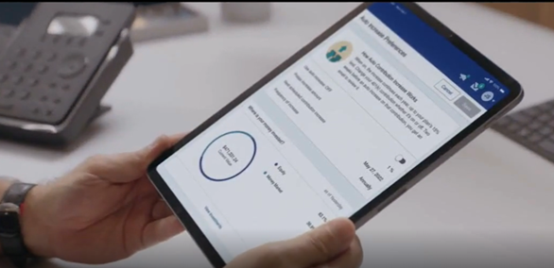



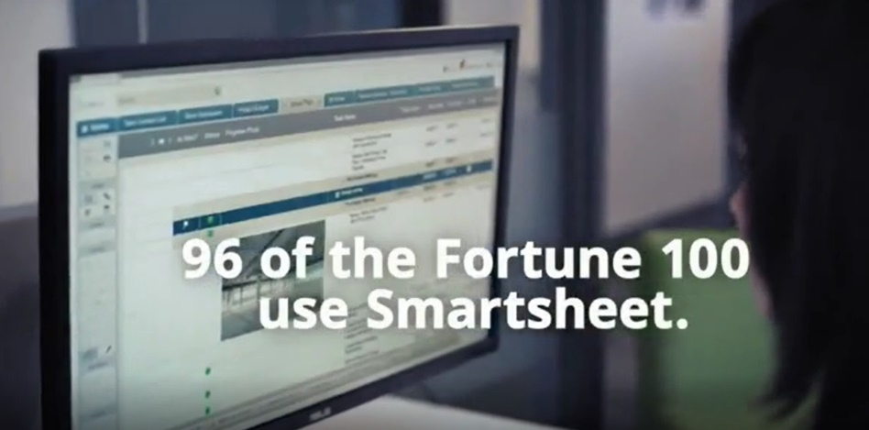

From an ad attention perspective, B2B video creative that features lighthearted messaging and strong visual branding tends to be the most engaging and helps initiate the purchase journey for their best prospects
Lighthearted, funny and relatable messaging
Visual branding with a focus on products services
‘Experience Without Barriers’
(TV Spot first aired: 3/30/20)
‘Get Out Of Your Own Way With Kim: What People Want’
(TV Spot first aired: 9/29/20)
‘Every Business Needs a Website’
(TV Spot first aired: 9/20/20)
'Making 401(k) Simple’
(TV Spot first aired: 7/30/21)
159
Ad Attention Index
155
Ad Attention Index
160
Ad Attention Index
154
Ad Attention Index
Super Bowl 2019 TV Spot, 'Expensify This' Featuring 2 Chainz, Adam Scott
(TV Spot first aired: 2/3/19)
‘Make it Easier’
(TV Spot first aired: 10/26/19)
‘96 of 100’
(TV Spot first aired: 10/9/18)
'Protect Your Home' Featuring Danny Lipford
(TV Spot first aired: 10/11/20)
152
Ad Attention Index
132
Ad Attention Index
141
Ad Attention Index
132
Ad Attention Index
How to read: ‘Experience Without Barriers’ (159 index) had 59% less interruptions than other ads in the context of the media placement with a 100 score being average.
Source: Creative from iSpot.tv, time period of airing 4/1/18 – 4/30/22, note: each creative execution had to launch before 4/30/22 so some may still be actively airing on TV. Ad Attention Index within iSpot.tv’s Attention Analytics. Index scale is 0-200 with a 100 index seeing ad performance as expected. Click above images to watch TV spots.
This information is exclusively provided to VAB members and qualified marketers. Further distribution is prohibited.
PAGE 24

Slide 25
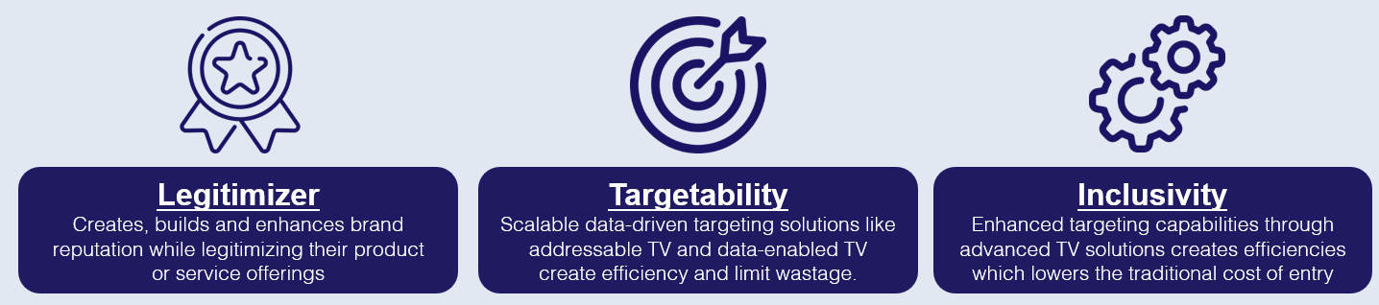
Even with a niche target, B2B advertisers are balancing the branding power of marquee TV events with the targetability of audience-based TV buying to engage their best customer prospects across TV programming

Slide 26




























B2B advertisers are leveraging marquee TV events like the Superbowl, sports playoffs, awards specials and entertainment series to legitimize their brand across a wide array of stakeholders
54% of B2B brand marketing leaders say brand building is equally as important as demand generation*
Sampling of Marquee Nat’l TV Programs Advertised On
Based Over a Four-Year Time Period: Apr ‘18 – Apr ‘22
Source: VAB analysis of Nielsen AdIntel, 04/01/18-04/30/22, National TV includes cable TV, broadcast TV, Spanish language cable TV and Spanish language broadcast TV across 25 brands included in analysis. Note: Listed genres and programs are only a sampling. *Transmission, ‘The State of B2B Brand Building 2022”, Base: 500 B2B senior marketing leaders, Question: How important are brand building programs compared to demand/lead generation programs in terms of contribution to your marketing goals?
This information is exclusively provided to VAB members and qualified marketers. Further distribution is prohibited.
PAGE 26

Slide 27












Successful brands with niche audiences, like in B2B categories, are
utilizing the personalization and targetability of audience-based buying
to effectively optimize their TV buys against their best customer prospects
Marketers can buy TV on buying habits, characteristics or viewing behaviors (programs, genres watched)
which is a more accurate, and cost-effective, surrogate for their customer than a prescribed age bucket
B2B Targeting Examples
Buying Habits
Personal Characteristics
TV Viewing Behaviors
Software
Business Licenses
Business
Decision Makers
C-Suite
Executives
Business News
Award Shows
Computers
Commercial
Real Estate
Small Business Owners
Managers
Sports
Drama
This information is exclusively provided to VAB members and qualified marketers. Further distribution is prohibited.
PAGE 27

Slide 28

B2B brands implement an audience-first approach, evidenced by their TV campaigns which run across a broad mix of programming
Over the last four years, the 25 brands in total have advertised across 118 national TV networks, 132 genres and 6,843 programs
25 B2B Brand Average: Nat’l TV Programs, Genres and Networks
Based Over a Four-Year Time Period: Apr ‘18 – Apr ‘22
21
28
464
Avg #
of TV Networks
Avg #
of Genres*
Avg #
of Programs
To reach targeted stakeholders, B2B brands are advertising across a mix of sports, lifestyle and entertainment networks in addition to business and news programming
Source: VAB analysis of Nielsen AdIntel, 04/01/18-04/30/22, National TV includes cable TV, broadcast TV, Spanish language cable TV and Spanish language broadcast TV across 25 brands included in analysis. *Number of Genres includes sub-genres, e.g. ‘Sports Event: NFL Football / Regular Season.’ The total count for the 25 brands reflects an unduplicated count across national TV networks, genres and programs.
This information is exclusively provided to VAB members and qualified marketers. Further distribution is prohibited.
PAGE 28

Slide 29
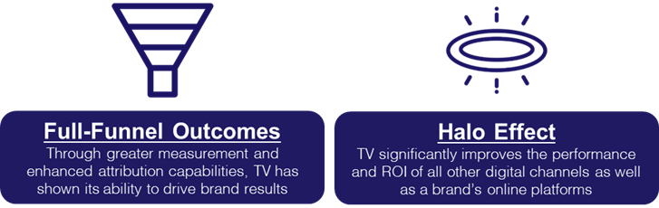
B2B TV campaigns featuring dynamic creative messaging, impactful media placements and targeted program alignments ignited business outcomes through the purchase journey and beyond

Slide 30






Awareness & Interest
B2B TV campaigns drove awareness and interest among potential customers resulting in a spike in online brand searches across
the launch period and beyond
Brands that launched campaigns, even with different flight lengths, saw the direct impact of TV spend on their search volume
Weekly National TV Spend vs. Weekly Google Trends Index
1 Month Campaign
12 Month Campaign
18+ Month Campaign
Avira saw an immediate spike in searches, their highest level, when they launched their first-ever
TV campaign
Kabbage’s TV campaign drove their brand to see it’s highest level of search queries and lifts through the campaign
Canva launched their first TV campaign and saw sustained highest-ever levels of search activity with their TV spend
Click here to see three more real-world examples of how TV spend drives search for brands
Source: VAB analysis of Google Trends, United States only, All Categories, Web Search, 04/01/18-04/30/22. *Google Search Index represents search interest relative to the highest point on the chart for the given region and time period, a value of 100 is the peak popularity for the term, a value of 50 means that the term is half as popular. VAB analysis of Nielsen AdIntel for TV spending, 07/01/18-06/30/22, TV spend includes cable TV, broadcast TV, Spanish language cable TV, Spanish language broadcast TV, spot TV, and syndicated TV. U.S. TV spend only; Note: Magenta line marks the first week of TV spending for each brand.
This information is exclusively provided to VAB members and qualified marketers. Further distribution is prohibited.
PAGE 30

Slide 31
Intent
Beyond increased search volume, TV campaign launches drove immediate, double-digit lifts in prospects to B2B brands’ own websites
These lifts were achieved even with the average brand age being 30 years old and presumably other media buys (such as social, search and print) implemented in the years prior to their TV launch
25 B2B Brands Analysis: Average Monthly Website Unique Visitors
Monthly Website Unique Visitors (000) Comparison
Based Over a Four-Year Time Period: Apr ‘18 – Apr ‘22
TV launch month vs.
three months average prior to TV launch
+15%
+127K monthly uniques
(monthly average)
Source: VAB analysis of Comscore mediametrix multiplatform media trend data, P18+. April 2018 – April 2022 (calendar months), figures are based on monthly averages for the 25 brands analyzed.
This information is exclusively provided to VAB members and qualified marketers. Further distribution is prohibited.
PAGE 31

Slide 32
Intent
Since most B2B buyers are not currently in-market at any one time,
a sustained presence on TV beyond its launch drives more new customer prospects to a brand’s digital platform each month across their campaign
25 B2B Brands Analysis: Average Monthly Website Unique Visitors
Monthly Website Unique Visitors (000) Comparison
Based Over a Four-Year Time Period: Apr ‘18 – Apr ‘22
+35%
+305K monthly uniques
+15%
+127K monthly uniques
vs. three months average prior to TV launch
vs. three months average prior to TV launch
(monthly average)
(TV launch – April 2022)
Source: VAB analysis of Comscore mediametrix multiplatform media trend data, P18+. April 2018 – April 2022 (calendar months), figures are based on monthly averages for the 25 brands analyzed. ‘When On TV’ represents the monthly average for brands in months where they spend on national TV as measured through Nielsen AdIntel across the April 2018 – April 2022 (calendar months) time period across the 25 brands analyzed. During this four-year analysis, the average B2B advertiser was on TV for 12 months.
This information is exclusively provided to VAB members and qualified marketers. Further distribution is prohibited.
PAGE 32

Slide 33






Intent
Many individual B2B brands saw double- and triple-digit increases
of prospective buyers to their digital platforms when they were actively
on TV, with smaller brands seeing some of the largest increases
Sampling of Brands: Monthly Website Unique Visitors (000) Comparison
Based Over a Four-Year Time Period: Apr ‘18 – Apr ‘22
Brand | B2B Category | Three-Month Average: Prior to TV Launch | Monthly Average: ‘When On TV’ | # Diff (000) | % Diff
 | Software | 71 | 153 | +82 | +115%
 | Graphic Design | 5,281 | 9,480 | +4,199 | +80%
 | Security | 217 | 644 | +427 | +197%
 | Expense Mgmt. | 240 | 477 | +237 | +99%
 | Banking/Finance | 118 | 241 | +123 | +105%
 | Software | 142 | 306 | +164 | +116%
 | Staffing | 118 | 163 | +45 | +38%
 | Software | 1,288 | 1,723 | +434 | +34%
 | Comm. Real Estate | 144 | 419 | +275 | +191%
 | Freelancing | 1,542 | 1,759 | +216 | +14%
 | Software | 387 | 698 | +312 | +81%
 | Human Resources | 15 | 156 | +141 | +929%
Source: VAB analysis of Comscore mediametrix multiplatform media trend data, P18+. April 2018 – April 2022 (calendar months), figures are based on monthly averages for the 25 brands analyzed. ‘When On TV’ represents the monthly average for brands in months where they spend on national TV as measured through Nielsen AdIntel across the April 2018 – April 2022 (calendar months) time period across the 25 brands analyzed.
This information is exclusively provided to VAB members and qualified marketers. Further distribution is prohibited.
PAGE 33

Slide 34
Intent
A ‘halo effect’ exists after campaign launch due to the memorability of brand advertising which means that companies’ websites continue to see more visitors than pre-TV launch even in months when they are not on TV
25 B2B Brands Analysis
Monthly Website Unique Visitors (000) Comparison
Based Over a Four-Year Time Period: Apr ‘18 – Apr ‘22
+35%
+26%
+305K monthly uniques
+226K monthly uniques
vs. three months average prior to TV launch
vs. three months average prior to TV launch
Monthly Average ‘When On TV’
(monthly average)
(TV launch – April 2022)
(TV launch – April 2022)
Source: VAB analysis of Comscore mediametrix multiplatform media trend data, P18+. April 2018 – April 2022 (calendar months), figures are based on monthly averages for the 25 brands analyzed. ‘When On TV’ represents the monthly average for brands in months where they spend on national TV as measured through Nielsen AdIntel across the April 2018 – April 2022 (calendar months) time period across the 25 brands analyzed. ‘When Not On Air’ represents the monthly average for brands in months where they don’t spend on national TV, after their first month of TV spend, as measured through Nielsen AdIntel across the April 2018 – April 2022 (calendar months) time period across the 25 brands analyzed.
This information is exclusively provided to VAB members and qualified marketers. Further distribution is prohibited.
PAGE 34

Slide 35
Intent
Younger brands that accelerated their path to TV saw the largest impact from their campaign launch as they used the platform to establish their product, story and identity in the marketplace among targeted stakeholders
15 Years or Younger: 10 B2B Brands Analysis
Monthly Website Unique Visitors (000) Comparison
Based Over a Four-Year Time Period: Apr ‘18 – Apr ‘22
Average brand age: 11 years old
+52%
+618K monthly uniques
+16%
+194K monthly uniques
vs. three months average prior to TV launch
vs. three months average prior to TV launch
(monthly average)
(TV launch – April 2022)
Source: VAB analysis of Comscore mediametrix multiplatform media trend data, P18+. April 2018 – April 2022 (calendar months), figures are based on monthly averages for the 10 brands analyzed. ‘When On TV’ represents the monthly average for brands in months where they spend on national TV as measured through Nielsen AdIntel across the April 2018 – April 2022 (calendar months) time period across the 10 brands analyzed. ‘15 Years and Younger’ represents 10 B2B brands of the 25 total. ‘15 Years and Younger’ Brands: BlueVine, Canva, Clear, Expensify, Fiverr, Kabbage, Kajabi, Twilio, Upwork and Webflow.
This information is exclusively provided to VAB members and qualified marketers. Further distribution is prohibited.
PAGE 35

Slide 36
Intent
Even more established brands that have existed for decades witnessed double-digit increases in traffic as their TV campaign launch funneled new sets of potential customers to their company’s website
16 Years or Older: 15 B2B Brands Analysis
Monthly Website Unique Visitors (000) Comparison
Based Over a Four-Year Time Period: Apr ‘18 – Apr ‘22
Average brand age: 40 years old
+13%
+15%
+82K monthly uniques
+97K monthly uniques
vs. three months average prior to TV launch
vs. three months average prior to TV launch
(monthly average)
(TV launch – April 2022)
Source: VAB analysis of Comscore mediametrix multiplatform media trend data, P18+. April 2018 – April 2022 (calendar months), figures are based on monthly averages for the 15 brands analyzed. ‘When On TV’ represents the monthly average for brands in months where they spend on national TV as measured through Nielsen AdIntel across the April 2018 – April 2022 (calendar months) time period across the 15 brands analyzed. ‘16 Years and Older’ represents 15 B2B brands of the 25 total. ‘16 Years and Older’ Brands: AAPC, ABM Industries, AON Consulting, Avira, E-Y Parthenon, Leviton Manufacturing, Loopnet, Palo Alto Networks, Patriot Software, Paychex, Peopleready, ServiceNow, Smartsheet, Ten-X Relators and Workhuman.
This information is exclusively provided to VAB members and qualified marketers. Further distribution is prohibited.
PAGE 36

Slide 37

Sales
Not only are the creative and TV strategies, including utilizing audience-based buying to target key stakeholders, driving greater engagement but they are also delivering substantial revenue growth for public companies
Brand
Year Before TV
2019
2019
2018
2020
U.S. Revenue (000)
$808,900
$1,725,300
$105,900
$5,032,000
Annual TV Spend (000)
$0
$0
$0
$0
Year of TV Launch
2020
2020
2019
2021
U.S. Revenue (000)
$1,282,200
$2,276,000
$137,400
$5,459,000
Annual TV Spend (000)
$937
$18,913
$1,746
$1,934
TV Launch Year vs Year Prior
U.S. Revenue Lift %
+59%
+32%
+30%
+8%
Sources: Revenues are based on company filings (10-K) via sources such as SEC.gov (EDGAR) and S&P Global Market Intelligence. TV spend based on VAB analysis of Nielsen Ad Intel data (national cable TV, national broadcast TV, Spanish language broadcast TV, Spanish language cable TV, spot TV, syndication TV). For comparison purposes, annual TV spend is representative of the correlating calendar year. Note: Upwork revenues are based on ‘Talent’ & ‘Client’ U.S. revenues.
This information is exclusively provided to VAB members and qualified marketers. Further distribution is prohibited.
PAGE 37

Slide 38


Advocacy
Capitalizing on their established legitimacy and increased customer base, several private B2B companies have also raised a sizeable amount
of investor funding after they launched their initial TV campaign
Brand
Year Founded
TV Start Month
Total Funding
$$$
Funding %
(TV Start – May ‘22)
Cume TV Spend
$$$
2012
Sep ‘20
$572.6 MM
47%
$60.4 MM
2010
Oct ‘18
$135.0 MM
74%
$6.3 MM
2008
Feb ‘19
$138.2 MM
72%
$6.2 MM
2008
Jan ‘19
$2.5 B
36%
$8.3 MM
2010
Sep ‘20
$550.0 MM
100%
$8.7 MM
2008
Sep ‘20
$614.4 MM
62%
$1.4 MM
2013
Aug ‘20
$334.9 MM
78%
$2.2 MM
Sources: Funding figures based on VAB analysis of crunchbase.com, as of August 2022. TV spend based on VAB analysis of Nielsen Ad Intel data (national cable TV, national broadcast TV, Spanish language broadcast TV, Spanish language cable TV, spot TV, syndication TV), May 2018 – May 2022. Cume TV spend reflects the aggregated spending between May 2018 – May 2022.
This information is exclusively provided to VAB members and qualified marketers. Further distribution is prohibited.
PAGE 38

Slide 39

In summary, successful B2B brands are achieving positive business outcomes when they capitalize on the key benefits of multiscreen TV
7 key reasons brands launch TV campaigns
Availability & Accessibility
Greater product availability creates greater TV accessibility both on the national and local level
Legitimizer
Creates, builds and enhances brand reputation while legitimizing their product
or service offerings
Targetability
Scalable data-driven targeting solutions like addressable TV and data-enabled TV create efficiency and limit wastage.
Full-Funnel Outcomes
Through greater measurement and enhanced attribution capabilities, TV has shown its ability to drive brand results
Inclusivity
Enhanced targeting capabilities through advanced TV solutions creates efficiencies which lowers the traditional cost of entry
Storytelling
Sight, sound and motion a TV ad can convey brand identity and further humanizes the brand and what it stands for
Halo Effect
TV significantly improves the performance and ROI of all other digital channels as well as a brand’s online platforms
Click here to download ‘The Halo Effect: TV as a Growth Engine’ to learn more about why and how brands are accelerating their path to TV
This information is exclusively provided to VAB members and qualified marketers. Further distribution is prohibited.
PAGE 39

Slide 40




Key Takeaways For Business-to-Business Marketing Plans
With much of the research process for niche products and services occurring online now, it’s imperative for marketers to develop branding strategies that drive qualified customers
to their digital storefronts
Creative messaging that humanizes the brand through personal stories, more lighthearted moments and strong visuals can drive a deeper connection with their best customer prospects
Keep in mind that business decision makers are people too, so balancing the power of marquee TV events with the targetability of audience-based TV buying can maximize reach and engagement across key stakeholders
Data-enabled multiscreen TV campaigns ignite full-funnel business outcomes by building ‘top-of-mind’ awareness, encouraging consideration, driving sales and creating advocates
This information is exclusively provided to VAB members and qualified marketers. Further distribution is prohibited.
PAGE 40

Slide 41






Download our companion guide ‘Let It Grow’ to learn more about the importance of brand-building for niche marketers and how they are using multiscreen TV to effectively engage best customer prospects
What You Will Learn In ‘Let It Grow’…
How does branding impact purchase decisions for business buyers?
What are the short- and long-term benefits of B2B branding?
How are niche marketers capitalizing on the brand-building benefits of multiscreen TV?
How can audience-based TV buying
drive outcomes for niche brands?
Download Here
This information is exclusively provided to VAB members and qualified marketers. Further distribution is prohibited.
PAGE 41

Slide 42












Creators
Jason Wiese
Reed Kiely
Karolina Guillen
SVP, Director of Strategic Insights
jasonw@thevab.com
Associate Insights Director
reedk@thevab.com
Insights Manager
karolinag@thevab.com
Interested in learning more? Check out this related content:
VAB Members, brand marketers and agencies get free and immediate access to VAB’s content library. Get access at theVAB.com
The Secret of My Success
Examining the winning marketing strategy that’s fueling high-growth DTC brands
The Halo Effect
TV as a growth engine
You Oughta Know
Why all impressions aren't created equal & what it means for video measurement
Under Pressure
6 marketing strategies to successfully navigate your brand through inflation
The VAB Top 10
A top-line view of how the industry is adopting audience-based buying
An Insider’s Look
Why agencies and brands are shifting to audience-based TV buying
Proven Strategies & Tactics In Audience-Based TV Buying
Success stories highlighted through real-world case studies
Welcome to TV
Meet the Advertisers Seizing Opportunities During a New Wave of Uncertainty
This information is exclusively provided to VAB members and qualified marketers. Further distribution is prohibited.
PAGE 42

Slide 43


About VAB
VAB is an insights-driven organization that inspires marketers to reimagine their media strategies resulting in fully informed decisions.
Drawing on our marketing expertise, we simplify the complexities in our industry and discover new insights that transform the way marketers look at their media strategy.
We are committed to your business growth and proud to offer VAB members, brand marketers and agencies complimentary access to our continuously-growing Insights library. Get immediate access at theVAB.com.
Curious to learn more about VAB? Check out this quick video to see what we do and how we can help you develop business-driving marketing strategies.
This information is exclusively provided to VAB members and qualified marketers. Further distribution is prohibited.
PAGE 43

Slide 44
Appendix:
Additional Google Trends Analysis

Slide 45







Additional B2B brands that saw a spike in online brand searches across their TV campaign launch period and beyond
Click to return to slide 30
Brands that launched with campaigns of different lengths saw the direct impact of TV spend on their search volume
Weekly National TV Spend vs. Weekly Google Trends Index
1 Month Campaign
12 Month Campaign
18+ Month Campaign
Source: VAB analysis of Google Trends, United States only, All Categories, Web Search, 07/01/18-06/30/22. *Google Search Index represents search interest relative to the highest point on the chart for the given region and time period, a value of 100 is the peak popularity for the term, a value of 50 means that the term is half as popular. VAB analysis of Nielsen AdIntel for TV spending, 07/01/18-06/30/22, TV spend includes cable TV, broadcast TV, Spanish language cable TV, Spanish language broadcast TV, spot TV, and syndicated TV. U.S. TV spend only; Note: Magenta line marks the first week of TV spending for each brand.
This information is exclusively provided to VAB members and qualified marketers. Further distribution is prohibited.
PAGE 45

