Slide 1




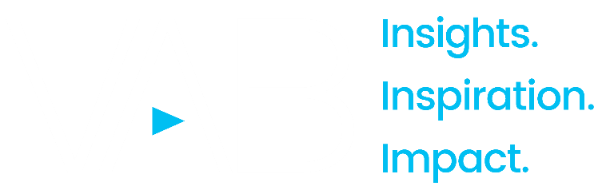
2023
Let it Grow
Understanding the Importance of Brand-Building for Niche Marketers

Slide 2
What You’ll Learn…
Understand the unique challenges that brands with niche audiences, like business-to-business (B2B), must overcome – including engaging with a finite prospective customer base and establishing product ‘buy-in’ among multiple stakeholders
Learn how successful niche marketers are using brand-building to create ‘top-of-mind’ awareness which, in turn, drives key business outcomes from consideration to sales, through to advocacy
Explore how marketers can capitalize on the brand-building benefits of multiscreen TV by using targeted, data-enabled solutions like audience-based buying to effectively engage niche targets such as B2B decision makers
This information is exclusively provided to VAB members and qualified marketers. Further distribution is prohibited.
PAGE 2

Slide 3

Why is brand-building so important
for brands with niche audiences,
like ‘business-to-business’ (B2B)?

Slide 4









A key challenge for B2B marketers is their need to effectively reach very niche audiences of business decision makers, regardless of category
U.S. Business Decision Maker Universes
% of Adults 18+
Total Business Decision Makers
14.8%
(38MM)
Business Decision Makers by Purchase Category
Business Decision Makers by Business Size
Banking Services
Telco / Communications
Computer Software
2.4%
(6.2MM)
2.4%
(6.2MM)
2.2%
(5.6MM)
Small Business
(<$10K spend)
Medium Business
($10k-$100k spend)
Large Business
(>$100k spend)
Temporary Help
Consultation Services
Comm. Real Estate
7.2%
(18MM)
4.7%
(12MM)
2.9%
(7MM)
1.8%
(4.5MM)
1.6%
(4.0MM)
0.7%
(1.9MM)
Source: MRI-Simmons Summer 2022 USA Study, Business Decision Makers represent respondents that have made business purchases in the last 12 months. Base = Adults 18+. Purchase categories reflects a sampling of business categories. Business size spend is based on last 12 months.
This information is exclusively provided to VAB members and qualified marketers. Further distribution is prohibited.
PAGE 4

Slide 5





Additionally, B2B brands face a set of unique challenges that most ‘consumer-facing’ brands don’t have to overcome
The average B2B purchase decision for a complex solution can involve between 6-10 people*
Business-to-Business Purchase Decision Challenges
Stakeholders
Rationality
High Stakes / High Costs
Purchase Journey
Multiple stakeholders, including decision-makers, procurement, influencers and analysts
Individual stakeholders who
are discouraged from acknowledging the role
that emotion plays, instead focusing on data and analysis
Higher stakes decisions often impact future success of business and careers due to the high cost and commitment
Longer customer journeys during which emotions and biases may evolve
Source: ARF, ‘Professionals are People Too’ webinar including HawkPartners data in the panel discussion, 7/20/22. *Gartner, ‘The B2B Buying Journey: The B2B buying process has changed, has your sales strategy?’, 2021.
This information is exclusively provided to VAB members and qualified marketers. Further distribution is prohibited.
PAGE 5

Slide 6
Understanding the needs and triggers that cause customers to enter
the market can enable brands to build top-of-mind awareness with them, which increases the probability of purchase in buying situations
The Relationship Between Category Entry Points & Mental Availability*
Where
Location
(e.g., working from home)
“When B2B customers connect their personal values and motivations, such
as professional credibility, success, and influence, to a brand – rather than to just strong perceptions of business value like features, functionality and service – they are twice as likely to make a purchase, pay a premium, and advocate for the brand.”
How
Feelings and emotions (e.g., to feel pride /
sense of achievement)
With Whom
Other people
(e.g., the board would approve)
B2B Brands
Why
Motives and benefits (e.g., to get promoted)
With What
Co-Purchase/Categories
(e.g., with privacy software)
When
Timing issues
(e.g., end of financial year)
While
Co-Activities
(e.g., while in a meeting)
Dipanjan Chatterjee
VP, Principal Analyst at Forrester
Forrester – ‘Drive B2B Brand Value With Emotion and Experience’
Source: ‘How B2B Brands Grow,’ The B2B Institute at LinkedIn with Ehrenberg-Bass Institute for Marketing Science (The University of South Australia), August 2021. ARF, ‘Professionals are People Too’ webinar including HawkPartners data in the panel discussion, 7/20/22. *Mental availability represents ‘the extent to which a brand comes automatically to mind when a consumer finds themselves in a purchase situation.’
This information is exclusively provided to VAB members and qualified marketers. Further distribution is prohibited.
PAGE 6

Slide 7


Establishing ‘top-of-mind’ awareness is also important for B2B marketers due to the greater likelihood they will be included in a customer prospects’ consideration set even before they start their research process
80% – 90%
90%
of B2B decision makers have a
set of vendors in mind before they do any research, depending on what they are buying
of B2B decision makers ultimately choose a vendor they had in mind before beginning the search process
Source: Harvard Business Review, ‘What B2Bs Need to Know About Their Buyers’, September 2022, survey by
Bain and Google of 1,208 people at U.S. companies who are involved in buying software, cloud hosting, hardware, telecommunications, logistics, marketing, and industrial equipment.
This information is exclusively provided to VAB members and qualified marketers. Further distribution is prohibited.
PAGE 7

Slide 8

Because of the need to build ‘top-of-mind’ awareness and gain buy-in from multiple stakeholders, branding is very important for the B2B category and more likely to drive business purchases than consumer purchases
% of Purchase Decisions Driven by ‘Brand’
Source: Lippincott, ‘B2B Brands in the Human Era’, November 2019. Analysis and survey based on tablet purchasers which is a product category with both business & consumer buyers..Business purchase decisions: 39% driven by brand, 34% driven by features, 27% driven by price; Consumer purchase decisions: 39% driven by price, 34% driven by features, 27% driven by brand.
This information is exclusively provided to VAB members and qualified marketers. Further distribution is prohibited.
PAGE 8

Slide 9








Strong B2B brand-building can deliver benefits that go beyond ‘one-off’ purchases by creating committed customers and driving ongoing,
long-term value
Short-Term Benefits of B2B Branding
Long-Term Benefits of B2B Branding
Staying front of mind for customers
Building barriers for competitors in contested industries
Landing on customers’ shortlists
Making new market entry more effective and efficient
Winning the coin toss in close calls – making it easer to say yes
Winning permission to play in adjacent spaces and play higher value-add roles
Capturing a larger share of wallet and preferred supplier position
Engaging current employees and enhancing talent recruitment efforts
Source: Lippincott, ‘B2B Brands in the Human Era’, November 2019.
This information is exclusively provided to VAB members and qualified marketers. Further distribution is prohibited.
PAGE 9

Slide 10






Brand-building is increasingly important for B2B companies as marketers are using it to drive key business outcomes from awareness to advocacy
What Are Your Top Five Brand Marketing Objectives for the Next 12 Months?
% of B2B Marketers
71%
43%
42%
41%
40%
40%
of B2B marketing leaders say brand marketing has
increased in importance
in the last 12 months
Growing brand awareness
and familiarity
Improving creative stand out and creative identity
Strengthening brand
strategy and positioning
Improving
brand experience
(digitally and physically)
Growing
brand loyalty
and advocacy
Source: Transmission, ‘The State of B2B Brand Building 2022’, Base: 500 B2B senior marketing leaders, Question: Summary of Top 5 - “Looking ahead to the next 12 months, what are your top five brand marketing objectives or priorities?”
This information is exclusively provided to VAB members and qualified marketers. Further distribution is prohibited.
PAGE 10

Slide 11



B2B companies are projected to increase their brand-building efforts even further since they are a proven driver of revenue growth
43%
81%
57%
of B2B marketers say brand building programs are more
important than demand / lead generation programs
(vs. 3% who say it is less important)
of B2B marketing leaders say brand marketing is critical
or very important to their organization's revenue growth
of B2B marketers saying that brand building budgets will increase in the next fiscal year
Source: Transmission, ‘The State of B2B Brand Building 2022’, Base: 500 B2B senior marketing leaders, Question: “How important are brand building programs compared to demand/lead generation programs in terms of contribution to your marketing goals?”
This information is exclusively provided to VAB members and qualified marketers. Further distribution is prohibited.
PAGE 11

Slide 12
Due to the short-term benefits and long-term effects of branding, annual advertising investment in the B2B category is projected to grow 72%
between 2020 and 2024, an increase of over $15 billion
U.S. B2B Total Ad Spending
2020-2024, $ in Billions
+72%
Growth from 2020 to 2024
Source: eMarketer, ‘US B2B Ad Spending’ July 2022. Note: includes digital (desktop/laptop, mobile, and other internet-connected devices), directories, magazine, newspapers, out-of-home, radio and TV.
This information is exclusively provided to VAB members and qualified marketers. Further distribution is prohibited.
PAGE 12

Slide 13
How can marketers capitalize on the brand-building benefits of multiscreen TV to effectively engage niche targets like
B2B decision makers?

Slide 14
Another key B2B challenge is that most buyers are not in market for a brand’s product category right now, however advertising can instill ‘top-of-mind’ awareness which is activated when they do come into the market
95%
“To grow a brand, you need
to advertise to people who aren’t in the market now,
so that when they do enter
the market your brand is one they are familiar with.”
of business clients are
not in the market for many
goods and services
at any one time
John Dawes
Associate Director of the Ehrenberg-Bass Institute
& Professor at University of South Australia
Ehrenberg-Bass Institute for Marketing Science , ‘How B2B Brands Grow’
Source: ‘How B2B Brands Grow,’ The B2B Institute at LinkedIn with Ehrenberg-Bass Institute for Marketing Science (The University of South Australia), August 2021.
This information is exclusively provided to VAB members and qualified marketers. Further distribution is prohibited.
PAGE 14

Slide 15
Advertising excels at creating long term ‘top-of-mind’ awareness among decision makers who are not currently in-market because its full impact is not seen until months, or even years, after an ad is seen
Share of Sales Impact by Timeframe
Sales can be spread across hours, days, weeks even years, after an ad is seen
Hours / Days
Weeks / Months
Months / Years
100%
42%
18%
(via digital attribution)
(via marketing mix modeling)
(via brand equity modeling)
How to read: 18% of sales derived from advertising occurs within hours/days of exposure
Source: VAB, ‘The Halo Effect: TV As a Growth Engine’ based on Ebiquity research, ‘Advertising Through a Recession,’ April 2020. Click here to download ‘The Halo Effect: TV as a Growth Engine’ to learn more about the impact of TV on sales.
This information is exclusively provided to VAB members and qualified marketers. Further distribution is prohibited.
PAGE 15

Slide 16







When it comes to brand-building and establishing ‘top-of-mind’ awareness while fostering customer action, advertisers of all sizes and life stages are capitalizing on the key benefits of TV to accelerate their growth
7 key reasons brands launch TV campaigns
Availability & Accessibility
Greater product availability creates greater TV accessibility both on the national and local level
Legitimizer
Creates, builds and enhances brand reputation while legitimizing their product or
service offerings
Targetability
Scalable data-driven targeting solutions like addressable TV and data-enabled TV create efficiency and limit wastage
Full-Funnel Outcomes
Through greater measurement and enhanced attribution capabilities, TV has shown its ability to drive brand results
Inclusivity
Enhanced targeting capabilities through advanced TV solutions creates efficiencies which lowers the traditional cost of entry
Storytelling
Sight, sound and motion a TV ad can convey brand identity and further humanizes the brand and what it stands for
Halo Effect
TV significantly improves the performance and ROI of all other digital channels as well as a brand’s online platforms
Click here to download ‘The Halo Effect: TV as a Growth Engine’ to learn more about why and how brands are accelerating their path to TV
This information is exclusively provided to VAB members and qualified marketers. Further distribution is prohibited.
PAGE 16

Slide 17




Many B2B executives credit TV advertising for establishing their brands as household names and positioning them as a market leader
86% of B2B brand marketing leaders say ‘brand marketing’ is very high or high importance for their CEO and board
“As we expand the scope and reach of CLEAR’s offerings, we’re excited about the potential of “You Get You Places” [campaign] and other investments we’re making in our brand, to elevate awareness about the benefits of membership,
and to help establish CLEAR into a household name.”
“The world's first music video you can expense is basically the greatest and most fun product demonstration ever, and even better with legendary "Expensivest" 2 Chainz. We want everyone to experience Expensify, so they can get back to what they truly set out to do.”
Pamela Catlett, Chief Brand & Strategy Officer, CLEAR
(BusinessWire, CLEAR Launches First Nationwide Brand Campaign, 10/9/2018)
Hannes Ciatti, Executive Creative Director of JohnXHannes NY
(PRNewswire, Expensify Teams Up with 2 Chainz and Adam Scott for World's First Music Video You Can Expense and Super Bowl Campaign, 1/24/2019)
“Fiverr has gone through some dramatic changes these past ten years and this brand evolution reflects the advancement and sophistication of the company while simultaneously embodying its purpose of providing opportunities for anyone, anywhere, to build their business, brand or dreams. Every detail, down to the font sizes and intricate color palette, was examined and reviewed to ensure that this shows the boldness of who we are as a company.”
“This is an important opportunity for ABM to raise our profile and continue to position ourselves as a leader with diverse capabilities to create healthier spaces. The spotlight on essential workers and essential services is here to stay and celebrated in this commercial and across our business. It is our hope that people will feel more confident in returning to the places and spaces they love when they recognize the ABM logo.”
Duncan Bird, Vice President of Brand and Digital, Fiverr
(Fiverr Unveils New Brand Campaign “It Starts Here”, Spotlights
Three Real Businesses on Their Path to Digital Transformation, 9/9/2020)
Cary Bainbridge, Chief Marketing Officer, ABM
(CleanLink, ABM Launches First Ever National TV Commercial, 2/24/21)
Source: Transmission, ‘The State of B2B Brand Building 2022’, Base: 500 B2B senior marketing leaders, Question: How much importance is placed on brand marketing by your board and/or leadership team of your company?
This information is exclusively provided to VAB members and qualified marketers. Further distribution is prohibited.
PAGE 17

Slide 18
B2B advertisers, along with other niche brands, are increasingly leveraging more targeted solutions across data-enabled multiscreen TV platforms
to engage their best customer prospects effectively and efficiently
Source: VAB, ‘How might customized, targeted video ads help create stronger engagement?’. Advertiser Perceptions, 2H 2021 Video Advertising Convergence Report. Based on survey of 250 marketer and agency respondents who are involved in video advertising decision-making. Click here to download ‘How might customized, targeted video ads help create stronger engagement?’ to learn more about how personalized, targeted ads drive engagement with brands.
This information is exclusively provided to VAB members and qualified marketers. Further distribution is prohibited.
PAGE 18

Slide 19


Targeted, data-enabled multiscreen TV enables B2B brands to deepen their engagement with perspective customers by personalizing their messaging to them
60%
41%
of B2B buyers/sellers say that personalized experiences are very important
of B2B marketers will add more personalized content and offers to their customers*
Source: GoodFirms, ‘B2B Services: Intelligence, Competition, and Future’, September 2022, Survey of 410 B2B buyers and sellers across comprise of ecommerce, SaaS, IT, logistics, fashion, healthcare, finance, and more.
*eMarketer, ‘US B2B Digital Ad Spending Forecast 2022’, September 2022.
This information is exclusively provided to VAB members and qualified marketers. Further distribution is prohibited.
PAGE 19

Slide 20


“Every engagement with our clients has to be that much more fruitful, we can’t have wasted impressions or activity, so every engagement has to count…Looking at our targeting strategies,
we have to be really specific and precise to make sure we are reaching the most important clients and prospects.”
Robyn McRae, Global VP of Paid Media & Marketing Automation, IBM
‘Advertising in Uncertain Times: Adapt Your Messaging to Today’s Environment’ panel session,
Advertising Week New York, October 2022
This information is exclusively provided to VAB members and qualified marketers. Further distribution is prohibited.
PAGE 20

Slide 21












Successful brands with niche audiences, like in B2B categories, are
utilizing the personalization and targetability of audience-based buying
to effectively optimize their TV buys against their best customer prospects
Marketers can buy TV on buying habits, characteristics or viewing behaviors (programs, genres watched)
which is a more accurate, and cost-effective, surrogate for their customer than a prescribed age bucket
B2B Targeting Examples
Buying Habits
Personal Characteristics
TV Viewing Behaviors
Software
Business Licenses
Business
Decision Makers
C-Suite
Executives
Business News
Award Shows
Computers
Commercial
Real Estate
Small Business Owners
Managers
Sports
Drama
This information is exclusively provided to VAB members and qualified marketers. Further distribution is prohibited.
PAGE 21

Slide 22

Marketers are driving business outcomes through the purchase journey by implementing audience-based buying within their TV strategy
Awareness
Consideration
Intent
Sales
Full-Funnel
Source: VAB / Advertiser Perceptions ‘Audience-Based Buying Survey,’ fielded March 23 – 31, 2021. Survey base: Advertising decision-makers who are involved in buying or planning digital video, cable / broadcast TV, or advanced TV (n=211). Q150. To what extent do you believe audience-based buying of TV advertising can impact each of the following KPIs? (extremely impactful / very impactful). Base: Total Respondents. *such as site visits, sign ups, login ins, downloads. To learn more about how marketers are finding success with ABB, read more in “The VAB Top 10: A top-line view of how the industry is adopting audience-based buying”.
This information is exclusively provided to VAB members and qualified marketers. Further distribution is prohibited.
PAGE 22

Slide 23
Companies that deliver greater personalized messaging to better engage prospective buyers are more likely to increase their category market share
% of Companies With Increased Market Share, by Degree of Personalization
% of respondents by market share move
Source: McKinsey, ‘The new B2B Growth Equation’, February 2022, respondents indicating market share in the past 12 months increased more than 1 percentage point vs peers.
This information is exclusively provided to VAB members and qualified marketers. Further distribution is prohibited.
PAGE 23

Slide 24





Key Takeaways For Niche Marketing Plans (Like B2B)
Brand-building is important for niche advertisers looking to create ‘top-of-mind’ awareness and an emotional connection between their product / service and their target audience
Strong branding campaigns can produce long-term brand value by driving outcomes through the purchase funnel - from awareness to advocacy -
and creating loyal,
recurring customers
The scale and storytelling of multiscreen TV offers several key benefits to brands that want to establish ‘top-of-mind’ awareness and build their image among multiple sets of stakeholders
By utilizing targeted, data-enabled platforms and solutions like audience-based buying, multiscreen TV enables niche brands to effectively, and efficiently, target their best prospects
This information is exclusively provided to VAB members and qualified marketers. Further distribution is prohibited.
PAGE 24

Slide 25
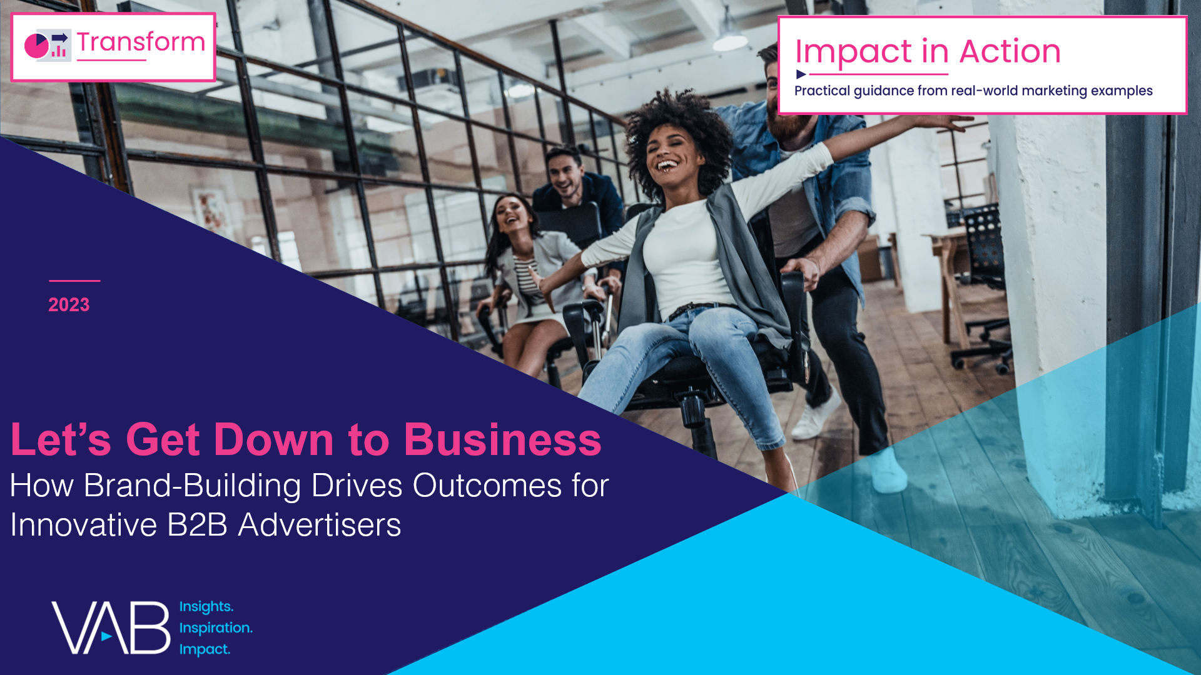
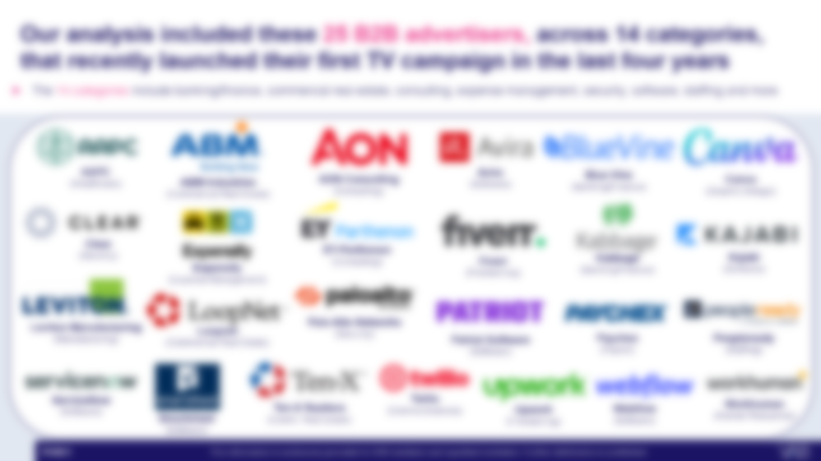

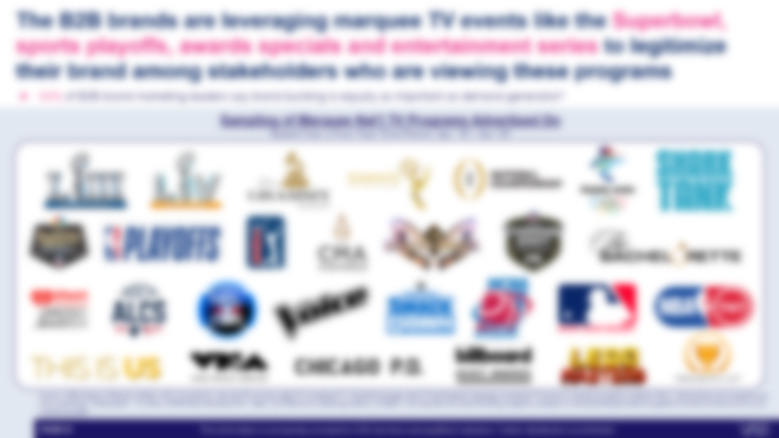
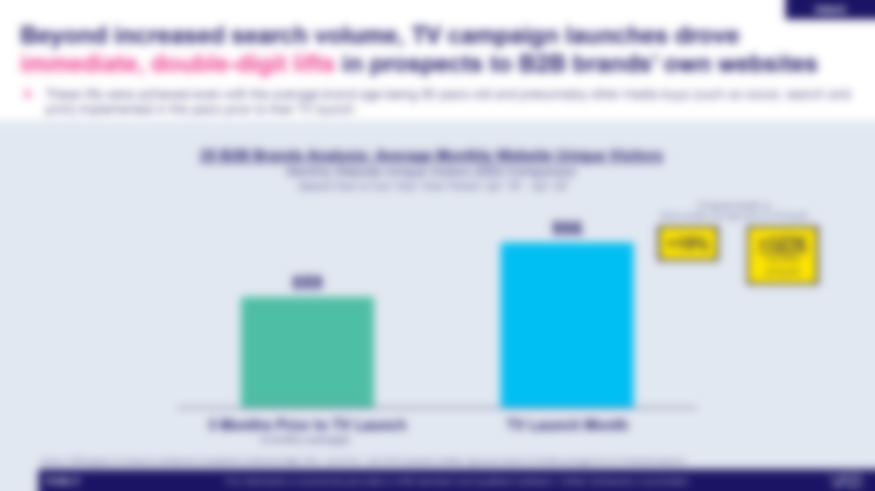
Download our companion guide ‘Let’s Get Down to Business’ which features an analysis of 25 B2B advertisers that are using multiscreen TV to convert branding into business outcomes across the purchase funnel
What You Will Learn In ‘Let’s Get Down To Business’…
Who are the 25 brands and
what categories do they represent?
What are the six key creative strategies fostering greater emotional connections?
How are these 25 brands planning
& buying their TV campaigns?
How is TV driving awareness, interest, intent and sales?
Download Here
This information is exclusively provided to VAB members and qualified marketers. Further distribution is prohibited.
PAGE 25

Slide 26
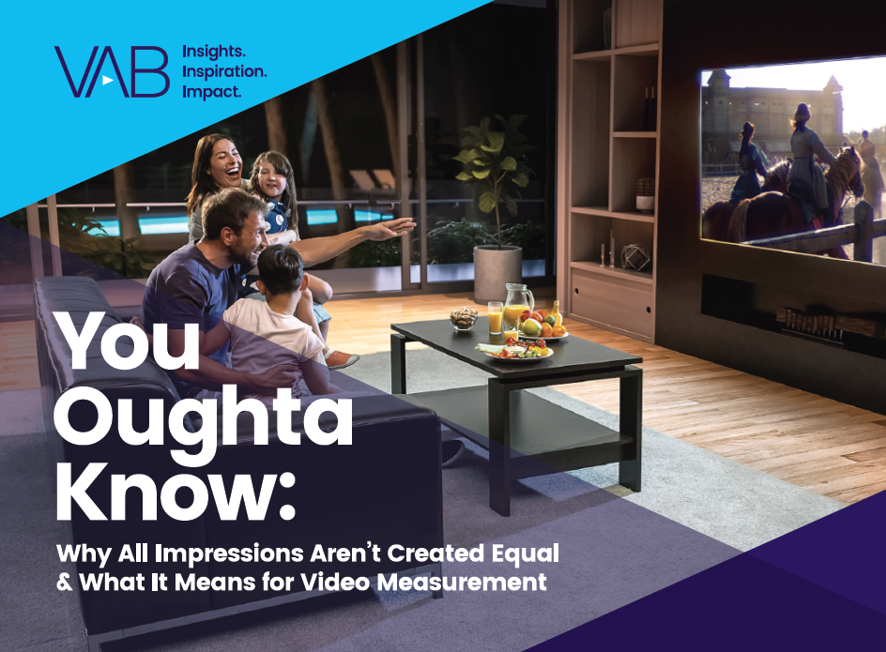
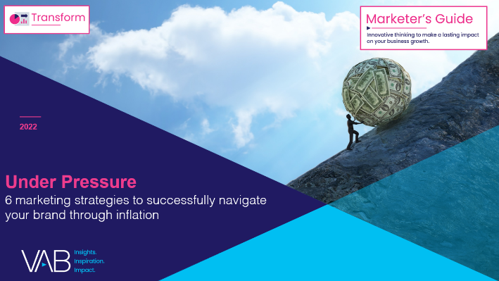
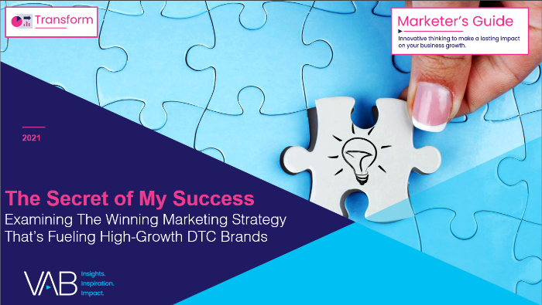
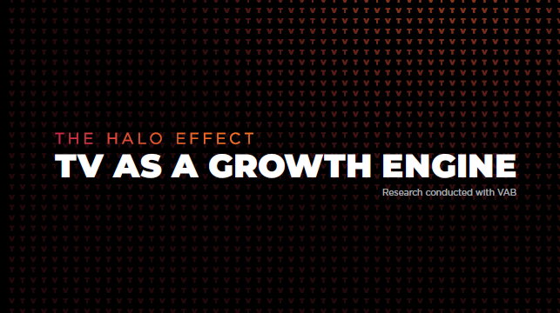
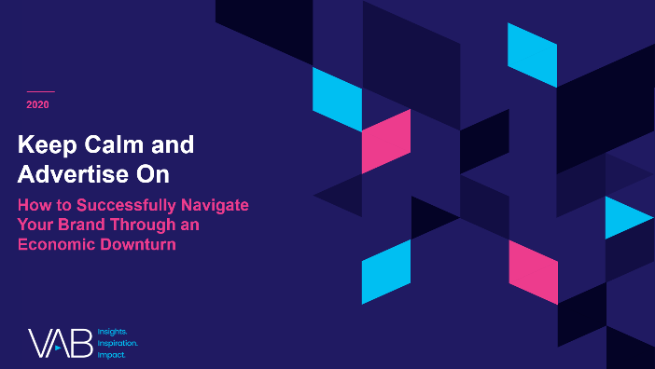

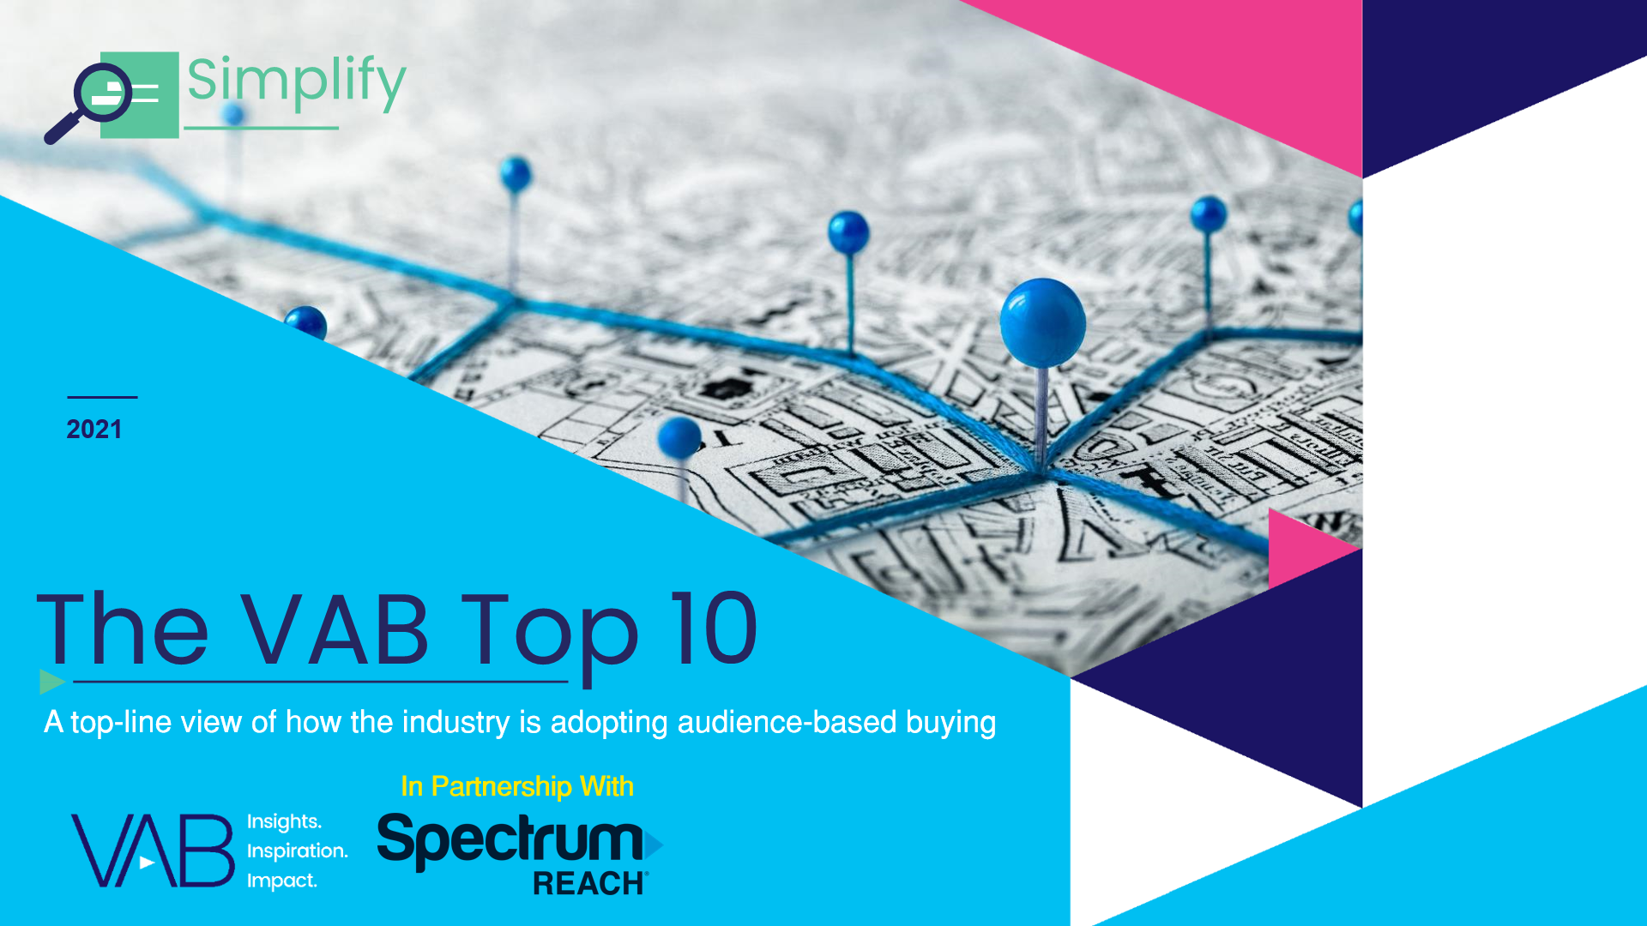
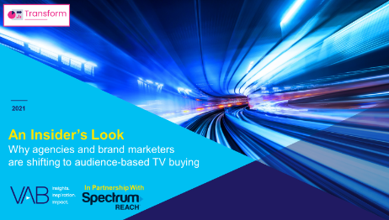
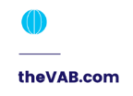
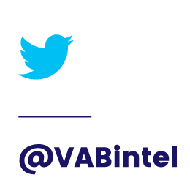


Creators
Jason Wiese
Reed Kiely
Karolina Guillen
SVP, Director of Strategic Insights
jasonw@thevab.com
Associate Insights Director
reedk@thevab.com
Insights Manager
karolinag@thevab.com
Interested in learning more? Check out this related content:
VAB Members, brand marketers and agencies get free and immediate access to VAB’s content library. Get access at theVAB.com
You Oughta Know
Why all impressions aren't created equal & what it means for video measurement
Under Pressure
6 marketing strategies to successfully navigate your brand through inflation
The Secret of My Success
Examining the winning marketing strategy that’s fueling high-growth DTC brands
The Halo Effect
TV as a growth engine
Keep Calm and Advertise On
How to successfully navigate your brand through an economic downturn
A Matter of Principle
6 Reassessing Your Strategy
in Today’s Environment
The VAB Top 10
A top-line view of how the industry is adopting audience-based buying
An Insider’s Look
Why agencies and brands are shifting to audience-based TV buying
This information is exclusively provided to VAB members and qualified marketers. Further distribution is prohibited.
PAGE 26

Slide 27

About VAB
VAB is an insights-driven organization that inspires marketers to reimagine their media strategies resulting in fully informed decisions.
Drawing on our marketing expertise, we simplify the complexities in our industry and discover new insights that transform the way marketers look at their media strategy.
We are committed to your business growth and proud to offer VAB members, brand marketers and agencies complimentary access to our continuously-growing Insights library. Get immediate access at theVAB.com.
Curious to learn more about VAB? Check out this quick video to see what we do and how we can help you develop business-driving marketing strategies.
This information is exclusively provided to VAB members and qualified marketers. Further distribution is prohibited.
PAGE 27

