Slide 1





Left to Your Own Devices
The Latest on Multiplatform Video Consumption
June 2025

Slide 2






What You’ll Learn
People today have more options for entertainment than ever before. As a result, it's important to stay current on viewership trends and consumption behaviors to be in-the-know on shifting and emerging opportunities.
This analysis equips you with the latest updates on:
1
2
3
4
Device Ownership & Usage
Video Viewing Behaviors
Video Ad Engagement
OOH Video Opportunities
Click through a box above to be brought directly to the appropriate section
This information is exclusively provided to VAB members and qualified marketers.
PAGE 2

Slide 3

1
Device Ownership & Usage

Slide 4







Households are highly connected, reinforcing the need for seamless multiscreen video strategies across both personal and shared devices
Which of the following devices do you and other household members currently own?
94%
93%
76%
61%
TV
Smartphone
Laptop
Tablet
+1% YoY
(93% in 2023)
Flat YoY
(93% in 2023)
+3% YoY
(74% in 2023)
Flat YoY
(61% in 2023)
42%
42%
39%
Game Console
Desktop Computer
Smart Speaker
+5% YoY
(40% in 2023)
Flat YoY
(42% in 2023)
+11% YoY
(35% in 2023)
Source: VAB analysis of ARF DASH study, full year 2023 vs. full year 2024. Based on survey of 10,000 A18+. Q3: Which of the following devices do you and other household members currently own? Based on household weighting.
This information is exclusively provided to VAB members and qualified marketers.
PAGE 4

Slide 5
TVs remain the most-owned device in the home, with the average number of TVs per home increasing by 10% YoY, outpacing all other screens
Households: Average Number of Devices Owned
2.5
2.2
2.0
1.7
TV
Smartphone
Smart Speaker
Game Console
+10% YoY
(2.4 in 2023)
Flat YoY
(2.2 in 2023)
Flat YoY
(2.0 in 2023)
Flat YoY
(1.7 in 2023)
1.7
1.6
1.3
Laptop
Tablet
Desktop Computer
-6% YoY
(1.8 in 2023)
-6% YoY
(1.7 in 2023)
Flat YoY
(1.3 in 2023)
Source: VAB analysis of ARF DASH study, full year 2023 vs. full year 2024. Based on survey of 10,000 A18+. Q4: How many of the following devices do you and the members of your household own and have used in the past 6 months? Based on household weighting.
This information is exclusively provided to VAB members and qualified marketers.
PAGE 5

Slide 6

Consumers primarily use devices like smartphones, tablets and smart speakers for non-video activities, reinforcing TV as the key device for engaging audiences through video content with
complementary touchpoints on mobile

Slide 7


Among the many activities habitually done by the majority of mobile device users, watching video clips is common but ranks 8th
Top 10 Activities Done with Mobile Phone, Tablet or E-Reader
A18+
Source: VAB analysis of MRI-Simmons 2023 vs. 2025 Winter USA study, A18+. Based on activities done in the last 30 days by respondents who personally have a working cellular / mobile phone, tablet or e-reader. Other video-based activities: ‘watched other video’ (47%), ‘watched a downloaded or streamed TV program’ (34%), ‘watched a full-length movie’ (23%), ‘watched live television’ (20%).
This information is exclusively provided to VAB members and qualified marketers.
PAGE 7

Slide 8
While more common among adults 18 to 34, watching video clips trails behind habitual activities like texting, listening to music and using search
Top 10 Activities Done with Mobile Phone, Tablet or E-Reader
A18-34
Source: VAB analysis of MRI-Simmons 2023 vs. 2025 Winter USA study, A18-34. Based on activities done in the last 30 days by respondents who personally have a working cellular / mobile phone, tablet or e-reader. Other video-based activities: ‘watched other video’ (60%), ‘watched a downloaded or streamed TV program’ (47%), ‘watched a full-length movie’ (34%), ‘watched live television’ (24%).
This information is exclusively provided to VAB members and qualified marketers.
PAGE 8

Slide 9

Smart speakers are most often used for passive, everyday tasks like streaming music and checking the weather
Top 10 Activities Done with a Smart Speaker
A18+
Source: VAB analysis of MRI-Simmons 2023 vs. 2025 Winter USA study, A18+. Based on respondents who own a smart speaker. *e.g., Pandora, Spotify, etc. **e.g., turned on lights, TV, controlled thermostat, etc. ***e.g., local information, movie times, recipes, etc. Other responses: ‘listened to an audiobook’ (9%), ‘purchased / ordered a product or service’ (9%).
This information is exclusively provided to VAB members and qualified marketers.
PAGE 9

Slide 10
Younger adults use smart speakers in similar ways, with slightly higher engagement in activities like making phone calls or listening to podcasts
Top 10 Activities Done with a Smart Speaker
A18-34
Source: VAB analysis of MRI-Simmons 2023 vs. 2025 Winter USA study, A18-34. Based on respondents who own a smart speaker. *e.g., Pandora, Spotify, etc. **e.g., turned on lights, TV, controlled thermostat, etc. ***e.g., local information, movie times, recipes, etc. Other responses: ‘listened to an audiobook’ (9%), ‘purchased / ordered a product or service’ (7%).
This information is exclusively provided to VAB members and qualified marketers.
PAGE 10

Slide 11
Comparatively, watching video is by far the most dominant activity on Smart TVs
% of Smart TV Owners Who Use Their TV Set to…
(from Spotify, Amazon Music, Apple Music or other)
(using non-video smart TV apps)
(streamed and played without needing game console)
(from a service like Shutterfly or Flickr)
(when off or not being watched)
(like lights, smart doorbells or security device)
Source: VAB analysis of Hub Entertainment Research data. Base: Smart TV Set Household (n=2,215). Q25. Smart TVs also have capabilities in addition to just viewing TV programs. Which, if any, of the following features have you used on the smart TVs in your home? *Base: TV HH (n=4,936). Q123. About how often is a smart TV in our home used to stream movies or TV shows?
This information is exclusively provided to VAB members and qualified marketers.
PAGE 11

Slide 12
2
Video Viewing Behaviors

Slide 13


Homes are watching traditional TV throughout the day and across dozens of networks, enabling many touchpoints for brands to reach consumers
Breakdown of Traditional TV Viewership
73%
66%
27
of viewing occurs outside of primetime
of viewing is on cable
average networks viewed per household
Source: Comcast Advertising, Multiscreen TV Advertising Report, 2H 2024. Comcast Aggregated Viewership Data (2H ‘24). Based on average time spent per day with Live, DVR and VOD viewing (6 hours, 11 minutes).
This information is exclusively provided to VAB members and qualified marketers.
PAGE 13

Slide 14

Audiences prefer to maximize their viewing experience by watching movies, shows and sports on a TV rather than smaller screens
Preferred Platform for Watching Different Content Types
Source: LG Ad Solutions, The Big Shift: US Edition, 2025.
This information is exclusively provided to VAB members and qualified marketers.
PAGE 14

Slide 15



That preference is reflected in digital video viewing habits, with connected TV leading all devices, accounting for nearly 60% of daily video time
Average Time Spent Per Day With Digital Video, by Device
Hours:Minutes
Connected TV
Mobile Device
Desktop / Laptop
2:19
1:23
0:18
Source: EMARKETER Forecast, January 2025. Note: Ages 18+; internet users of any age who watch streaming or downloaded video content via any device at least once per month; includes all time spent with online video activities; includes viewing via any device; includes time spent with video via social networks. Additional Note: Time spent with each medium includes multitasking; for example, 1 hour of multitasking on a mobile phone while watching TV is counted as 1 hour for mobile phone and 1 hour for TV. Figures are rounded to the nearest minute. Estimates of average time spent with media are based on the number of users of each medium. Methodology: Estimates are based on the analysis of estimates from other research firms, consumer media consumption trends, device adoption trends, company reports, primary research, and interviews.
This information is exclusively provided to VAB members and qualified marketers.
PAGE 15

Slide 16



To further enhance their experience, more viewers are buying larger TVs, with 40% of recent TV sales being sets over 55 inches
% of A18+ who recently purchased a TV with the following screen size
Small
Under 27"
Medium
27” – 35”
Large
36” – 42”
X-Large
43” – 54”
-5%
vs. ‘23
-1%
vs. ‘23
+3%
vs. ‘23
+9%
vs. ‘23
4%
11%
16%
21%
XX-Large
55” – 69”
XXX-Large
70”+
+6%
vs. ‘23
+21%
vs. ‘23
30%
10%
Source: VAB analysis of MRI-Simmons 2023 vs. 2025 Winter USA study, A18+. Based on most recent purchase.
This information is exclusively provided to VAB members and qualified marketers.
PAGE 16

Slide 17
Beyond factors like screen size, people are also embracing audience connection and flexibility, with more co-viewing and watching ‘on-the-go’
How Audiences Prefer to Watch TV
% of respondents
% change vs. 2023
-2%
+3%
-2%
+1%
+2%
-1%
+2%
+2%
+2%
Flat
+5%
+4%
+12%
Source: VAB analysis of MRI-Simmons 2023 vs. 2025 Winter USA study, A18+. Based on respondents who answered ‘somewhat important’ or ‘very important’. Find out where audiences are watching video on the go.
This information is exclusively provided to VAB members and qualified marketers.
PAGE 17

Slide 18
3
Video Ad Engagement

Slide 19
Ad-supported content on the TV screen is the primary way people watch, with a continued skew towards traditional TV (cable & broadcast)
Q1 2025 Ad Supported TV Share
Total Day, P2+
Source: Nielsen, The Gauge. Analysis of Q1 2025 (12/30/2024 – 03/30/2025). Nielsen National TV Panel Data augmented by Streaming Platform Ratings. Ad-supported includes broadcast and independents, Ad-Supported Cable, and Streaming minus non ad-supported streaming.
This information is exclusively provided to VAB members and qualified marketers.
PAGE 19

Slide 20

Nearly 60% of ad-supported digital video content is live, driven by sporting events, and most is long-form programming
U.S. Ad View Composition by Content Type
2H ‘24
Short-Form
LIVE
VOD
VOD
Long-Form
Source: Freewheel, Video Marketplace Report, 2H 2024. Note: VMR categorization of ‘live’ includes FAST channels. Mechanically, ad requests for FAST set ‘mode=live’. Linear addressable is not included in report data. Short-form video is classified as a video content under 6 minutes in duration.
This information is exclusively provided to VAB members and qualified marketers.
PAGE 20

Slide 21
Between CTV and set-top box VOD, nearly 90% of digital ad views occur on the television set
Ad View Composition By Device
2H 2023
TV Set
Source: Freewheel, Video Marketplace Report , 2H 2024. Reflects U.S. data only.
This information is exclusively provided to VAB members and qualified marketers.
PAGE 21

Slide 22




Ad tolerance is growing, with consumers embracing personalization, choice and relevance as ways to enhance the viewing experience
Tolerant or in Favor of Ads
% of respondents
What could improve the experience of watching
ads during TV shows and movies?
% of respondents
43%
42%
Customize ad categories
Personalized ads
41%
34%
Chose which ad to watch
Retail-influenced ads
Source: TiVo, Q4 2024 Video Trends Report.
This information is exclusively provided to VAB members and qualified marketers.
PAGE 22

Slide 23
With most viewing being ad-supported, delivering a quality ad experience is essential to maintaining engagement
Source: TiVo, Q4 2024 Video Trends Report.
This information is exclusively provided to VAB members and qualified marketers.
PAGE 23

Slide 24
4
Out-of-Home Video Opportunities

Slide 25


Consumers are taking their video experiences into the car as well, from commuting to quick stops and road trips and everywhere in between
Top Reasons for Watching Video In-Car
% of respondents who watch video in-car
44%
75%
of adults 18+ who own
a car say that video is watched in their vehicle
(+6% vs. Q4 ‘23)
of those who watch video in the car do so at least a few times a month
(-3% vs. Q4 ‘23)
Source: TiVo, Q4 2024 Video Trends Report. Based on survey of A18+.
This information is exclusively provided to VAB members and qualified marketers.
PAGE 25

Slide 26








Out-of-home video has turned everyday stops into consumer touchpoints, with restaurants, salons, gyms and more becoming media hubs
Digital Out-of-Home Video Viewing
Adult 18+ Monthly Reach
81.7MM
35.8MM
22.0MM
Airports, Office Buildings, Doctor’s Offices, Salons & more
Bars & Restaurants
Fast Food / QSRs
16.1MM
6.1MM
9.2MM
Auto Centers
Gyms & Fitness Centers
Retail Stores
Source: Atmosphere TV, The People Platform, March 2025. Reach based on one view with Atmosphere TV content / ads. To learn more about Atmosphere TV, click here.
This information is exclusively provided to VAB members and qualified marketers.
PAGE 26

Slide 27
With viewers spending extended time in front of screens, out-of-home video delivers not just reach, but also extended attention
Digital Out-of-Home Video Viewing
Adult 18+ Dwell Time
59 Minutes
44 Minutes
35 Minutes
Bars & Restaurants
Gyms & Fitness Centers
Auto Centers
34 Minutes
34 Minutes
18 Minutes
Airports, Office Buildings, Doctor’s Offices, Salons & more
Retail Stores
Fast Food / QSRs
Source: Atmosphere TV, The People Platform, March 2025. Dwell Time = Time spent within viewing cone of the TV/CTV screen. To learn more about Atmosphere TV, click here.
This information is exclusively provided to VAB members and qualified marketers.
PAGE 27

Slide 28

With nearly one-third of adults seeing out-of-home video ads weekly, marketers have an emerging avenue for engaging audiences on-the-go
31%
of adults have seen a video ad outside their home in the last 7 days
Source: VAB analysis of MRI-Simmons 2025 Winter USA study, A18+. Based on respondents who have seen video ads in the following locations in the last 7 days: grocery stores, drug stores, large discount / department stores, warehouse / club stores, shopping malls, shopping mall food courts, bars / pubs, fast food / family restaurants, coffee shops, cafes, delis, gyms / health clubs, medical offices, office building lobbies, office building elevators, flexible / coworking office spaces, movie theater lobbies, sports / entertainment events, buses, trains, subways, bus stops, train stations, airports, taxis or gas stations.
This information is exclusively provided to VAB members and qualified marketers.
PAGE 28

Slide 29

While households remain highly connected across devices, TV stands out as the primary screen for video engagement with mobile devices serving a more complementary role within people’s consumption habits
Multiscreen TV continues to lead in engagement as viewers lean in for immersive, shared and flexible viewing, making it a powerful platform for brands to connect across content types, dayparts and device preferences
With most viewing happening on the TV screen and within ad-supported environments, marketers have a valuable opportunity to drive impact through relevant and engaging ad experiences
As viewing extends beyond the living room, out-of-home video offers a high-impact way to reach audiences during everyday routines and moments on the go, combining significant scale with strong attention
Key Marketer Takeaways
This information is exclusively provided to VAB members and qualified marketers.
PAGE 29

Slide 30
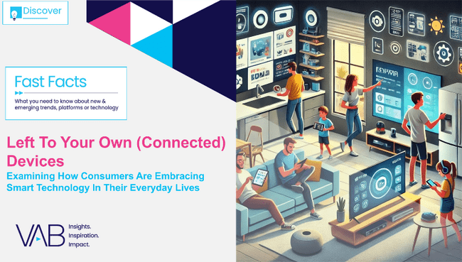
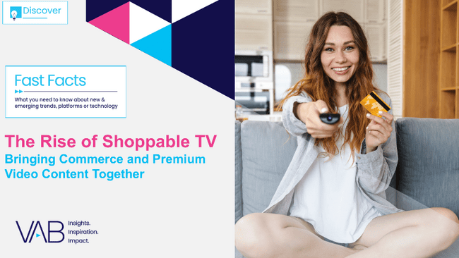
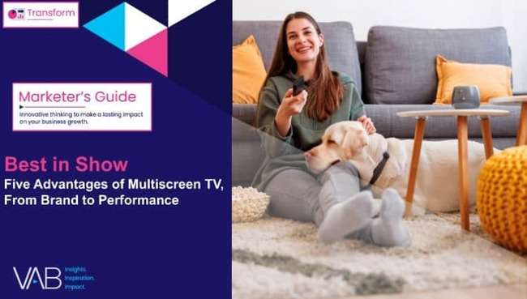

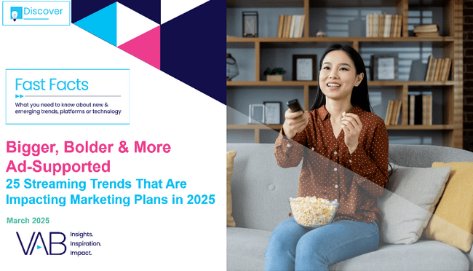


Creators
Jason Wiese
Leah Montner-Dixon
EVP, Strategic Insights & Measurement
jasonw@thevab.com
Director, Audience & Behavioral Insights
leahm@thevab.com
Left To Your Own (Connected) Devices
Examining How Consumers Are Embracing Smart Technology In Their Everyday Lives
The Rise of Shoppable TV
Bringing Commerce and Premium Video Content Together
Discover more
Looking for more data, insights and takeaways? Check out this related VAB content
Best in Show
Five Advantages of Multiscreen TV,
From Brand to Performance
The Power of Premium Video
What It Means for Multiscreen TV
and Why It Matters to Marketers
Through Upfront season, marketers are making important decisions about their video investment strategy.
We’re here to help.
Visit our Upfront Planning Resource Center
for a curated a list of resources filled with the data, analysis and insights needed to make informed investment decisions.
Bigger, Bolder, More Ad-Supported
25 Streaming Trends That Are Impacting
Marketing Plans in 2025
Welcome to TV – Full Year 2024
The Billion and a Half Dollar Investment from New Advertisers – Full Year 2024
VAB Members, brand marketers and agencies get free and immediate access to VAB’s content library. Get access at theVAB.com
This information is exclusively provided to VAB members and qualified marketers.
PAGE 30

Slide 31


About VAB
VAB plays a dual role in the video advertising industry. We are leading the change to bring about a more innovative and transparent marketplace. We also provide the insights and thought leadership that enables marketers to develop business-driving marketing strategies.
Drawing on our marketing expertise, we simplify the complexities in our industry and discover new insights that transform the way marketers look at their media strategy.
We are committed to your business growth and proud to offer VAB members, brand marketers and agencies complimentary access to our continuously-growing Insights library. Get immediate access at theVAB.com.
This information is exclusively provided to VAB members and qualified marketers.
PAGE 31

